Slide 1
Attitudes & Beliefs and Early Childhood Inclusion
Notes:
Jani

Slide 2
Outcomes
To understand the importance of beliefs & attitudes regarding inclusion
To understand what shapes our own beliefs & attitudes
Notes:
Today we will explore the role attitudes and beliefs play in early childhood inclusion and dig into how attitudes and beliefs are shaped and formed.

Slide 3
What Does the Word “Include” Mean?
Involve
Hold
Embrace
Encompass
Take in
Notes:
Ask participants to call out words of what inclusion means to them.
After that bring these “synonyms” in one at a time.

Slide 4
IDEA
“Disability is a natural part of the human experience and in no way diminishes the right of an individual to participate in or contribute to society. Improving educational results for children with disabilities is an essential element of our national policy of ensuring equality of opportunity, full participation, independent living, and economic self-sufficiency for individuals with disabilities.”
Notes:
Ask participants to read this to themselves and then to share what are the words or phrases that stand out to them.

Slide 5
A Definition of Inclusion from DEC/NAEYC
Early childhood inclusion embodies the values, policies, and practices that support the right of every infant and young child and his or her fam­ily, regardless of ability, to participate in a broad range of activities and contexts as full members of families, communities, and society. The desired re­sults of inclusive experiences for children with and without disabilities and their families include a sense of belonging and membership, positive social relationships and friendships, and development and learning to reach their full potential. The defin­ing features of inclusion that can be used to identify high quality early childhood programs and services are access, participation, and supports.

Slide 6
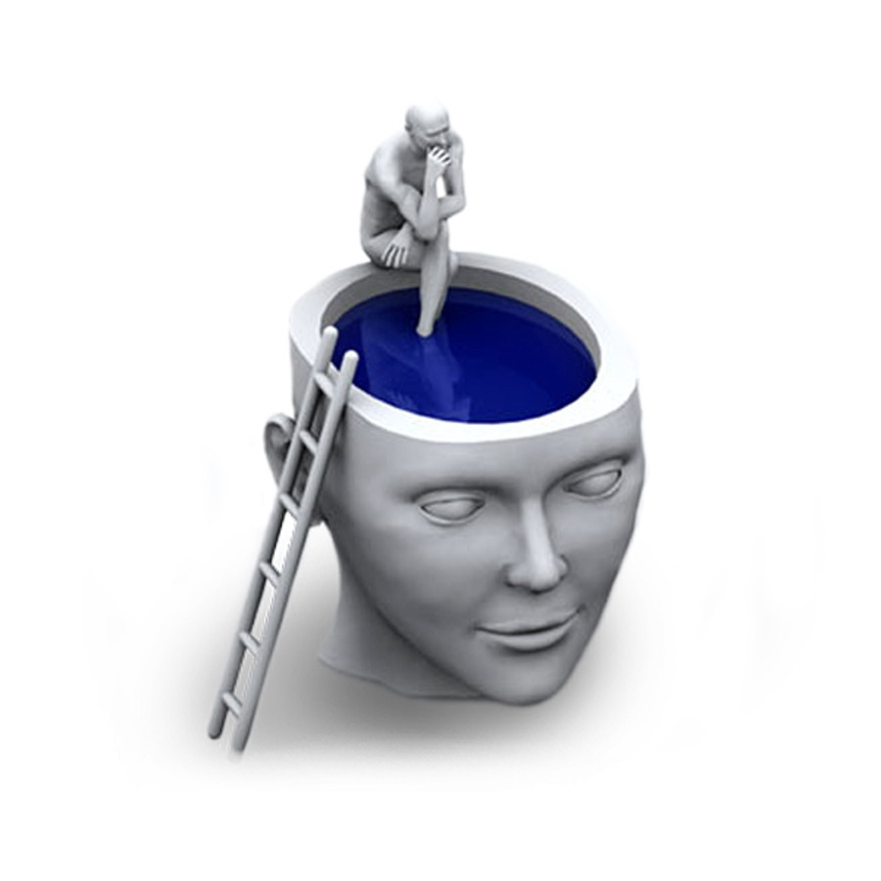
Inclusion is Not a Place
It is a philosophy
It is an attitude
It is a belief

Slide 7
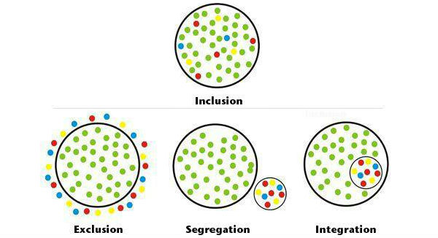
Notes:
Describe these 4 models
Ask for thoughts

Slide 8
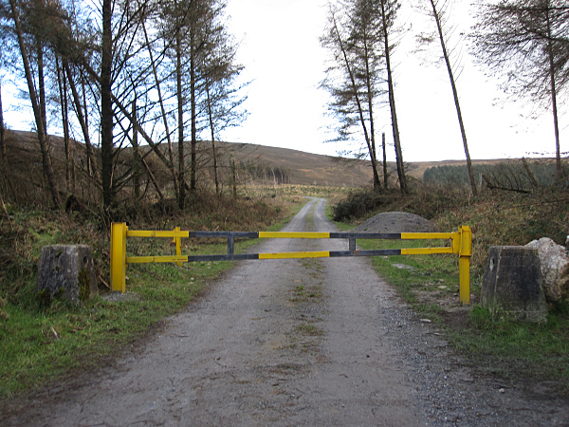
Barriers
“The most frequently reported barrier to early childhood inclusion that has remained largely unchanged over the past several decades are attitudes and beliefs.” (Barton, E. E., & Smith, B. J., 2015)
Influenced by:
Misinformation
Fear
Resistance to change
Stereotyping children

Slide 9
Attitude
A settled way of thinking or feeling about someone or something, typically one that is reflected in a person's behavior.

Slide 10
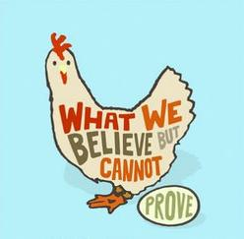
Belief
An acceptance that a statement is true or that something exists.

Slide 11
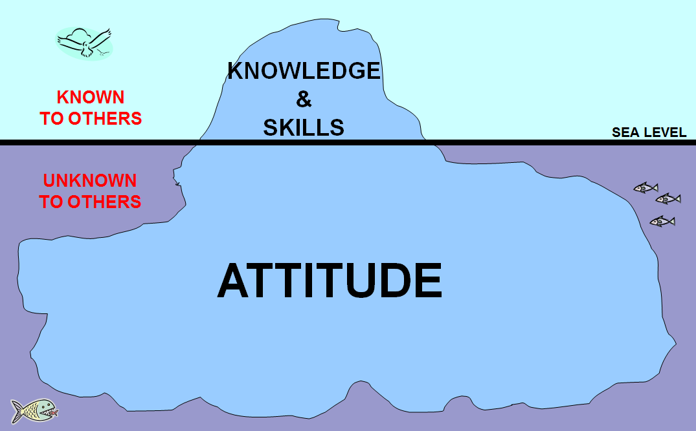
Notes:
This is a great visual to illustrate that even though attitude may be a big part of who we are it may not be known or seen to others.

Slide 12
So…. where do our attitudes & beliefs come from?
Notes:
We want to help change people’s perceptions and misconceptions about inclusion.
But in order to do that it is important to first think about where/how each of has developed the attitudes & beliefs we hold.
Our attitudes & beliefs come from our own experiences – whether it is an actual experience or something we have learned, read, seen, brought up with. They can be molded by the people who are closest to us and those we respect. They can also come from fears and having had NO experience.
Tell participants that they are going to explore some of their own attitudes and beliefs.

Slide 13
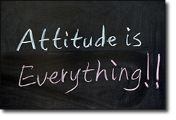
Ask Yourself...
What is a current attitude/belief you hold deeply?
Notes:
Pass out the handout and ask participants to silently answer this question.
Tell them that during these activities they will not be asked to share anything they chose not to.

Slide 14
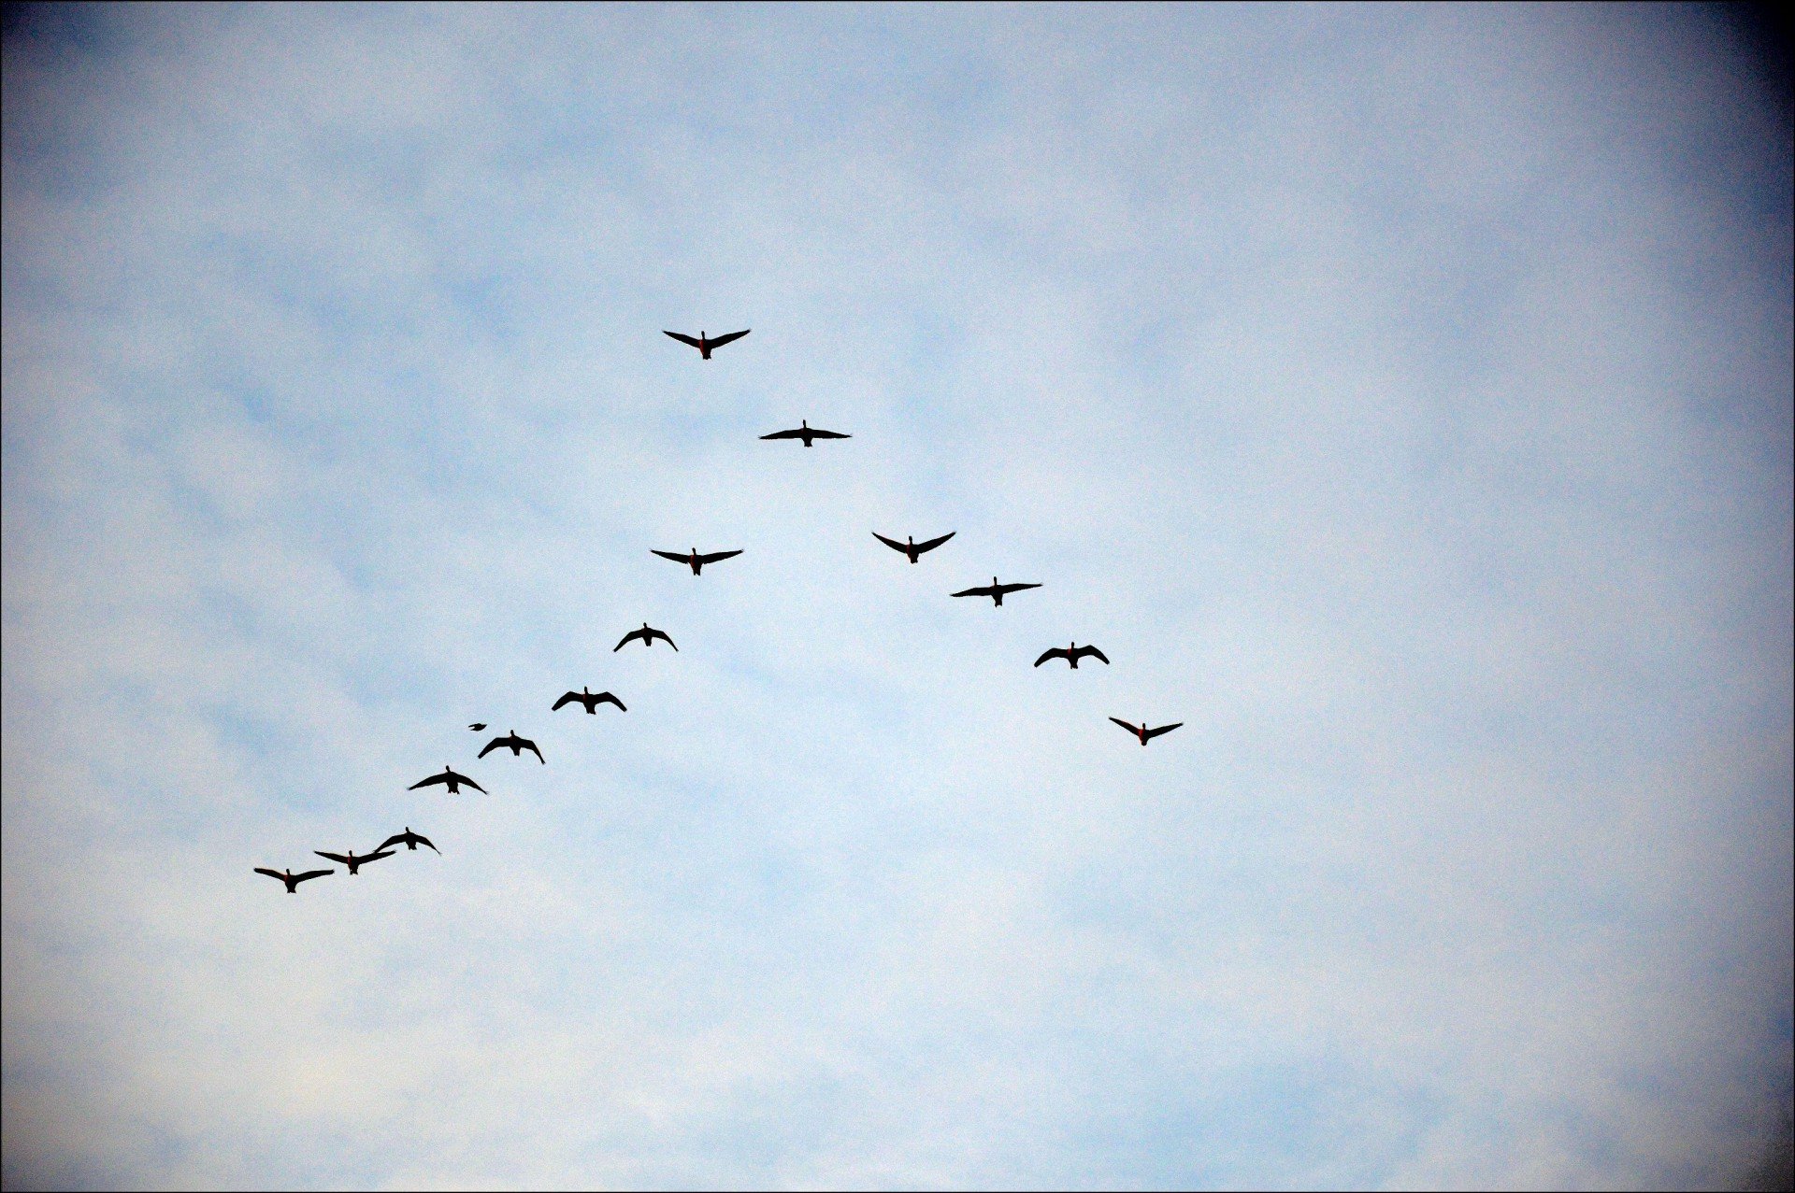
Answer These Questions
What experiences have you had that have helped form these attitudes & beliefs?
What was your upbringing related to this belief?
What were you taught?
What have you read?
What have you seen?
What have you heard?
What have you experienced?
Notes:
Ask participants to continue on the handout by answering these questions.
When everyone is done lead a group discussion around these questions.

Slide 15
Change Happens
What is an attitude/belief you used to hold but have changed?
This Photo by Unknown Author is licensed under CC BY
Notes:
Ask participants to silently answer this question.
Tell them that during these activities they will not be asked to share anything they chose not to.

Slide 16
Answer These Questions
What have been your experiences that helped you change these attitudes/beliefs?
Did you learn something new?
Did you see or hear something different?
Did you have an experience that made you think differently?
Was it the influence of someone you respected?
Notes:
Ask participants to continue on the handout by answering these questions.
When everyone is done lead a group discussion around these questions.

Slide 17
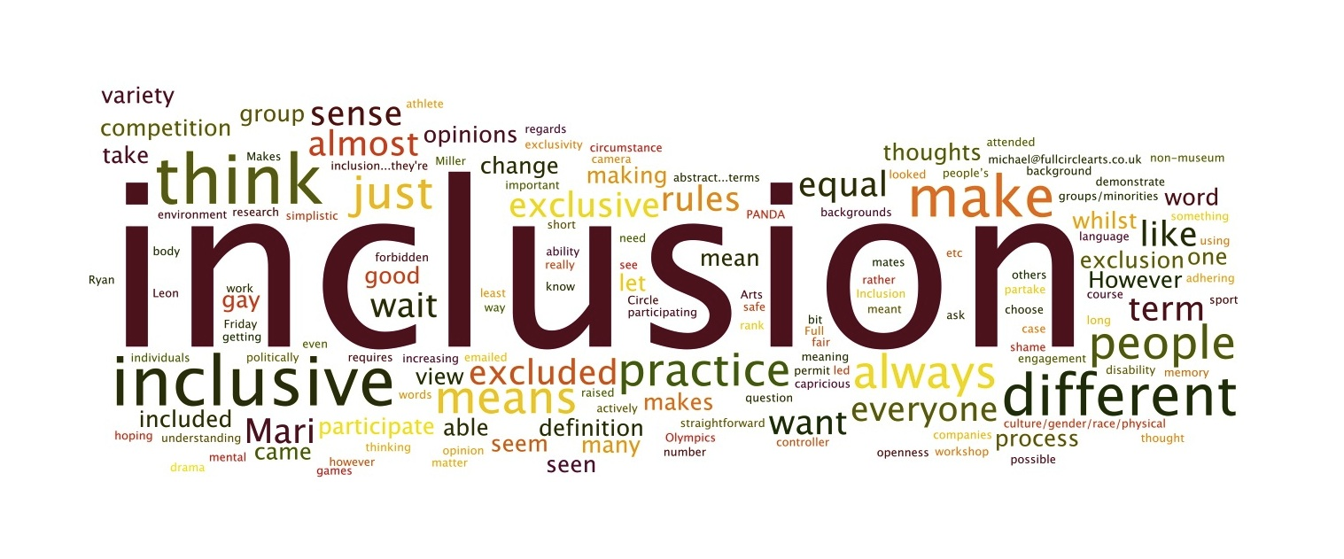
Your Current Thinking
What are your current attitudes & beliefs about early childhood inclusion?
This Photo by Unknown Author is licensed under CC BY-SA-NC
Notes:
Ask participants to silently answer this question.
Tell them that during these activities they will not be asked to share anything they chose not to.

Slide 18
Answer These Questions
What do you believe has formed those?
What experiences?
What information?
What people?
Notes:
Ask participants to continue on the handout by answering these questions.
When everyone is done lead a group discussion around these questions.

Slide 19
How would you respond?
INCLUSION​
What are your attitudes and beliefs about those who do not support early childhood inclusion?
Notes:
Ask participants to silently answer this question.
Tell them that during these activities they will not be asked to share anything they chose not to.

Slide 20
Change Ahead...
What can you do to help others change their attitudes & beliefs about early childhood inclusion?
Notes:
Ask participants to continue on the handout by answering these questions.
When everyone is done lead a group discussion around these questions.

Slide 21
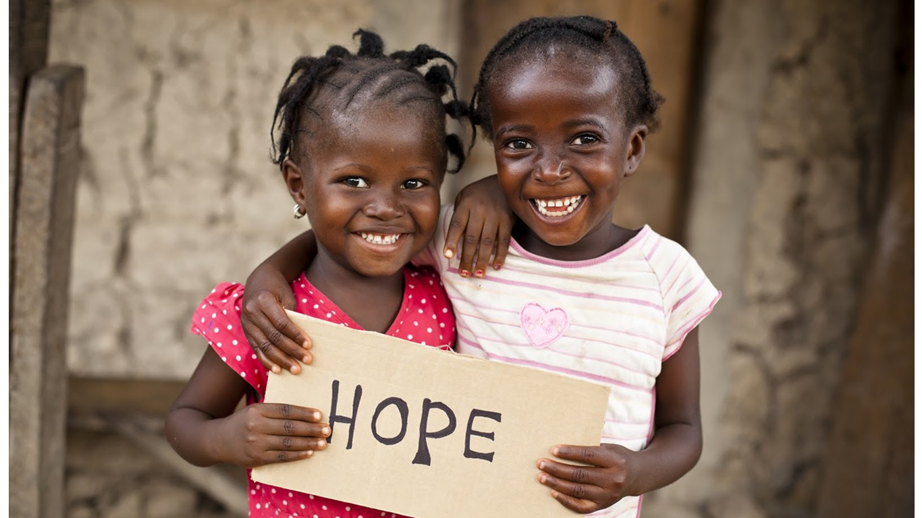
In Summary
Attitudes and beliefs are formed by many factors
It’s important to look at our attitudes and beliefs and where they come from
Understanding how attitudes and beliefs are formed can aid in helping others shift

Slide 22
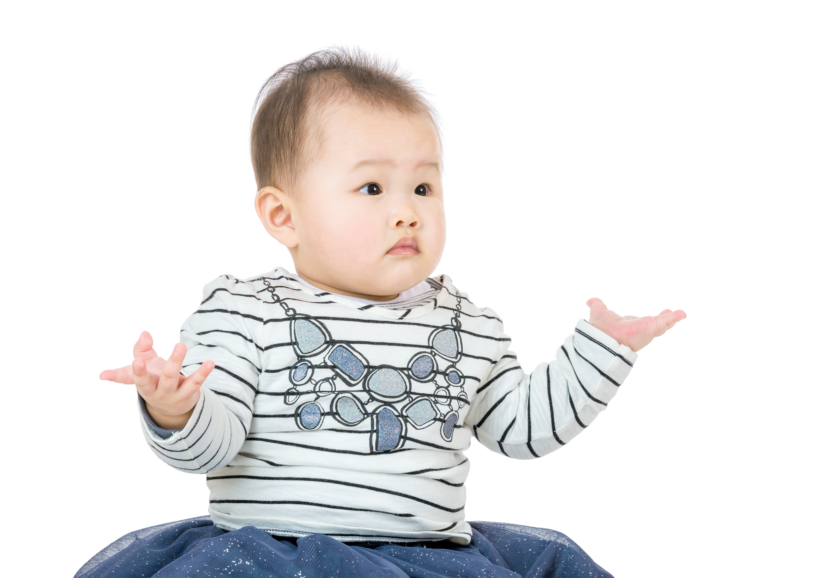
Any last thoughts or questions?

