Slide 1
Indiana Early Intervention Structure & System

Slide 2
Structure

Slide 3
State Agency Structure
Cathy Robinson
Deputy Director
Jessica Harlan-York
Chief Operating Officer
State of Indiana
Family and Social Service Administration (FSSA)
Dan Rusyniak,
Secretary
Division of Disability and Rehabilitative Services
Kelly Mitchell,
Director
Kyle Ingram
Director of Policy & Strategic Initiatives
Christina Commons
Director
Bureau of Child Development Services
Theresa Koleszar
Director
Bureau of Rehabilitative Services
Holly Wimsatt
Director
Bureau of Disability Services

Slide 4
Bureau of Child Development Services
Christina Commons
Part C Coordinator/BCDS
Director
100% State Funded
Organizational Chart
David Brandon-Friedman
Policy & Strategic Initiatives Director
100% State Funded
Maggie McCall
Quality Assurance Director
100% State Funded
Constance Young
Outreach and Training Director
100% Part C Funded
Barbara Sanders
Family Engagement Manager
100% Part C Funded
Marie-Therese Smith
Data & Fiscal Compliance
Manager
100% Part C Funded
Katherine Goodwell
Program Services Manager
100% State Funded
Amy Torres
Training Manager
100% Part C Funded
Note: All BCDS staff are 100% dedicated to the First Steps Early Intervention program.

Slide 5
Indiana First Steps Early Intervention System
System Points of
Entry &
Local Planning and Coordinating Councils (LPCC)
UCEDD Indiana
University,
Early Childhood
Center
EIS Provider
Agencies
Independent EIS
Providers
Data System,
EIHub
Public Awareness & Child Find
Developmental Therapy
Nutrition
Fund Recovery
Professional
Development
Psychology
Provider Enrollment
Referrals & Intake
Occupational Therapy
Social Work
Learning Management
System
Audiology
Program Evaluation
Evaluation &
Assessment
Case Management
Physical Therapy
Medical/Nursing
Transportation
Service Logging
Federal Reporting
Service Coordination
Speech Therapy
Family Portal (Family
Cost Participation)
Interpretation

Slide 6
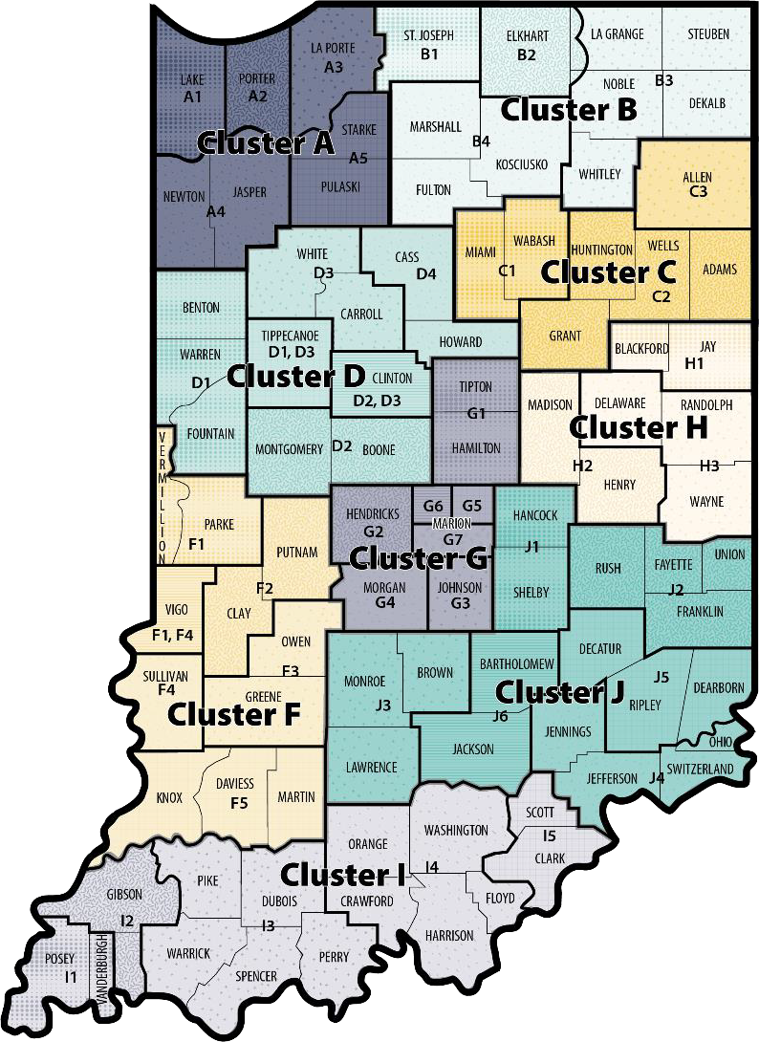
System Point of Entry (SPOE)
9 service regions called Clusters
Each Cluster has a SPOE/LPCC
4 contractors
1st Kids (Clusters A, B, C, D)
Blue River Services (Clusters F & I)
ProKids (Cluster G)
Thrive Alliance (Clusters H & J)
SPOE Responsibilities
Referral
Evaluation & Assessment
Service Coordination
Fiscal Matters
Competitively procured via RFP
Governed by contract
Receives partial Part C funding for Service Coordination
Funding allocation determined based on historical child count
figures
Evaluation & Assessment services partially Part C funded based on fee for service

Slide 7
Local Planning & Coordinating Council
Each Cluster has an LPCC
Modeled after the State Interagency Coordinating Council
LPCC Responsibilities
Public Awareness & Child Find
Provider Recruitment
Procedural Safeguards, Information and Services, and Quality Assurance
Transition and Interagency Agreements
Fiscal Matters
Procured jointly with the SPOE and governed by the same contract
LPCC functions are covered by State funds

Slide 8
Provider Agencies & Independent Providers
40 Multidisciplinary Provider Agencies
Operate within defined Service Areas
Provide Developmental Therapists, Occupational Therapists,
Physical Therapists, and Speech Language Pathologists
3 Specialized Agencies
Operate throughout the entire state
Provide Blind and Low Vision or Deaf and Hard of Hearing Services
100+ Independent Providers
Operate throughout the state
Provide Nutrition, Psychology, Social Work, Audiology, Medical/Nursing, Transportation, and Interpreter Services
Fiscal Matters
Open Enrollment Application Process
Agency Provider Agreement with State governs relationship with
entities/independent providers
Individual Provider Agreement with State governs relationship with
rendering providers
Fee for Service structure
Centralized payment structure

Slide 9
UCEDD Indiana University, Early Childhood Center (ECC)
Program Evaluation & Federal Reporting
Quality Review (annual monitoring)
SPP/APR Consultation
Professional Development and Technical Assistance
Family-Guided Routines-Based Intervention
Orientation Trainings
Early Intervention Conference
Technical Assistance to SPOE/LPCCs, Agencies, and Providers
Fiscal Matters
Competitively procured via RFP
Relationship governed by contracts
PD/TA is partially Part C funded

Slide 10
PCG – Data System EIHub and Central Reimbursement Office (CRO)
Statewide Data System
Provider Enrollment and Management
Learning Management
Case Management
Service Logging
Billing and Claiming
Family Portal (Family Cost Participation)
Fiscal Matters
Competitively produced via RFP
Relationship governed by contract
Partially Part C funded

Slide 11
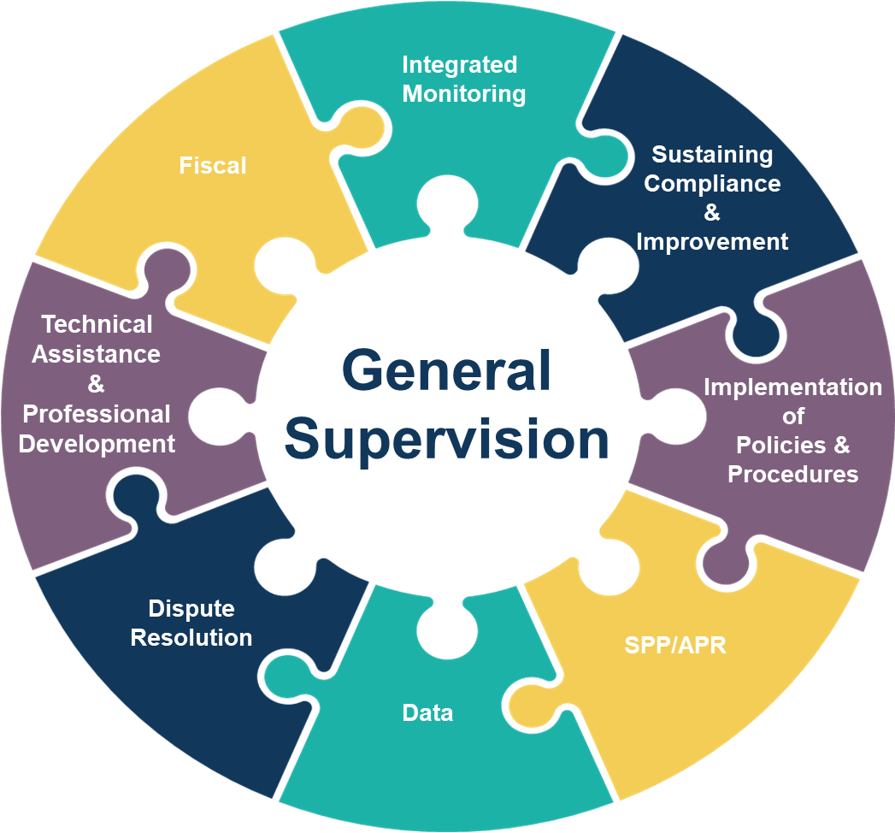

Slide 12
Public Awareness & Child Find
Lead Agency
Local Planning and Coordinating Councils
Public Awareness & Child Find Vendor
Christina Commons,
Director of BCDS
Interagency and Collaborative Partnerships/Initiatives
Constance Young, Director of Training & Outreach
Marketing/Outreach
Materials
Presentations & Tabling with Primary Referral Sources
Barbara Sanders, Family Engagement Manager
Family-focused
Presentations & Tabling
LPCC Coordinators and
Members
Tracking and data analysis of primary and secondary referral sources
Ongoing informational activities with potential referral sources such as local childcare, physicians, hospitals, social service agencies, Department of Child Services, and families
Branding refresh
Creation of outreach material
https://www.in.gov/fssa/firststeps/first- steps-outreach-materials/
Establish presence and
connections social media
Family and physician
testimonial videos
https://www.in.gov/fssa/firststeps/first- steps-offices/
Print media campaigns

