Slide 1
Strengthening the Quality, Use, and Accessibility of Part B IDEA Section 618 Data
Tuesday, August 14, 2018

Slide 2
Presenters
Meredith Miceli, OSEP, Research to Practice Division
Amanda Hoffman, OSEP Research to Practice Division
Becca Smith, OSEP, Research to Practice Division
Amy Bae, OSEP, Monitoring and State Improvement Planning Division
Liz Fening, NCES, Elementary Secondary Branch/ EDFacts
Julia Redmon, AEM Corporation, EDFacts Technology and Support Services II (ETSS)

Slide 3
Agenda
IDEA Section 618 Part B Data Quality Review
Data Use, Publication, & Access to IDEA Section 618 Part B Data
Upcoming Changes to the IDEA Section 618 Part B Data Work

Slide 4
IDEA Section 618 Part B Data Quality Review

Slide 5
Representing the EDFacts Team
Liz Fening
NCES, Administrative Data Division, Elementary and Secondary Branch (ESB) Liaison
Julia Redmon
AEM Corporation, EDFacts Technology and Support Services II (ETSS), Data Management Co-Lead

Slide 6
DQ Review Process
Review data to identify anomalies/unexpected values
Timeliness, Completeness, Accuracy
Provide feedback to State through PSC and OMB Max
Receive updated data and/or state responses
Repeat for a second round of feedback (Assessment only)
Review data and assesses final quality that informs internal data use, final public file production and public data notes document

Slide 7
November DQ Follow-up SY 2015-16 v. SY 2016-17
The table shows the number of states resubmitting files during the reopen
Approximately the
File | SY 2015-16 | SY 2016-17
Part B Discipline | 10 | 15
Part B Existing | 16 | 13
Part B Personnel | 9 | 6
Part B Dispute | 5 | 5
Part C Dispute | 2 | 3
Part C Exiting | 5 | 6
same number of states triggered errors in each year
The year-to-year errors trigger for the largest number of states
Aside from year-to-year errors, generally fewer than 5 states triggered any of the errors

Slide 8
November DQ Follow-up Focus on SY 2016-17
Seven states resolved one or more “Review 2” error through resubmission
Two states were responsible for 13% of “Review 1” errors and 30% of the remaining “Review 2” the errors; these states did not resubmit during the reopen
States also resubmitted SSS-IDEA to correct inconsistencies

Slide 9
January
February
March
April
May
June
July
August
CCD Directory
CCD Dropouts and Completers
CCD Membership, Staffing and Special Populations
IDEA Discipline, Exiting, Personnel
IDEA Child Count
IDEA MOE/CEIS
Assessment
Assessment
DQ Review Calendar
CSPR Part I
CSPR Part I
IDEA Assessment
IDEA Assessment
DQ outreach, resubmission and state notes
ACGR
ACGR
CSPR Part II
CSPR Part II
GFSA
GFSA

Slide 10
IDEA DQ Review Calendar
January
February
March
April
May
June
July
August
IDEA Discipline, Exiting, Personnel
IDEA Child Count
IDEA MOE/CEIS
Discipline
005 – CWD Removal to Interim Alternative Educational Setting
006 - CWD Suspensions/Expulsions
007 – CWD Reasons for Unilateral Removal
088 – CWD Disciplinary Removals
143 – CWD Total Disciplinary Removals
144 - Educational Services During Expulsion
Part C Dispute Resolution
Exiting
009 – CWD Exiting Special Education
Part C Exiting
Personnel
070 - Special Education Teachers (FTE)
099 - Special Education Related Services Personnel
112 - Special Education Paraprofessionals
002 – CWD School Age
089 – CWD Early
Part C Child Count and Settings
Maintenance of Effort Reduction (MOE) and Coordinated Early Intervening Services (CEIS)
IDEA Assessment
IDEA Assessment
175: Academic Achievement in Mathematics
178: Academic Achievement in Reading (Language Arts)
185: Assessment Participation in Mathematics
188: Assessment Participation in Reading/Language Arts

Slide 11
IDEA DQ Review Calendar
 | FILE DUE DATE | DQ REVIEW DELIVERY | DQ RESPONSE DUE DATE
IDEA Discipline, Exiting, and Personnel | 1st Wed in Nov | Early-Jan | Late-May
IDEA Assessment | Wed in mid-Dec | Review 1 Early-Feb Review 2 Late- March | Close 2 Late-Feb Close 3 Mid-April
IDEA Child Count | 1st Wed in Apr | Early-June | Mid-July
IDEA MOE/CEIS | 1st Wed in May | Mid-July | Late-August

Slide 12
Key EDFacts Websites
EDFacts Initiative website
https://ed.gov/edfacts
Documentation
LEA and School public data files
EDFacts Community Site
https://edfacts.grads360.org
PSC Resources

Slide 13
IDEA Section 618 Data Quality Challenges
Reporting zero counts
Zero counts are required for State level data submissions
However, if your state does not use a permitted value/ data element, do not report a zero and do not use that permitted value in the file.

Slide 14
IDEA Section 618 Data Quality Challenges
Aligning to metadata
The responses to the metadata surveys and the permitted values reported in the data file must align.
Metadata surveys:
EMAPS State Supplementary Survey – IDEA (SSS-IDEA)
EMAPS Assessment Metadata Survey

Slide 15
Discussion How can osep help states address IDEA section 618 data quality challenges?

Slide 16
DISCUSSION
how DO you verify the quality of the IDEA 618 data before submitting to EDFacts?

Slide 17
State Data Quality Checks
How do verify your data after it is submitted to ESS?
What data quality verification steps do you follow?
Do you use ERS reports? Which ones?
Have you built your own reports?

Slide 18
Data Use, Publication, and Analysis: APR, Matrix, & Determinations

Slide 19
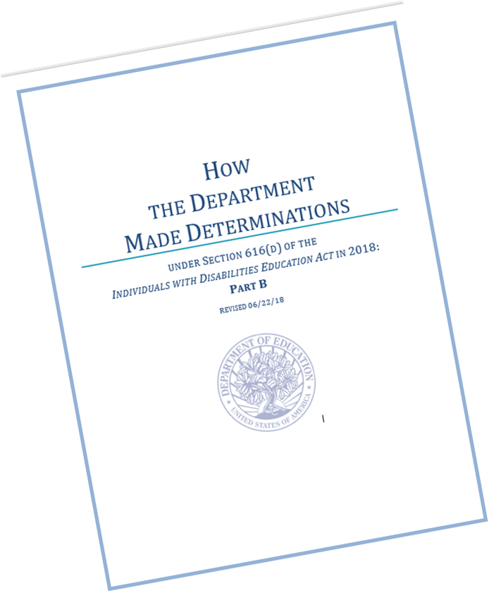
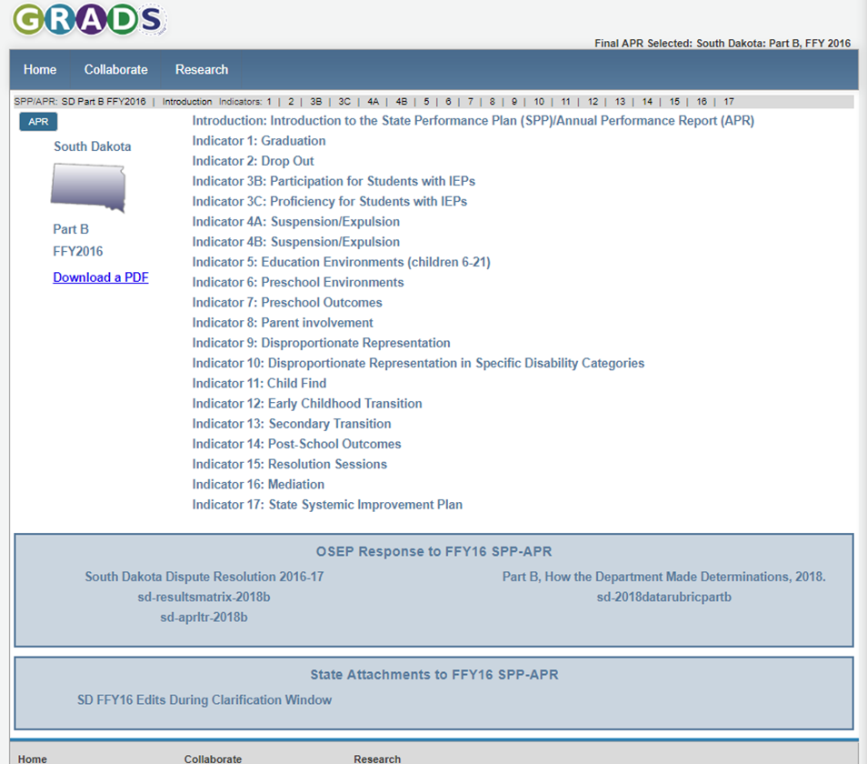
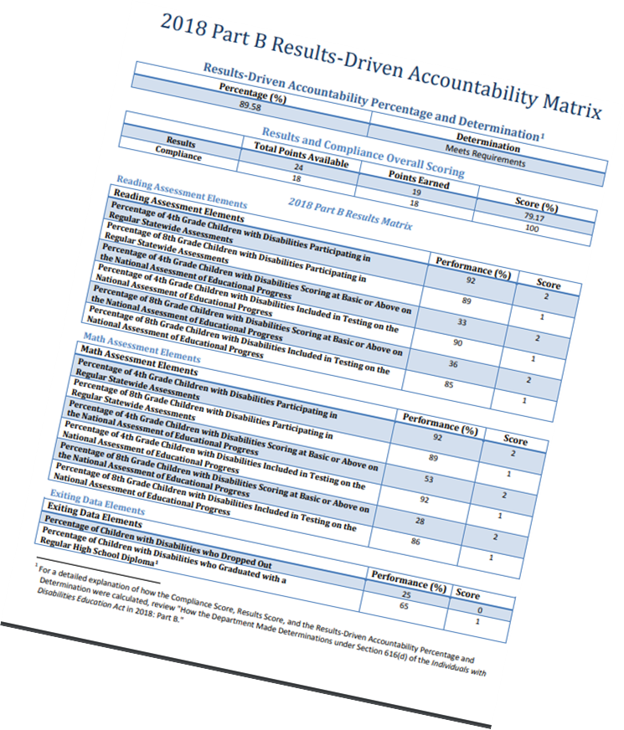
How the 618 Data Are Used in the APR, Accountability Matrix, and Determinations

Slide 20
Results Driven Accountability Matrix
Results Matrix
Compliance Matrix
RDA Percentage & Determination

Slide 21
Results Matrix
Results Matrix
Compliance Matrix
RDA Percentage & Determination

Slide 22
2018 PART B RESULTS MATRIX
In making each State’s 2018 determination, the Department used a Results Matrix reflecting the following data:
The percentage of fourth-grade CWD participating in regular Statewide assessments;
The percentage of eighth-grade CWD participating in regular Statewide assessments;
The percentage of fourth-grade CWD scoring at basic or above on the NAEP;
The percentage of fourth-grade CWD included in NAEP testing;
The percentage of eighth-grade CWD scoring at basic or above on the NAEP;
The percentage of eighth-grade CWD included in NAEP testing;
The percentage of CWD exiting school by dropping out; and
The percentage of CWD exiting school by graduating with a regular high school diploma.

Slide 25
Compliance Matrix
Results Matrix
Compliance Matrix
RDA Percentage & Determination

Slide 26
2018 PART B COMPLIANCE MATRIX
In making each State’s 2018 determination, the Department used a Compliance Matrix, reflecting the following data:
The State’s FFY 2016 data for Part B Compliance Indicators 4B, 9, 10, 11, 12, and 13 (including whether the State reported valid and reliable data for each indicator); and whether the State demonstrated correction of all findings of noncompliance it had identified in FFY 2015 under such indicators;
The timeliness and accuracy of data reported by the State under sections 616 and 618 of the IDEA;
The State’s FFY 2016 data, reported under section 618 of the IDEA, for the timeliness of State complaint and due process hearing decisions; and
Longstanding Noncompliance.

Slide 28
Data Rubric

Slide 29
618 Data Rubric Criteria
Timely – A State will receive one point if it submits all EDFacts files or the entire EMAPS survey associated with the IDEA Section 618 data collection to ED by the initial due date for that collection
Complete Data – A State will receive one point if it submits data for all files, permitted values, category sets, subtotals, and totals associated with a specific data collection by the initial due date. No data is reported as missing. No placeholder data is submitted. The data submitted to EDFacts aligns with the metadata survey responses provided by the state in the State Supplemental Survey IDEA (SSS IDEA) and Assessment Metadata survey in EMAPS. State-level data include data from all districts or agencies.

Slide 30
618 Data Rubric Criteria (Cont’d)
Passed Edit Check – A State will receive one point if it submits data that meets all the edit checks related to the specific data collection by the initial due date. The counts included in 618 data submissions are internally consistent within a data collection.

Slide 31
Accountability Matrix
Results Matrix
Compliance Matrix
RDA Percentage & Determination

Slide 32
2018 RDA Percentage and 2018 Determination

Slide 33
2018 RDA Percentage and 2018 Determination
The State’s RDA Percentage was calculated by adding 50% of the State’s Results Score and 50% of the State’s Compliance Score. The State’s RDA Determination is defined as follows:
Meets Requirements A State’s 2018 RDA Determination is Meets Requirements if the RDA Percentage is at least 80%, unless the Department has imposed Special Conditions on the State’s last three (FFYs 2015, 2016, and 2017) IDEA Part B grant awards, and those Special Conditions are in effect at the time of the 2018 determination.
Needs Assistance A State’s 2018 RDA Determination is Needs Assistance if the RDA Percentage is at least 60% but less than 80%. A State would also be Needs Assistance if its RDA Determination percentage is 80% or above, but the Department has imposed Special Conditions on the State’s last three (FFYs 2015, 2016, and 2017) IDEA Part B grant awards, and those Special Conditions are in effect at the time of the 2018 determination.
Needs Intervention A State’s 2018 RDA Determination is Needs Intervention if the RDA Percentage is less than 60%.
Needs Substantial Intervention The Department did not make a determination of Needs Substantial Intervention for any State in 2018.

Slide 34
2018 RDA Part B Determinations
Determination | # States/ Entities
Meets Requirements | 22
Needs Assistance (1 Year) | 7
Needs Assistance (2 or more Consecutive Years) | 26
Needs Intervention (1 Year) | 4
Needs Intervention (7 or more Consecutive Years) | 1

Slide 35
APR Look-Fors
N-size vs cell size
Reporting number of district using the minimum n-size
Representativeness
Reporting progress
09/02
Using accurate citations

Slide 36
Using the APR Data to Drive Continuous Improvement
Looking at the matrix data to identify areas for improvement
Focusing on data close to the targets
Clearing up long standing non compliance
Identifying data that aligns with other current improvement efforts

Slide 37
Where To Find Information on the APR, Accountability Matrix, and Determinations
https://osep.grads360.org/#program/spp-apr-resources
https://sites.ed.gov/idea/data/

Slide 38
Data Use, Publication, and Analysis: Disclosure Avoidance Methodologies

Slide 39
Disclosure Review Board (DRB)
Disclosure Review Board (DRB) is a collaborative council that reviews proposed data releases and disclosure avoidance methodologies by ED’s program offices for consistency and privacy protection standards.
EDFacts resource: https://www2.ed.gov/about/inits/ed/edfacts/ed-disclosure-avoidance-overview.pdf

Slide 40
Disclosure Avoidance Methodology for Part B Child Count and Educational Environments Data File
Report data by specific disability category for age ranges only.
Suppress all data for any demographic group (i.e., race, gender, or LEP status) that has only 1-2 individuals for the entity.
Suppress all data for the next smallest demographic group, if necessary.
If one group suppressed under Steps 2 and 3 does not have a value of greater than 1, suppress all data for an additional demographic group with a value of greater than 1.
Suppress all data for “Inside regular classroom <40% of the day” and “Separate School” if there is only 1-2 individuals in an age group for either category in the state/ entity.
Suppress data for a 2nd state/ entity if data are suppressed for only one state/ entity.

Slide 41
Disclosure Avoidance Methodology for Part B Exiting Data File
Suppress all data for any demographic group (i.e., discrete age, race, gender, or LEP status) that has only 1-2 individuals for the entity.
Suppress all data for the next smallest demographic group, if necessary.
Suppress data for a 2nd state/ entity if data is suppressed for only one state/ entity.
If only 1 demographic group is suppressed, suppress all data for the next smallest (non- zero) demographic group.
Create a new variable that is the subtotal of “certificates” plus “diplomas” categories.
If either the “certificate” or “diploma” category contains 0-2 individuals for any disability, suppress both categories for that disability and only report the subtotal for that disability.
If the “certificate” and “diploma” categories are only suppressed for 1 disability category, also suppress the “certificate” and “diploma” categories and only report the subtotal for the next smallest disability category.
If one group suppressed under Steps 1-6 does not have a value of greater than 1, suppress all data for an additional demographic group with a value of greater than 1.
Suppress data for a 2nd state/ entity if data are suppressed for only one state/ entity.

Slide 42
Disclosure Avoidance Methodology for Part B Discipline Data File
Suppress all disciplinary variables for any disability category or demographic group (i.e., race, gender, or LEP status) for which there are 1-2 individuals ages 3-21 at the state/ entity level.
Suppress all disciplinary variables for the next smallest disability category or demographic group, if necessary.
If one category or group suppressed under Steps 1 and 2 does not have a value of greater than 1, suppress all disciplinary variables for an additional demographic group with a value of greater than 1.
Suppress data for a 2nd state/ entity if data are suppressed for only one state/ entity.

Slide 43
Disclosure Avoidance Methodology for Part B IDEA Assessment Data File
Bottom-coding for all counts of students proficient or higher by grade and by assessment type.
All values for these counts that are less than or equal to 3 (0, 1, 2, and 3) will be replaced with a bottom-coding of ≤3.

Slide 44
Other IDEA Part B Section 618 Data Files
No disclosure avoidance methodology applied to:
Part B Personnel
Part B Dispute Resolution
Part B MOE Reduction and CEIS

Slide 45
Source for IDEA Section 618 Data File Disclosure Avoidance Methodologies
IDEA Section 618 data file documentation – available at:
https://www2.ed.gov/programs/osepidea/618-data/collection-documentation/index.html#datadocs

Slide 46
Discussion How do states use the idea section 618 data?

Slide 47
Upcoming changes: Part B Exiting Data File

Slide 48
Upcoming changes: EMAPS Interface

Slide 49
POTENTIAL Upcoming changes: LEA-Level Data Quality and Publication Work

Slide 50
Overview of the LEA Part B Child Count and Educational Environments Data Quality Review
Background:
NCES releases LEA-level Part B Child Count Data in ElSi (https://nces.ed.gov/ccd/elsi/default.aspx?agree=0 )
Counts pulled from C002 and C089
NCES has conducted data quality reviews on these data
Starting with 2018 data:
OSEP will collaborate with NCES to review the quality of these data submissions
NCES will continue to publish the counts on their website

Slide 51
Scope of Data Quality Review
EDFacts file submissions for C002 and C089
Data submitted as of the due date
1st Wednesday in April
Will not impact or be considered for IDEA Part B Determination process

Slide 52
LEA-level Data Quality Review
Timeliness
Completeness
Accuracy
Year to Year

Slide 53
Edits for C002
DQ Rule Definition / Edit Logic | Comment to State
Counts were not submitted for each LEA. | The LEA-level total reported for the unduplicated number of children with disabilities (IDEA) ages 6 through 21 is missing. Please resubmit data where necessary to ensure completeness.
The sum of the total unduplicated number of children with disabilities (IDEA) ages 6 through 21 for all LEAs in the state and the total unduplicated number of children with disabilities (IDEA) ages 6 through 21 in the state was not equal. | The state-level count reported for the unduplicated number of children with disabilities (IDEA) ages 6 through 21 <###> is not equal to the sum for all LEAs in the state <###>.
The total unduplicated number of children with disabilities (IDEA) ages 6 through 21 for Subtotal by Disability Category (IDEA) and Education Unit total was not equal. | The LEA-level count reported for the unduplicated number of children with disabilities (IDEA) ages 6 through 21 <###> is not equal to the sum of the subtotal by disability category <###> for the LEA.
For the current collection year, data for file specification 002 were not submitted by the due date. | LEA-level data were not reported for file specification 002 on the file due date.

Slide 54
Edits for C089
DQ Rule Definition / Edit Logic | Comment to State
Counts were not submitted for each LEA. | The LEA-level total reported for the unduplicated number of children with disabilities (IDEA) ages 3 through 5 is missing. Please resubmit data where necessary to ensure completeness.
The sum of the total unduplicated number of children with disabilities (IDEA) ages 3 through 5 for all LEAs in the state and the total unduplicated number of children with disabilities (IDEA) ages 3 through 5 in the state was not equal. | The state-level count reported for the unduplicated number of children with disabilities (IDEA) ages 3 through 5 <###> is not equal to the sum for all LEAs in the state <###>.
The total unduplicated number of children with disabilities (IDEA) ages 3 through 5 for Subtotal by Disability Category (IDEA) and Education Unit total was not equal. | The LEA-level count reported for the unduplicated number of children with disabilities (IDEA) ages 3 through 5 <###> is not equal to the sum of the subtotal by disability category <###> for the LEA.
For the current collection year, data for file specification 089 were not submitted by the due date. | LEA-level data were not reported for file specification 089 on the file due date.

Slide 55
Year to Year Comparison Edits
DQ Rule Definition / Edit Logic | Comment to State
LEAs were excluded from the YTY comparison if they did not match with the 2017-18 IDEA Part B CC data file. The count of excluded LEAs is aggregated to the state level. | [###] LEAs with 2018-19 data for file specification 002 were not included in the YTY analysis because data for 2017-18 were not available.
The counts of unduplicated number of children with disabilities (IDEA) ages 6 through 21 in identified categories have changed more than 50 units and 20% (either greater than or less than) from the previous year. | A large year-to-year change was identified for the LEA child count of <###> students and <##%> between 2018-19 (###) and 2017-18 (###). Please submit a data note explaining the large year-to-year change in the data.
LEAs were excluded from the YTY comparison if they did not match with the 2017-18 IDEA Part B CC data file. The count of excluded LEAs is aggregated to the state level. | [###] LEAs with 2018-19 data for file specification 089 were not included in the YTY analysis because data for 2017-18 were not available.
The counts of unduplicated number of children with disabilities (IDEA) ages 3 through 5 in identified categories have changed more than 50 units and 20% (either greater than or less than) from the previous year. | A large year-to-year change was identified for the LEA child count of <###> students and <##%> between 2018-19 (###) and 2017-18 (###). Please submit a data note explaining the large year-to-year change in the data.

Slide 56
Example Data Quality Report

Slide 57
Partner Support Center (PSC)
The PSC is open from 8 a.m. to 6 p.m. ET, Monday through Friday:
Toll Free: 877-457-3336 (877-HLP-EDEN) Fax: 888-329-3336 (888-FAX-EDEN) Federal Relay Service: 800-877-0996 (Voice/TTY) / federalrelay@sprint.com E-mail: EDEN_SS@ed.gov

Slide 58
Questions?

