Slide 1

Using Suspension and Expulsion Data to Support Equity in Early Childhood Settings
Jen Neitzel, Ph.D. Megan Vinh, PH.D. Lise Fox, PH.d
Improving Data, Improving Outcomes Conference 2018

Slide 2
Goals of this Session:
After taking part in this session, participants will:
have an increased understanding of suspension/expulsion in early childhood settings and the importance of collecting data;
have an introduction to the Behavior Incident Report ; and
discuss challenges, barriers, and solutions to collecting data.

Slide 3
Who We Are
Jen Neitzel, Ph.D.
Research Scientist at FPG Child Development Institute, UNC-Chapel Hill
Lise Fox, Ph.D.
Professor in the Dept. of Child and Family Studies at University of South Florida and Co-Director of Florida Center for Inclusive Communities.
Megan Vinh, Ph.D.
Advanced Technical Assistance Specialist at FPG Child Development Institute, UNC-Chapel Hill

Slide 4
Getting to Know You
Part C Coordinator
Part C Data Manager
619 Coordinator
Part B Data Manager
SICC Chair/Staff
State PD/TA Provider
National TA Provider
IHE staff
Regional Administrator
Direct Service Provider
Families
Other?

Slide 5
What is Early Childhood Suspension and Expulsion?
Notes:
When I say suspension and expulsion what do you think that means?

Slide 6
Expulsion: Complete and permanent removal of a child from an early learning programs

Slide 7
Suspension: A “disciplinary action that is administered as a consequence of a student’s inappropriate behavior, requires that a student absent him/herself from the classroom or from the school for a specified period of time.”

Slide 8

What does this REALLY look like in early childhood?
http://preventexpulsion.org/wp-content/uploads/2016/08/WhatSuspensionExpulsionLooksLike_infographic_v4.png

Slide 9
Civil Rights Data Collection
Biennial (i.e., every other school year)
Survey Required by the U.S. Department of Education’s Office for Civil Rights since 1968
Collected data from all public local education agencies (LEA) and schools, including long-term secure juvenile facilities, charter schools, alternative schools, and schools serving students with disabilities
Notes:
Included preschool data for the first time in 2014. C

Slide 10
Civil Rights Data Collection
It included the number of preschool children who:
had at least one out-of-school suspension,
had more than one suspension,
were expelled, and
received corporal punishment.
Notes:
Included preschool data for the first time in 2014. C

Slide 11

Patterns of racial and gender disproportionality:
5,000 preschoolers were suspended at least once and nearly 2,500 were suspended a second time (2014)
Black preschoolers: 3.6 times more likely to be suspended than their White peers (2016)
  Black children: 18 percent of the preschool population, but 48% of suspensions (2014)
Boys: 49% of the preschool population, but 82% of all suspensions (2014)
(United States Department of Education, 2014 & 2016)
Notes:
Black boys: 54% of the preschool population, but 78% of those suspended
Black girls: 20% of preschool female population, but 54% of girls suspended from preschool

Slide 12

Studies spanning 40 years show that Black children are up to four times more likely to be suspended than White students.
(Bradshaw et al., 2010; Children’s Defense Fund, 1975; Milner, 2013; Skiba et al., 2011)

Slide 13
How does your state look?
Go to this website: https://ocrdata.ed.gov/DataAnalysisTools/DataSetBuilder?Report=1
Work with a partner and compare your state data.
  Select a data point
  Add your states
Discuss:
  Does this seem “accurate”?
  What surprised you?
  What might be missing?
  How can you interpret this data?
https://ocrdata.ed.gov/

Slide 14

Why Does it Matter?

Slide 15
“Cradle to Prison Pipeline”
Preschool-to-prison pipeline was coined to describe the disproportionate number of young Black children who are suspended or expelled from early learning environments
Exclusionary practices:
  Result in interrupted education
  Increase the likelihood that Black children experience repeated suspensions and expulsions both in early childhood and beyond
  Are related to later academic achievement and school dropout rates

Slide 16


Slide 17
What Data Are We Missing?

Slide 18
One Key Strategy (Among Many):
Set goals for Improvement and Analyze Data to Assess Progress:
Important that all programs:
  set their own goals,
  monitor their data to assess progress, and
  modify their practices and investments, as needed, to reach their goals.
Several types of data can be useful in assessing progress depending on the specific goal.
Notes:
The focus of our session is on data…
How many of your programs collect this data?

Slide 19
Examples of Useful Data to Collect
  Percentage of:
    teachers with regular access to a behavioral or mental health consultant;
    children who receive developmental and behavioral screenings on regular schedules; and
    children with challenging behaviors who have received a comprehensive evaluation for services under Part B or Part C.
  Number of:
    behavior incidence reports, broken down by child and setting characteristics;
    suspension and expulsions broken down by race, gender, and disability; and
    suspensions and expulsion broken down by teacher/provider, class/group size, teacher-child ratio, and length of day.

Slide 20
Key Concepts for Data-Based Decision-Making
Identify your questions
Identify a process for looking at data and making interpretations
Identify the data sources or data needed to answer your questions
Notes:
Examining disparities in educational practices, particularly related to special education/gifted identification, and suspensions and expulsions, provides a starting point for identifying underlying attitudes that may be effecting how certain groups of students are treated (Carter et al., 2017). Townsend (2000) recommends using a standard definition for disproportionality to accurately identify trends. For example, disproportionality occurs when the frequency of special education identification or school exclusion is greater than their percentage in the population by 10% or more (Harry & Anderson, 1995).
Analysis of trends within schools also provides a context for implementing high-quality professional development activities that are specifically designed to reduce racial biases within educational settings. Having a mechanism for monitoring student achievement and disciplinary exclusions ensures that schools and districts are held accountable for racial/ethnic disparities, and to assist in the allotment of necessary resources to overcome patterns in academic achievement (Losen et al., 2014).

Slide 21
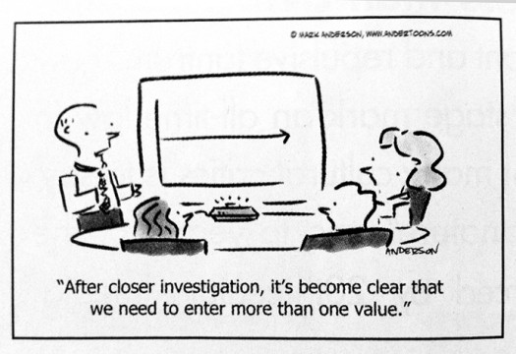
What are your data sources? What do you currently collect?

Slide 22
What is the BIRS 2.0?
The Behavior Incident Report System (BIRS) collects and analyzes behavior incidents in early childhood settings – similar to tracking of Office Discipline Referrals
Initially developed in 2010 (TACSEI); revised by the Pyramid Equity Project
NCPMI BIRS Materials
  Excel spreadsheet (requires MS Excel 2010 or newer)
  Data entry guide
  On-line teacher training
  Will be available on www.challengingbehavior.org, October 2018

Slide 23
Behavior Incident Report (BIR)
Form for recording serious behavior incidents and child demographics
Generate graphs that reviewed by the leadership team
Analyze across children, across teachers, individual children, identify potential issues of disproportionality.
Goal is to support the child, teacher, and consider actions needed for program improvement

Slide 24
Out of School Suspension = Sent home for remainder of day, sent home for 1 or more days
In School Suspension = time in different classroom
Expulsion = Dismissal from program
Notes:
24
24
24

Slide 25
Tracking Behavior Incidents
Behaviors
  Physical aggression, Tantrums, Inconsolable crying, non-compliance, etc.
Activities
  Centers, circle, diaper, snack, nap, etc.
Motivations
  Obtain item, obtain attention, avoid activity, avoid sensory, etc.
Responses
  Verbal reminder, move in group, provide comfort, remove from area, physical guidance, etc.
Notes:
The fields for data collection are adjusted to match the behaviors, activities and procedures that occur in ECE

Slide 26
BIR Analytic Elements
Measure | Analysis | Factors
Behavior incident frequency | Program Classroom Child | Type of Problem Behavior Activity Others involved Possible motivation Strategy/Response Administrative follow-up
Disproportionality | BIR Composition BIR Risk Risk Ratio | Race/Ethnicity Gender IEP status DLL

Slide 27
Tracking Administrative Actions
Expulsion/Dismissal
In School Suspension
  Temporary removal from classroom
  Time in different classroom or adult outside the classroom
Short Term Suspension
  Sent home for remainder of day -Child is sent home for some part of the school day.
Suspension
  Sent home for one or more days - Child is sent home and not allowed to return to school for one or more days.

Slide 28
Common Metrics
Risk (“Risk Index”)
  % of children in a racial/ethnic group who have at least one BIR
Risk Ratio
  Risk of one group vs. risk of another group
  Best single measure to summarize a group’s risk
Composition
  % of children who received BIRs who belong to a specific racial/ethnic group
BIR Composition
  % of BIRs generated by a specific racial/ethnic group
  Impacted by children who receive multiple BIRs
Notes:
Overview – will explain each in next set of slides

Slide 29
Process
Complete BIR Form
- Completed by the classroom teacher or staff member following a behavior incident that is not developmentally normative or is a cause for a concern
Forms provided to data entry staff
- BIR Form is provided to a designated person on staff who enters data into the spreadsheet
Data Analysis
- The spreadsheet provides a summary of for examining factors related to behavior incidents
Teachers Trained
- Teachers receive online training on how and when to use a BIR form for a behavior incident

Slide 30
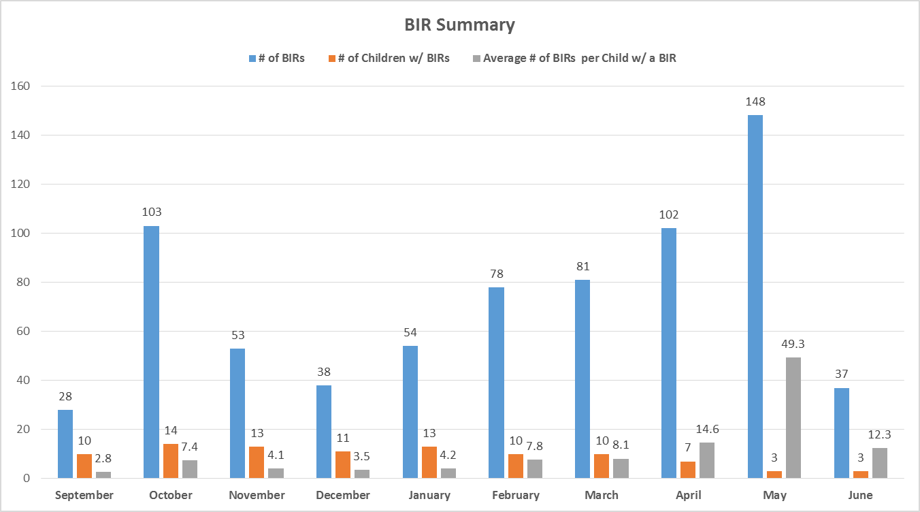

Slide 31
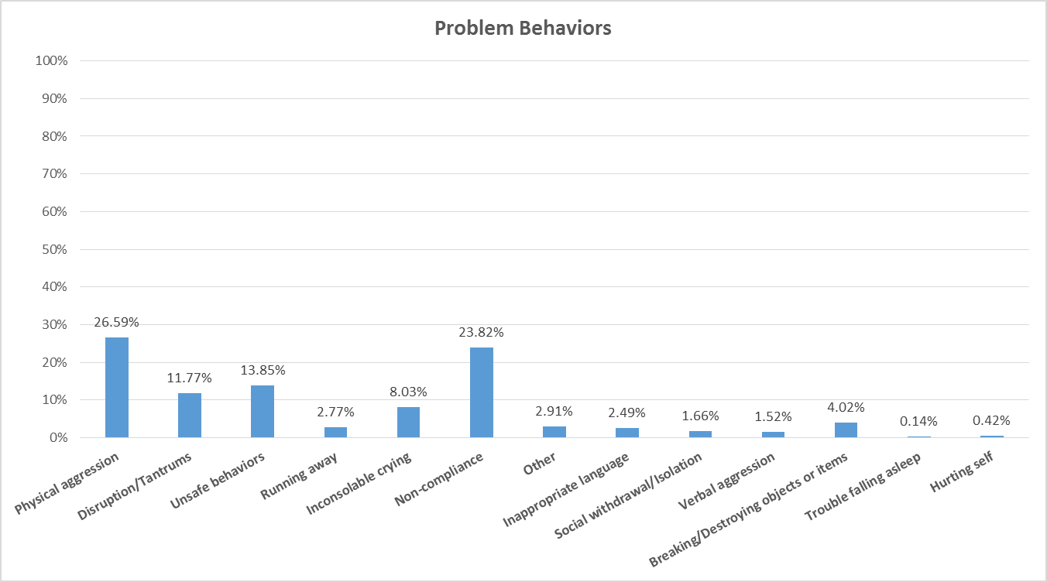

Slide 32
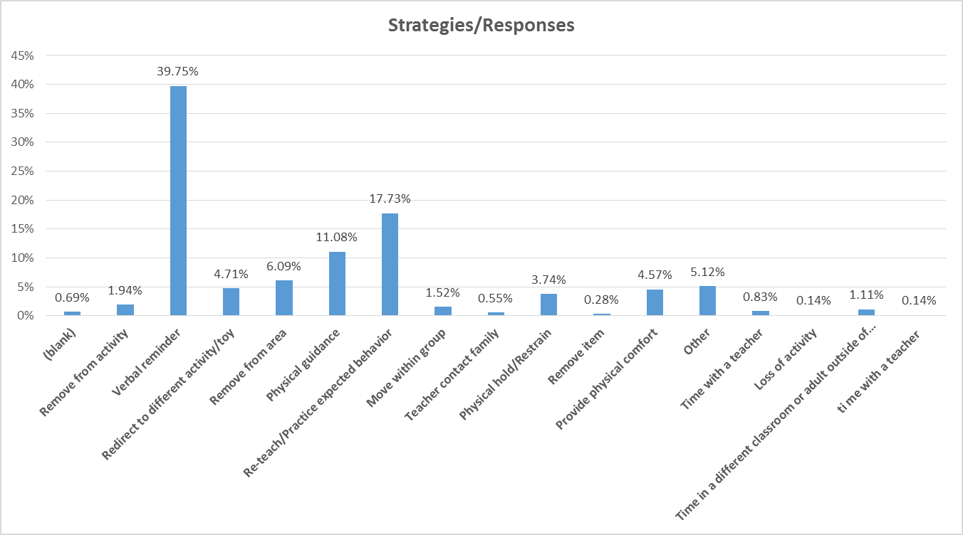

Slide 33
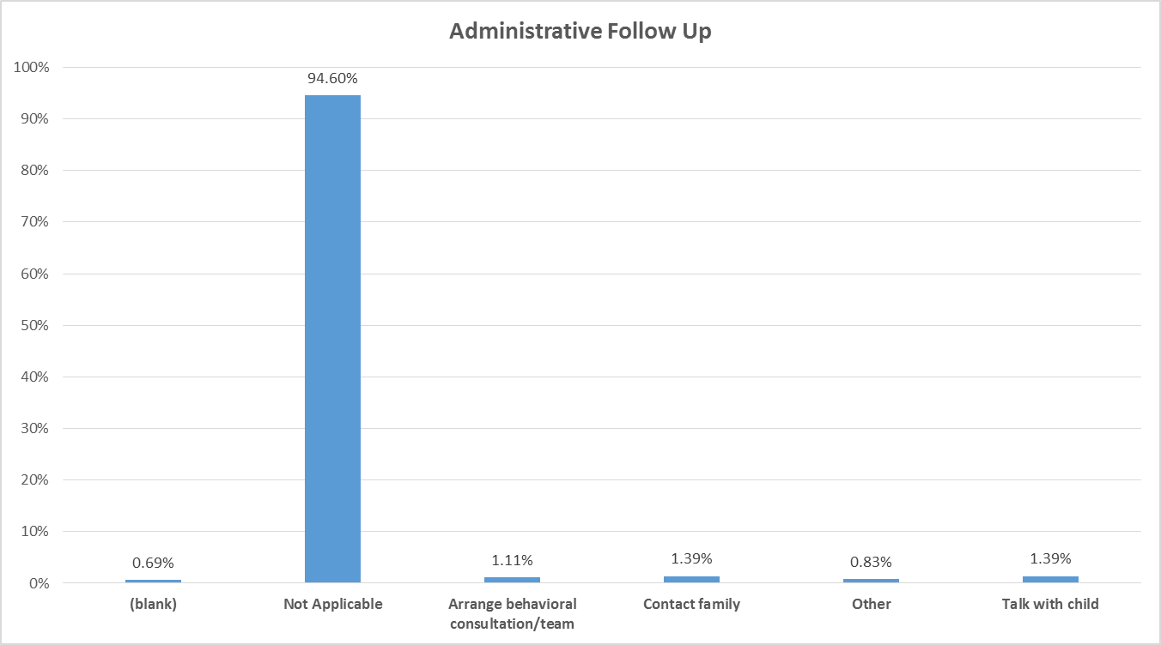

Slide 34
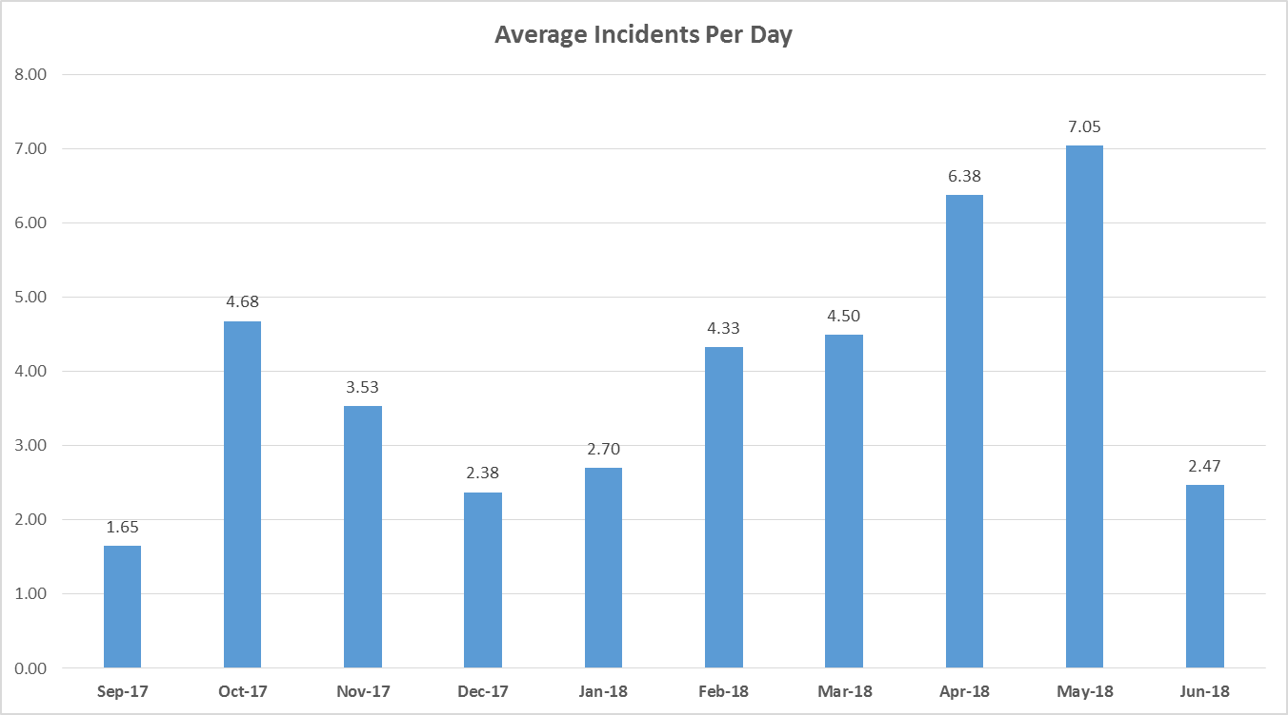

Slide 36
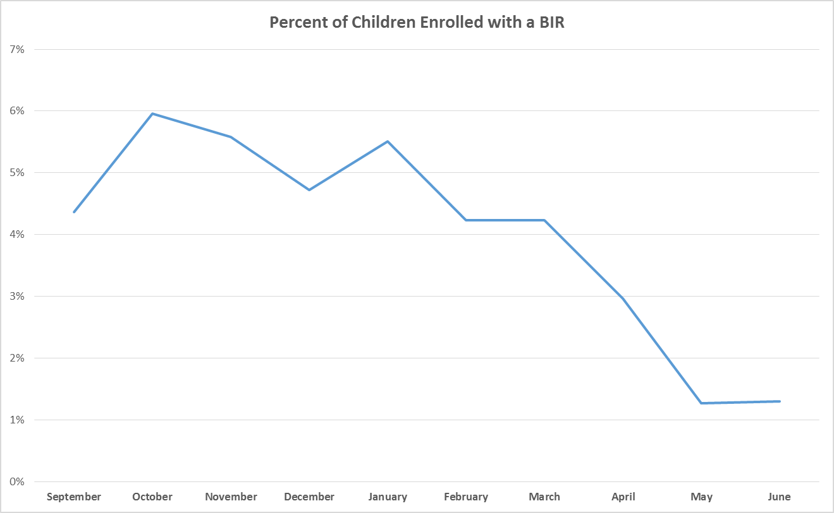

Slide 39
Equity Alert BIR
Of the 39 children who received at least one BIR, 76.9% are Hispanic/Latino; this group comprises 56.7% of the total child enrollment.
Children identified as Hispanic/Latino receive an average of 2.91 BIRs per child.
Hispanic/Latino children are 2.54 times more likely to have at least one BIR than all other children.
Of the 722 BIRs generated, 54.4% were attributed to Hispanic/Latino children.
Of the 135 Hispanic/Latino children, 22.2% have at least one BIR.

Slide 40
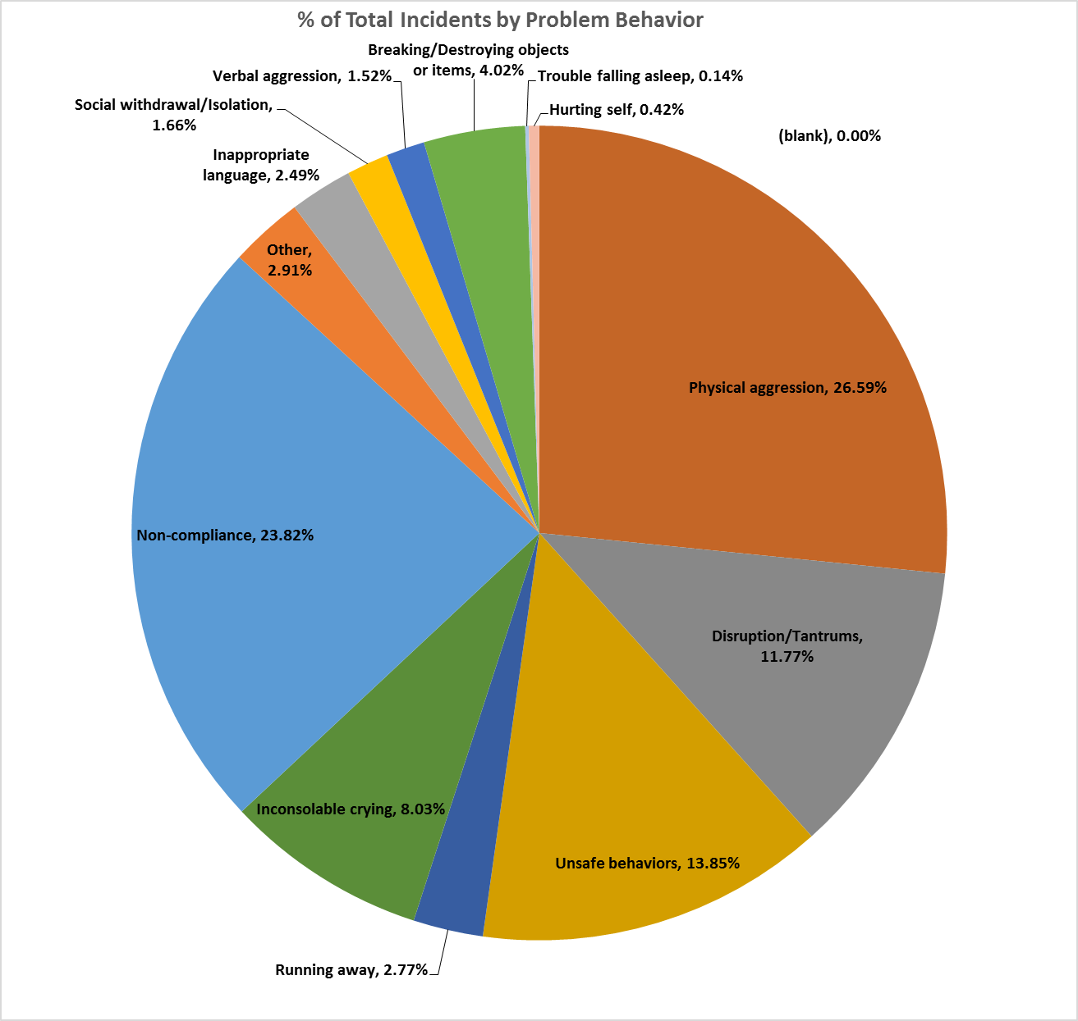

Slide 41
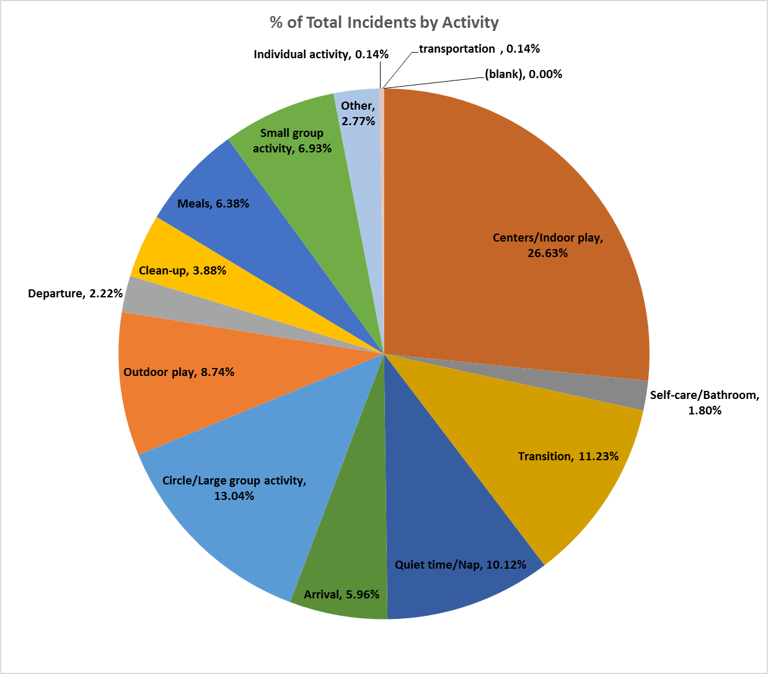

Slide 42
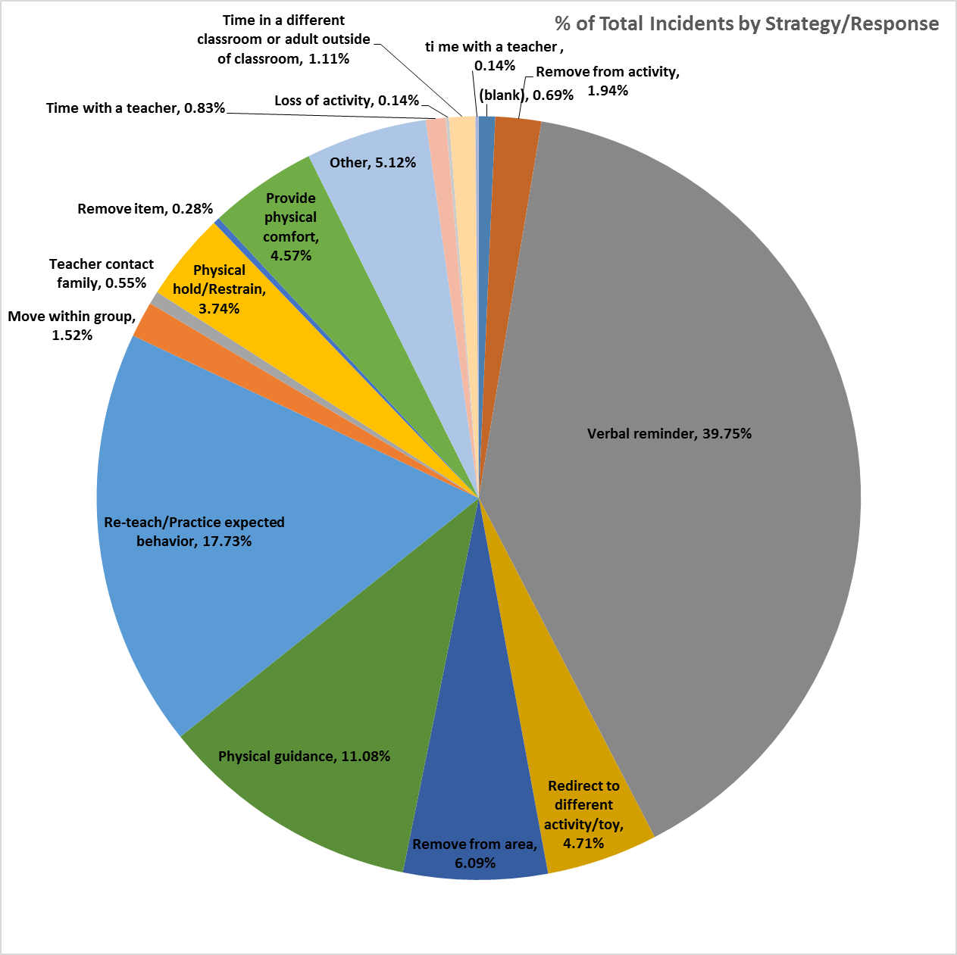

Slide 46
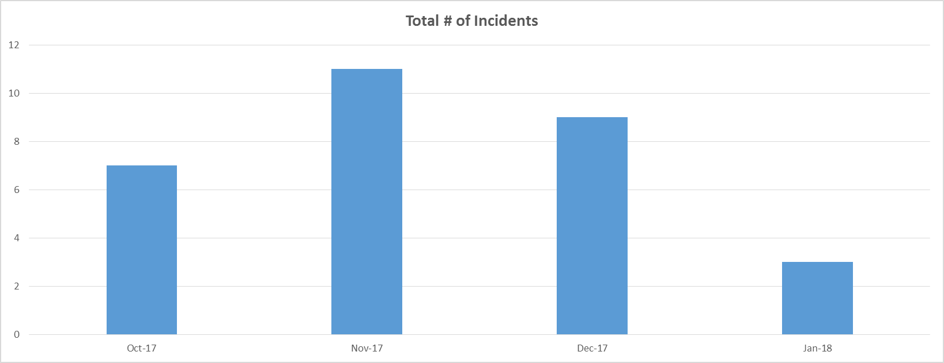
Individual Child/Individual Classroom

Slide 47
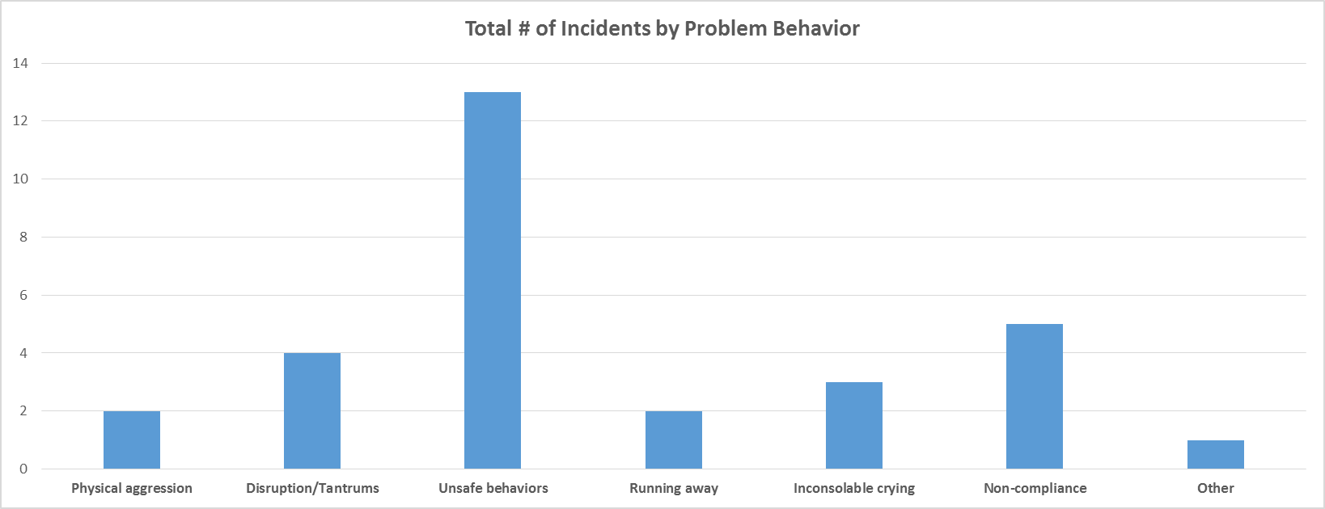

Slide 48
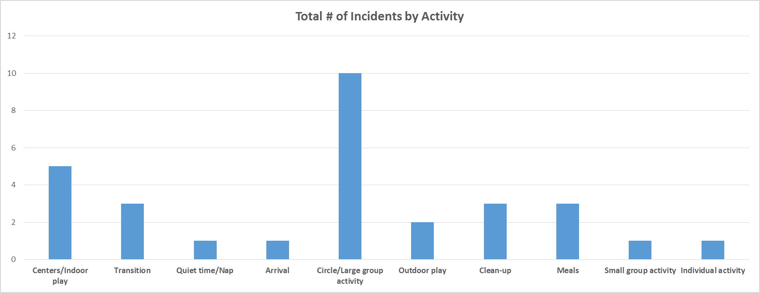

Slide 49
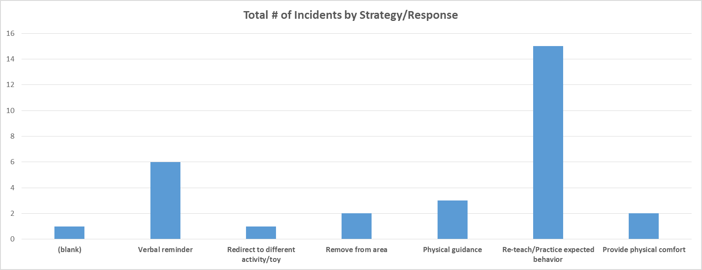

Slide 50
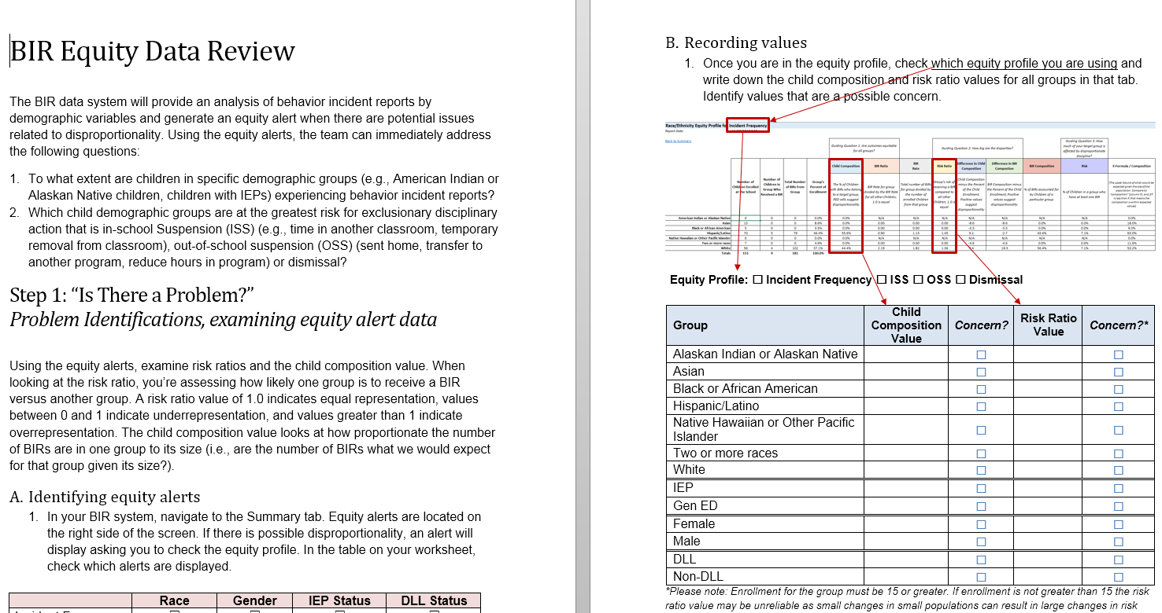
BIR Data Equity Guide
The BIRs Data Decision-Making Guide is used by the Leadership Team to identify factors related to disproportionality and develop an action plan

Slide 51
What are the Barriers to Collecting Data on Suspension and Expulsion in ALL Programs?

Slide 52
Cultural Barriers to Data-Based Decision Making
EI providers/teachers: Personal metric for judging effectiveness of intervention/teaching differs from those of external parties (e.g., state accountability systems, school boards)
EI providers/teachers and administrators: Decisions may be based on experience, intuition, and anecdotal information (professional judgment) rather than on systematically collected information.
Little agreement among stakeholders about which child outcomes are most important and what kinds of data are meaningful
Some EI providers/teachers disassociate their own performance and that of children, which leads them to overlook useful data.

Slide 53
Technical Barriers Data-Based Decision Making
Data that EI providers /teachers want (about “really important outcomes”) are rarely available and are usually hard to measure.
Programs and schools rarely provide the time needed to collect and analyze data.

Slide 54
Small Group Activity
In a group of 3-4, discuss:
  What are your barriers to collecting data on suspension/expulsion?
  What are some potential solutions to collecting data on suspension/expulsion?
  How could you create a culture of data-based decision making (i.e., people use data on suspension/expulsion and inequity to identify areas for improvement and create actions to improve)?

Slide 55
Contact Information
Megan Vinh, Ph.D. Lise Fox, Ph.D.
megan.vinh@unc.edu lisefox@usf.edu
Jen Neitzel, Ph.D.
jen.neitzel@unc.edu

Slide 56


