Slide 1
Preparing Coaches to Support EI Practitioners in Implementing
DEC Recommended Family Practices
Presenters:
Ravyn Hawkins, Arkansas Department of Human Services
Grace Kelley, National Center for Systemic Improvement (NCSI)
Mary Peters, Early Childhood TA Center (ECTA)
2018 Improving Data, Improving Outcomes Conference
Arlington, VA
August 2018
Notes:
Title: Preparing Coaches to Support EI Practitioners in Implementing DEC Recommended Family Practices
Description: Family Outcomes Cross State Learning Collaborative describes the work of the CSLC in supporting states in implementing Family Practices to improve family outcomes, assessing implementation, and measuring progress. FO CSLC is followed by 2 states (Part C) from the FO CSLC showcasing their work in preparing peer coaches/mentors that support EI Practitioners in Implementing DEC Recommended Family Practices (20 minutes each). Format for remaining 25 minutes is an audience Q/A with panel(3 presenters).
Presenters: Ravyn Hawkins, Grace Kelley, Mary Peters

Slide 2





Welcome!

Slide 3
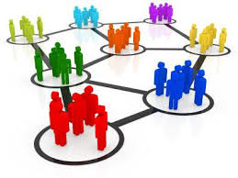
NCSI Cross-State Learning Collaboratives
Cross-State Learning Collaboratives bring states together to form networks of shared leadership and peer support.
We believe we can learn best from each other and improve together in networked communities.

Slide 4
NCSI Improving Family Outcomes Practices Cross State Learning Collaborative
Improve practices for improving family outcomes
Support States to
  deepen their content knowledge in data & evidence-based practices
  build capacity in stakeholder engagement
  support infrastructure development using implementation science
  be persistent in authentic stakeholder engagement & realize the best results achieved from rich and varied perspectives
Be a place for States to
  share, interact with other States & work together
  deepen interactivity & inter-connectivity at a national & state level
Create an environment that supports States to
  engage in new learning, apply knowledge & implement it in their states
  establish individualized and cross-state learning

Slide 5

NCSI Guiding Principles as Applied to CSLCs
Shared leadership and authentic stakeholder engagement
Customized and differentiated technical assistance to meet unique state needs and contexts
Leveraging resources to maximize collaboration and value…and avoid duplication

Slide 6
Our Story
The Arkansas Journey into Coaching

Slide 7
Supporting EI Practitioners in Implementing EBPs
Arkansas’ Journey into Coaching:
SSIP planning:
How do we support EI Practitioners to change practice in addition to training?
What support do EI Practitioners need?
How do we plan ahead for staff turnover?
How do we measure implementation statewide with limited training staff?

Slide 8
Supporting EI Practitioners in Implementing EBPs
Arkansas’ Journey into Coaching:
EI Practitioners Implement DEC Recommended Practices with Fidelity
Training + Support to Implement and a Way to Measure Fidelity
(Internal) Peer Coaches Supported by (External) Coaches
How?
How?

Slide 9
Supporting EI Practitioners in Implementing EBPs
Arkansas’ Journey into Coaching:
Preparing (Internal) Peer Coaches:
Who do we choose?
What do these EI Practitioners need in order to feel confident and competent in serving as a peer coach?
What ongoing support do peer coaches need?

Slide 10
Supporting EI Practitioners in Implementing EBPs
Arkansas’ Journey into Coaching:
Preparing (Internal) Peer Coaches:
Who do we choose?
Pilot group (1st cohort) received training on what qualities/characteristics to look for in selecting coaches
Each program in the pilot selected their own coach(es)

Slide 11
Supporting EI Practitioners in Implementing EBPs
Arkansas’ Journey into Coaching:
Preparing (Internal) Peer Coaches:
What do these EI Practitioners need in order to feel confident and competent in serving as a peer coach?
The coach(es) from each program in the pilot were experts in their field, but did not feel like experts in coaching professional peers.
Training in coaching methods and principles of adult learning in addition to training in implementing DEC Recommended Practices

Slide 12
Supporting EI Practitioners in Implementing EBPs
Arkansas’ Journey into Coaching:
Preparing (Internal) Peer Coaches:
What ongoing support do peer coaches need?
A community of practice with other coaches that they can consult with
External “expert” coaches to consult with as needed

Slide 13
Supporting EI Practitioners in Implementing EBPs
Arkansas’ Journey into Coaching:
Training Coaches and Forming a Coaches’ Community of Practice:
Monthly Coaches’ Calls provided training in methods of coaching and began forming a community of practice
Coaches’ blog space with guided questions where coaches learned from one another and reflected on their coaching practice

Slide 14
Supporting EI Practitioners in Implementing EBPs
Arkansas’ Journey into Coaching:
Training in methods of coaching:
Powerful Interactions, Dombro, Jablon, Johnsen and Ensler (2015)
Switch, Chip and Dan Heath
Coaches’ blog space:
Weebly

Slide 15
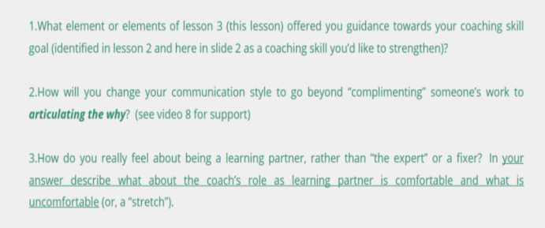
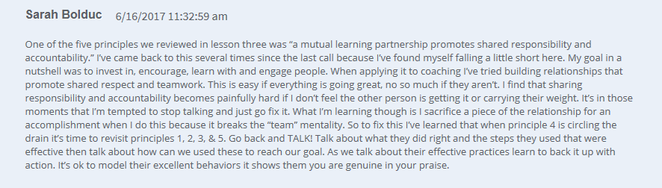
Supporting EI Practitioners in Implementing EBPs
Arkansas’ Journey into Coaching:

Slide 16

Supporting EI Practitioners in Implementing EBPs
Arkansas’ Journey into Coaching:
Sample blog activity for UP Coaches on
COACHING WITH POWERFUL INTERACTIONS

Slide 17
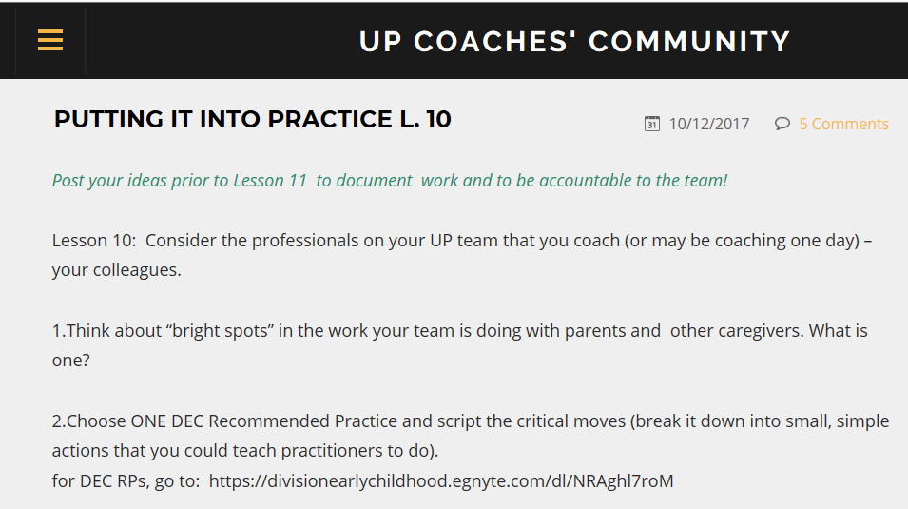
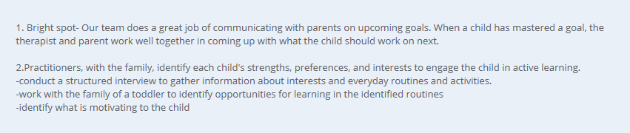
Supporting EI Practitioners in Implementing EBPs
Arkansas’ Journey into Coaching:

Slide 18
Supporting EI Practitioners in Implementing EBPs
Arkansas’ Journey into Coaching:
Sample blog activity for UP Coaches on SWITCH

Slide 19
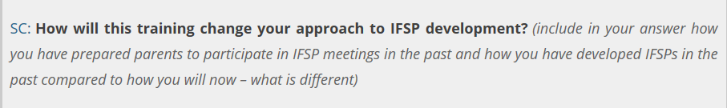
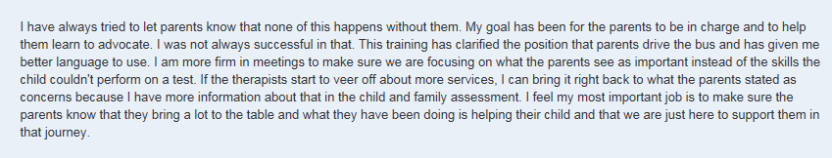
Supporting EI Practitioners in Implementing EBPs
Arkansas’ Journey into Coaching:
Sample blog post from UP team member trained and coached

Slide 20
Group Activity

Slide 21
Small Group Exercise – Consultancy Protocol
A consultancy protocol is a structured process for helping an individual or team think more expansively about a particular dilemma or barrier. It can ignite change by giving a voice to an issue and seek solutions.

Slide 22
Small Group Exercise – Consultancy Protocol - handout
Consider a dilemma
Write it out
Develop a focus question
Present
Clarifying questions
Group Discussion
Participant Discussion

Slide 23
Wrap -up
Small group report out
What did we learn from this exercise ?

Slide 24
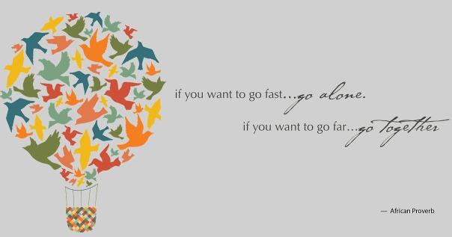

Slide 25
Resources
Resources to help you on your journey

Slide 26
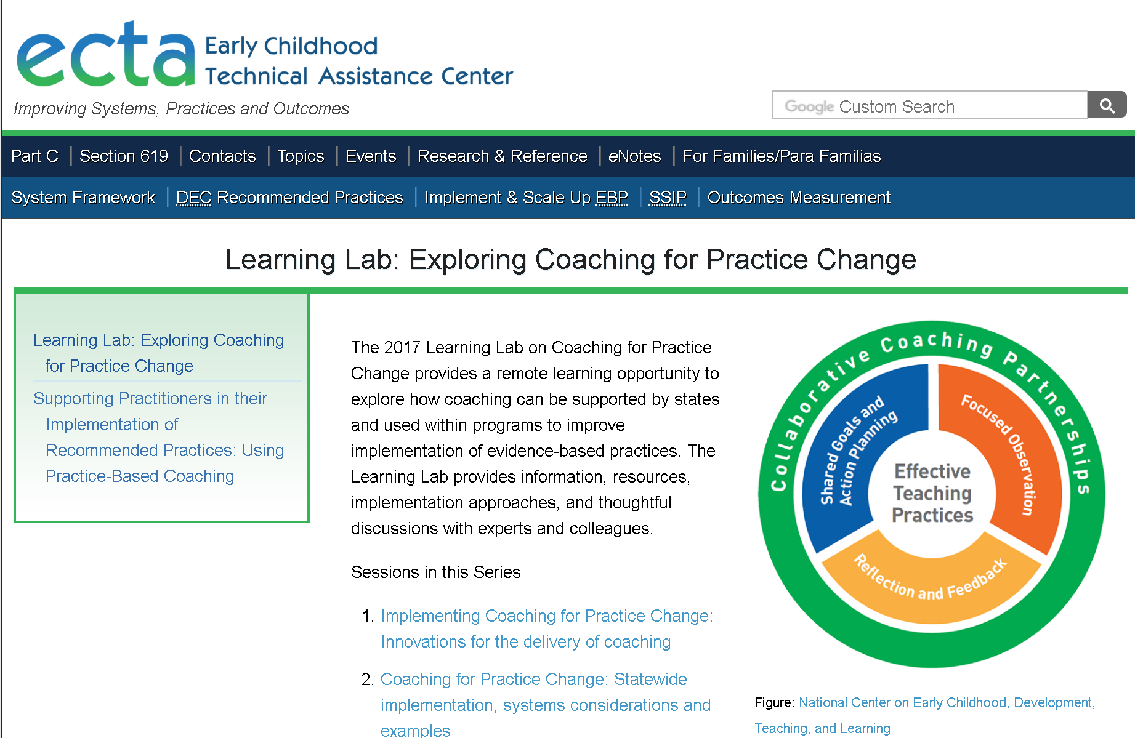
http://ectacenter.org/~calls/2017/learninglab.asp
Notes:
In addition to presentations by national experts, you will find state examples and resources.

Slide 27
Sessions in this Series
Two introductory videos explain the importance of coaching and describe each component of Practice Based Coaching.
Sessions:
  Implementing Coaching for Practice Change: Innovations for the delivery of coaching
  Coaching for Practice Change: Statewide implementation, systems considerations and examples
  Coaching for Practice Change: Considerations for local and regional programs
  Data Decision-Making and the Implementation of Practice-Based Coaching
Notes:
Into #1: Dr. Patricia Snyder establishes why coaching on practices is important for ensuring fidelity of implementation of evidence-based practices, how research indicates are important components of an evidence-based, practice-based coaching framework, and how the practice-based coaching framework was developed, validated, and evaluated.

Slide 28


http://challengingbehavior.cbcs.usf.edu/Training/Webinar/archive/2018/07-16/2018-07-16_The-Power-of-Practice-Based-Coaching.html
Additional information is now available from the National Center Pyramid Model Innovations

Slide 29
Thank you!
Ravyn Hawkins, Ravyn.Hawkins@dhs.arkansas.gov
Grace Kelley, grace.kelley@sri.com
Mary L. Peters, mary.peters@unc.edu
Notes:
Title: Preparing Coaches to Support EI Practitioners in Implementing DEC Recommended Family Practices
Description: Family Outcomes Cross State Learning Collaborative describes the work of the CSLC in supporting states in implementing Family Practices to improve family outcomes, assessing implementation, and measuring progress. FO CSLC is followed by 2 states (Part C) from the FO CSLC showcasing their work in preparing peer coaches/mentors that support EI Practitioners in Implementing DEC Recommended Family Practices (20 minutes each). Format for remaining 25 minutes is an audience Q/A with panel(3 presenters).
Presenters: Ravyn Hawkins, Grace Kelley, Mary Peters

