Slide 1
Examining Data to Identify Meaningful Difference
Tony Ruggiero, DaSy
Robin Nelson, DaSy
Gary Harmon, DaSy/ECTA
Cornelia Taylor, DaSy/ECTA
Improving Data, Improving Outcomes
Arlington, VA
August, 2018

Slide 2
Session Outcomes
Participants will learn:
the importance of determining meaningful differences
the difference between descriptive and inferential statistics
how to use some of these methods through the interactive opportunity

Slide 3
Introduction
What are statistics?
“the science of assembling, classifying, tabulating, and analyzing such facts for data” – Webster’s New World Dictionary
Statistics are a tool for solving problems
Usually begins with a question or hypothesis
Statistical analysis helps to determine if meaningful substantive relationships exist between and among variables
Notes:
Definition Source: Webster’s New World Dictionary of the American Language Second College Edition
Source: Knoke and Bohrnstedt

Slide 4
Introduction
The importance of determining meaningful differences
Many people are interested in going beyond descriptive data and want to look at relationships
Certain types of statistics provide the opportunity to account for observed differences
You can have more confidence that your differences are real and not just a result of random fluctuation or guesswork
You can make inferences that generalize to your population
Notes:
Source: Knoke and Bohrnstedt
Statistics provide the opportunity to account for observed differences (i.e., not just looking to see if something is higher or lower but looking for possible reasons for differences)

Slide 5
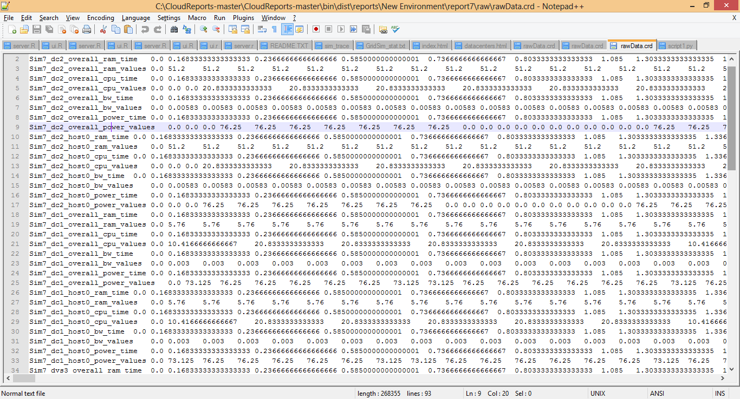
Descriptive Statistics
Data in its raw form can be large and unorganized
Notes:
Source: University of Baltimore home.ubalt.edu/ntsbarsh/business-statc/WhyI.doc

Slide 6
Descriptive Statistics
Analysis of data that helps describe, present or summarize data
Through numerical calculations or graphs or tables
Gain valuable insights about your data
About data quality
About the kinds of analyses you can and should do.
Notes:
Doing a descriptive statistical analysis of your dataset is crucial. A lot of people skip this part and therefore lose a lot of valuable insights about their data, which often leads to wrong conclusions.
What are the implications of the distribution of that data on data analysis and interpretation.
Most of you probably knew this at some point in your life.
The important point to all of this being that it impacts what kind of analyses you do.

Slide 7
Inferential Statistics
Inference
Generalization or conclusion about a characteristic of a population
Used to make decisions about degree to which an observed difference is meaningful vs. due to chance

Slide 8
Types of Data
Data
Qualitative
Quantitative
Categorical/Discrete
Ordinal
Continuous
Class rank, socioeconomic status
Age in months, hours of service
Gender,
Service type
Notes:
Focus is on quantitative data; certainly recognize that numbers can be associated with qual. data; resources on qual data.
Categorical data, also called nominal, for example:
Gender
Race/ethnicity
Type of service
Ordinal – the order matters, but the differences does not
Survey question, rate/”rank” quality from poor to excellent
Continuous data, for example:
Age
Income
Quantitative
"1" for poor, "2" for below average, "3" for average, "4" for very good and "5" for excellent. Here the numbers assigned have an order or rank; that is, a ranking of "4” is better than a ranking of “2.” However, even though you have assigned a number to your opinion, this number is not a quantitative measure: Although a ranking of “4” is clearly better than a ranking of “2,” it is not necessarily twice as good.

Slide 9
Data Transformation
You can always transform continuous data into categorical data
Age in months into broader age categories
Income in dollars into income ranges
You can always collapse a large number of categories into a smaller number
Examine the distribution of the data to help make these decisions
Notes:
Use of other
Exit data– some states have more exit reasons
Data on average hours of service

Slide 10
Types of Descriptive Statistics
Frequencies, crosstabs
Measures of central tendency
Describe the central position of a set of data
Measures of variability
Describe how spread out the data are
Notes:
Doing a descriptive statistical analysis of your dataset is crucial. A lot of people skip this part and therefore lose a lot of valuable insights about their data, which often leads to wrong conclusions.
What are the implications of the distribution of that data on data analysis and interpretation.
Most of you probably knew this at some point in your life.
The important point to all of this being that it impacts what kind of analyses you do.

Slide 11
Frequencies and Cross-tabs
Frequency (count, percentage)
16 boys, 62%
10 girls, 38%
Cross-tabulation (data element by data element)
12 boys with Communication Delays, 4 Other
5 girls with Communication Delays, 5 Other

Slide 12
Example of Frequency Table
Ages of Children Enrolled at Happy Valley Preschool
Age | Number | Percent
Three | 34 | 43
Four | 45 | 57
Total | 79 | 100

Slide 13
Example of Cross-Tab
 | OSEP Progress Categories for Outcome 1
Program | a | b | c | d | e | Row total
Children’s Corner | 1 | 1 | 3 | 1 | 8 | 14
Elite Care | 1 | 6 | 2 | 2 | 6 | 17
Community Cares | 1 | 3 | 3 | 11 | 13 | 31
New Horizons | 0 | 1 | 4 | 2 | 3 | 10
Opportunities, Inc. | 0 | 2 | 3 | 2 | 10 | 17
Column total | 3 | 13 | 15 | 18 | 40 | 89
Notes:
Tables that show two variables crossed with one another
Gender and race/ethnicity
Disability and age
Program and disability
Number of cells determined by number of values
Gender (2) by race/ethnicity (5) = 10

Slide 14
Analyzing Categorical Data
Row percentages – percentages computed with the Row total as the denominator
Column percentages – percentages computed with the Column total as the denominator
Total percentage – percentages computed with the overall total as the denominator
Notes:
Which you use: row or column percentages, depends on the question you have. And then there’s always percentage of the total.

Slide 15
Measures of Central Tendency
Mean = average
Most popular and well known
Disadvantage: susceptible to influence of outliers
Median = middle value in a data set with values arranged from low to high
Think “median of the road”; also 50th percentile
Mode = most commonly occurring value

Slide 16
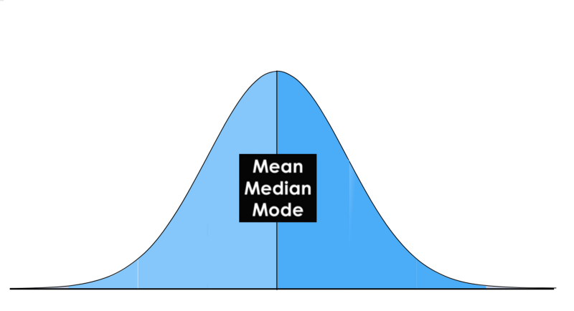
Normal Distribution

Slide 17
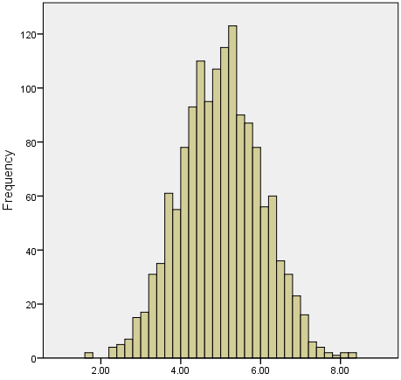
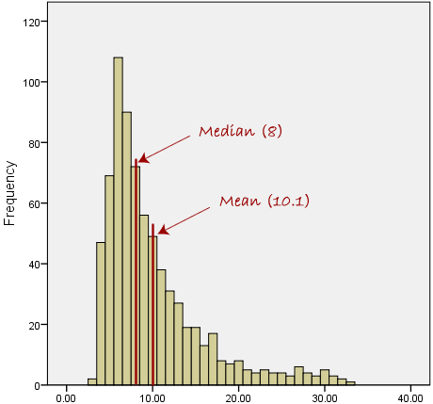
Normal vs. Skewed Distribution

Slide 18
Two sets of data, both with mean =3.75
Percent
Percent
Notes:
Do you look at the distribution of ratings on Amazon, on Trip Advisor, or just the average ratings?
Those 5 points on the vertical axis represent ratings, 5 being highest/best, 1 lowest – for a hotel room, a nice jacket you’ve been eyeing.
This is an example where the mean doesn’t allow you to see some important underlying information.
What would these data suggest if they represented scores on a knowledge test, or provider perceptions of how well they engage or team with families in developing IFSP/IEP outcomes?

Slide 19
Reasons to Review Distribution
$70K
$75K
$82K
$80K
$76K
$78K
$580 K
Notes:
When working with data, whether quantitative or qualitative, look it over first, get a feel for it before jumping into analysis.
When you look at the salaries of these 6 people:
With just the six “suits”, mean/average = 77k; median = 77k
What happens when that little blue creature enters the room?
Well, the mean is now 149k; and the median = 78k
So among other things, the distribution helps you consider how to summarize your data: what statistic to use, e.g., mean vs. median,

Slide 20
When to use each measure (in general)
Type of Data | Best Measure of Central Tendency
Categorical | Mode
Ordinal | Median
Continuous (not skewed) | Mean
Continuous (skewed) | Median

Slide 21
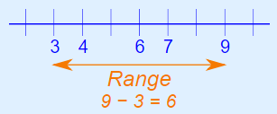
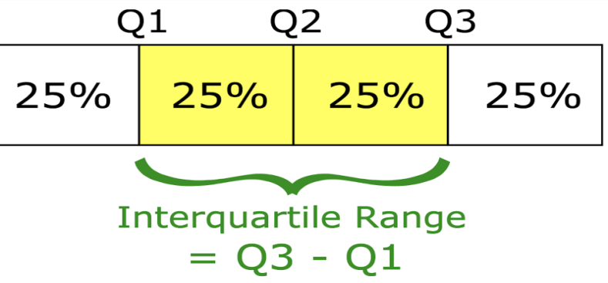
Measures of Variability
Range = difference between the largest and smallest points in your data
Interquartile range = difference between the 75th percentile (Q3)and the 25th percentile(Q1)
Notes:
Variability – measure the amount of spread (dispersion) in your data.
Most common measures of variability:
Plus the interquartile range, a measure of statistical dispersion between upper (75th) and lower (25th) quartiles; A measure of where the majority of the values lie.
SD – measure of how spread out values are from the mean
For variance, the squares are used during the calculation because they weight outliers more heavily than points that are near to the mean. This prevents that differences above the mean neutralize those below the mean. But the unit of measurement is not the same as your original data.

Slide 22
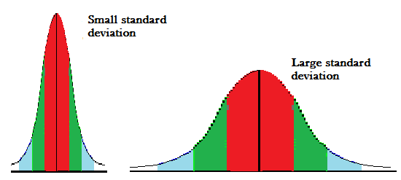
Measures of Variability (continued)
Standard deviation – a measure of how spread out the values are from the mean
Notes:
Variability – measure the amount of spread (dispersion) in your data.
Most common measures of variability:
Plus the interquartile range, a measure of statistical dispersion between upper (75th) and lower (25th) quartiles; A measure of where the majority of the values lie.
SD – measure of how spread out values are from the mean
For variance, the squares are used during the calculation because they weight outliers more heavily than points that are near to the mean. This prevents that differences above the mean neutralize those below the mean. But the unit of measurement is not the same as your original data.

Slide 23
Box Plot (Box and Whisker Plot)
Scale
100
Maximum observation
75th percentile
Interquartile Range
Median
+
25th percentile
Minimum observation
0
Notes:
A box and whisker plot (sometimes called a boxplot) is a graph that presents information from a five-number summary. ...
In a box and whisker plot: the ends of the box are the upper and lower quartiles, so the box spans the interquartile range. the median is marked by a vertical line inside the box.
These values are presented together and ordered from lowest to highest: minimum value, lower quartile (Q₁), median value (Q₂), upper quartile (Q₃), maximum value.
What the key values are, such as: the average, median 25th percentile etc.
If there are any outliers and what their values are.
Is the data symmetrical.
How tightly is the data grouped.
If the data is skewed and if so, in what direction.
What about the box plot to the far right – what do we know about the distribution?

Slide 24
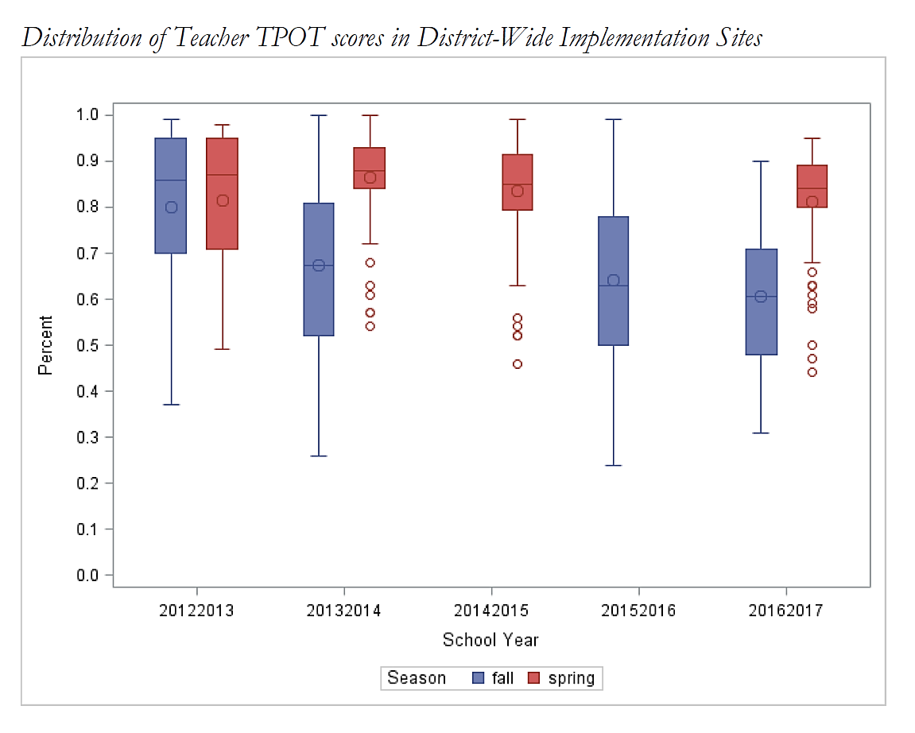
Box Plot Example
Notes:
North Carolina Part B data

Slide 25
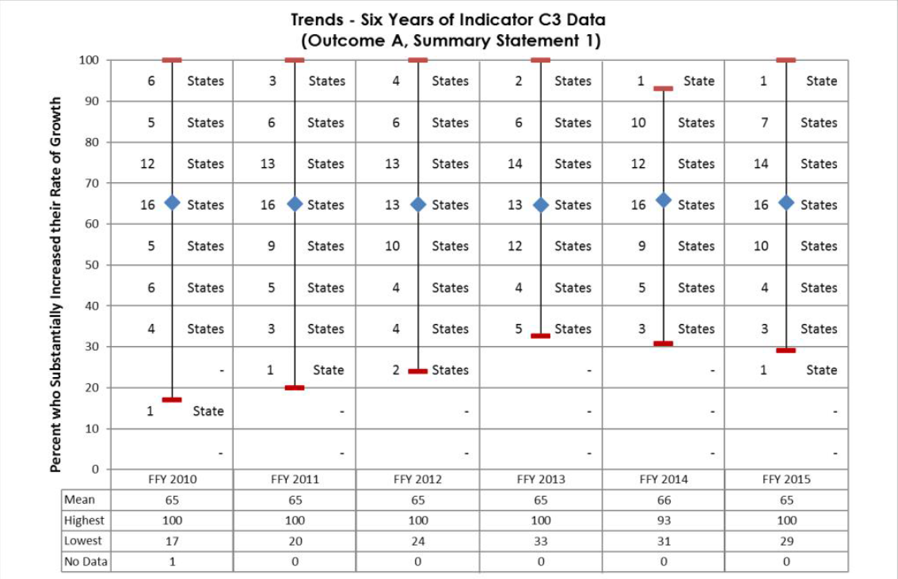
Child Outcomes SS1 by Year

Slide 26
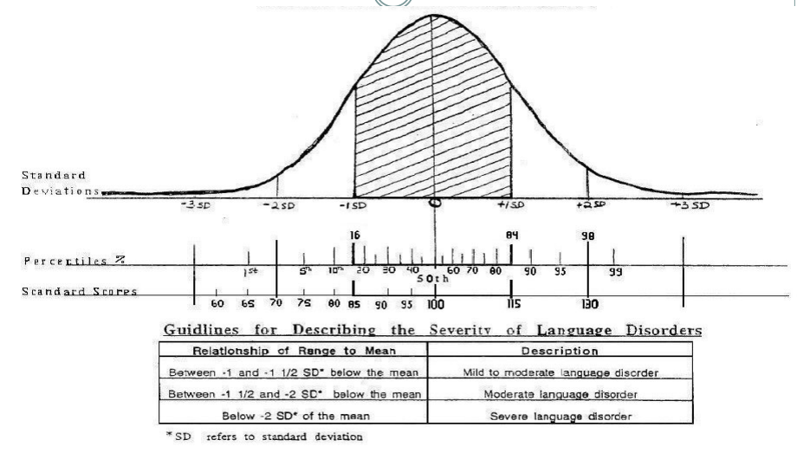
Use of SD in Eligibility Criteria
Notes:
For eligibility criteria:
2 SDs below the mean in one domain
1.5 SDs below the mean in two domains
Diagnosed condition
Clinical judgment
2 SDs ~ standard score of 70 or below
1.5 SDs ~ standard score of 78 or below
Rosenberg and
Percent or Months Delay, although commonly used, can create problems in eligibility definitions.
We don't recommend establishing Part C eligibility using percent delay, which is computed from developmental age.
In general developmental age scores should not be subtracted or divided by children’s chronological ages.
The problem is that developmental age doesn't have a strong relationship to chronological age for children with delays. The same percent delay at one chronological age can mean something very different for children at another chronological age.

Slide 27
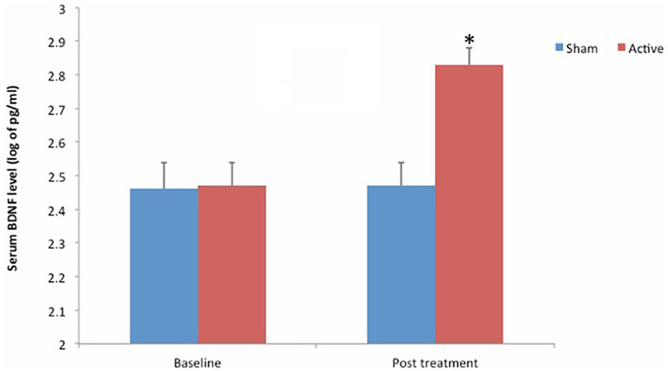
Statistical Testing
Used to make inferences on the data you have
Many different types of statistical tests depending on what you are trying to accomplish
In general, you compute a test statistic and identify the degree to which it is meaningful due to chance
Notes:
GARY

Slide 28
Statistical Testing
You must first figure out what you are testing
Example: Testing Percentage vs. Testing Averages
Notes:
GARY – will do example for each

Slide 29
Testing Percentage
Example: Did significantly more teachers achieve 80% on the fidelity measure in the coaching group compared to the group without coaching?

Slide 30
Testing Percentage – Raw Data
Teacher ID | Coaching? | ≥80% Fidelity?
1 | Y | Y
2 | N | N
3 | N | Y
4 | N | N
5 | Y | Y
6 | Y | Y
7 | N | N
8 | Y | Y
9 | Y | Y
10 | Y | N
11 | N | Y
12 | N | N

Slide 31
Testing Percentage - Summarize
 | 80% or Greater | <80%
Coaching | 5 | 1
No Coaching | 2 | 4
Notes:
2x2 Table

Slide 32
Testing Percentage – Chi-Square
You would then run the appropriate statistical test for a 2x2 table - Chi-Square Test
In this example, the result is NOT significant at the 0.05 level (p = 0.079)
Notes:
2x2 Table

Slide 33
Testing Averages
Example: Was the mean score higher on the fidelity measure in the coaching group compared to the group without coaching?

Slide 34
Testing Averages – Raw Data
Teacher ID | Coaching? | Fidelity Score
1 | Y | 82
2 | N | 67
3 | N | 91
4 | N | 74
5 | Y | 88
6 | Y | 81
7 | N | 42
8 | Y | 92
9 | Y | 84
10 | Y | 77
11 | N | 80
12 | N | 57

Slide 35
Testing Averages - Summarize
 | Mean Fidelity Score
Coaching | 84
No Coaching | 68.5
Notes:
2x2 Table

Slide 36
Testing Averages – 2 Sample T-Test
You would then run the appropriate statistical test to compare means from two different groups (those coached and those not coached) – 2 Sample T-Test
In this example, the result IS significant at the 0.05 level (p = 0.031)
Notes:
Talk about how you have different results that say something different. In the first example, you would say that there was not a significant difference in the number of teachers reaching fidelity based on coaching status. In the second example, you would say that teachers who were coached on average scored significantly greater than teachers who were not coached. In the second example, you could also highlight that the coached group achieved a mean greater than 80% (if that is a defined cut-off for the fidelity measure).

Slide 37
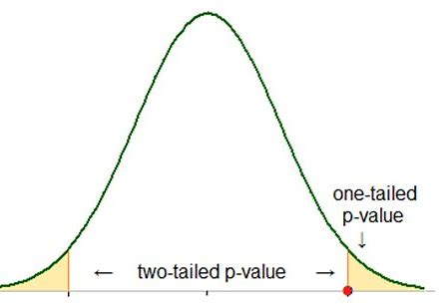
Statistical Testing
Set a criteria for significance and apply it consistently across your analysis
A standard often used is the p-value of <0.05
Notes:
GARY –
*Rosner, Bernard (Bernard A.). (2011). Fundamentals of biostatistics. Boston :Brooks/Cole, Cengage Learning

Slide 38
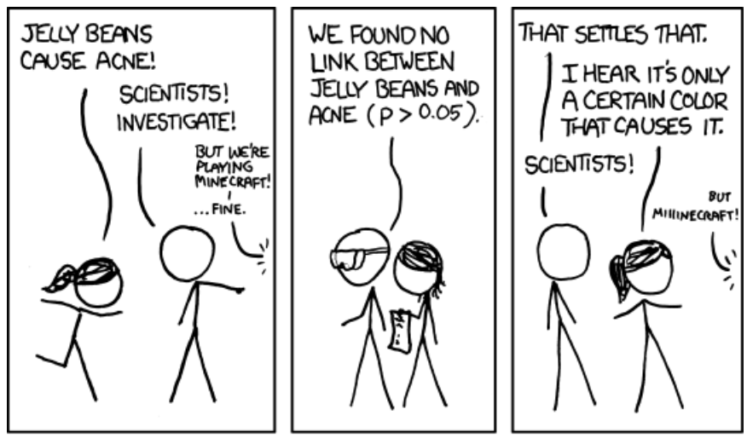
Statistical Testing
Multiple Testing – when you run multiple statistical tests you increase the probability of labeling a result as statistically different when it could be due to chance
Notes:
GARY –
https://xkcd.com/882
This work is licensed under a Creative Commons Attribution-NonCommercial 2.5 License.
This means you're free to copy and share these comics (but not to sell them). More details.

Slide 39
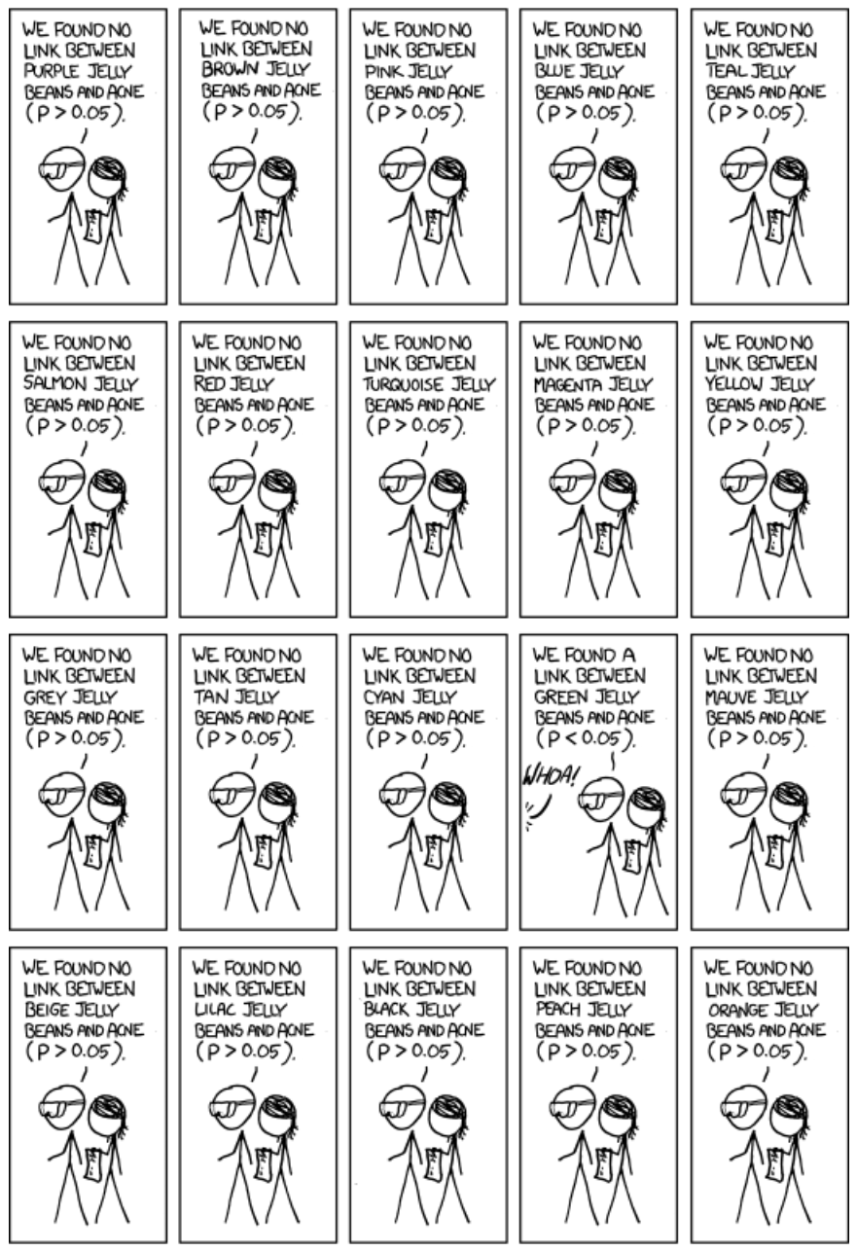

Slide 40
Statistical Testing
Multiple Testing (cont.)
Consider a case where you have 20 hypotheses to test, and a significance level of 0.05.
Example: Comparing Mean Child Outcomes Entrance Ratings and Child Demographics
Notes:
GARY – tinker with bullet 1

Slide 41
Statistical Testing
Multiple Testing (cont.)
Test | Dependent Variable | Independent Variable
1 | ECO SE Entrance Rating | Age
2 | ECO SE Entrance Rating | Gender
3 | ECO SE Entrance Rating | Race
4 | ECO SE Entrance Rating | Zip Code
5 | ECO SE Entrance Rating | Disability
6 | ECO SE Entrance Rating | Length in Program
7 | ECO SE Entrance Rating | Time to Start Services
8 | ECO SE Entrance Rating | Number of Services
9 | ECO SE Entrance Rating | Ethnicity
10 | ECO SE Entrance Rating | Language
11 | ECO SE Entrance Rating | Income
… | ECO SE Entrance Rating | …
20 | ECO SE Entrance Rating | Service Coordinator
Notes:
GARY – here is an example with

Slide 42
What’s the probability of observing at least one significant result just due to chance?

Slide 43
Statistical Testing
64%
Notes:
GARY
Talk about what this means:
So, with 20 tests being considered, we have a 64% chance of observing at least one significant result, even if all of the tests are actually not significant.
Statistical methods exist to adjust for multiple testing
Check with a statistician if you have further questions

Slide 44
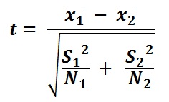
Statistical Testing
Sample Size and Statistical Significance
In general, important to understand the relationship between sample size (number of individuals in the sample data you have) and the effect it has on detecting a difference during statistical testing
Note Sample Size in Formula!
Notes:
GARY – look for formula

Slide 45
Statistical Testing
Sample Size and Statistical Significance Example
Sample Size = 100
Sample Size = 10,000
Notes:
GARY
Mention DaSy Child Outcomes Meaningful Differences Calculator as example

Slide 46
Data Activity

Slide 47
Histogram Activity
With the knowledge that this state calculates age at entry by computing the difference between the birth date and the entry date, what transformations had to be made to prep the data into the table on the spreadsheet?
How would you describe the shape of the distribution?
What is the mode of the distribution?
How might presenting the mean of this distribution misrepresent the data?

Slide 48
 | Progress Categories Outcome 1
Program | a | b | c | d | e | Row percent totals
Children’s Corner | 33% | 8% | 20% | 6% | 20% | 16%
Elite Care | 33% | 46% | 13% | 11% | 15% | 19%
Community Cares | 33% | 23% | 20% | 61% | 33% | 35%
New Horizons | 0% | 8% | 27% | 11% | 8% | 11%
Opportunities, Inc. | 0% | 15% | 20% | 11% | 25% | 19%
Column percent totals | 100% | 100% | 100% | 100% | 100% | 100%
Which program in these data serves the most children?
How does the differing number of children in each program impact interpretation of column percentages?

Slide 49
 | Progress Categories Outcome 1
Program | a | b | c | d | e | Row percent totals
Children’s Corner | 7% | 7% | 21% | 7% | 57% | 100%
Elite Care | 6% | 35% | 12% | 12% | 35% | 100%
Community Cares | 3% | 10% | 10% | 35% | 42% | 100%
New Horizons | 0% | 10% | 40% | 20% | 30% | 100%
Opportunities, Inc | 0% | 12% | 18% | 12% | 59% | 100%
Column percent totals | 3% | 15% | 17% | 20% | 45% | 100%
If you needed to know the percentage of children in Community Cares who made greater than expected progress should you use the row percentage of column percentage?
If you needed to know the percent of all children that entered and exited at age expectations (progress category ‘e’) that went to Opportunities Inc. would you use a row or column percentage?

Slide 50
Are there outliers in these data? Which states?
Are the data skewed? If so, in what direction?

Slide 51
What is the Interquartile range?
Given the distribution of these data, what should be considered in interpreting any states value in comparison to the average across states?
What might be a transformation that would make these data easier to interpret across states?
Statistic | Value
Minimum | 6
25th Percentile | 2479.25
Median (50th Percentile) | 9540.5
75th Percentile | 17539
Maximim | 80903
Standard Deviation | 15574.37

Slide 52
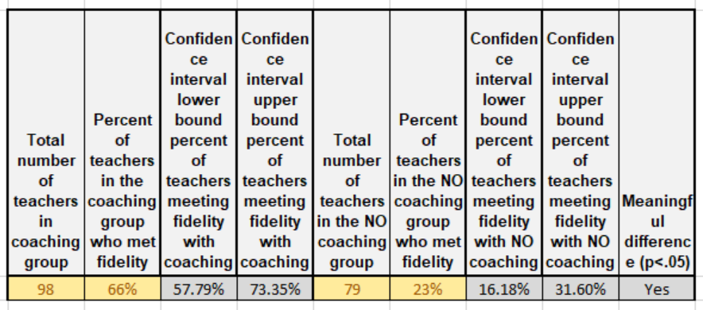
What happens to the confidence interval if you increase the number of teachers in each group?
How close do the percentages need to be to no longer be statistically significant?
How would you interpret the finding that the teachers with coaching performed statistically significantly better than the teachers with no coaching

Slide 53
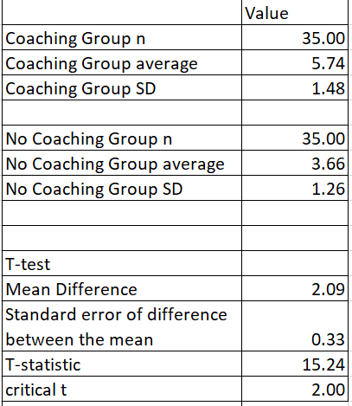
Looking at the table in the Testing Averages tab, is the difference between the two averages statistically significant?
How would you interpret a statistically significant difference in averages differently than a statistically significant different in the percent of teachers that met fidelity criteria?
Writing over the values in the table, what happens to the critical t when you increase the sample size?

Slide 54
Statistical Testing
Bias and Error
Random vs. Systematic
Programs using one assessment always score higher than programs using another assessment (or using same assessment- why higher in one or another? Tony has a great example from DE on TS GOLD)
Standard measurement is important because it reduces error related to an individuals interpretation of how to use the measurement. How to use an assessment tool and knowing child development (i.e. child outcomes)
Notes:
concept of how bias introduces error.
Take home – if a measure has a lot of error, need a lot more data to get good estimate than if they have a measure that is very precise.
Variables differ in how accurate they are – like weight. Others more difficult – like functional performance. Statistical testing for a difficult measure needs more data to reduce noise. Noise being systematic vs. random.
BDI – high probably of error. Additional prompts – higher performing when administered by a provider.
Does this go here or in the front? A data quality issue.

Slide 55
Resources
DaSy Child Outcomes Meaningful Difference Calculator (http://ectacenter.org/eco/pages/childoutcomes-calc.asp )

Slide 56
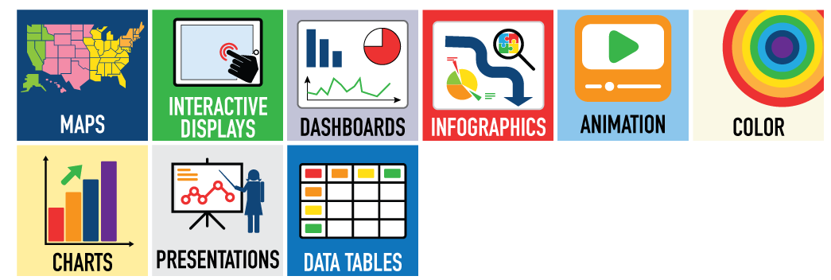
Data Visualization
DaSy Data Visualization Toolkit at http://dasycenter.org/data-visualization-toolkit/

Slide 57
Final presentation slide
Visit the DaSy website at: http://dasycenter.org/
Follow DaSy on Twitter: @DaSyCenter
Visit the ECTA website at: http://ectacenter.org/
Follow ECTA on Twitter: @ECTACenter

Slide 58
Thank you
The contents of this tool and guidance were developed under grants from the U.S. Department of Education, #H326P120002 and #H326P170001. However, those contents do not necessarily represent the policy of the U.S. Department of Education, and you should not assume endorsement by the Federal Government. Project Officers: Meredith Miceli, Richelle Davis, and Julia Martin Eile.
Notes:
Instructions to presenters: This slide is to be included as the last slide in your deck but you are not expected to show it to the audience. Please be sure to delete these instructions from this slide’s notes page in your presentation.

