Slide 1
Child Outcomes Data Collection: Results of the ITCA National Survey and Discussion of Policies and Considerations
Christina Kasprzak, ECTA/DaSy
Cornelia Taylor, DaSy/ECTA
Maureen Greer, ITCA/DaSy
Robin Nelson, DaSy
2016 Improving Data, Improving Outcomes Conference
New Orleans, LA
August 2016

Slide 2
Intended Outcomes
Increased participant knowledge of the variability in policies and procedures for the collection of child outcomes data across states.
Increased participant understanding of the importance of reviewing policies and procedures and their impact on the completeness and accuracy of the data.

Slide 3
Agenda
Introduction and Background
Analysis and Results
Discussion and Recommendations

Slide 4
How Did We Get Here?
Determinations, ITCA comment on denominator “Completeness” of the data should be determined based on a denominator supplied by the state with accompanying rationale and documentation.
Question on the listserv from a TA provider on behalf of a state :
A considerable percentage of kids are getting removed from the ECO data because the Entrance ECO to the Exiting ECO is less than 6 months. But in actuality the child is in the program more than 6 months based on the initial IFSP date and the Exiting date. What are other states doing in this situation?
Other states responded and were interested in a compilation of the responses.
Notes:
Question posted January 2016 by Haidee

Slide 5
Survey on Child Outcomes Data Collection
ITCA Data Committee, in collaboration with DaSy and ECTA, developed a survey.
Distributed to Part C programs in April 2016
Consisted of 17 questions:
Criteria for start and end dates for “6 months of service”
Other criteria used, including gaps in service
Approach and frequency of ratings
Policies on family participation
Procedures for exit ratings for unanticipated exits
Minimum age for entry ratings
Notes:
4 with state contact information
Primary approach, i.e., COS, BDI-2, AEPS
And whether they have or intend to change approach
2 additional questions:
integration of outcome ratings in IFSP;
ability of state to determine number of children who should have ratings

Slide 6
Analysis and Results
* 48 surveys received; Of those, 2 surveys had no responses other than state and contact name. Therefore, results based on 46 respondents.
* Unless otherwise noted, frequency
refers to an unduplicated count of
the number of State respondents.

Slide 7
Primary Approach for Outcomes
 | FREQUENCY (# States) | PERCENT
COS | 36 | 78%
BDI-2 | 5 | 11%
AEPS | 3 | 7%
Other | 2 | 4%
Based on ITCA survey results

Slide 8
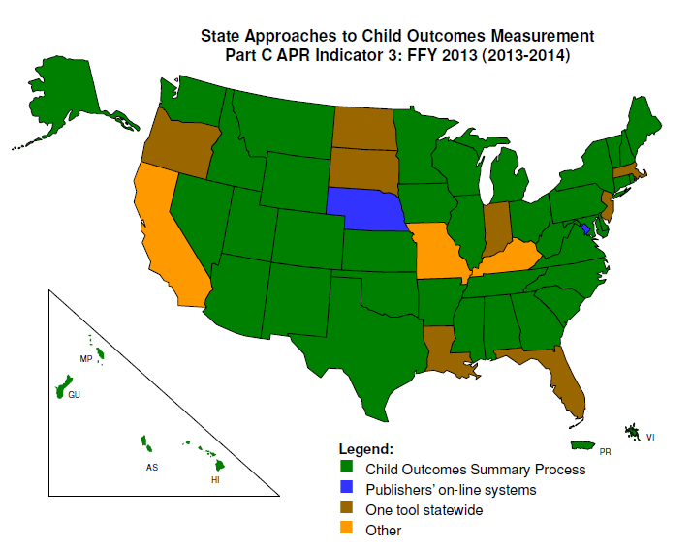
Notes:
2014-2015 data
43 use COS, 77%
13 use other approach, 23%

Slide 9
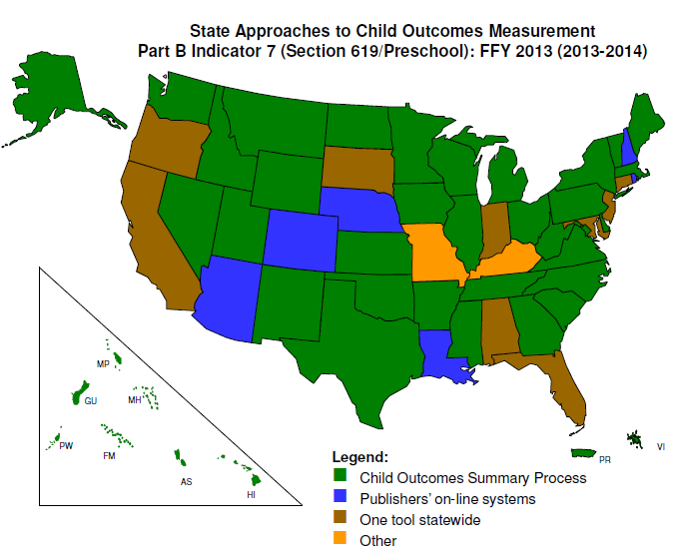

Slide 10
Date Used for Start Date, Unduplicated
Notes:
Duplicate count
Initial IFSP – 30
Rating completed – 8
Elig deter – 6
First delivered services – 4
Eval date – 2

Slide 11
Date Used for End Date, Unduplicated
Notes:
Much more variability
Duplicate
Exit date – 30
Date of exit rating – 15
Third birthday – 9
IFSP end date – 8
Date exit assessment if lost to contact - 6

Slide 12
Pairings of Start and End Date
 | FREQUENCY | PERCENT
Initial IFSP date/ Exit date, 3rd bday | 22 | 48%
Date of entry rating / Date of exit rating | 8 | 17%
Elig deter date / Exit date | 6 | 13%
Notes:
One state indicated Initial IFSP date and date of entry rating, exit date and date of exit rating

Slide 13
Frequency of Ratings/Scores
 | FREQUENCY | PERCENT
Entry and exit | 29 | 63%
Entry, annual and exit | 11 | 24%
Entry and exit, optional at annual | 2 | 4%
Entry, then annual or exit | 1 | 2%
Semi-annually (at 6-mo IFSP review) | 2 | 4%
Quarterly | 1 | 2%

Slide 14
Require Family Participation in Ratings
 | FREQUENCY | PERCENT
Entry only | 4 | 9%
Entry and exit | 27 | 59%
No | 14 | 30%
Piloting | 1 | 2%

Slide 15
P&Ps for Exit Ratings/Scores for Children who Exit Unexpectedly
 | FREQUENCY
No policies or procedures | 2
Yes, we use the last periodic child outcomes rating/score that was completed before the child exited as long as it meets our state-established timeline for being current. | 16
Yes, the team meets and determines the rating/score after the child exits based on ongoing assessment information. | 24
Other | 5
Notes:
Include other; reconcile 47

Slide 16
Accounting for Gaps in Services to Determine 6 Months in Service, Duplicated
Notes:
Duplicated count. Of those states that accounted for gaps in services, the highest number was for children who exited and re-entered the program, sometimes multiple times.
If they reported one of the other reasons, they usually reported more than one.

Slide 17
Minimum Age for Entry Rating/Score
 | FREQUENCY | PERCENT
No Minimum Age | 38 | 83%
Min. Age 2 Months | 1 | 2%
Min. Age 4 Months | 0 | 0%
Min. Age 6 Months | 6 | 13%
Other Min. Age | 1 | 2%

Slide 18
Change in Approach (including overall and other changes)
 | In Process of Changing Approach
 |  | YES | NO
Changed Approach Last 3 Years | YES | 7 | 8 | 15
 | NO | 7 | 24 | 31
 |  | 14 | 32
Notes:
Change in approach doesn’t usually represent major change in approach;
Rather, changes to the process, e.g., more training, change in policies/procedures, increased family participation

Slide 19
Other Findings
45 Part C early intervention programs reported being able to determine the number of children exiting who were in the program at least six months, and therefore should have child outcomes ratings/scores.
20 Part C early intervention programs reported that they integrated the child outcomes ratings/scores into the IFSP.

Slide 20
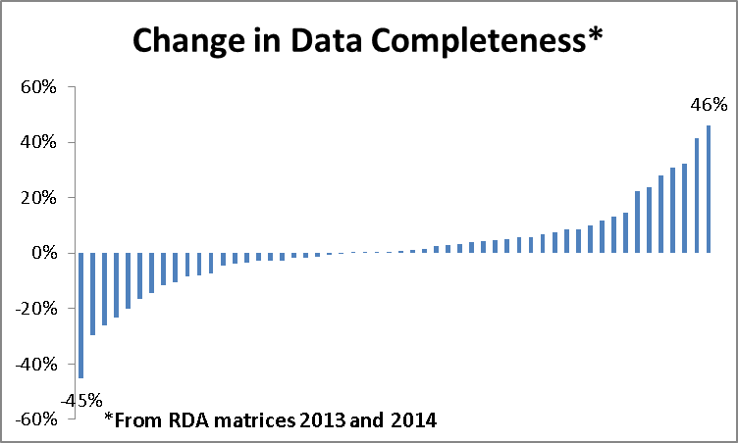

Slide 21
History of Indicator 3 Requirements and Expectations
8/19/2005 instructions for Part C State Performance Plan, due December 2, 2005
First year (2/1/07) will be status upon entry. Following years (starting with 2/1/08) will be progress from entry to exit or other naturally occurring point near exit (such as IFSP/IEP review) for children who have received Part C services for 6 months or more.
Notes:
“6 months” NOT mentioned in 10/19/06 measurement table or any measurement table thereafter.
However, OSEP is working on adding language back into the measurement table that used to be there around including children who had at least 6 mo. of service.

Slide 22
Related FAQs
How soon after entry and how close to exit do children need to be assessed?
This is a State decision. In order to capture the most progress, States should consider assessing children as close to entry and exit as possible. OSEP recommends that exit data be collected within 90 days of a child’s exit from Part C or 619.
For children to be included in this data collection they must have received services for 6 months or more, do children need to be in the same program for 6 months?
No, 6 months refers to time in service.
Notes:
September 2006, Frequently Asked Questions regarding the SPP/APR: Early Childhood Outcomes (Part C Indicator #3 and Part B Indicator #7)

Slide 23
Related FAQs continued
Does a child’s time in service need to be consecutive?
6 months of service is generally 6 months of consecutive service. However, if a child is in a program for 2 months, leaves and takes a month to move with his family and shows up in another program across the State where he receives services for another 4 months, this would be considered equivalent to 6 months of consecutive service.
How do States report on children who exit unexpectedly (i.e. they move or parents withdraw from program) and there are no exit child outcome data?
States are encouraged to assess the extent to which this is a problem in their State. If a State reports high numbers/percentages of missing child outcome data due to children exiting unexpectedly, OSEP may contact the State for additional information.

Slide 24
Discussion and Recommendations
What are the impacts of the dates selected to define 6 month in service?
Is your first measurement truly a baseline of performance for the child?
Are you able to include all of the children who should have made progress in your program?

Slide 25
Discussion and Recommendations
What defines a gap in service?
Would you expect that these gaps impact performance?
How many children are not included in the outcomes data because of gaps in data?

Slide 26
Discussion and Recommendations
When using a minimum age at first measurement consider
Impact of gaps between the entry date (e.g. Initial IFSP Date) and the first assessment date.

Slide 27
Discussion and Recommendations
How do you engage families in the outcomes measurement process?

Slide 28
Stay in Touch with DaSy
Visit the DaSy website at: http://dasycenter.org/
Like us on Facebook: https://www.facebook.com/dasycenter
Follow us on Twitter: @DaSyCenter

Slide 29
Stay in Touch with ECTA
Visit the ECTA website at: http://ectacenter.org/
Like us on Facebook: https://www.facebook.com/pages/ECTA-Center/304774389667984
Follow us on Twitter: https://twitter.com/ECTACenter

Slide 30
The contents of this tool and guidance were developed under grants from the U.S. Department of Education, #H326P120002 and #H373Z120002. However, those contents do not necessarily represent the policy of the U.S. Department of Education, and you should not assume endorsement by the Federal Government. Project Officers: Meredith Miceli, Richelle Davis, and Julia Martin Eile.
Notes:
Instructions to presenters: This slide is to be included as the last slide in your deck but you are not expected to show it to the audience. Please be sure to delete these instructions from this slide’s notes page in your presentation.

