Slide 1

Measuring Part C Participation Rates: Results, Feasibility, and Utility of the Birth Cohort Methodology
Improving Data, Improving Outcomes Conference
Aug. 15-17, 2016
Amy Bitterman, IDC
Kirsten Siegenthaler, NYS Department of Health
Laura Taylor, IDC

Slide 2
Agenda
Overview of Birth Cohort Methodology
Comparison of the Three Child Counts
Birth Cohort Interview and Data Analysis
Advantages and Challenges of the Child Counts
Discussion and Q&A

Slide 3
Goals of Presentation
Discuss the various methodologies for counting the number of children served in Part C, including the advantages and challenges of each methodology
Present counts of children served in Part C based on each methodology
Describe the birth cohort interview and present analysis of interview data

Slide 4
Overview of Birth Cohort Count
ITCA initiative
Voluntary for Part C programs to submit
Annual count by the child’s year of birth
Most recent birth year completed was calendar year 2011
Twenty-five states participate
States complete an Excel file template and email to ITCA
Compiled into one summary report each year
Birth cohort data from 2008 through 2011 have been collected.
Notes:
ITCA is the IDEA Infant and Toddlers Coordinator Association. It’s a not-for-profit corporation to promote mutual assistance, cooperation, and exchange of information and ideas in the administration of Part C and to provide support to state and territory Part C coordinators. The purpose is to identify and represent the interests of state and territory infant and toddler early intervention programs at the national level;
Develop and recommend models, standards, policies, and programs that promote quality services to eligible infants and toddlers and their families; and
Strengthen current leadership and foster new leadership in early intervention programs at the local, state or territory, and national levels. Many states’ data managers and Part C coordinators are members.
One of their many activities is collecting what is called birth cohort data from states.

Slide 5
Purpose of Birth Cohort Data Collection
Belief that states are serving more infants and toddlers ages birth to three than captured through the 618 data
Collect additional data elements beyond the number served to get full picture of how many children move through Part C
Notes:
Mention the Rosenberg

Slide 6
ITCA Birth Cohort Data Collection Elements
Number of resident births in a given year (e.g., number of births in 2010 for the 2010 birth cohort)
Number and percent of children who at any time during the three years they were eligible for Part C (e.g., 2010-2013 for the 2010 birth cohort) were:
Referred to Part C
Evaluated for Part C
Eligible for Part C
Exited Part B eligible

Slide 7
2010 Birth Cohort Data Results
 | Referred to Part C | Evaluated for Part C | Eligible for Part C | Exited Part B eligible (of those eligible for Part C)
Average | 16% | 13% | 10% | 42%
Median | 15% | 10% | 8% | 38%
Range | 7-30% | 6-29% | 5-21% | 8-100%
Notes:
% referred to Part C, evaluated for Part C and eligible for Part C all of the total number of births in 2010.
In comparison, for indicator C6 (Percent of infants and toddlers birth to three with IFSPs) nationally about 3% of infants and toddlers birth to 3 had IFSPs in each of 2010-11 through 2013-14 and 6% of children ages birth to 3 had IFSPs in 2010 per the cumulative count.
Keep in mind birth cohort data is only 28 states, and C6 is 56 states and jurisdictions. The cumulative count in 2010 was based on 30 states. 21 of the 28 states that reported birth cohort data reported cumulative counts for 2010.
Also, the birth cohort is an average across all 28 states and the cumulative percent is an average across the 30 states while C6 are the national percents.

Slide 8
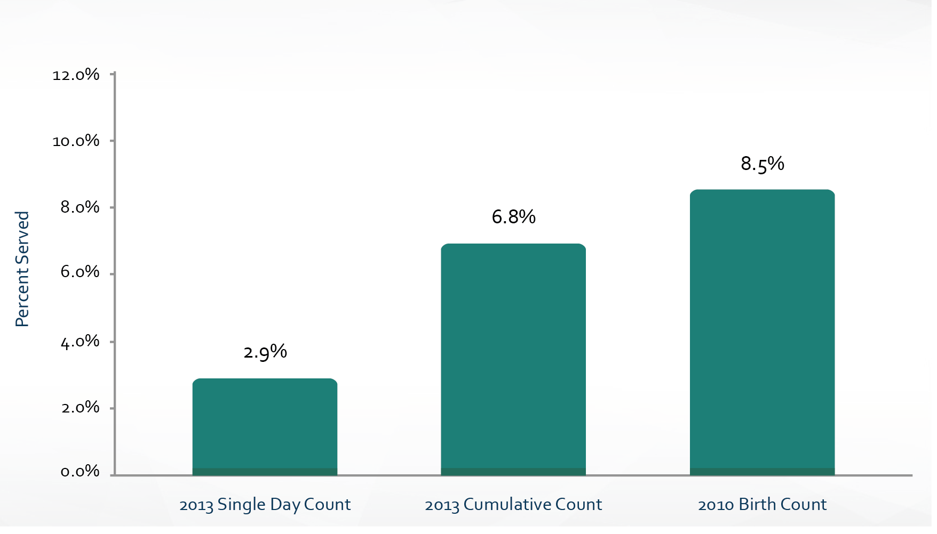
Birth Cohort Results Compared to 618 Data
Child Count Comparisons
Notes:
Just the 28 states that reported birth cohort data – not all states for single day and cumulative counts
Used 2013 single day and cumulative count as comparison since 2010 BC was collected from 2010 – 2013. Can discuss whether a more appropriate comparison would be 2010 single day and cumulative count to 2013 BC (add 2010 single count and cumulative count to notes)

Slide 9
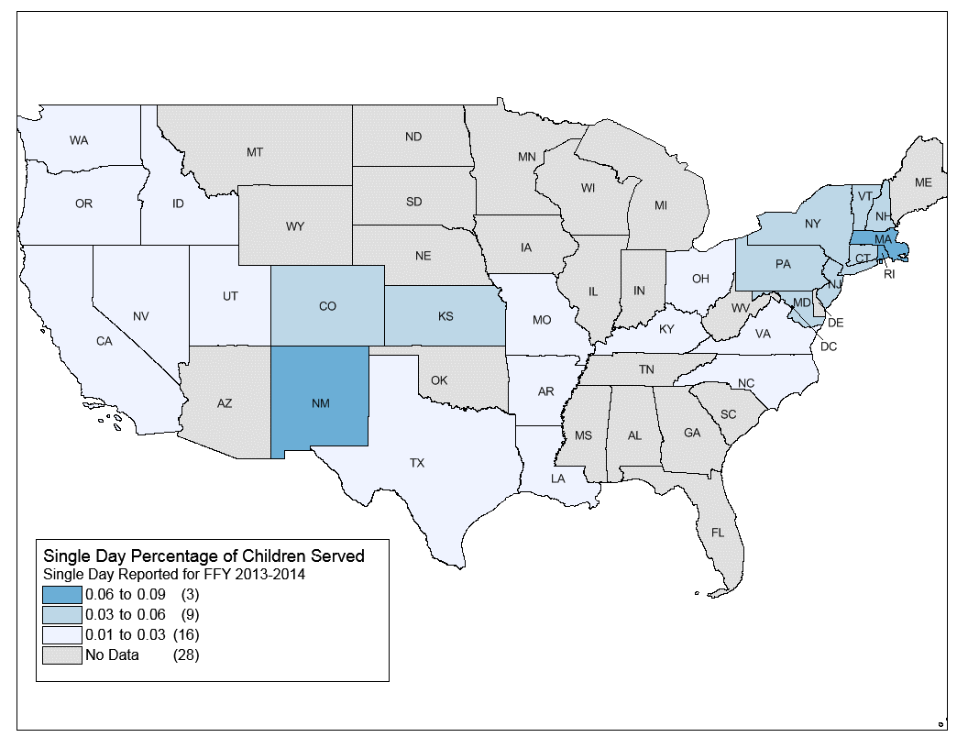

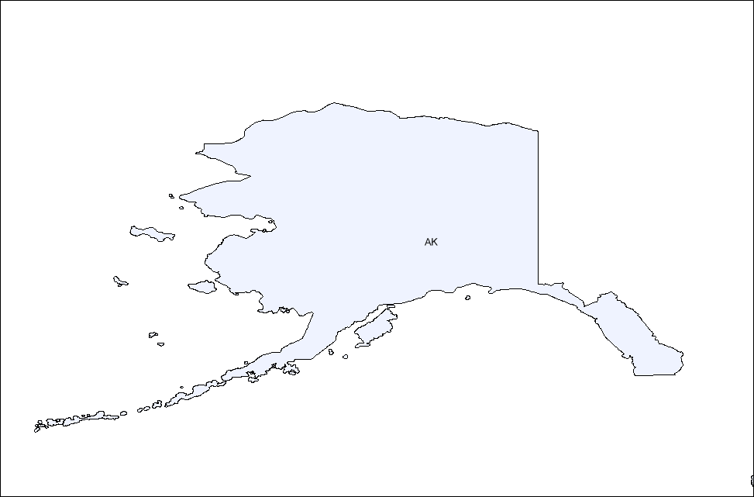
Percentage of Children Served Based on Single-Day Count
DC
AK
Note: States’ data were not included if they did not submit birth cohort counts for 2010.

Slide 10
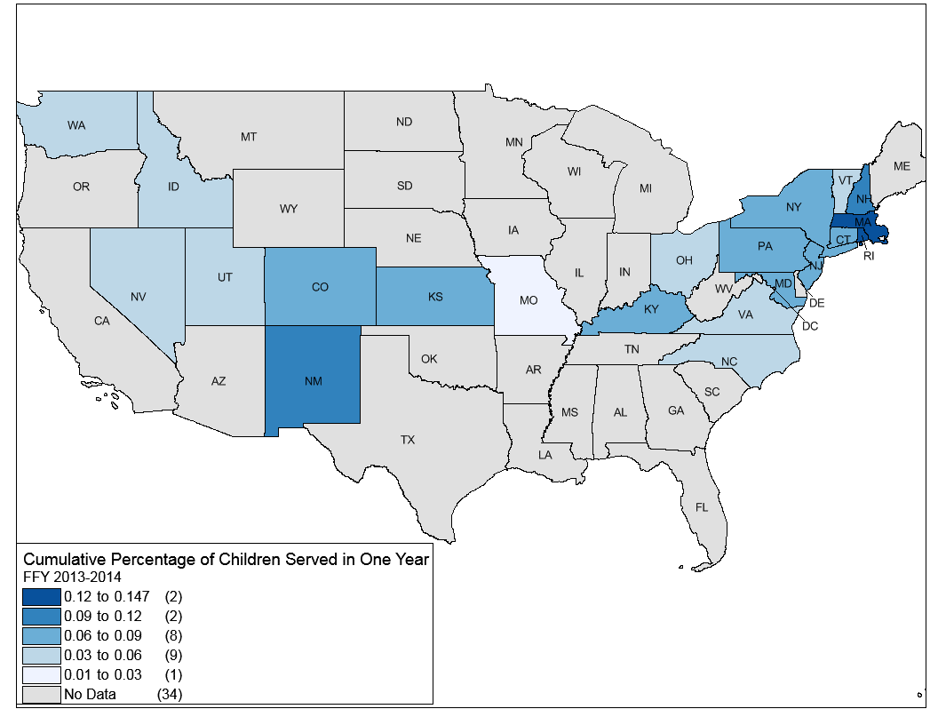

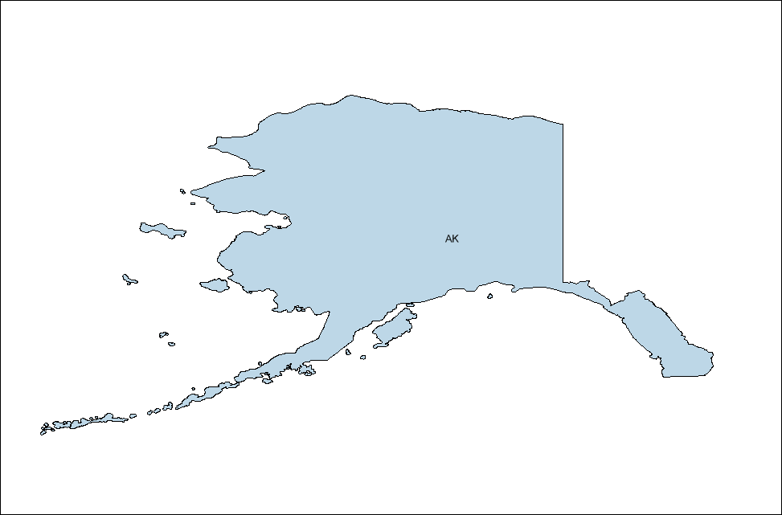
Percentage of Children Served Based on Cumulative Count
DC
AK

Slide 11
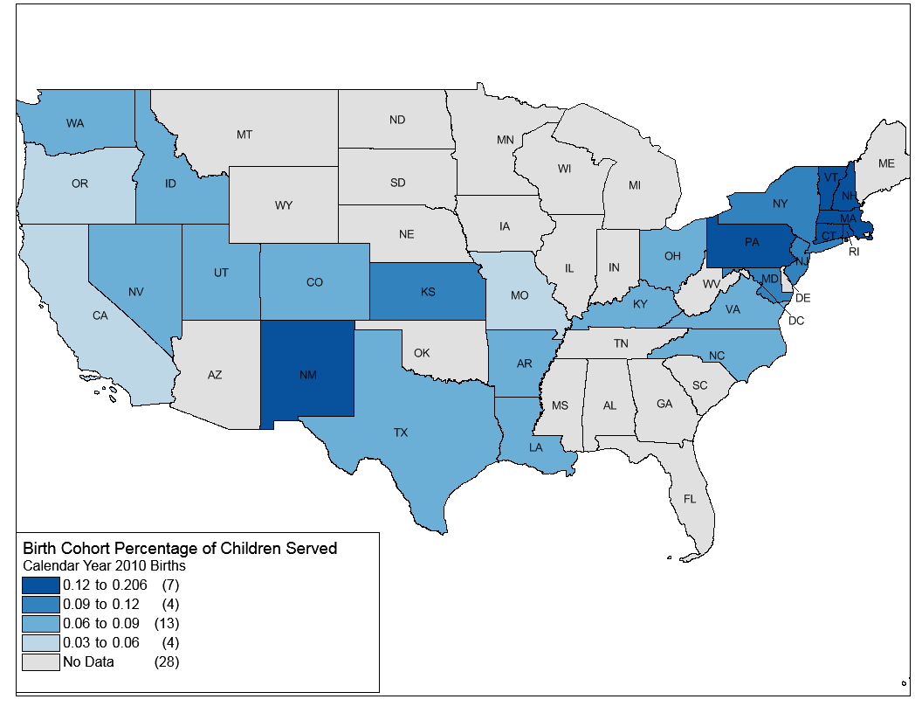

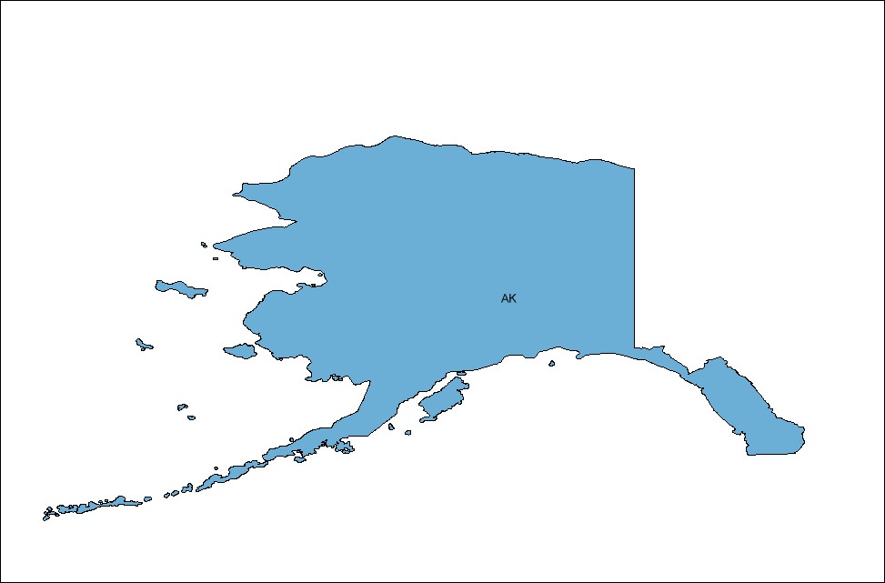
Percentage of Children Served Based on Birth Cohort Count
DC
AK

Slide 12
Discussion
Have any of your states submitted birth cohort data?
If so, did you encounter any challenges in providing the requested data?
Have you used the birth cohort data in your state and if so, how?

Slide 13
Analysis of Birth Cohort Interview Data
Purpose of the interviews was to gain an in-depth understanding of the policies, data collection methods, data analyses, and definitions used by states in preparing birth cohort data
Examined interview responses by birth cohort data to determine factors potentially related to differences across states

Slide 14
Interview Development
New York State and Utah Part C Programs with input from ITCA
Developed a structured interview
To better understand the data elements that were being submitted for the birth cohort count
9 policy-related questions
9 data analysis-related questions
Notes:
A request was sent to Part C programs by ITCA, and was discussed on the ITCA data committee call. States volunteered for the interview. The interview questions were sent ahead of time and calls were scheduled with Part C coordinators and/or data managers.

Slide 15
Birth Cohort Interviews Items
Program administration
Lead agency
Number of staff
How state defines local program
Process for referring and entering families into the system
Eligibility
Definition of eligibility for Part C and enrolled in EI
How state captures eligibility status in database
Does state serve at-risk children or children over age 3
Data analysis and reporting
Unduplication of birth cohort data
States’ ability to provide counts of children who are eligible for C, have an IFSP, and receive at least one EI service
Exiting Part C
Cumulative count reporting period
Process for receiving confirmation from Part B of eligibility
Reporting confirmed Part B eligibility

Slide 16
Interview Time Period
Conducted 0ne-hour interviews with Part C Data Managers/Coordinators
11 interviews completed in summer/fall 2014 by NYS Part C interns
16 interviews completed in late 2015/early 2016 by IDC

Slide 17
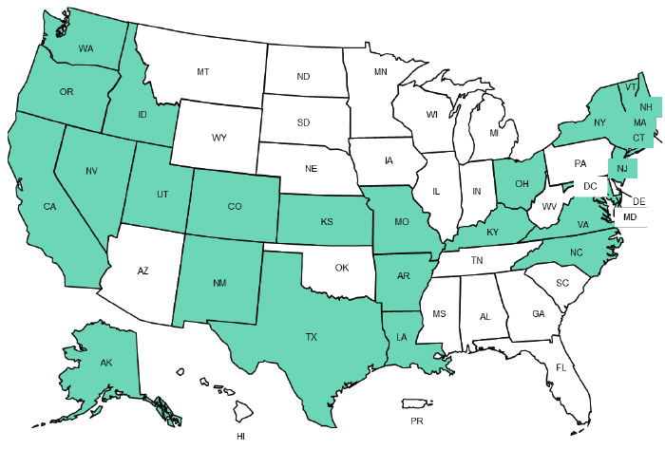
Participating States
Note: States in green participated.

Slide 18
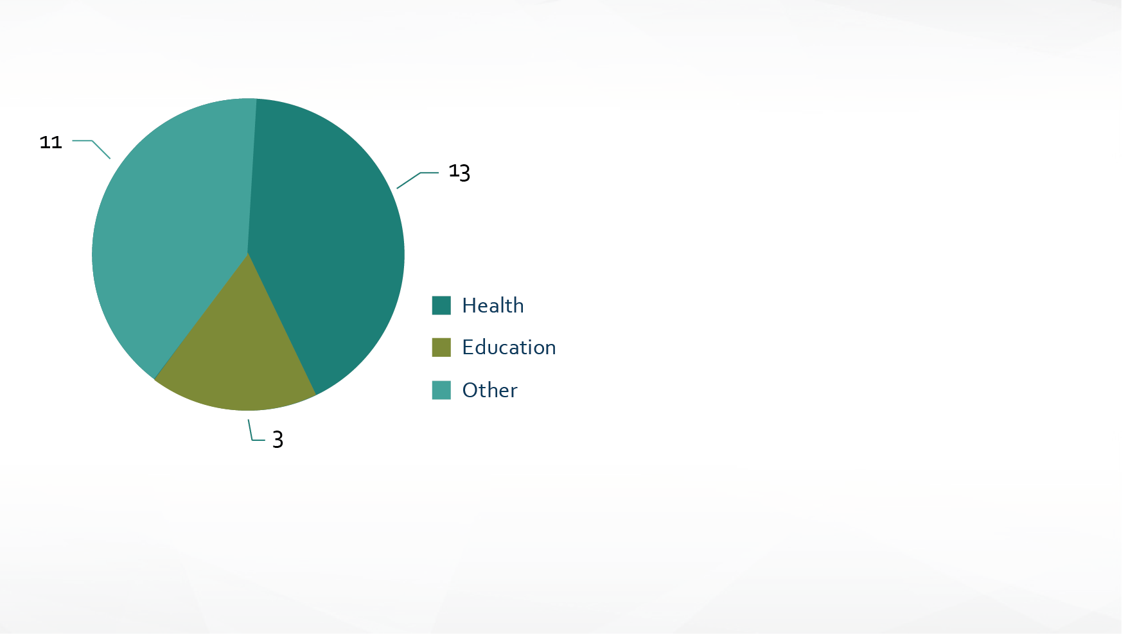
Administrative Structure
Lead agency
Staffing at the state level
  Average of 12 employees
  Staff ranges from 2–20 people
Other Lead Agencies include, for example, Departments of Early Learning and Early Support of Infants, Agencies of Education and Human Services, and Department of Health and Welfare
Notes:
I need a catchy name for this slide.

Slide 19
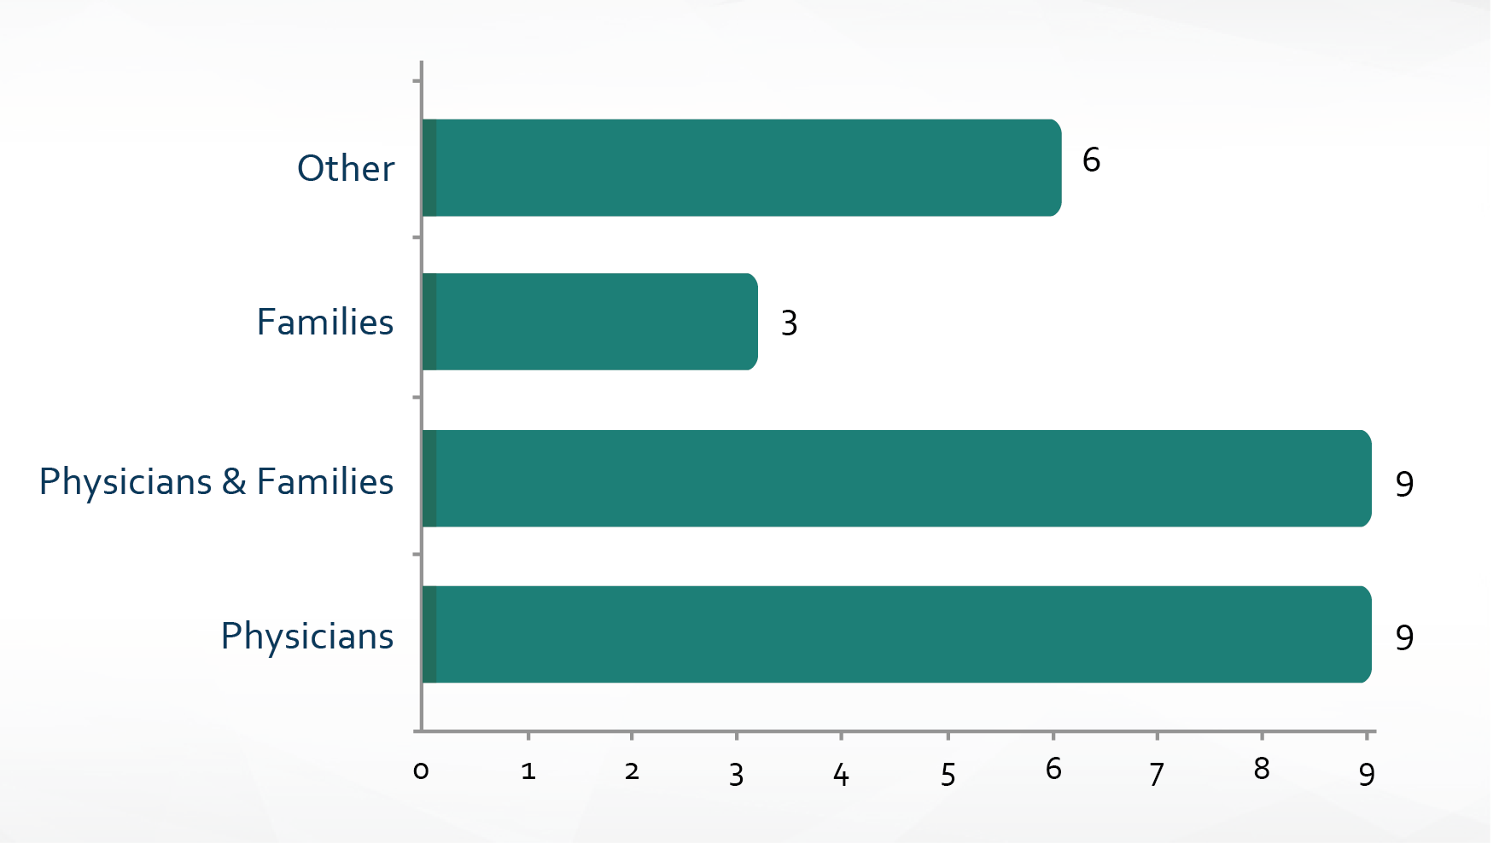
Who Is Primarily Making Referrals?
N=27

Slide 20
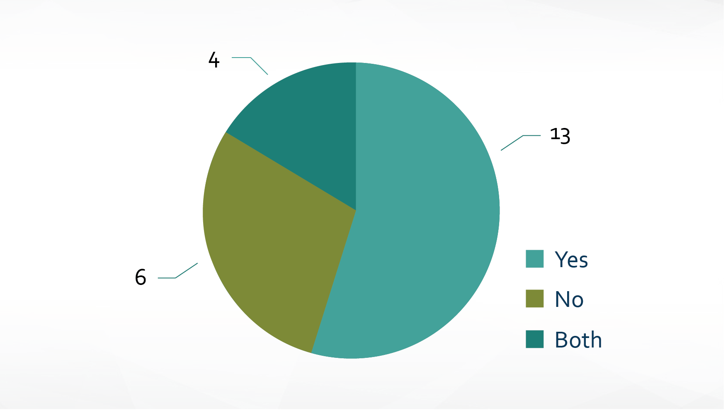
Are the Referrals Unduplicated?
N=23

Slide 21
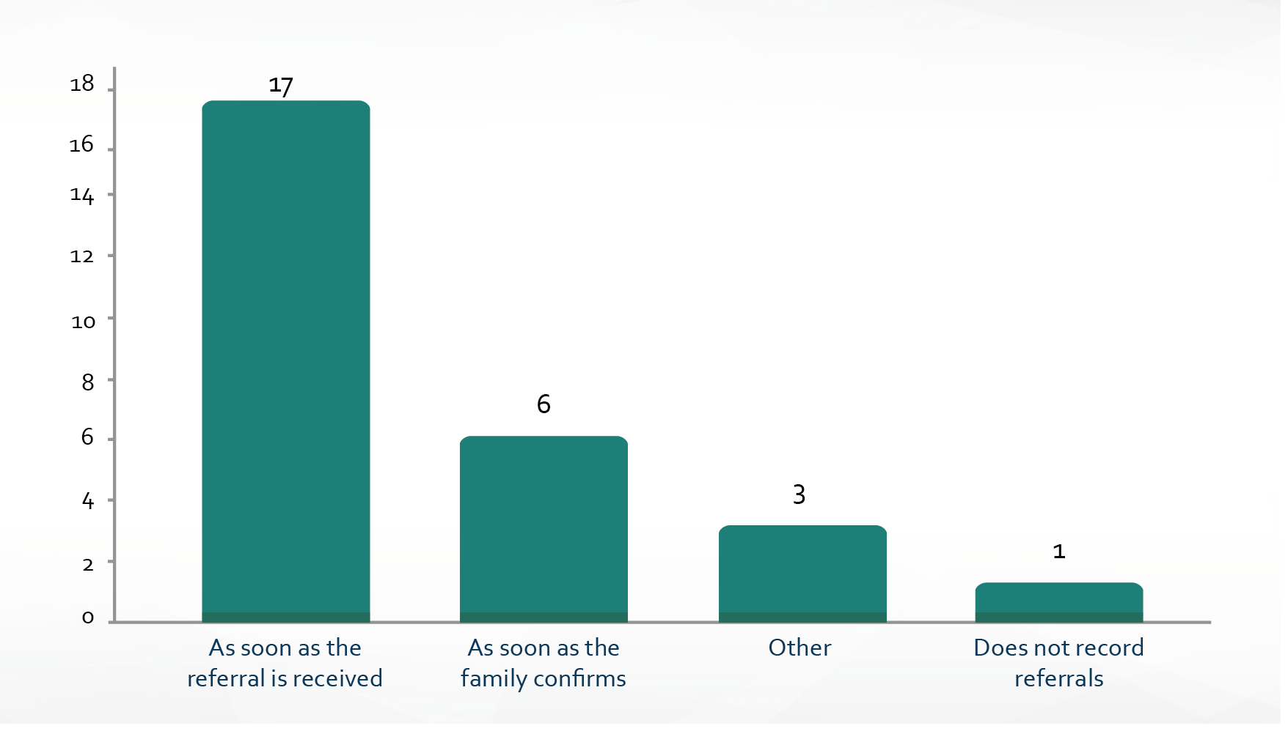
At What Point in the Process Is the Referral Recorded?
N=27

Slide 22

Eligibility Criteria
  At Risk, Any Delay, Atypical Development, 1 SD in 1 domain, 20% delay in 2+ domains, 22% in 2+ domains, 25% in 1+ domains (Category A)
  25% in 2+ domains, 30% delay in 1+ domains, 1.3 SD in 2 domains, 1.5 SD in any domain, 33% delay in 1 domain
  (Category B)
  33% delay in 2+ domains, 40% delay in 1 domain, 50% delay in 1 domain, 1.5 SD in 2+ domains, 1.75 SD in 1 domain, 2 SD in 1 domain, 2 SD in 2+ domains
  (Category C)
N=27

Slide 23
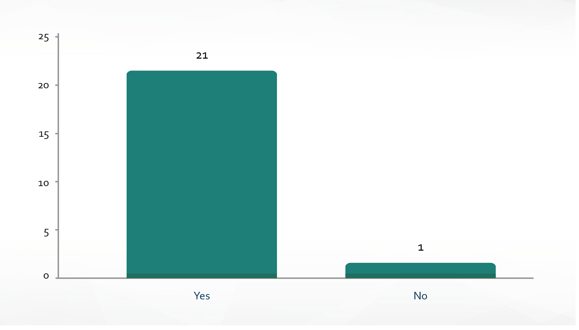
Does the State Use Prior Medical Diagnosis to Determine Eligibility?
N=22

Slide 24
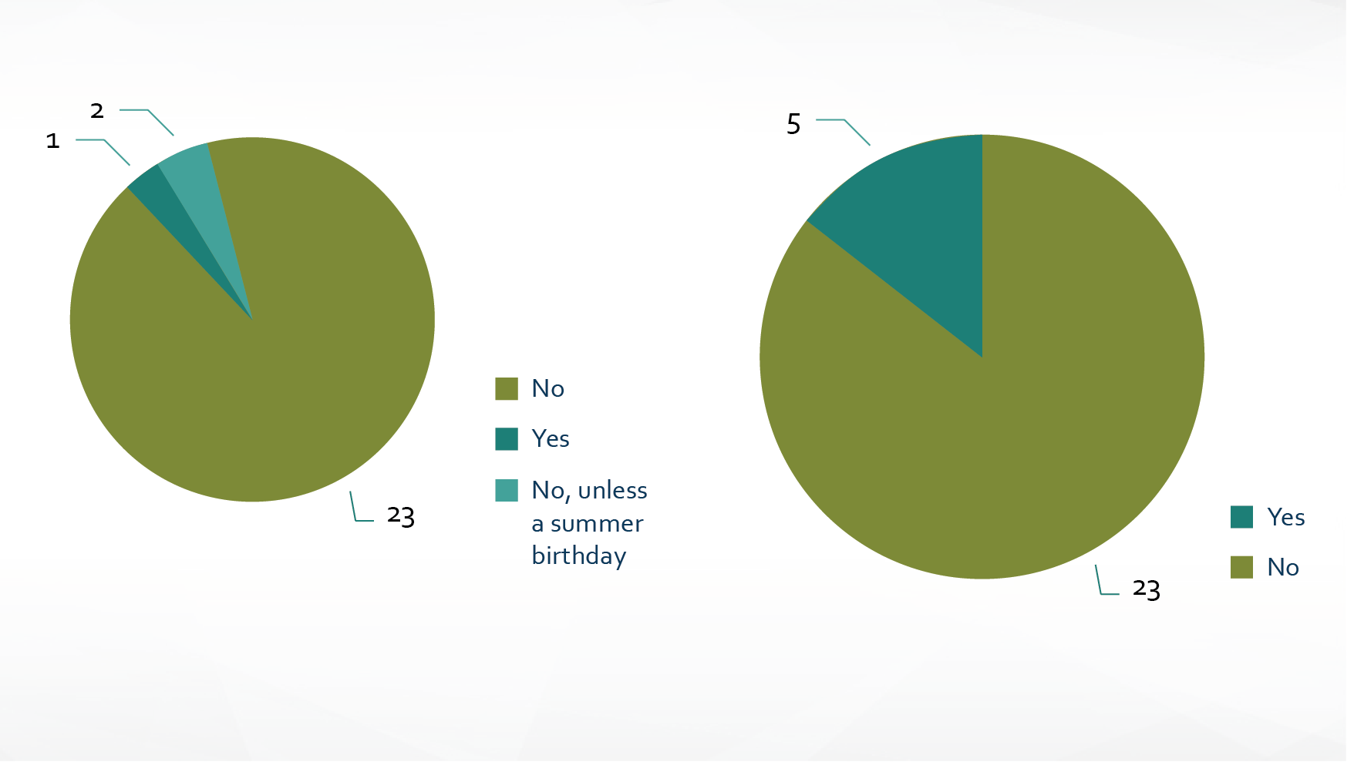
Children Served
Children Over Age 3
At-Risk Children
N=25
N=28

Slide 25
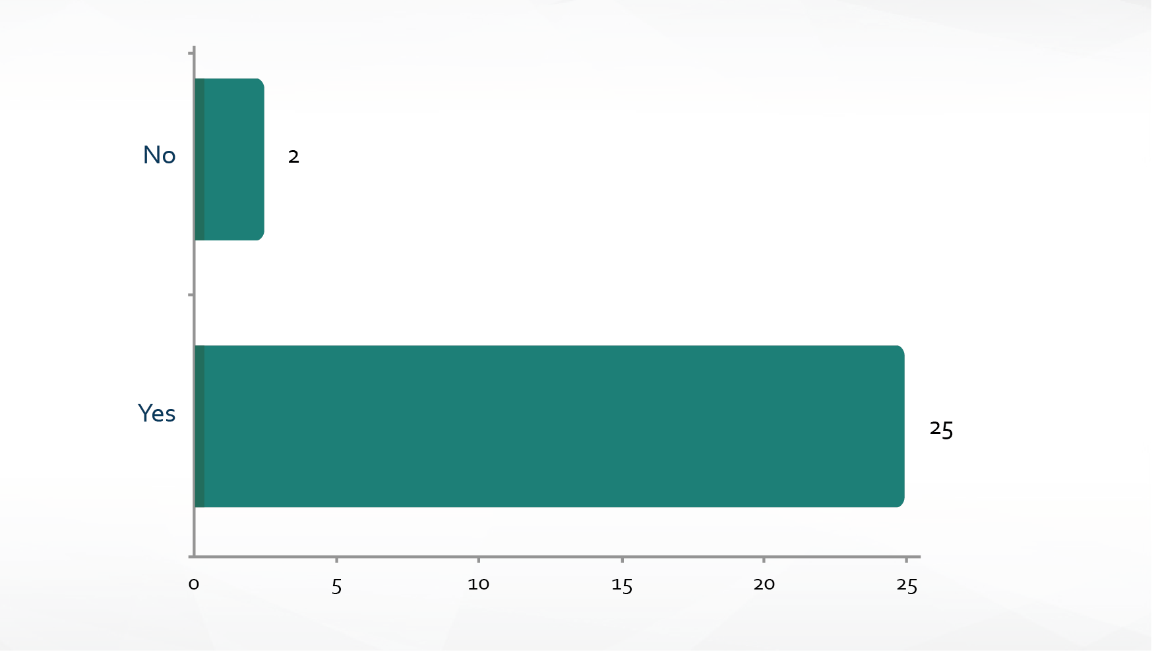
Does the State Record the Eligibility Status?
N=27
Notes:
Describe what we mean by record eligibility status. Condition that makes the child eligible or eligibility category (DD, at risk, clinical opinion)

Slide 26
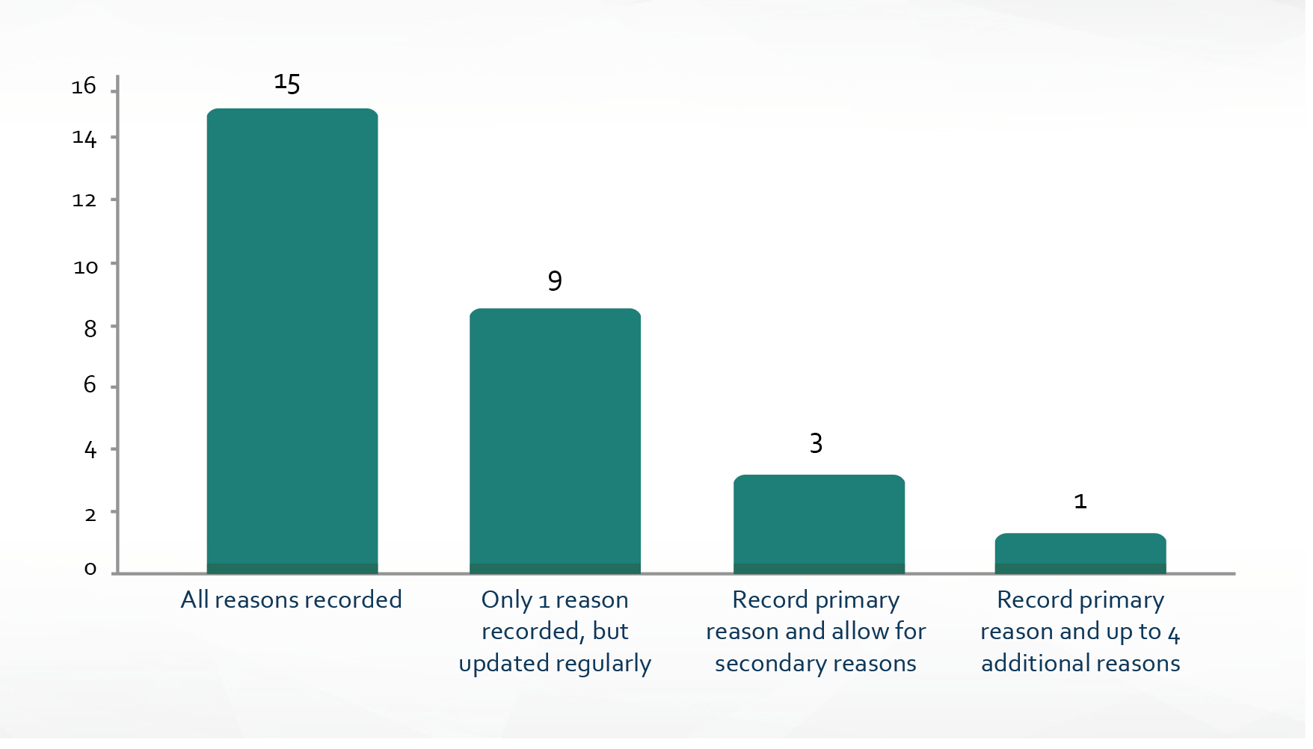
How Is Eligibility Status Recorded in the System?

Slide 27
Definition of Enrolled in Early Intervention
24 states: “Eligible + IFSP”
2 states: “Eligible + IFSP” for 618, but “Eligible” for the birth cohort data
1 state: “Eligible”
1 state: “Eligible + IFSP + Receipt of a service”

Slide 28
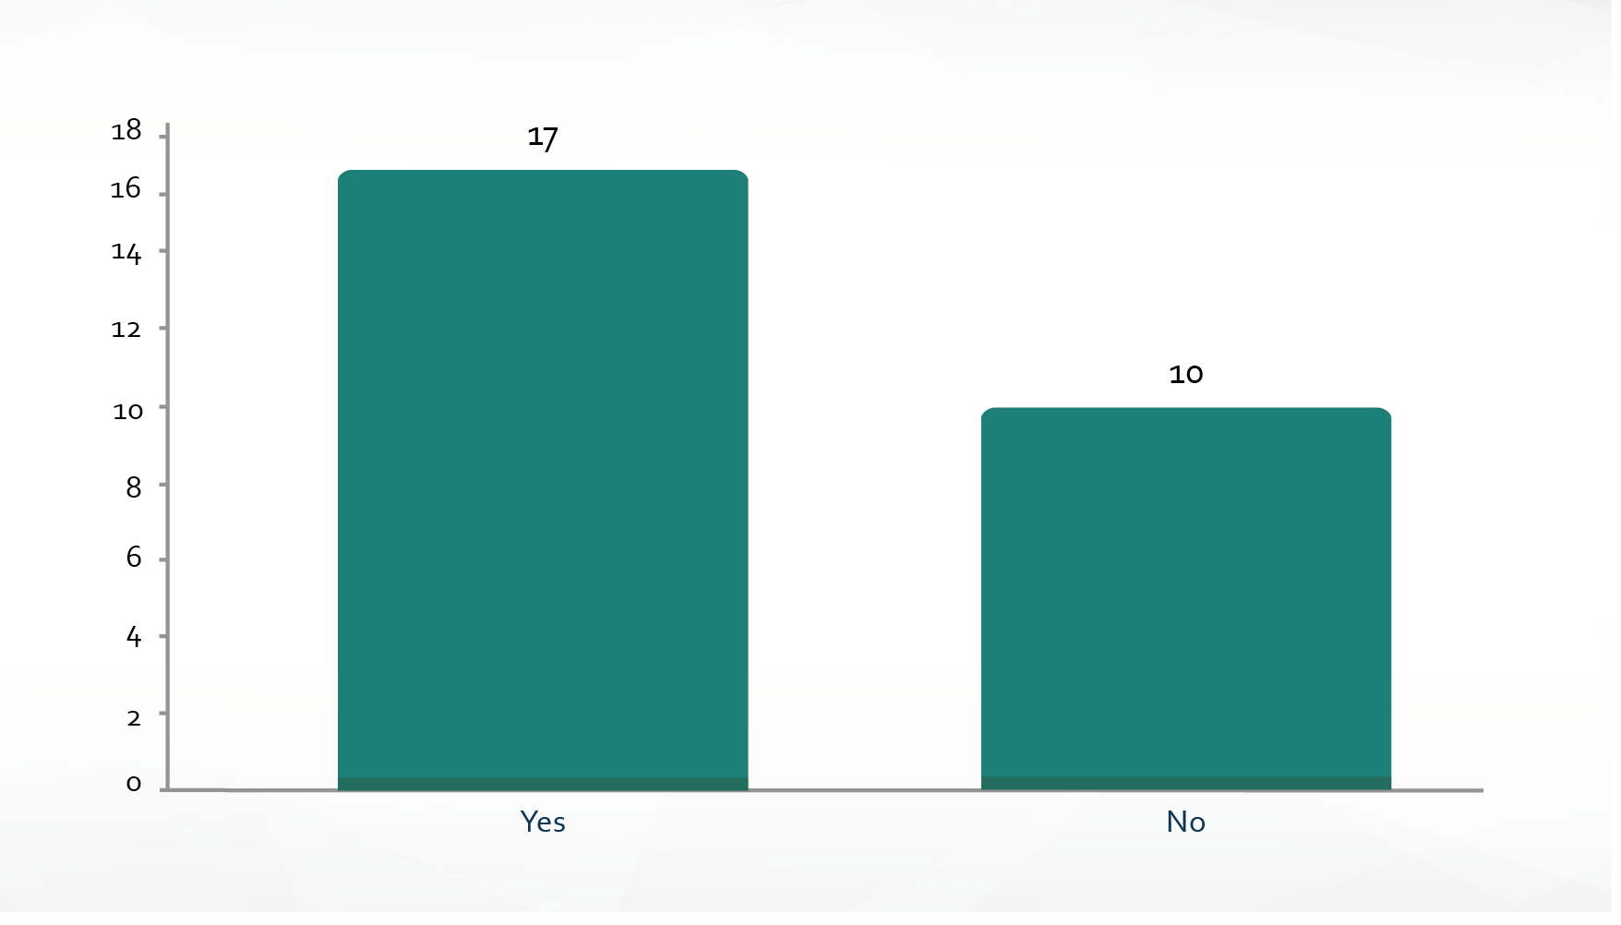
  Does the State Receive Confirmation of Part B Eligibility?

Slide 29
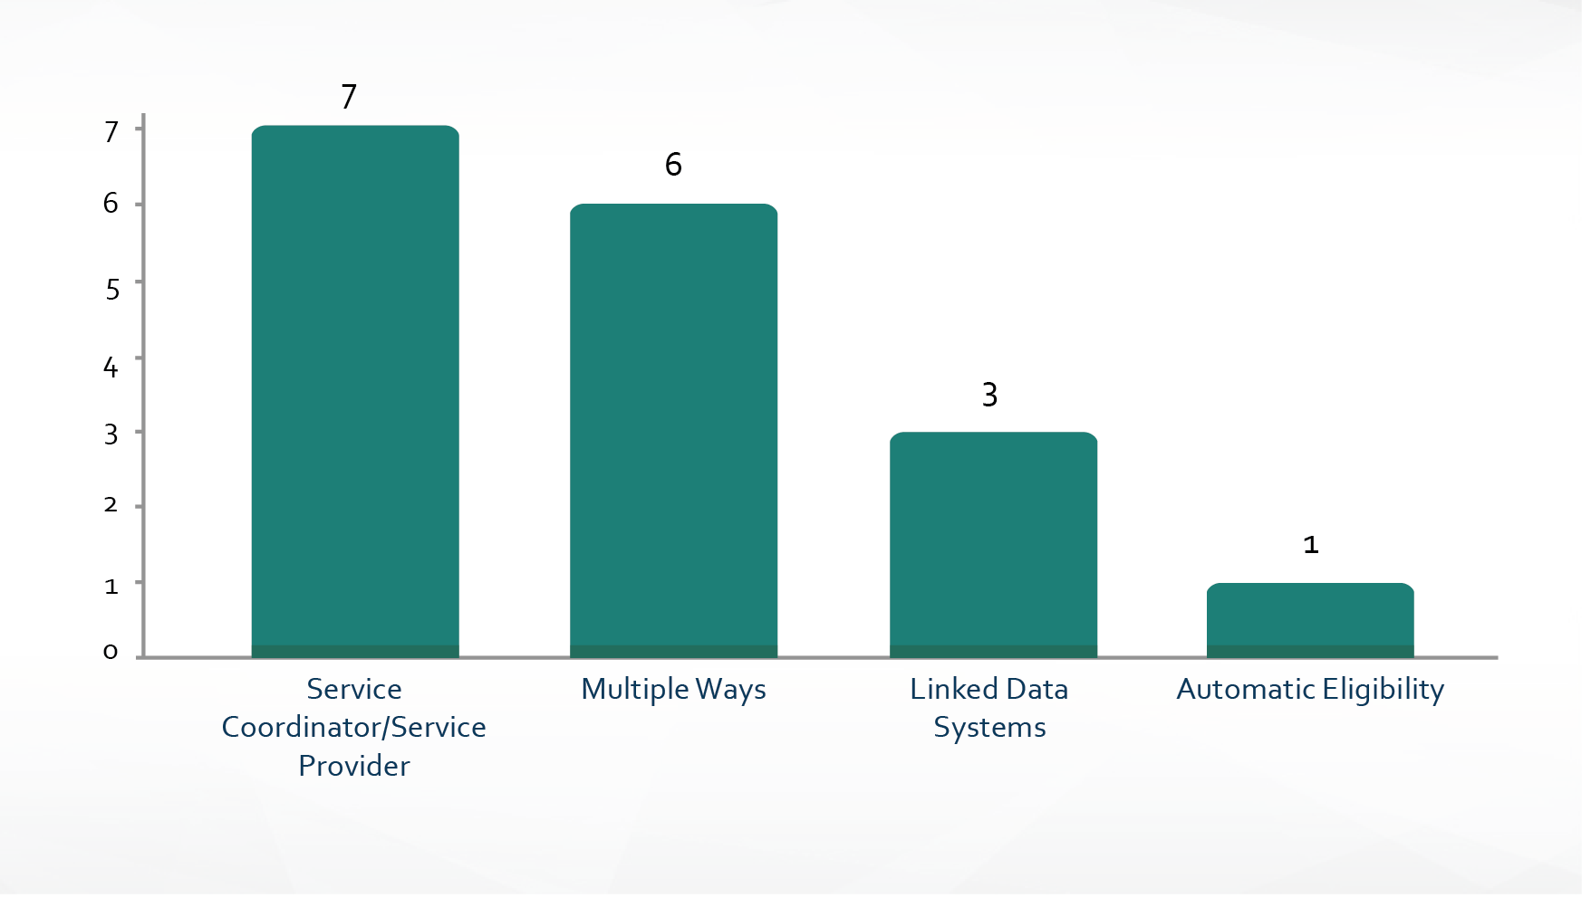
How Does Part C Receive Confirmation From Part B of Eligibility for Part B?
N= 17

Slide 30
Discussion
Any additional questions to include if the interviews are conducted again in the future?
Any surprises in the results?

Slide 31
Lead Agency
Lead agency | % Referred | % Evaluated | % Eligible for C (of resident births) | % Eligible for C (of evaluated) | % Exited C Eligible B (of eligible for C) | % Exited C Eligible for B (of resident births)
Health (13) | 17.9% | 14.3% | 10.7% | 76.3% | 37.3% | 3.9%
Education (3) | 12.8% | 10.4% | 6.7% | 65.7% | 53.2% | 2.9%
Other (11) | 15.3% | 12.5% | 10.0% | 80.9% | 45.1% | 4.6%
Total (27) | 16.3% | 13.2% | 10.0% | 77.0% | 42.2% | 4.1%
Notes:
Ask audience their thoughts on why health lead agencies have higher average rate of referred, evaluated and eligible.
These are average percents across the categories of states.

Slide 32
Serve At-Risk Children
Serve at-risk | % Referred | % Evaluated | % Eligible for C (of resident births) | % Eligible for C (of evaluated) | % Exited C eligible B (of eligible for C) | % Exited C eligible for B (of resident births)
No (22) | 15.5% | 12.0% | 8.9% | 76.1% | 46.0% | 4.1%
Yes (5) | 19.9% | 18.1% | 14.7% | 80.8% | 25.7% | 4.1%
Total (27) | 16.3% | 13.2% | 10.0% | 77.0% | 42.2% | 4.1%

Slide 33
Point in the Process When Referral Gets Recorded
Point in process referral recorded | % Referred | % Evaluated | % Eligible for C (of resident births)
As soon as referral made (17) | 15.5% | 11.7% | 8.7%
Once family confirms (6) | 18.0% | 15.6% | 12.9%
Other (3) | 20.6% | 18.2% | 13.4%
Total (26) | 16.6% | 13.4% | 10.8%
Notes:
Ask audience their thoughts on why if referral is recorded once family confirms has higher avg rates then if referral recorded as soon as it comes in.

Slide 34
Eligibility Criteria
Eligibility category | % Referred | % Evaluated | % Eligible for C (of resident births) | % Eligible for C (of evaluated) | % Exited C eligible B (of eligible for C) | % Exited C eligible for B (of resident births)
A (10) | 16.1% | 13.0% | 10.6% | 82.2% | 47.7% | 4.9%
B (9) | 17.3% | 14.5% | 10.3% | 72.1% | 32.2% | 3.3%
C (8) | 15.4% | 11.8% | 8.9% | 75.9% | 46.6% | 3.8%
Total (27) | 16.3% | 13.2% | 10.0% | 77.0% | 42.2% | 4.1%
Eligibility categories were established by the ITCA Data Committee as of 2010.
Notes:
Category A: At Risk, Any Delay, Atypical Development, one standard deviation in one domain,20% delay in two or more domains, 22% in two or more domains, 25% delay in one or more
domains.
Category B: 25% in two or more domains, 30% delay in one or more domains, 1.3 standard deviations in two domains, 1.5 standard deviations in any domain, 33% delay in one domain.
Category C: 33% delay in two or more domains, 40% delay in one domain, 50% delay in one domain, 1.5 standard deviations in 2 or more domains, 1.75 standard deviations in one domain, 2 standard deviations in one domain, 2 standard deviations in two or more domains.
States self declare the category that most closely aligns with their eligibility criteria
Eligibility categories were established by the ITCA Data Committee as of 2010.

Slide 35
Confirmation by Part B to Part C of Eligibility for Part B
Part C receives Part B eligibility from Part B | % Exited C eligible B (of eligible for C) | % Exited C eligible for B (of resident births)
Yes (17) | 47.7% | 4.6%
No (10) | 32.9% | 3.2%
Total (27) | 42.2% | 4.1%

Slide 36
Comparisons Between the Three Methods—Advantages and Challenges
Point-in-Time Count (cross-sectional):
Advantages: Required, every program reports, historic data available
Challenges: Different dates are used, counts can vary a lot between single days, potential undercount
Cumulative Count:
Advantages: Required starting this past year, less variability in counts in one year
Disadvantages: Duplicate counts of children from one year to next, different date ranges allowed
Birth Cohort (incidence):
Advantages: No duplication in counts, consistently higher percentage of children served using birth cohort methodology, more complete picture of how many children are served from referral to exit
Disadvantages: Takes a long time to have complete data, not every program reports

Slide 37
Discussion
Next steps?
For states that haven’t reported birth cohort data, why?
Is it feasible for you to report birth cohort data?
If not, why not and what support is needed to be able to?
How can states, OSEP, researchers, and policymakers use the birth cohort data?
What benefits or challenges do you see for the birth cohort methodology in comparison to the other child counts?

Slide 38


Slide 39

For More Information
Visit the IDC website
http://ideadata.org/
Follow us on Twitter
https://twitter.com/ideadatacenter

Slide 40




The contents of this presentation were developed under a grant
from the U.S. Department of Education, #H373Y130002. However, the contents do not necessarily represent the policy of the Department of Education, and you should not assume endorsement by the Federal Government.
Project Officers: Richelle Davis and Meredith Miceli

