Slide 1

Part C Data Managers — Review, Resources, and Relationship Building
Improving Data Improving Outcomes Conference
Aug. 15-17, 2016
Lindsay Wise, IDC
Joy Markowitz, IDC
Carolee Eslinger, IDC

Slide 2
Agenda
Introductions
Overview of IDC
Overview of 618 data submissions and system
618 data as they relate to the SPP/APR
IDC supports and resources

Slide 3

Introductions
  Who is in the room?

Slide 4
What Is IDC?
  IDC provides technical assistance to build capacity within states for collecting, reporting, analyzing, and using high- quality IDEA data.
Notes:
Carolee- Use a state liaison model to support states, discuss more about IDC and what we do. Lay groundwork for having a discussion and asking questions.

Slide 5
Why Do We Call Them 618 Data?
All states are eligible Individuals with Disabilities Education Act (IDEA) grantees. Each grantee must submit annual data to show that IDEA is being implemented in the state. Required 618 data elements are identified in Office of Management and Budget (OMB)-approved file specifications and forms.

Slide 6

EDFacts Systems-
  618 data required for Part C
  Child Count and Settings
  Exiting
  Dispute Resolution
  Contact Partner Support Center for log in
  Access User Guides on EDFacts Initiative page

Slide 7

EDFacts Systems-
Using OMB Max, states:
Receive and send information to OSEP Data Team
Receive Data Quality Reports from OSEP on 618 data submissions
Submit data notes in response to OSEP feedback

Slide 8
Reviewing and Resubmitting 618 Data
Reviewing Data Quality Reports
  Timely, Complete, and Accurate
Correct and resubmit data, if necessary
Enter an explanatory data note in OMB Max

Slide 9
Pause and Reflect
Share experiences using EMAPS and OMB Max
  Lessons learned?
  Questions?

Slide 10
Why Do We Call Them 616 Data?
Data to meet the IDEA requirements for monitoring, the State Performance Plan (SPP), and the Annual Performance Report (APR)
  In accordance with 20 U.S.C. 1416(b)(2)(C)(ii)(II) and 1442 of the Individuals with Disabilities Education Act (IDEA), each state lead agency (LA) must report annually, through the Part C Annual Performance Report (Part C – APR) to the Secretary on the state’s performance under its Part C State Performance Plan (Part C – SPP).
(OSEP memo 13-7)

Slide 11
618 Data in the SPP/APR
Indicator 2
  Percent of infants and toddlers with Individual Family Service Plans (IFSPs) who primarily receive early intervention services in the home or community-based settings
  From 618 Child Count and Settings data
Indicator 5
  Percent of infants and toddlers birth to 1 with IFSPs compared to national data provided by OSEP
  From 618 Child Count and Settings data

Slide 12
618 Data in the SPP/APR (cont’d)
Indicator 6
  Percent of infants and toddlers birth to 3 with IFSPs compared to national data
  From 618 Child Count and Settings data
Indicator 9
  Percent of hearing requests that went to resolution sessions that were resolved through resolution session settlement agreements (applicable if Part B due process procedures are adopted) (20 U.S.C. 1416(a)(3)(B) and 1442)
  From Part C Dispute Resolution data

Slide 13
618 Data in the SPP/APR (cont’d)
Indicator 10
  Percent of mediations held that resulted in mediation agreements (20 U.S.C. 1416(a)(3)(B) and 1442)
  From Part C Dispute Resolution data

Slide 14
Pause and Reflect
What is your role in preparing the SPP/APR data?
Share your state’s process for reviewing indicator data for the APR.
  Is a team involved?
  Does it vary across indicators?

Slide 15
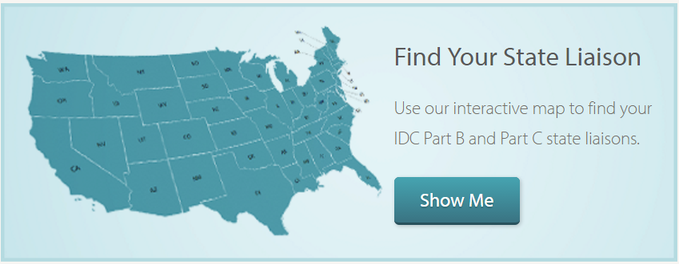
New Data Manager Support From IDC
State Liaisons
  IDC’s model of support
  Initial support and overview of TA landscape
  Ongoing support and resources
Notes:
Carolee

Slide 16
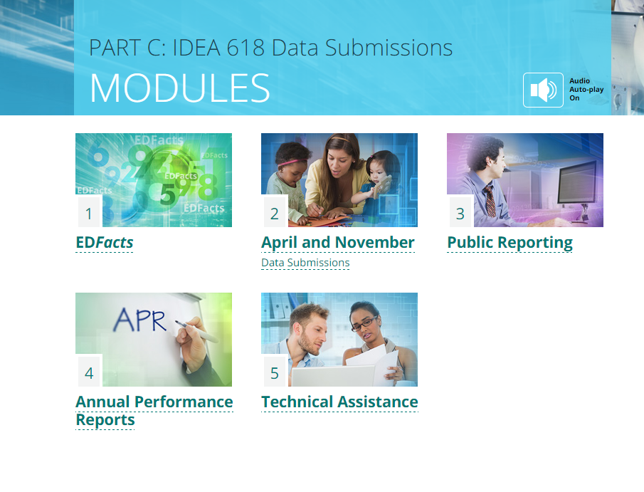
New Data Manager Support From IDC
Data Manager Coaching Program
New Data Manager Toolkit
IDEA Data Training Modules

Slide 17

Reaching Out for Assistance?
Any TA Center door is the right door!
OSEP-funded TA centers work together and strive to provide seamless assistance.
We can refer you to the correct center.

Slide 18
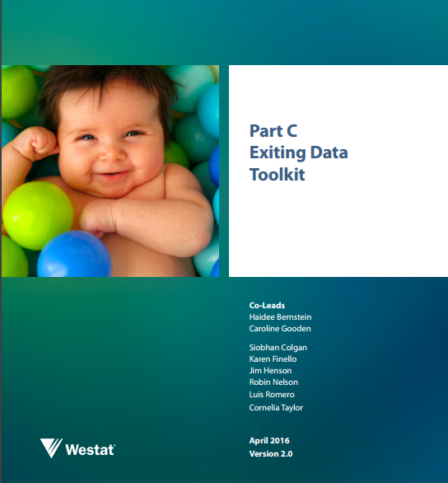
Additional Tools and Resources
Available on the IDC website:
  Part C Exiting Data Toolkit
  IDEA Data Quality: Outlier Analyses Tools
  IDEA Section 618 Public Reporting Data Elements Checklists and Section 618 Public Reporting Requirements Infographic

Slide 19
Pause and Reflect
How has your state used any of these tools?
How do you imagine your state using some of the tools we’ve discussed today?
Do you have any other questions?

Slide 20

IDEA Part C Data Processes Toolkit
Coming Fall 2016

Slide 21
IDEA Part C Data Processes Toolkit—Purpose
Establish a well-managed process for data collection, analysis, and reporting
Create and maintain a culture of high-quality data
Establish and support consistent practices that produce valid and reliable data
Build the capacity of data stewards

Slide 22
IDEA Part C Data Processes Toolkit (cont’d)
Data collection protocols
Calendar
Additional reference materials
Provides data stewards a map for documenting data processes
Recommend a team approach to completing the template
Contact your State Liaison to get started

Slide 23
Pause and Reflect
Share you thoughts about the IDEA Part C Data Processes Toolkit
Would it be useful to your state?
Wrap- Up

Slide 24

For More Information
Visit the IDC website
http://ideadata.org/
Follow us on Twitter
https://twitter.com/ideadatacenter

Slide 25




The contents of this presentation were developed under a grant
from the U.S. Department of Education, #H373Y130002. However,
the contents do not necessarily represent the policy of the Department
of Education, and you should not assume endorsement by the
Federal Government.
Project Officers: Richelle Davis and Meredith Miceli
Project Officers: Richelle Davis and Meredith Miceli

