Slide 1

Evolving Roles of Part B 619 Data Mangers: A New Era
Improving data, improving outcomes conference
August 15-17, 2016
Carol Seay, GA Department of Education
Fred Edora, SC Department of Education
Jeff Sellers, IDC
Tony Ruggiero, IDC

Slide 2
Objectives
Learn the reasons for the changing roles
Learn how to support your state’s effort in obtaining high-quality data for policy and program improvement
Learn from Georgia and South Carolina about their roles in supporting their state work

Slide 3
The Work
OSEP shift from monitoring to Results-Driven Accountability
State Systemic Improvement Plan
Early Childhood Integrated Data Systems and State Longitudinal Data Systems
Notes:
RDA, SSIP, ECIDS, and SLDS are ushering in a movement toward high-quality data and data use that is intended to support data driven decision making to for policy and program improvement. Part B 619 data managers roles are changing from primarily focusing on data collection to building relationships to collect and use high-quality data as evidence to ultimately improve early childhood outcomes.

Slide 4


Data Governance
Interagency Resource Management Committee
Early Childhood Council
P20 Council
State Data Governance Council
State Department’s IT or Data Collection Office
Notes:
The importance of a data manager’s role should not be underestimated. A state may have several “data governance” boards or committees that a Part B 619 data manager should connect with. These governance structures oversee data work (e.g., essential questions and data items as they related to school readiness, building or enhancing data systems) and may provide the support that is needed to carry out the work. Chances are that the Part B 619 data manager should be connected to more than one governance entity.

Slide 5
Cross-Department Information Sharing
IDEA Part C
Parents as Teachers
Head Start and Early Head Start
Departments that have child care center data
State Health Department
Notes:
Collaboration is key! Building rapport across departments can help with gaining support for an ECIDS or SLDS or for helping with exchange data for transitions from Part C to Part B 619.

Slide 6
Data Usability – Working With LEAs
Develop essential questions
Identify data elements to answer questions
Data visualization
Notes:
Discussions can prove beneficial because LEAs have access to the data but may not run their own data or may not know how to interpret their data. This is the beginning of building a data culture because people will become more engaged to increase the quality of the data so they can rely on the data to help improve child outcomes. Data Visualization techniques can be used to help people see the data in a clear fashion.

Slide 7
Data Analysis
Benefits of going above and beyond federal and state reporting requirements are great.
Analysis can provide evidence to support program and policy needs.
Ultimate goal is to serve our children and families the best we can so they can live their lives to their fullest capacity.

Slide 8
Data Distribution
Site visits
Promote data culture
  Behavior change
  Encourage participation
Educate locals on data quality and findings
“Shared” early child outcomes data
  IDEA Part B 619
  Head Start and Early Head Start
Notes:
Even though the LEAs may have this data it is important to “share” reports that are produced to begin conversations regarding data quality.

Slide 9
The New Part b 619 data manager
South Carolina

Slide 10
The Traditional Part B 619 Data Manager
South Carolina
Gather Data
Combine Data
Report Data
Check Data

Slide 11
The New Part B 619 Data Manager
South Carolina
Part B “Information Manager”
Technical Assistance
Quality Control
Data Security
Business Intelligence
Stakeholder
Project Manager
Gather Data
Combine Data
Report Data
Check Data

Slide 12
The New Part B Data Manager
South Carolina
Why the change?
  Promote knowledge-driven decisionmaking
  Process data into information
  Apply business analysis techniques
  Create business intelligence for special education
  Increased use of data visualization
  Use analysis and information for upcoming federal projects (e.g. SSIP, policies, law changes, etc.)

Slide 13
The New Part B Data Manager
Technical Assistance
Helping other people understand special education reports and available data
Promote a culture of data use and high data quality
Customer-service oriented
You can become a “state-level IDC”
  Serve the customer (your LEAs)
  Provide resources
  Ensure data quality

Slide 14
The New Part B Data Manager
Technical Assistance
South Carolina, 2015–2016
  Developed year-long training plan and vision
  Delivered eight statewide webinars specifically focused on all Part B 618 and 619 data reporting requirements (SPP/APR indicators and EDFacts tables) to LEA Data Managers, Data Support Staff, and LEA Directors and Superintendents
  Two reporting workshops to new LEA Data Managers, LEA Support Staff, and LEA Directors
  Two reporting presentations to LEA Directors

Slide 15
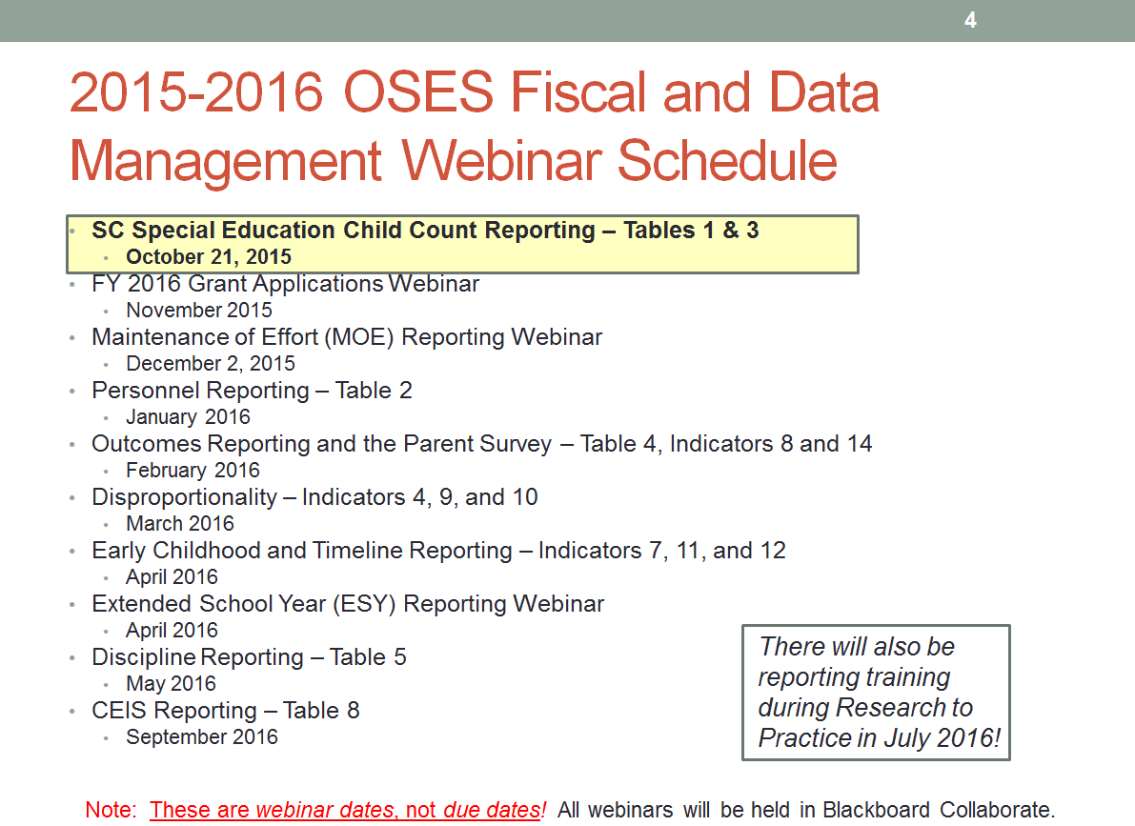
The New Part B Data Manager
Technical Assistance

Slide 16
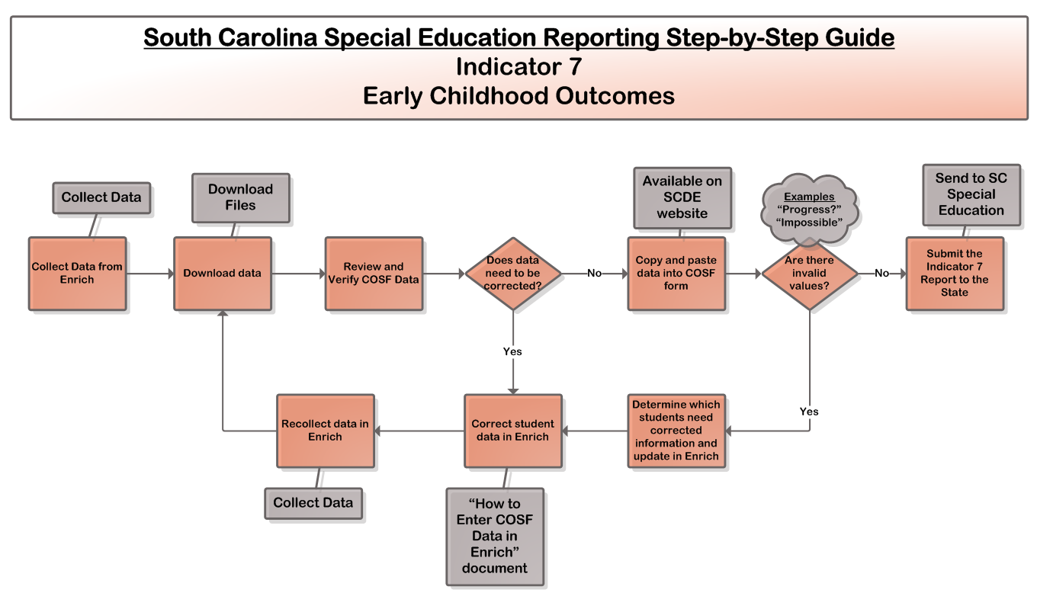
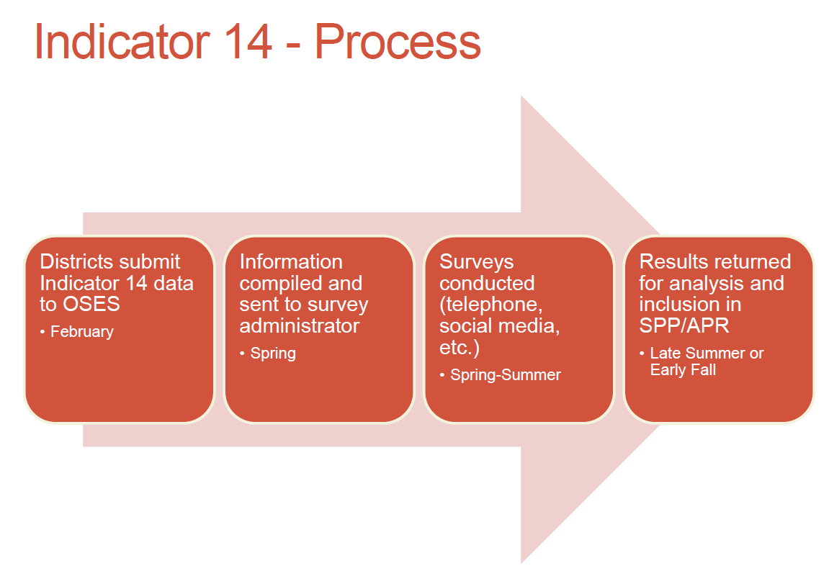
The New Part B Data Manager
Technical Assistance

Slide 17
The New Part B Data Manager
Quality Control
Good data are more likely to lead to good analysis.
Bad data will always lead to bad analysis.
  High data quality is still a top priority.
  It is the new Part B Data Manager’s responsibility to be proactive about data quality.
  Where are the places in our state’s data collection processes that can be improved?
  Frame data quality in a way that makes sense to your audience.

Slide 18
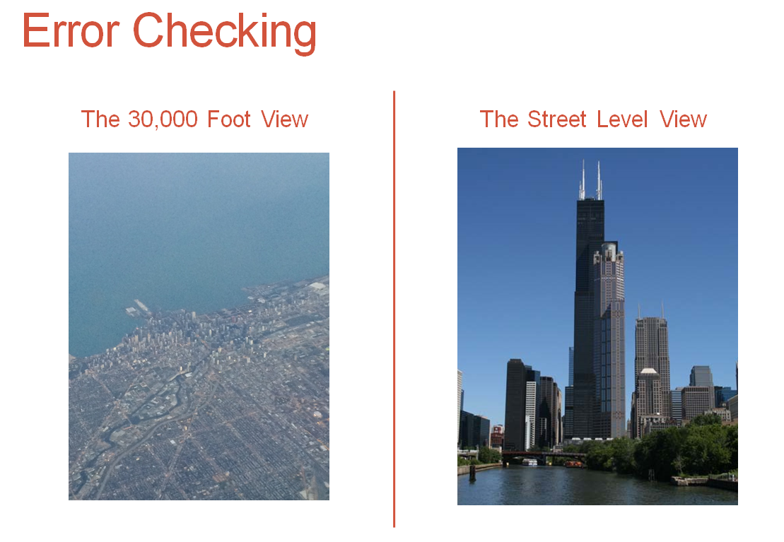
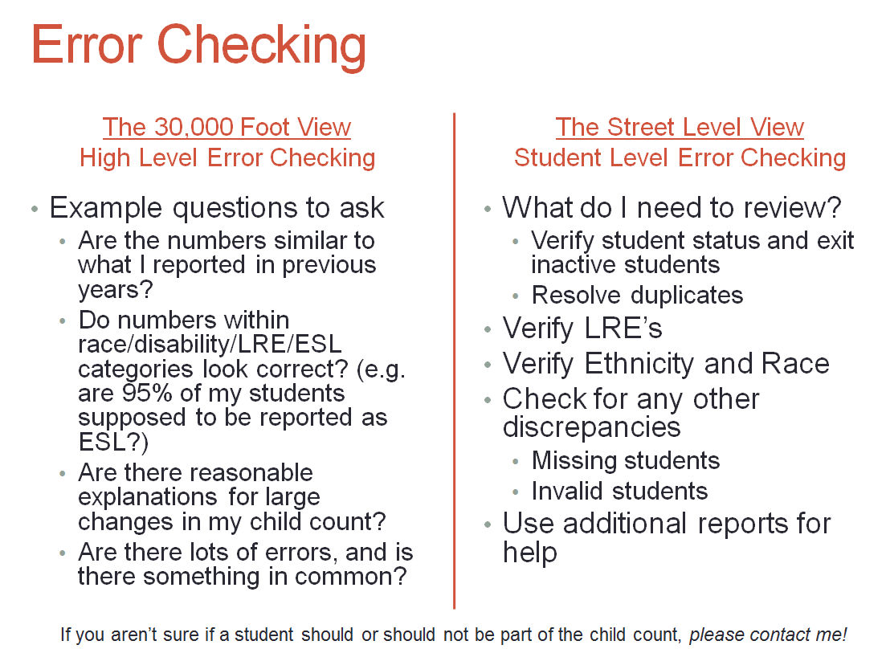
The New Part B Data Manager
Quality Control

Slide 19
The New Part B Data Manager
Data Security
“Companies spend millions of dollars on firewalls, encryption, and secure access devices and it's money wasted because none of these measures address the weakest link in the security chain: the people who use, administer, operate and account for computer systems that contain protected information.” –Kevin Mitnick
  http://www.economist.com/node/1389553

Slide 20
The New Part B Data Manager
Data Security
Data managers have high security privileges.
  Handle student data carefully
  Protect student data well
  Tell others to do the same
Data managers [should] understand security, privacy, and other local laws and agency regulations.
  FERPA
  Freedom of Information Act (FOIA)
  IT and agency regulations
  Data governance
  Encryption

Slide 21
The New Part B Data Manager
Business Intelligence
“The amount of data that crosses the Internet every second is greater than all the data stored in the Internet just 20 years ago.” –Andrew McAfee and Erik Brynjolfsson, MIT
  http://www.sas.com/en_us/insights/articles/analytics/why-your-brain-needs-data-visualization.html?utm_source=FBPAGE&utm_medium=s ocial&utm_ campaign=BI/Visualization&postid=512271191

Slide 22
The New Part B Data Manager
Business Intelligence
“We don’t need ‘data driven’ schools. We desperately need ‘knowledge driven’ schools. There is a big difference. Data is a way of expressing ideas and they have very little value in and of themselves. Data are useless unless they are first organized into meaningful patterns called information…Knowledge is applying information appropriately and productively in a contextual situation.” –Ronald Thomas, Education Week
  http://www.edweek.org/ew/articles/2011/06/15/35thomas.h30.html

Slide 23
The New Part B Data Manager
Business Intelligence
“It is a capital mistake to theorize before one has data.” –Sir Arthur Conan Doyle, the author of Sherlock Holmes

Slide 24
The New Part B Data Manager
Business Intelligence
LEA comment during SSIP Phase I: “We are data rich but analysis poor!”
  You can change this narrative!
  Districts want to know how to use their data.

Slide 25
The New Part B Data Manager
Business Intelligence
What are some examples of business intelligence in education?
  Analyzing data for trends, patterns, and themes (transforming data into knowledge)
  Triangulation of data (checking multiple sources)
  Understanding how to present that data in a way that can speak to different audiences (context and data visualization)
  Presenting actionable information to help education leaders at the state and local levels to make better and more informed decisions

Slide 26
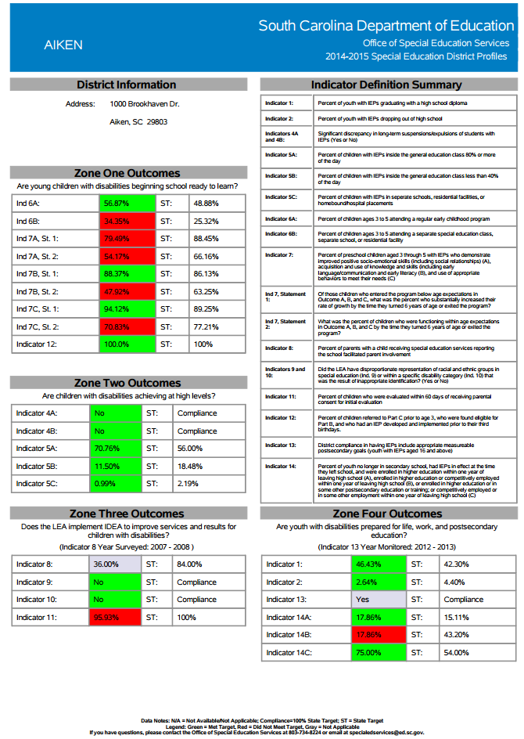
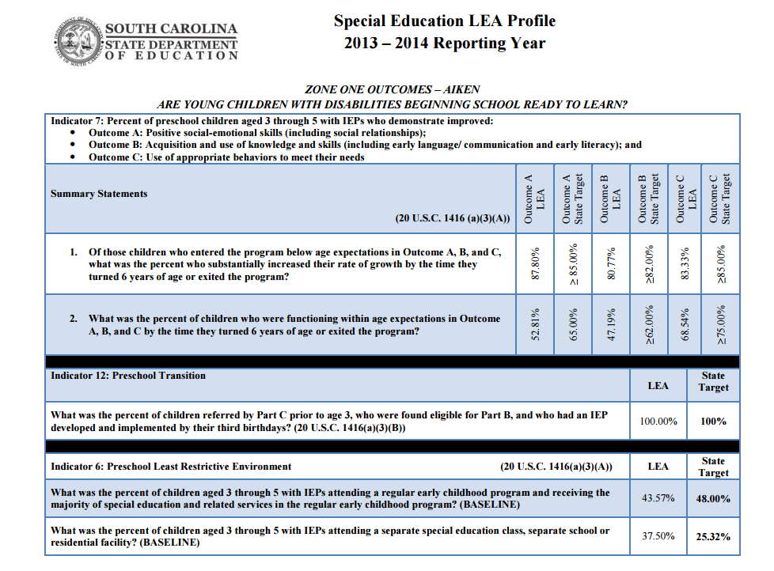
The New Part B Data Manager
Business Intelligence

Slide 27
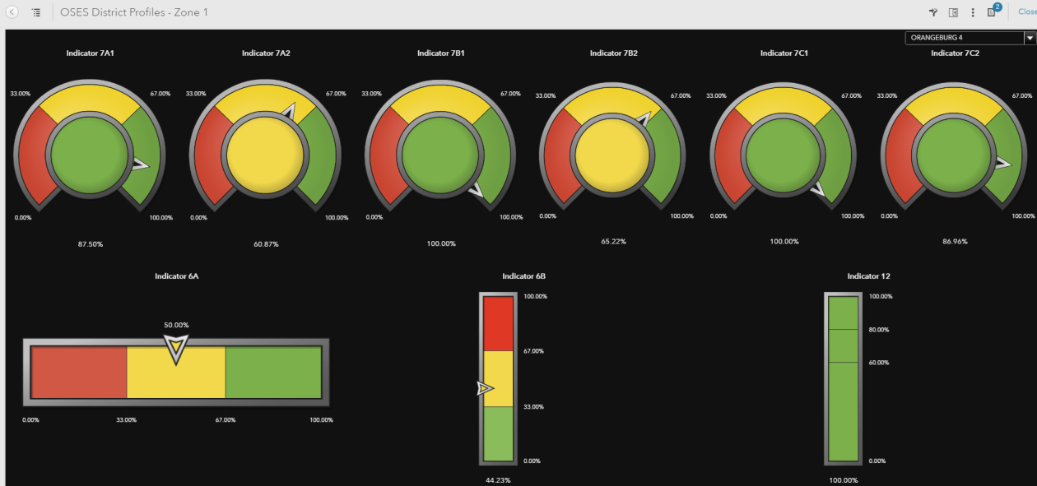
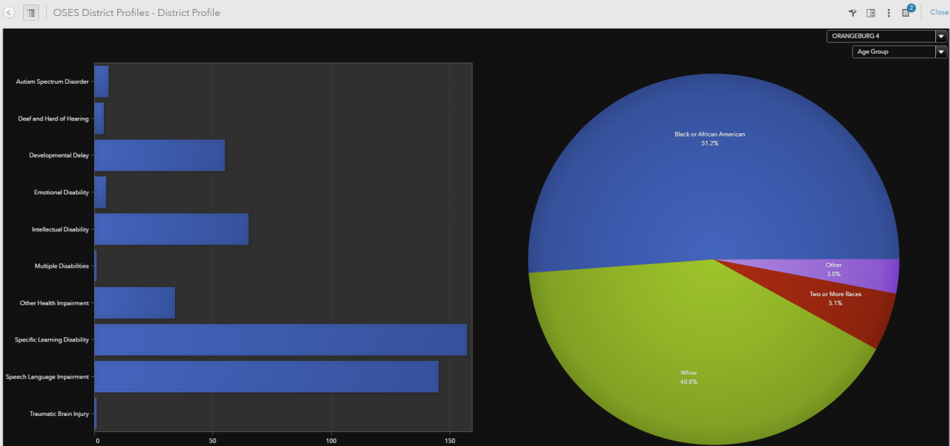
The New Part B Data Manager
Business Intelligence
Data visualization and South Carolina’s district profiles (coming soon)

Slide 28
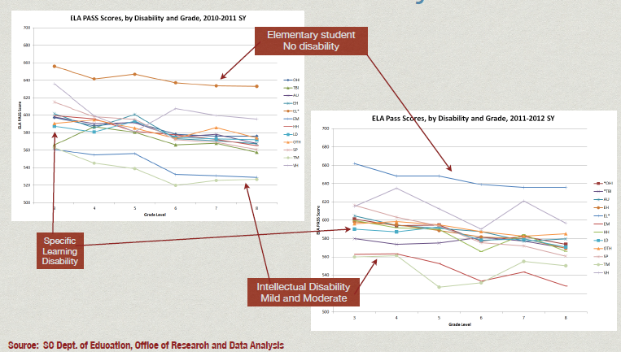
The New Part B Data Manager
Business Intelligence

Slide 29
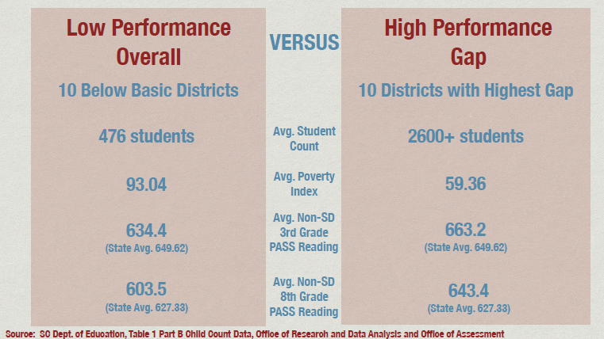
The New Part B Data Manager
Business Intelligence

Slide 30
The New Part B Data Manager
Stakeholder
The Data Manager must be the subject matter expert on your state’s special education data.
  Who has the data?
  What data are available? (Are we collecting the right data?)
  When are they collected?
  Where do we get the data?
  Why do we collect the data?
  How can the data be used to meet the state’s needs (or how can I frame the analysis to meet the audience’s needs)?
The Part B Data Manager must be a key stakeholder in the special education decisionmaking process.

Slide 31
The New Part B Data Manager
Stakeholder – South Carolina Part B SSIP
South Carolina Part B Data Manager
  Data Analysis Lead (Phase I)
    Provide subject matter expertise
    Collaborate with other offices
    Talk with stakeholders, including LEAs, families, and special education students
  Evaluation Lead (Phases II and III)
    Liaise to the external evaluators at the University of South Carolina to evaluate the SSIP project

Slide 32
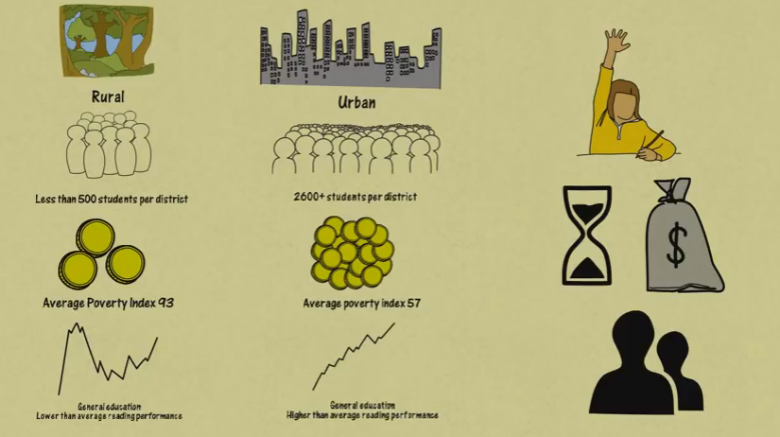
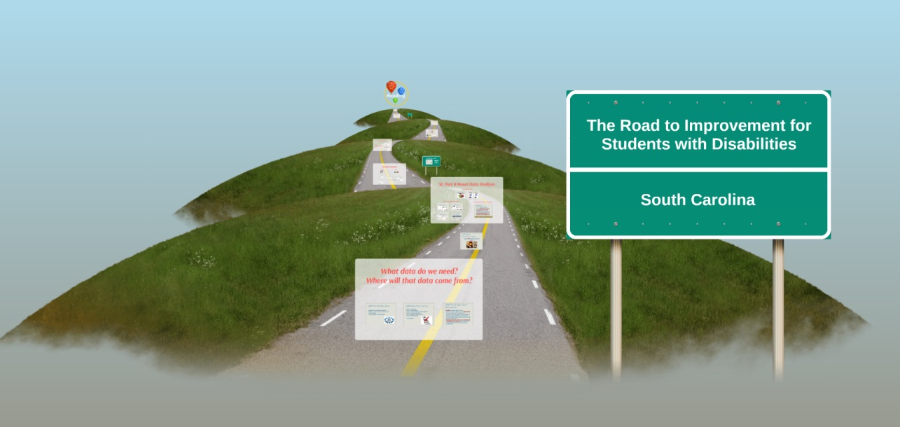
The New Part B Data Manager
Stakeholder – South Carolina Part B SSIP
Frame data analysis through a common thread with your audience.

Slide 33
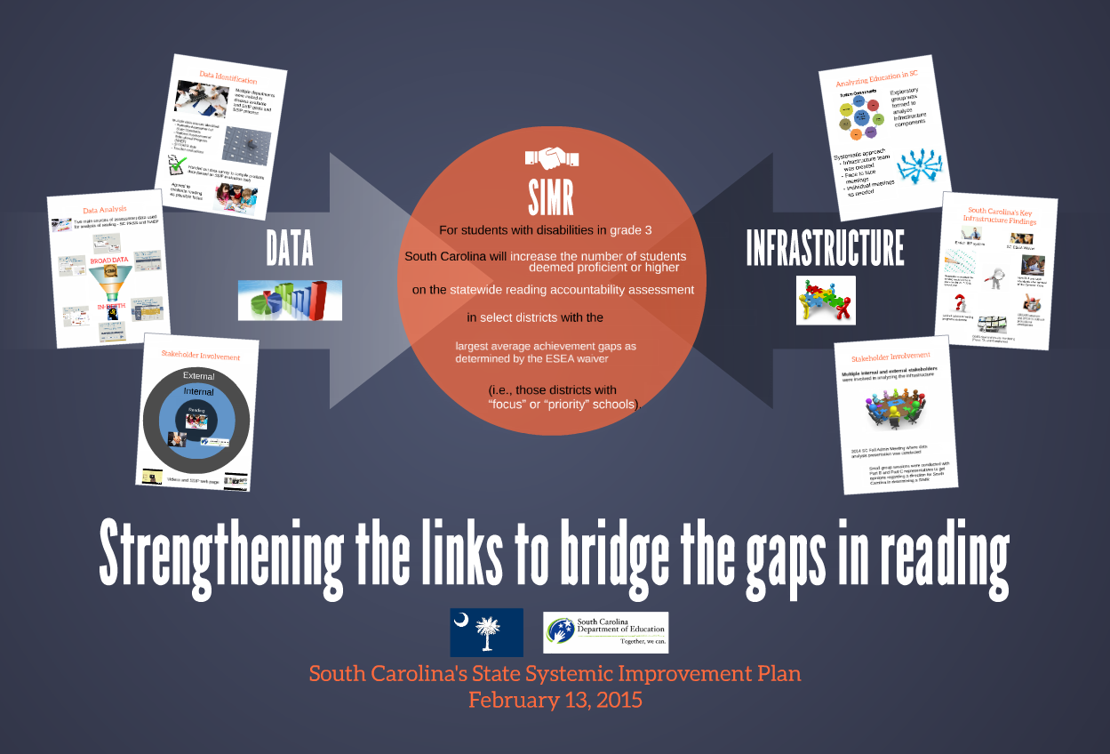
The New Part B Data Manager
Stakeholder – South Carolina Part B SSIP
Frame data analysis through a common thread with your audience.

Slide 34
The New Part B Data Manager
Project Manager
Creating and taking advantage of opportunities to improve data use, data quality, and analysis
Networking with your national TA centers
Timing – Is it right for my state? Are the right people at the table? Are we passionate about improving data?
Project management?
  Data collection is a project!
  Data analysis is a project!
  Data quality is a project!
  Data use is a project!

Slide 35
The New Part B Data Manager
Project Manager
South Carolina projects 2014–2016
  Linking Part B data to Part C (DaSy)
  Capturing Personnel and Discipline data at the student level (CIID/IDC)
  Revamping fiscal monitoring (CIFR)
  Meeting special education public reporting requirements (IDC)
  State Systemic Improvement Plan (RRCP/NCSI)
  Updating the SEA website to make reporting instructions easier to find for the LEAs
  Creating visual data dashboards for internal use and public reporting
  Introducing a new data-driven Determinations System

Slide 36
South Carolina
Linking Part B 619 Data to Part C
Two data systems in two different agencies
Working towards sharing outcomes data between Part B and Part C
South Carolina’s vision
  Create a true birth-to-21 data analysis system to inform policy and practice at the local and state level
  Data analysis and governance collaboration

Slide 37
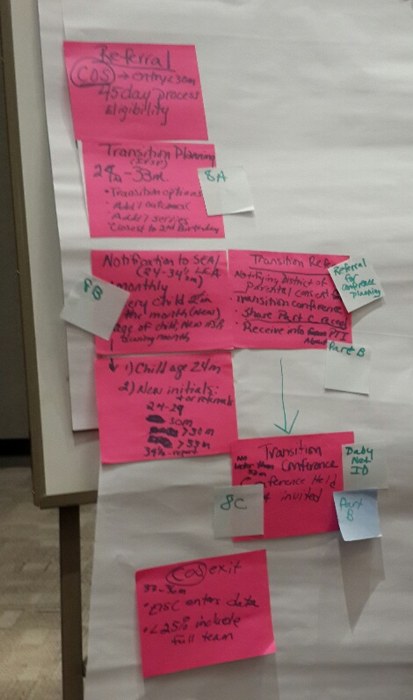
South Carolina
Linking Part B 619 Data to Part C
Sometimes doing great things with data requires getting away from the work environment to think.
The new Data Manager is collaborative and proactive.

Slide 38
The New Part B Data Manager
Conclusions
The new Data Manager is a key stakeholder and subject matter expert in shaping special education policy.
The new Data Manager must go beyond collecting, combining, cleaning, and reporting data.
The new Data Manager must be proactive in understanding how data can be analyzed and used to make better decisions.
The new Data Manager has evolved to an Information Manager!

Slide 39
The New Part b 619 data manager
Georgia

Slide 40

What’s missing?
Notes:
We’ve all gotten pretty good at compliance. We know the law, rules, the standards, but are we use the compliance data to help children?

Slide 41


As the Data Manager, what is my role?

Slide 42
Essential Questions
How can the use of quality data make a difference for young children?
How do I, as a Data Manager, ensure the use of quality data regarding early childhood education?
What is my role in supporting the LEAs?

Slide 43
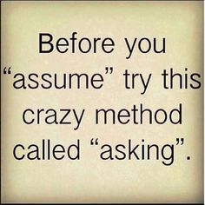
“But you are making assumptions without all the facts, and that’s not a sign of intelligence”
unknown

Slide 44
Data Manager, a New Role
Promoting data access
Providing professional learning
Promoting understanding of data
  Understanding leads to using data
  Using data leads to positive results
Providing support
  A phone call away
Collaboration

Slide 45
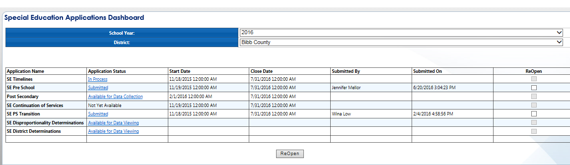
Special Education Dashboard

Slide 46
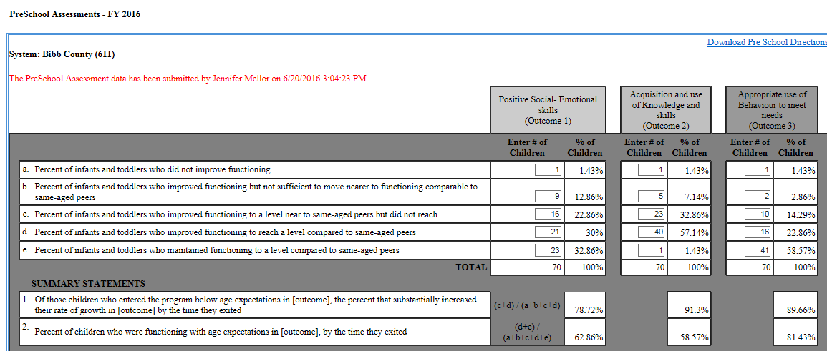

Slide 47
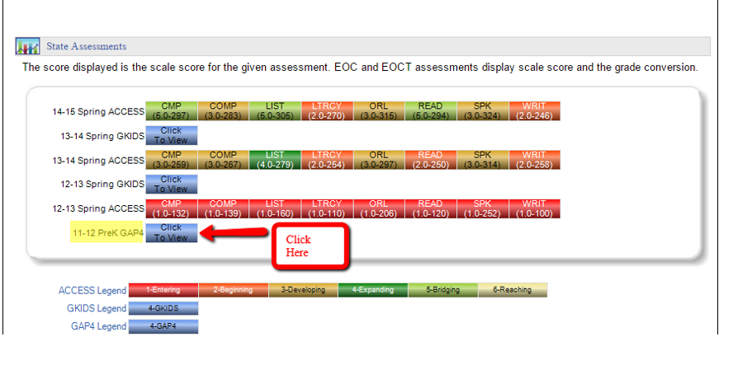
LDS – Preschool Data

Slide 48
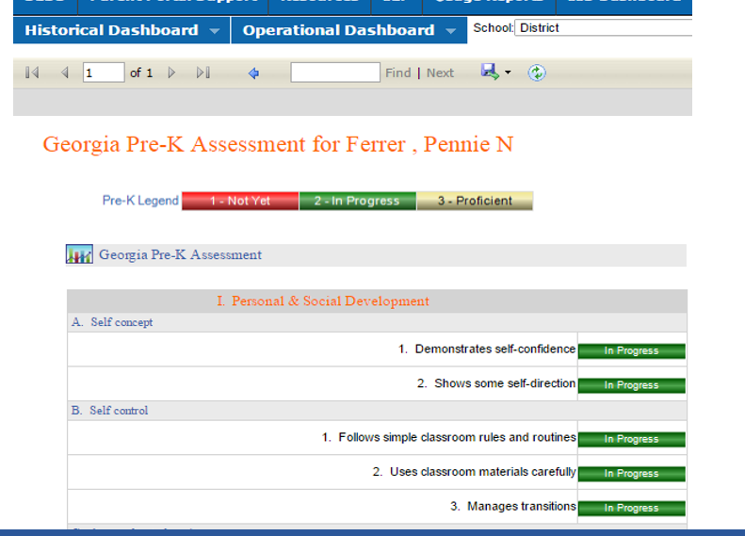
Obfuscated data

Slide 49
Cross-Agency Child Data System
(CACDS) Sources
Early Head Start and Head Start from Child Plus
Childcare and Parent Service (CAPS) data from Maxstar
Pre-K student attendance data
Work Sampling from Pearson
Licensed child care providers and their quality rating

Slide 50
Cross-Agency Child Data System
(CACDS) Sources
Children 1st and CIDS – birth records screened for possible needs
IDEA C
IDEA B 619
Home Visiting

Slide 51
Linking Early Childhood Data
Cross-Agency Data System Data-Sharing Agreement (MOU)
  Georgia Department of Education
  Georgia Department of Early Care and Learning
  Department of Public Health
  Department of Human Services

Slide 52
Professional Learning
Annual Data Conference
  In partnership with Data Collections Division
Federal Programs Conference
New Special Education Directors
  New directors academy
District Liaison
  Providing consistent support to districts
Georgia Learning Resource System
  Helping to lead the change
  SSIP

Slide 53

Preschool Data, Compliance
SPP/APR Indicators:
Early Childhood Transition
  Are we providing services in a timely manner?
  Why does timeliness matter?
LRE Data
  Where are we serving students?
  Why is this important?
Preschool Outcomes
  Results
  Are we using these data or just complying with the mandate to report them?

Slide 54
What do I do with these data, what do they mean?

Slide 55
FY15 Preschool LRE in GA
Met LRE Target
Did not meet
LRE Target
What do I do with these data, what do they mean?

Slide 56
What do I do with these data, what do they mean?
Notes:
Share with stakeholders

Slide 57

SSIP in GA
GA’s SIMR increases the graduation rate of students with disabilities
Where does the ?
“Children who participate in high-quality prekindergarten programs require less special education and are less likely to repeat a grade or need child welfare services…The participating children go on to higher achievement later in life, graduating from high school and attending college at a higher rate….” Robert Lynch, Enriching Children., Enriching the Nation 2007

Slide 59
Georgia’s SSIP: Theory of Action
Effective teachers and leaders are critical to improve outcomes for students.
If state and regional teams provide seamless technical assistance to build capacity for district leadership,
Then students will achieve better outcomes.

Slide 60
Logic Model – Inputs
Partnerships with stakeholders
GADOE personnel across divisions
  School and district effectiveness, curriculum and instruction, special education
Regional technical assistance
  Georgia Learning Resource System
GADOE standards, frameworks, toolkits, and other resources
Comprehensive data system to support decisionmaking at all levels of the state system

Slide 61
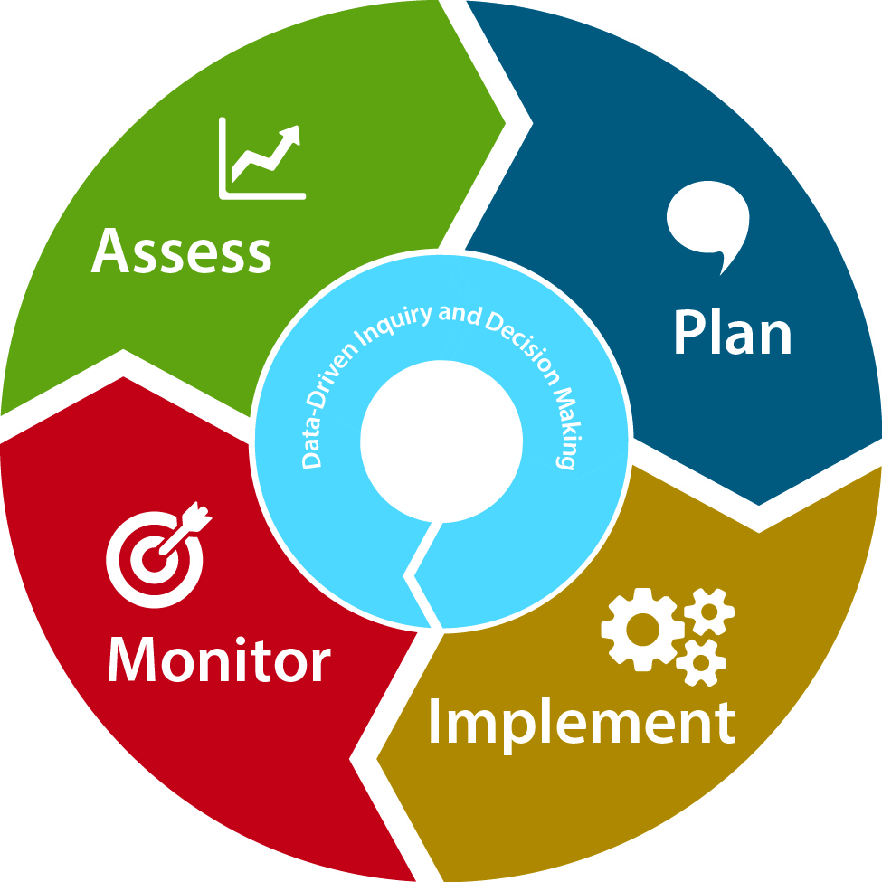
Data-Driven Inquiry and Decisionmaking
Quality Data
Quality Analysis
Quality Decisions
Improved Outcomes
Comprehensive Needs Assessment

Slide 62
Questions
How does your state currently view the Part B Data Manager role?
What would a “state-level IDC” look like in your state?
Is your state “data rich, analysis poor” and what steps has your state taken, if any, to be analysis rich?

Slide 63

For More Information
Visit the IDC website
http://ideadata.org/
Follow us on Twitter
https://twitter.com/ideadatacenter

Slide 64




The contents of this presentation were developed under a grant
from the U.S. Department of Education, #H373Y130002. However,
the contents do not necessarily represent the policy of the Department
of Education, and you should not assume endorsement by the
Federal Government.
Project Officers: Richelle Davis and Meredith Miceli
Project Officers: Richelle Davis and Meredith Miceli

