Slide 1
Data Quality Profiles
Child Outcomes Data Workshop: Hands-on analysis of your own state child outcomes data
2016 Improving Data, Improving Outcomes Conference
New Orleans, LA
Monday, August 15, 2016

Slide 2
State Child Outcomes Data Quality Profiles FFY 2014-15
38
Notes:
Many of you have hopefully seen the state child outcomes data quality profiles before, but I’m going to provide a quick overview in case they are new to you or you need a refresher.

Slide 3
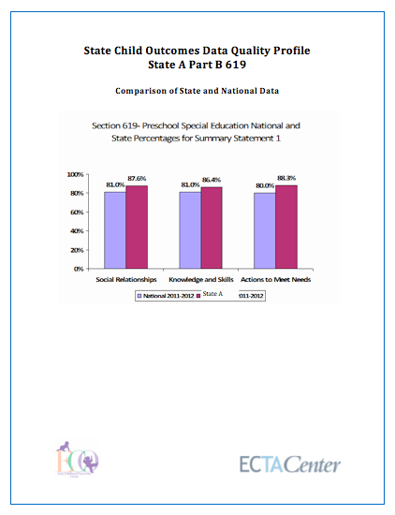
Overview
State Child Outcomes Data Quality Profiles present data on:
State compared to national
State data in relation to quality criteria used for inclusion in the national analysis
Reporting data on enough children
Within expected patterns in the data
Note: Part C profiles include criteria for determinations
Trends over time
Expanded profiles include progress category data
Notes:
The profiles basically take the info that we collect as part of doing our national analysis and then give it back to you in an individualized state profile form.
We put your state summary state values compared to the national estimate, we show you the data we have on the completeness of the data, which is limited to looking at the number of exiters or child count, but you can see based on the numbers we have if you meet that criteria for inclusion based on completeness.
Also for the progress categories you can see if you have no flags for patterning.
If you meet completeness and have no flags and are not sampling, then you would be included in the national analysis.
Then we also graph the state trends over time for you.
The nice piece is that these graphs include what you wouldn’t be able to do on your own, which is that, since we have national data, we’re able to add in a line for the national average and then also a line for one standard deviation above and one standard deviation below so you can get a sense of not only how comparable are you to the national average but are you within that 1 standard deviation range of the national average to give you another comparison point.
Notes: The Part C profiles include information related to OSEP determinations criteria for comparison to the national analysis inclusion criteria – as we’ve said before quality is a continuum and there is not one set of quality criteria

Slide 4
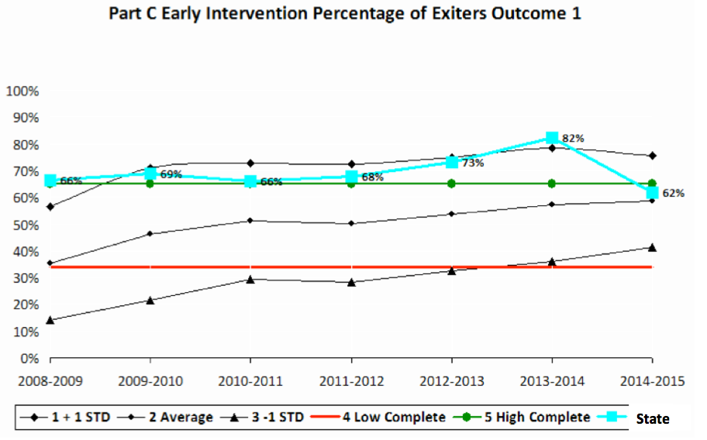
Part C Specific: Completeness
38
Notes:
As we have said, quality is not a yes/no, it is a continuum and involves multiple criteria. The state child outcomes data quality profiles are primarily based on the criteria used for inclusion in the national analysis and estimates, which are not identical to those used for Part C determinations this year.
Therefore, for the Part C profiles, we made additions to make comparisons to or align with the criteria for inclusion in the national analysis and the Part C determinations criteria used by OSEP this federal fiscal year.
The two main revisions were that we included the data completeness criteria for determinations and color coded lines to the completeness graphs to be able to compare where your state data fall in relation to the national average, 1 standard deviation above and below as well as the low and higher completeness cutoffs used for determinations.
We also show whether there are unexpected patterns for all 5 progress categories, to be more comprehensive, but we still focus on a and e for the national analysis.
Note: OSEP decreased criteria for a 2 to be 65% of exiters

Slide 5
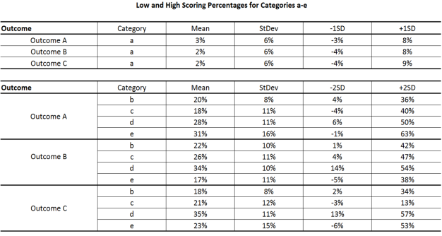
Part C Specific: Progress Categories
Determinations - Anomalies
ECTA Expected Patterns
38
Notes:
Also for progress categories, we added in some explanation of how anomalies in progress categories were defined in the determinations and how they differ from ECTA’s expected patterns for progress categories. In a nutshell, the ECTA expected patterns are based upon previous national data and other data sources used to establish expected percentages and reasonable patterns for the progress categories. For the purpose of determinations, a measure of data anomalies was used and was based upon 1 or 2 standard deviations above or below the average across all states and territories.

Slide 6
The contents of this tool and guidance were developed under grants from the U.S. Department of Education, #H326P120002 and #H373Z120002. However, those contents do not necessarily represent the policy of the U.S. Department of Education, and you should not assume endorsement by the Federal Government. Project Officers: Meredith Miceli, Richelle Davis, and Julia Martin Eile.

