Slide 1
Using Child and Program Standards to Improve Child Outcomes
Kathy Hebbeler
September 2014
Improving Data, Improving Outcomes
New Orleans, LA

Slide 2
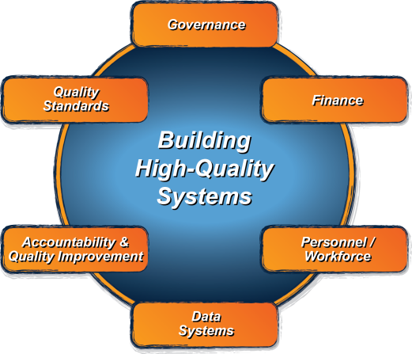
ECTA System Framework
What does a state need to put into place in order to encourage, support, require local implementation of effective practices?
ectacenter.org/sysframe

Slide 3
Quality Standard Component: Purpose
…to guide Part C and Section 619 coordinators, staff, and leadership in an ongoing process of evaluating the quality of their programs and services within the context of the larger early care and education community, in order to identify areas for improvement.

Slide 4
Two Subcomponents
Child Level Standards
Program Level Standards

Slide 5
Child Level Standards
QS1: The state has articulated what children under age five, including children with disabilities, are expected to know and do. (12 elements)
QS2: The child level standards are used to support the implementation of high-quality practices. (3 elements)
QS3: The state has an infrastructure in place to support the effective use of child level standards. (5 elements)

Slide 6
Program Level Standards
QS4: The state has articulated what constitutes quality in early care and education programs. (9 elements)
QS5: The state has articulated expectations for what constitutes high quality early intervention and preschool special education services (EI/ECSE). (9 elements)
QS6: The state has an infrastructure in place to support the full range of programs in meeting program standards. (7 elements)

Slide 7
How to Address Children with Disabilities
State’s child level standards need to reflect the unique characteristics of young children with disabilities.
State’s program level standards need to address the unique features of program serving young children with disabilities.
Federal and state legal requirements
Consistent with professional practice guidelines (e.g., DEC Recommended Practices, ASHA Practice Policies)
Coordinated and consistent with other early care and education programs across the state

