Slide 1
Universal Online
Part C Early Intervention Curriculum
DaSY - September 2014 - New Orleans
Sarah Nichols, Lynda Pletcher, & Naomi Younggren

Slide 2
Who’s here?
What’s the curriculum?
Why it’s being developed?
How is it being developed?
When it’s ready & where it is?
2

Slide 3
Whoo’s here?
How do you use online training?
3

Slide 4
What is the Curriculum?
Self-paced & adaptable online modules
Facilitators Guide
Supplemental Resources
Free for universal use

Slide 5
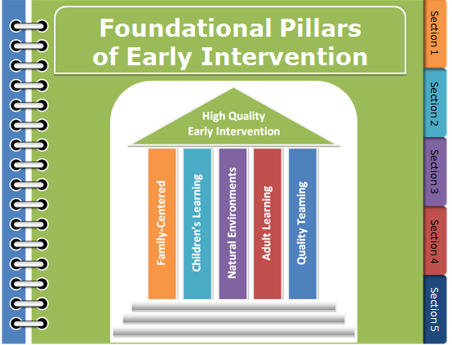
What are the modules?
Mission and Key Principles of Early Intervention
Foundational Pillars of Early Intervention

Slide 6
Mission & Key Principles Preview

Slide 7
Foundational Pillars Preview

Slide 8
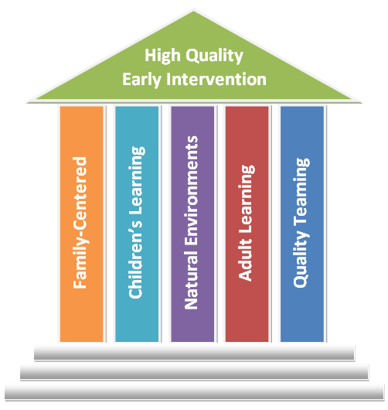
Foundational Pillars of Early Intervention
8

Slide 9
Why?
Pool Resources
Reduce Redundancy
Key Principles & Practices
Evidence-Based Foundations
State Systematic Improvement Plan
Improve Child and Family Outcomes
9

Slide 10
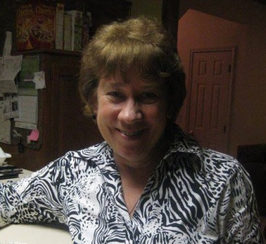
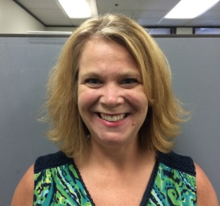
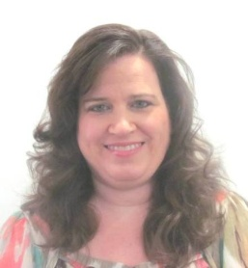
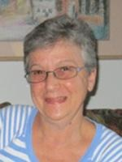
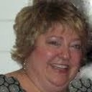
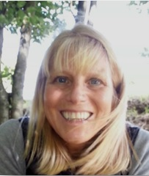
How?
Fran Dayal
Rachel Moyer-Trimyer
Carol Ann Schumann
Sarah Nichols
Lynda Pletcher
Cori Hill
Naomi Younggren
10

Slide 11
How?
Survey to identify topics
Review available resources
11

Slide 12
How?
Explore ways to share the curriculum
12

Slide 13
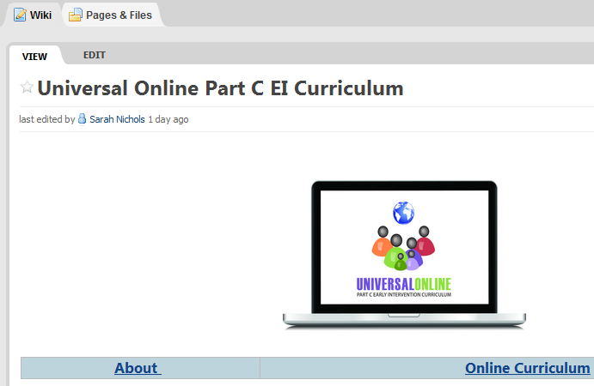
Where and When?
13

Slide 14
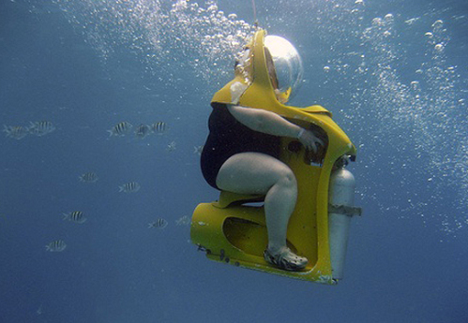
Looking deeper
guided exploration
14

Slide 15
How might we use this?
What else is needed?
How can I be involved?
15

Slide 16
snichols@illinoiseitraining.org lynda.pletcher@unc.edu naomi.younggren@gmail.com

