Slide 1
Tools states can use for building effective early intervention and preschool special education systems
Improving Data, Improving Outcomes Conference
September, 2014
Lori Connors-Tadros, CEELO
Terry Harrison, NJ Part C
Christina Kasprzak, ECTA
Jana Martella, CEELO
Ann Reale, ICF International

Slide 2
What we’ll cover:
Review of two tools for supporting system improvement
Sharing the perspective and experience of New Jersey
Discussion of system issues and how the tools might support your work

Slide 3
Getting Started
What are some of the system challenges/ questions that you are trying to address in your state?
Are you familiar with either of the two tools?
ECTA System Framework
Comprehensive Early Childhood System Building: A Tool to Inform Discussions on Collaborative, Cross-Sector Planning

Slide 4
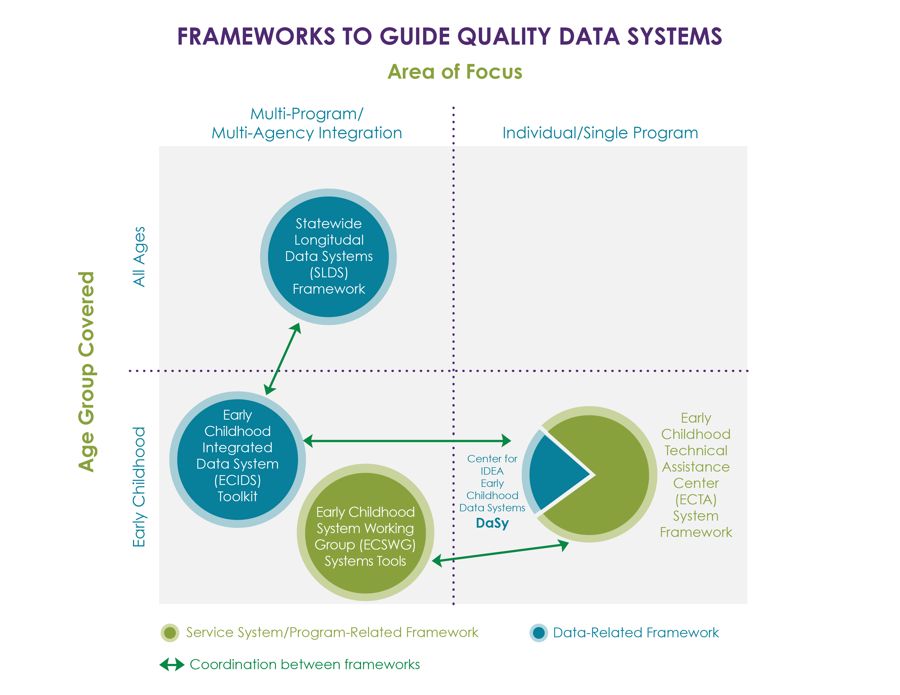
Draft

Slide 5
Comparing Components
ECTA Framework Elements | COMMON THEMES | ECSWG System Tool Strategies
Governance | Leadership Finance Use of data Accountability Program Improvement Standards Stakeholder Engagement | Define and Coordinate Leadership
Finance |  | Finance Strategically
Data Systems |  | Create and Support Improvement Strategies
Accountability and Quality Improvement |  | Ensure Accountability
Quality Standards |  | Align Standards
Personnel/Workforce |  | Recruit and Engage Stakeholders
Notes:
Christina- I incorporated the words on the prior slide, and thought we could call those “Common Themes”, but then noticed you’re using that language in slide 9 for the ECTA tool. Thinking we might want to wordsmith one or the other to avoid confusion?

Slide 6
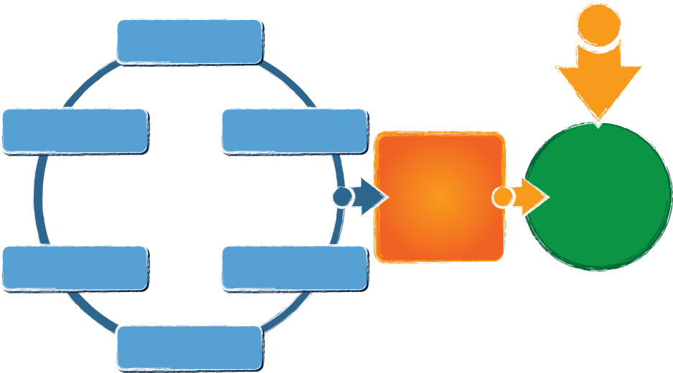
ECTA Center System Framework
What does a state need to put into place in order to encourage, support, require local implementation of effective practices?
Governance
Finance
Personnel / Workforce
Data Systems
Accountability & Quality Improvement
Quality Standards
Result:
Implementation of effective practices
Good outcomes for children with disabilities and their families
Available from: http://ectacenter.org/sysframe
Notes:
What does a state need to put into place in order to encourage, support, require local implementation of effective practices?
Governance
Quality Standards
Finance
Accountability & Quality Improvement
Personnel/Workforce
Data Systems
(leading to)
Implementation of effective practices
(leading to)
Result: Good Outcomes for children with disabilities and their families

Slide 7
System Framework: Purpose and Audience
Purpose: to guide states in evaluating their current Part C/619 system, identifying areas for improvement, and providing direction on how to develop a more effective, efficient Part C and Section 619 system that requires, supports, and encourages implementation of effective practices.
Audience: the key audience is state Part C and state Section 619 coordinators and staff, with acknowledgement that other key staff and leadership in a state will need to be involved.

Slide 8
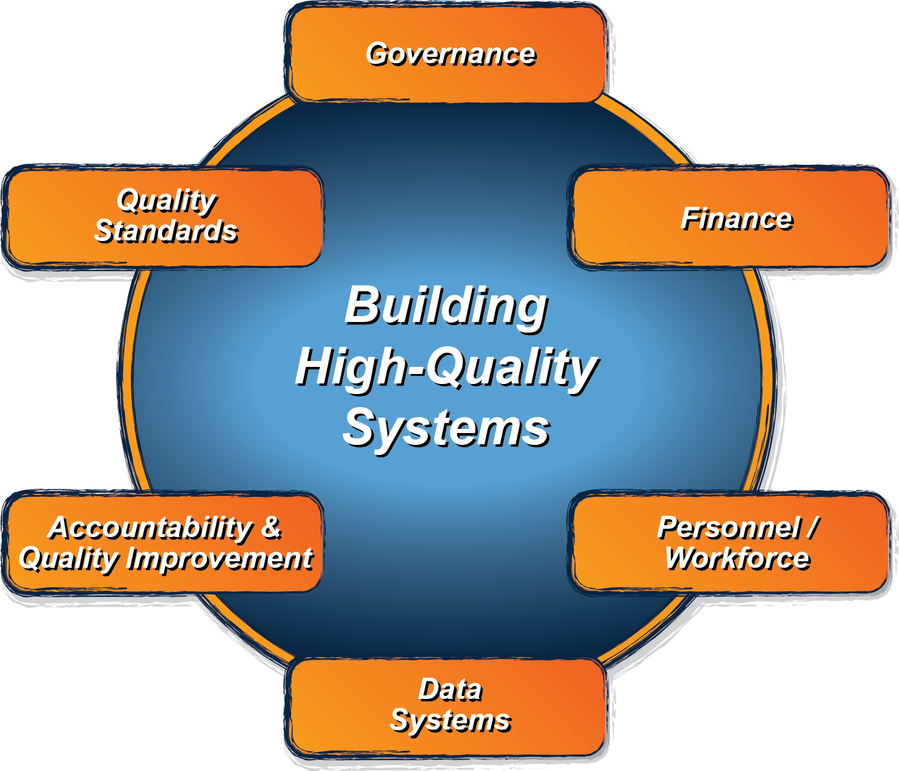
Cross cutting themes
Engaging stakeholders, including families
Establishing/revising policies
Promoting collaboration
Using data for improvement
Communicating effectively
Family Leadership & Support
Coordinating/Integrating across early childhood

Slide 9
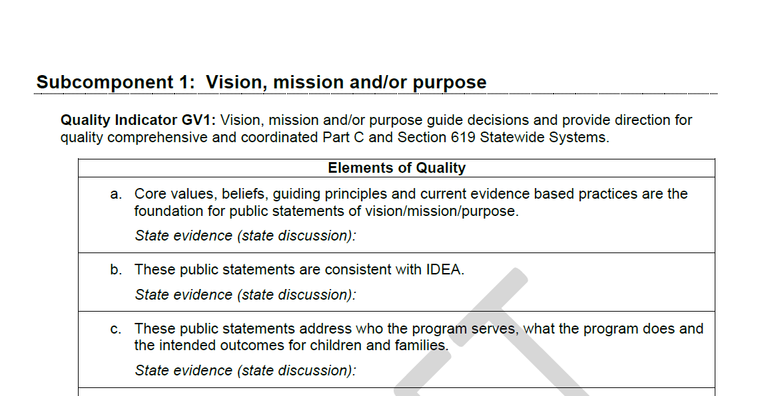
Framework Structure
Framework
Subcomponents
Quality Indicators
Elements of Quality
Self-assessment (coming soon!):
Scale for assessing quality indicators
Place for state evidence

Slide 10
Look for updates about the System Framework via the ECTA web site: http://ectacenter.org/sysframe

Slide 11
What is the Early Childhood Systems Working Group (ECSWG)?
A peer learning community made up of organizations and individuals who provide technical assistance to state leaders
Since 2006, the ECSWG has been meeting on an ad hoc, volunteer basis to discuss TA needs and develop resources for states.
Notes:
SUSAN
The Early Childhood Systems Working Group is comprised of national experts who provide resources and technical assistance to state leaders who are building and implementing EC systems.
The group originally came together in 2006 and have continued to convene, voluntarily, as needed.
A list on the next slide shows you the depth and breadth of the members. . .

Slide 12
What Results Should a Comprehensive Early Childhood System Deliver?
Comprehensive services that promote children’s physical, developmental, and mental health
Nurturing relationships, safe environments, and enriching experiences that foster learning and development
Early Learning and Development
Resources, experiences, and relationships that strengthen families, engage them as leaders, and enhance their capacity to support children’s well being
Outcome:
Thriving
Children
and Families
Family Leadership and Support
Health
Values and Principles of a comprehensive early childhood system:
Reach all children and families, as early as possible, with needed services and supports
Genuinely include and effectively accommodate children with special needs
Reflect and respect the strengths, needs, values, languages, cultures and communities of children and families
Ensure stability and continuity of services along a continuum from prenatal into school entry and beyond
Ease access for families and transitions for children
Value parents as decision makers and leaders
Catalyze and maximize investment and foster innovation
Notes:
ANN
These are positioned across the bottom to show that they are the foundation of the ovals, and while what’s in the ovals may change or shift from one to another, the principles remain the same. Let’s take a closer look very quickly…

Slide 13
Guiding Values and Principles of a Comprehensive Early Childhood System
Reach all children and families, as early as possible, with needed services and supports
Genuinely include and effectively accommodate children with special needs
Reflect and respect the strengths, needs, values, languages, cultures and communities of children and families
Ensure stability and continuity of services along a continuum from prenatal into school entry and beyond
Ease access for families and transitions for children
Value parents as decision makers and leaders
Catalyze and maximize investment and foster innovation
Notes:
ANN
You’ll see a theme across all of these- about reaching and including all families and children, and empowering families to make good decisions.
So now you’ve seen the three ovals, and the seven guiding principles that underlie and support them.
But the ECSWG also spent a lot of time thinking about HOW those three systems can connect. From our work with state leaders, and our understanding of case studies and research on system change, we came up with a set of six strategies that help bring those three ovals closer together, and help the people who work in those three systems use these principles in actionable ways to guide their work, their policy decisions, their interactions with families. These six strategies also form the framework of the tool we’d like to walk through with you today.
13

Slide 14
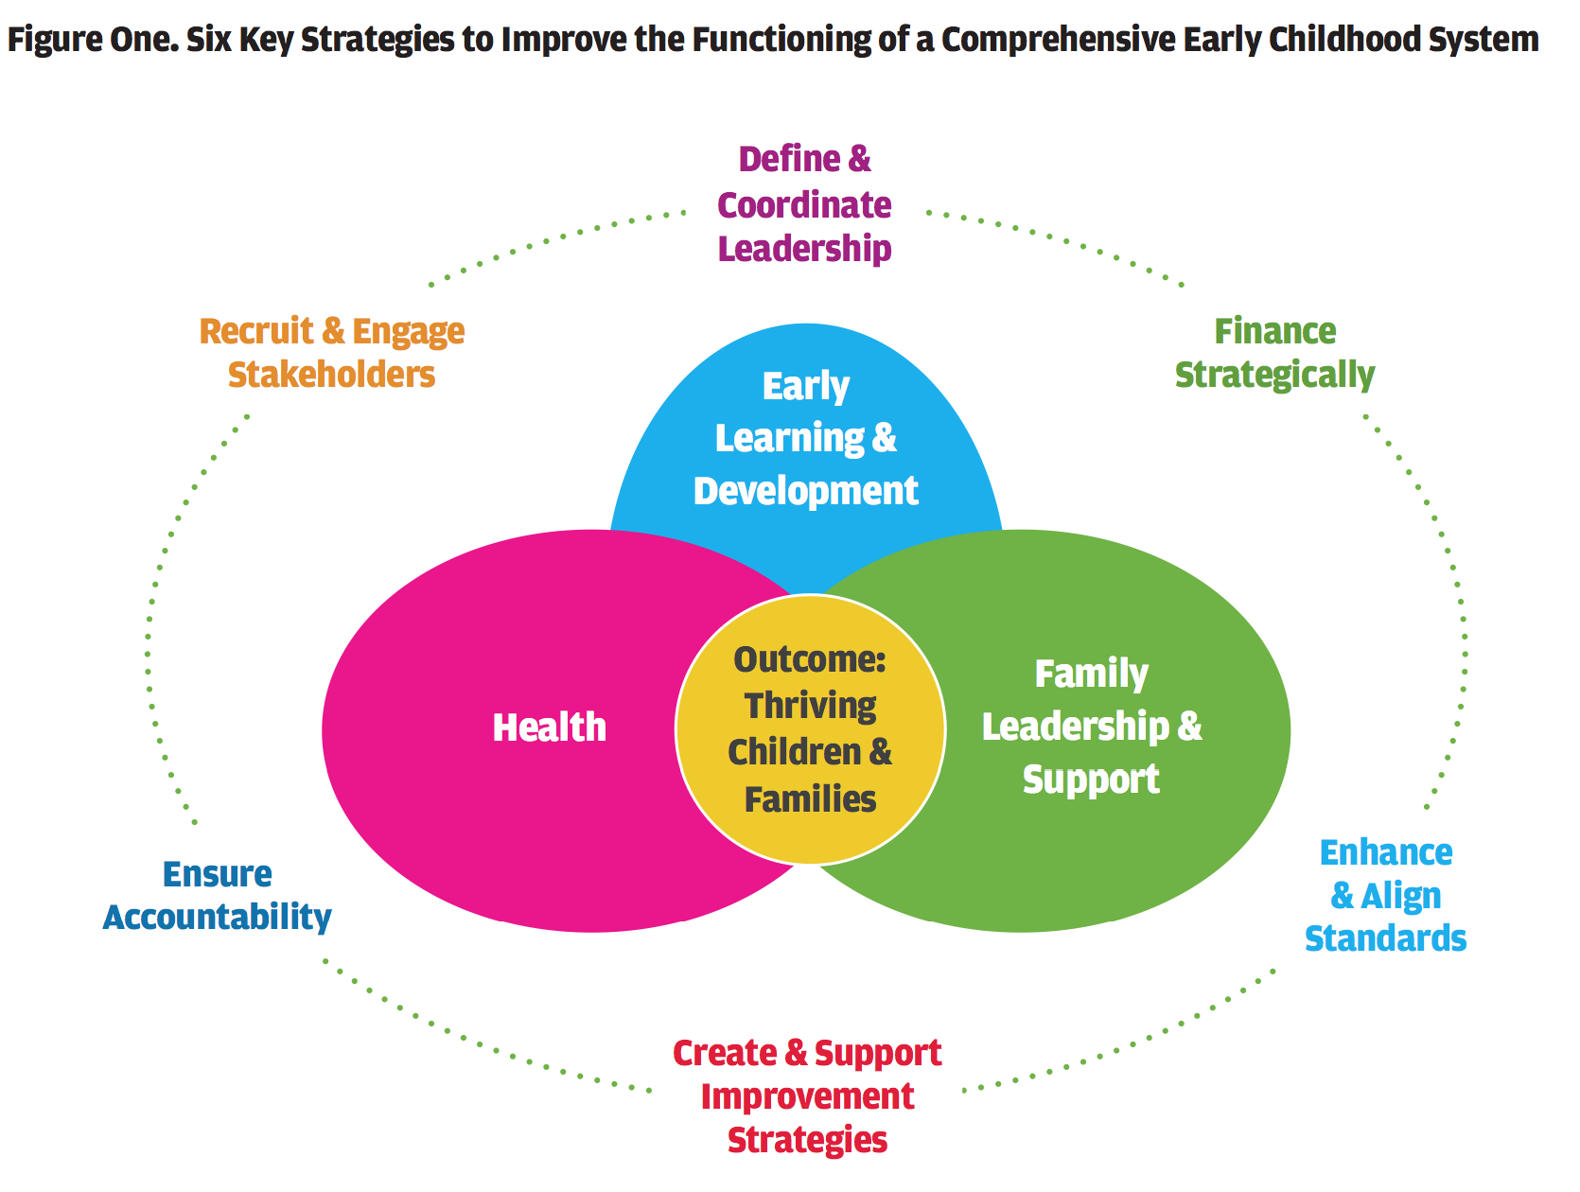
Notes:
Early Childhood Systems Working Group
14
ANN
Any collaborative effort is only as strong as the commitment and trust among its stakeholders. The more those stakeholders can communicate the importance of the effort with one voice, the louder and more significant the message becomes. In this case, the message is not only that investment in young children is critical, but that acting together to build a comprehensive system is critical to support, build and sustain that investment.
Use strategic communication to increase understanding of requirements and benefits of a comprehensive early childhood system.
Build a broad constituency to support investment in a comprehensive early childhood system.
Partner with families as leaders in building a comprehensive early childhood system.
And now it’s my pleasure to introduce Billie Young who will walk through the new tool that provides a way for state to think more deeply about what each of these strategies mean in “real life”, in the day-to-day work that you’re doing in your states or your TA activities.

Slide 15
To access the tool: http://www.buildinitiative.org/Portals/0/Uploads/Documents/ECSWG%20Systems%20Planning%20Tool_2014.pdf

Slide 16
The ECSWG System Tool: What it is and is not
It is:
A set of strategy considerations to improve “systems thinking” in decision-making.
A tool for facilitators to use with groups of cross-sector early childhood stakeholders.
It is not:
An assessment tool.
A tool to be used all at once in its entirety.

Slide 17
Notes:
BILLIE—each of the six strategy pages present you with some key considerations. So let’s start with “define and coordinate leadership”. Here are two sample considerations: (read them). Altogether, there are 8 and you may develop even more as you work with state teams. So tell us how your state or the state you are working with uses cross-sector data. Remember, cross sector means including health, early learning and development and family leadership and support. Let’s find out (POLL)
A. Identify cross sector leadership (sectors of health, early learning and development, and family leadership and
support), with clear authority to modify existing cross sector relationships, establish priorities, leverage fi scal and
human resources, and implement system change.
B. Ensure that cross sector leadership is inclusive and representative of families participating in the early
childhood system; providers, administrators, and other professionals within delivery system partners (sectors of
health, early learning and development, and family leadership and support); policymakers; and private stakeholders
(business, civic, faith-based, and philanthropic communities).
C. Set vision, mission, and principles or group norms for how the system sectors work together.
D. Set outcomes and benchmarks across sectors for what the comprehensive early childhood system delivers.
E. Establish processes for ongoing communication, coordination, and decision-making among governance
structures and across system sectors as they relate to achieving shared goals.
F. Identify or build organizational structures, rules, or policies that can be a foundation for ongoing collaboration
and coordination across sectors.
G. Promote development of individual and collective skills that facilitate collaboration and coordinated crosssector
early childhood leadership sector leadership.
H. Use cross-sector data to inform planning and policy decisions.

Slide 19
New Jersey Early Intervention System

Slide 20
NJEIS Use of ECTA System Framework
Providing a framework for a State Interagency Coordinating Council (SICC) Service Delivery Committee working on recommendations to the lead agency for the development of a competitive Early Intervention Program Request for Applications (RFA).
Guiding the lead agency in work with stakeholders to complete infrastructure analysis for the State Systemic Improvement Plan (SSIP)
Supporting the NJ Interdepartmental work across early childhood with the:
NJ Council for Young Children
Race To The Top-Early Learning Challenge Grant
Interdepartmental Planning Group

Slide 21
Comprehensive Early Childhood System Building: A Tool to Inform Discussions on Collaborative, Cross-Sector Planning
This tool provides the core values, principles and key strategies that are useful in guiding the work of the NJCYC, RTTT-ELC Grant and Interdepartmental Planning Group in building a NJ Comprehensive Early Childhood System.

Slide 22
SICC Service Delivery Committee
Six months of monthly meetings generated relevant discussions without significant progress in establishing recommendations for the RFA.
The committee decided that the foundation for a decision making process to restructure the EIPs lied in identifying the competencies that needed to be established to become an EIP provider agencies in the NJEIS.

Slide 23
SICC –Commits to Framework
The System Framework Partnership was presented to the committee early in 2014 and while recognizing that the ECTA framework had a different purpose, the committee “firmly believes that there is value in aligning with the categories in restructuring the way services are delivered (with regards to providers) in the State of NJ”.
The committee began their review with the Finance Component, Subcomponents, Indicators and Elements of Quality which were adjusted to reflect the competencies recommended to be required of a NJEIS service provider.

Slide 24
Finance – Fiscal Data Example
Quality Indicators
State and Regional and or local structures have access to fiscal data for their program planning, budget development and required reporting
State and Regional and or local structures use fiscal data to manage the budget.
Committee recommendation combined into:
NJEIS agencies will use fiscal data for their program planning, budget development and required reporting.

Slide 25
ECTA System Framework
Provided a focus and design to move the committee forward in a constructive and effective direction.
Review has been completed for Governance, Finance, Accountability and Quality Improvement and Personnel/Workforce.
A next step is to propose suggested evidence for each of the elements of quality that would be used in RFA review/scoring.

Slide 26
Small Group Discussions:
What system questions are addressing in your state?
What successful processes have you used to address critical system questions in the past?
(Please record your small group ideas to share back at the end)

Slide 27
Thank you!
If you have questions, please contact us!
Lori Connors-Tadros, CEELO ltadros@nieer.org
Terry Harrison, NJ Part C Terry.Harrison@doh.state.nj.us
Christina Kasprzak, ECTA Christina.Kasprzak@unc.edu
Jana Martella, CEELO
jmartella@edc.org
Ann Reale, ICF International
ann.reale@icfi.com

