Slide 1
All sections to appear here
The box on the right designates where all your slides will appear.
Feel free to move or resize the box.

Slide 2
Developing Quality 619 Practices
Robin McWilliam
robin.mcwilliam@siskin.org

Slide 3
Implementing Quality 619 Practices

Slide 4
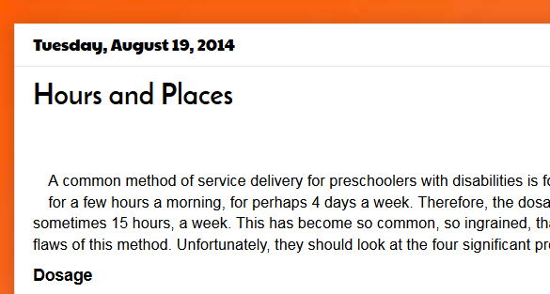
naturalenvironments.blogspot.com

Slide 5
Quality and the Model
pptPlex Section Divider
The slides after this divider will be grouped into a section and given the label you type above. Feel free to move this slide to any position in the deck.

Slide 6
Quality Issues
Working with families
Functional needs assessment and goals
Focus on engagement, independence, & social relationships
Amount and quality of instruction
Dosage of special-ed-supported classroom time
Capacity of classroom teacher to address IEP goals +
Integration of ECSE and therapies with classroom routines (consultation skills)
Classroom management (role of itinerant?)
Quality of inservice training

Slide 7
Routines-Based Model Components (AKA Engagement Classroom Model)
Ecomap
RBI
Participation-based goals
Incidental teaching
Integrated services
Zone defense schedule
Sit and Watch
Collaborative consultation
Checklist-based training

Slide 8
Which components address which quality issues?
Quality Issues | Routines-Based Model Components
1. Working with families | Ecomap
2. Functional needs asst/goals | RBI
3. Focus on EISR | Participation-based goals
4. Instruction | Incidental teaching
5. Dosage | Integrated services
6. Classroom teacher’s capacity | Zone defense schedule
7. Integrated services | Sit and Watch
8. Classroom management | Collaborative consultation
9. Quality of training | Checklist-based training

Slide 9
Match of Quality to RBM Components
Quality Issues | Routines-Based Model Components | Match with Quality Issues
1. Working with families | Ecomap | 1
2. Functional needs asst/goals | RBI | 1, 2, 3
3. Focus on EISR | Participation-based goals | 2
4. Instruction | Incidental teaching | 4
5. Dosage | Integrated services | 6, 7
6. Classroom teacher’s capacity | Zone defense schedule | 8
7. Integrated services | Sit and Watch | 8
8. Classroom management | Collaborative consultation | 6, 7 (5)
9. Quality of training | Checklist-based training | 1, 2, 3, 4, 7, 8

Slide 10
Importance of being able to succeed with special-ed-supported classrooms
Assume special ed is effective
Classrooms supported by special ed are effective
Children engaged, independent, good social relationships
Inclusion: Ability to pass on strategies to regular teachers
Collaborative consultation
No
ECSEs and therapists
Only effective when delivered out of context?

Slide 11
Outcomes
pptPlex Section Divider
The slides after this divider will be grouped into a section and given the label you type above. Feel free to move this slide to any position in the deck.

Slide 12
What are we trying to do?
Provide classroom experiences?
Comply with IDEA?
Promote optimal functioning in life—and preparation for future functioning, including learning?

Slide 13
Engagement
A measurable construct
Precise: Measure amount of time engaged at various levels—difficult
Imprecise but reliable: Rate child’s engagement in routines
Overall
With adults
With peers
With materials
Sophistication level
STARE

Slide 14
Mastery of Engagement, Independence, and Social Relationships in the Classroom
ClaMEISR
Now crosswalked with federal outcomes (Naomi and ECTA/DaSy colleagues)
Discussed in session tomorrow
Available for field testing in 1 month. robin.mcwilliam@siskin.org

Slide 15
Implementation Planning
pptPlex Section Divider
The slides after this divider will be grouped into a section and given the label you type above. Feel free to move this slide to any position in the deck.

Slide 16
McWilliam Process for Implementation Planning
Decision maker becomes familiar with model
Helps stakeholders become familiar with model (presentation, meeting, reading)
Robin facilitates meeting to review model and find out quality issues in the state (or other entity)
Match model to quality needs (noting which needs not met)
Select model components state would like to implement

Slide 17
Process (cont.)
Add other initiatives state plans to undertake
Establish timelines for each component and other initiatives
Define implementation goal: full, partial?
Dotted line to prepare, solid line to implement, full-implementation deadline, dotted line for maintenance
Write action plan for each component: Use Implementation Stage grid to address “drivers”

Slide 18
Goal – Early intervention in Maine will be engaged in these best practices by winter 2018 5 Year Time-line
R-BEI Best Practice Implementation Plan
 | August 2013 | August 2014 | August 2015 | August 2016 | August 2017 | August 2018
Ecomap & R-BI |  | X
Goal writing |  |  |  | X
Consultative Home Visits |  |  |  |  | X
Consultative Center visits ↕ Integrated therapy (ZDS) |  |  | X |  | X
Incidental teaching |  |  | X |  | X
Natural environments |  | X
Program Evaluation |  |  |  | X |  | X
Check points along the way

Slide 19
Nebraska

Slide 20
Goal – Early intervention in Aotearoa will be engaged in these best practices by July 2018 5 Year Time-line
R-BEI Best Practice Implementation Plan
Implementation | Now | July 2014 | July 2015 | July 2016 | July 2017 | July 2018
Ecomap & Cultural profile
RBI
Functional participation based goal writing
Keyworker (PSP) |  | Piloting model | Model developed
Support based home visits
Collaborative consultation & ECE engagement model/coaching
Incidental teaching (responsive teaching)
Natural environments
Evaluation FINESSEII (adapted) Case Studies STARE data
Check points along the way

Slide 21
Bottom Line
Until we commit to high-quality itinerant services, we won’t have successful inclusion
Either increase dosage of special-ed-supported classroom time or work with families and other caregivers
Work with families anyway, if you want to be effective
Increase the amount of instruction children receive
Some classrooms need help in organization, before anything else can happen
Rooms and homes need an effective default consequation strategy
Our people need effective training: checklist-based feedback
If you measure functioning (EISR), you’ll have good info for outcome summaries

Slide 22
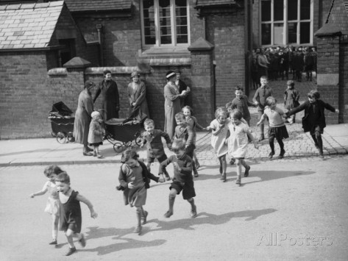
How to Make This Impossible List Possible
Implementation plan
Ways I can support states:
Visit and work with you (+ 2 & 3)
Consult with you from afar (+ 3)
Materials

