Slide 1
State Part C Considerations for Using Outcome Data in Local Determinations
Improving Data, Improving Outcomes Conference
New Orleans
September 8-10, 2014

Slide 2
Presenters
Lisa Backer, MN Part C Data Manager, ECSE Supervisor
Christine Robin Payne, RI Part C Data Manager
Beth Tolley, VA Part C Team Leader
Christy Scott, CO Part C Data Manager
Sharon Walsh, ECTA and DaSY

Slide 3
Public Reporting
§303.702 State use of targets and reporting.
(b)(1)(A) Report annually to the public on the performance of each EIS program located in the State on the targets in the State’s performance plan as soon as practicable but no later than 120 days following the State’s submission of its annual performance report to the Secretary…

Slide 4
Local Determinations
States must make local determinations annually about the performance of each EIS program using the same categories as the federal determinations (34 CFR 303.700(a)(2):
Meets Requirements
Needs Assistance
Needs Intervention
Needs Substantial Intervention

Slide 5
Criteria for Determinations
States must consider…
Performance on compliance indicators;
Whether data submitted by EIS programs are valid, reliable, and timely;
Uncorrected noncompliance from other sources; and
Any audit findings.
In addition, States could also consider…
Performance on performance indicators; and
Other information.

Slide 6
Let’s Discuss
What indicators do you use for determinations?
Have you changed in last several years? Are you considering changing soon?
What are possible opportunities to using child or family outcomes in local determinations?
What are issues/concerns to using child or family outcomes in local determinations?

Slide 7
Virginia State Structure
Lead Agency: Department of Behavioral Health and Developmental Disabilities
40 Local Systems
Local Lead agencies include Community Service Boards, Universities, Local School Systems, Cities, Health Departments
Annual Child count ranges from 64 to 2,220
Catchment areas range from 1 county or city to 10 cities/counties

Slide 8
Virginia Current Determinations
Include service settings, family outcomes and child count
Child outcomes results are included in the report, but not in the calculations
The results indicators are scored together to receive the same possible rating as one compliance indicator

Slide 9
Section 4: SPP/APR Results Indicators
Indicator | State Target | Local Result | % of State Target | Prior Year % of State Target | Score
02: Primary Service Setting
03A: Positive Social-Emotional Skills (Summary 1)
03A: Positive Social-Emotional Skills (Summary 2)
03B: Acquire/Use Knowledge/Skills (Summary 1)
03B: Acquire/Use Knowledge/Skills (Summary 2)
03C: Take Actions to Meet Needs (Summary 1)
03C: Take Actions to Meet Needs (Summary 2)
04A: Family Outcomes (Know their rights)
04B: Family Outcomes (Communicate needs)
04C: Family Outcomes (Help child learn)
05: Child Find 0-1
06: Child Find 0-3
Section 4 displays SPP/APR results indicators for FFY13/SFY14 as collected. Indicators 02, 05 and 06 are reported on copy 1/2; indicators 03 and 04 will be reported on copy 2/2. Section 4 will be scored on copy 2/2. Scoring is based on combined performance; maximum possible points = 2 4 + or more (other 2 any combination) = 0 points 4 - or more (other 2 any combination) = 2 points All other combinations = 1 point + = Met or exceeded state target p = Progress (defined as local result w/in 90%-99% state target or 10-point increase in % of state target from prior year result – = Does not meet state target and progress not being made (as defined above)

Slide 10
Virginia Scoring Results Indicators
Scoring is based on combined performance; maximum possible points = 2
+ = Met or exceeded state target
p = Progress (defined as local result w/in 90%-99% state target or
10-point increase in % of state target from prior year result
– = Does not meet state target and progress not being made
0 points = 4 + or more (other 2 any combination)
2 points = 4 - or more (other 2 any combination)
1 point = All other combinations
NOTE: Points are scored when requirements/targets are not met. 0 is the best score.

Slide 11
Section 4: SPP/APR Results Indicators
Indicator | State Target | Local Result | % of State Target | Prior Year % of State Target | Score
02: Primary Service Setting | 98.0% | 99.3% | 101% | 101% | +
03A: Positive Social-Emotional Skills (Summary 1) | 73.6% | 76.9% | 104.5%
03A: Positive Social-Emotional Skills (Summary 2) | 69.7% | 72.3% | 103.7%
03B: Acquire/Use Knowledge/Skills (Summary 1) | 78.5% | 83.5% | 106.4%
03B: Acquire/Use Knowledge/Skills (Summary 2) | 60.9% | 48.5% | 79.6%
03C: Take Actions to Meet Needs (Summary 1) | 81.4% | 84.9% | 104.3%
03C: Take Actions to Meet Needs (Summary 2) | 59.9% | 42.6% | 71.1%
04A: Family Outcomes (Know their rights) | 76.4% | 73.8% | 97% | 120% | p
04B: Family Outcomes (Communicate needs) | 73.2% | 70.8% | 97% | 125% | p
04C: Family Outcomes (Help child learn) | 84.9% | 81.5% | 96% | 106% | p
05: Child Find 0-1 | 1.03% | 0.97% | 94% | 116% | p
06: Child Find 0-3 | 2.88% | 2.39% | 83% | 102% | -
Section 4 displays SPP/APR results indicators for FFY13/SFY14 as collected. Indicators 02, 05 and 06 are reported on copy 1/2; indicators 03 and 04 will be reported on copy 2/2. Section 4 will be scored on copy 2/2. Scoring is based on combined performance; maximum possible points = 2 4 + or more (other 2 any combination) = 0 points 4 - or more (other 2 any combination) = 2 points All other combinations = 1 point + = Met or exceeded state target p = Progress (defined as local result w/in 90%-99% state target or 10-point increase in % of state target from prior year result – = Does not meet state target and progress not being made (as defined above) |  |  |  |  | 1
Notes:
Example
11

Slide 12
Section 7: Local EIS Determination Tabulation Table
Section | Possible Points | Score
Section 1: SPP/APR Compliance Indicators | 10
Section 2: “Out-of-Cycle” Compliance Indicator Findings and/or Other Noncompliance | 2
Section 3: Timely Correction of Noncompliance | 2
Section 4: SPP/APR Results Indicators | 2
Section 5: Fiscal Monitoring | 2
Section 6: Data Quality | 2
Local EIS 2014 TOTAL Points
Local EIS FFY13/SFY14 Determination % [ = (20 - Local EIS Total Points) / 20]
Local EIS Lowest Compliance Indicator %
Local EIS FFY13/SFY14 Determination Category
Enforcements Required

Slide 13
Determination Categories
Meets Requirements (MR) | Determination % = 90%-100% AND no compliance indicator < 85% AND all noncompliance identified in Section 3 corrected
Needs Assistance (NA) | Determination % = 61%-89% OR Determination % = 90%-99% with a compliance indicator < 85% AND/OR noncompliance identified in Section 3 not corrected
Needs Intervention (NI) | Determination % = 50%-60%
Needs Substantial Intervention (NSI) | Determination % < 50%

Slide 14
Virginia - What has changed?
Initially, all results indicators, except child outcomes were included and were weighted equally to each other and to the compliance indicators
Based on stakeholder input
Child outcomes were not available initially
Weighting of results indicators was changed several years ago
To be more in alignment with OSEP ratings
Because systems that were consistently meeting compliance indicators were being adversely affected by the results indicators (mostly child find) that were not meeting state determined targets
Notes:
Virginia has always felt that the results indicators were as important as the compliance indicators and we wanted our determinations to reflect that.
14

Slide 15
Virginia Possible Changes/Cautions
Focus on results indicators has had both positive and negative consequences
Positive: improvements in processes leading to improved results
Negative: more focus on getting better scores than on the reasons for the scores
Considering how child outcome results can be included without shifting the current positive focus on improved processes and services to one where the ratings are skewed in order to get better scores
Notes:
Virginia has always felt that the results indicators were as important as the compliance indicators and we wanted our determinations to reflect that.
15

Slide 16
Virginia - Relationship of Determinations to SSIP
Benefits of SSIP work
System Managers are paying more attention to the child outcomes
System Managers and practitioners are engaged and committed to improving quality of the outcome data including rating accuracy, interrater reliability, data completeness
Concerns raised
Fear that local variability in populations/diagnoses won’t be accounted for in expectations and scoring
Continuing concerns about consistency of child outcome ratings across local systems

Slide 17
Beth Tolley
Early Intervention Team Leader
Infant & Toddler Connection of Virginia
Department of Behavioral Health and
Developmental Services
beth.tolley@dbhds.virginia.gov
804-371-6595

Slide 18
Rhode Island - Focused Monitoring
Annual Program Self-Assessments
Federal Indicators
Targeted Performance Improvement
Annual Desk Audit
Site Visits to Verify Self-Assessments
Self-Assessment Verified or Findings Identified
Corrective Action Plan for Identified Findings
Findings Closed
Rhode Island Executive Office of Health and Human Services

Slide 19
Rhode Island Early Intervention Determinations
Determination
Criteria (1) (2)
Enforcement
Meets
Compliance on all compliance indicators
and/or significant
TA will be provided up on request and a
Requirements
improvement on all compliance indicators that were not in
letter of recogn
ition will be sent to
substantial compliance. Data is considered timely, reliable, and
provider.
valid. Findings of non
-
compliance are corrected timely.
Needs
One or two indicators did not meet compliance and/or significant
TA will be offered and encouraged to
Assistance
improvement not demonstrated on all compliance indicators that
address areas in need of assistance
did not meet substantial compliance. Data is considered timely,
reliable, and
valid. Findings of non
-
compliance are corrected
timely.
Needs
2
nd
year of needs assistance
TA will be offered and encouraged to
Assistance (2)
address areas in need of assistance.
Submit a report to OHHS indicating use of
TA.
Needs
Three or more indicators did not meet compliance and/or
TA will be required to address areas in
Intervention
significant improvement not demonstrated on some compliance
need of intervention. Submit a report to
indicators. Data may not be considered timely, reliable, and
OHHS indicating use of TA.
valid. Fin
dings of non
-
compliance may not be corrected timely.
Programs that would fall in NA for the third year will be placed
in this category
Needs
2
nd
year of needs intervention
TA will be required to address areas in
Interv
ention (2)
need of intervention
Needs
3
rd
year of needs intervention
Program will be required to adhere to
Intervention (3)
compliance agreement in order to correct
the identified are
a(s) in need of
intervention
Needs
Compliance not met for any compliance indicator and significant
Funds to provider will be withheld in
Substantial
improvement not demonstrated on any compliance indicator
whole or part.
Intervention
and/or provider unwilling to comply. Data may not be considered
timely, r
eliable, and valid. Findings of non
-
compliance may not
be corrected timely. Programs that would fall in NI for the fourth
year will be placed in this category.
Rhode Island Executive Office of Health and Human Services

Slide 20
Rhode Island - Using Outcome Data
RI Local Determination process allows child and family outcomes to be considered as factor in local determination
Current focus has been on technical assistance for child outcomes
Review may result in a provider Improvement Plan (PIP)
Family Outcomes are on target and not a concern
No connection has been discovered between family and child outcomes
State staff reviews child outcome statewide and by provider
Outliers receive further review
Longitudinal comparisons made
Process in place for review of Child and Family Outcomes data
TA ongoing to support data improvement
Small geographic area allows on-site TA for providers without built in capacity
Rhode Island Executive Office of Health and Human Services

Slide 21
Using Outcome Data
Providers population vary from small to large. All providers have assess to their outcome data quarterly but may not have resources to review in detail
Demographic for each provider may change year to year.
Age of referrals
Eligibility category
Insurance numbers
Characteristics of the providers population large % of private insurance greater progress…% of I, 6 months at referral= less progress; longer length of enrollment = less progress;
Change in demographic of a provider’s referral may be a valid reason for child outcomes
Numbers are not always a clear indication or progress or regression.
Rhode Island Executive Office of Health and Human Services

Slide 22
State Systemic Improvement Plan Team
Brenda Duhamel, Part C Coordinator
Leslie Bobrowski, Technical Assistance (CSPD) Casey Ferrara, Provider
Deborah Masland, Rhode Island Parent Information Network
Donna Novak, Quality Assurance
Christine Robin-Payne, Data Manager
Maureen Whelan, Technical Assistance (CSPD)
Rhode Island Executive Office of Health and Human Services
www.eohhs.ri.gov
US Department of Education Grant Award H181A110101

Slide 23
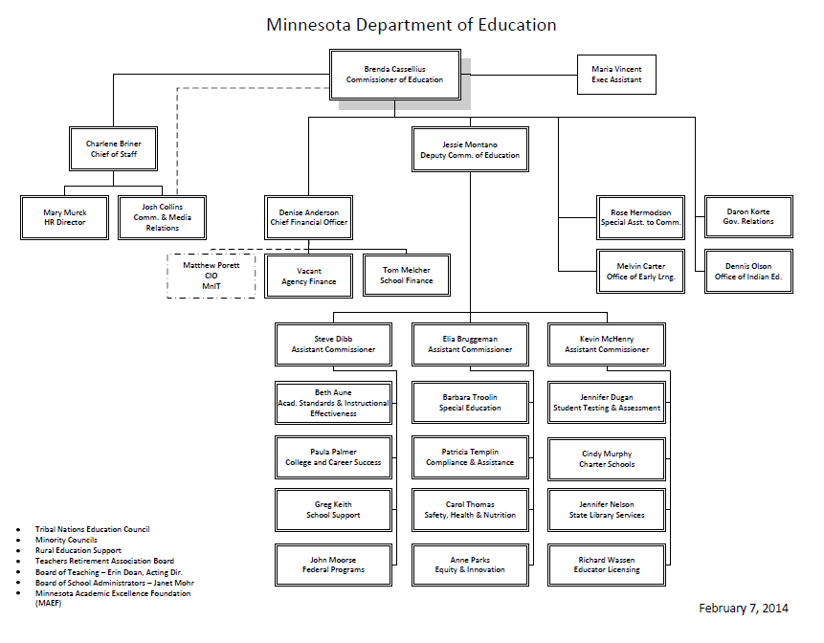

Slide 24
Minnesota - Factors in Part C Determinations
Compliance Indicators
Each program has current data two years in a five year cycle
Fiscal Findings
Timely and accurate data submission
No change over time in Determinations process
State leaders have not yet discussed including results indicators in Determinations Process

Slide 25
Colorado Local Status Determinations
Structure
20 local early intervention programs
Categorized as large; medium; small; extra small, dependent upon the expected number of children served based on state target
Smallest program serves average per month (AME) 7 children which makes small “n” sizes challenging
Largest program serves AME 1,626

Slide 26
Indicators for Determinations
Timely Correction of Noncompliance
Valid and Reliable Data
Timely Data
Dispute Resolution
Fiscal Requirements
Local Interagency Agreements
Indicator 2 – Natural Environments
Indicator 3A, 3B, 3C – Child Outcomes
Indicator 5, 6 - Child Count

Slide 27
How We Weight
Point Values
Timely Correction
Valid and Reliable
Timely Data
Dispute Resolution
Fiscal
IAs
100% on all Compliance Indicators

Slide 28
How We Weight
Calculate:
Compliance Indicators <90%
Compliance Indicators <80%
Compliance Indicators <60%
Performance Indicators <90%*
Performance Indicators <80%*
Performance Indicators <60%*
*Calculated on percentage of target

Slide 29
Local Determinations
Meets Requirements – No Compliance Indicators <90% and 30-40 points
Needs Assistance – No more than one Compliance Indicator <80% and 25-30
Needs Intervention – Two or more Indicators <80% or one or more Indicator <60% or 20-24 points
Less than 20 points

Slide 30
Why Colorado Includes Performance
The Colorado Interagency Coordinating Council (CICC) determined that performance indicators were as important as compliance indicators
The CICC was involved in the development of the public reporting format and concluded that all data reported should be included in local determinations
To-date the inclusion of performance indicators has not caused a decline in an EI program’s determination status

Slide 31
Discussion Questions
Does your SSIP work impact your plans or discussions about local determinations?
Will OSEP plans to use results indicators in June 2015 Part C determinations affect your state use of these data in local determinations?
What TA will be needed in this area? What would be helpful?

