Slide 1
Use of Data for Monitoring Part C and 619
Debbie Cate, ECTA
Krista Scott, DC 619
Bruce Bull, DaSy Consultant
Improving Data, Improving Outcomes
Washington, DC September 15 - 17, 2013

Slide 2

Session Agenda
672 months
Defining Monitoring
State Efforts
Resources
State Challenges
With opportunities for questions and smaller group discussion
35 months
9 months
21 months

Slide 3
To Calibrate: IDEA 2004
Focused monitoring.--The primary focus of Federal and State monitoring activities described in paragraph (1) shall be on--
``(A) improving educational results and functional outcomes for all children with disabilities; and
``(B) ensuring that States meet the program requirements under this part, with a particular emphasis on those requirements that are most closely related to improving educational results for children with disabilities.

Slide 4
(To confuse?)
What do we mean when we say, Monitoring?
Targeted
RDA (Results)
Qualitative (interviews)
SSIP
Focused
Fiscal
Prong 1, Prong 2
Tiered
Desk Audits
Data-driven
Determination-driven
Data verification-File review
Compliance
Cyclical

Slide 5
(To confuse?)
What do we mean when we say, Monitoring?
Targeted
5 Min C /619 Breakout
“Monitoring” Reaction? (What jumps out?)
Which terms are most and least identified with?
Which terms are least data-centric? Why?
RDA (Results)
Qualitative (interviews)
SSIP
Focused
Fiscal
Prong 1, Prong 2
Tiered
Desk Audits
Data-driven
Determination-driven
Data verification-File review
Compliance
Cyclical

Slide 6
Selected SPP/APR Indicators and Data Sources
Part C Indicators | Data Source
 | 618 or Data System | Monitoring or Other
1. Percent of infants and toddlers with IFSPs who receive the early intervention services on their IFSPs in a timely manner. | State data system | Monitoring
2. Percent of infants and toddlers with IFSPs who primarily receive early intervention services in the home or community-based settings. | 618 data
3. Percent of infants and toddlers with IFSPs who demonstrate improved: A. positive social-emotional skills (including social relationships); B. acquisition and use of knowledge and skills (including early language/ communication); and C. use of appropriate behaviors to meet their needs. | State data system | Monitoring
4. Percent of families participating in Part C who report that early intervention services have helped the family: A. know their rights; B. effectively communicate their children's needs; and C. help their children develop and learn. |  | Annual Survey
5. Percent of infants and toddlers birth to 1 with IFSPs compared to national data. | 618 data
6. Percent of infants and toddlers birth to 3 with IFSPs compared to national data. | 618 data
7. Percent of eligible infants and toddlers with IFSPs for whom an initial evaluation and initial assessment and an initial IFSP meeting were conducted within Part C’s 45-day timeline. | State data system | Monitoring
8. Percent of all children exiting Part C who received timely transition planning to support the child’s transition to preschool and other appropriate community services by their third birthday including: A. IFSPs with transition steps and services; B. notification to LEA, if child potentially eligible for Part B; and C. transition conference, if child potentially eligible for Part B. | State data system | Monitoring
9. Percent of noncompliance findings (identified through monitoring and complaints/ hearings) that are corrected within one year. | Cumulative | Monitoring reports, complaints/ hearing
14. Percent of EI/ILP program reported data (child count and exiting data, monthly data entry, contract submission requirements, CAPs, etc.) that are timely. | Child count documenta-tion | APR Reporting Documenta-tion
Notes:
Ask about those using one year of data (from a system) vs partial year of data. If no data system or incomplete data system, how are you monitoring (for compliance or results)? Are there certain percentages of records that are looked at? Or?

Slide 7
Selected SPP/APR Indicators and Data Sources
Part B Indicators | Data Source
 | 618 or Data System | Monitoring or Other
Percent of children aged 3 through 5 with IEPs attending a: Regular early childhood program and receiving the majority of special education and related services in the regular early childhood program; and B. Separate special education class, separate school or residential facility. | 618 data
7. Percent of preschool children with IEPs who demonstrate improved: Positive social-emotional skills (including social relationships); Acquisition and use of knowledge and skills (including early language/ communication and early literacy); and Use of appropriate behaviors to meet their needs. | Selected State data source
11. Percent of children who were evaluated within 60 days of receiving parental consent for initial evaluation or, if the State establishes a timeframe within which the evaluation must be conducted, within that timeframe. | State data system | Monitoring
12. Percent of children referred by Part C prior to age 3 and who are found eligible for Part B who have an IEP developed and implemented by their third birthdays. | State data system | Monitoring
General supervision system (including monitoring, complaints, hearings, etc.) identifies and corrects noncompliance as soon as possible but in no case later than one year from identification. | Cumulative | Monitoring, complaints, hearings
State reported data (618 and State Performance Plan and Annual Performance Report) are timely and accurate. | State data sources, including data system, SPP/APR

Slide 8
What do we mean when we say, Monitoring?
Targeted
RDA (Results)
Not all types of monitoring necessarily addressed via indicator data
Qualitative (interviews)
SSIP
Focused
Fiscal
Prong 1, Prong 2
Tiered
Desk Audits
Data-driven
Determination-driven
Data verification-File review
Compliance
Cyclical

Slide 9
Questions/Comments Data sets, monitoring activities.
Next: State Sharing:
Krista Scott, DC

Slide 10
District of Columbia Part C Monitoring: History
Housed in a larger Quality Assurance and Monitoring (QAM) Unit
Monitor both contracted programs AND a state-run local program
Initially, only onsite monitoring
  Interviews, file reviews and no database monitoring

Slide 11
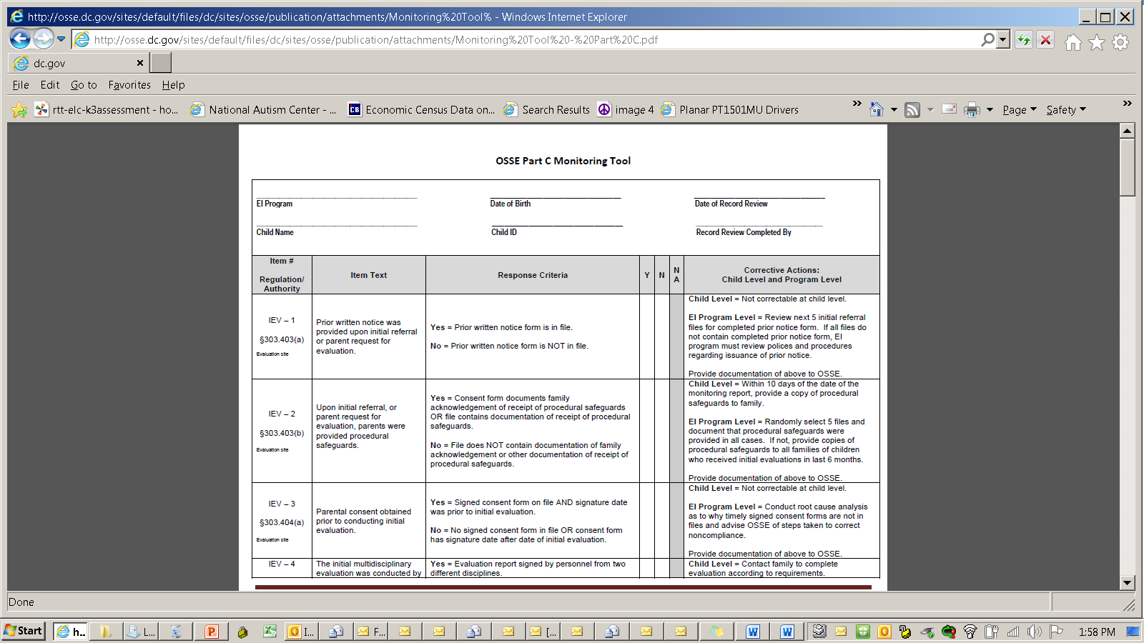

Slide 12
District of Columbia Part C Monitoring: Present and Future
Bi-annual data reviews for compliance indicators
Onsite monitoring
  File review tool
  Interview protocols that provide quantitative feedback of qualitative information for training and TA.
Capacity to identify areas for focused monitoring; template for focused monitoring process that is customized to the topic area

Slide 13
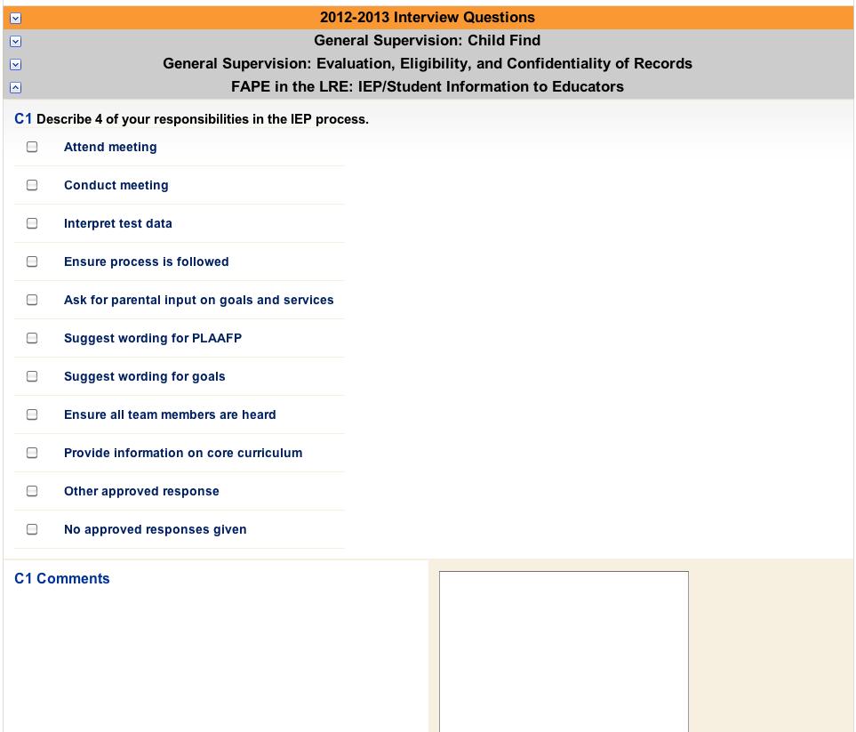
Quantifying Qualitative Interviews to Inform Professional Development
Quantify interview collection by asking questions in such a way that you can track responses numerically.
Notes:
The collection methodology above and corresponding report on next page is one approach to conducting interviews designed to collect and report interview results that are easy to manage and helpful to both local and state level improvement efforts. Moreover, this approach saves time as it bypasses the need to take, review, and write a report based on copious interview notes.

Slide 14
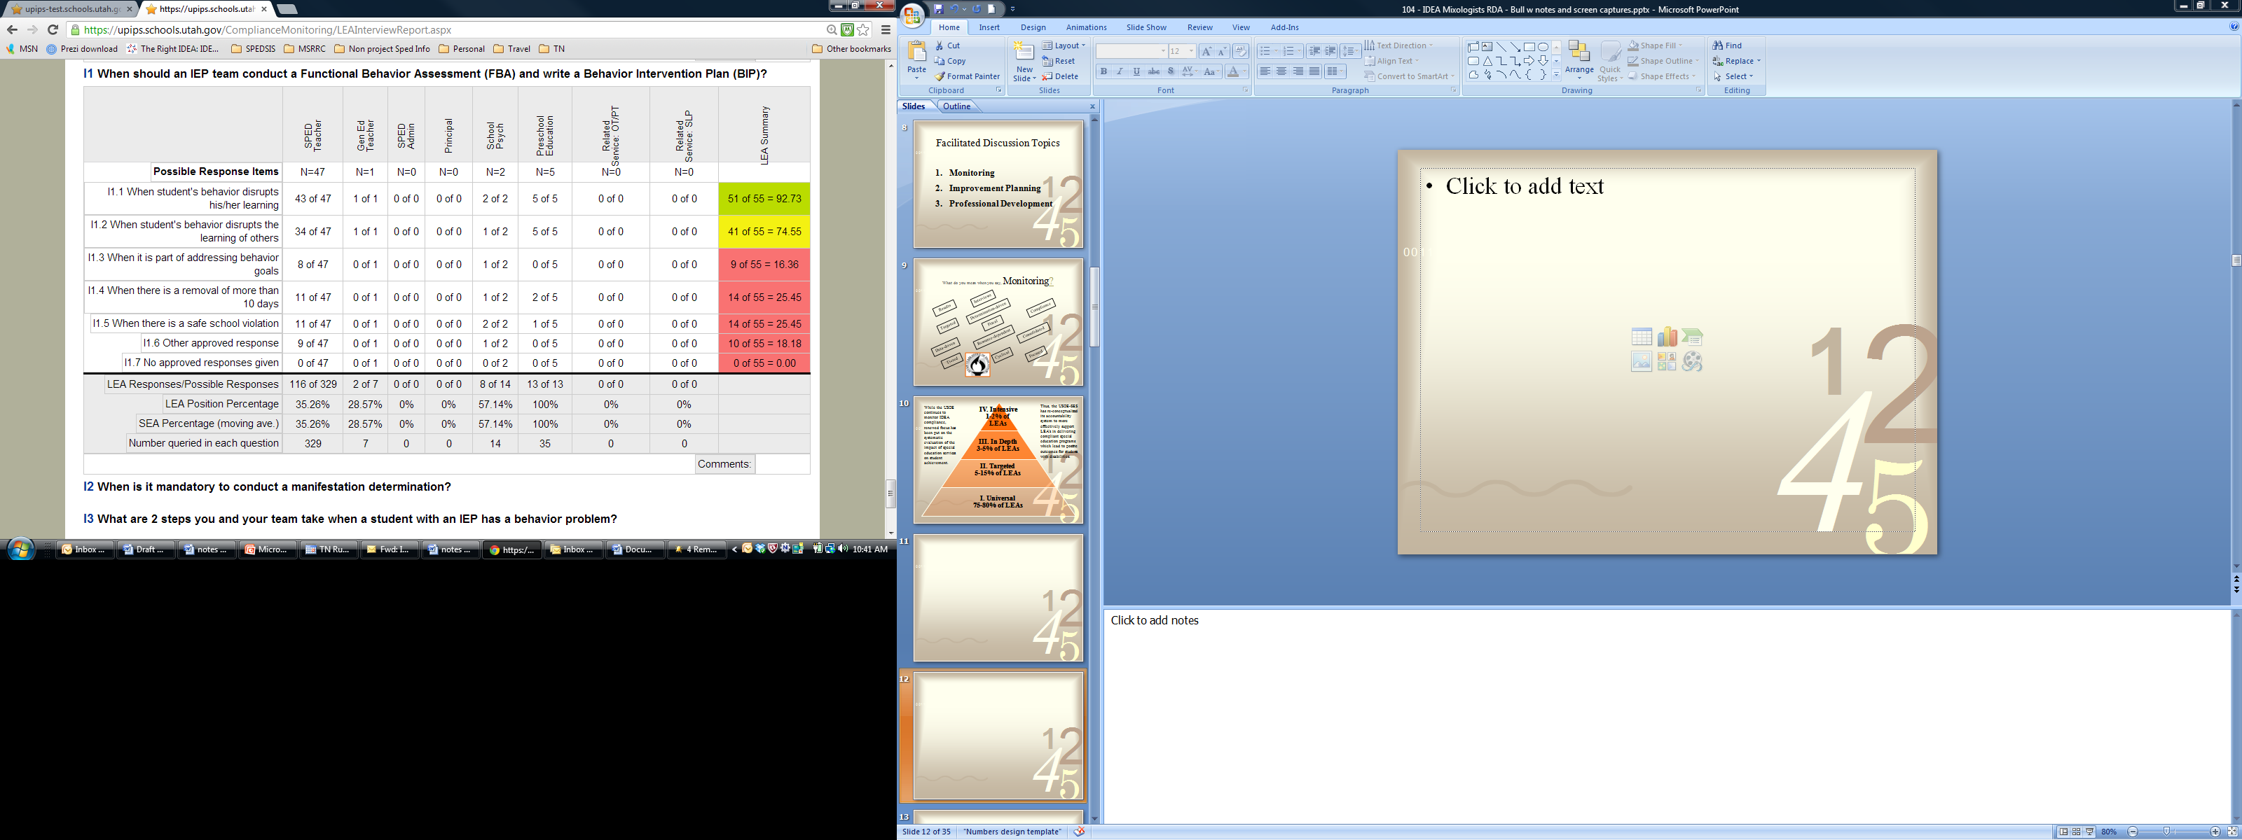
Quantifying Qualitative Interviews to Inform Professional Development
Then analyze results by respondent role x topical area x local agency to inform professional development and technical assistance.

Slide 15
Questions for Krista
Next: Process one state used to move to tiered monitoring incorporating stakeholder input on results, compliance, and other data sets. (Part B, 3-21)

Slide 16

Note: Data VALIDITY as well as VALUE
Notes:
Engaged stakeholders in considering both the VALUE and VALIDITY of different data types (Part B). Both results and compliance data (and other, e.g., fiscal, dispute resolution). Not everything can be a top priority. Not all data are as clean and valid as we might like.

Slide 17
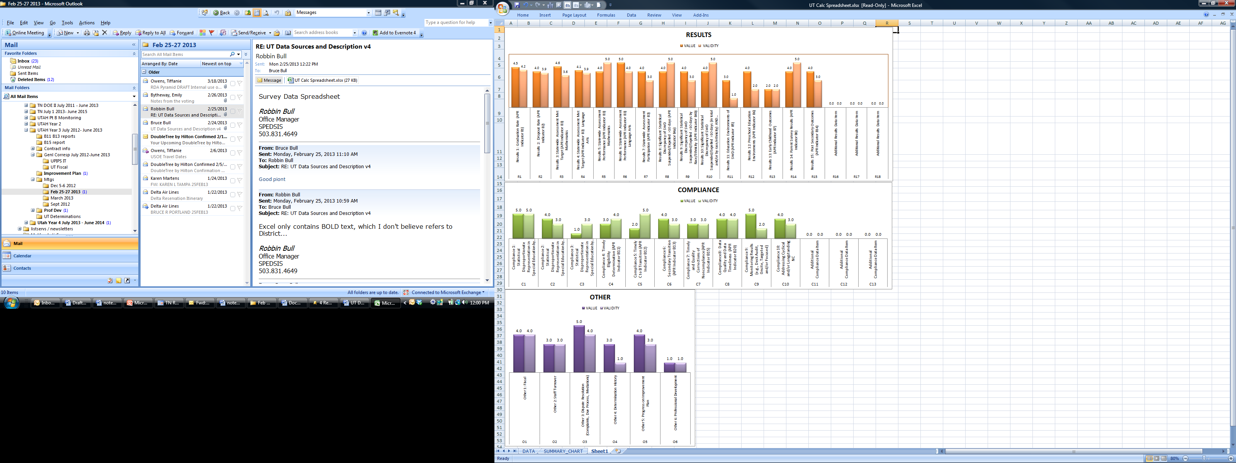
Notes:
Results of the stakeholders VALUE and VALIDITY scores across data types. Data types not important. Big picture: Some things are more valuable and valid than others. Now the SEA and Lead Agency staff can use these results for monitoring efforts.

Slide 18
IV. Intensive
1-2% of LEAs
III. In Depth
3-5% of LEAs
II. Targeted
5-15% of LEAs
I. Universal
75-80% of LEAs
This state continues to monitor IDEA compliance, but has renewed focus on the impact of special education services on student results.
This state has
reconceptualized monitoring to better support LEA’s that must to increase perfor-mance of students with disabilities.
Notes:
Data from APR indicators, determinations, results, dispute resolution, finance, and other state priorities are weighted and analyzed. Then LEAs are assigned a level of monitoring based on their data. LEAs in these tiers are supported by differentiated improvement plans and Professional Development. How might this tiered approach align with local determinations in your state? Perfectly? Close? Not related?

Slide 19
Questions/Discuss: Tiered monitoring, data sets, determinations in relation to differentiated monitoring activities.
Next: Integrating Results Driven Accountability with SSIP. Beyond compliance a draft of model one state is considering.

Slide 20
TN: Results-Based
Monitoring for
Improvement
DRAFT

Slide 21
TN’s Results-Based Monitoring for Improvement is an opportunity the Tennessee Early Intervention System is considering to update and align Part C work to the broader work of the TN DOE to increase performance of all students. RBMI takes advantage of TEIS location within TDOE to coordinate with 619 and Part B.

Slide 22
1. TEIS Topic Selection based on Early
Learning Standards
2. Local Agency(s) Selection based on data
3. Administer Improvement Strategy Tool
4. Develop Local Agency Improvement Plan
5. Implement Improvement Plan
► TEIS Technical Assistance Efforts
► Local Efforts
► Local Provider Efforts
6. Ongoing Measurement Until Criteria

Slide 23
Topic selection is supported by content in the Revised TN Early Learning Developmental Standards (TN ELDS) Birth-48 Months. These pre-academic concepts align with the broader work and focus of IDEA Part B, Part B SSIP and TDOE’s efforts to improve all student performance.

Slide 24

Revised TN Early Learning Developmental Standards (TN ELDS) Birth-48 Months

Slide 25
Qustions/Discuss RBMI, integrating Results Driven Accountability with SSIP.
Next: Other resources, Debbie Cate, ECTA

Slide 26
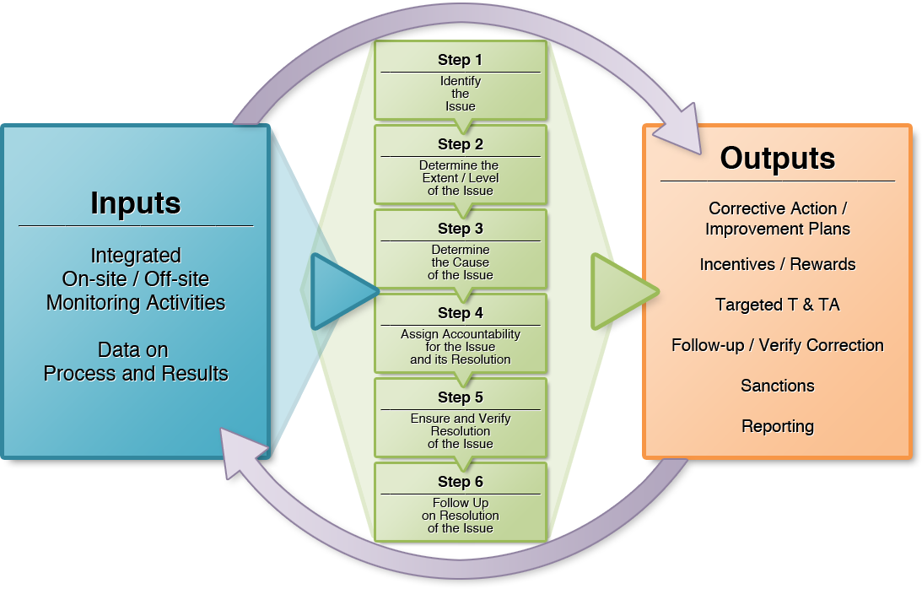
Six Step Framework

Slide 27
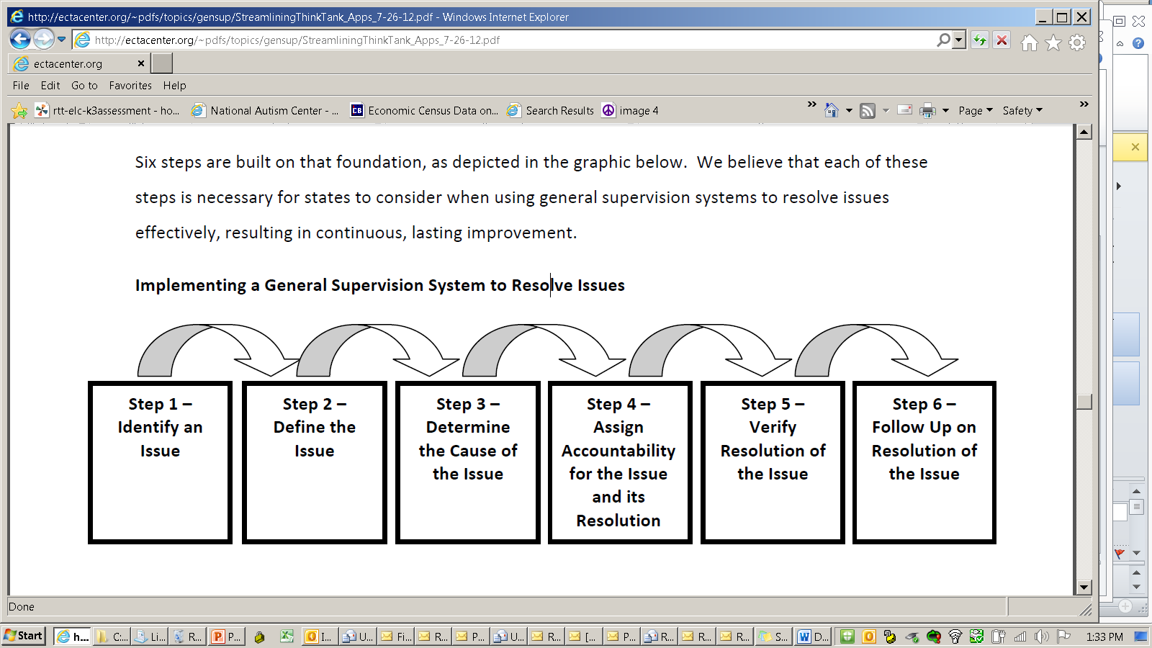
Implementing a General Supervision System
to Resolve Issues
Where does data play a part in your system?
Notes:
Step 1, 3, 5, possibly 6?

Slide 28

http://ectacenter.org/topics/gensup/interactive/systemresources.asp
Notes:
Step 1, 3, 5, possibly 6?

Slide 29
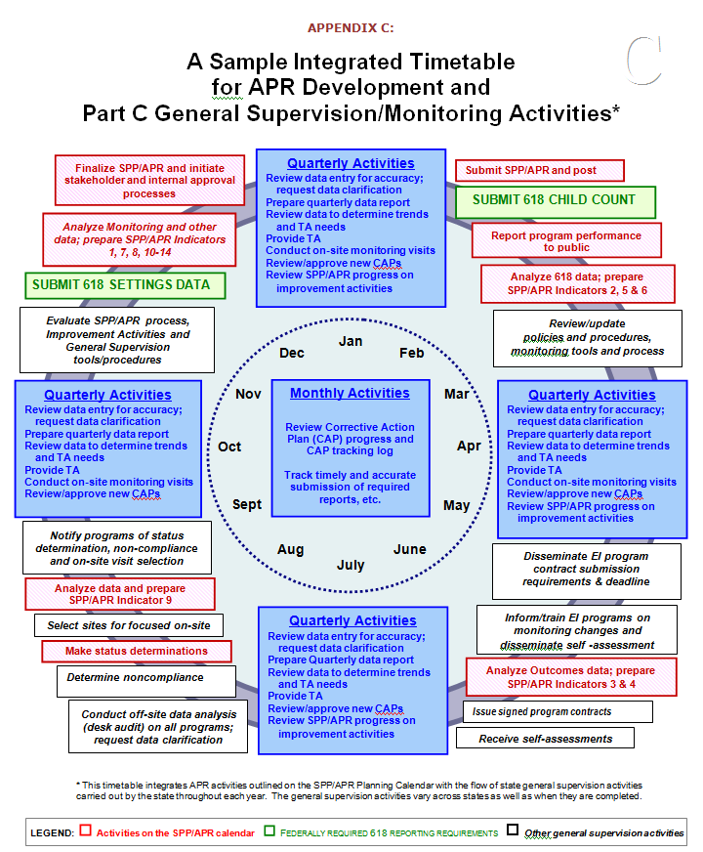
Screen shot here of above here . .
Notes:
Step 1, 3, 5, possibly 6?

Slide 30
Questions/Discuss Resources
Next Where is your monitoring heading?

Slide 31
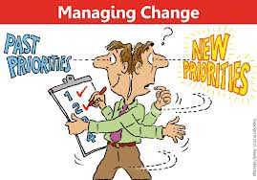

Slide 32
What monitoring changes and challenges are coming your way?
Integrating SSIP, Results Data within Monitoring.
Any change to an existing processes . . .
Tiered monitoring
Desk audits
Determinations
Increased use of data system
Incorporating Improvement Planning based on monitoring results
Addressing Professional Development/Technical Assistance deficits (e.g., based on results data)
What is needed?
Additional resources
Technical assistance (internal?, external?)
Stakeholder involvement
Integration with SSIP
Improved data
Etc.
Breakout and Report back to large group.

Slide 33
. . . and they monitored happily ever after.
The End

Slide 34
(Go ahead, contact us.)
Debbie Cate
Debbie.Cate@unc.edu
Krista Scott
Krista.Scott@dc.gov
Bruce Bull, DaSy Consultant
Bruce.Bull@spedsis.com

Slide 35
Appendices (possible reference during presentation)
Improvement Planning
  Based on review of data
  Priority needs established based on local review
Compliance Monitoring Collection and Management
  View of tools to support compliance

Slide 36
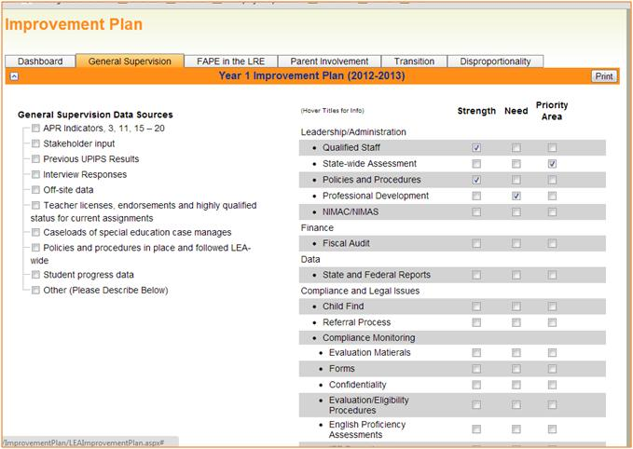
Notes:
This improvement plan system has local agencies a) reviewing multiple data sources for each of the tabbed areas above (Gen Sup, FAPE, etc.) Both data sources (left) and areas (right) are dependent on the tabbed area selected. Once the self assessment is conducted (all subject to SEA/LA approval), an improvement plan based on the data can be developed.

Slide 37
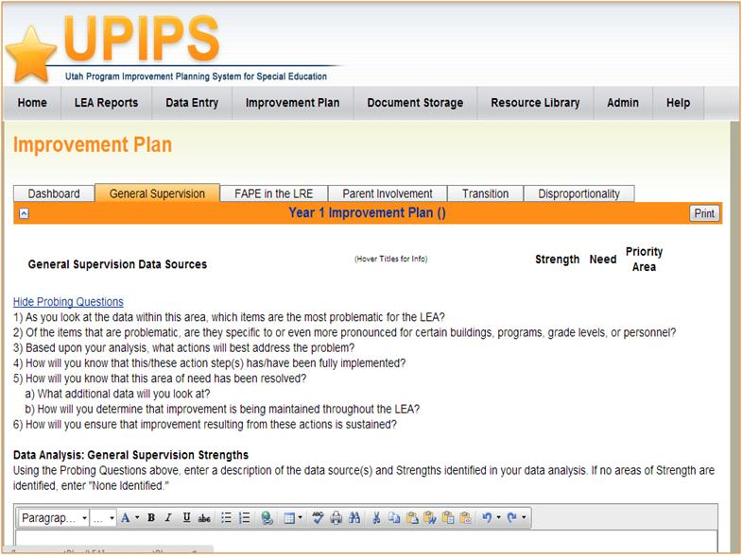
Notes:
Probing questions by topical area help the local agency in addition to their review of data and their previously established prioities. Probing questions help discover the root cause, and address the area(s) accordingly.

Slide 38
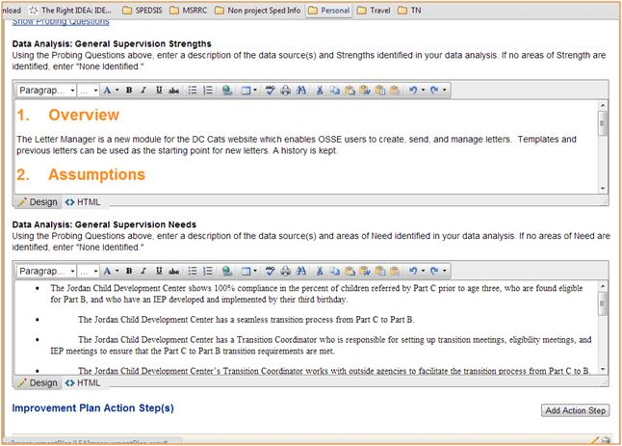
Notes:
The improvement plan is written in the system and subject to approval by SEA.

Slide 39
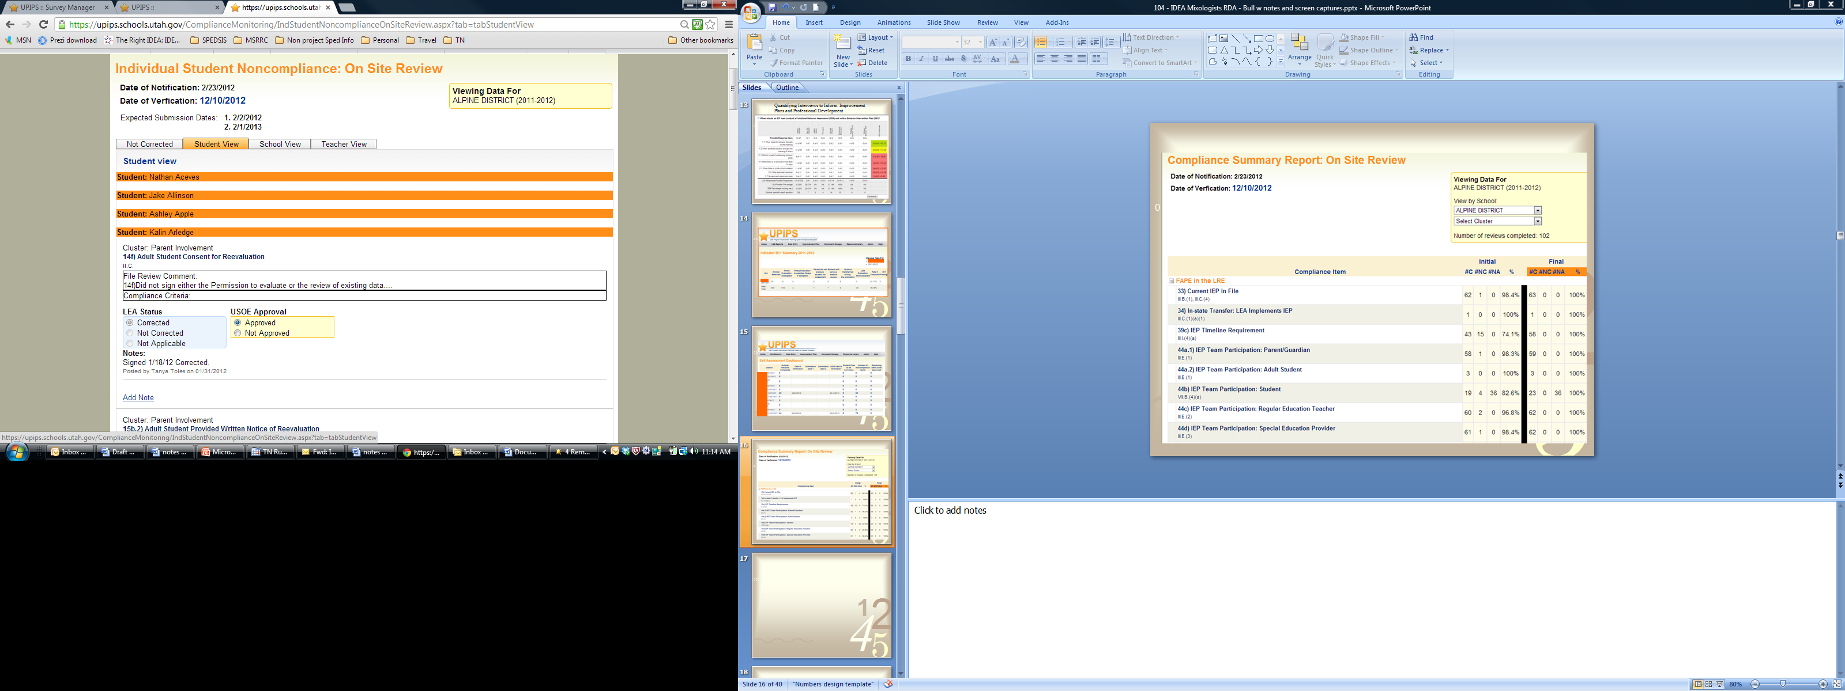
Notes:
Our old friend Prong 1 . . .

Slide 40

Notes:
Same compliance focus with an initial correction period provided the local agency.

Slide 41

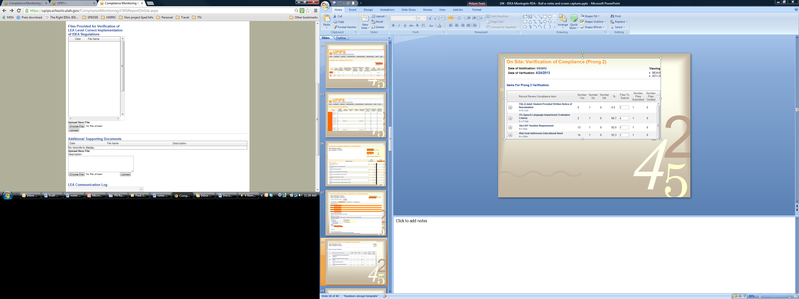
Notes:
And our other old friend Prong 2 . . . A method of addressing the review of additional data and tracking timelines, etc.

Slide 42
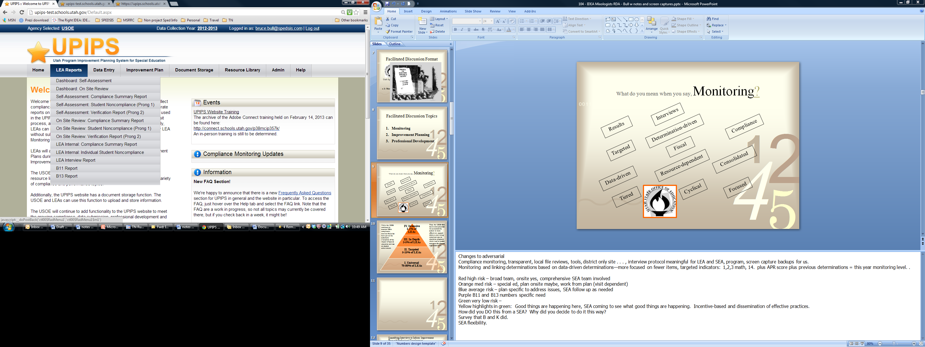
Notes:
Management of monitoring efforts takes a considerable effort—especially when addressing any found noncompliance.

Slide 43

Notes:
Another view of managing compliance data, addressing Prong 1, Prong 2, timelines, agency, etc.

