Slide 1
Key Fiscal Tools and Indicators to Include in Early Childhood Data Collections
DaSy Improving Data, Improving Outcomes Conference
Sunday, September 15, 2013
Ron Benham
Maureen Greer
Jamie Kilpatrick

Slide 2
Introductions
Ron Benham, Part C Coordinator, Massachusetts Department of Public Health
Maureen Greer, ITCA, Emerald Consulting
Jamie Kilpatrick, Sr. Consultant, Public Consulting Group, Inc.

Slide 3
Finance Data Elements
Child Data
Program Eligibilities
Diagnosis
Family Data
Income
Insurance eligibility (public or private)
Services
Services Authorized
Services Delivered
Payment Sources
Units of Services by Discipline
Units of Service by Payor
Procedure Codes
Date of Service
ICD-9 Codes
CPT Codes
HCPC Codes

Slide 4
Finance Data Elements
Providers
Payment Source and Amount
Uniform Financial Report submitted to the State
Financial Stability
What do you do with outliers?
Cost Study
Time and Effort
Billing Patterns
Trend information
Issues/Drivers:
Economic environment
Health Indicators
Environmental Issues

Slide 5
Structure for Developing and Sustaining a Part C Finance System
Demographic information about the population of Part C eligible children in the state:
What proportions of children are likely to be eligible for which sources of funds?
Where are they in the state?
Necessary agreements, negotiations, applications for use of funds: MOUs?
Waivers?
Ongoing monitoring: ➔Changing demographics?
➔Changing political and economic context?
➔Need new interagency agreements?
➔New funding sources?
➔Revised policies?
➔Better support and guidance?
➔More state funding?
➔Narrower Part C eligibility criteria?
Design a finance and data system based on the demographics, political and economic context of the state
Information about possible fiscal resources:
Requirements?
What can each pay for?
Who is eligible?
Infrastructure to support the documentation of use of funds and/or billing
Establishing a Vision
Existing and potential political and economic context in the state:
Traditional, current uses of funds?
Existing resources?
Competing priorities?
Anticipated political changes?
Development of policies and procedures for accessing resources and supports and/or billing
Development of guidance and provision of ongoing support for localities and service providers in implementing policies and procedures

Slide 6
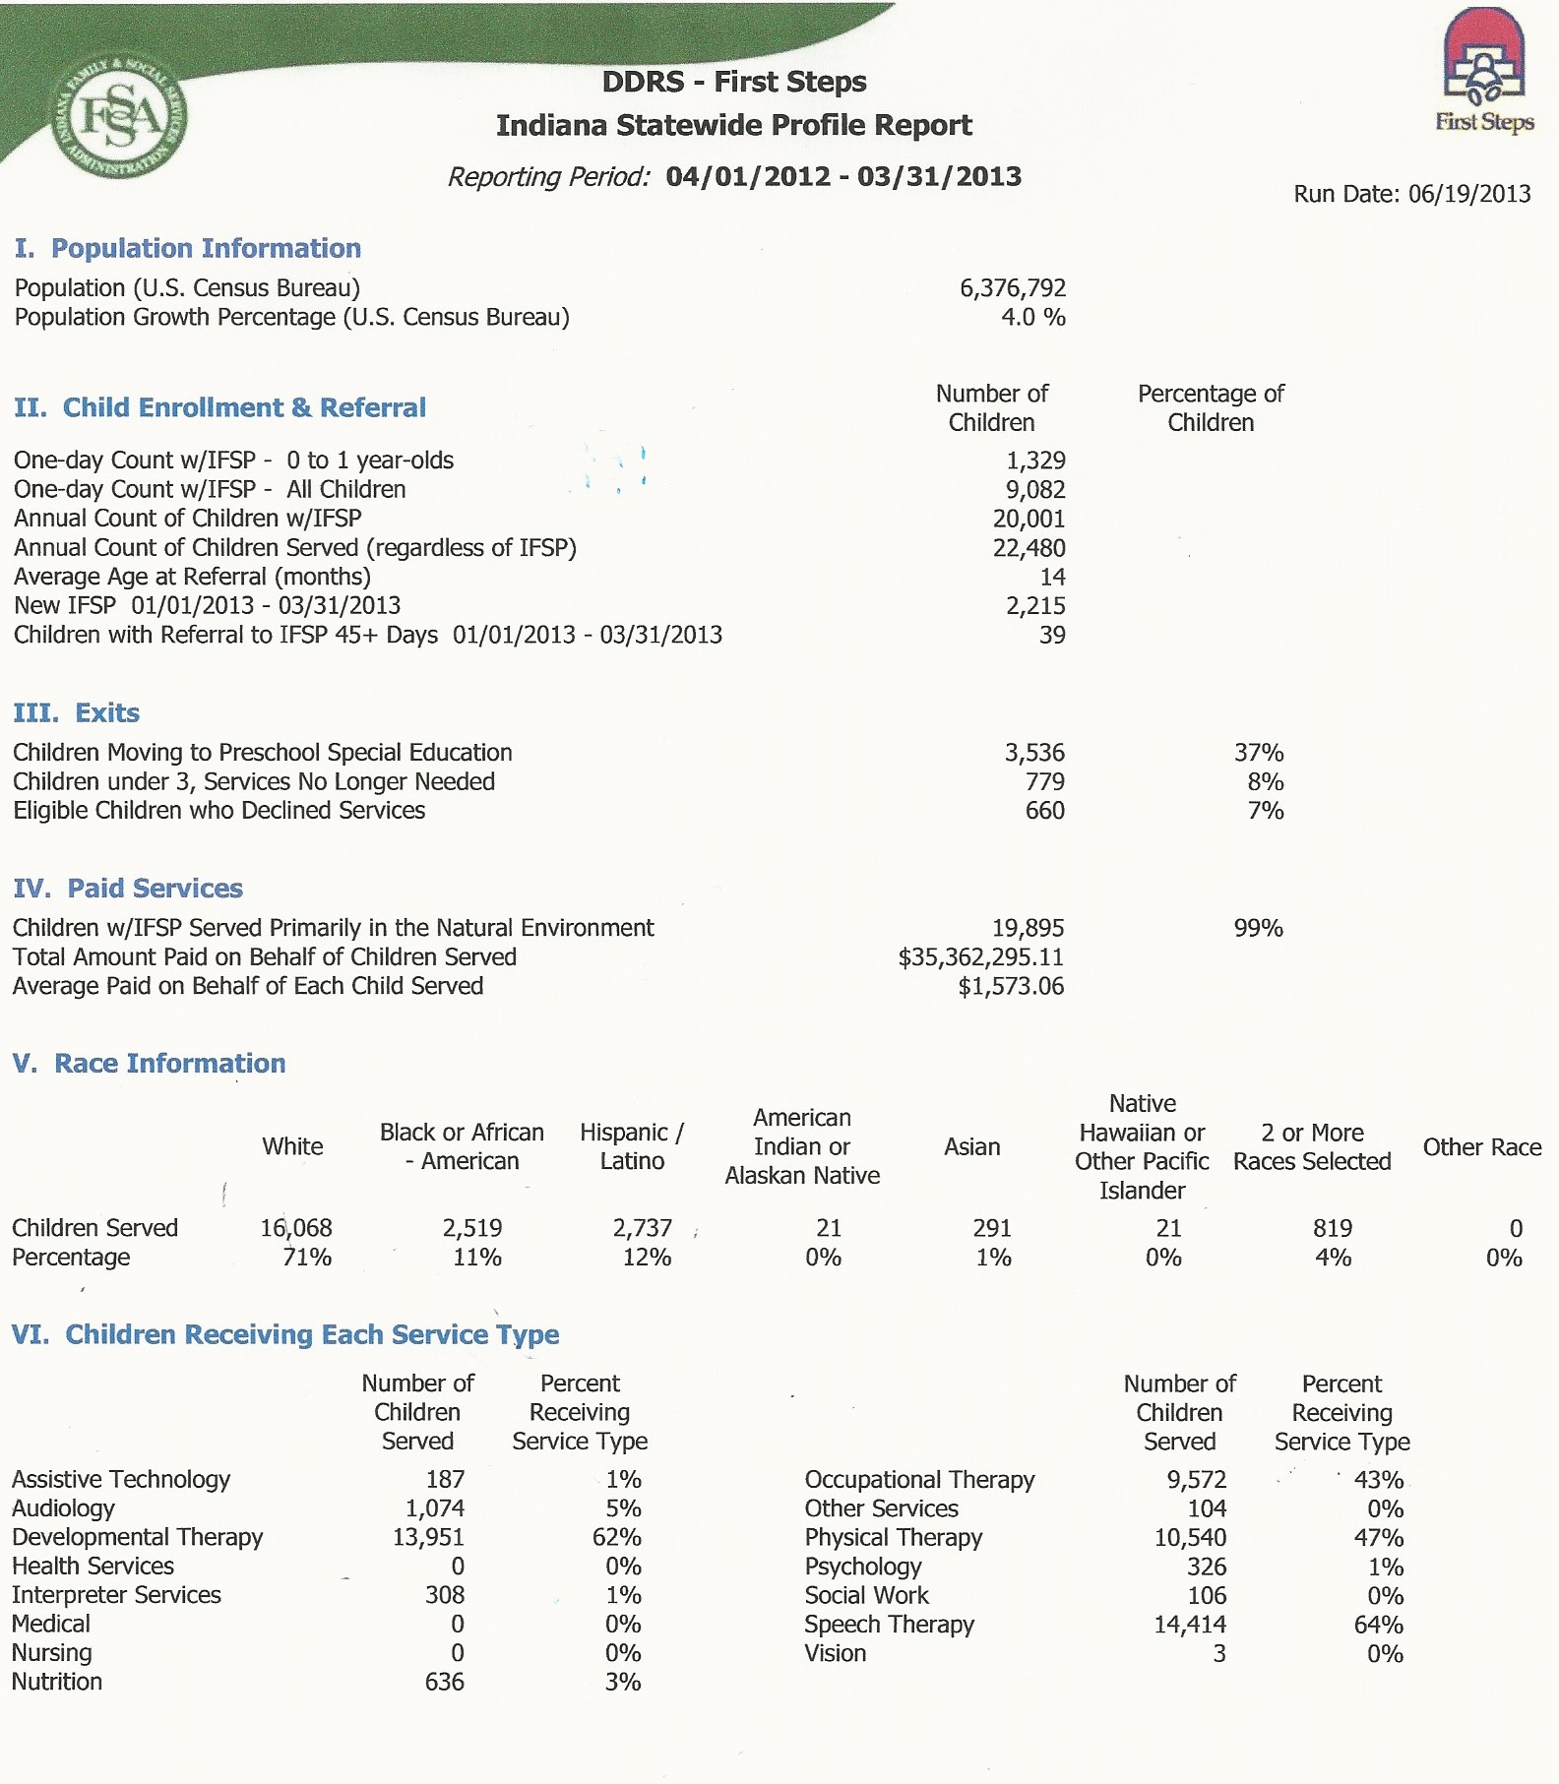

Slide 7
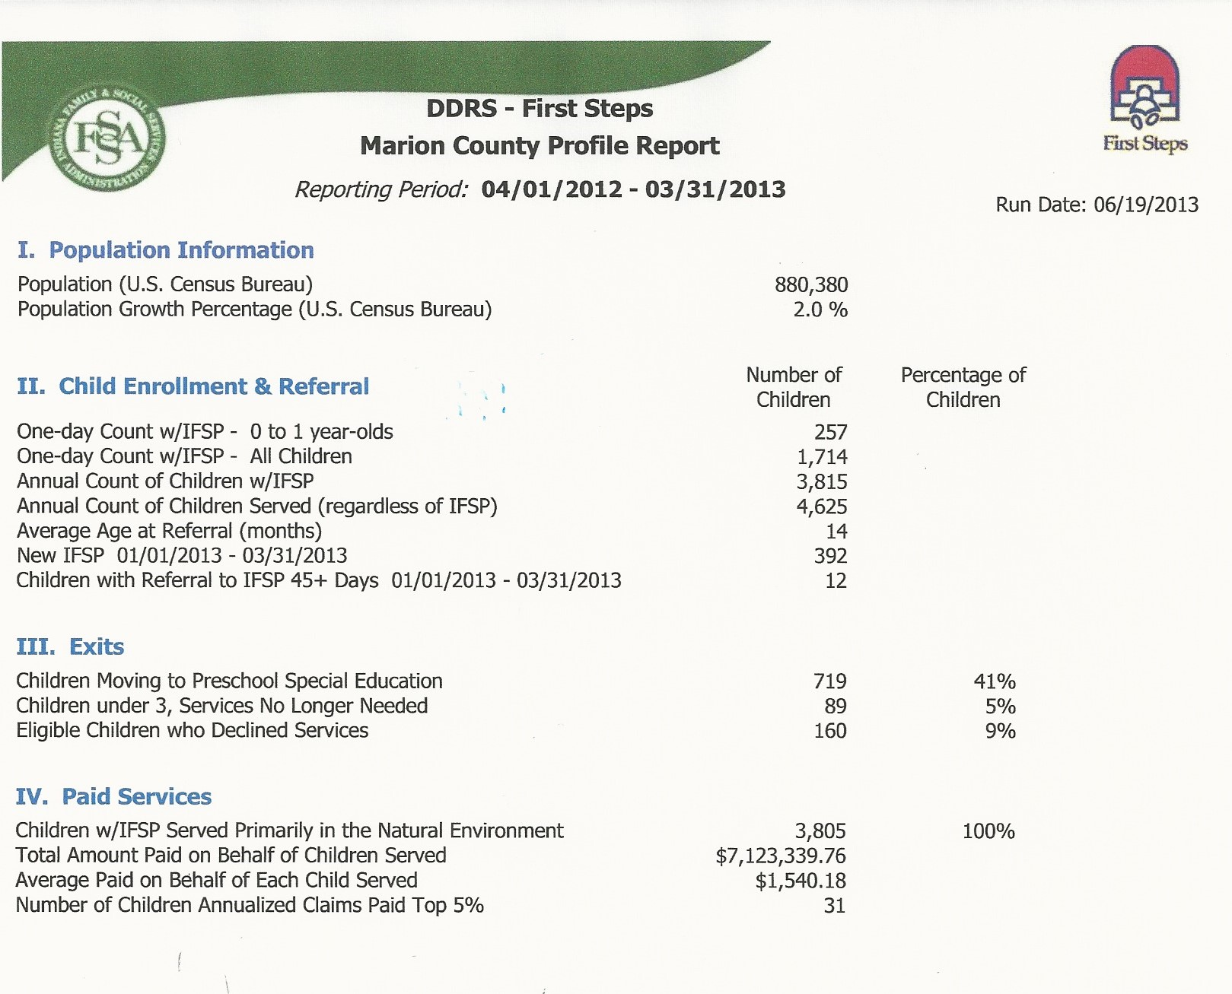

Slide 8
Sample Demographic Factors*
LBW/VLBW
Births to mothers with less than 12 years of education
Births to women with late or no prenatal care
Teen births
Births to unmarried women
Births to women who smoked during pregnancy
Children in families where no parent has full time work
Children below 150% of poverty
Children<5 without insurance
Children in single parent households
Substantiated incidences of abuse/neglect

Slide 9
Possible Variables
Poverty
Low Birthweight
Birth Defects
Maternal Education
Race
Preterm Births
Abuse and Neglect

Slide 10
Demographic Discussion Points
What, if any, is the impact of a single variable upon our catchment area?
What is the impact of a cluster of variables upon our catchment area?
Child Find efforts
Engaging materials in the right places
Informing, engaging a diversity of referral sources
Cultural diversity – religious sects, populations of special consideration (teen moms, poverty)
Finding and retaining qualified staff
Training and supervision to ensure cultural competency
Non-English speaking-families, children
Translation/interpreter services
Homelessness
Military Dependents, Installations
Migrant, Immigrant Populations, Multinational Adoptions
Partnerships with community resources
Families, children with multiple risk factors

Slide 11
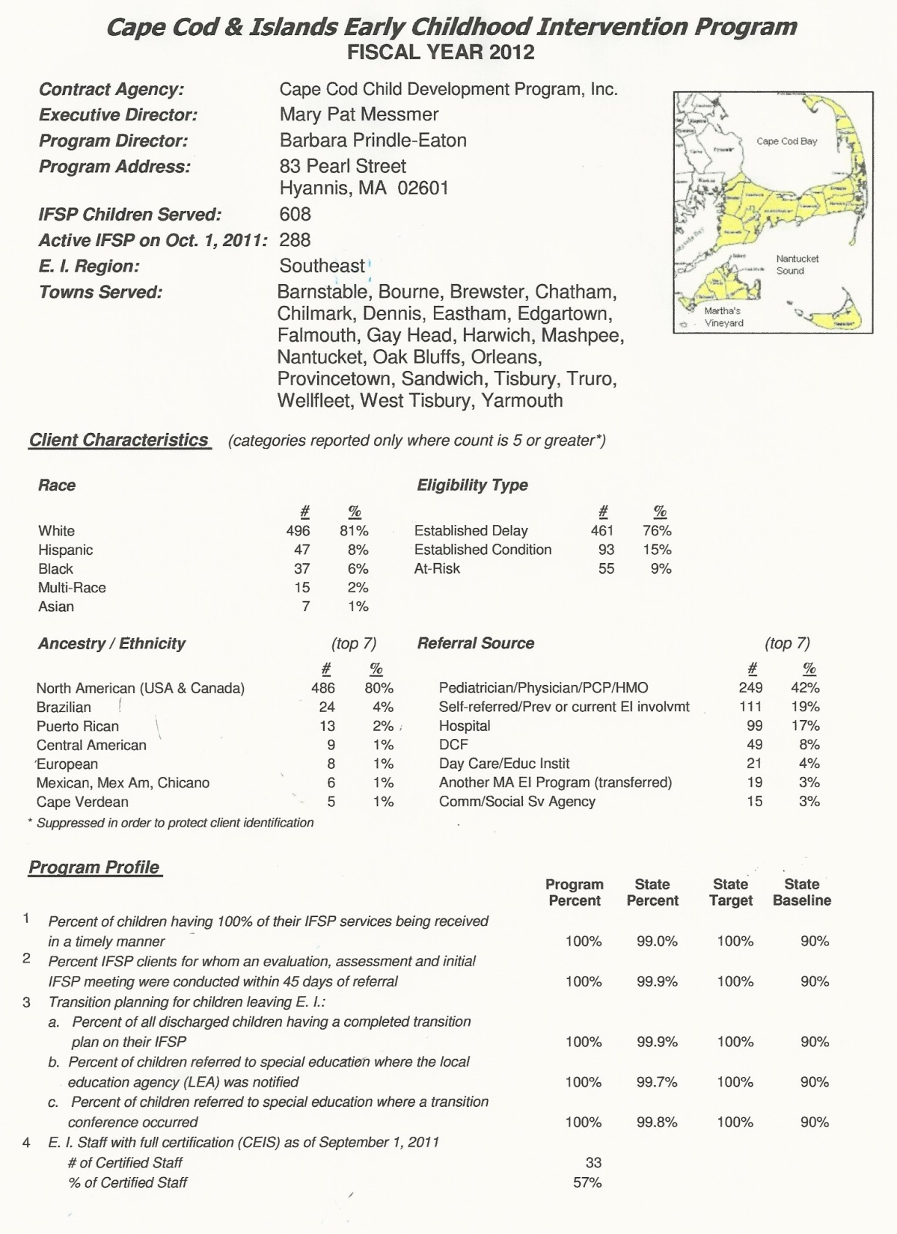

Slide 12
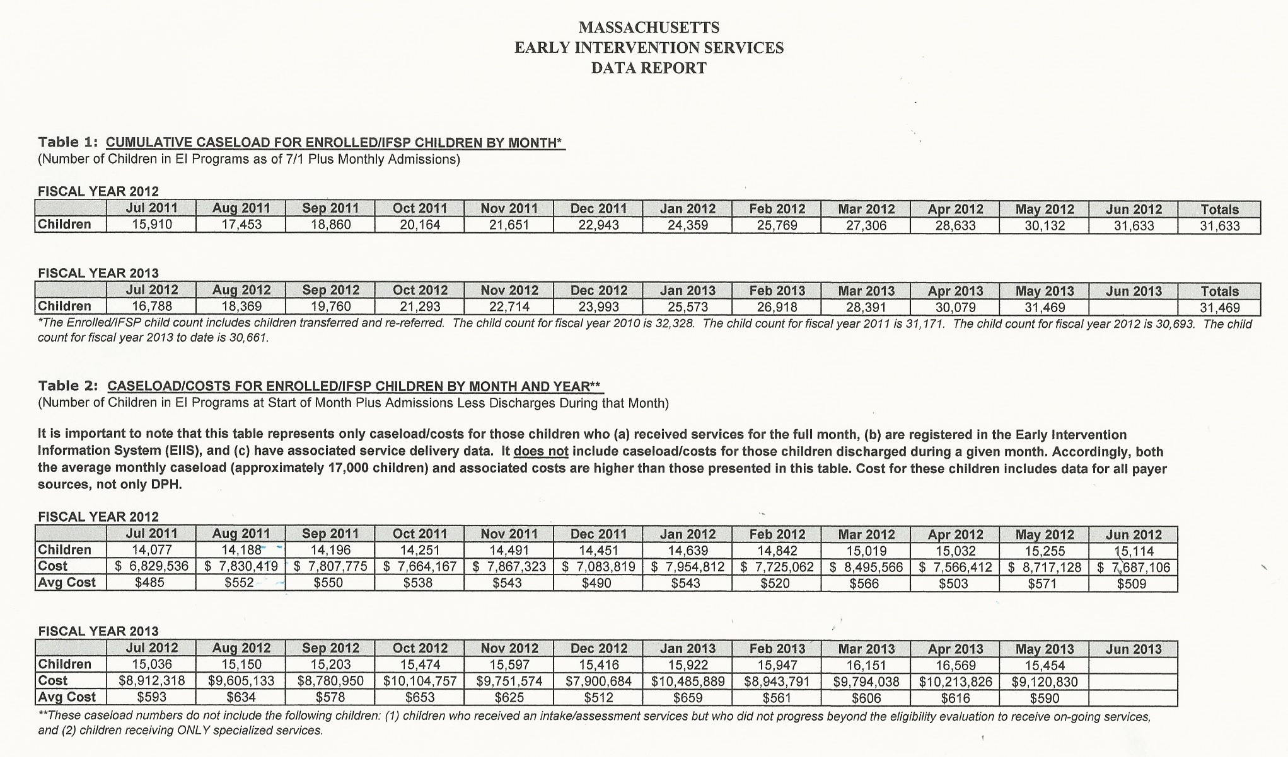
Massachusetts Early Intervention Services
Data Reports

Slide 13
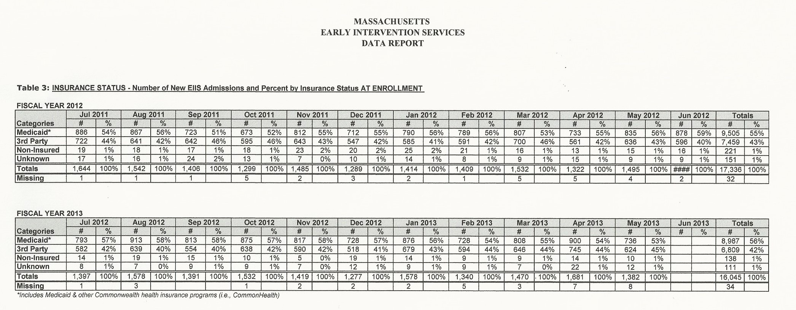
Massachusetts Early Intervention Services
Data Reports

Slide 14
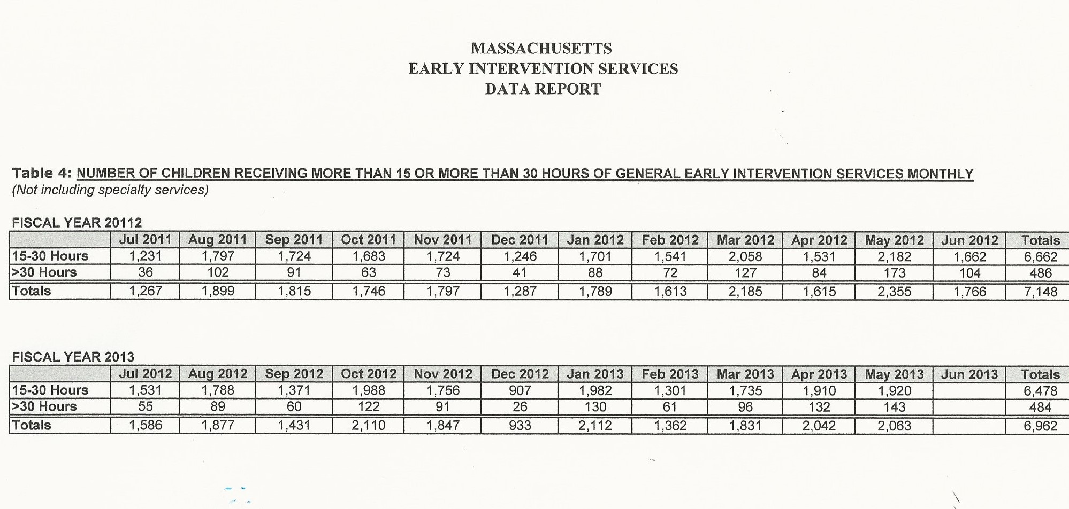
Massachusetts Early Intervention Services
Data Reports

Slide 15
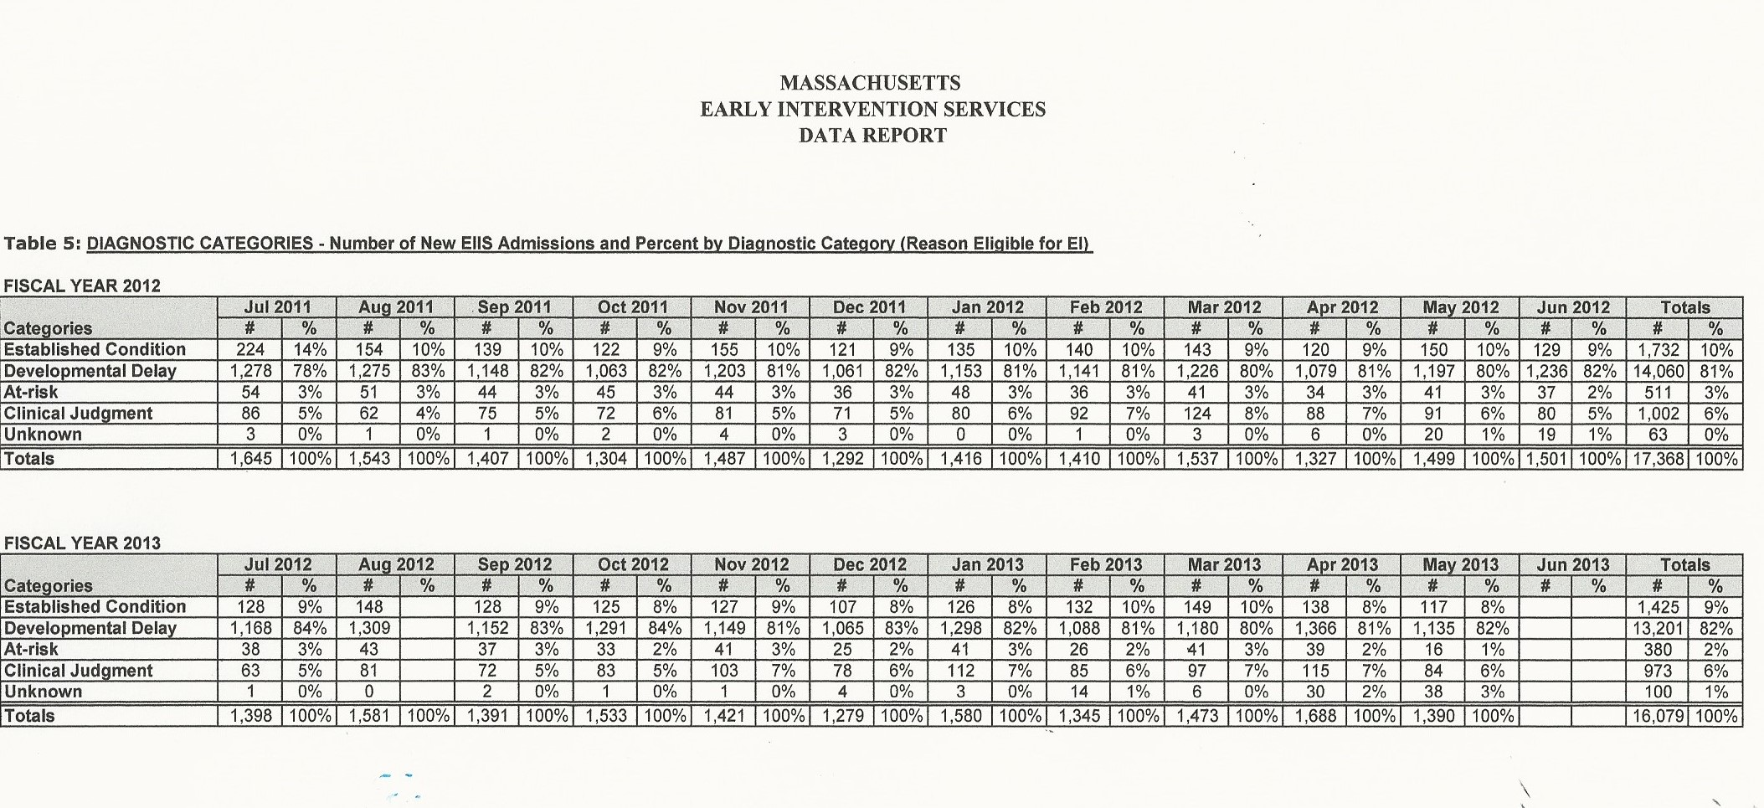
Massachusetts Early Intervention Services
Data Reports

Slide 16
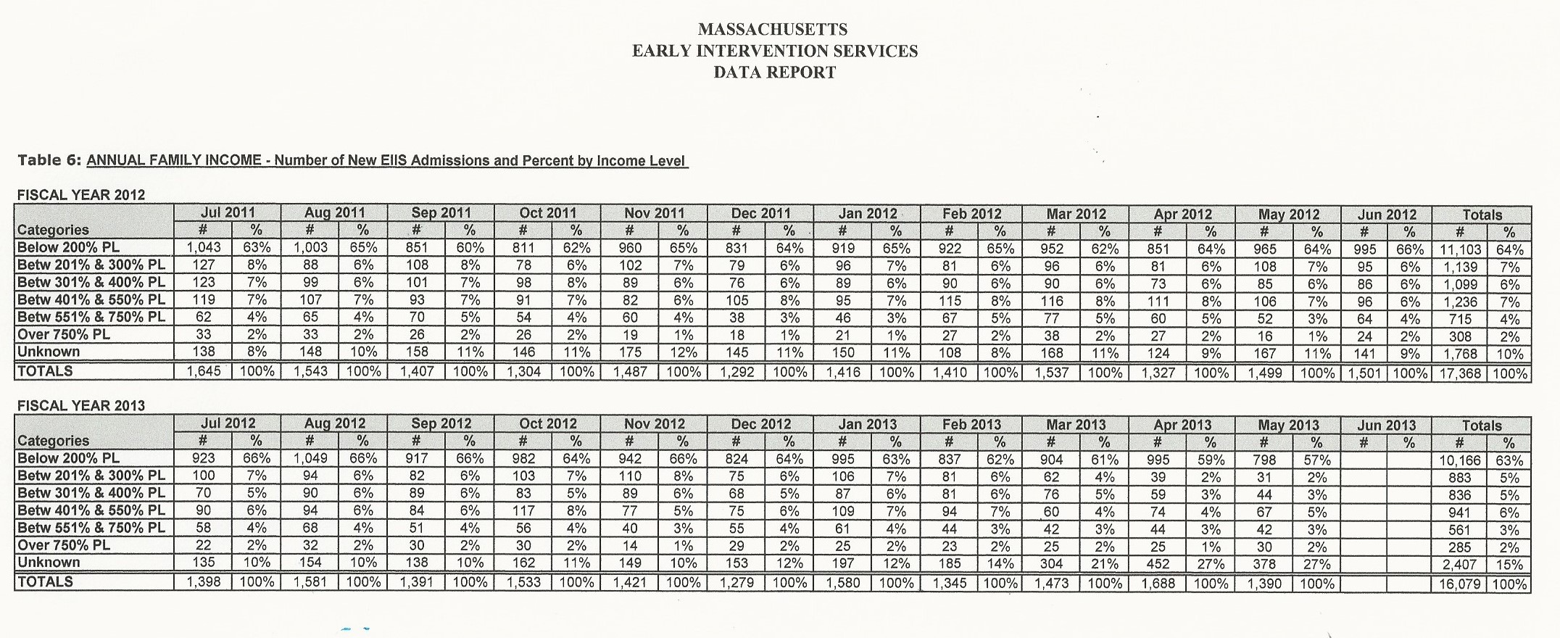
Massachusetts Early Intervention Services
Data Reports

Slide 17
Contact Information
Ron Benham
MA Part C Coordinator
Ron.benham@state.ma.us
Maureen Greer
ITCA, Emerald Consulting
mhmgreer@aol.com
(317) 251-0125
Jamie Kilpatrick
Sr. Consultant, Public Consulting Group
jkilpatrick@pcgus.com
(615) 983-5318

