Slide 1
In Search of the Perfect Data System
Improving Data, Improving Outcomes
Washington, DC September 15 - 17, 2013

Slide 2
Presenters
Christy Scott
Program Quality and Data Coordinator, CO
Mike Hinricher
Part C State Data Manager, TN
Bruce Bull
DaSy Consultant

Slide 3
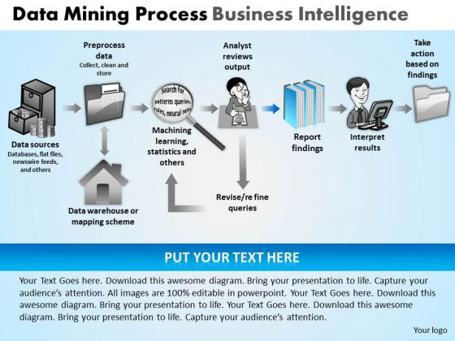
We know garbage in garbage out.
Our role is to minimize the garbage (that others assume does not exist.)

Slide 4
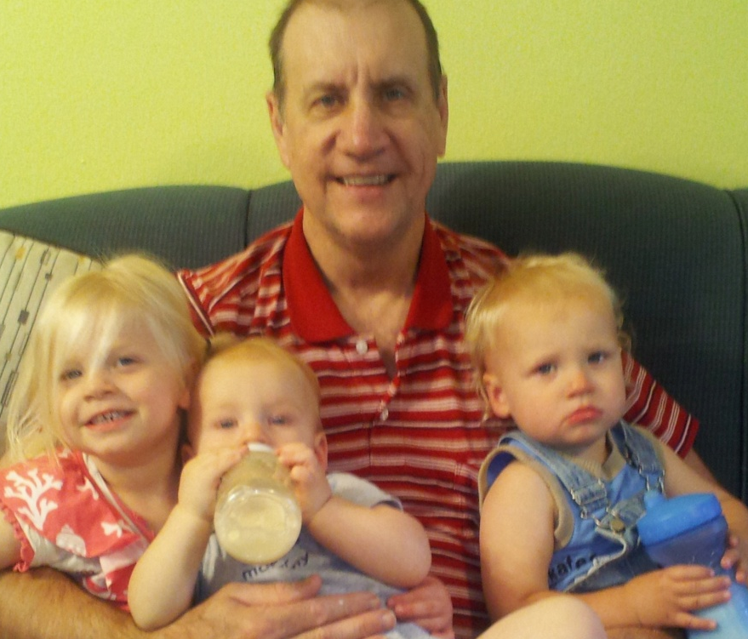
Session Agenda
Efforts to improve data
TN and CO show and tell
Q and A: Invited at end of each section (data quote prompt)
672 months
35 months
9 months
21 months
(Requisite “cute kid” pic)

Slide 5
As we talk, consider, challenges you have (or suspect) with your:
Data
Data system
Data users
Share to get suggestions.

Slide 6
Section Headings
Data Governance
Structure ● Security
Contractor ● Training
(System) Support ● Reporting
Data Manipulation
Data Drill Down Examples
Timely Service Delivery
Child Outcomes

Slide 7
Life is made up of a series of judgments on insufficient data, and if we waited to run down all our doubts, it would flow past us.
- Learned Hand

Slide 8
Data Governance (Christy)
Data instructions are posted & available.
Instructions are updated as needed and local programs notified of changes
Data entry requirements annually included in program contracts and in Early Intervention State Plan
Each program must have an EI Data Manager
Notes:
Christy’s is this dark slide. Mike’s is all blue.

Slide 9
Data Governance (Mike)
Structure
Master a complete understanding of:
Data dictionaries
Table definitions
Table relationships and
Database organization structure
Consider a table of data validations with error statements assigned to each type of validation
Codd’s 12 Rules on a Relational Database Management System

Slide 10
Data Governance
Contractor
Contractor—Customer relationship
Product only as good as the data.
Limited data access = limited analysis possible
COTS software started as someone’s idea—(just not yours . . .)
Upgrade functions based on agency benefit. (Don’t add short term enhancements.)

Slide 11
Data Governance
Contractor
Keep enhancements list with suggestions by you, other Lead Agency staff AND field personnel
Overhaul one database area with several changes rather than enhancements over time
Mock up a design layout to show programmers
List upgrades by priority . . . Once “done” expect problems. Test, test, test.

Slide 12
Data Governance
(System) Support
Add additional hours (e.g., 500 hours/yr) for unforeseen upgrades.
Include contract clause that supports database if contract is NOT renewed. (E.g., contractor to provide up to 18 months hourly-based support after contract period.)

Slide 13
Data matures like wine, applications . . . like fish.
- James Governor

Slide 14
Data Governance
Security
Map user levels including screens, functions, reports, etc. by user type
Data Manager must be able to view everything
Clarify in writing details of database recovery

Slide 15
Data Governance
Training
Upgrade user guide annually
Describe each screen’s purpose, prerequisites, user access levels, necessary definitions, associated validations, affects and controls

Slide 16
Data Governance
Reporting
Consistent and frequent queries justify canned reports.
A canned report can lose accuracy as system progresses. (Revise or trash)
Insist on ability to run queries to check accuracy of canned reports.

Slide 17
Data Governance
Reporting
Key Performance Reports measure agency performance. Examples of potential monthly Key Performance Reports:
Funding – (revenue)
Expenditures
Referrals
Caseloads
Outcomes

Slide 18
Hiding within those mounds of data is knowledge that could change the life of a patient, or change the world.
– Atul Butte

Slide 19
Data Validation and Manipulation
Daily updated edit reports are available online (indicators, child count, billing invoice, funding utilization).
Required data checks embedded
System checks for data entry logic (e.g., not allow billing for services not on IFSP; prevent billing rate higher than rate on file; cross checks for relational fields)

Slide 20
Data Validation and Manipulation
Programs required to confirm data related to child count and funding
Desk audits of specific child records are conducted as warranted

Slide 21
Data Validation and Manipulation
Run query
Sort for errors (e.g., future dates)
Run calculation logic (e.g., referral before birth)
◄ Erroneous dates THE most troublesome ►

Slide 22
Data Validation and Manipulation
Generate trend report for a high level reality check on referrals, child eligibility, caseloads, settings, etc.
Look for not so obvious trends:
Which day of the month are records closed?
Are significant numbers of children found not eligible coming from same referral source?

Slide 23
Data Validation and Manipulation
All reports need to serve a purpose (e.g., data cleaning, inform policy, problem solve).
Once purpose is served, stop.

Slide 24
Everyone gets so much information all day long hat they lose their common sense.
– Gertrude Stein

Slide 25
Data Drill Down Area: Timely Service Initiation
State and local performance consistently high
Drilled down on family exceptions
Family schedule was most frequently identified as an issue
Contacted local programs for more detail and presented data in a TA call

Slide 26
Data Drill Down Area: Timely Service Initiation
Determined family exceptions were not over-reported and were reasonable
Unexpected outcome: Drop in family exceptions after attention to this area

Slide 27
Anything that is measured and watched improves.
- Bob Parsons

Slide 28
Data Drill Down Area: Child Outcomes
Looked at State and local ECO performance monthly
Drilled-down to determine patterns for children not making substantial progress in each outcome area
Analyzed child-specific data by subgroups (e.g., demographics, area of delay(s), level of delay, diagnoses) for patterns

Slide 29
Data Drill Down Area: Child Outcomes
Found children eligible for Medicaid tended to have lower progress at exit. (More than 50% of children served are eligible for Medicaid.) Story behind the numbers? While many are Medicaid eligible due to income, many are eligible through SSI due to the level of disability.

Slide 30
Numbers have an important story to tell. They rely on you to give them a voice.
- Stephen Few

Slide 31
Data Drill Down
Area: Child Outcomes
Compare data across district, region, state:
Aggregate Part C entrance scores against aggregate exit scores
Aggregate Part C exit scores against aggregate Part B entrance scores

Slide 32
Data Drill Down
Area: Child Outcomes
Break down the data into areas and data sets to review
Compare by demographics, disabilities, providers, number of service hours, etc.
Look for hidden trends

Slide 33
Data Drill Down
Area: Child Outcomes
Track children whose rate of improvement was outside the norm. Training need? Poor service?
Look for missing entrance or exit scores. Training? Service coordinator? Data entry? Other?

Slide 34
Comparing Entrance Ratings to Exit Rating. ECTA concept.
Most children fall into the 1 point difference range
Additional children may fall in the 2 point range
Are children with > 2 point difference outside normal rating?

Slide 35
Errors using inadequate data are much less than those using no data at all.
- Charles Babbage

Slide 36
Challenges you have (or suspect) with your:
Data?
Data system?
Data users?

Slide 37
Data are just summaries of thousands of stories – tell a few of those stories to help make the data meaningful.
– Chip & Dan Heath

Slide 38
Contact Information
Christy Scott
Program Quality and Data Coordinator
Christy.Scott@state.co.us
Mike Hinricher
Part C State Data Manager
Mike.Hinricher@tn.gov
Bruce Bull
DaSy Consultant
Bruce.Bull@spedsis.com

