Slide 1
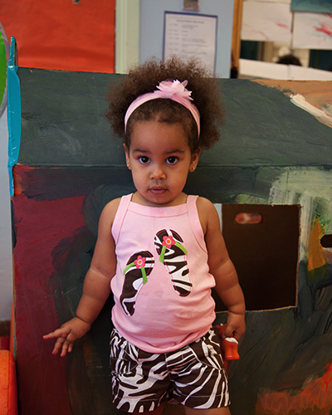
A Guide to the Implementation Process Stages, Steps and Activities
July 29, 2014
3 - 4pm EDT
ECTA Implementation Process Team

Slide 2
Purpose
Share the new on-line Guide to the Implementation Process and Self Assessment tools
Present Wisconsin’s use of the Guide and Self Assessments in implementing a state-wide change in practice
Share additional resources and web sites related to an effective implementation process.

Slide 3
“Implementation:
The process of
moving an idea
from concept to reality”

Slide 4
Rationale for Creating the Guide
The ECTA Center’s proposal called for developing guidance to strengthen state capacity to implement recommended practices
State colleagues have been asking for help planning and carrying out systemic change
Need to organize, synthesize and “translate” the existing wealth of information to EC systems

Slide 5
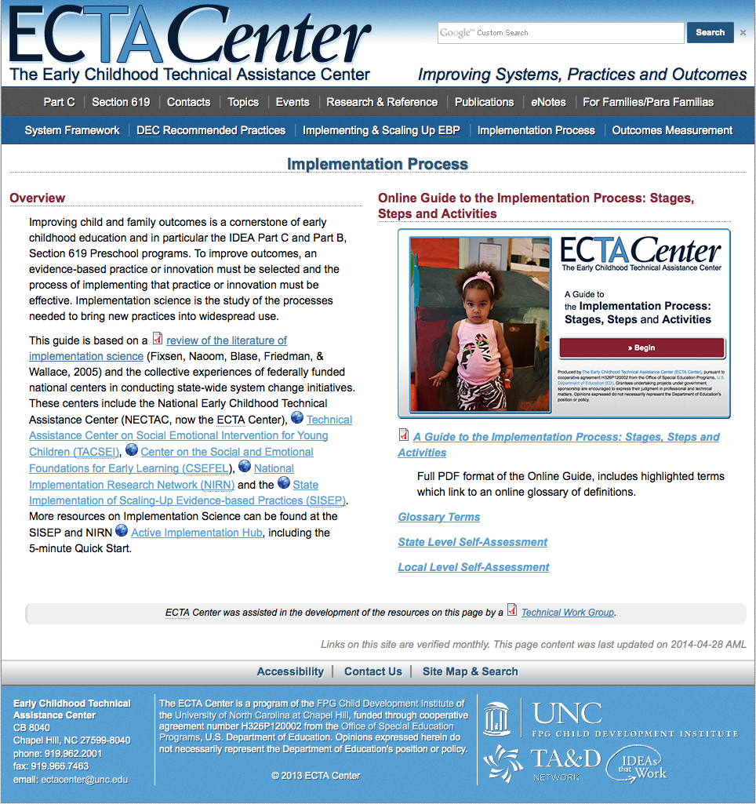
A Web Tour
Implementation Process Page
On-Line Guide
Glossary
State Level Self Assessment
Local Level Self Assessment
http://ectacenter.org/implementprocess/implementprocess.asp

Slide 6
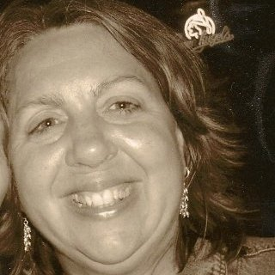
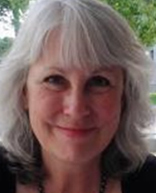
Wisconsin’s Journey: State-wide Implementation of Practice Improvement
Terri Enters
Part C Coordinator Department of Health Services
Birth to 3 Program
Carol Noddings Eichinger
Director of EC Professional Development
Waisman Center

Slide 7
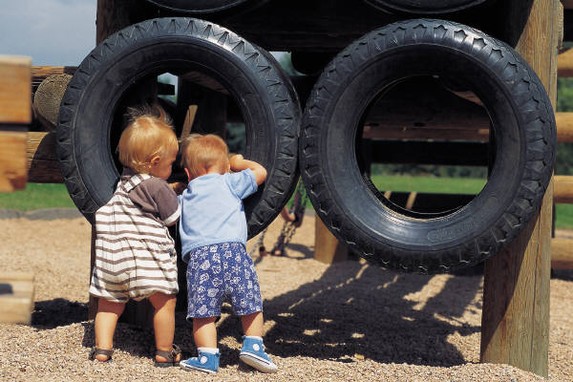
Implementation of Practice Change in Wisconsin… A Journey July 29, 2014
Terri Enters, Part C Coordinator Department of Health Services Birth to 3 Program
Carol Noddings Eichinger, Director of EC Professional Development, Waisman Center

Slide 8
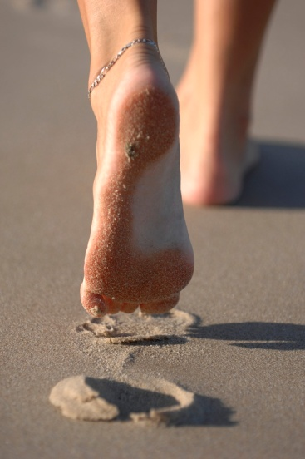
Beginning the journey….changing practice
Primary Coach Approach to Teaming Within Natural Environments had been shared as an evidence-based practice beginning in 2009 with ARRA funding allowing statewide training and technical assistance potential.
Many activities continued encouraging the implementation of these practices with fidelity……
Notes:
We started this journey towards evidence-based practice implementation in 2009, with ARRA funding allowing the state to move forward with intensive training and technical assistance around these practices. Of interest, Carol was the Part C Coordinator at that time, and we had a stable technical assistance and training team at CESA 5 and the University of Wisconsin-Waisman Center, but the state staff at the Department of Health Services had been in flux. Carol has since moved over to the Waisman Center, the TA team with CESA 5 has remained stable, and the Part C Coordinator position at DHS has had several vacant periods and changed hands twice. Terri has been the Part C Coordinator for two years now, and has continued the forward momentum of these practices with collaboration and supportive guidance.

Slide 9
Many activities….
2009 ARRA funded “Crossing Borders” initiative on evidence-based practices
Leadership Event for T&TA Network 2010
Intensive Institutes 2010 and 2011
Preparing Mentor Project 2010
On-Line Blog and FAQ
Regional Institutes with follow-up TA 2012
Comprehensive TA and Coaching 2010-today
On-Line Learning Modules 2013
Notes:
Before we understood Implementation Science, we created a thoughtful multi-year plan with many intentional supports including intensive institutes for training, collaboration across county lines with consortia networking, an initial group of well-trained mentors and champions, on-line resources to support the practices, and ongoing technical assistance personalized for each county. We were pleased with our plan, but noticed there were specific roadblocks for a number of counties in their confidence and readiness for implementing these practice changes.

Slide 10
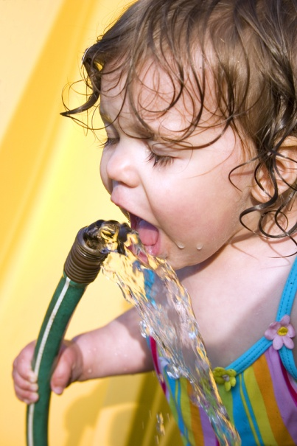
Discovery of Implementation Science….MAJOR influence
Karen Blasé at 2011 Statewide Intersecting Interest event
AH HA…..”So, it takes a number of years and a sequence of stages to arrive at implementation…….?”
Starting in the middle…
Notes:
Two years into this process of practice and system change, we discovered this new frame of thinking called “Implementation Science” and invited Karen Blasé to speak before our entire cross system technical assistance professional group. We were amazed to discover that some of our roadblocks were expectable, and required a different planning framework to address well, and that there was an expectation that system change at this magnitude is really a five year journey. There was some relief in recognizing that we were moving along rather well in that timeline, but also some dismay to recognize some of our major “missed steps” in an implementation journey.

Slide 11
Wisconsin Birth to 3 Leadership Event May, 2013
Joicey Hurth and Barbara Smith…..Implementation Science 101
The road ahead……
Notes:
Wisconsin then took advantage of additional national TA from ECTA through Joiece Hurth and Barbara Smith, realizing we needed a guide by our side to help us step back to analyze and record our journey to date to really be able to clearly see the road ahead.

Slide 12
Implementation Self Assessment
Discovered the many things we had thought through and initiated in this journey
Recognized specific oversights and the opportunity to correct….
Completed statewide Self Assessment of Implementation tool and posted on website
http://www.waisman.wisc.edu/birthto3/ImpScience.php
Notes:
The Implementation Self Assessment process was still in a pilot stage with ECTA, and we agreed to be one of the states that would “test it out”. The guidance was clear, and incredibly informative. We decided the best strategy, since we were actually “in the middle” of installation was to return to the earlier steps, particularly Exploration, and record a narrative summary of what we had considered. We did see that we had thoughtfully considered many of the steps, but also discovered clear oversight on some very important ones. Of great interest, those were the oversights that were still causing the most challenges for the “later adopters” of these practices.
We have posted, with transparency and humility, our journey on the website cited here, so the Birth to 3 Programs in the counties could learn from our process, and also consider their own journey. We also posted a draft County Self Assessment that Jociey and Barbara created for us, to delineate the county and local differences in implementation.

Slide 13
Where are our Stakeholder voices?
State leadership team voices:
Department of Health Services Birth to 3 Program Team
RESource Regional Technical Assistance Facilitators
University of Wisconsin-Wisconsin Professional Development Project (WPDP)
72 County Leads
Notes:
Our biggest “Ah ha” was the recognition that we had quite a few “inside” voices at our table, all of the professionals already versed in Birth to 3 Program practices and familiar with Part C requirements.

Slide 14
Adding more voices at “our table”
Parent
Headstart/Childcare
IHE faculty
Physician
Department of Public Instruction Part B/619
Department of Public Instruction/ Child Outcomes
Interagency Coordinating Council member (ICC)
Section Chief Child Welfare Policy Program, Department of Children and Families (DCF)
Inclusion Coordinator for Child Care (DCF)
Race to the Top Professional Development Project
Foster Care
Wisconsin Pediatrician’s Association
Former Mentors and Champions from ARRA funding
Home Visiting representative
Private vendors practicing in the field
Notes:
However, we had neglected most of our statewide and local community partners who are also very involved in positive outcomes for young children, and in many cases actually serve the same families and children within multiple systems. This led to some thoughtful discussion of who the other important partners might be. Parents, obviously, needed a voice. Other systems that provide services to children, such as Headstart and Child Care, school systems and Part B/619 who continue the journey with the children leaving the Part C services, our ICC, the Department of Children and Families and systems that were responsible for our CAPTA referrals and children in foster care, the doctors and clinics that provide a medical home and/or diagnostic processes for our children, the home visiting world of professionals who support some of the families with more complex dynamics, our earliest champions in the practice, and the contracted vendors who work side by side with County Birth to 3 Programs in providing services. These other perspectives are essential as we consider our own work. Also, their understanding of the way Part C services are delivered, as well as their voiced support of these practices, is an important part of future success and sustainability.

Slide 15
Biggest Lesson: Value for our community partners
State Systemic Improvement Plan opportunity ahead with focus on stakeholder input in implementing a change to make a difference in the lives of young children
More specific focus on measures (Child Outcomes) and messaging (to various community partners and the public at large)
Notes:
Then, the next opportunity arose for consideration and continuous improvement with the State Systemic Improvement Plan processes beginning. We were able to convene a Stakeholder event in June this summer to invite some of those “missing voices” into the discussion. We were able to consider our understanding of the measures we utilize to evidence that we do make a difference in the lives of young children and how they might inform our next steps. We were confronted with the reality that our messaging needs further attention and clarity.

Slide 16
Where are we now: Considering our focus
Child Outcomes and trends discovered from data for Outcome 1 (Positive Social and Emotional Skills)
Primary Coach Approach to Teaming (PCATT) full implementation for all counties
Results Driven Accountability, which includes the newly required State Systemic Improvement Plan (SSIP)
Notes:
We are currently taking a look at trends we have discovered in our child outcome data, as well as our family outcome data, and moving towards further analysis of fidelity of practice change throughout the various counties to see how those link together. We are beginning to formulate our Theory of Action, and have a second large Stakeholder Focus Group scheduled the end of September to further explore our practice change and the move towards full implementation state-wide of these practices.

Slide 17
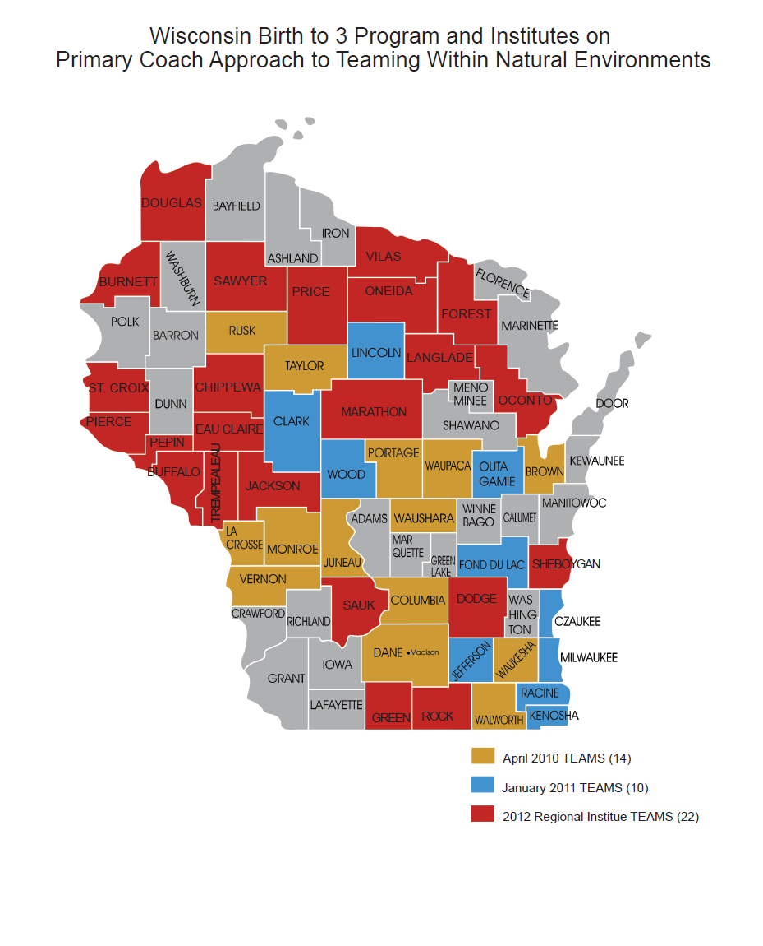
Notes:
This map shows some of the movement across the state, from 2010 through 2012, as different counties became more intentionally committed to the change in practice. This next year, we hope to utilize a variety of fidelity measures to help counties more effectively rate their own journey from “exploration through full implementation” of the Primary Coach Approach to Teaming within Natural Environments with fidelity. At this time, all 72 counties are at different stages in this implementation process.

Slide 18
Sustaining the changes, continuation of a journey
Plan to update our Self Assessment stages with new information and progress
More intentional messaging and collaboration with community partners
More thoughtful inclusion of local level agency participation
Notes:
We completed our first analysis of implementation in the Self Assessment posted this past December, at the website cited earlier. We have made substantial progress since then, and plan to update with additions to this Self Assessment later in the year.
We are also learning from our community partners and more carefully examining our messaging and supporting products or materials for public access that describe these practices.
AND, though we have always held great respect for our local level agency contributions, we are more intentionally exploring ways to include those voices at the state level discussions as we move forward with a variety of Community of Practice opportunities as well as state level committee work on fiscal and practice questions.

Slide 19
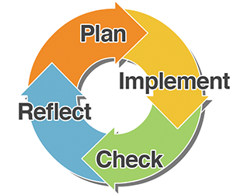
The Continuous Improvement cycle continues
Appreciation for the cyclical nature of change
Abandonment of a linear expectation
Value in one another
The ongoing journey…..
Notes:
We are both humbled and inspired by this journey, and our entire statewide team has great respect and admiration for one another. We have also recognized the many “pause points” where we stop and check ourselves, reflecting thoughtfully, and returning to planning as we discover the un-anticipated along the way. This is a cyclical process, and we have abandoned the idea of a sequence of linear steps that will be completed and then we’ll be done. The process is fascinating and worthy, and we will continue on our way….

Slide 20
Adventures ahead….
Please feel free to contact us…
Terri Enters, Part C Coordinator, Wisconsin Department of Health Services Birth to 3 Program
terri.enters@dhs.wisconsin.gov
Carol Noddings Eichinger, MS,LPC,IMH-E® (IV)
Program Director, Early Childhood Professional Development Program, University Center for Excellence in Developmental Disabilities, Waisman Center, University of Wisconsin-Madison
eichinger@waisman.wisc.edu

