Slide 1
Engaging PD to Improve and Change Practices (EPIC-P) Cycle for Strengthening Statewide PD Support
Sherri Britt Williams
Paula Grubbs
Session 5: Evaluation
Seena Skelton
Notes:
In previous sessions we’ve discussed the first three components of the cycle — Needs Analysis, Design, and Experiences. Now, let’s talk about the final component of the EPIC-P Cycle—Evaluation. The Evaluation component guides you in collecting and using data that matters. But Evaluation isn’t a one-time task—it emphasizes the importance of using multiple data sources, involving partners most affected by the PD support in interpreting findings, and using what you learn to inform future planning.

Slide 2
You will...
Review
key points from the previous three EPIC-P Cycle components.
Explain
the purpose and outcomes of the Evaluation component and its connection to other EPIC-P Cycle components.
Describe
contributions of essential support structures in planning, collecting, and using evaluation data.
Identify
key activities relating to planning and using evaluation data.

Slide 3
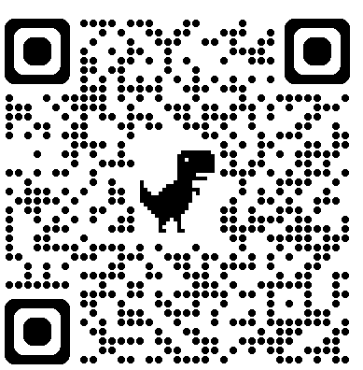
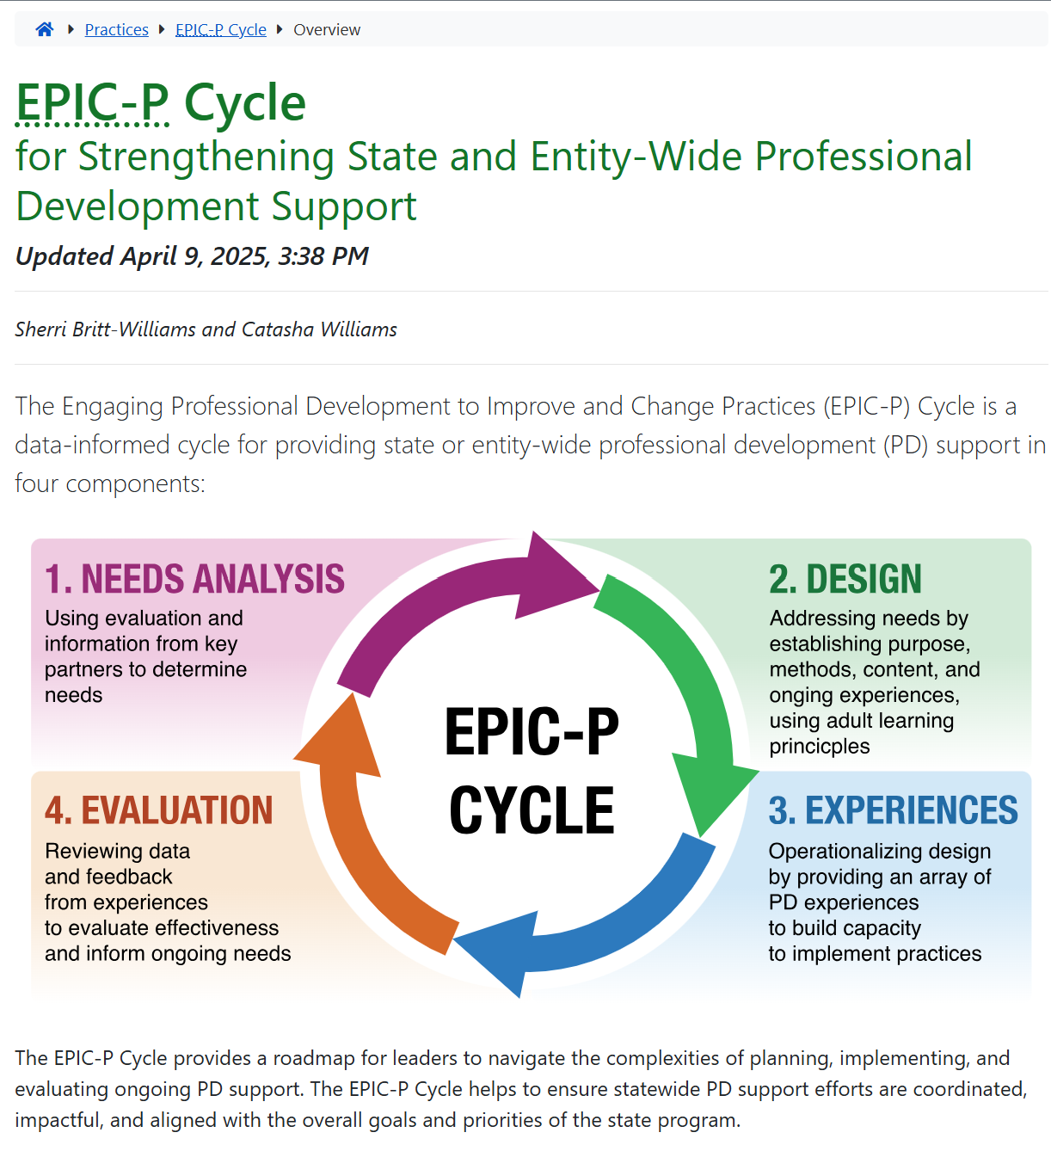
Online Resources
https://ectacenter.org/epic-p/
Notes:
Recall from the overview session that the EPIC-P Cycle can be found online; you can scan the QR code to find the EPIC-P cycle web page. When you get to the web page, you’ll find a brief introduction and an image representing the four components of the EPIC-P Cycle: Needs Analysis, Design, PD Experiences, and Evaluation. The short introduction explains what the EPIC-P Cycle is, who it’s designed for, and how it can be used to support meaningful, system-wide PD.
You’ll also see the acronym spelled out again—Engaging Professional Development to Improve and Change Practices—and a quick reminder of how the cycle flows: Explore needs, Plan PD, Implement PD, and Check for impact.
This cycle is useful for state agencies, TA providers, and regional or local teams supporting PD at scale.
URL: https://ectacenter.org/epic-p/

Slide 4
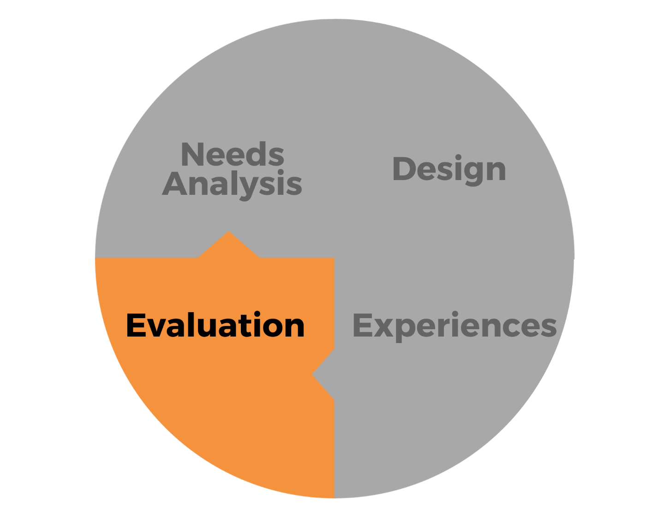
Evaluation
Reviewing Data and Feedback from Experiences to Evaluate Effectiveness and Impact and Inform Ongoing Needs
Notes:
In today’s webinar, we’re focusing on the Evaluation component of the EPIC-P Cycle.
This component is all about reviewing data and feedback from professional learning experiences to assess their effectiveness and impact.
Evaluation helps us answer critical questions:
Did the PD meet its intended goals?
What changed as a result of the experience?
And most importantly—what do we still need to address moving forward?
By engaging in thoughtful evaluation, we can inform ongoing needs and make data-informed decisions that continuously improve our professional development efforts.
Let’s take a closer look at how to approach this component with purpose and clarity.

Slide 5

Evaluation Purpose and Outcomes
Evaluation is a systematic method for using data (information) to answer questions about the quality and impact of professional learning experience.
Image from Shutterstock
Notes:
When we mention evaluation, many people immediately picture a resource-heavy process—one that involves hiring external evaluators or data analysts to create an elaborate plan, gather and analyze data, and produce a formal report of findings.
And while that’s certainly one valid approach, evaluation doesn’t always have to look like that.
Evaluation can be designed and led internally by members of your organization. It can even be conducted by the very people who are participating in the learning experience or innovation. This approach is often called participatory evaluation.
The key takeaway here is that evaluation isn’t about complexity; it’s about using data in a systematic way to answer important questions about the quality and impact of a professional learning experience, program, or innovation.
A strong PD evaluation allow us to address questions such as,
Was PD effective in meeting outcomes?
Was it useful and relevant?
Did participants gain knowledge and develop skills?
How is new knowledge applied?
Did the PD fit real-world contexts?
How are new skills being implemented?
What does this tell us about needs, design, and experiences?

Slide 6
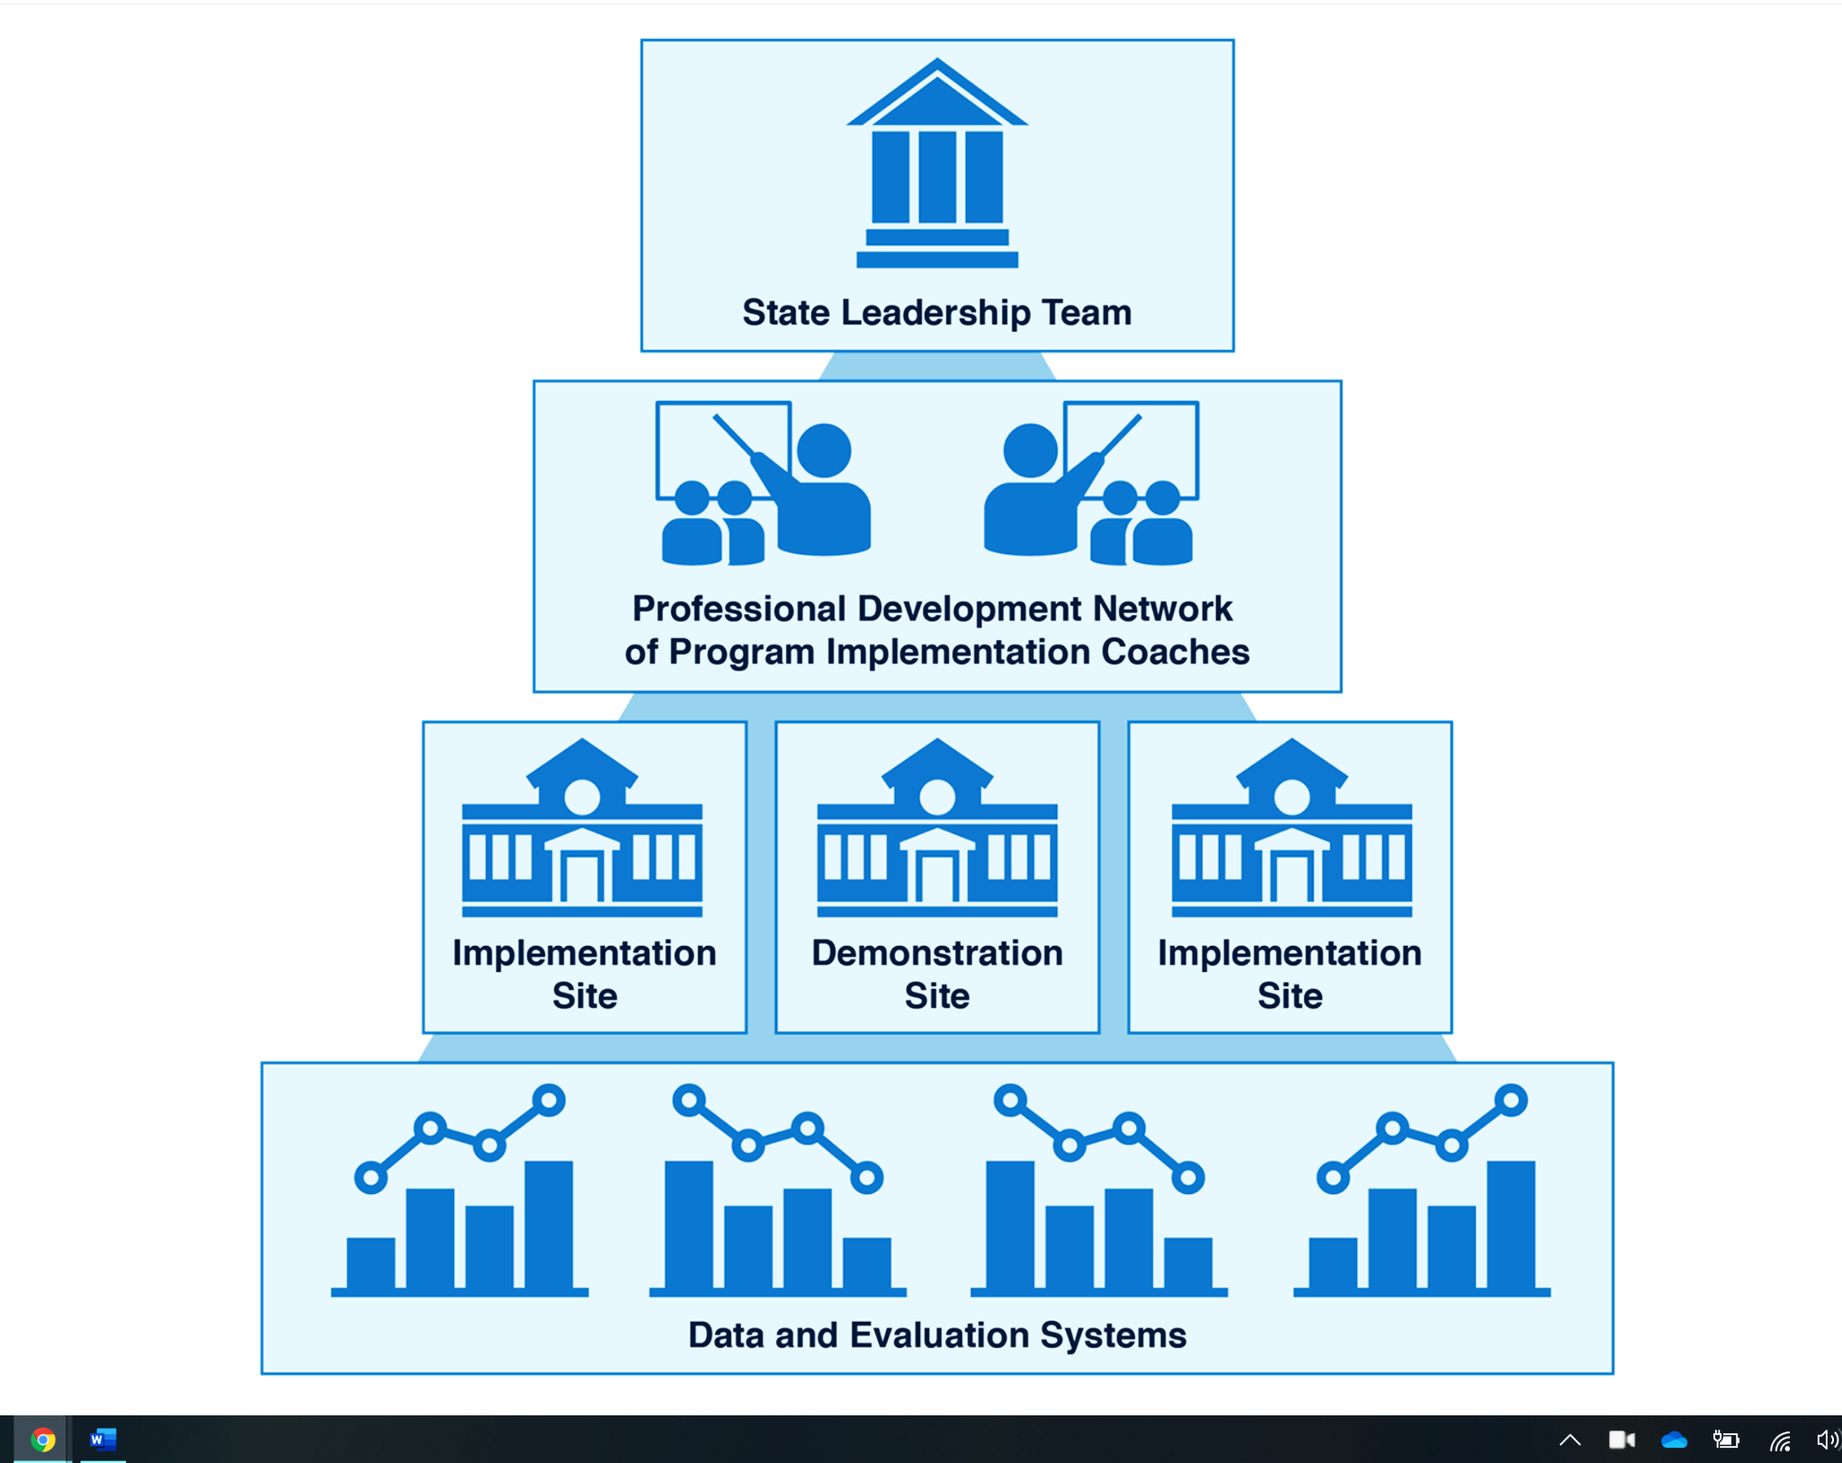
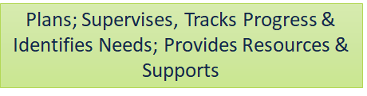

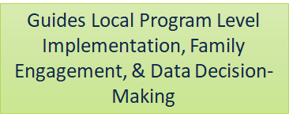
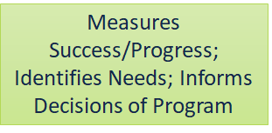
Essential Support Structures Working Together to Create Effective Professional Development
https://ectacenter.org/sig/ess.asp
Notes:
And just like the other EPIC-P Cycle components, the essential support structures play an important role and should be leveraged for the evaluation component.

Slide 7
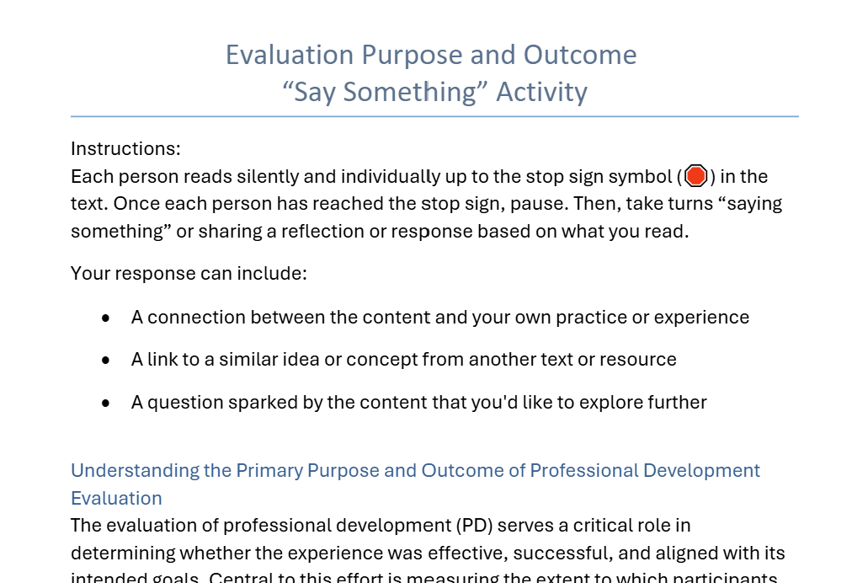
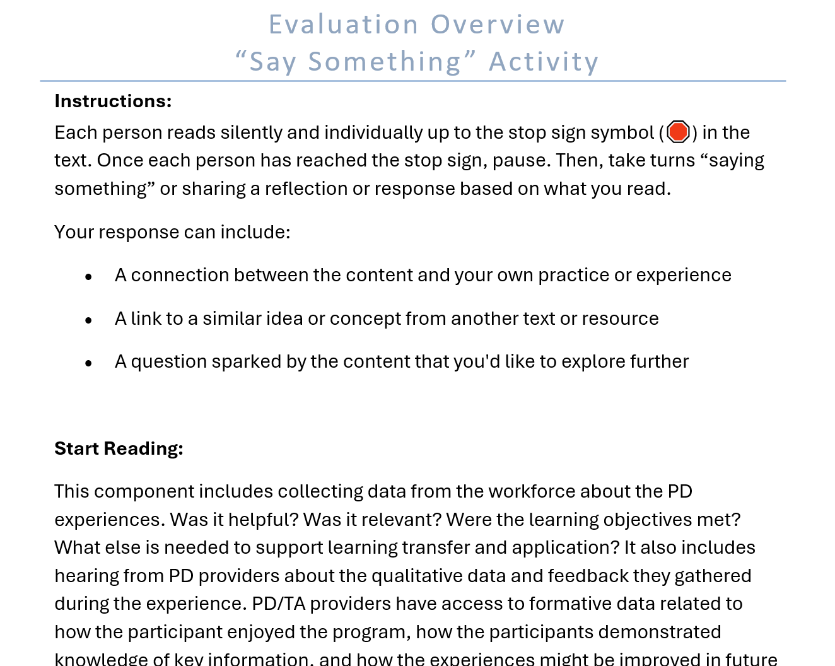
Say Something Pair Activity
Read your assigned handout to the STOP Sign.
Stop reading and “Say Something” about what you just read.
  A connection with your own experience
  A connection with a resource or reference
  A question you’d like to explore
Continue this process at each STOP Sign.

Slide 8
From Data to Knowledge
“[K]nowledge is information that changes something or somebody - either by becoming grounds for actions, or by making an individual (or an institution) capable of different or more effective action.”
(Drucker, 1989)
Tobias Arhelger on Shutterstock

Slide 9
Using Qualitative & Quantitative Data Helps to Tell A More Comprehensive Story
Qualitative Data
Quantitative Data
All quantitative data is based upon qualitative judgments; and all qualitative data can be described and manipulated numerically.
(Trochim, 2006)
Notes:
Quality evaluation starts with quality data, data that helps us tell a rich, meaningful story about what’s happening and why. But to collect meaningful data, we first need to be clear about our evaluation questions.
What is it we truly want to understand?
What change or outcome are we hoping to see?
Strong evaluation questions are specific and closely aligned with our overall goals and intended learning objectives. They should also be informed by what we learned during the needs analysis at the beginning of the EPIC-P Cycle.
To paint a fuller picture, effective evaluations often draw on both quantitative and qualitative data. And while it’s common to think of data as purely objective, the reality is—all data are shaped by context and interpretation. What matters most is choosing the right mix of methods to generate insights that are meaningful, trustworthy, and actionable.

Slide 10
Methods of Data Collection
Content Assessments (Knowledge)
Surveys (Perception)
Observations/Walkthroughs (Knowledge/Skills/Practice)
Photovoice
(Participatory Evaluation))
Interviews
(Self-Report)
Focus Groups
(Self-Report)
Notes:
As we explore different ways to evaluate professional learning, let’s take a quick look at some common data collection methods:
Content Assessments (Knowledge): These measure participants’ understanding of key concepts before and after a learning experience to gauge knowledge gains.
Surveys (Perception): Surveys capture participants’ beliefs, attitudes, or perceptions about the relevance, quality, and impact of a professional development experience.
Observations/Walkthroughs (Knowledge/Skills/Practice): These involve watching practice in action to assess whether and how participants are applying new knowledge and skills.
Photovoice (Participatory Evaluation): This creative method invites participants to use photographs and narratives to reflect on their experiences and offer insight from their perspective.
Interviews (Self-Report): One-on-one interviews provide an opportunity for participants to share their personal experiences, reflections, and feedback in more depth.
Focus Groups (Self-Report): Focus groups bring participants together to discuss their experiences collectively, allowing evaluators to identify shared themes and diverse viewpoints.
Each of these methods offers a unique window into the impact of professional learning and can be used individually or in combination, depending on your goals.

Slide 11

Data – Information - Knowledge
Transformation
  “Therefore, data, prior to becoming knowledge, is in a raw state and is not connected in a meaningful way to a context or situation.”
  (Breiter & Light, 2006, p.209)
Knowledge
Information
Data
Notes:
Data becomes information through providing context:
Information becomes knowledge when it is considered through a critical lens and is tested over time
Knowledge becomes wisdom when action is implemented as a result of the knowledge and repeated over time until it is internalized and the behavior can be implemented with a level of automaticity and nuanced to apply to shifting contexts.

Slide 12
Evaluation
From Data to Wisdom In Action
Service providers from across the region attended a two-day professional development session on a new family interview protocol for early intervention home assessments. At the end of the session, participants completed a survey to rate the relevance of the session content to their work.
Notes:
Let’s illustrate how we transform data into wisdom through this scenario.

Slide 13
From Data to Information
Data
N=75/80
90% Relevant or highly relevant
10% Low or not relevant
85% positive ratings were in urban or suburban locations
5% positive ratings were from rural locations
Themes from Open Response.
The protocol seems robust and will enable the collection of a lot of good information
The app will support ease of data entry in real-time
The number of questions seems overwhelming and might come off as too intrusive
Many of my family members live in dead zones, so I’m not sure how reliable the app is going to be
Context
The regional PD Network is known for the quantity and quality of its PD offerings, which are typically well attended, particularly by suburban service providers.
There’s been a significant decline in participation from rural settings in PD events over time
There is a 30% gap between families in rural areas and those in urban and suburban areas accessing services
Information
Although 90% of participants found the session relevant or highly relevant, most of the positive responses came from urban and suburban providers, suggesting that the content and format of the session may not be aligned with the realities or needs of rural service providers.
The decline in rural participation over time is a red flag and may reflect systemic barriers or a perception that PD offerings are not tailored to rural contexts.
The 10% who rated the session as less relevant may disproportionately represent rural participants, indicating that the protocol and training may not fully account for the logistical, cultural, or relational dynamics in rural early intervention (EI) service delivery.
The gap in family access to EI services between rural and urban/suburban areas could be exacerbated if providers in rural communities are not effectively engaged or equipped with tools like the new family interview protocol.
Notes:
Data becomes information through providing context: For example, participant survey data regarding the increase in understanding of content presented in a PD session about a new family interview protocol, becomes information when we put it into context (The majority of the staff members at the center are required to use the protocol, as part of the family assessment process to determine service plans, and the date there have only been an overview presentation of the protocol at a monthly staff meeting.)
How do you connect a story in a meaningful way to a broader context?

Slide 14
From Information to Knowledge
Information
High Overall Satisfaction Masks Geographic Disparities
Decreased Rural Participation in PD Is Concerning
Relevance May Be Geographically Contextual
Potential Impact on Service Equity
Knowledge
Adapt and Differentiate PD Offerings: Considering the information provided, moving forward, we will develop targeted sessions or follow-ups that are customized for rural contexts, leveraging the PD Network to possibly co-design with rural providers.
Engage Rural Providers Proactively: We will explore barriers to participation (e.g., time, access, perceived relevance) and address them through more flexible, hybrid, or locally facilitated formats.
Monitor Equity in Implementation: We will partner with local provider supervisors to track how the interview protocol is adopted across geographies and whether it contributes to reducing or widening access gaps among families.
Notes:
The key difference between information and knowledge lies in their nature and application. Information is data that provides context, while knowledge is the understanding and application of that information within a specific context. Information becomes knowledge when it is considered through a critical lens and is tested over time.
Essentially, information is what you know, and knowledge is how you know it and what you can do with it.

Slide 15
From Knowledge to Wisdom
Wisdom
Repetition and Refinement
Internalization and Automaticity
Wisdom-informed Practice:
  Includes diverse provider perspectives in planning
  Ensures access and relevance
  Makes decisions reponding to shifting demographic and systemic realities
Knowledge
Adapt and Differentiate PD Offerings
Engage Rural Providers Proactively
Monitor Equity in Implementation
Notes:
Knowledge becomes wisdom when action is implemented as a result of the knowledge and repeated over time until it is internalized and the behavior can be implemented with a level of automaticity and nuanced to apply to shifting contexts.
When PD designers act on it consistently, learn from outcomes, and adjust their practice until inclusive design becomes second nature, they transform knowledge into wisdom. That wisdom ensures every future session is more equitable, relevant, and impactful across
Repetition and Refinement:
Through an ongoing cycle of reflection and refinement, PD designers start internalizing what truly works across different provider contexts.
Internalization and Automaticity: Over time, PD designers no longer need to "react" to rural disengagement—they design with geographic, cultural, and infrastructural variability in mind from the start.
Wisdom in Practice:
PD design becomes wisdom-informed when:
Inclusion of diverse provider perspectives is built into planning,
Equity of access and relevance is a foundational assumption,
Design decisions are responsive to shifting demographic and systemic realities, without requiring fresh discovery each time.

Slide 16
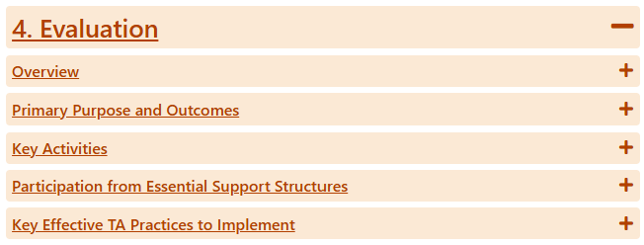
Evaluation Overview
https://ectacenter.org/epic-p/

Slide 17

Application Activity
In your small group:
Download the Evaluation Report.
Assign group roles: Facilitator, Timekeeper, Recorder/Reporter.
Use the prompts to consider the data and make decisions that would inform future PD efforts.
Prepare to share 1 or 2 examples with the whole group.
Image by iStock
Notes:
Application Activity-
20 min Divide participants into breakout groups of 6 to 8 people. Assign roles: Facilitator, Reporter/Notetaker, and timekeeper. Once in group, each group will read and discuss the
Groups are provided an evaluation report scenario based on the evaluation data collected from session. Using information from the report and decision-making prompts, group members will make meaning of the data and make data-informed decisions that would inform the team’s future PD efforts.

Slide 18
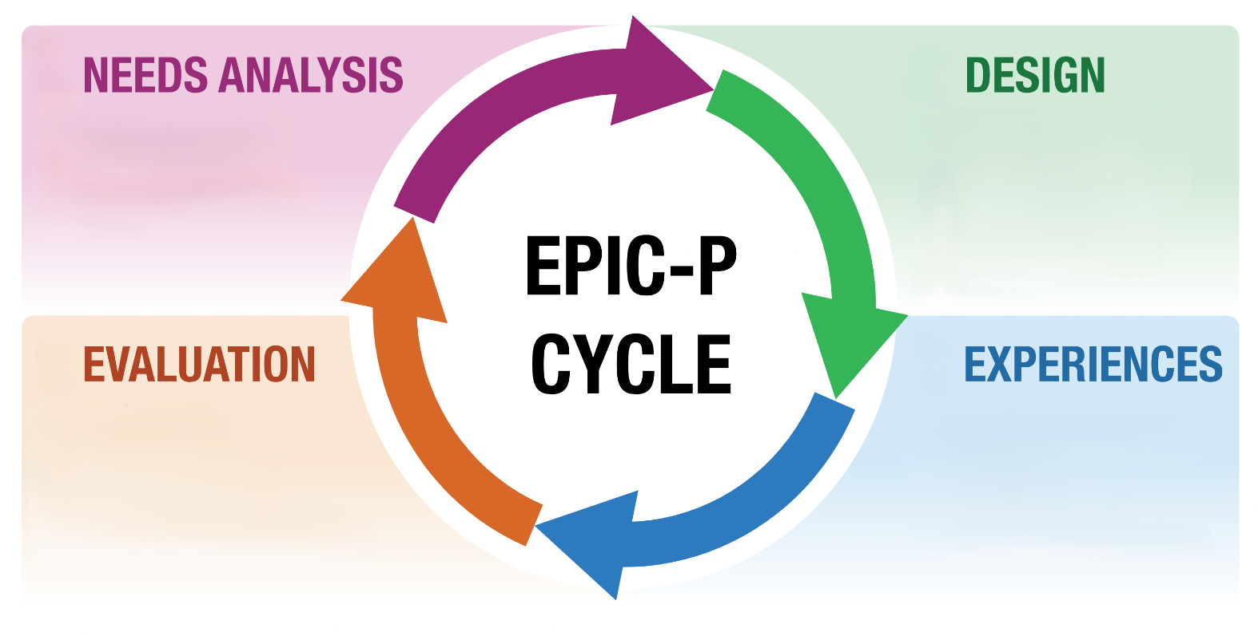

Keep the Cycle Turning!
Align PD support with program planning and improvement
Run full and “quick” cycles
Use the EPIC-P Cycle Self Assessment and Team Reflection Tools
Stay connected to EPIC-P Cycle webpage to find information and resources
Celebrate successes and learning– and apply that to ongoing PD support
https://ectacenter.org/epic-p/
Notes:
Over the past four sessions we took you on a step-by-step journey each component, one at a time....Needs Analysis, Design, PD Experiences, and Evaluation. But the EPIC-P cycle is never linear—it’s cyclical and ongoing.
The EPIC-P Cycle should be built into your continuous improvement plans. As your plans identify what must change. The EPIC-P cycle lays out a process for making sure people have the information and resources they need to make that change. As your strategic and continuous improvement planning uncovers gaps, the EPIC-P Cycle helps you align PD support to the solution, so your change strategies have PD support built in.
The EPIC-P Cycle is adaptable and scalable in a way that you can run full or “quick” cycles. You can do a deep, comprehensive cycle as part of your routine strategic planning process and you can move through a more rapid fire mini-cycle for an urgent need or a just-in-time PD support.
Use the resources on the webpage. The EPIC-P Cycle Self Assessment gives you a scan of strengths and gaps aligned with each component of the cycle; and the team reflection activity is a good way to facilitate discussion on each team member’s strengths, roles, and priorities relating to each component of the cycle.
We will be posting more samples, templates, activities, and other resources to the EPIC-P Cycle page—including the scenarios and activities we used during this web series– so stay connected to the webpage and use the information you find there.
Celebrate those moments when you implement supports that make a positive impact and also celebrate and apply the things you learn when you may implement something that seemed to miss the mark.

Slide 19

What is one action you can take over the next few weeks to connect your work or the work of your team to one or more of the EPIC-P Cycle components?
Image by ymyphoto from Pixabay

Slide 20
Find out more at ectacenter.org
The ECTA Center is a program of the FPG Child Development Institute of the University of North Carolina at Chapel Hill, funded through cooperative agreement number H326P170001 from the Office of Special Education Programs, U.S. Department of Education. Opinions expressed herein do not necessarily represent the Department of Education's position or policy.

