Slide 1
Engaging PD to Improve and Change Practices (EPIC-P) Cycle for Strengthening Statewide PD Support
Sherri Britt Williams
Paula Grubbs
Session 4: Experiences
Seena Skelton
Notes:
In previous sessions we’ve discussed the first two components of the cycle — Needs Analysis and Design. Now, let’s talk about the third component of the EPIC-P Cycle—the Professional Development Experiences.
This is where you bring your professional development design plan to life. After you’ve identified needs and carefully designed the support, the PD Experience is the moment when educators, practitioners, and other partners engage in and apply learning that can shift practice.

Slide 2

Resonating Quotes
Quote 1: “Tell me and I forget, teach me and I may remember, involve me and I learn.”
- Xun Kuang, Chinese Confucian philosopher.
Quote 2: “Learning is experience. Everything else is just information.”
- Albert Einstein
Quote 3: “The learning process is something you can incite, literally incite, like a riot."
- Audre Lorde
What resonated with you about the quote?
How do you connect the quote to today’s session topic?
Image by Clker-Free-Vector-Images from Pixabay

Slide 3
You will...
Explain
the purpose of the Experiences component in the EPIC-P-Cycle and its connection to the Needs Analysis and Design components.
Describe
the roles and contributions of essential support structures in creating impactful learning experiences.
Identify
the key activities associated with creating professional learning experiences that elicit high participant engagement and deep learning.

Slide 4
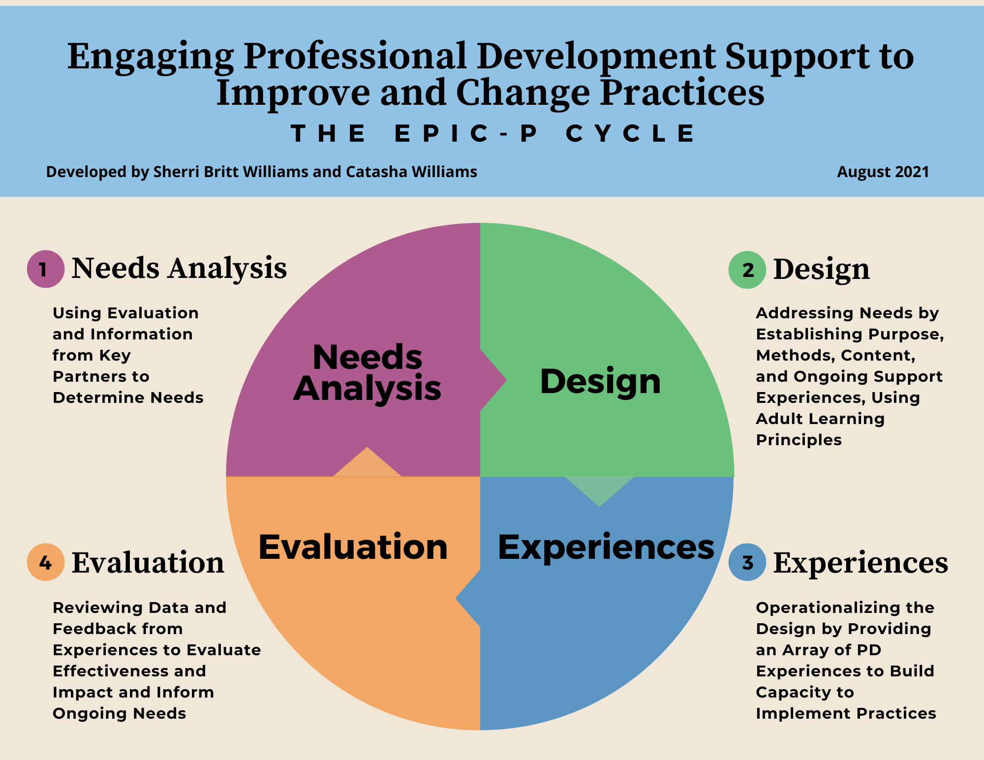

EPIC-P Cycle
Using a
Data-Informed Process to Assess Needs, Design, Deliver, and Evaluate PD Support

Slide 5
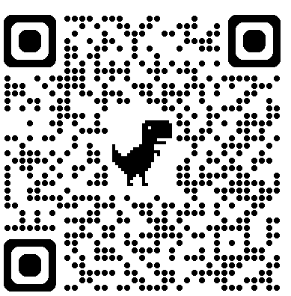
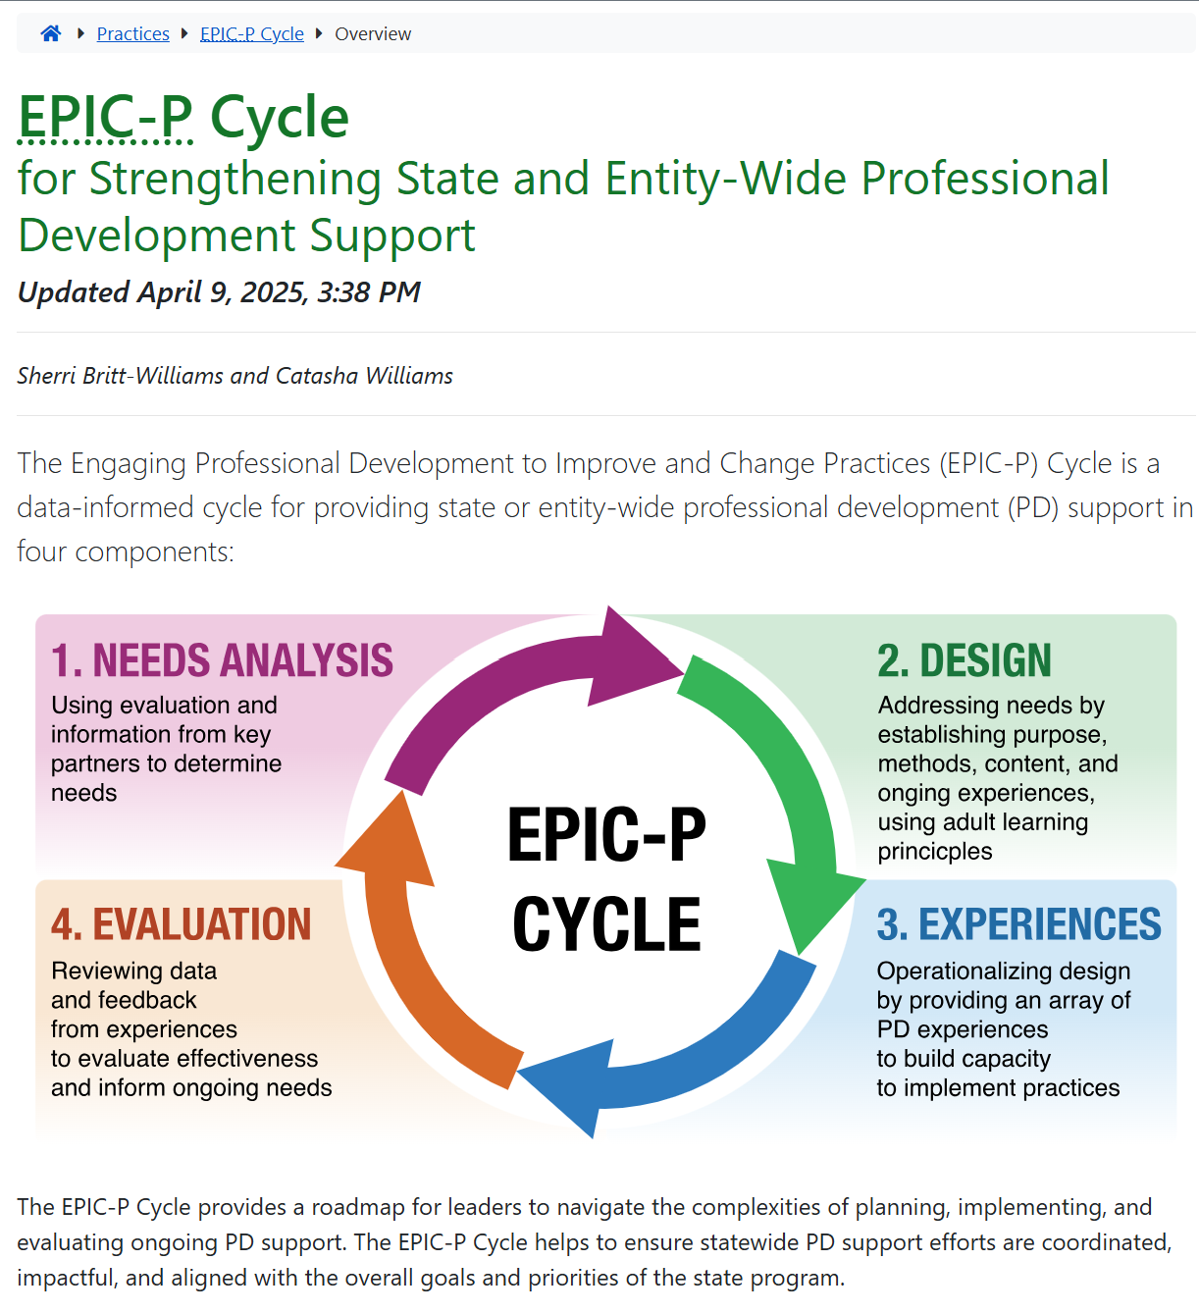
Online Resources
https://ectacenter.org/epic-p/
Notes:
Recall from the overview session that the EPIC-P Cycle can be found online; you can scan the QR code to find the EPIC-P cycle web page. We will also place a link to the site in the chat box. When you get to the web page, you’ll find a brief introduction and an image representing the four components of the EPIC-P Cycle: Needs Analysis, Design, PD Experiences, and Evaluation. The short introduction explains what the EPIC-P Cycle is, who it’s designed for, and how it can be used to support meaningful, system-wide PD.
URL: https://ectacenter.org/epic-p/

Slide 6
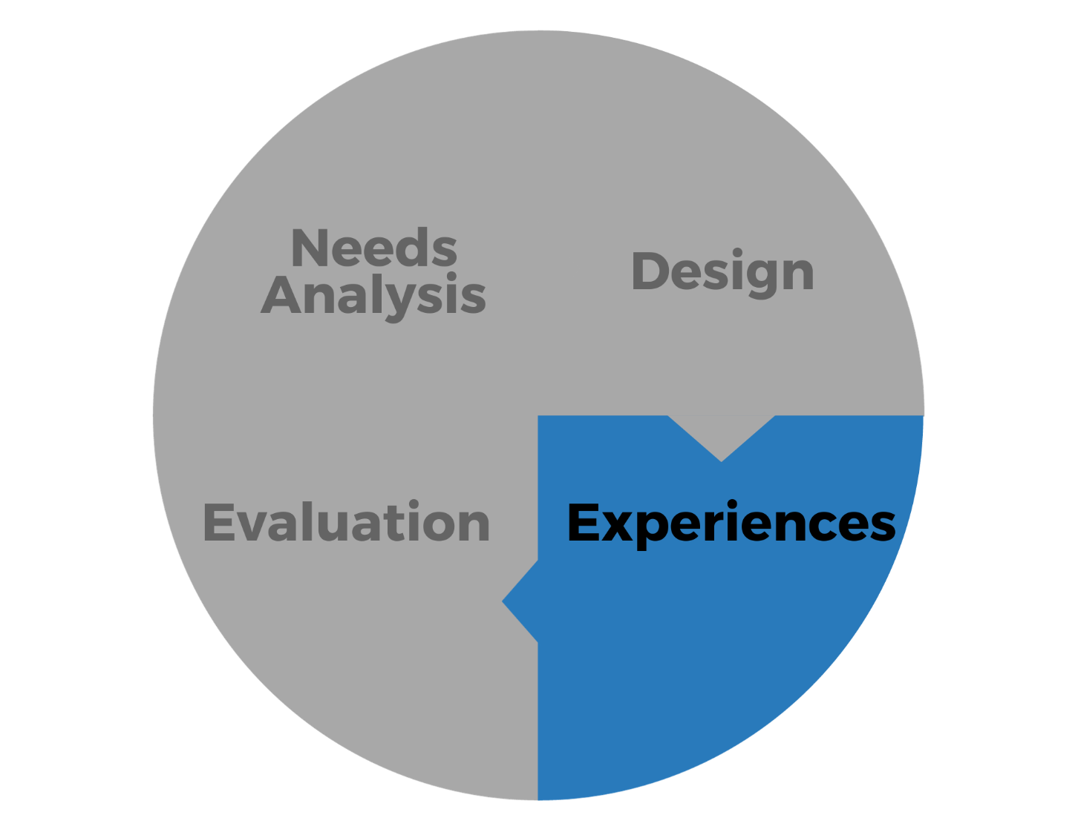
Experiences
Operationalizing the Design
by Providing an Array of PD
Experiences to Build
Capacity to Implement
Practices​

Slide 7

Journaling as Learning Tool
Promotes Metacognition
Supports Meaning-Making
Encourages Critical Reflection
Image by Prostock Studio via Shutterstock
Notes:
Journaling can be a powerful tool to facilitate learning, particularly in adult and professional learning environments. Journaling encourages learners to think about their thinking, helping them reflect on how they learn, what they understand, and where they need support. Journaling helps learners connect new knowledge to prior experiences, which deepens understanding and makes learning more relevant and personalized. When learners pause to write about what they’ve learned, they reinforce and internalize the content, making it easier to recall and apply later. Journaling also allows space to question assumptions, recognize biases, and grapple with complex ideas, these are keys to transformative learning.

Slide 8
Connecting the Dots
Information gathered from the Need Analysis informs the design plan
The Design plan provides structure for the learning experiences
The Experiences are the activities and supports that facilitate, expand, or deepen participant understanding, skill development, or application.
Notes:
Over the last three sessions, we’ve explored the core components of the EPIC-P Cycle laying the foundation for understanding how to design and deliver truly impactful professional learning. Now, let’s connect the dots.
Recall that it all begins with the comprehensive needs analysis, a discovery process that helps us understand where the participants are starting from, what their context looks like, and what supports will be most meaningful to them.
From there, we move into the design plan. Think of this as the architectural blueprint. It organizes the goals, strategies, and scaffolding needed to ensure the learning experience is coherent, intentional, and aligned with both participant needs and organizational priorities. And then, we bring it to life through the learning experiences themselves. These are the interactive, purposefully designed activities that support knowledge construction, skill development, and practical application. Each phase builds on the last, and together, they create a continuous cycle of learning that is responsive, relevant, and impactful.

Slide 9

Connecting the Dots 1 - Minute Journal Prompt
Think back on a professional learning experience you’ve helped design or were a participant.
Which phase (needs analysis, design planning, or learning experience delivery) was most clearly defined or impactful for you, and why?
Image by Johnstocker Production via Shutterstock

Slide 10

Considerations for Experiences
Grounded in Adult Learning Principles
Adaptive & Inclusive
Learning as an Environment, Not Just Delivery
Multi-Dimensional Engagement
Real-Time Evaluation & Responsiveness
Learning as a Process, Not an Event
Image via Shutterstock
Notes:
Professional development isn’t just about delivering content—it’s about creating meaningful learning experiences. And when we’re designing those experiences for adults, we need to ground our approach in what we know about how adults actually learn.
Experiences should be grounded in adult learning principles. Adults learn best when they’re actively involved, when the content is relevant to their current roles, and when it connects to their lived experiences. They want to understand why something matters, how it applies to them, and how it will improve their work or life. That’s what drives engagement and, more importantly, retention and application.
So, when we plan professional learning, we have to start by asking: Is this relevant? Is this real? And does it respect the wisdom and experiences each person brings into the room?
We also have to remember that no two learners are the same. That’s why professional development must be adaptive and inclusive. It’s not enough to have a one-size-fits-all approach. We need to recognize and plan for diverse learning styles, access needs, and preferences. This means using a variety of methods, group discussions, case studies, panels with lived experience, self-reflection tools, whatever it takes to keep people engaged and allow them to discover meaning for themselves. Inclusive design doesn’t just benefit some participants; it improves the experience for everyone.
PD planners should move beyond the idea of “delivering PD” to “creating learning environments”. This includes building in performance supports, things like job aids, coaching, and tools that help people implement what they’ve learned. It includes peer-to-peer learning. Impactful learning experiences also include real opportunities for practice and application.
Truly powerful learning experiences engage participants on three dimensions:
Behavioral – What are participants doing? Are they active, collaborating, making decisions?
Cognitive – Are they being intellectually challenged? Are they thinking critically?
Emotional – How are they feeling during the experience? Are they inspired, affirmed, maybe even a little uncomfortable in productive ways?
When all three dimensions are engaged, we move beyond a transactional model of PD—and into transformational learning.
Another key element of effective facilitation is being responsive in the moment. PD facilitators have to read the room; they have to determine in real time what’s landing and what’s not, and adjust accordingly. That could mean shifting pace, revisiting a concept, or creating more space for reflection. This real-time evaluation keeps the experience authentic and personalized, which is ultimately what makes it impactful.
And finally, we have to remember that learning is a process. People need multiple, scaffolded opportunities to return to concepts, to try things out, to make mistakes, and refine their practice. That’s how real change happens—over time, with intention and support. Effective learning experiences honor people’s lived experiences, support their growth, and invite them into deeper connection with themselves, with their peers, and with the work that brought them here.

Slide 11
Experiences Upacked 2 - Minute Journal Prompt
Think about a professional learning experience in which you’ve recently facilitated or participated.
How well did it honor adult learning principles?
Was it relevant, engaging, and connected to your lived experience?
  In what ways did the experience feel inclusive and adaptive to different learning styles and needs?
  Did the learning environment support you behaviorally, cognitively, and emotionally?
What’s one shift you could make as a facilitator or a learner to help move future PD from transactional to transformational?
Image by Johnstocker Production via Shutterstock
Notes:
S

Slide 12
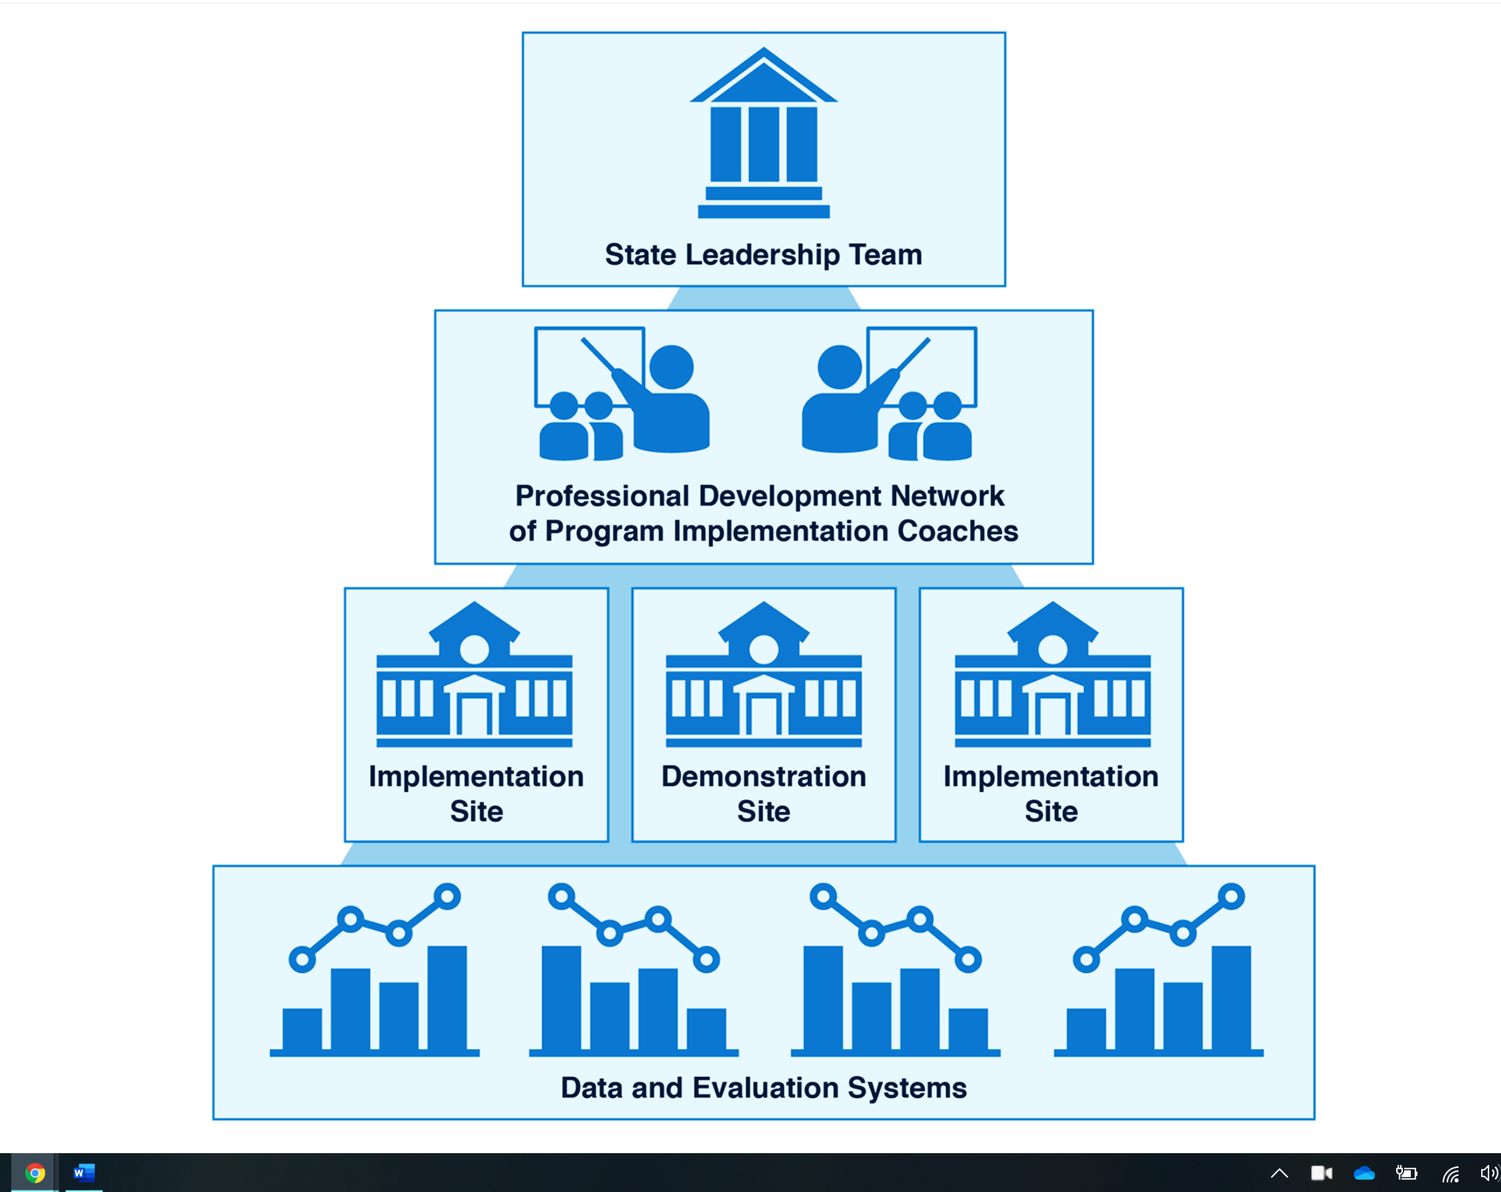
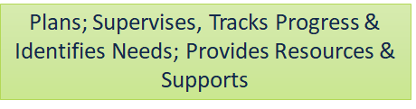

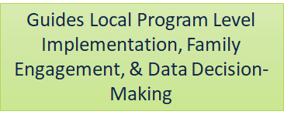
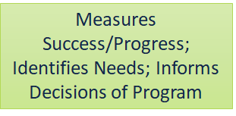
Essential Support Structures Working Together to Create Effective Professional Development
https://ectacenter.org/sig/ess.asp
Notes:
When designing PD experiences, we have to keep in mind the essential support structures. State Leadership Team (SLT) members play a dual role in professional learning experiences—as both facilitators and active learners. Their participation signals a commitment to ongoing growth and provides valuable insights that inform needed changes to policies, procedures, and systems that support learning transfer and application.
The Professional Development Network (PDN), composed of facilitators skilled in adult learning principles, designs and leads learning experiences that engage participants on behavioral, cognitive, and emotional levels. They ensure content is relevant, intellectually stimulating, and emotionally resonant, all while using strategies that promote retention and application of new knowledge.
Implementation site staff and partners are the primary participants in these learning experiences. They engage with PD to enhance their practices in ways that ultimately improve outcomes for children with disabilities and their families.
Finally, data and evaluation systems play a critical role by providing real-time feedback through formative assessments and post-session surveys. These tools help facilitators tailor learning in the moment and refine future experiences based on participant engagement, satisfaction, and perceived relevance.

Slide 13
Experiences Upacked 2 - Minute Prompt
Think about your professional learning context and the interconnected roles of:
  The State Leadership Team (SLT)
  Professional Development Network (PDN)
  Implementation Site staff
  Data and evaluation systems
Where do you see yourself within this ecosystem?
How do you contribute to making learning experiences relevant, engaging, and impactful?
Reflect on one way you can strengthen the connection between professional learning and improved outcomes for children with disabilities and their families.
Image by Johnstocker Production via Shutterstock

Slide 14
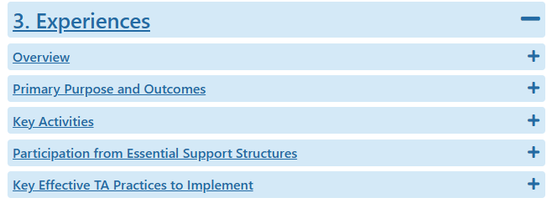
Experiences Overview
https://ectacenter.org/epic-p/

Slide 15
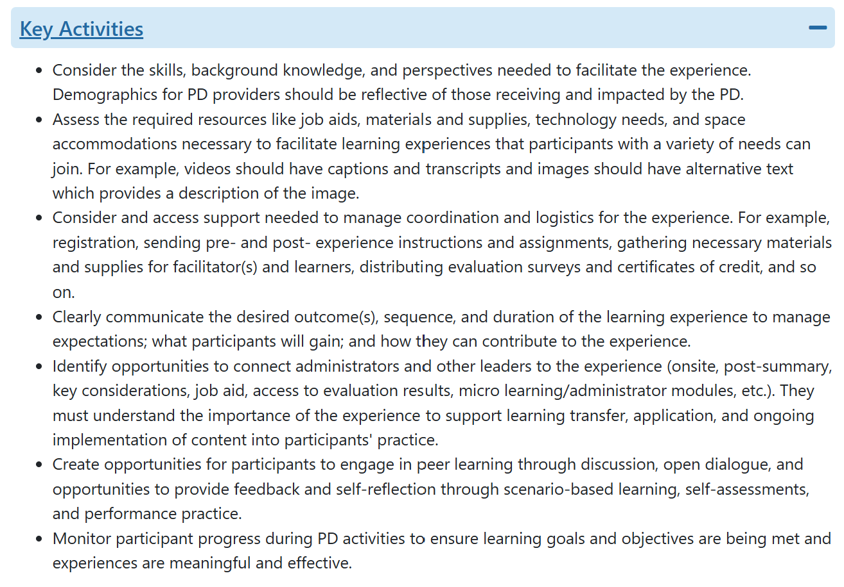
Experiences Key Activities
Relevant facilitators who reflective those receiving and impacted by PD
Accessible materials and environments
Coordinate logistics and supports
Engage leadership for alignment and implementation support
Communicate goals and structure
Facilitate peer learning and reflection
Monitor progress
https://ectacenter.org/epic-p/

Slide 16
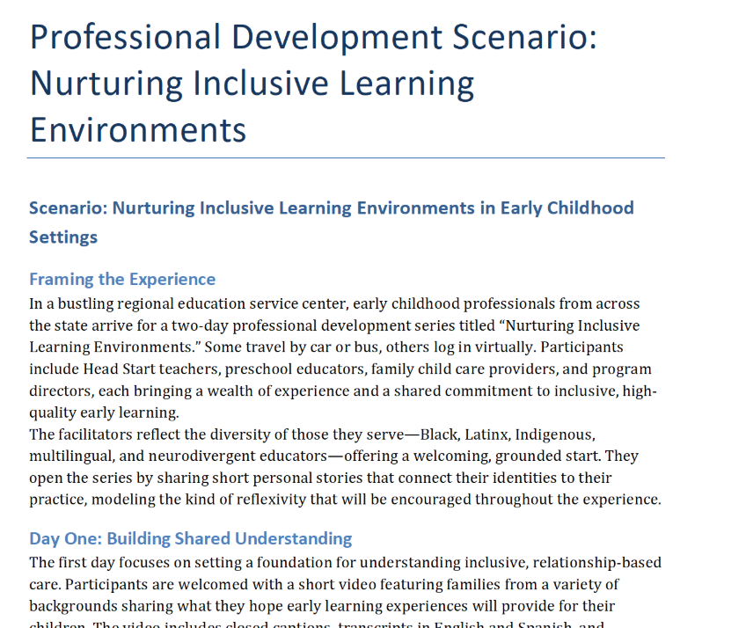
Application Activity
In your small group
Download the Activity scenario.
Assign group roles: Facilitator, Timekeeper, Recorder/Reporter.
Identify and annotate illustrations of the key activities reflecting effective PD experiences.
Prepare to share 1 or 2 examples with the whole group.

Slide 17

What is one thing you heard today that you can share or use in your work context?
Image by Miguel R Perez Rivas from Pixabay

Slide 18
Find out more at ectacenter.org
The ECTA Center is a program of the FPG Child Development Institute of the University of North Carolina at Chapel Hill, funded through cooperative agreement number H326P170001 from the Office of Special Education Programs, U.S. Department of Education. Opinions expressed herein do not necessarily represent the Department of Education's position or policy.

