Slide 1
Engaging PD to Improve and Change Practices (EPIC-P) Cycle for Strengthening Statewide PD Support
Sherri Britt Williams
Paula Grubbs
Session 3: Design
Seena Skelton
Notes:
This session introduces step two in the EPIC-P cycle. EPIC-P stands for: Engaging Professional Development to Improve and Change Practices. It’s a structured approach grounded in implementation science meant to support system-level teams as they plan and implement PD support. Design helps to align the priorities and goals of the system with the needs and demands of people implementing changes across the system.

Slide 2
Password
We will give one clue at a time.
Try to guess the “secret word” by placing your guess in the Chat box, or you can enable your hands-up reaction. You have 7 seconds to guess.
You will have five tries to guess the word.
The first person to correctly guess the secret word wins.
AI Generated
Notes:
Instructions for Password Chat Game:
We’ll give you word clues, one at a time.
After each clue, type your best guess for the mystery word into the chat box, as soon as you think you’ve got it!
We’ll be keeping an eye on the chat for correct guesses.
You’ll have a total of five one-word clues to figure out the word.

Slide 3
Password Clues
1. Construct
4. Design
2. Frame
3. Form
Notes:
I will present each clue. You’ll have 7 seconds to try to guess the word. Place your guess in the chat box. If no one guesses the word, after 7 seconds, I will present the next clue, and we will go on until someone guesses the secret word or we give out all five clues.
(Clues are animated. Present one clue at a time, allow 7 seconds before the presentation of the next word.)

Slide 4
Password Game Answer
Structure
Secret Word
Notes:
Our password is Structure, the focus of today’s webinar. PD design planning is a strategic and thoughtful process that involves creating an effective and engaging learning structure for planning professional learning experiences. A comprehensive professional learning design that uses proven instructional strategies and methodologies creates a structured, effective, and engaging learning experience. The learning objectives align with the goals of both the learners and the organization. Well-designed professional learning engages participants by using varied interactive and dynamic methods and planned supports for assisting participants in transferring what they learned during the experience to their professional practice.

Slide 5
You will...
Identify
the goals of a strong professional development design based on a comprehensive needs analysis.
Describe
the roles and contributions of essential support structures in PD design.
Explain
how PD design structures effective learning experiences.
Create
indicators for key activities included in a PD design process.

Slide 6
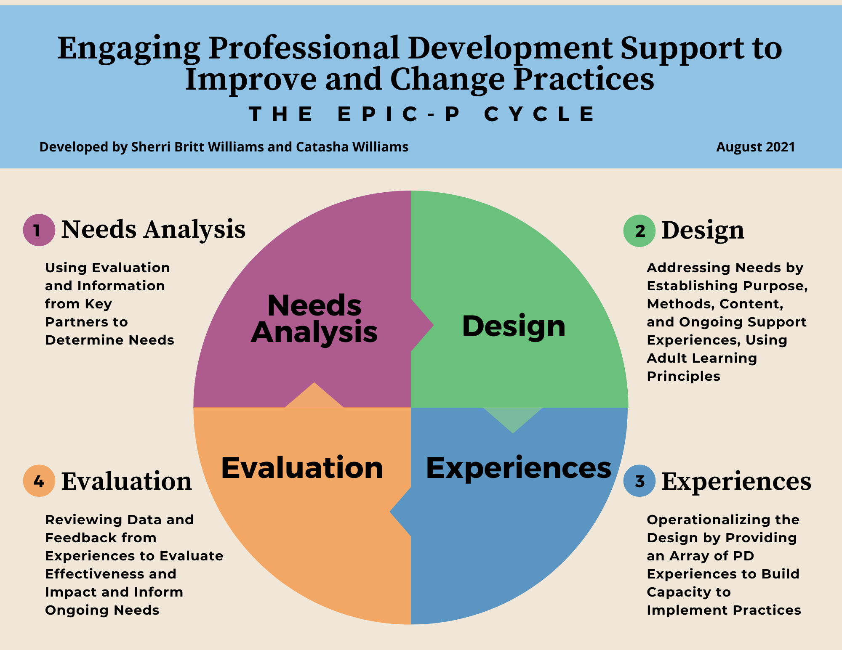
EPIC-P Cycle
Using a
Data-Informed Process to Assess Needs, Design, Deliver, and Evaluate PD Support
https://drive.google.com/file/d/1bv85u9UCRWsAULqZNjkbOHeR8FhWSwwV/view?usp=sharing
Notes:
As a reminder, the EPIC-P Cycle uses a data-informed process to assess needs, design, deliver, and evaluate professional development opportunities. The EPIC-P Cycle organizes this ongoing process using these four general components: needs analysis, design, experiences, and evaluation. Today, our focus will be on the Design component.

Slide 7
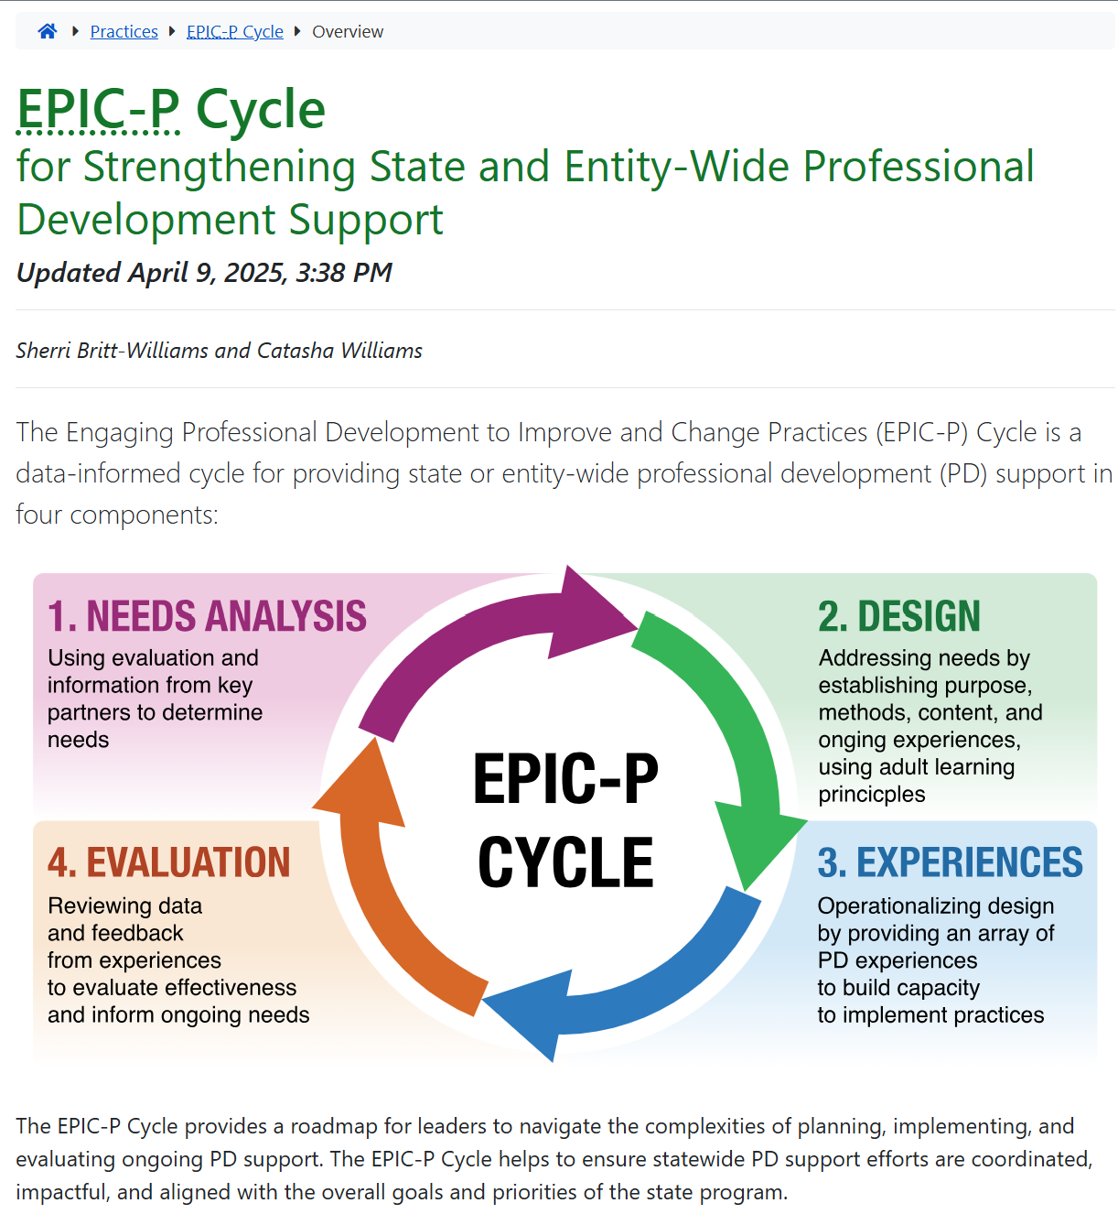
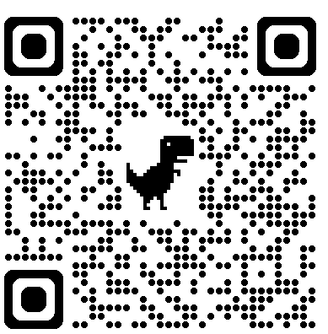
Online Resources
https://ectacenter.org/epic-p/
Notes:
We will be accessing the EPIC-P cycle web page during this session. Please use the QR code to find the EPIC-P cycle online. We will also place a link to the site in the chat box. When you get to the web page, you’ll find a brief introduction and an image representing the four components of the EPIC-P Cycle: Needs Analysis, Design, PD Experiences, and Evaluation.
Please take time now to open the webpage. Go to the second tab, labeled “Design”. We will be focusing on this section during our time together.
URL: https://ectacenter.org/epic-p/

Slide 8
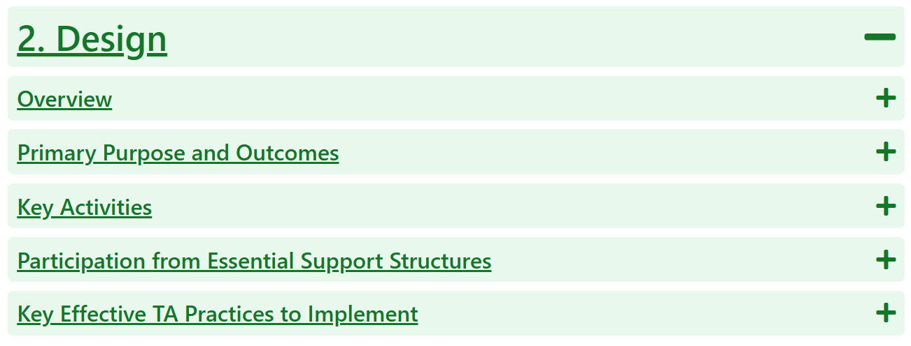
Design Deep Dive
https://ectacenter.org/epic-p/
Notes:
Please take time now to open the design tab by selecting the ‘+’ symbol beside the word “Design”

Slide 9
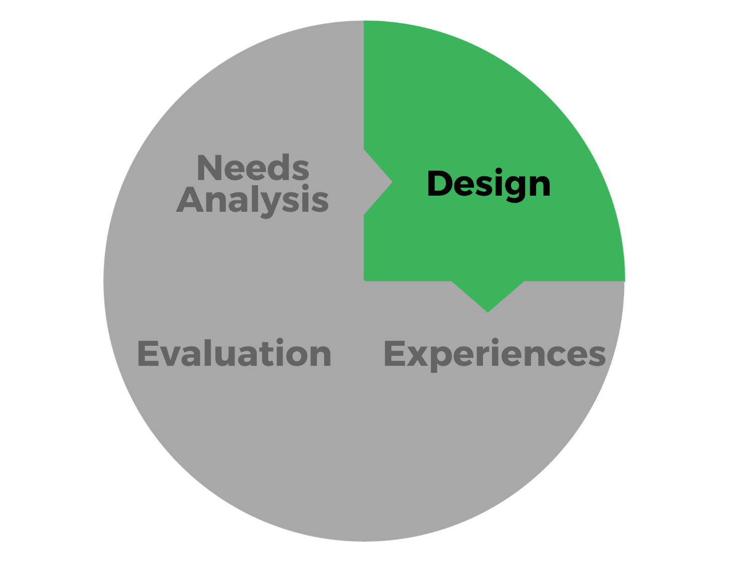
Design
1. Strategic and Contextual
2. Learner-Centered and Relevant
3. Engaging and Evidence-Based Instruction
4. Flexible and Multi-Modal Delivery
5. Resource-Conscious and Impact-Oriented
Notes:
Notes on Design:
1. Strategic and Contextual
Professional development (PD) design is a purposeful and strategic process that aligns learning experiences with both organizational goals and the specific contexts of learners—including their roles, geographic regions, and community settings.
2. Learner-Centered and Relevant
Effective PD is tailored to the needs, experiences, and daily responsibilities of participants. This ensures relevance, encourages application, and honors diverse learning preferences and modalities.
3. Engaging and Evidence-Based Instruction
PD incorporates proven instructional strategies—such as chunking, spaced repetition, practice opportunities, and connections to prior knowledge—to enhance engagement and knowledge retention.
4. Flexible and Multi-Modal Delivery
PD design goes beyond traditional training formats, offering a range of delivery options such as microlearning, self-study, job aids, and videos to accommodate different learning styles and schedules.
5. Resource-Conscious and Impact-Oriented
Design planning ensures efficient use of time, budget, and personnel. It focuses on achievable learning objectives and includes ongoing feedback and assessment to drive meaningful outcomes.

Slide 10
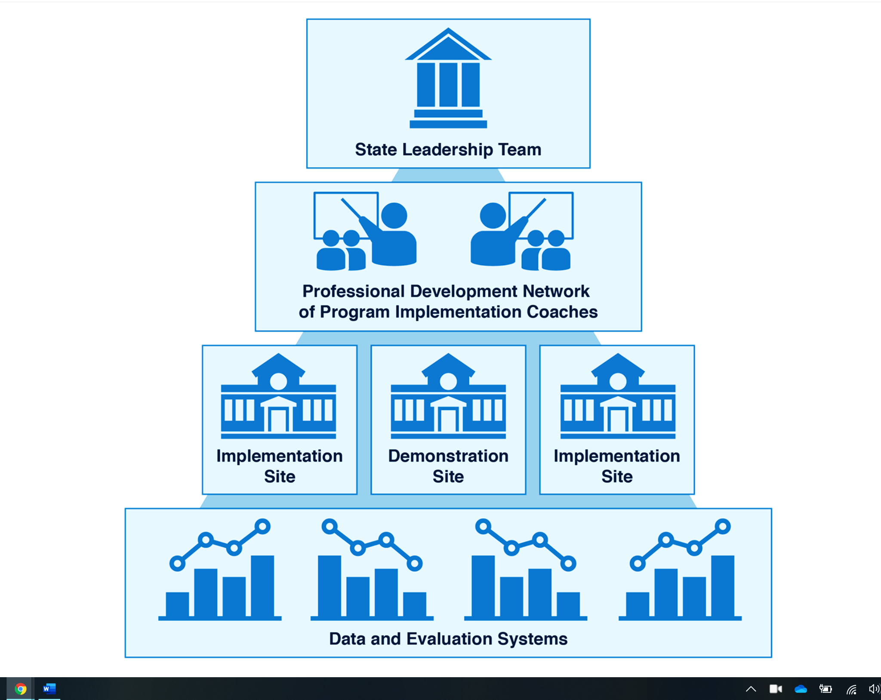
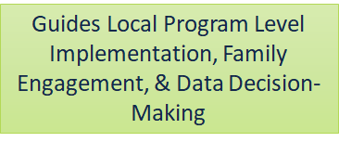
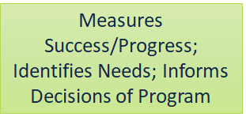
Essential Support Structures Working Together to Support Professional Development
https://ectacenter.org/sig/ess.asp
Notes:
Remember that state- or system-wide implementation of robust professional development support relies on a coordinated structure of leadership, coaching, and data-informed decision-making. A State Leadership Team, composed of interagency representatives, oversees the initiative by ensuring that implementation sites receive the necessary training, resources, and support. Program Implementation Coaches provide guidance to local Program Leadership Teams to promote high-fidelity practice. These local teams lead on-the-ground efforts, including coaching, partnering with families and communities, supporting behavior change, and using data to guide implementation. Implementation and progress are tracked through a Data and Evaluation System, which informs decision-making at both the site and state levels.
In the professional development (PD) design process, the essential support structures for statewide implementation help ensure that the design is thoughtful, relevant, and effective. The State Leadership Team plays a key role by making sure PD efforts are aligned with statewide goals and that schools and districts have the support they need. This helps tailor PD to the specific needs of different roles, communities, and regions. The PD Network of Implementation Coaches works closely with local Program Leadership Teams at demonstration and implementation sites to make sure PD is practical and connected to educators' day-to-day responsibilities. These local teams also support different ways of delivering PD—like coaching, self-paced learning, and tools for family engagement—so it’s accessible and engaging for everyone involved. Throughout the process, data is used to track progress and guide improvements, making sure time and resources are used wisely and that PD efforts lead to real, lasting impact.

Slide 11
Mapping Your Collaboration Efforts Worksheet Part 1
Essential Support Structures and their features
Notes:
Where do you concentrate most of your efforts when designing or supporting the design of professional development?
When you view the Mapping Your Design Collaboration Efforts Worksheet document, you will find two sections. The first section includes a list of the essential support structures and the specific features related to the design process. Read the features listed for each essential support structure and note those you’ve personally participated in. Select the two support structures you leverage the most when you design professional learning experiences.

Slide 12
Your Collaboration Efforts Worksheet Part 2
Notes:
The second section includes a series of discussion prompts.
In discussion pairs, reflect on and discuss where your efforts have been concentrated in terms of the essential support structures that you leverage the most in the PD design process.

Slide 13
Mapping Your Collaboration Efforts Think-Pair-Share
Take 3 minutes to individually read the features listed for each essential support structure; reflect and note those you’ve personally participated in for each support structure.
Based on your review, place a check mark in the checkboxes next to the two support structures you leverage the most when you design professional learning events.
In your discussion pair, you have 10 minutes to reflect on and discuss where your efforts have been concentrated in terms of the essential support structures that you leverage the most in the design process
Notes:
Activity Instructions:
Take 3 minutes to individually read the features listed for each essential support structure; reflect and note those you’ve personally participated in for each support structure.
Based on your review, place a check mark in the checkboxes next to the two support structures you leverage the most when you design professional learning events.
In your discussion pair, you have 10 minutes to reflect on and discuss where your efforts have been concentrated in terms of the essential support structures that you leverage the most in the design process.

Slide 14
Design Key Activities
Get grounded in the unique strengths, needs, and contexts of participants to ensure relevance and accessibility.
Connect to well-defined, measurable learning goals to shape the sequence and organization of learning experiences.
Incorporate interactive methods to encourage participation, reflection, and real-world application.
Select inclusive technologies and curate materials to support diverse learning needs and enhance the experience.
Use formative and summative assessments to measure learning and improve outcomes, in partnership with facilitators to ensure effective delivery.
Image by Rawpixel.com via Shutterstock
Notes:
The design component of professional development (PD) planning involves a thoughtful and collaborative process that encompasses several key activities. It starts with understanding learners’ strengths, needs, and contexts. Clear, measurable learning objectives guide the structure and flow of the PD, ensuring it is purposeful and achievable. Designers organize content in a logical sequence, using a variety of engaging, interactive strategies that encourage reflection, participation, and real-world application. PD design also incorporates accessible tools and technologies, addresses potential barriers to participation, and includes resources that support the learning goals. Pre-learning activities prepare participants, while built-in opportunities for practice and reflection help deepen understanding. Ongoing assessment both during and after the PD experience ensures that learning is taking place and supports continuous improvement. Close collaboration with facilitators helps ensure the plan is realistic, flexible, and impactful.

Slide 15
Look Like, Sound Like, Feels Like Activity
In breakout groups:
Expand Key Activities section of the Design component on the webpage
Assign group roles: Facilitator, Timekeeper, Reporter/Recorder
Using the provided Padlet link, access your group’s Padlet
Complete your Padlet by describing what it would look like, sound like, and feel like to engage in your group’s assigned key activity.
Prepare to share with the whole group
Image from HG19 via Shutterstock
Notes:
Application Activity- 15 min.
Divide participants into 10 groups.
Each group is assigned one of the 10 Design component activities.
For each assigned activity, participants generate indicators by describing what it would look like, sound like, and feel like to engage in the activity.
Notes will be captured on a Padlet.
5-10 min. Whole group share out

Slide 16
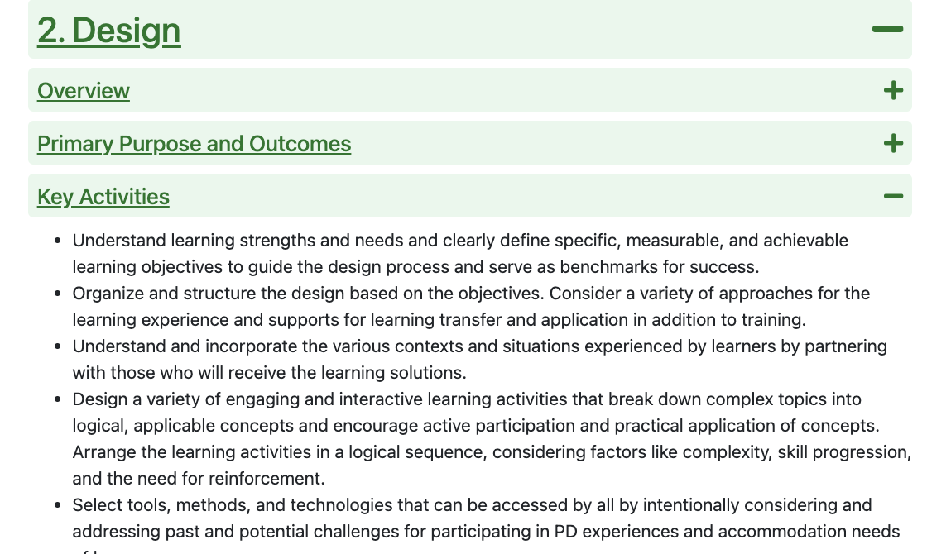
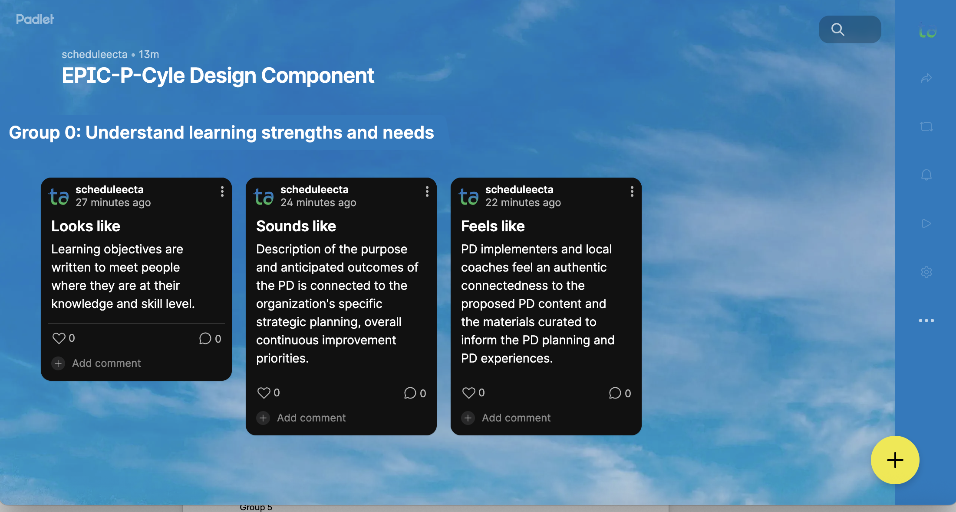
Example
Notes:
Example for the first Design Key Activity:
Understand learning strengths and needs and clearly define specific, measurable, and achievable learning objectives to guide the design process and serve as benchmarks for success.
Your Padlet link will take to directly to group’s specific Padlet. The group number at the top of the Padlet should coincide with the group number of your breakout room. The first few words at the top of your Padlet should match the first few words of the Key activity description on the webpage. Toggle to the webpage to be sure you are working on the correct key activity.
Your have 15 minutes for this activity

Slide 17
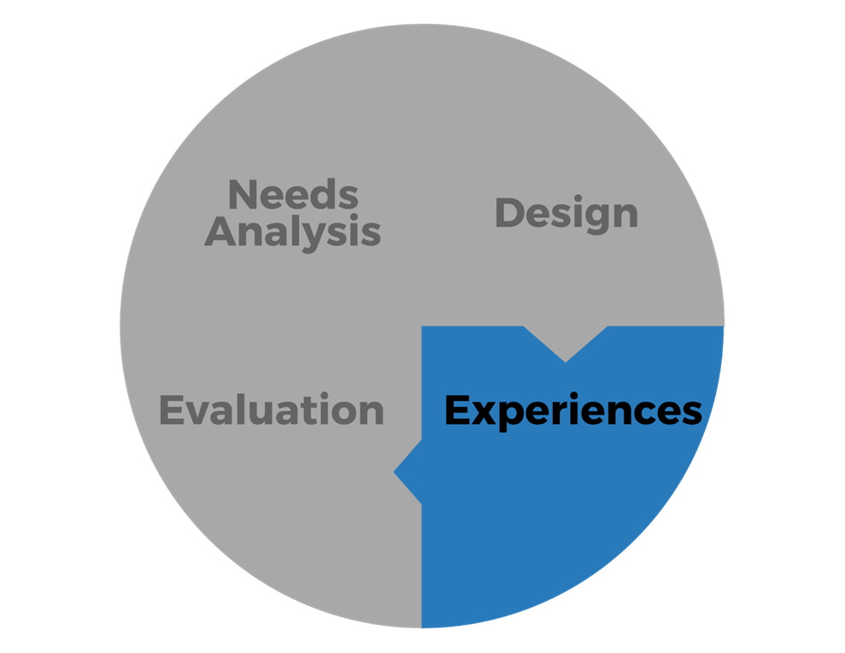
Next Session
Session 4: Experiences
Tuesday, July 29, 2025,
3:00 – 4:30 PM EDT
Notes:
Today we talked about using what we learned in the needs analysis process for design, including establishing the purpose, methods, content, and ongoing support experiences that are grounded in adult learning principles​.
Our next session together will focus on operationalizing the design by providing the PD experience(s) that will strengthen capacity to implement change or practices.

Slide 18
Final Thoughts
What is one thing you’d like to discuss with someone or explore more deeply?
Image by Jeniffer, Wai Ting Tan from Pixabay

Slide 19
Find out more at ectacenter.org
The ECTA Center is a program of the FPG Child Development Institute of the University of North Carolina at Chapel Hill, funded through cooperative agreement number H326P170001 from the Office of Special Education Programs, U.S. Department of Education. Opinions expressed herein do not necessarily represent the Department of Education's position or policy.

