Slide 1
Engaging PD to Improve and Change Practices (EPIC-P) Cycle for Strengthening Statewide PD Support
Sherri Britt Williams
Paula Grubbs
Session 2: Needs Analysis
Seena Skelton
Notes:
This session introduces step one in the EPIC-P cycle that’s both data-driven and deeply responsive to the needs of your system, practitioners, and the children and families they serve. EPIC-P stands for: Engaging Professional Development to Improve and Change Practices. It’s a structured approach grounded in implementation science meant to support system-level teams as they plan and implement PD support aligned with the priorities and goals of the system while also meeting the needs and demands of people implementing changes across the system.

Slide 2
A Note about Access and Participation
This session is interactive, we will engage in reflections and breakout room activities.
You may need a way to capture notes.
To join the discussion, enable your mics and cameras (optional). Please mute mics when not speaking.
Subtitles and language interpreters are available.
Please take care of your mind/body needs. Make yourself comfortable.
Feel free to use private messages for personal questions.
Notes:
Before we begin, let’s review some key notes regarding access and participation. This session is designed to be highly interactive to facilitate deeper learning and active engagement. We also want to maximize accessibility for all participants. For some activities, you may need a writing utensil or a way to capture your thoughts and reflections. We encourage people to join the discussion; this can be done either through the Chat box or verbally. Please remember to enable your mic to share, and if you are comfortable to also enable your camera. Please mute your mic when you are not speaking. The subtitles or captioning function can be used; we also have Spanish and ASL language interpreters available. Our interpreters will be available during the large group and small group breakout room discussions. It is important to us that you are comfortable, please take care of your mind/body needs, and feel free to use the private message for personal questions for EPIC-P team members.

Slide 3
T-P-S Professional Development Reflection
Individually: Think about a PD experience you delivered or participated in.
Was there evidence that a thoughtful and effective needs analysis had taken place, or not?
What specific aspects of the experience led you to that conclusion?
Pair and Share: Your reflections with your breakout room partner.
Image by freepik
Notes:
Think about a professional development (PD) experience you delivered or participated in. Was there evidence that a thoughtful and effective needs analysis had taken place, or not? What was it about that experience that led you to that conclusion? Was it that the experience was relatable or relevant? Was the experience particularly engaging or aligned with your program’s priorities and needs? These are things that should be evident during PD experiences when a solid needs analysis is completed. We are going to talk more today about Needs Analysis and some of the key activities included in this component that will set you up for success as you design and deliver your PD support experience.
We will give you the opportunity to share your reflections with a fellow participant during a brief breakout activity. There will be two people in each room. You will have 5 minutes (about 2 and a half minutes for each person) to share your reflections.

Slide 4
You will...
Identify
the core purposes and goals of conducting a Needs Analysis within a state or entity-wide PD system.
Describe
the roles and contributions of the State Leadership Team (SLT), Professional Development Network (PDN), implementation sites, and evaluation systems in the Needs Analysis process.
Explain
how Needs Analysis informs the alignment of professional learning supports with organizational goals and practitioner needs.
Apply
the Needs Analysis process by reviewing a sample scenario and identifying /mapping the key activities for the Needs Analysis component.
Notes:
During this session, we will identify the core purposes and goals of conducting a Needs Analysis within a state or entity-wide PD system.
We will describe the roles and contributions of the State Leadership Team (SLT), Professional Development Network (PDN), implementation sites, and evaluation systems in the Needs Analysis process.
Explain how Needs Analysis informs the alignment of professional learning supports with organizational goals and practitioner needs.
Apply the Needs Analysis process by reviewing a sample scenario and identifying /mapping the key activities for the Needs Analysis component.

Slide 5
One Word Round Up
What is one word that comes to mind when you think about needs analysis?
Place the word in the chat box.
One Word!
Image by PeopleImages.com - Yuri Afrom Shutterstock
Notes:
What is one word that comes to mind when you think about needs analysis? Please type the word in the chat box.

Slide 6
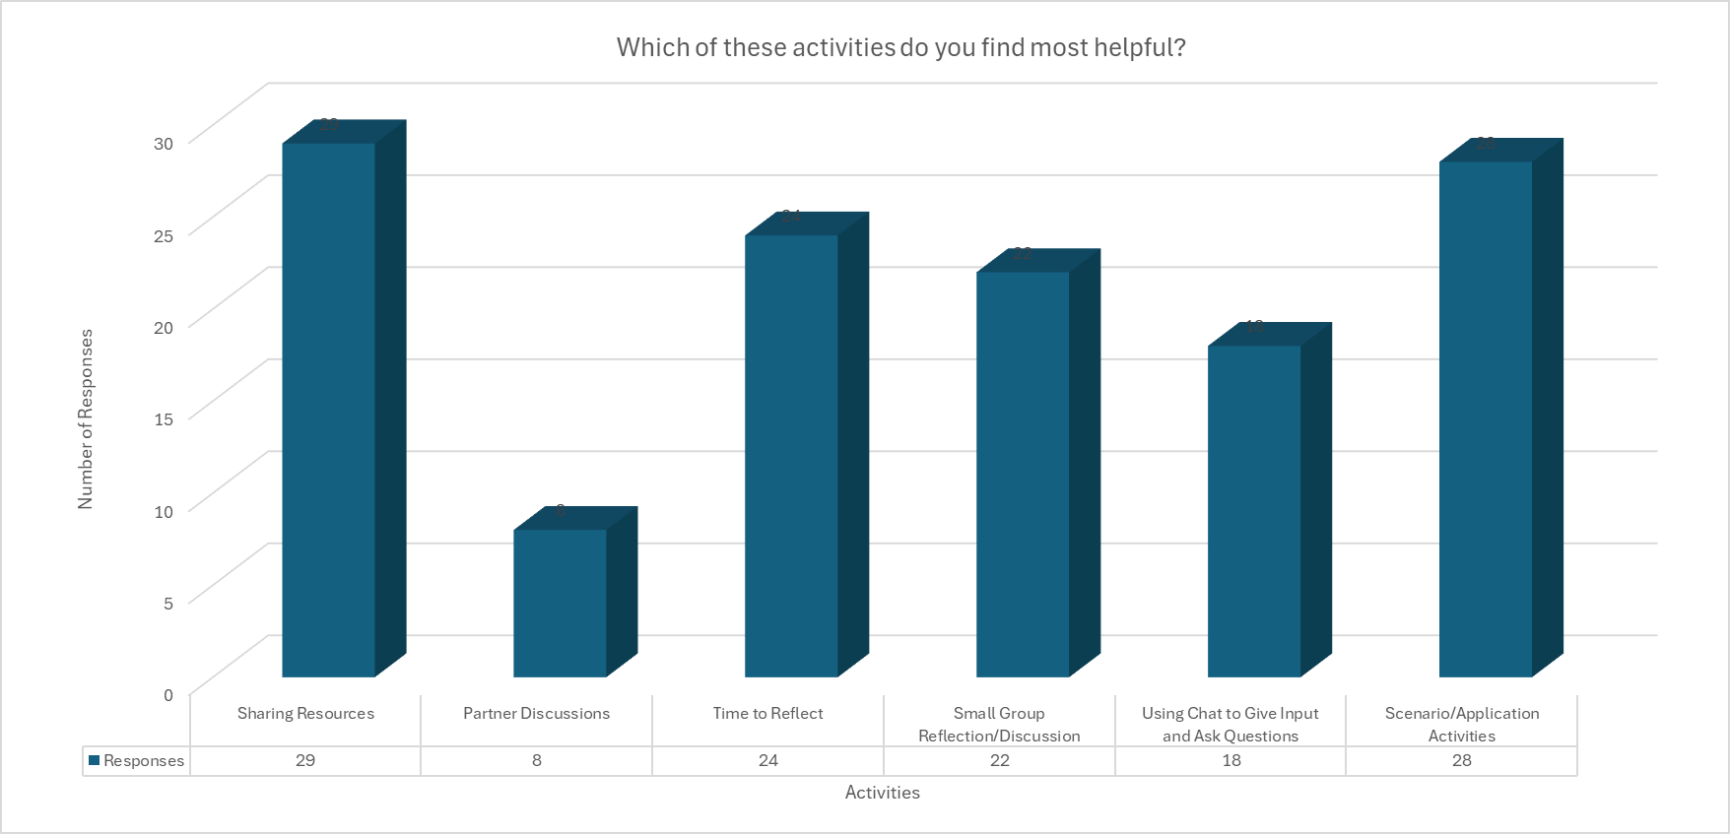
Using Needs Analysis Data from Session I to Inform Design
Notes:
During session 1, we asked participants questions about the formats and types of activities they found most beneficial to facilitate their learning. While all the types of activities were selected, a couple stood out and were selected the most. These were times for reflection, application activities, Small group discussion/reflection, and sharing resources. We have used this needs analysis data to inform the design of this session.

Slide 7
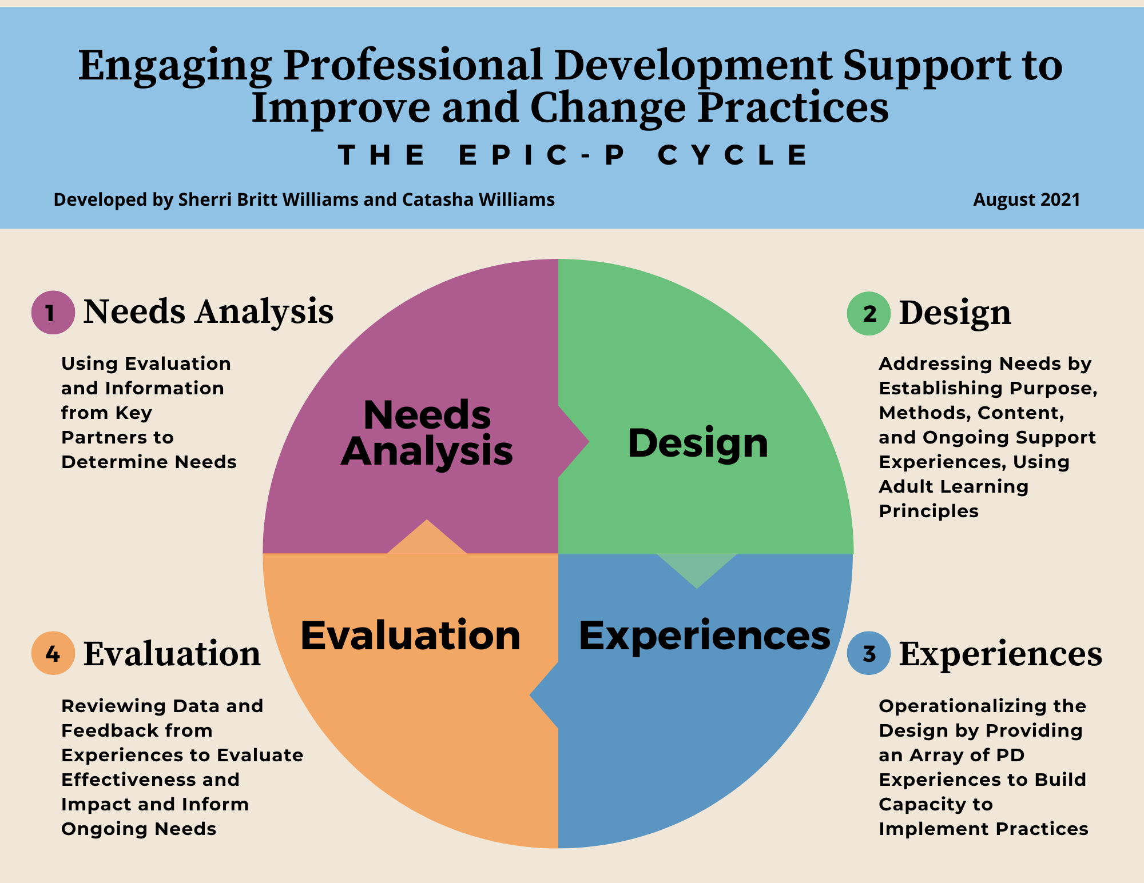
EPIC-P Cycle
Using a
Data-Informed Process to Assess Needs, Design, Deliver, and Evaluate PD Support
https://drive.google.com/file/d/1bv85u9UCRWsAULqZNjkbOHeR8FhWSwwV/view?usp=sharing
Notes:
Last session, we shared our ongoing data-informed process needed to successfully implement statewide PD supports. The EPIC-P Cycle organizes this ongoing process using four general components: needs analysis, design, experiences, and evaluation. Today our focus will be on the Needs Analysis component.

Slide 8
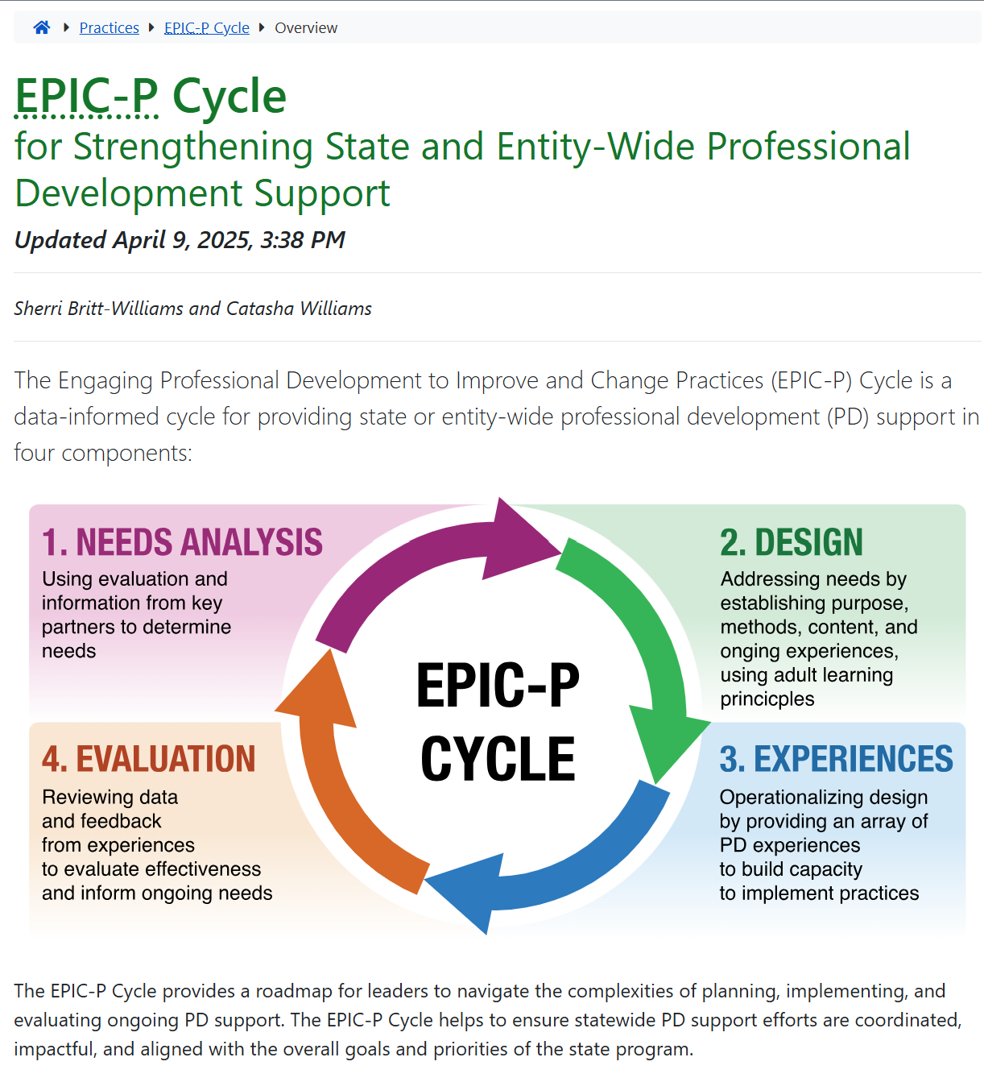
Online Resources
https://ectacenter.org/epic-p/
Notes:
Recall from the overview session that the EPIC-P Cycle can be found online; you can scan the QR code to find the EPIC-P cycle web page. We will also place a link to the site in the chat box. When you get to the web page, you’ll find a brief introduction and an image representing the four components of the EPIC-P Cycle: Needs Analysis, Design, PD Experiences, and Evaluation. The short introduction explains what the EPIC-P Cycle is, who it’s designed for, and how it can be used to support meaningful, system-wide PD. You’ll also see the acronym spelled out again—Engaging Professional Development to Improve and Change Practices—and a quick reminder of how the cycle flows: Explore needs, Plan PD, Implement PD, and Check for impact. This cycle is useful for state agencies, TA providers, and regional or local teams supporting PD at scale.
URL: https://ectacenter.org/epic-p/

Slide 9
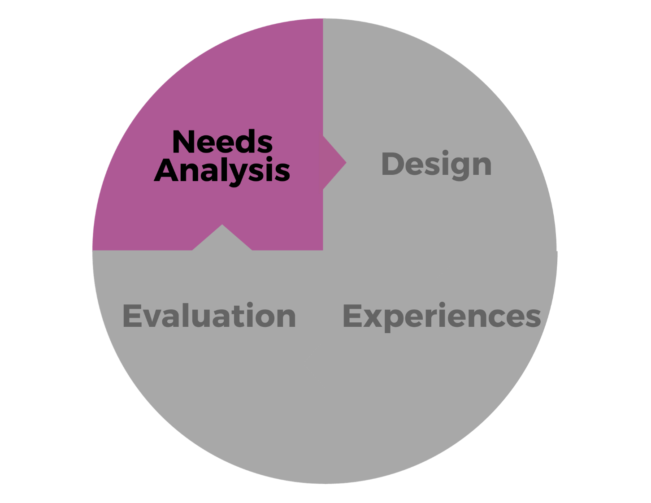
Needs Analysis
Using Evaluation and Information from Key Partners to Determine Needs
Notes:
In this session, we will discuss the first component of the EPIC-P Cycle —Needs Analysis is the process that helps identify and prioritize the specific learning needs and requirements to enhance PD support that aligns with the organization's goals. It enables PD designers to gather pertinent information about the context in which the professional learning experience will be situated. This process is crucial in cultivating a learning culture by ensuring that learning initiatives are targeted, relevant, collaborative, ongoing, and effective. It allows designers and implementers to identify specific strengths and knowledge and skill gaps, so that state systems can design learning solutions that directly build upon the capacity as well as address the gaps of PD recipients. It facilitates the appropriate distribution of professional learning resources more effectively by focusing on areas that impact growth and performance most. It also ensures more powerful impacts as Individuals and teams acquire the skills and knowledge needed to excel in their roles and grow and develop in ways that align with both their career goals and the organization's strategic objectives.
Needs analysis involves using information from key partners to determine learning needs and solutions to meet those needs. Needs analysis data helps us understand what success looks like - not just in words but in actions. It helps us define what people in the workforce are doing when they meet expectations? Needs analysis helps us pinpoint strengths, learning needs, and potential solutions, so the PD support we plan and provide is relevant to the workforce and aligns with the state or program’s priorities and goals.
Needs analysis is about gathering, analyzing, and discussing data on how the workforce is implementing expected practices---including information that comes from the voices and experiences of those most impacted by professional development, the workforce, and also the children and families we serve. Needs analysis helps us determine what skills, knowledge, behaviors, and attitudes the workforce needs and generate solutions for customizing PD support so that it builds on workforce strengths and also addresses their needs in a way that is relevant and meaningful to them.
Needs analysis can also help us identify potential barriers to accessing the PD support needed and come up with possible solutions. It's not just about understanding needs; it's about unleashing the potential of our workforce, building on strengths, supporting them as they implement practices and procedures that are necessary to meet the priorities and goals of the overall program.

Slide 10
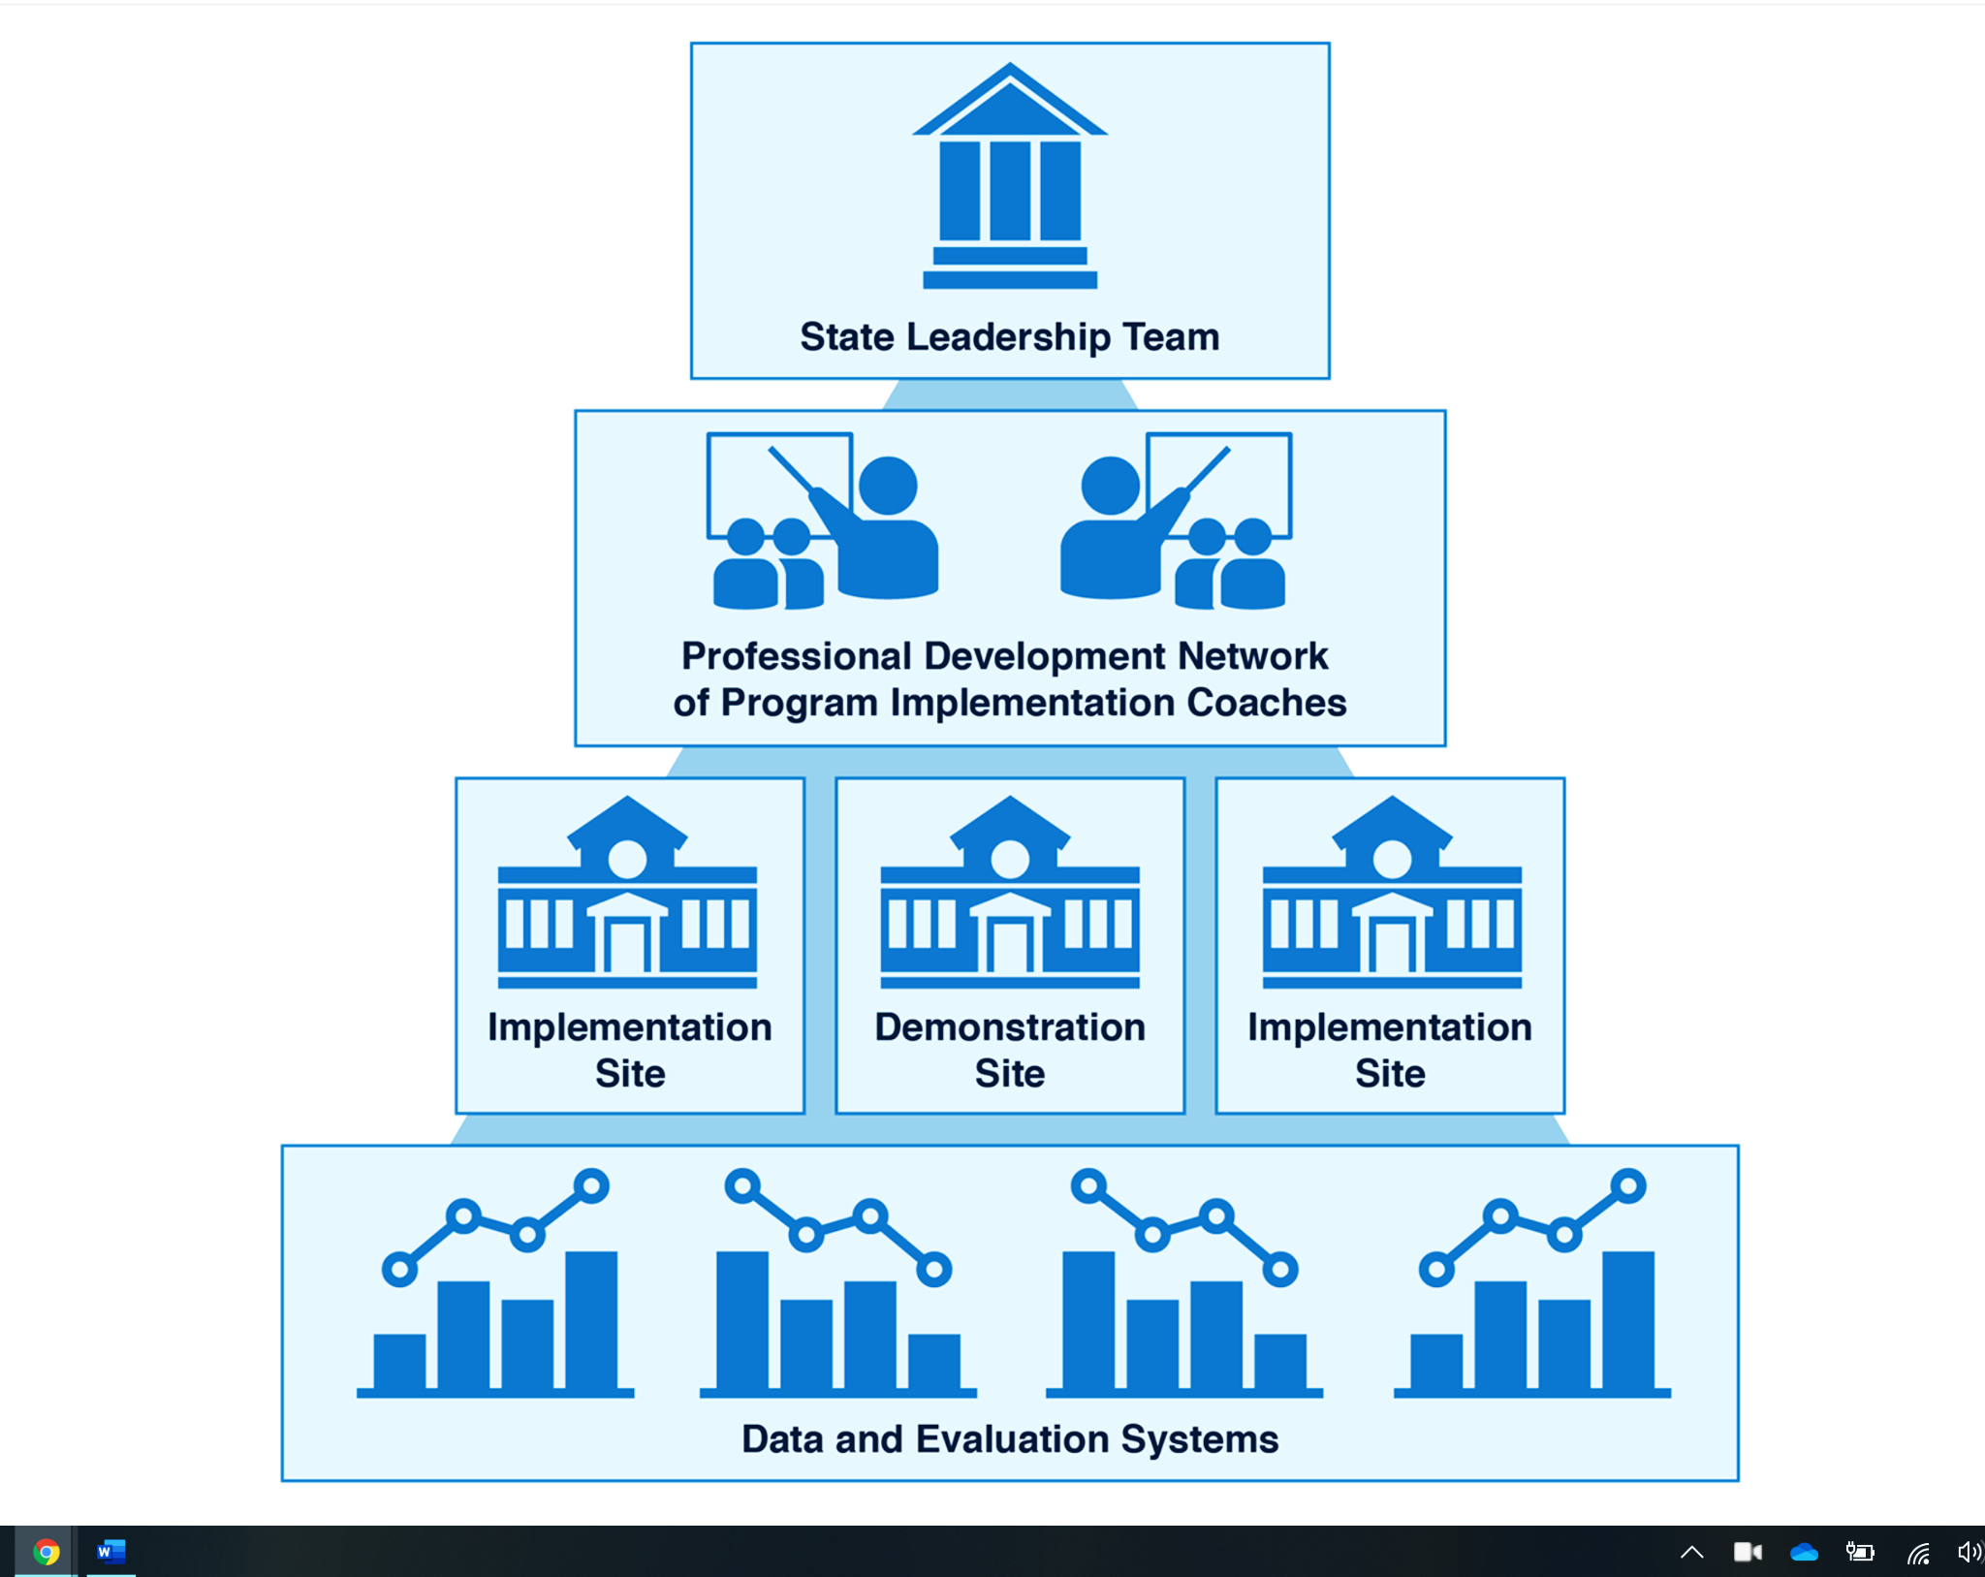
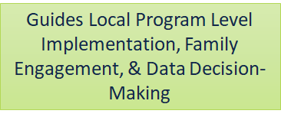
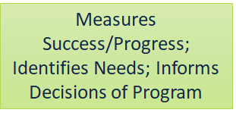
Essential Support Structures Working Together to Support Professional Development
https://ectacenter.org/sig/ess.asp
Notes:
When we think about implementing any effort, we also always want to keep in mind the supports that drive and sustain that implementation. The supports are essential for sustaining PD supports and can be organized into these 4 essential support structures for implementation. These structures may be organized and named differently in different states or systems, but generally, leaders at the state or system level should establish similar essential support structures to successfully implement any initiative, including a system of PD support. You can learn more about the essential support structures at the link shown on the slide.

Slide 11
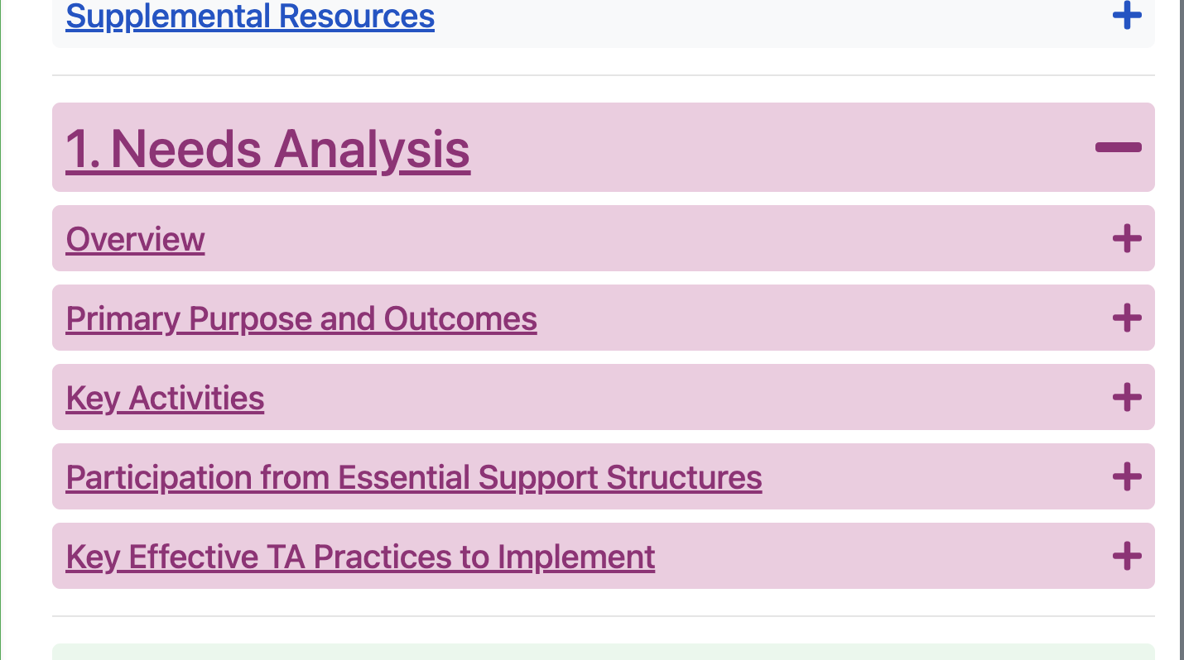
Need Analysis Deep Dive
https://ectacenter.org/epic-p/
Notes:
We are going to give you an opportunity to take a deeper look at the Needs Analysis component. In breakout study groups, you will go to the EPIC P Cycle website and the Needs Analysis component. Click on the plus to expand and reveal the five needs analysis sections – Overview, Primary Purpose and Outcomes, Key Activities, Participation from Essential Support Structures, and the Key Effective TA Practices to Implement.

Slide 12
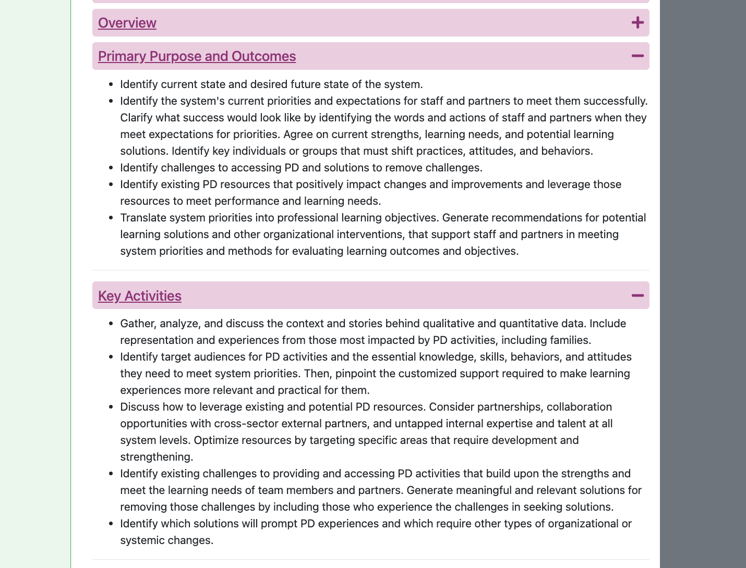
EPIC-P CYCLE WEBSITE
https://ectacenter.org/epic-p/
Notes:
Each study group will be assigned a section to study. The group reading assignments will be presented on a slide. Once you are in your breakout room, note the number of the room to know your group’s assigned section. In your group, you will read and discuss the bullet points that detail the section and prepare to share what you have learned in the larger group.

Slide 13
Needs Analysis Jigsaw
Open the Activity Packet in the chat box.
Navigate to the following sections using the tabs:
Group Reading Assignments
Activity Instructions
Discussion Prompts
Follow the instructions provided and be prepared to share key highlights from your group’s discussion.
Image from Adobe Stock
Notes:
You will have 20 minutes to read and discuss your section, using the discussion prompts. Once in your group, assign a facilitator, a timekeeper, and a note-taker. Groups will be asked to share what they have learned about their assigned section.

Slide 14
Activity 1 Share Out
Overview
Primary Purpose and Outcomes (1&2)
Key Activities (3&4)
Participation from Essential Support Structures: SLT (5&6)
Key Effective TA Practices to Implement (11&12)
Participation from Essential Support Structures: Implementation Sites (7&8)
Participation from Essential Support Structures: Data & Evaluation Systems (9&10)
Notes:
Group reporter, please prepare briefly to share 1 or 2 highlights from your group discussion. Please keep your shares to 2 minutes.
As your session and groups appear, I will ask the reporters from the group to share.

Slide 15
Problem of Practice Scenario Application Activity
MidState Early Learning Collaborative
The State Office for Early Learning
The MidState Early Learning Collaborative (MELC) was preparing to host a regional professional development (PD) session aimed at strengthening inclusive practices across early childhood education (ECE) settings. The planning team was excited to build on the momentum of their last training event and had just eight weeks to pull everything together.
The State Office for Early Learning (SOEL) had been tasked with developing a new professional development (PD) initiative focused on strengthening inclusive practices in early childhood education settings across the state. The initiative was part of a broader effort to align with IDEA requirements and increase access to quality inclusion for young children with disabilities.
Notes:
Now that we’ve taken a deeper dive into the characteristics of the Needs Analysis component, let's see how they are applied in action in a problem of practice scenario. You are going to return to your discussion groups and read about either the MidState Early Learning Collaborative's or the State Office for Early Learning’s (SOEL) venture into PD planning. I’m going to give a brief overview of each scenario.
The MidState Early Learning Collaborative (MELC) was preparing to host a regional professional development (PD) session aimed at strengthening inclusive practices across early childhood education (ECE) settings. The planning team was excited to build on the momentum of their last training event and had just eight weeks to pull everything together.
The State Office for Early Learning (SOEL) had been tasked with developing a new professional development (PD) initiative focused on strengthening inclusive practices in early childhood education settings across the state. The initiative was part of a broader effort to align with IDEA requirements and increase access to quality inclusion for young children with disabilities.

Slide 16
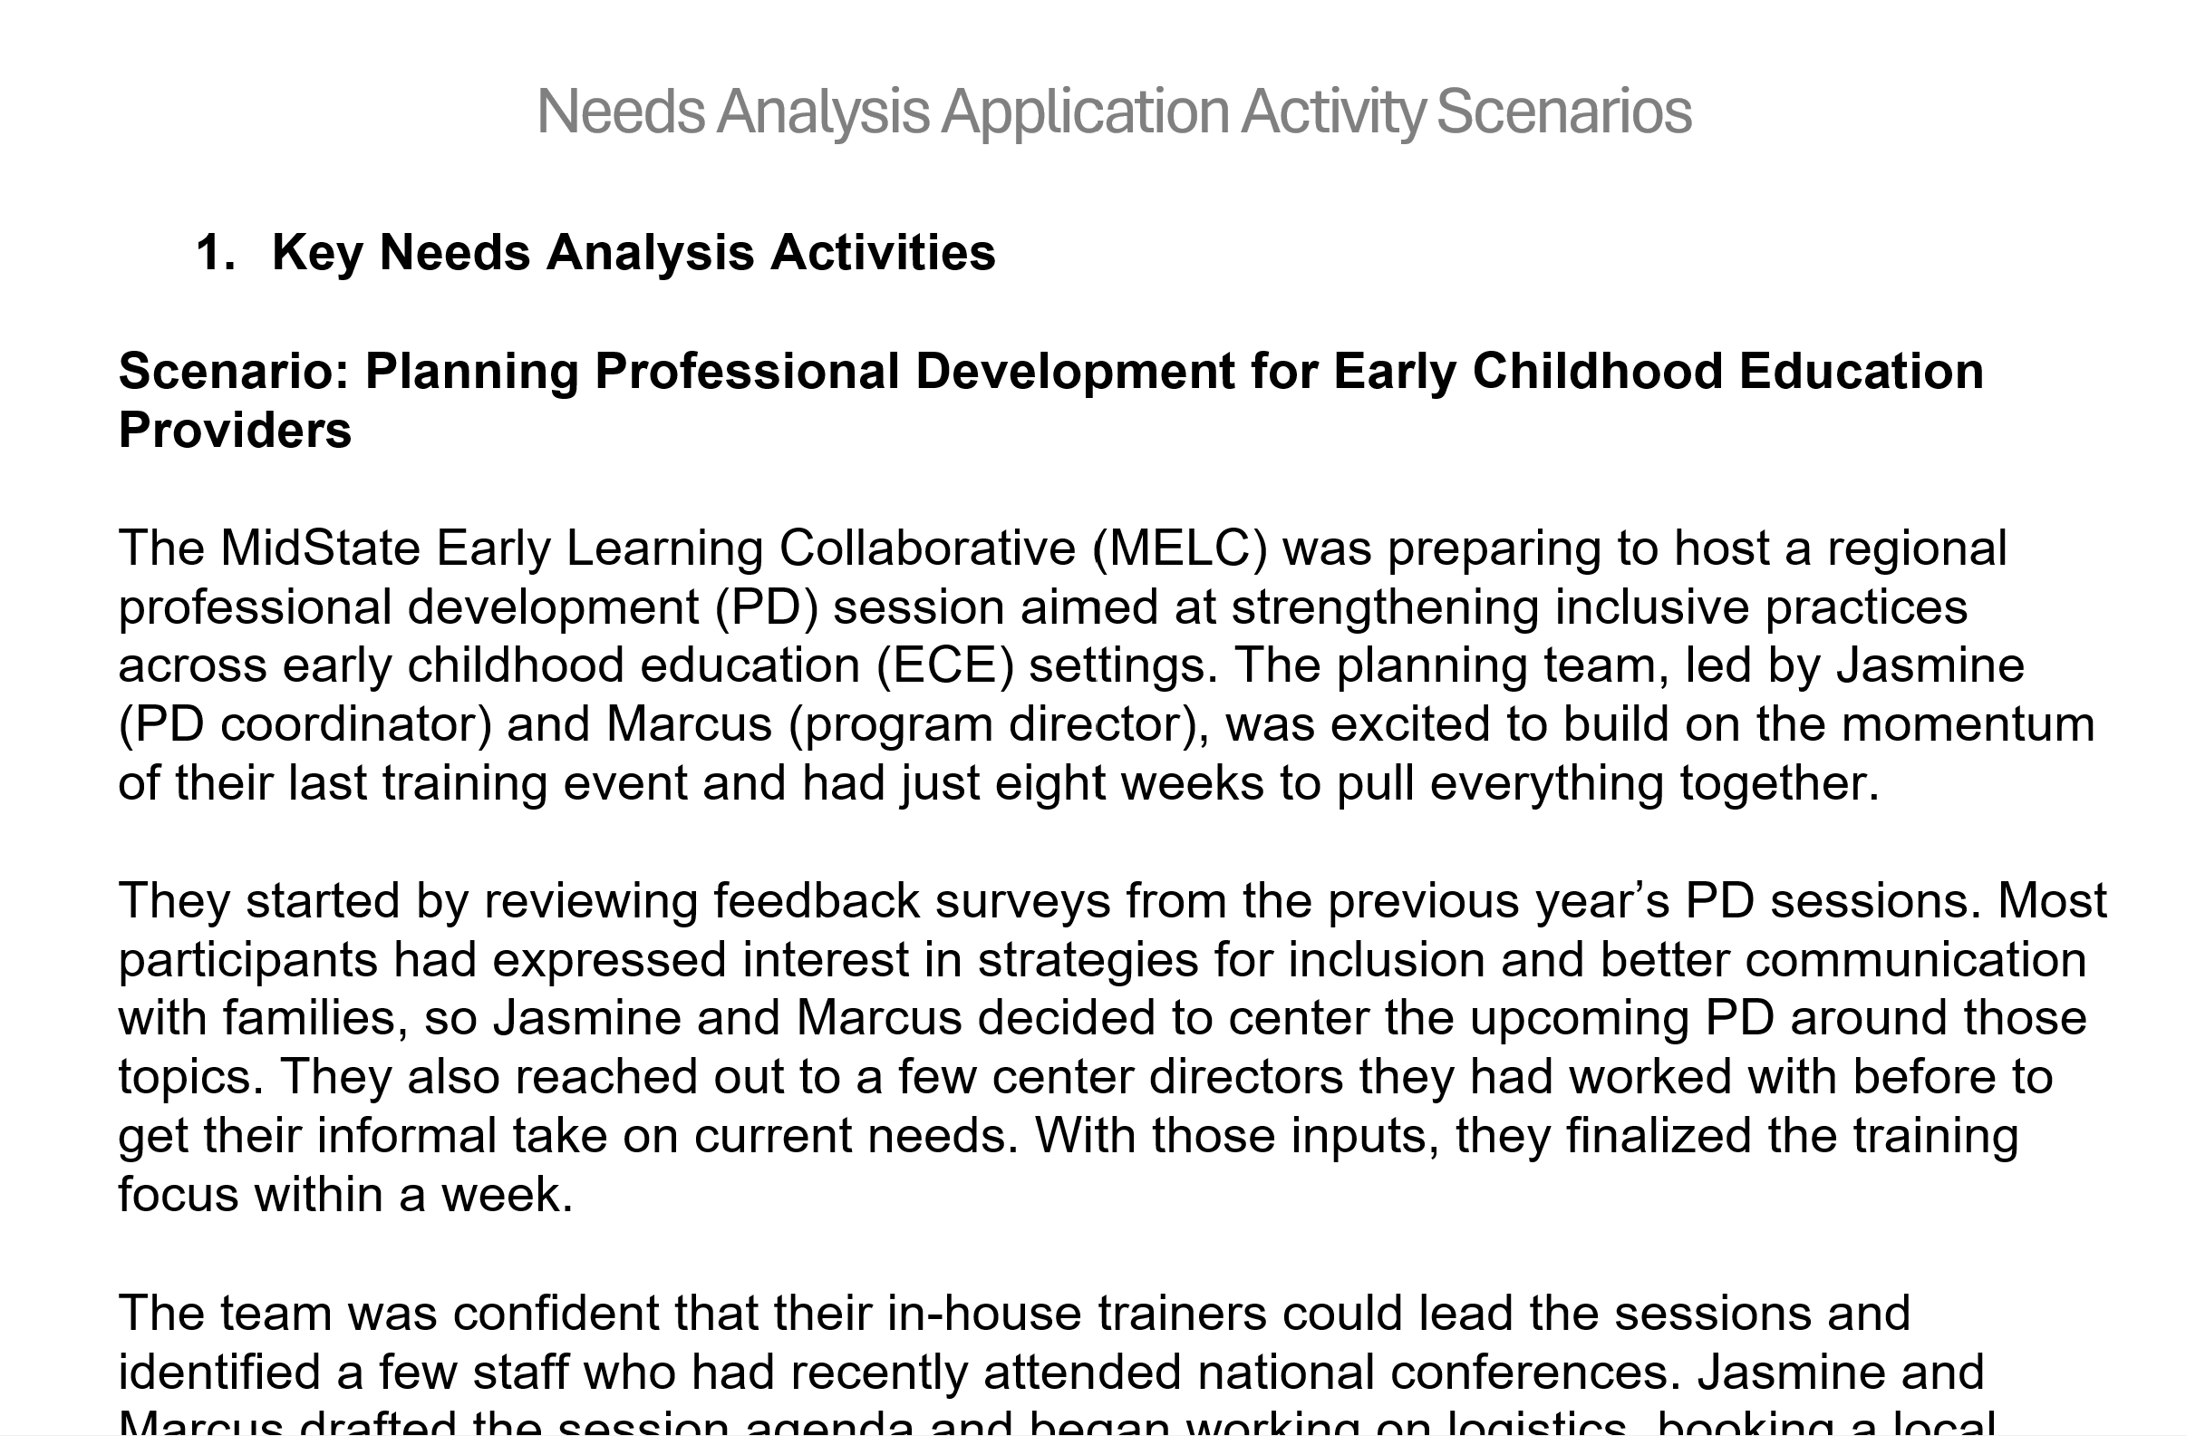
Applying the Needs Analysis Process
Return the same group and Activity Packet.
Select the problem of the practice scenario that your group would like to read
The scenario will include some key Needs Analysis characteristics and leave out others.
Using the prompts, discuss the scenario and prepare to share highlights from your discussion with the whole group.
Notes:
We will reopen the breakout rooms. Once in your group, you may decide to reassign roles or continue with the same assignments. Use the link placed in the chat box to access the problem-solving practice scenarios. Review the instructions on the first page. As a group, select which scenario you would like to focus on. Navigate to the scenario using the tabs on the left. Read and, using the question prompts, discuss the scenario. Prepare to share with the whole group. You will have 25 minutes for this activity

Slide 17
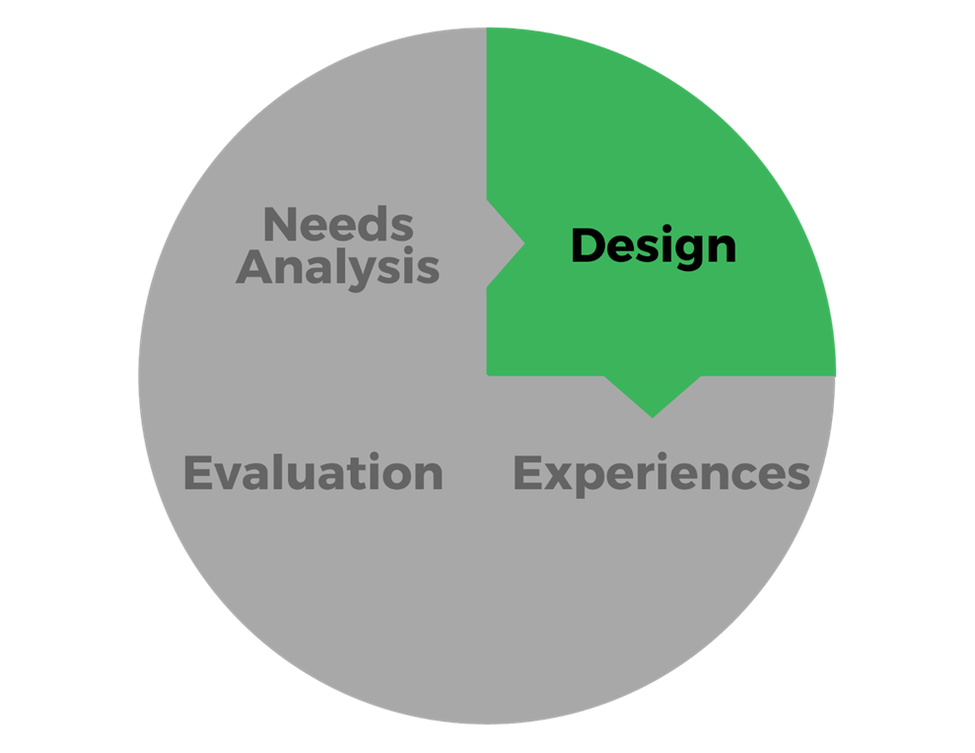
Next Session
Session 2: Design Component
Monday, July 15, 2025
3:00-4:30 PM ET
Notes:
If we want professional development to really make an impact, we must start with understanding what’s needed—and why. That’s what Needs Analysis is all about. Too often, PD planning begins with a topic or training idea before teams take time to explore the actual needs of educators, programs, or the system as a whole.
But skipping that step can lead to disconnected, one-size-fits-all support. A strong needs analysis process helps you to align your PD support efforts with real challenges and opportunities across the system. Please review the Needs Analysis component to learn more. Our next session, Design will focus on developing a plan for structuring professional learning experiences.

Slide 18
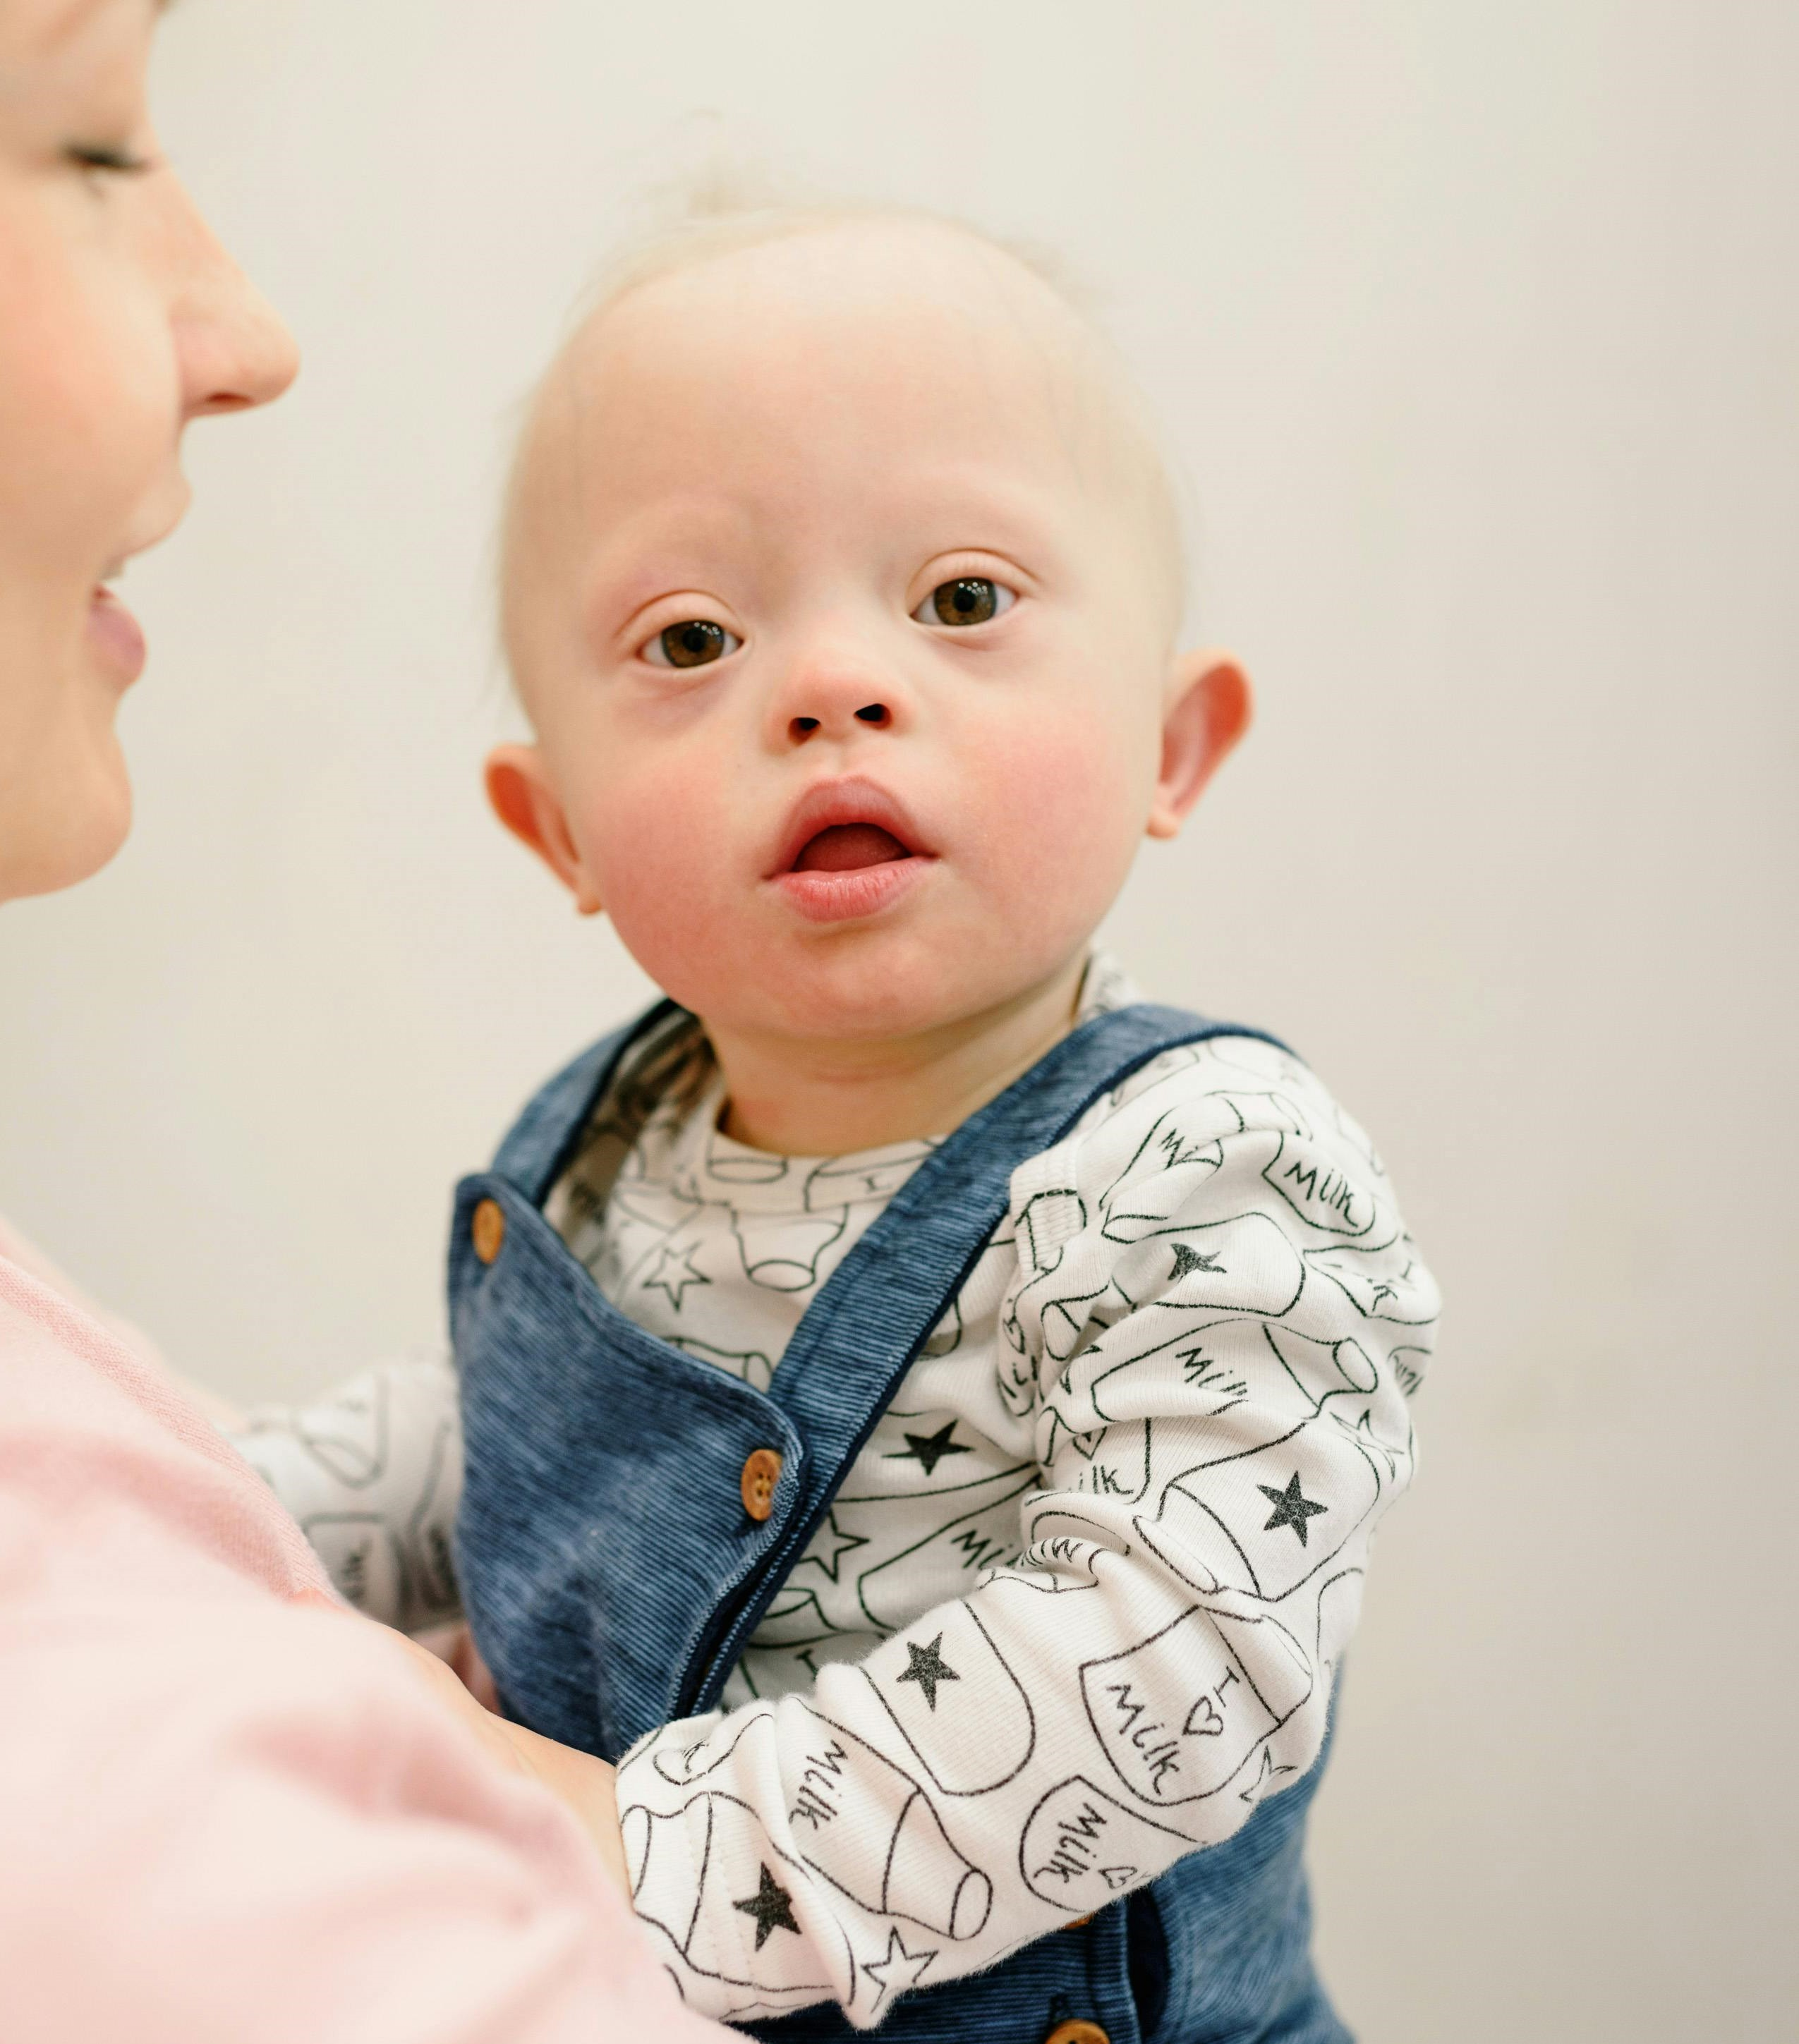
Final Thoughts
What is one thing you’d like to discuss with someone or explore more deeply?
Image by Ksenia Chernaya from Pexels
Notes:
What did you hear today that you want to discuss more with someone or explore more deeply (enter in chat)?

Slide 19
Find out more at ectacenter.org
The ECTA Center is a program of the FPG Child Development Institute of the University of North Carolina at Chapel Hill, funded through cooperative agreement number H326P170001 from the Office of Special Education Programs, U.S. Department of Education. Opinions expressed herein do not necessarily represent the Department of Education's position or policy.

