Slide 1
Engaging PD to Improve and Change Practices (EPIC-P) Cycle for Strengthening Statewide PD Support
Sherri Britt Williams
Paula Grubbs
Session 1: Overview
Seena Skelton
Notes:
This session introduces a four-step cycle that’s both data-driven and deeply responsive to the needs of your system, practitioners, and the children and families they serve. EPIC-P stands for: Engaging Professional Development to Improve and Change Practices. It’s a structured approach grounded in implementation science meant to support system-level teams as they plan and implement PD support aligned with the priorities and goals of the system while also meeting the needs and demands of people implementing changes across the system.

Slide 2
You will...
Identify
the components of a data-informed cycle for planning, implementing, and evaluating ongoing statewide PD support.
Review
tools that teams supporting PD can use to strengthen their capacity to provide effective statewide PD support.
Examine
your own roles in supporting PD and identify areas of strength and opportunities for development.
Identify
a next step for further exploring and applying session content and resources to work supporting PD.

Slide 3
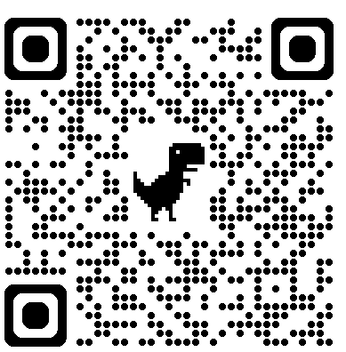
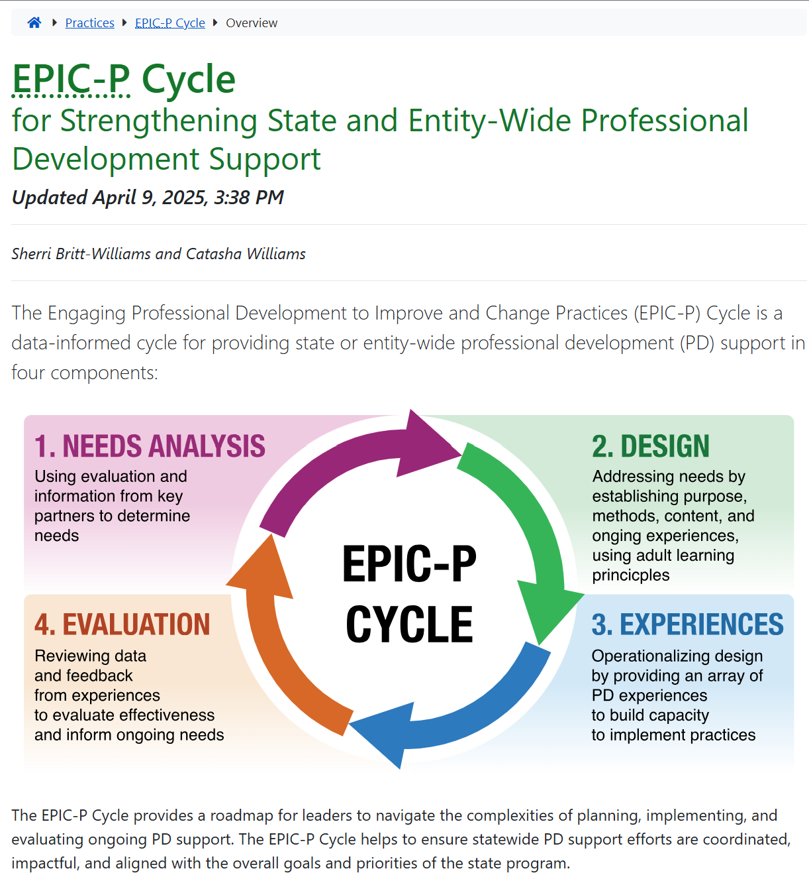
Online Resources
https://ectacenter.org/epic-p/
Notes:
You can scan the QR code to find the EPIC-P cycle web page. When you get to the web page you’ll find a brief introduction and an image representing the four components of the EPIC-P Cycle: Needs Analysis, Design, PD Experiences, and Evaluation. The short introduction explains what the EPIC-P Cycle is, who it’s designed for, and how it can be used to support meaningful, system-wide PD. You’ll also see the acronym spelled out again—Engaging Professional Development to Improve and Change Practices—and a quick reminder of how the cycle flows: Explore needs, Plan PD, Implement PD, and Check for impact. This cycle is useful for state agencies, TA providers, and regional or local teams supporting PD at scale.

Slide 4
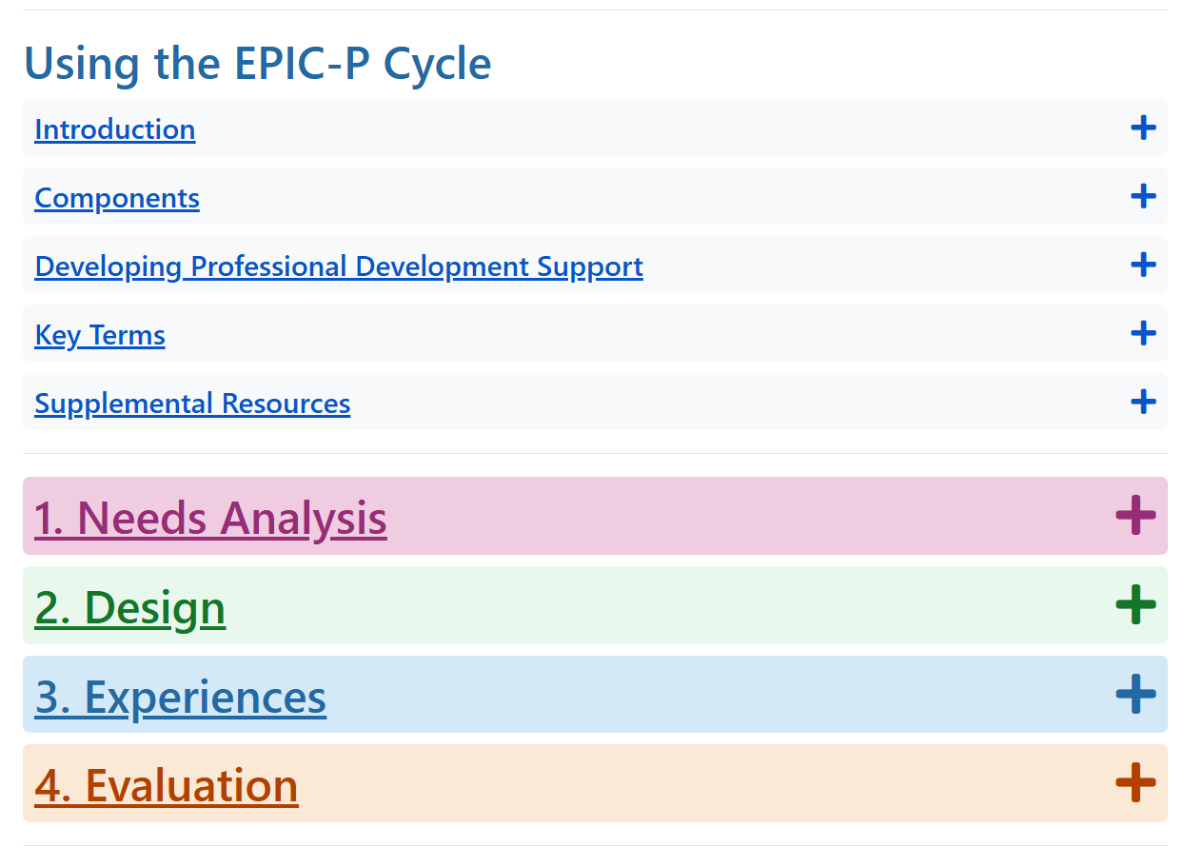
Online Resources 2
Online Resources
https://ectacenter.org/epic-p/
Notes:
You’ll also find some headers. The first gives information on using the EPIC P Cycle, which includes an introduction, more details on the components, some information on developing PD support, some key terms you’ll find throughout the information under each component of the cycle, and also supplemental resources.
As you scroll down, you’ll find the four key components of the cycle: - Needs Analysis – where you figure out what’s really needed by reviewing data and listening to partners - Design – where you create a plan for PD that’s intentional, achievable, and responsive - PD Experiences – where the learning and guided practice actually happen in ways that are engaging and job-embedded - Evaluation – where you look at what’s working and what needs to be improved
Each section is organized the same way, so it’s easy to follow. When you expand each component, you find:
An Overview of the component
The Primary Purpose and Outcomes for the component
A list of Key Activities that typically happen when you are implementing the component
Guidance on Essential Support Structures—those roles and teams that help make the work sustainable
And Key Effective TA Practices to help you align with what we know works in implementation and adult learning

Slide 5
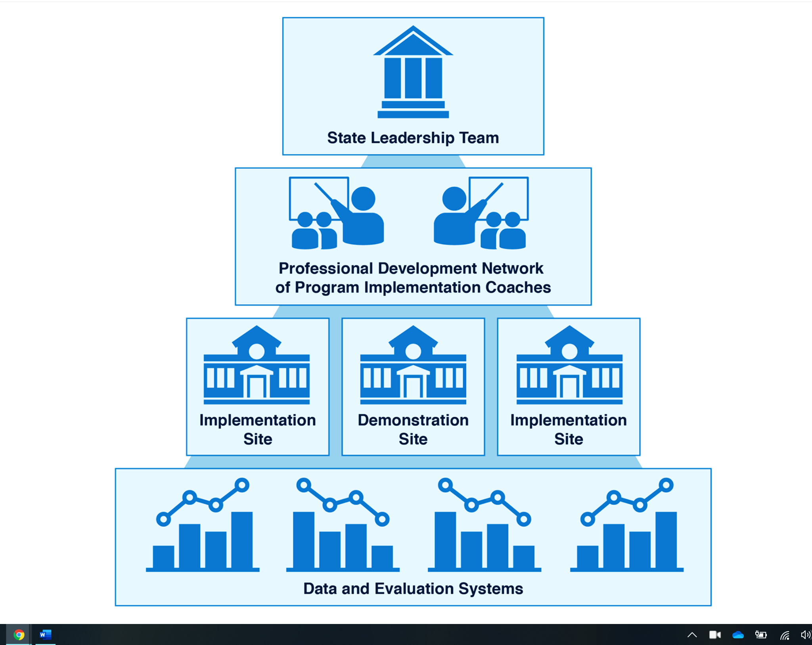
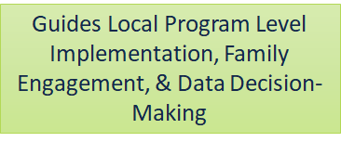
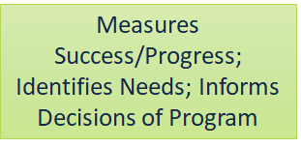
Essential Support Structures Working Together to Support Professional Development
https://ectacenter.org/sig/ess.asp
Notes:
When we think about implementing any effort, we also think about the supports that drive and sustain that implementation and organize those supports into these 4 essential support structures for implementation. These structures may be organized and named differently in different states or systems, but generally leaders at the state or system level should establish similar essential support structures to successfully implement any initiative, including a system of PD support. You can learn more about the essential support structures at the link shown on the slide.

Slide 6
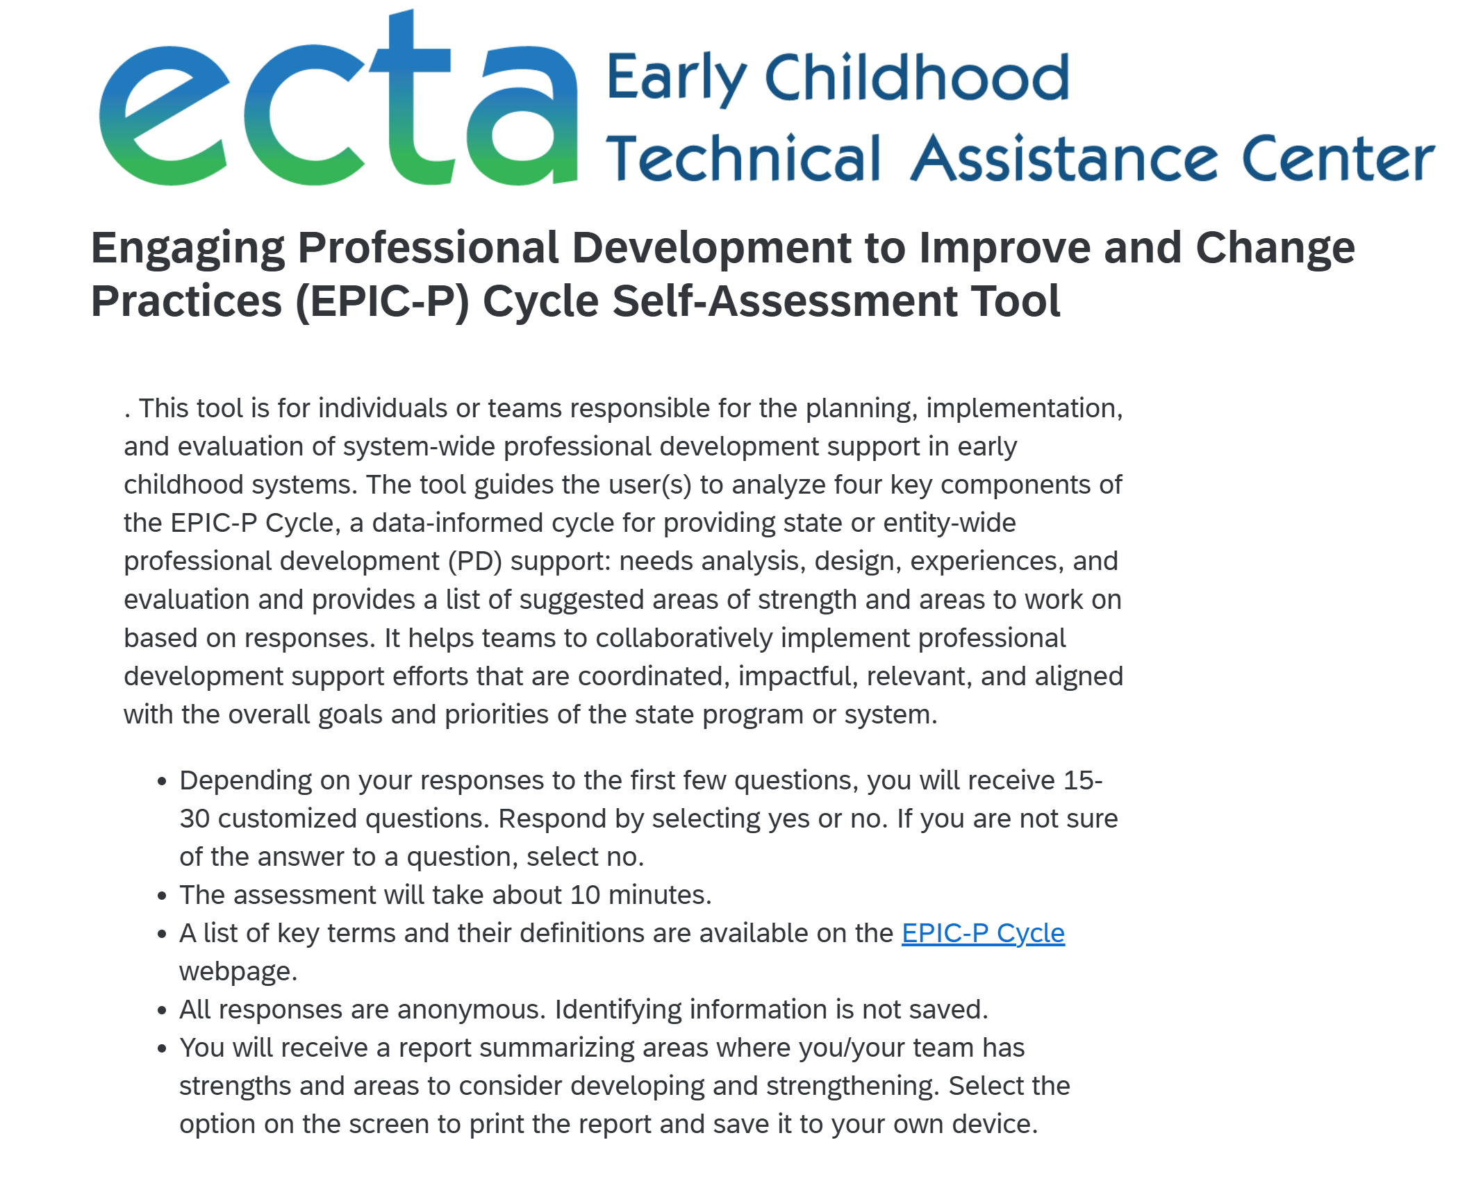
Online Resources 3
Online Resources
https://ectacenter.org/epic-p/
Notes:
When you scroll beyond the sections explaining each EPIC-P cycle component, you will see a couple of very helpful tools. One is the EPIC-P Cycle Self-Assessment Tool.

Slide 7
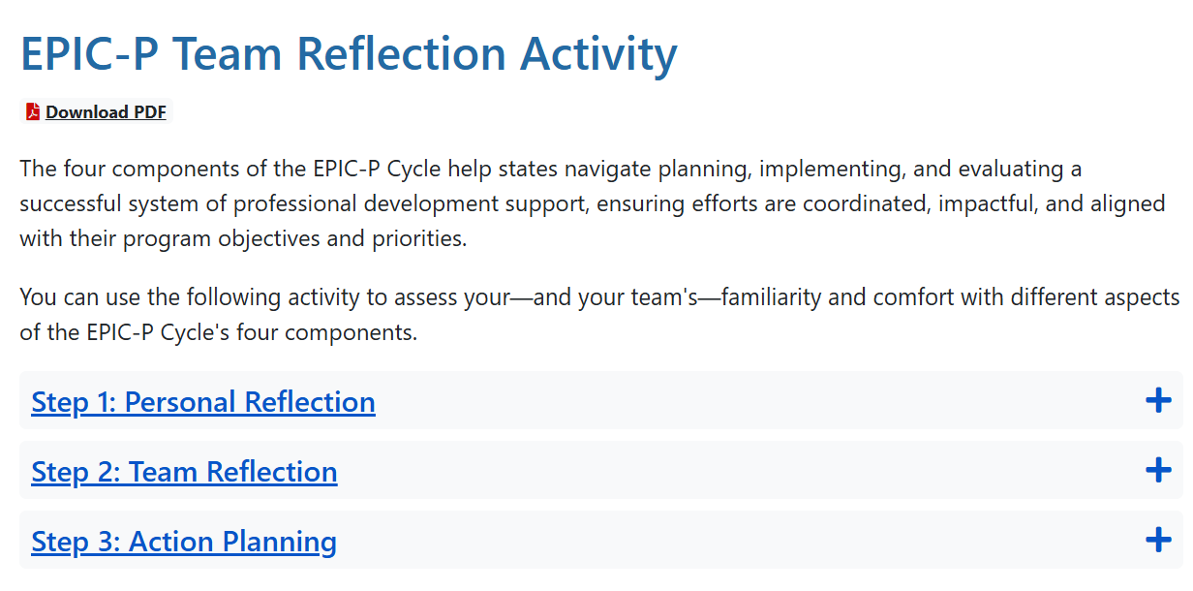
Online Resources 4
Online Resources
https://ectacenter.org/epic-p/
Notes:
You’ll also find the EPIC-P Cycle Team Reflection Activity. This is a tool that is not quite as detailed or comprehensive as the self-assessment tool. It’s intended to help individuals on teams to assess their individual and also their team’s familiarity and comfort with the different aspects of the EPIC-P Cycle’s four components.

Slide 8
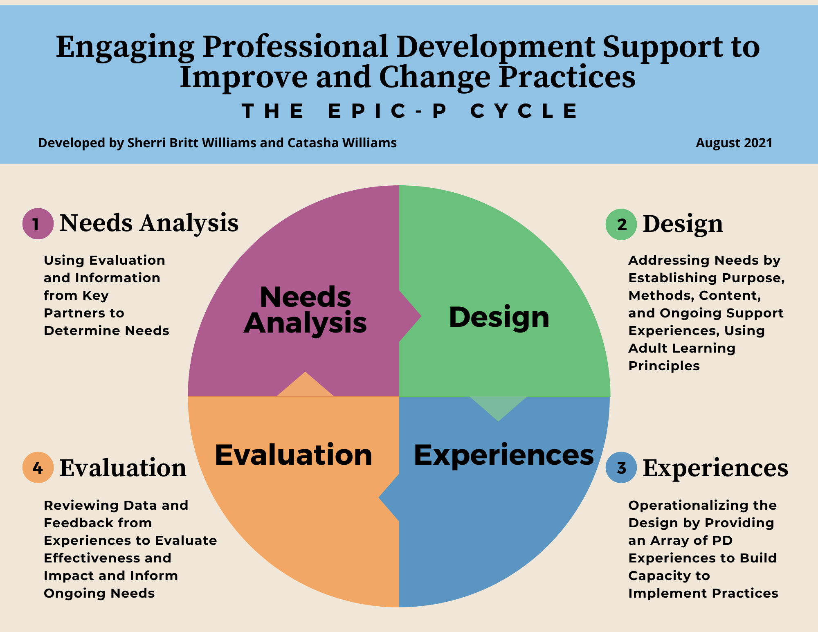
EPIC-P Cycle
Using a
Data-Informed Process to Assess Needs, Design, Deliver, and Evaluate PD Support
https://drive.google.com/file/d/1bv85u9UCRWsAULqZNjkbOHeR8FhWSwwV/view?usp=sharing
Notes:
As we consider the essential support structures needed to support implementation of relevant and responsive statewide PD (professional development) supports, we also need to establish an ongoing data-informed process that leverages each of these essential support structures to successfully implement statewide PD supports. The EPIC-P Cycle organizes this ongoing process using four general components: needs analysis, design, experiences, and evaluation.

Slide 9
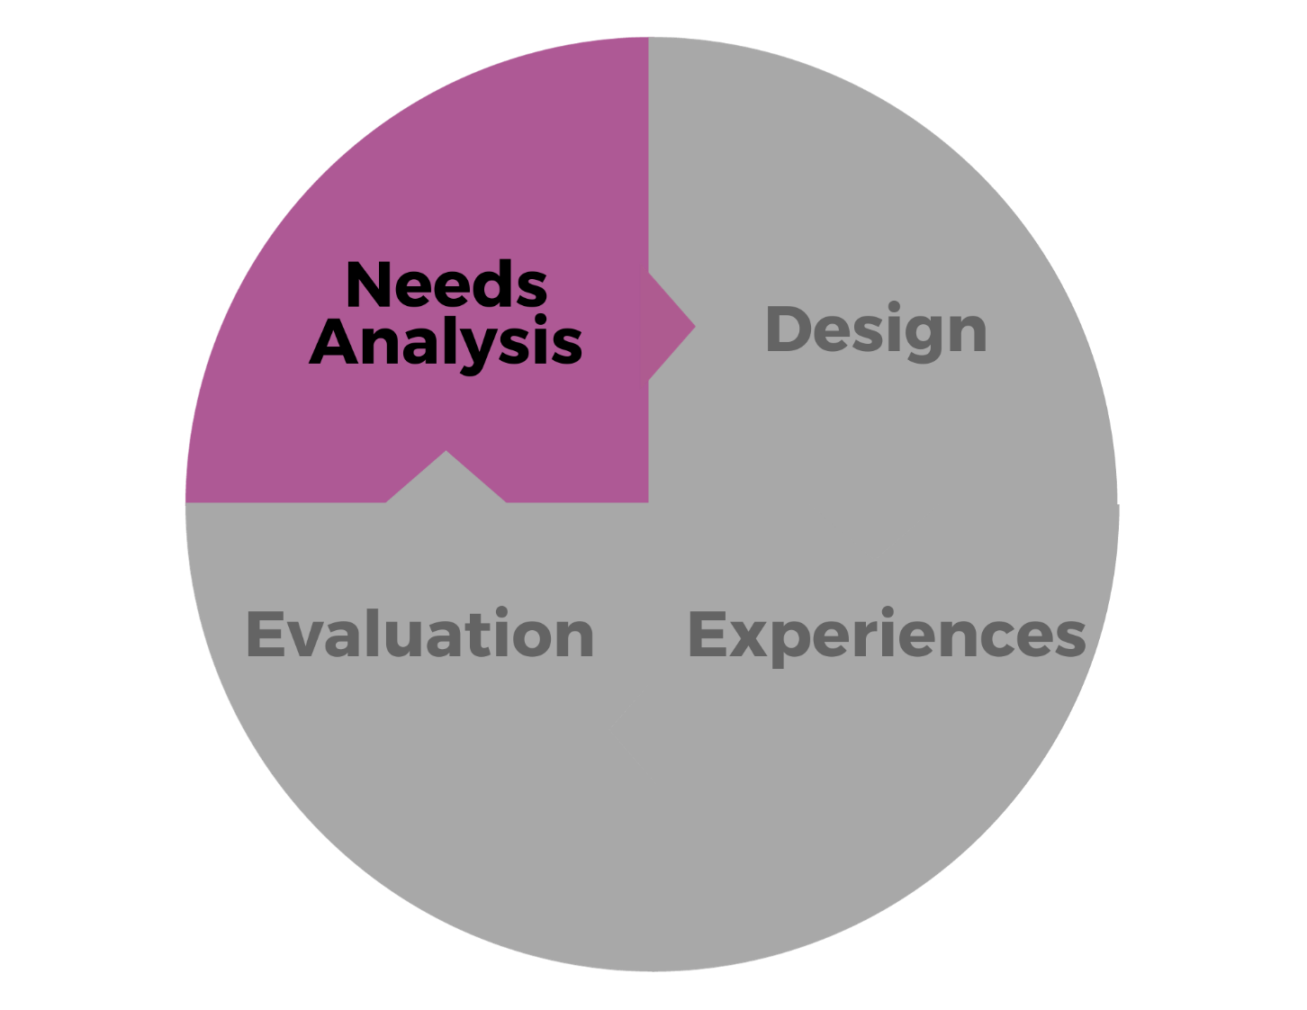
Needs Analysis
Using Evaluation and Information from Key Partners to Determine Needs
Notes:
Needs analysis involves using evaluation and information from key partners to determine learning needs and solutions to meet those needs. We also want to know what success looks like - not just in words but in actions. What are people in our workforce doing when they meet expectations? Needs analysis helps us pinpoint strengths, learning needs, and potential solutions, so the PD support we plan and provide is relevant to the workforce and also aligns with the state or program’s priorities and goals.
Needs analysis is about gathering, analyzing, and discussing data on how the workforce is implementing expected practices---including information that comes from the voices and experiences of those most impacted by professional development, the workforce and also the children and families we serve. Needs analysis helps us determine what skills, knowledge, behaviors, and attitudes the workforce needs and generate solutions for customizing PD support so that it builds on workforce strengths and also addresses their needs in a way that is relevant and meaningful to them.
Needs analysis can also help us identify potential barriers to accessing the PD support needed and come up with possible solutions. It's not just about understanding needs; it's about unleashing the potential of our workforce, building on strengths, supporting them as they implement practices and procedures that are necessary to meet the priorities and goals of the overall program.

Slide 10
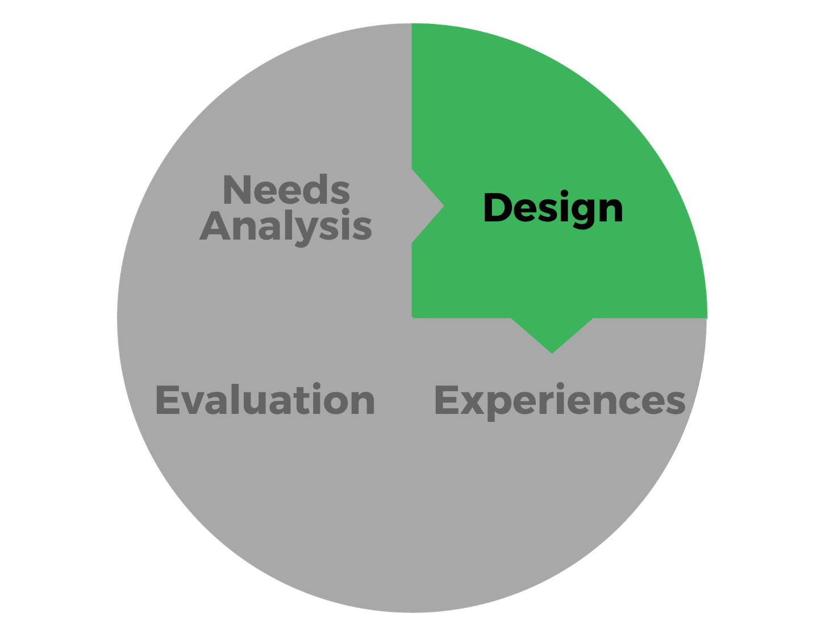
Design
Addressing Needs by Establishing Purpose, Methods, Content, and Ongoing Support Experiences Using Adult Learning Principles
Notes:
The design process is about addressing the needs identified in the needs analysis process by establishing purpose, specific learning objectives, methods, content, and ongoing support experiences needed to support the workforce to implement desired practices and procedures. It’s a blueprint for guiding us to provide support that leads to improved knowledge and skills and behaviors.
We review the needs analysis information, clarify learning objectives, and craft a plan that will work within the resources that are provided. We outline a structured approach to create engaging learning experiences that acknowledge the diverse contexts of our workforce ensuring that everyone sees how the learning experience relates to their work. It’s not just about planning a training– it’s about considering a variety of approaches (ex: coaching, job aids and tools, micro-learning opportunities, learning communities, reflection, action planning) so people can apply what they learn.
You should plan facilitation in a way that breaks down complex topics into digestible pieces, or concepts, and ensure participants have the right tools to participate. Design involves providing reflection questions, acknowledging strengths, and creating opportunities for practice. It also includes planning how to assess learning successes and additional needs throughout the process and at the conclusion of the learning experience.

Slide 11
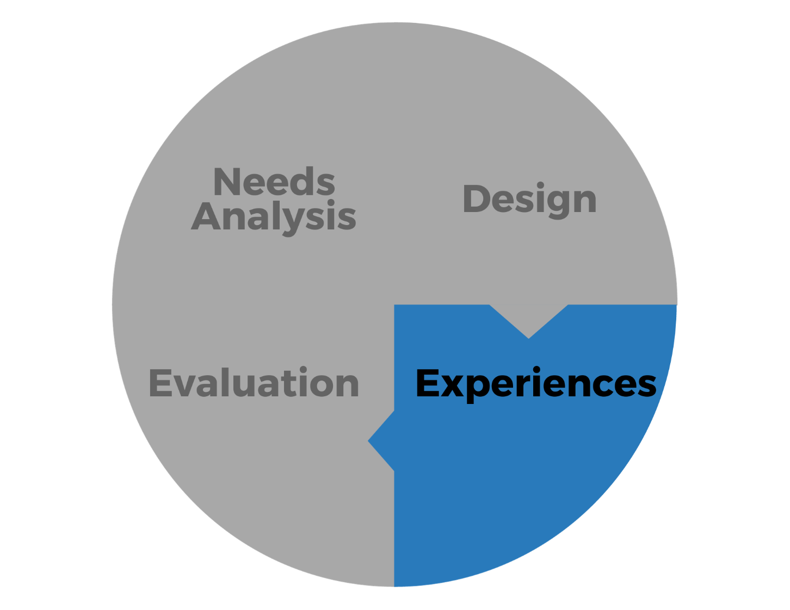
Experiences
Operationalizing the Design by Providing an Array of PD Experiences to Build Capacity to Implement Practices
Notes:
Professional Development (PD) experiences are an array of intentional supports rather than a one-off event. Every activity, discussion, and resource is tailored for the experience and sequenced to build or scaffold understanding so that participants can apply it in their daily work. Adults learn best when they know why it matters. That’s why we use real-world case studies, self-assessments of current practice, and discussions that tie ideas directly to people’s roles.
Engagement in the experience happens on three levels: what participants do (tasks, simulations, role-plays), how we challenge their thinking (problem-solving scenarios, reflection questions), and how they feel (creating a safe, motivating space connected to purpose). Balancing these keeps everyone invested.
Mastery takes time. We build cycles: introduce a concept, guide practice, get peer feedback, then move toward independent use. For example, after explaining a strategy, we might have participants role-play it with a real case, then reflect on what worked and what to tweak. We plan follow-ups or spaced learning—brief check-ins or practice assignments after and between experiences—to reinforce and extend learning.
During experiences, we also do quick checks—polls, self-assessments, observing exercises—to see who’s unsure (so we can revisit) or who’s ready for a deeper dive. Pre- and post-measures show shifts in knowledge, confidence, or intent. We use that data immediately to tweak pacing, examples, or depth so the PD experience stays responsive and effective.
Other key activities during the experience component include: selecting facilitators with expertise and lived experience that resonate with participants, ensuring materials and tech are accessible, ensuring registration and pre-session instructions are clear so participants are ready to focus on engaging during the PD experience.

Slide 12
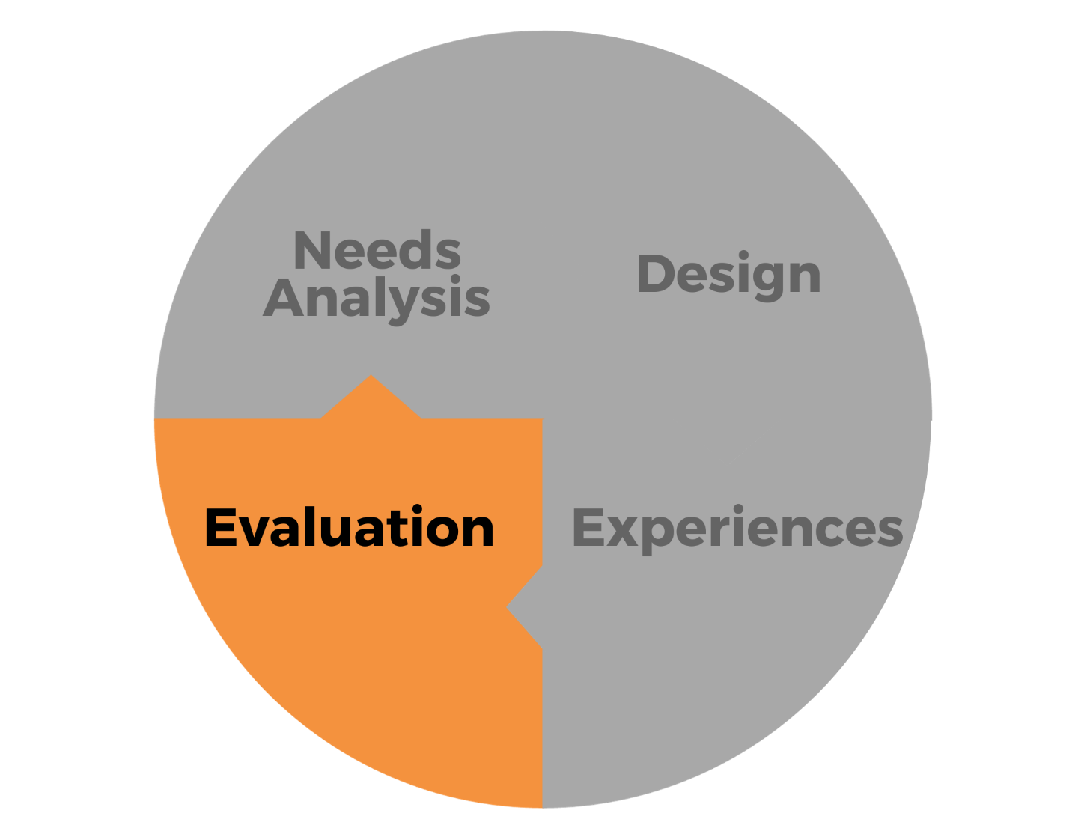
Evaluation
Reviewing Data and Feedback from Experiences to Evaluation Effectiveness and Impact and Inform Ongoing Needs
Notes:
Evaluation includes gathering data from the workforce: Was the PD helpful? Did participants find it relevant? Were the learning objectives met? What else do they need to transfer learning into their day-to-day work? At the same time, we listen to PD providers: What qualitative feedback did they notice during the sessions? They often gather helpful observations on how participants engage and gather information that can help to improve and feed into future PD experiences.
Effective evaluation goes beyond rating satisfaction; it measures whether the experience actually built knowledge and skills and, most importantly, whether participants apply those skills on the job. We look at pre- and post-data, follow-up checks, and real-world examples of change in practice. This tells us the true value of the PD and helps us identify problems of practice so that future design can address those needs more directly.
We also pause to consider who might be missing from the feedback loop. Who didn’t attend, or who attended but didn’t respond? Where are there gaps in the PD we have planned? Disaggregating data by role, location, or other factors helps us spot patterns and barriers, so we can improve access and relevance for everyone.
In practical terms, we check: Did the PD meet its objectives? Did participants find it favorable and job-relevant? Did they acquire and apply new knowledge and skills? We analyze on-the-job application to refine follow-up supports and use feedback to improve future engagement. Carefully considering our evaluation data ensures continuous improvement leading to relevant and meaningful professional development.

Slide 13
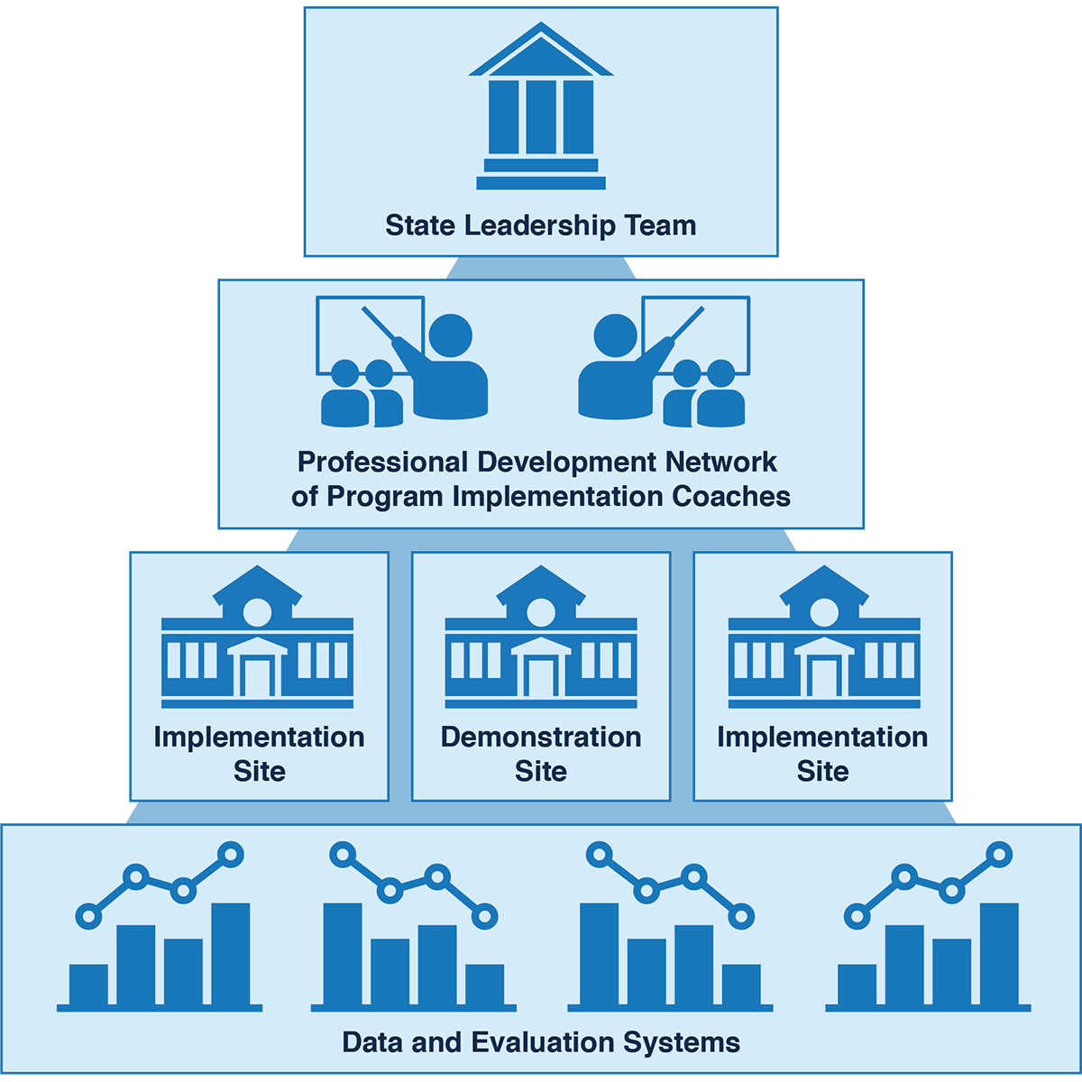
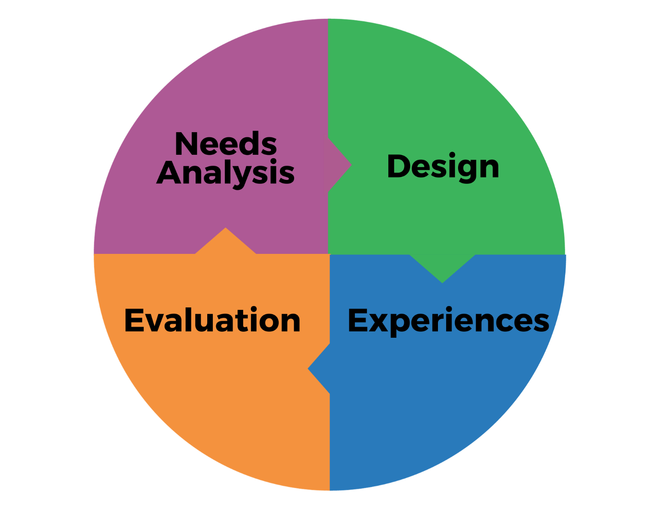
Essential Support Structures and EPIC-P Cycle
Notes:
Reflecting back on those four essential support structures—the cross-sector state leadership team, the professional development network, the local implementation sites, and the data and evaluation systems—and considering the components of this process for planning and implementing the statewide PD support, we see how each of the essential support structures has a role to play in each of the components of this cycle.
For example, the cross-sector leadership team has a significant role in the needs analysis component since the cross-sector state leadership team identifies emerging trends, including priorities, workforce demands, and technology. The cross-sector team plans for the long term, and they anticipate how learning needs might evolve. They discuss strategies to be prepared to support people through those changes.
Those discussions lead to making informed decisions for prioritizing learning needs and communicating professional learning support to key partners to foster buy-in, alignment, partnerships, and collaboration. The State Leadership Team (the SLT) can also consider how the professional learning needs analysis has implications for policies and resource allocation. The involvement of SLT in this process encourages their ownership and understanding of professional development support and their responsibility in addressing any challenges and allocating resources as needed to support PD.
The professional development network for the state system or program is heavily involved in the design and experiences components.
The local implementation sites are usually the participants in the “experiences” component.
And the fourth essential support structure, the data and evaluation systems support structure, has key roles in the evaluation and needs analysis components. So, the essential support structures all work together to make the statewide professional development support happen in a way that’s relevant and useful for the field.

Slide 14
EPIC-P Cycle Self-Assessment Tool
https://ectacenter.org/epic-p/
Notes:
The EPIC-P Cycle Self-Assessment is a web-based tool designed for individuals or teams who lead or support professional development (PD) efforts across early childhood systems.
Whether you're planning, delivering, or evaluating system-wide PD, this tool offers a structured way to reflect on and strengthen your efforts.
It’s built around the EPIC-P Cycle, four essential components of high-quality PD: Needs Analysis, Design, Learning Experiences, and Evaluation, and includes statements for you to indicate yes or no if you engage in the practice described.
Each item asks you to reflect on your current practices when planning and delivering professional development.
Based on your responses, the tool highlights current strengths and suggests areas for growth, helping you and your team ensure that your PD efforts are coordinated, relevant, and aligned with broader system goals.
The assessment is quick—just 10 minutes—and adapts to your answers, offering 15 to 30 tailored yes/no questions.
If you're unsure about a response, simply select “no.” All responses are anonymous, and no identifying information is collected.
Once complete, you'll receive a summary report that can be printed or saved, making it easy to share and use as a springboard for discussion and planning. For additional support, key terms are defined on the EPIC-P Cycle webpage.

Slide 15
EPIC-P Cycle Team Reflection Activity
https://ectacenter.org/epic-p/
Notes:
Also included as one of the web-based resources is the EPIC-P Team Reflection Activity. This Team reflection activity provides an opportunity for teams to assess their familiarity and comfort with different aspects of the EPIC-P Cycle's four components​.

Slide 16
Next Session
Session 2: Needs Analysis Component
Monday, June 30, 2025
3:00-4:30 PM ET
Notes:
If we want professional development to really make an impact, we must start with understanding what’s needed—and why. That’s what Needs Analysis is all about. Too often, PD planning begins with a topic or training idea before teams take time to explore the actual needs of educators, programs, or the system as a whole. But skipping that step can lead to disconnected, one-size-fits-all support. A strong needs analysis process helps you to align your PD support efforts with real challenges and opportunities across the system. Please review the Needs Analysis component to learn more.

Slide 17
What is one thing you’d like to discuss with someone or explore more deeply?
Image by Adobe Stock
Notes:
Think about something you want to discuss, explore further, or implement as part of the PD support you are involved with in your state or program. Take a moment to note somewhere what that next step for you will be.

Slide 18
Find out more at ectacenter.org
The ECTA Center is a program of the FPG Child Development Institute of the University of North Carolina at Chapel Hill, funded through cooperative agreement number H326P170001 from the Office of Special Education Programs, U.S. Department of Education. Opinions expressed herein do not necessarily represent the Department of Education's position or policy.

