Slide 1
Part C Indicator 4
Family Outcomes Data
FFY 2022
(Feb 2024 APR submission)
Prepared by:
Thomas McGhee, Jenna Nguyen, Tony Ruggiero,
Patrick Thornton, Naomi Younggren
Notes:
Hello and welcome to the Part C Indicator 4 Family Outcomes Data Webinar, presented by the Early Childhood Technical Assistance Center (ECTA) and the Center for IDEA Early Childhood Data Systems (DaSy). This webinar highlights data from federal fiscal year 2022 as reported in state's 2024 Annual Performance (APR) submission.

Slide 2

Family Outcomes Data
Background
State Approaches
Data Quality
Performance Data
Resources
Notes:
After a brief overview of the background to this indicator, the main topics we will cover are state approaches, data quality, performance data, and resources.
State approaches refers to use of a collection tool.
The data quality characteristics we’ll review include response rates and representativeness.
In terms of performance data, we’ll review national trends, and in closing we’ll share some key national resources.

Slide 3

Background
Notes:
Now, let’s look at an overview of Part C Annual Performance Report (or APR) Indicator 4 – Measuring Family Outcomes.

Slide 4
FFY 2022 Part C APR Indicator 4
Percent of families who report that early intervention services have helped the family:
Know their rights
Effectively communicate their child's needs
Help their child develop and learn
Notes:
Indicator 4 of the Part C APR has three parts, all addressing the measurement of how helpful the early intervention program has been for helping families:
A) Know their rights
B) Effectively communicate their child's needs, and
C) Help their child develop and learn
Throughout this brief webinar, we will share various data related to this indicator and drill down into some variations across states.

Slide 5
Which Data Are Included?
Federal Fiscal Year (FFY) 2022
  Data from February 2024 Annual Performance Report (APR) submission
  School year/State fiscal year 2022-2023
56 states, territories, and jurisdictions reported Part C Indicator 4 data.
Quantitative data as reported to OSEP
Qualitative data coded by DaSy/ECTA
Note: not all states reported on all qualitative variables
Notes:
Before we jump into the data, we want to remind everyone what data are included and where the data came from.
These data are from Federal Fiscal Year (or FFY) 2022, which states submitted in their February 2024 APR submission.
All 50 states are included, along with 6 territories and jurisdictions, for a total of 56. Beyond the states, the territories and jurisdictions included are American Samoa, the District of Columbia, Guam, the Northern Mariana Islands, Puerto Rico, and the Virgin Islands. We will use the term “states” throughout the webinar to include states, territories, and jurisdictions.
All 56 states submitted Part C Indicator 4 data.
As far as the data sources go, the quantitative data are exported from the online system and provided to us by the Office of Special Education Programs (or OSEP).
ECTA and DaSy coded a number of additional variables by reading through each states’ APR and looking for the key variables that you will see here.
Let’s move on.

Slide 6

State
Measurement
Approaches
Notes:
Now, let’s look at an overview of the state measurement approaches.

Slide 7
FFY 2022 State Approaches
56 states reported using a collection tool (survey).
Frequently used surveys include:
  FOS
  FOS-R
  NCSEAM
  State developed
10 states reported that it is a new or revised survey tool.
Notes:
As part of the FFY 2022 APRs, all 56 states reported using a survey to measure the family outcomes.
The APR does not require states to name or further describe the survey they are using.
Yet, it is important to note that there are variations in the surveys. For example, some surveys include multiple questions for each of the three family outcomes; others have one question for each outcome; and some use a statistical methodology called Rasch scoring to assess performance on the three outcomes based on the family’s overall score.
The frequently used surveys include: the Early Childhood Outcomes – Family Outcomes Survey or FOS including the original version and the revised version or FOS-R, the NCSEAM Survey, and state developed surveys.
During the FFY 2022, 10 states reported using a new or revised survey tool, while the remaining 46 states continued using the tool they had used previously.

Slide 8

Data
Quality
Notes:
Now, let’s take a brief look at data quality. Here we will see the national picture of family outcomes with respect to response rates and representativeness.

Slide 9
FFY 2022 Survey Response Rates
56 of 56 states reported a response rate
Response rates ranged from 3% to 100%
Mean response rate = 33%
Notes:
Shown here are the state survey response rates. Response rates are calculated by dividing the number of surveys returned by the number of surveys disseminated.
All 56 states reported a response rate.
The individual state response rates varied greatly from a low of 3% to a high of 100%.
The mean response rate was 33%.
Interestingly, the range in FFY 2022 is the same as it was in FFY 2021.

Slide 10
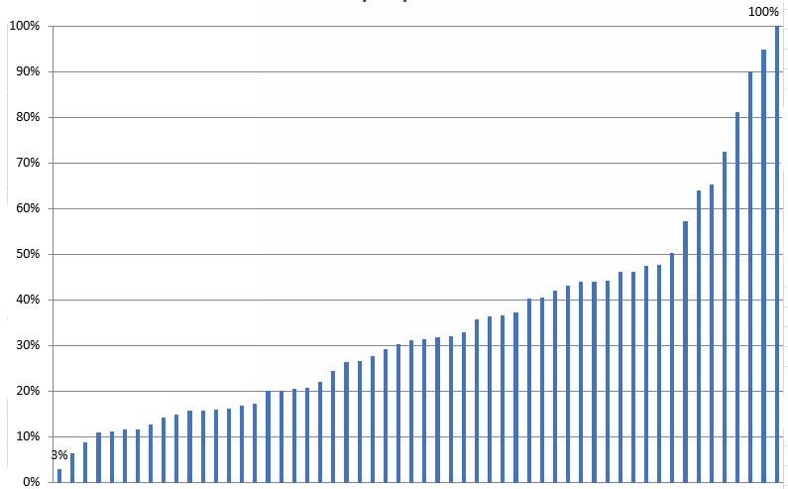
Survey Response Rates by State FFY 2022
Mean = 33%
Notes:
This graph shows the distribution of response rates by each of the 56 states. Each blue bars represents a states and its response rate.
In this graph you can see the variation across the states showing the range from 3% to 100%.
**animate – This purple line shows the mean response rate of 33%.

Slide 11
FFY 2022 Representativeness of Family Data
State reported responses: “The demographics of infants or toddlers for whom families responded are representative of the demographics of infants and toddlers enrolled in the Part C program.”
  Yes: 25 states (45%)
  No: 31 states (55%)
Notes:
Next, we will look at representativeness. This refers to the degree to which you think your survey data adequately represent the families in your program.
All states report on whether they determined their survey results were or were not representative of the children in the program.
The data shown here are states’ self-reported response to the question in their APR. Quote: “The demographics of the families responding are representative of the demographics of infants, toddlers, and families enrolled in the Part C program.”
This year, the number of states that answered “Yes” to this question increased from 22 to 25, and the number of states that answered “No” decreased from 34 to 31 from FFY 2021 to FFY 2022.

Slide 12
FFY 2022 Assessing Representativeness
Variables for Assessing Representativeness | Yes, Representative | No, Not Representative
Race/Ethnicity | 24 states (43%) | 25 states (45%)
Geographic Region | 13 states (23%) | 20 states (36%)
Child Gender | 11 states (20%) | 3 state (5%)
Other Variable (Child age, disability/eligibility categories, length of time in services, income, primary language) | 20 states (36%) | 9 states (16%)
Notes:
Also included in our analysis of the state APRs was an examination of the variables states used to analyze representativeness.
The top three variables states looked at and determined representativeness by were race/ethnicity, geographic region, and child gender. This was the first year that analysis by race/ethnicity was required.
Race and ethnicity
For race/ethnicity, 24 states indicated their data were representative and 25 states indicated their data were not representative by this variable.
For the remaining states it was unclear whether their data were or were not representative by this variable.
Geographic variables
Geographic regions that states used to assess representativeness included looking across regions, counties, districts, or urban/rural residency.
13 states indicated their data were representative by geographic region, while 20 states indicated their data were not representative by this variable.
Child gender
For child gender, 11 states indicated their data were representative, and 3 state indicated their data were not representative by this variable.
Other variables states examined, albeit less frequently, included: the child’s age (including age at referral), disability or eligibility categories, length of time in services, income (such as household income based on Medicaid), and primary language.
20 states indicated their data were representative by some other variable, and 9 states indicated their data were not representative by one of these other variables.
It’s important to note that states must look at an additional variable beyond race/ethnicity, so these are not mutually exclusive. In other words, a single state could be reflected in more than one of the variable groups reported here.

Slide 13
Considerations for
Assessing Representativeness
Are response rates disproportionate across family subgroups (e.g., race/ethnicity)?
Were minimum response rates met among each subgroup?
Are differences across subgroups and across years statistically significant?
Was each subgroup size sufficiently large enough to draw conclusions?
Notes:
It is common to see variation in survey data across subgroups and across years.
States vary as to how they assess representativeness and how they make conclusions about their data.
When assessing representativeness, it is important to consider a variety of factors that could affect data quality and interpretation.
Questions such as these:
Are response rates disproportionate across family subgroups (e.g., race/ethnicity)?
Were minimum response rates met among each subgroup?
Are differences across subgroups and across years statistically significant?
Was each subgroup size sufficiently large enough to draw conclusions?
These are just a few examples to help states with their data analysis and accurate assessment of representativeness.

Slide 14

Performance
Data
Notes:
Next, we will review the performance data. These data show how states performed on each of the three family outcomes.

Slide 15
Indicator C4 FFY 2022 Performance Data
Percent of families who report that early intervention services have helped them:
  Know their rights: 91%
  Effectively communicate child's needs: 91%
  Help child develop and learn: 92%
Notes:
Nationally, in FFY 2022:
91% of families reported that early intervention services helped them know their rights.
91% reported that the program helped them effectively communicate their child’s needs.
And 92% reported that the program helped their child develop and learn.
Overall, we consider these data stable over time. Typically, these data are only fluctuating plus or minus (+/-) a percentage point within each category from year to year.

Slide 16
Indicator C4 National Family Survey Data Trends FFY 2022
Notes:
Now, let’s take a moment to review the national Indicator 4 results over multiple years.
Shown here are the national averages for the percent of families who report that early intervention has helped their family achieve the three family outcomes.
The outcome “know their rights” is shown in purple, “effectively communicate their children’s needs” is in blue, and “help their children develop and learn” is in green.
The years are reported at the bottom, and the percent for each outcome is included at the top of each of the colored bars.
As you can see here, these data have remained high over the years.
Among the three family outcomes, the highest percent has consistently been in the area of “helping their children develop and learn” (shown in green) and that remains true for this year.
There is also general consistency across years within individual states, although the performance data may differ across family subgroups.

Slide 17
Resources
General Information About the Family Outcomes (ECTA)
Improving Practices and Family Outcomes (ECTA)
  Family Engagement Resources
  DEC Practice Improvement Tools
  DEC Recommended Practices
DaSy Center Toolkits
Calculators and Graphing Templates (ECTA)
DaSy Center SPP/APR Checklist and Tips
Notes:
As we wrap up, we’d like to share a few of our most popular resources around family outcomes data.
Here are several online resources, with embedded links, you can find readily available on the ECTA and DaSy Center websites, including background information about family outcomes, strategies for family engagement, recommended practices, toolkits, calculators, and graphing templates.
We encourage you to take some time to review these resources on your own.

Slide 18
Contact us
Thomas McGhee thomas.mcghee@unc.edu
Jenna Nguyen jenna.nguyen@sri.com
Tony Ruggiero tony.ruggiero@aemcorp.com
Naomi Younggren naomi.younggren@gmail.com
Notes:
If you have any questions or feedback, please contact the DaSy and ECTA staff listed here.

Slide 19
ECTA and DaSy Contact Information
Find out more at
ectacenter.org and dasycenter.org
Notes:
Thank you very much and have a wonderful day!

