Slide 1
2022-23 Child Outcomes Data Highlights
Presenters:
Nicholas Ortiz & Kellen Reid
Notes:
Hello and welcome to the 13th annual national webinar on child outcomes data, presented by the Early Childhood Technical Assistance Center and the Center for IDEA Early Childhood Data Systems. This webinar presents data from federal fiscal year 2022, which states submitted in their 2024 Annual Performance Reports, roughly corresponding to the 2022-23 school year. As in past years, this webinar will show highlights from our analysis of the data that states submitted in their Annual Performance Reports for child outcomes. The Indicators used in the analyses were Indicator 3 for the Part C infant and toddler programs, and Indicator 7 for the Part B, Section 619 preschool programs.

Slide 2
Intended Outcomes
Learn about:
the latest national child outcomes findings
where to find more information about the national analysis, and
how to find resources to support state and local child outcomes data use
Notes:
In this webinar, you will learn about findings from our analysis of the Part C and Part B child outcomes Indicators, where to find more information about the analysis, and where to find resources to help you use the outcomes data at the state and local levels.

Slide 3
General Background
Looking at compliance is not enough to produce good results, so the focus has shifted to looking at results.
All federal agencies are required to report on the outcomes achieved by their programs.
The Office of Special Education Programs (OSEP) uses child outcomes data to:
Justify the funding for Part C and Part B Preschool.
Monitor state results through Results Driven Accountability processes (Part C only).
Notes:
Throughout this webinar, we present the child outcomes data that states collected from around July 1, 2022 through June 30, 2023 and which was reported in 2024. As you may know, states first began collecting, analyzing, and reporting outcomes data in 2005. It was at that time that the US Department of Education's Office of Special Education Programs (OSEP) shifted its monitoring focus from compliance to results. They found that just monitoring for compliance to the Individuals with Disabilities Education Act (IDEA) requirements had not always resulted in better outcomes for children with disabilities and their families. At the same time, the federal Office of Management and Budget (OMB) began to hold all federal agencies accountable for results and required all federal agencies to report data that show the extent to which their programs make a difference. If agencies are unable to show positive results, they risk funding cuts. That’s why OSEP needs these data - to justify funding for Part C and Part B services. Also, outcomes data reporting is part of OSEP’s Part C Results Driven Accountability process.

Slide 4
Three Child Outcomes
In 2005, OSEP required states to report data on 3 child outcomes:
Children have positive social emotional skills (including social relationships)
Children acquire and use knowledge and skills (including early language/communication and early literacy)
Children use appropriate behaviors to meet their needs
Notes:
OSEP originally worked with the Early Childhood Outcomes Center (also known as the ECO Center) to engage affected parties in identifying which outcomes should be measured. Those parties determined that the outcomes to be measured should be functional in nature and integrated across areas of development. Their work resulted in these three targeted outcomes: A) children should have positive social emotional skills (including social relationships), B) children should acquire and use knowledge and skills (including early language and communication [and for preschoolers, early literacy]), and C) children should use appropriate behaviors to meet their needs.

Slide 5
OSEP Progress Categories As Developmental Trajectories
70
60
50
40
30
20
10
0
Did not improve functioning
Improved functioning, no change in trajectory
Moved closer to functioning like same-aged peers
Improved functioning to that of same-aged peers
Functioning like same-aged peers
e
d
c
Growth in Outcome
b
a
0 6 12 18 24 30 36 42 48 54 60 66
Age in Months
Notes:
In addition to articulating the outcomes themselves, OSEP also worked with the ECO Center and other assessment experts to determine how programs must show progress. Because of the complexity of children, families, areas of disability, and service systems, it was clear that OSEP must ask more than a yes/no question about whether children made progress as a result of services they received in a Part C or Part B 619 program. Experts said that children might demonstrate several different levels of progress, depending upon the trajectory of their development. They concluded by summarizing children’s progress in five categories of development.
The chart here will show a hypothetical trajectory of a single child’s development in each of the 5 categories of development, also known as progress categories. The horizontal axis represents a child’s chronological age, while the vertical axis represents a child’s actual developmental growth.
[advance slide animation one click]
The first progress category, category (a), represents a child who did not show any improved functioning between program entry and exit, as illustrated by the dashed grey line labeled ‘a’ toward the bottom of the graph; often, there are relatively few children in this category compared to the other categories.
[advance slide animation one click]
On the opposite end of the spectrum, category (e) represents a child who maintained age-expected functioning from program entry to exit, as represented by the solid purple line.
Somewhere in the middle lie the 3 other categories.
[advance slide animation one click]
Category (b) represents a child who demonstrated some improvement in functioning, although without changing their developmental trajectory, as represented by the blue dashed and double-dotted line.
[advance slide animation one click]
Category (c) represents a child who improved functioning to the extent that they moved closer to age-expected functioning, but without catching up, as represented by the green dashed and single-dotted line.
[advance slide animation one click]
Finally, category (d) represents a child who improved functioning to the extent that they caught up with their same-aged peers by the time they exited the program, as represented by the orange dashed line.
Within each outcome area, states are expected to tally and report the number and proportion of children in each category.
Sometimes people ask how children who are eligible for services can enter a program with age-expected skills (as denoted by category ‘e’). The children reported in category ‘e’ are those whose developmental issues affect just one or two outcome areas – not all three. These can also be children for whom services mean maintaining use of assistive technology to support age-expected development.

Slide 6
The Summary Statements
Of those children who entered or exited the program below age expectations in each outcome, the percent who substantially increased their rate of growth by program exit.
$$\frac{Total\left(c+d\right)}{Total\left(a+b+c+d\right)}$$
X 100
The percent of children who were functioning within age expectations in each outcome by program exit.
$$\frac{Total\left(d+e\right)}{Total\left(a+b+c+d+e\right)}$$
X 100
Notes:
Once the working partners had defined three outcomes and five levels of progress, they were reengaged to identify a succinct metric to summarize the data. This process yielded these two summary statements. Summary Statement 1 is the percent of children who moved closer to age expected functioning while in the program.
[advance slide animation one click]
We calculate the percentage for Summary Statement 1 by adding the number of children in categories c plus d, divided by the total number of children in categories a+b+c+d.
[advance slide animation one click]
Summary Statement 2 is the percent of children who exited the program functioning like their same age peers.
[advance slide animation one click]
We calculate the percentage for Summary Statement 2 by adding the number of children in categories d and e, divided by those in all progress categories a+b+c+d+e.

Slide 7
State Approaches to Measuring Child Outcomes (FFY 2022)
Approach | Number of Part C Programs | Number of Part B Preschool Programs
Child Outcomes Summary (COS) Process | 40 (71%) | 38 (64%)
One Tool Statewide/Publisher’s Online System | 12 (21%) | 12 (20%)
State-Specific Approach | 4 (7%) | 5 (8%)
Transitioning Approaches | None this year | 4 (7%)
Total | 56 (100%) | 59 (100%)
Notes:
Since 2005, states have measured child outcomes using a wide variety of approaches. For the purpose of describing the national picture of outcomes measurement systems, we group these approaches into 4 categories. And those of you who have studied this report in the past may notice we have modified the categories to more accurately reflect the variety of approaches in use across the country.
The Child Outcomes Summary process, also known as the C-O-S or COS process, is a process whereby a team reaches consensus on a child’s rating at entry and at exit based on a 7-point scale using multiple sources of information about a child’s functional performance. This is the most frequently used methodology across both Part C and Part B preschool programs. The ratings are then converted into the progress categories and summary statements required for federal reporting.
The next most common approach is to gather child outcomes data through one common tool statewide. This usually entails entering item level data into online assessment platforms like those of commercially developed assessments like the Batelle Developmental Inventory, Teaching Strategies GOLD, or AEPSi—or even a tool that a state has developed itself, such as California’s Desired Results Developmental Profile. Item level data from these systems are then combined and analyzed using algorithms created and maintained by the state or the assessment publishers to produce entry and exit ratings, sometimes using a 7-point scale similar to the COS process. The algorithms may also convert data to the progress categories directly.
Next, there are some states who use a rather state-specific approach. This may include states leveraging algorithms from multiple assessment tools as opposed to one single tool but using a process different than that of the COS and/or base entry and exit ratings on a different scale than the commonly used 7-point scale for calculating progress categories and summary statements.
Lastly, we have separately grouped states who are in the midst of transitioning to a different measurement approach, such as those moving from the COS process to a publisher’s online system, or vice versa. States in this category may have some children with entry scores using one approach who then exited the program with exit scores from another approach in a given reporting cycle.
We want to underscore the variety of approaches in use, even within a category. For example, the specific mechanics of the team-based consensus scoring process may look quite different between two states using the COS process. Nonetheless, these categories are useful for understanding the national picture at a high level.
RESTATE THE FOLLOWING:
States that are listed as using one tool statewide are those that require a single assessment tool for all children in the state, for example, in California all preschoolers with IEPs are assessed on the Desired Results Developmental Profile – also known as DRDP. Also included in this category are states that use the Battelle Developmental Inventory (also known as BDI) to collect their outcomes data. This is the second most frequently used approach for both Part C and 619.
OLD LEFTOVER TEXT:
States that are listed as "other" include those using multiple tools and those using rating processes like the COS but with different scales.

Slide 8
Method for Calculating National Estimates
Weighted average of states that met minimum quality criteria
Minimum quality criteria for inclusion in national analysis:
Data Completeness
Part C: 28% or more of exiters
Part B Preschool: 12% or more of 3-5 child count
data reported on less than 100% of child count
Validity
category ‘a’ not greater than 10%
category ‘e’ not greater than 65%
Notes:
Let’s look at how we calculated the national estimate. To determine which states were included in the national estimate, we started by asking two fundamental questions about data quality: 1) did the data include an adequate number of children, and 2) did the data stay within expected patterns?
To determine the national picture, we calculate the national estimate of the outcomes of children exiting Part C and 619 using an average of state data, weighted by each state’s child count, limited to states that meet our data quality criteria. Please note that the criteria used to identify states to include in the national estimate represent basic criteria for data quality, and they are not sufficient to determine that the data are valid and reliable for all purposes.
We define criteria for data completeness and validity. Data from Part C programs are included in the national estimate when at least 28% of Part C exiters from a state's child count are reported in the outcomes data. Data from Part B preschool programs are complete when at least 12% of their count of children ages 3 through 5 is reported in the outcomes data. We set these 2 criteria very low because the goal is to exclude states with so much missing data that we cannot trust the validity of the performance data.
Data from both Part C and Part B preschool programs are considered valid when progress category ‘a’ (those making ‘no progress’) is less than 10% and progress category ‘e’ (those who maintained age-expected functioning) is less than 65%. We also excluded any state whose child outcomes report reflected greater than 100% of their child count as this is an unexpected pattern.
We also do not include data on states that use sampling methodologies for child outcomes. We exclude these states because we don’t have a method for estimating completeness of data.

Slide 9
Reasons for Excluding States From the National Estimate
Started with 50 states plus D.C. in each program
 | Part C | Part B Preschool
Reason for Exclusion (FFY 2022) | Number Excluded | Number Excluded
Sampling | 2 | 2
Missing data* | 1 | 2
Unusual patterns in progress categories ‘a’ and ‘e’** | 1 | 3
Data greater than 100% of child count | 0 | 0
Total number of states included in national analysis | 47 | 44
*For Part C: reported outcomes data on less than 28% of exiters. For Part B 619: reported outcomes data on less than 12% of child count.
**Had at least one outcome with category ‘a’ greater than 10% or category ‘e’ greater than 65%.
Please note, states may be counted in more than 1 row. Subtotals may not add up to the grand total.
Notes:
Let’s take a closer look at why certain states were excluded from the national estimate. This table here shows how many states were excluded from the FFY 2022 national analysis for various reasons. We started with all 50 states plus the District of Columbia.
For Part C, two states were excluded in FFY 2022 because they used a sampling method. One state reported outcomes data on fewer than 28% of the children who exited Part C and 1 state was excluded for unusual patterns of data in the ‘a’ and ‘e’ progress categories for Part C. This left 47 states for inclusion in the national analysis for Part C.
Now let’s look at Part B preschool. In FFY 2022, two states were excluded because they used a sampling method. Two states were excluded because they reported fewer than 12% of their preschool-age child count. Three states were excluded for unusual patterns in progress categories ‘a’ and ‘e’. This left 44 states for inclusion in the national analysis for Part B preschool.

Slide 10
The number of states included in the national estimate has increased substantially since 2008 and stabilized in the last few years.
Years refer to the federal fiscal year, which corresponds to the first half of the equivalent school year (for example: 2008 = 2008-09 school year).
Notes:
Now let’s look at the trends for inclusion in the national analysis. For federal fiscal year 2022, 47 states met the data quality criteria for Part C, and 44 states met the criteria for Part B preschool. The solid yellow line on this graph compares the number of states that met criteria for Part C across the past 15 years. You can see that the number of states has stayed relatively stable over the last few years with one additional state meeting the criteria this year compared to last year. The dashed blue line shows the number of states that met data quality criteria for Part B preschool. Although the number of Part B preschool programs meeting criteria decreased slightly since its peak, it has remained stable over the last few years, with several more states meeting the criteria this year compared to last year.

Slide 11
National Child Outcomes Data for Children Exiting in FFY 2022
Outcome | Part C: Summary Statement 1 | Part C: Summary Statement 2 | Part B Preschool: Summary Statement 1 | Part B Preschool: Summary Statement 2
Social Relationships | 66% | 51% | 80% | 52%
Knowledge and Skills | 71% | 42% | 80% | 49%
Action to Meet Needs | 69% | 51% | 79% | 59%
Note: Data are based on 47 states' Part C programs and 44 states' Part B Preschool programs. Only states who met minimum data quality criteria were included.
Notes:
Here are the national estimates for child outcomes data based on the criteria discussed earlier. Starting with Part C, Summary Statement 1, in the area of social relationships, we see that 66% of children substantially increased their rate of growth by program exit. For knowledge and skills it was 71%, and for taking action to meet needs it was 69%.
Now let’s look at Part C’s Summary Statement 2. 51% of children in Part C were functioning within age expectations in social relationships by the time they exited the program; for knowledge and skills it was 42%, and for taking action to meet needs it was 51%.
Moving over to Part B preschool, we see that 80% of exiting children substantially increased their rate of growth in Social Relationships and Knowledge and Skills, and 79% in Action to Meet Needs. And finally, for Summary Statement 2 for Part B Preschool, the percentage of children functioning within age expectations by the time they exited the program was 52% in the area of social relationships, 49% for knowledge and skills, and 59% for taking action to meet needs.

Slide 12
Part C Child Outcomes Data Trends: FFY 2012-2022
Percent making greater than expected growth (Summary Statement 1)
Percent exiting at or above age expectations (Summary Statement 2)
Notes:
We can see a fuller picture by looking at the data over time. This slide shows trends in child outcomes national estimates across the last decade for infants and toddlers exiting Part C programs.
Comparing FFY 2021 to FFY 2022 shows stabilization in all 3 outcome areas, despite downward trends in earlier years, particularly in Summary Statement 2.
The lowest percentage of children making greater than expected growth has consistently been in in the outcome of Social Relationships, represented by the peach dashed line in the chart on the left. The lowest percentage of children exiting at or above age expectations has consistently been in the outcome of Knowledge and Skills, represented by the blue dashed and dotted line in the chart on the right.

Slide 13
Part B Preschool Child Outcomes Data Trends: FFY 2012-2022
Percent making greater than expected growth (Summary Statement 1)
Percent exiting at or above age expectations (Summary Statement 2)
Notes:
Now let’s look at the trends for Part B 619 preschool. This slide shows trends in child outcomes across the last decade for children exiting Part B Preschool programs.
As seen in the chart on the left, the percentage of children who made greater than expected growth while in Part B Preschool had been quite stable and similar for the four years leading up to federal fiscal year 2020. However, between 2019 and 2020, there was a decrease in all 3 outcomes. In recent years, the percentages across outcomes have generally remained similar and level.
Now look at the percentage of children exiting at or above age expectations in the chart on the right. Since about 2017, results have been trending downward in all 3 outcomes. Outcome A (Social Relationships) has been decreasing at a slightly higher rate than Outcomes B and C over this period.
States reported several key reasons for changes in Part C and 619 performance including changes to state data collection methods, potential impacts of COVID-19, and other data quality issues. While further analyses are underway at the national level, more analyses are needed at the local levels to understand these trends. States should perform root cause analyses using available data and consider local contributing factors to explain patterns in their data.

Slide 14
How the Pandemic Overlaps With Child Outcomes Data Reports
Earliest possible entry date for children in this reporting cycle
Latest possible exit date for children in this reporting cycle
Notes:
One area of further analysis that TA centers are looking at is around the possible impact of COVID. Many states’ APRs cite the pandemic as a reason for slippage in recent years. This diagram shows how the pandemic overlaps with the annual child outcomes federal reports, and how the national data still represent the outcomes of those children who received services during the height of the pandemic.
The uppermost horizontal line is a timeline with key pandemic-related milestones noted above the line. As many of us remember, COVID-related shutdowns began in March 2020. At the end of 2020, the first COVID-19 vaccine was approved for use in adults and most schools were back to in-person instruction for the 2021-22 school year. Then in mid-2022, vaccines were finally approved for use with children 6 months to 11 years old.
The grey bars below the timeline show the earliest possible entry date and latest possible exit date for children reported within each reporting cycle for either Part C or Part B preschool programs. For example, the children reported in the 2020-21 SPP/APR could have entered as early as mid-2017 and exited as late as mid-2021. Here, we have included reporting years where children theoretically entered, received services, or exited during the height of the pandemic.
It is tempting to think we are out of the pandemic’s shadow, but in fact we are not when it comes to period of time children can receive services and the lagging nature of the child outcomes data in SPP/APRs. The SPP/APR data most recently submitted in February 2025 still show overlap with the pandemic period where the effects on the outcomes may increase for decreasing ages of entry. Depending on how long and to what extent the COVID related factors persisted in each state, child outcomes could be affected for another 1-2 reporting years.
And whatever effects we see in the data from the pandemic may endure for longer in Part B preschool data. In other words, children who are just now or will soon be entering Part B preschool services who received Part C services during the pandemic may not be reported in Part B child outcomes data for several more years.
Despite the systemic shock from the pandemic, we must note that, as seen on the previous slides, the nationwide downward trends in most summary statements began prior to the pandemic, which means other factors besides the pandemic are at play here.

Slide 15
State-Level Variation in Completeness of Child Outcomes Data and Performance Results
Notes:
Next, we will look at the variation across states in the completeness of their child outcomes data and performance for Part C and Part B 619.

Slide 16
Part C Completeness of Child Outcomes Data (FFY 2022)
National estimate inclusion criterion = 28% and higher
Completeness = Total with outcomes data/total exiters
Based on Outcome A (Social Relationships)
N=51
Notes:
As mentioned previously, the national estimates take into consideration the completeness of each state’s data. This slide shows the variation in completeness for Part C child outcomes data. We calculate completeness for Part C by dividing the total number of children reported in Outcome A by the total number of children who exited Part C during the reporting year. We include states in the national estimate that reported at least 28% of the total number of children who exited Part C during the reporting year. For FFY 2022, completeness ranged from 8% to 97%, with a median of 66%. States may have reported fewer than 28% of exiters for several reasons, including sampling and rolling out a new method of collecting child outcomes data.

Slide 17
Part B Preschool Completeness of Child Outcomes Data (FFY 2022)
National estimate inclusion criterion = 12% and higher
Completeness = Total with outcomes data/child count
Based on Outcome A (Social Relationships)
N=51
Notes:
This chart shows the variation in completeness for state's Part B 619 preschool programs. For preschool, we calculate completeness by dividing the total number of children reported in Outcome A by the total number of children ages 3 to 5 in the Part B child count. We include states in the national analysis that reported child outcomes data on at least 12% of their child count. Completeness ranged from 4% to 97%, with a median of 47%. Note that in FFY 2020, states began reporting a separate total for 5 year olds in Kindergarten, which led to a systematic decrease in the denominator for this completeness percentage as it now represents only 3, 4, and 5 year olds in preschool and not 5-year-olds in Kindergarten.

Slide 18
Part C State Variation (FFY 2022) Exited Within Age Expectations (Summary Statement 2) Outcome B: Knowledge and Skills
N=51
Notes:
Now let’s look at state variation in performance on Outcome 2 (Knowledge & Skills), specifically Summary Statement 2, which, as a reminder, is the percent of children who exited at age expectations. We do see quite a bit of variation in performance on this outcome across states. Notice the wide range– from 7% to 73% of infants and toddlers exiting at age expectations in Knowledge and Skills. The median performance among states was 42%. Reasons for differential performance across states included differences in assessment tools used to measure performance, restrictiveness of eligibility criteria or other differences in the population served by the state, and the quality of services provided.

Slide 19
Part B Preschool State Variation (FFY 2022) Exited Within Age Expectations (Summary Statement 2) Outcome B: Knowledge and Skills
N=51
Notes:
Now let’s look at the percent of children who exited Part B Preschool programs functioning at age expectations in the outcome of knowledge and skills. Again, we see a wide range across states – from 13% to 85%. The median performance was 47%.

Slide 20
Interpreting Differences Across States
What could this difference mean?
Notes:
In short, we see important variation across states in child outcomes performance. Let’s use data to evaluate the prediction that states with narrower eligibility criteria will have fewer children exiting at age expectations. In the figure shown here, notice the difference between State 1 and State 2 in the percentage of children who exited within age expectations. Why might State 1 have a greater proportion of their children exiting at age expectations? One explanation may be that State 1 serves a higher percentage of their overall population in this age group than state 2. States that serve higher percentages of their population are usually serving proportionately more children with milder delays or disabilities. It stands to reason that children with milder delays or disabilities are more likely to exit within age expectations, compared with children who have more severe delays or disabilities. In the next slide, we will look more closely at the differences in child outcomes across states by percentage of their overall population served.

Slide 21
States serving a higher proportion of their overall population ages 0-3 in Part C are more likely to have a higher percentage of children exiting Part C within age expectations
Values represent average % within each group
Total N = 51
FFY 2022
% of the state’s population birth to age 3 served in Part C
Notes:
Here, we categorized states into three groups according to the proportion of their overall population ages 0-3 served in Part C to determine whether there were differences. This slide shows results for children who exited Part C within age expectations.
The mesh purple bars toward the left of each outcome area represent the 6 states that served less than 2.5% of their overall infant and toddler population. The solid blue bars in the middle of each outcome area represent the 20 states that served between 2.5 and 3.9% of their infant and toddler population, and the green-colored bars with vertical stripes toward the right of each outcome area represent the 25 states that served greater than 3.9% of their overall infant and toddler population. The data pattern is as we would expect for all three outcome areas, meaning that states that served a smaller percent of their population reported lower percentages of children exiting within age expectations. This is especially clear when you compare the states in the purple mesh bars to the green striped bars within each outcome area.

Slide 22
States serving a higher proportion of their overall population ages 3-5 in Part B 619 were no more or less likely to have a higher percentage of children exiting Part B 619 within age expectations
Values represent average % within each group
Total N = 51
FFY 2022
% of the state’s population ages 3-5 served in Part B 619
Notes:
Now let’s see if this same pattern holds true for Part B preschool programs. The mesh purple bars represent the 17 states that served less than 4% of their preschool-age population. The solid blue bars represent the 20 states that served between 4% and slightly less than 6% of their preschool-age population, and the green bars with vertical stripes represent the 14 states that served 6% or more of of their preschool-age population.
The Part B preschool program results do not follow the expected pattern we saw within Part C. Across all three outcomes, the pattern is very different from what we saw with Part C. There is a sort of U-shaped pattern, where states in the middle group were less likely to see children exiting within age expectations, but states on either end of the spectrum were more likely to see children exiting within age expectations, at about the same rate as each other.
We do not currently have an alternative hypothesis to explain this pattern for Part B preschool programs, but states may wish to use other data available to them in order to dig deeper.

Slide 23
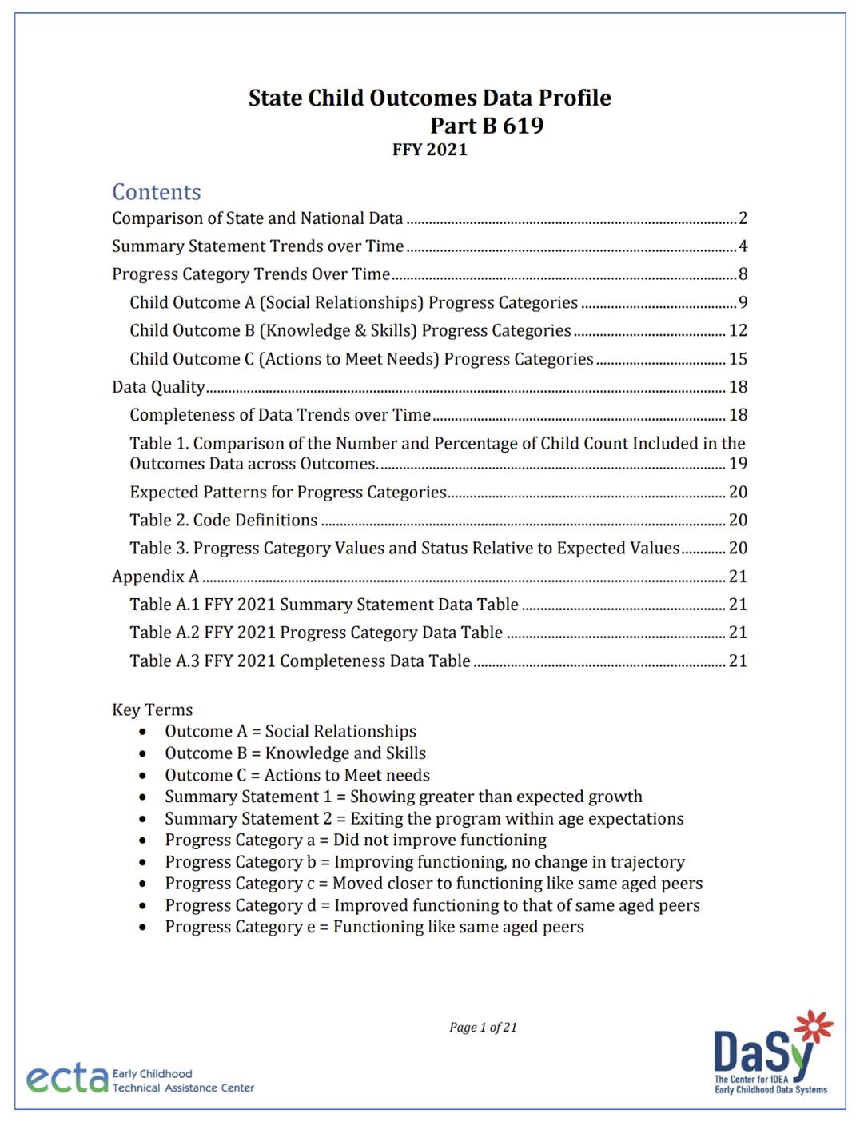
State Child Outcomes Data Quality Profiles
Notes:
To assist states in their ongoing review of child outcomes data, the DaSy Center creates unique child outcomes data reports for each state every year. This report is called the State Child Outcomes Data Quality Profile. This profile will help you review different aspects of data quality for your child outcomes. These reports are sent from the ECTA Liaisons to each Part C and Part B 619 Coordinator every year when they are completed. If you haven’t received a report, please reach out to your ECTA or DaSy contact.

Slide 24
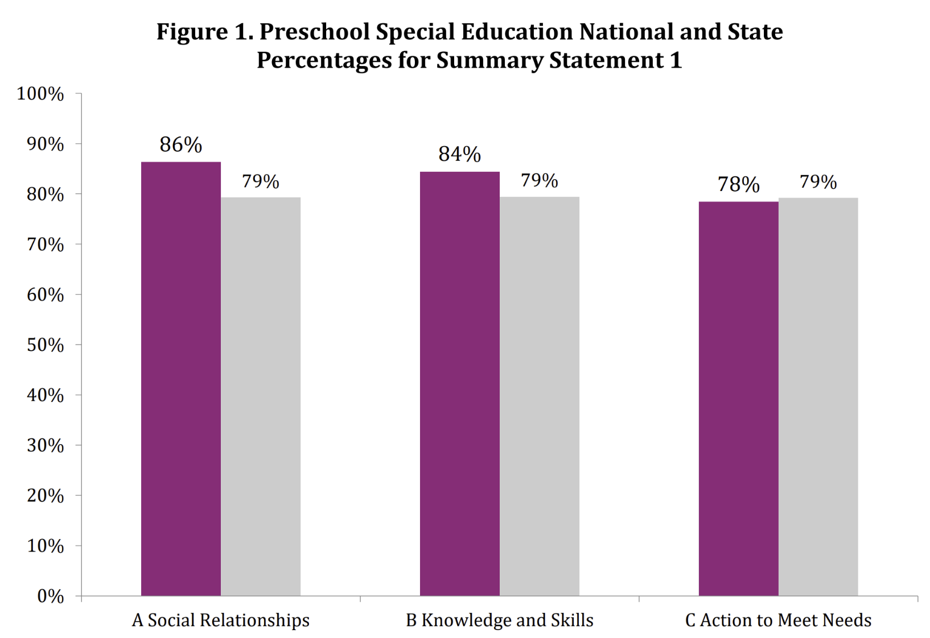
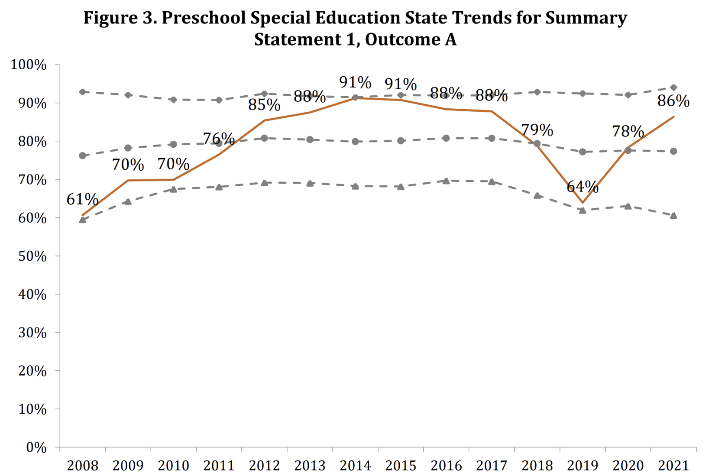
2022-23 State Data Quality Profiles
Notes:
Let’s take a peek inside the Child Outcomes Data Quality Profiles. Here you see a few examples of charts contained in a state's data quality profile. These reports contains valuable graphics and tables that can be used to identify trends in state performance and data quality issues that may require further exploration. The information can be easily shared with a variety of audiences. For example, charts can be pasted into state documents and presentation materials. Please contact your ECTA or DaSy liaison if you have questions or would just like to chat about your data!

Slide 25
Resources for Interpreting Child Outcomes Data
IDEA Child Outcomes Highlights for FFY 2022: A 2-page summary of the national results.
Child Outcomes Approach Maps: Data visualization displaying the child outcomes approach by state.
Take a Look at Your Child Outcomes Data Profile: Guidance on how to use your Child Outcomes Data Quality Profile.
Considerations of the Impact of COVID-19 on APR Indicator Data: Considerations related to data disruption that occurred as a result of the COVID-19 pandemic.
Year-to-Year Changes in State Child Outcomes Data: What Do They Mean?: A 4-page brief designed to help stakeholders learn what questions to ask to understand year-to-year changes in child outcomes data.
25
Notes:
Here are some further resources on the ECTA and DaSy Center websites to support your child outcomes measurement work, including:
a 2-page summary of the annual IDEA Child Outcomes Highlights,
a map of approaches to child outcomes measurement across the country,
guidance on how to use your child outcomes Data Quality Profile,
a document with practical strategies to examine the impact of COVID on your data quality and performance, and
a resource to help stakeholders ask questions to help understand year-to-year changes in child outcomes data.

Slide 26
Child Outcomes Professional Development Resources
Breadth of the Three Child Outcomes: An infographic defining six clusters of functional behaviors within each of the three child outcomes.
COS Practice Scenarios (COS-PS): A collection of scenarios of children, ages 6 months to 5 years, that allow you to practice aligning information about each child with the three child outcomes and anchoring the information by age.
Age Anchoring Guidance for Determining Child Outcomes Summary (COS) Ratings: guidance on how to accurately age anchor a child’s functional skills and explanations of how that guidance applies to COS teams.
Child Outcomes Summary (COS) Process Professional Development Resources: A collection of national resources to support training and TA on the COS process.
26
Notes:
And here are some additional professional development resources, including:
An infographic that depicts the breadth of the functional skills that are included in each of the three child outcomes,
Practice scenarios for the child outcomes summary process that provide an opportunity for staff using the COS to practice ratings and compare their ratings to the correct rating for the scenario.
Guidance for age anchoring to determine child outcomes summary ratings, and
A collection of even more professional development resources for the COS process.

Slide 27
Contact Us
Nicholas Ortiz: nicholas.ortiz@sri.com
Kellen Reid: kellen.reid@unc.com
Notes:
If you have any questions or feedback, please contact the DaSy and ECTA staff listed here.

Slide 28
Find out more at ectacenter.org and dasycenter.org
Notes:
For more information about the ECTA and DaSy Centers, please visit our websites at the addresses listed here.
This concludes our presentation. Thanks for your interest in child outcomes and have a great day.

