Slide 1
Part C Indicator 4 Family Outcomes Data FFY 2021
Prepared by:
Thomas McGhee, Jenna Nguyen, Tony Ruggiero,
Patrick Thornton, Naomi Younggren
Notes:
Hello and welcome to the Part C Indicator 4 Family Outcomes Data Webinar, presented by the Early Childhood Technical Assistance Center and the Center for IDEA Early Childhood Data Systems. This webinar highlights data from federal fiscal year 2021.

Slide 2
Family Outcomes Data
Background
State Approaches
Data Quality
Performance Data
Resources
Notes:
After a brief overview of the background to this indicator, the main topics we will cover are state approaches, data quality, performance data, and resources.
State approaches include:
What surveys were used;
The populations of families surveyed; and
Methodologies for survey dissemination and return
The data quality characteristics we’ll review include response rates and representativeness.
In terms of performance data, we’ll review national trends, and in closing we’ll share some key national resources.

Slide 3
FFY 2021 Part C APR Indicator 4
Percent of families who report that early intervention services have helped the family:
Know their rights
Effectively communicate their child's needs
Help their child develop and learn
Notes:
Throughout this webinar, we will share various data related to Indicator 4 of the Part C Annual Performance Report or APR.
This indicator has three parts, all addressing the measurement of how helpful the early intervention program has been for helping families:
A) Know their rights
B) Effectively communicate their child's needs, and
C) Help their child develop and learn
Although we will drill down into some variations across states, this is the unifying, common measurement regardless of the survey used or specific survey methodology.

Slide 4
Which Data Are Included?
Federal Fiscal Year (FFY) 2021
Data from February 2023 Annual Performance Report (APR) submission
School year/State fiscal year 2021-2022
56 states and jurisdictions reported Part C Indicator 4 Data
Quantitative data as reported to OSEP
Qualitative data coded by DaSy/ECTA
Note: not all states reported on all qualitative variables
Notes:
Before we jump into the data, we want to remind everyone what data are included and where the data came from.
These data are from Federal Fiscal Year or FFY 2021, which states submitted in their February 2023 APR submission.
Some states align to their school year or their state fiscal year, which would be the 2021-2022 year.
All 50 states are included, along with 6 territories and jurisdictions, for a total of 56. Beyond the states, the territories and jurisdictions included are American Samoa, the District of Columbia, Guam, the Northern Mariana Islands, Puerto Rico, and the Virgin Islands. We will use the term “states” throughout the webinar to include states, territories, and jurisdictions.
All 56 of 56 states submitted Part C Indicator 4 data.
As far as the data sources go, the numeric performance data are exported from the online system and provided to us by the Office of Special Education Programs, OSEP.
The Early Childhood Technical Assistance Center (ECTA) and the Center for IDEA Early Childhood Data System (DaSy) coded a number of additional variables by reading through each states’ APR and looking for the key variables that you will see here.
There is quite a bit of variation in the level of detail states include in their APRs. So, in some cases there are missing data, as these are not all required elements for inclusion in the APR submission.
Let’s move on.

Slide 5
State Measurement Approaches
Notes:
Now, let’s look at an overview of the various surveys used to measure the family outcomes.

Slide 6
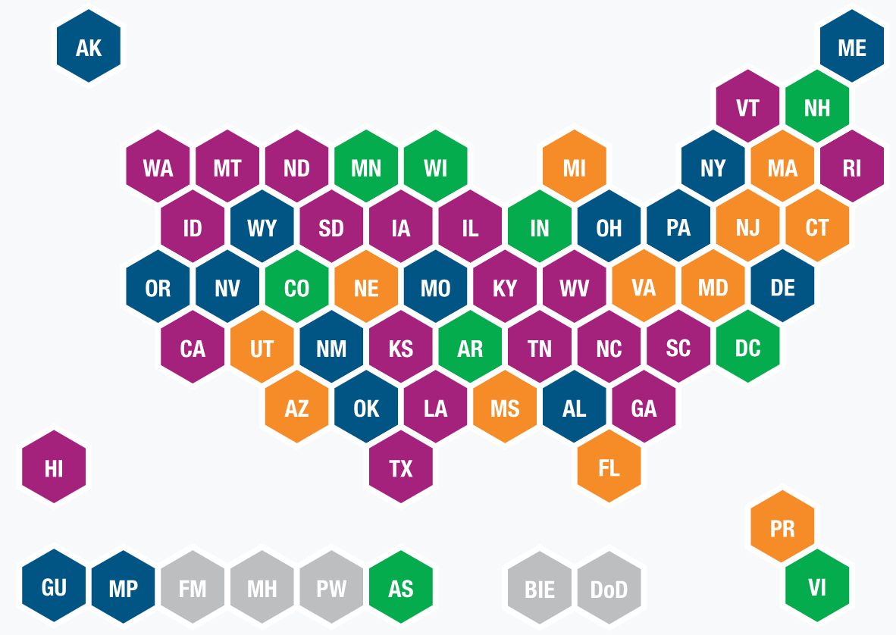
FFY 2020 Family Survey Used
 | ECO Family Outcomes Survey (Revised)
 | State Developed Survey
 | NCSEAM Survey
 | ECO Family Outcomes Survey (Original)
 | Not reporting C4 data
Notes:
All states should use a well-defined methodology for measuring families' outcomes for Indicator C4. Currently all states use a survey to measure the family outcomes.
This historic map shows the different family outcomes surveys states used in FFY 2020.
There are four different surveys types that states have been using. They are the original Early Childhood Outcomes or ECO Family Survey, the revised ECO Family Outcomes Survey, the National Center for Special Education Accountability Monitoring (NCSEAM), and State Developed Surveys.
State developed surveys are further defined by the items used in the survey to collect family outcome data for indicator C4. So, if a state used a survey they developed on their own, to get program information from families, but then added the questions from the Early Childhood Outcomes Center Original Family Outcomes Survey, or the ECO FOS-Original, or the NCSEAM survey for Indicator C4 reporting, they were coded on this map as using ECO-FOS Original, ECO-FOS Revised, or NCSEAM respectively.
Because states are not explicitly required to specifically name the survey, they are using in the APR it is becoming difficult to be certain which survey each state is using.

Slide 7
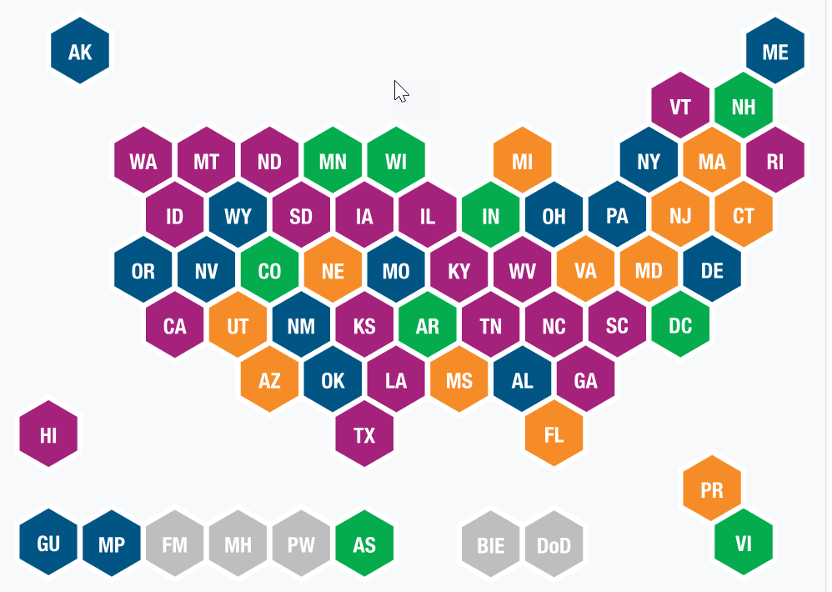
FFY 2021 State Approaches: Surveys Used
ECO FOS-Revised: 11 states (20%)
NCSEAM: 8 states (14%)
ECO FOS-Original: 3 states (5%)
Not reported or unclear: 30 states (54%)
Notes:
Now looking at FFY 2021 we can see the surveys states reported using for Indicator C4.
The most frequently reported survey being used was ECO FOS Revised survey, which 11 states reported using.
8 states reported using the NCSEAM survey.
3 states reported using the ECO FOS original survey.
And according to the FFY 2021 APR 30 states did not report, or it was unclear in the APR which survey was used.
Among these 30 states there are likely states using state developed surveys, but it is difficult to be certain
It is important to note that there are variations in the surveys. For example, some surveys include multiple questions for each of the three family outcomes; others have one question for each outcome; and some use a statistical methodology called Rasch scoring to assess performance on the three outcomes based on the family’s overall score.

Slide 8
FFY 2021 State Approaches: Family Populations Surveyed
Family subgroups
Six or more months of services: 19 states (34%)
All families in program: 15 states (27%)
Other: 7 states (13%)
Not reported: 15 states (27%)
Sampling plans: 9 states
Notes:
Next, we will take a deeper look at the various state approaches to family outcomes measurement by looking at the family populations that states are surveying.
Nationally we see that 19 states – about 34% -- included families who were in the program for a minimum of six months. This is usually based on the premise that families need to be in the program for some minimum amount of time to see benefits from the program.
Another group of 15 states – about 27% -- surveyed all families regardless of length of time in the program.
There were 7 states that have unique criteria, that is one that is different from these first two variations.
Another 15 states either did not report their approach or it was unclear to determine from their APR.
In addition, 9 states reported using an approved sampling plan that included using stratified random samples, samples from districts or regions, among others.

Slide 9
FFY 2021 State Approaches: Dissemination and Return
Dissemination Methods (N=56)
Multiple methods: 36 states
In-person: 4 states
Online: 4
Mail only: 2 states
Phone call: 1 state
Not reported: 9 states
Return Methods (N=56)
Multiple methods: 21 states
In-person: 1 state
Online: 3 states
Mail only: 1 state
Phone Call: 0 state
Not reported: 30 states
Notes:
Next, we will look at how states approach survey dissemination and return.
Dissemination methods refer to the ways states get the survey to the intended families.
For dissemination, 36 states reported using multiple methods, meaning they used more than one method to get surveys to families.
4 states reported using an in-person method to deliver the survey to families, which includes approaches such as a service coordinator or provider handing a paper survey to a family at a home visit or IFSP meeting.
4 states used online tools to collect survey data.
2 states used mail-only surveys and 1 state use phone calls.
Additionally, 9 states did not outline their dissemination methods in their APR.
Based upon the APRs some changes in dissemination methods were noted from last year to this year. For example, there was an increase of 2 states using multiple methods.
___
Moving over to the right side of this slide we’ll look at return methods. This refers to the ways in which families return a completed survey.
Here we see that 21 states reported using multiple methods for the families to return the survey.
Three states reported using an online only option.
A smaller portion of states reported using mail, in-person, or phone calls as their only return methods.
This year, 30 states did not report or it was unable to determine category.
While multiple dissemination and return methods allow greater flexibility for families to choose the method best suited for their unique needs, states are encouraged to carefully consider their population characteristics to determine the method or methods best for their state.

Slide 10
FFY 2021 State Approaches: Survey Timing
Annual survey/point in time: 15 states (27%)
At benchmarks in the program: 12 States (21%)
At exit from program: 9 states (16%)
At IFSP meeting: 3 states (5%)
Other: 7 states (13%)
Not reported: 22 states (39%)
Notes:
Next, we look at state approaches to survey timing.
Among the states that reported details about the timing of their survey collection, most states, that is 15 or 27%, reported administering the survey annually at a given point in time, which might include a survey window of several months.
12 states reported administering their survey according to benchmarks in the family’s participation in the program. This included 9 states collecting data at a child’s exit from the program, and 3 states collecting data at a formal IFSP meeting.
7 states reported using an “other” approach to survey timing.
And there were 22 states who did not report this information in their APR.
The inclusion of information about each states’ approach, including survey used, population surveyed, and dissemination and return methods, allows for greater national analysis and optimally better understanding about promising practices.

Slide 11
Data Quality
Notes:
Now, we move on to a brief look at data quality. Here we will see the national picture of family outcomes with respect to response rates and representativeness.

Slide 12
FFY 2021 Survey Response Rates
56 of 56 states reported a response rate
Response rates ranged from 3% to 100%
Mean response rate = 35%
Notes:
Shown here are the state survey response rates. Response rates are calculated by dividing the number of surveys returned by the number of surveys disseminated.
56 states reported a response rate.
The individual state response rates varied greatly from a low of 3% to a high of 100 %.
From last year to this year, the mean response rate went up by 2 percentage points from 33% to 35%.

Slide 13
FFY 2021 Representativeness of Family Data
State reported responses: “The demographics of infants or toddlers for whom families responded are representative of the demographics of infants and toddlers enrolled in the Part C program.”
Yes: 22 states (39%)
No: 34 states (61%)
Notes:
Next, we will look at representativeness. This refers to the degree to which you think your survey data adequately represent the families in your program.
All states report on whether they determined their survey results were or were not representative of the children in the program.
The data shown here are states’ self-reported response to the question in their APR. Quote: “The demographics of the families responding are representative of the demographics of infants, toddlers, and families enrolled in the Part C program”
This year, the number of states that answered “Yes” to this question decreased from 27 to 22, and the number of states that answered “No” increased from 28 to 34 from 2020 to 2021.
The reason for this change is still unclear.

Slide 14
FFY 2021 Assessing Representativeness
Variables for Assessing Representativeness | Yes, Representative | No, Not Representative
Race/Ethnicity | 19 states (34%) | 28 states (50%)
Geographic Region | 16 states (29% | 9 states (16%)
Child Gender | 12 states (21%) | 1 state (2%)
Other Variable (Child age, disability/eligibility categories, length of time in services, income, primary language) | 13 states (23%) | 9 states (16%)
Notes:
Also included in our analysis of the state APRs was an examination of the variables that states examined as part of their analysis of representativeness.
The top three variables that states looked and determined representativeness by were:
Race and ethnicity
19 states or (34%) indicated their data were representative by race/ethnicity and 28 states (50%) indicated their data were not representative by this variable
Geographic variables (such as by district, county, region, or urban/rural residency) –
16 states (29%) indicated their data were representative by geographic region while 9 states (16%) stated their data were not representative by this variable
Child gender
12 states (21%) indicated their data were representative by child gender and 1 state (2%) stated their data were not representative by this variable.
Other variables states examined, albeit less frequently, included: included: child’s age (including age at referral), disability or eligibility categories, length of time in services, income (such as household income based on Medicaid), and primary language.
13 states (23%) indicated their data were representative by some other variable and 9 states (16%) stated their data were not representative by one of these other variables.
It’s important to note that states often look at more than one variable, so these are not mutually exclusive. In other words, a single state could be reflected in more than one of the variable groups reported here.

Slide 15
Considerations for Assessing Representativeness
Are response rates disproportionate across family subgroups (e.g., race/ethnicity)?
Were minimum response rates met among each subgroup?
Are differences across subgroups and across years statistically significant?
Was each subgroup size sufficiently large enough to draw conclusions?
Notes:
It is common to see variation in survey data across subgroups and across years.
States vary as to how they assess representativeness and how they make conclusions about their data.
When assessing representativeness, it is important to consider a variety of factors that could affect data quality and interpretation.
Questions such these:
Are response rates disproportionate across family subgroups (e.g., race/ethnicity)?
Were minimum response rates met among each subgroup?
Are differences across subgroups and across years statistically significant?
Was each subgroup size sufficiently large enough to draw conclusions?
Are just a few examples to help states with their data analysis and accurate assessment of representativeness.

Slide 16
Performance Data
Notes:
Next, we will review the performance data. These data show how states performed on each of the three family outcomes.

Slide 17
Indicator C4 FFY 2021 Performance Data
Percent of families who report that early intervention services have helped them:
Know their rights: 89%
Effectively communicate child's needs: 90%
Help child develop and learn: 91%
Notes:
Nationally, in FFY 2021,
89% of families reported that early intervention services helped them know their rights.
90% reported that the program helped them effectively communicate their child’s needs.
And 91% reported that the program helped their child develop and learn.
Overall, we consider these data to be stable over time. Typically, these data are only fluctuating a percent point plus or minus within each category from year to year.

Slide 18
Indicator C4 National Family Survey Data Trends FFY 2021
Notes:
Now, let’s take a moment to review the national Indicator 4 results over multiple years.
Shown here are the national averages for the percentage of families who report that early intervention has helped their family achieve the three family outcomes. The outcome know their rights is shown in purple, communicate needs is in blue, and help their child learn is in green. The years are reported at the bottom and the percentage for each outcome is included at the top of each of the colored bars.
As you can see here these data have been mostly stable over time and have remained high since the inception of this indicator.
Among the three family outcomes, the highest percentage has consistently been in the area of helping their child develop and learn and that remains true for this year.
There is also general consistency across years within individual states, although the performance data may differ across family subgroups.

Slide 19
Resources
General Information About the Family Outcomes (ECTA)
Improving Practices and Family Outcomes (ECTA)
Family Engagement Resources
DEC Practice Improvement Tools
DEC Recommended Practices
DaSy Center Toolkits
Calculators and Graphing Templates (ECTA)
DaSy Center SPP/APR Checklist and Tips
Notes:
As we wrap up, we’d like to share a few of our most popular resources around family outcomes data.
Here are several online resources, with embedded links, you can find readily available on the ECTA and DaSy Center websites, including background information about family outcomes, strategies for family engagement, recommended practices, toolkits, calculators, and graphing templates.
We encourage you to take some time to review these resources on your own.

Slide 20
Contact us
Thomas McGhee thomas.mcghee@unc.edu
Jenna Nguyen jenna.nguyen@sri.com
Tony Ruggiero tony.ruggiero@aemcorp.com
Naomi Younggren naomi.younggren@gmail.com
Notes:
If you have any questions or feedback, please contact the DaSy and ECTA staff listed here.

Slide 21
ECTA and DaSy Contact Information
Find out more at
ectacenter.org and dasycenter.org

