Slide 1
Early Childhood Transition Basics:
Accurate Annual Reporting
Transition 101 Series – Session 3
Anne Lucas and Sally Shepherd
May 28, 2026

Slide 2
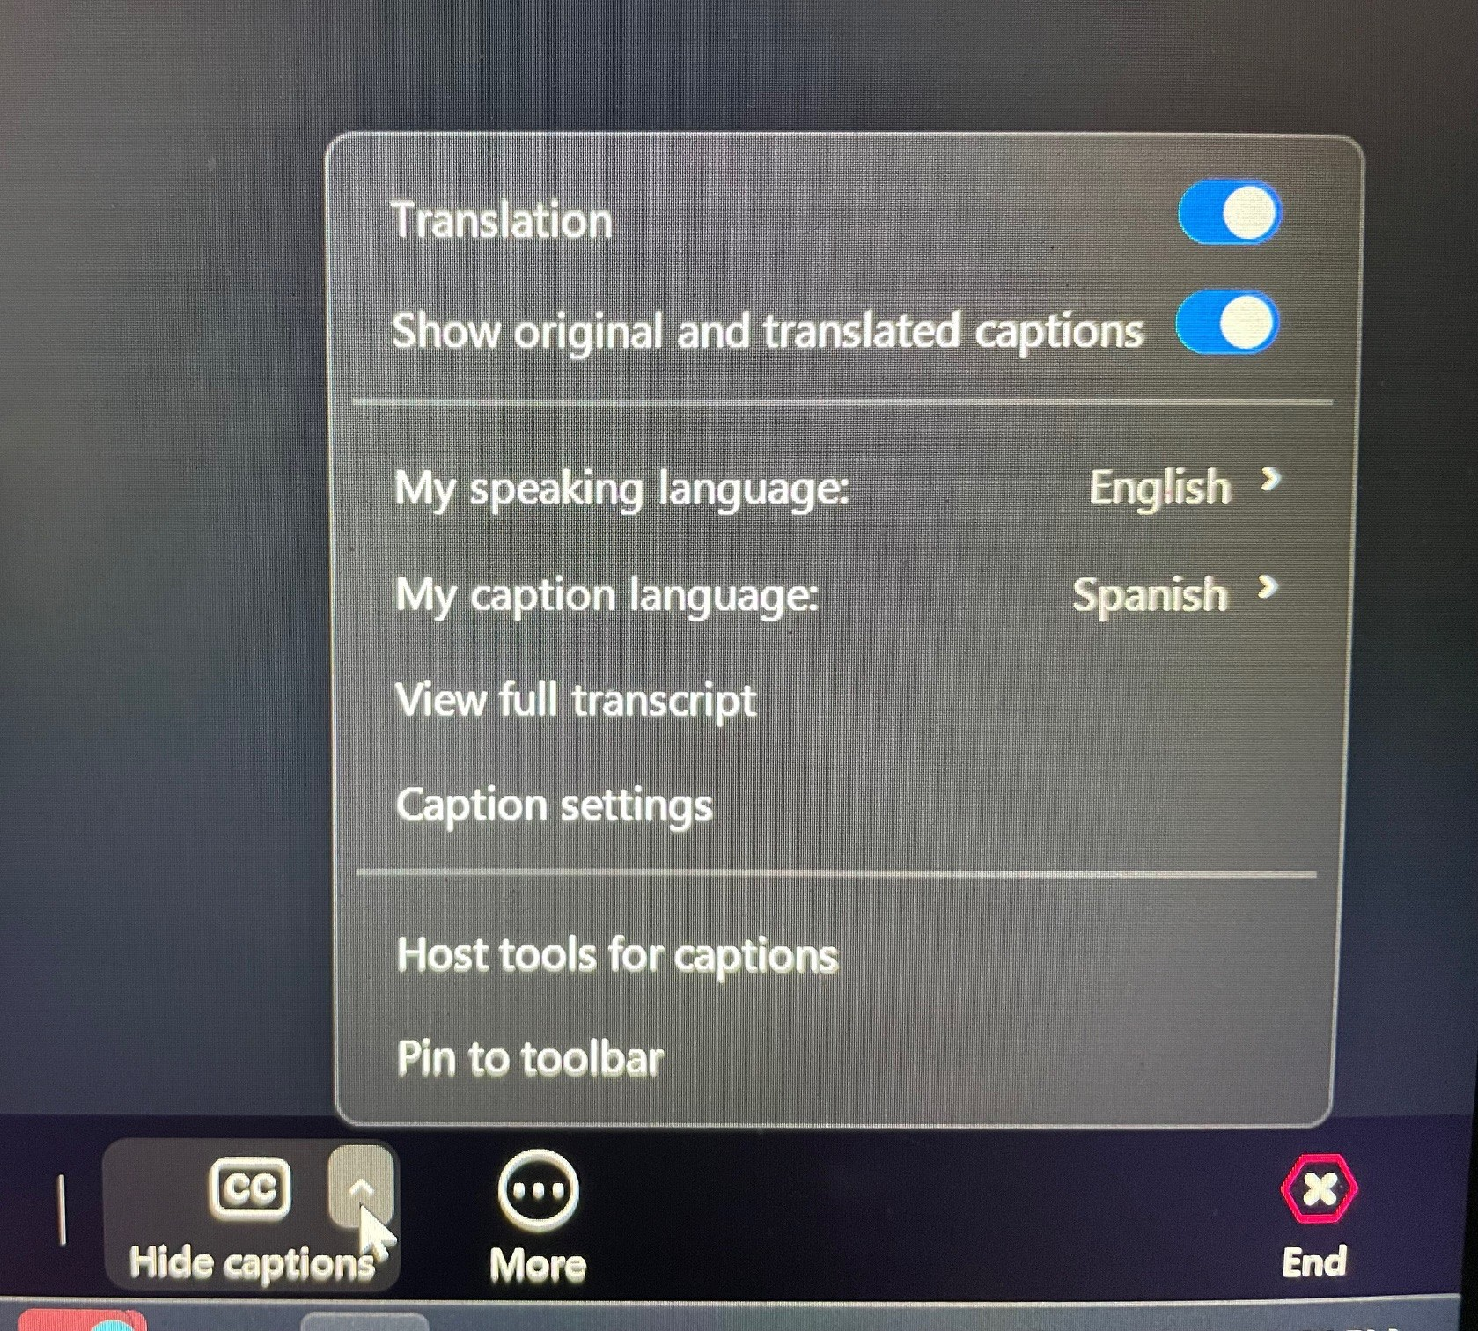
Captions for the webinar
On the menu bar, find the “Show Captions” option. You may need to click on the “More” or 3 dots to see this option.
Toggle on “Translation” and select the language you want to see. You can opt to show both English and the other language at the same time, or toggle off the “Show original and translated captions” option to show just the translation.
Captions will appear on your screen as the presenters are talking. Translated captions are auto-generated and may lag a few seconds at times.
Captions are available in many languages including Spanish. By default, captions are shown in English- there is no need to do anything unless you want a different language.
2
4
1

Slide 3
Engagement, Questions, and Follow-up
Today’s session will include interactive polls, chats, and state sharing.
Please submit questions using the Q&A feature.
Questions will be addressed in a posted FAQ.
Participants will be notified when the FAQ is available on our website.

Slide 4
Q&A Feature
The Q&A feature allows you an option to submit questions during the call.
To submit a question:
  Locate the "More" icon in the meeting toolbar
  Choose "Q&A" from the drop-down menu
  Type a question in the box, and hit "Send"

Slide 5

Welcome

Slide 6
Poll #1- Who’s Here Today?
What best describes your role?
How long have you worked in your current role supporting early childhood transition?

Slide 7

Agenda
SPP/APR Indicator C8 Overview and Calculations & Data​
SPP/APR Indicator B12 Overview and Calculations & Data​
Additional APR Compliance Requirements
Presentation from Alaska
Tips and Resources​

Slide 8
SPP/APR Indicator C8

Slide 9
Why Indicator C8
Ensure a seamless transition for children with disabilities who receive early intervention services under IDEA Part C to determine eligibility for and receipt of preschool services under IDEA Part B.
Ensure children continue to receive necessary supports and interventions during and after transition from Part C services.
Use transition data to assess if children are receiving timely transition plans, transition notifications, and transition conferences.

Slide 10
Indicator C8 Overview
Percent of all children exiting Part C who received timely transition planning to support the child's transition to preschool and other appropriate programs by their third birthday, including:
  IFSPs with transition steps and services;
  Notification to SEA and LEA, for child potentially eligible for Part B; and
  Transition conference, for child potentially eligible for Part B.
  (20 U.S.C. 1416(a)(3)(B) and 1442)

Slide 11
Indicator C8: Early Childhood Transition
The percentage of toddlers with disabilities exiting Part C with timely transition planning for whom the lead agency has…
  Developed an IFSP with transition steps and services at least 90 days, and at the discretion of all parties, not more than 9 months, prior to the toddler’s 3rd birthday.
  Provided notification (consistent with any opt-out policy adopted by the state) to the SEA and LEA where the toddler resides at least 90 days prior to the toddler’s 3rd birthday for toddlers potentially eligible for Part B preschool services.
  Conducted the transition conference held with the family’s approval at least 90 days, and at the discretion of all parties, not more than 9 months, prior to the toddler’s 3rd birthday.
Notes:
.

Slide 12

C8: Details
Compliance indicator (100% target)
Data Source:
  Database
    Full year or partial year
  Monitoring processes
Resource:
  Part C SPP/APR Measurement Table:
  https://sites.ed.gov/idea/grantees/#SPP-APR

Slide 13
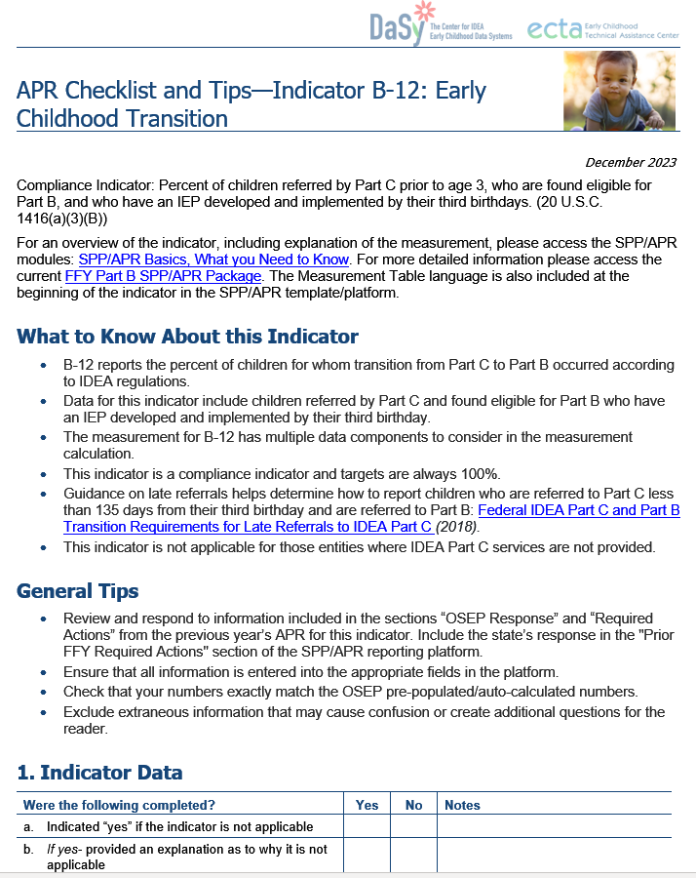
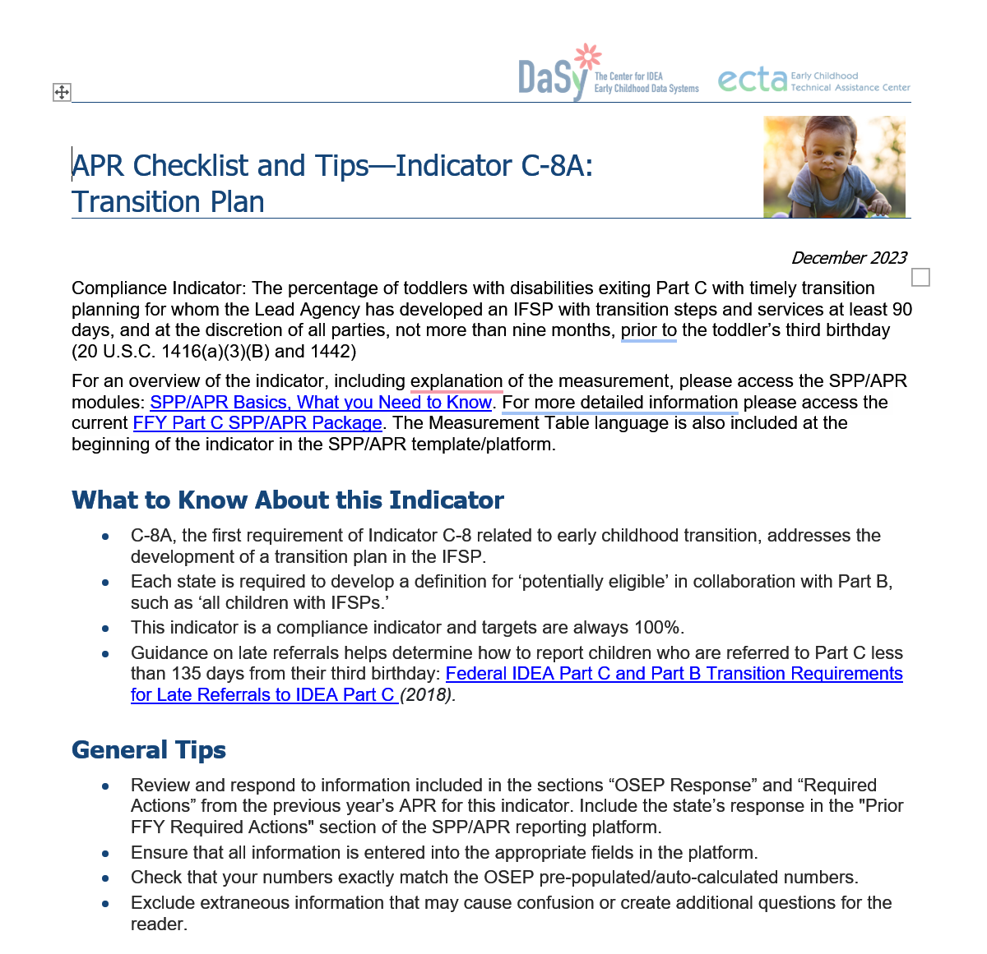
SPP/APR Checklists and Tips
Checklists:
  Developed to support states in annually preparing their SPP/APRs.
  Organized by indicator and the fields as they appear in the SPP/APR submission platform.
  Formatted to help states determine if all required fields have been completed.
Tips:
  Provided to ensure all relevant instructions are addressed for each indicator.
https://dasycenter.org/spp-apr-checklists-and-tips/
https://ectacenter.org/idea/sppaprmodule/

Slide 14
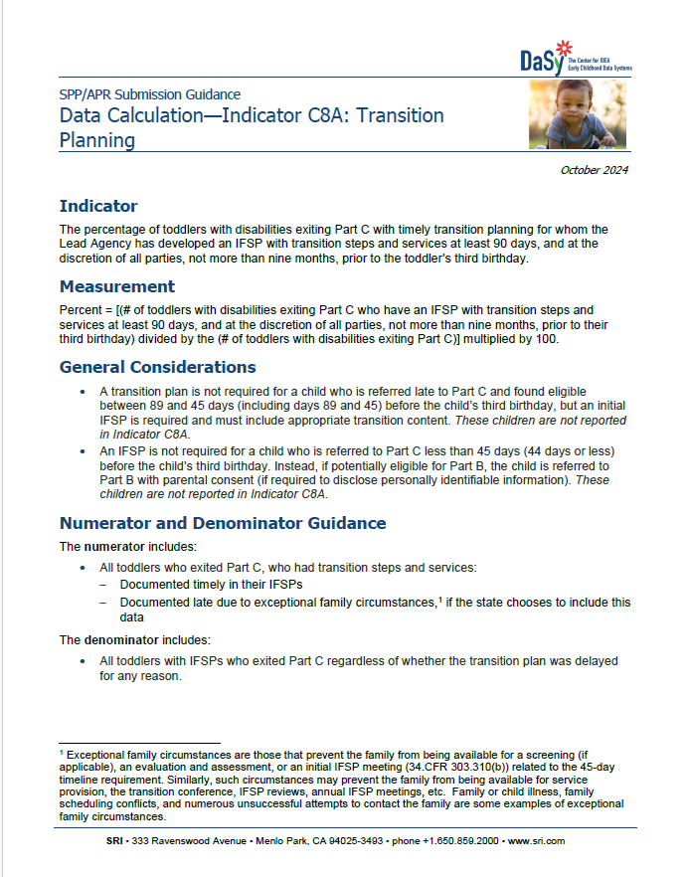
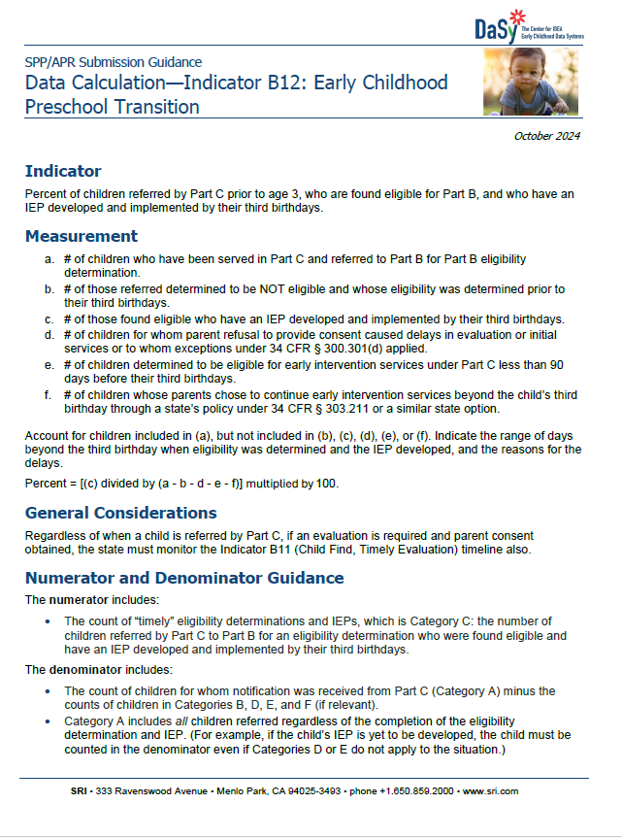
Data Calculations
Provide detailed information about the data needed for each indicator’s calculation based on the federal measurement tables and related documentation.
Provide information about the data for the numerator and denominator, data points for the calculation, data sources, and example calculations.

Slide 15
Calculations and Data

Slide 16
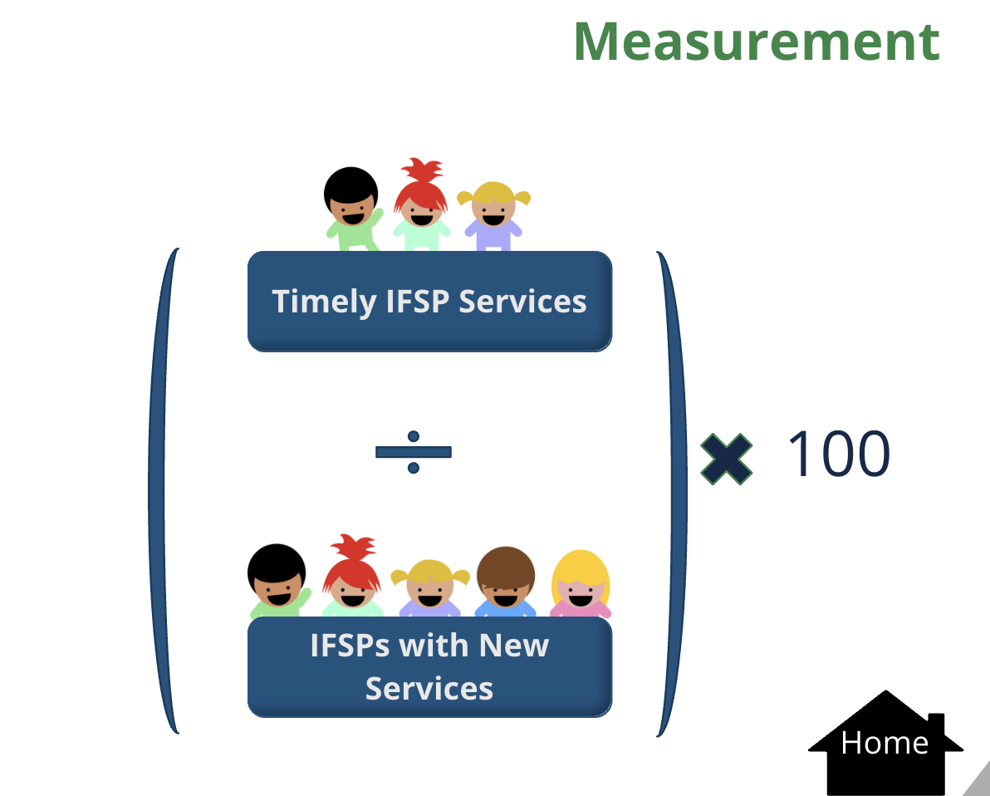


Calculating C8A/Transition Planning
# of toddlers with disabilities exiting Part C at age 3 who have an IFSP with transition steps and services at least 90 days prior to 3rd birthday (and not more than 9 months)
$$÷$$
$$× 100$$
# of toddlers with disabilities exiting Part C at age 3
U.S. DEPARTMENT OF EDUCATION Part C SPP/APR Measurement Table: https://sites.ed.gov/idea/grantees/#SPP-APR

Slide 17
C8A: Numerator and Denominator Guidance
The numerator includes all toddlers who exited Part C at age 3 who had transition steps and services:
  Documented timely in their IFSPs
  Documented late due to exceptional family circumstances, if the state chooses to include this data
The denominator includes toddlers with IFSPs who exited Part C at age 3 regardless of whether the transition plan was delayed due to:
  Program reasons
  Exceptional family circumstances, if state choses to include this data.

Slide 18
C8A: Who is Not Reported
Children found eligible less than 90 days prior to the child’s third birthday.
  A transition plan is not required for these children, but an initial IFSP is required and must include appropriate transition content.
Children referred less than 45 days prior to the child’s third birthday and are referred to Part B with parental consent if they may be eligible for Part B.
  Evaluation and assessment and initial IFSP for Part C is not required for these children.

Slide 19
Data Points Needed for Calculation
Child’s DOB
Whether the IFSP includes transition steps and services that meet the requirements of 34 CFR 303.344(h)(2)
Date transition steps were documented in IFSP
Reason for delay
Date of exit from Part C
NOTE: To determine if a child is considered a “Late Referral to Part C” (when child is found eligible for Part C 89 days or less prior to the child’s third birthday), the Part C eligibility date is needed.

Slide 20
Scavenger Hunt #1
Open the Checklist and Tips Document for Indicator 8A:Transition Planning
In the chat, put the page number where you can find tips on reporting Exceptional Family Circumstances and Reasons for Delay.

Slide 21
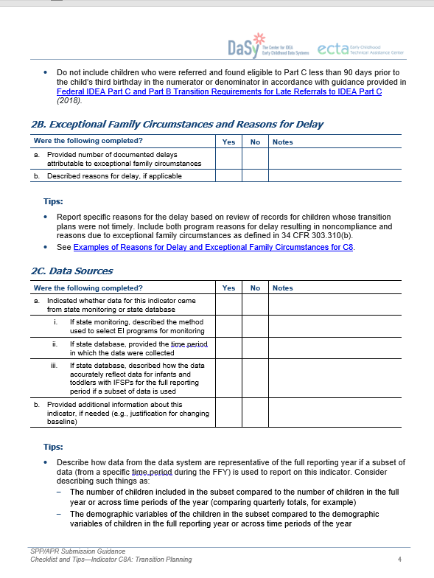
Checklist and Tips: Indicator C8A
Exceptional Family Circumstances and Reasons for Delay is on Page 4 2B

Slide 22


Calculating C8B/Notification
# of toddlers with disabilities exiting Part C where notification (consistent with any opt-out policy adopted by state) to the SEA and LEA occurred at least 90 days prior to 3rd birthday for toddlers potentially eligible for Part B preschool services
$$÷$$
$$× 100$$
# of toddlers with disabilities exiting Part C who were potentially eligible for Part B
U.S. DEPARTMENT OF EDUCATION Part C SPP/APR Measurement Table: https://sites.ed.gov/idea/grantees/#SPP-APR

Slide 23
C8B: Numerator and Denominator Guidance
The numerator includes:
Toddlers who exited Part C who were potentially eligible for Part B and for whom a notification was sent to the SEA and LEA at least 90 days prior to their third birthday
The denominator includes:
Toddlers who exited Part C who were potentially eligible for Part B, and whose parents did not opt-out of notification (if state has an opt-out policy)

Slide 24
C8B: Who is Not Reported
Children who are not considered potentially eligible for Part B.
Children found eligible for Part C less than 90 days before the child’s third birthday,
  Transition notification to the SEA and LEA of residence for these children is required as soon as possible (unless the State has an opt-out policy, and the parent chooses to opt-out).
Children referred to Part C less than 45 days from the child’s third birthday and the child is referred directly to Part B if he/she may be eligible for Part B.
  The notification to the SEA and LEA of residence is NOT required for these children.

Slide 25
C8B: Data Points Needed for Calculation
Child’s DOB
Whether child is potentially eligible for Part B
Date of SEA notification
Date of LEA notification
Documentation of parents’ decision to opt-out of SEA and LEA notification (If applicable)
Date of exit from Part C
NOTE: To determine if a child is considered a “Late Referral to Part C” (child is found eligible for Part C 89 days or less prior to the child’s third birthday unless the parent opted out of notification), the Part C eligibility date is needed.

Slide 26
C8B: General Considerations
Exceptional family circumstances do not apply to Indicator 8B.
The transition notification must be sent to the SEA and LEA unless state has an opt-out policy on file with OSEP, and parent chooses to opt out. Parental consent does not apply.
State’s definition of “potentially eligible” impacts calculation. Example, if all children with IFSPs are potentially eligible, then the denominator is the same as the denominator for Indicator C8A, if the same data source is used and if the state does not have an opt-out policy.
The notification must be sent to both the SEA and the LEA at least 90 days prior to the child’s third birthday for timely notification.

Slide 27

C8B: Chat Discussion
To ensure timely notification, how does your state track timelines for when the notification should be sent to Part B?

Slide 28



Calculating C8C/Transition Conference
# of toddlers exiting Part C where the transition conference occurred at least 90 days – and at the discretion of all parties, not more than 9 months – prior to toddler’s 3rd birthday for those potentially eligible for Part B
$$÷$$
$$× 100$$
# of toddlers between 2 years 3 months and 2 years 9 months exiting Part C who were potentially eligible for Part B
U.S. DEPARTMENT OF EDUCATION Part C SPP/APR Measurement Table: https://sites.ed.gov/idea/grantees/#SPP-APR

Slide 29
C8C: Numerator and Denominator Guidance
The numerator includes:
All toddlers who exited Part C who were potentially eligible for Part B where the transition conference:
  occurred at least 90 days but not more than 9 months before toddler’s third birthday, or
  was delayed due to exceptional family circumstances, if state chooses to include this data
The denominator includes:
Toddlers between 2 years 3 months and 2 years 9 months of age who exited Part C and were potentially eligible for Part B
  Including those who had a late transition conference due to exceptional family circumstances, if state chooses to include this data

Slide 30

C8C: Data Points Needed for Calculation
Child’s DOB
Whether child is potentially eligible for Part B
Date of transition conference
Reason for delay, if applicable
Date of exit from Part C
NOTE: To determine if a child is considered a “Late Referral to Part C” (when child is found eligible for Part C 89 days or less prior to the child’s third birthday), the Part C eligibility date is needed.

Slide 31
C8C: Who is Not Reported
Children who are not considered potentially eligible for Part B
Children who were found eligible less than 90 days before the child’s third birthday
  No transition conference is required for these children
Children referred to Part C less than 45 days before the child’s third birthday and if they may be eligible for Part B are referred directly to Part B

Slide 32

Scavenger Hunt #2
Open the Data Calculations Document for Indicator 8C
Find the Example Calculation
In the chat, put number of toddlers whose conferences were delayed due to exceptional family circumstances

Slide 33
C8C: Example Calculation
A state data system included 1,525 children exiting Part C who were potentially eligible for Part B
Families of 1,410 toddlers experienced a timely transition conference
Transition conferences for 22 toddlers whose conferences were delayed due to exceptional family circumstances
(1,410 + 22) / 1,525 = 0.939 x 100 = 93.9% of toddlers who exited Part C had timely transition conferences
https://dasycenter.org/wp-content/uploads/2024/10/DaSy_APRCalculations_Indicator_C8C_Acc.pdf

Slide 34
SPP/APR Indicator B12

Slide 35
Why Indicator B12
The transition processes and timeliness allow children to have continuity of services and minimal interruption of services.
Timely notifications are critical as they serve as the Part B referral, initiating Part B regulatory requirements and allowing for sufficient time to complete the process.

Slide 36
Indicator B12 Overview
Percent of children referred by Part C prior to age 3, who are found eligible for Part B, and who have an IEP developed and implemented by their third birthdays.
(20 U.S.C. 1416(a)(3)(B))
U.S. DEPARTMENT OF EDUCATION Part B SPP/APR Measurement Table: https://sites.ed.gov/idea/grantees/#SPP-APR

Slide 37
B12: Measurement
# of children who have been served in Part C and referred to Part B for Part B eligibility determination
# of those referred determined to be NOT eligible and whose eligibility was determined prior to their third birthdays
# of those found eligible who have an IEP developed and implemented by their third birthdays

Slide 38
B12: Measurement cont'd
# of children for whom parent refusal to provide consent caused delays in evaluation or initial services or to whom exceptions under 34 C.F.R. § 300.301(d) applied
# of children determined to be eligible for early intervention services under Part C less than 90 days before their third birthdays
# of children whose parents chose to continue early intervention services beyond the child’s third birthday through a State’s policy under 34 C.F.R. § 303.211 or a similar State option, if relevant

Slide 39
B12: Details
Compliance indicator (100% Target)
Data sources
  State Monitoring
    Describe method used to select LEAs for monitoring
  State Database
    Include data for entire reporting year
Resource:
  Part B SPP/APR Measurement Table: https://sites.ed.gov/idea/grantees/#SPP-APR

Slide 40

B12 : Timely Transition
Data elements needed:
  Date of third birthday
  Date of referral (notification) from Part C
  Eligibility for Part B
  IEP date
  Date of referral to Part C
  If delayed, reason for delay
NOTE: To determine if a child is considered a “Late Referral to Part C” (when child is found eligible for Part C 89 days or less prior to the child’s third birthday), the Part C eligibility date is needed.

Slide 41
B12: Calculation
c. # of those found eligible who have an IEP developed and implemented by their third birthdays
a – b – d – e - f
States must account for children included in the total who do not fall into one of the other categories.
States must report the range of days beyond the third birthday when eligibility was determined and the IEP developed, and the reasons for the delays.

Slide 42
Additional APR
Compliance Requirements for C8 & B12

Slide 43
Narrative to Include in SPP/APR Reporting
Description of reasons for delay
  C8: Report specific reasons for program delay based on review of records. Include both program reasons for delay resulting in noncompliance. Reasons for delay due to exceptional family circumstances are NOT required to be reported.
  B12: Report specific reasons for the delays based on review of records for children whose eligibility evaluation and IEP development were delayed due to the LEA.
Description of slippage
Number of findings issued in the prior year
Number of findings corrected or subsequently corrected
Description of how previously identified noncompliance was verified as corrected at the individual and system levels
Description of actions taken to ensure subsequent correction when timely correction has not occurred

Slide 44
Narrative Tips
Respond only to the narrative question/prompt – do not provide more information than what is being asked to avoid confusion
Describe reasons for program delays if data is less than 100%
Describe reasons for slippage to reflect what occurred in current year that caused slippage
Describe how the state verified correction of noncompliance - specifically what the state “did” (past tense) to verify correction of the specific findings that were issued
  Should not be a description of general process to verify correction
  Use terminology from OSEP QA 23-01
Check data/math in narrative to ensure it matches data in APR tables

Slide 45
Alaska

Slide 46
Resources

Slide 47
General Supervision & Data Reporting
General Supervision
  2023 Early Childhood Transition Questions and Answers (OSEP QA 24-01)
  Guidance on State General Supervision Responsibilities under Parts B and C of the IDEA (OSEP QA 23-01)
SPP/APR Data Reporting
  Part C State Performance Plan (SPP) and Annual Performance Report (APR) Indicator Measurement Table (FFY 2023)
  SPP/APR Modules on Indicator C8 and B12
  SPP/APR Checklists/Tips and Data Calculations

Slide 48
Other Related Resources
Part C to Part B Early Childhood Transition Timeline for SPP/APR Indicator C-8, B-11, and B-12 for Part C Children Determined Eligible at Least 90 Days Prior to Their 3rd Birthday
Federal IDEA Part C & Part B Transition Requirements for Late Referrals to IDEA Part C
*NEW* DaSyTalks Podcasts – Real talk for States by States

Slide 49
Next Steps and Follow-up​
Complete Session 3 Evaluation​
Link forthcoming after today's call​
Plan to Attend Session 4: Final Reflection and Listening Session
Thursday, July 30, 2026, 3:00–4:30 PM EDT​
Will culminate the series focusing on related topics such as state definition of potentially eligible, opt-out policies, and state specific practices
​REMINDER: Questions submitted through the Q&A feature will be addressed in a follow-up FAQ, which will be posted on our website. All participants will be notified when it is available.​

Slide 50
Find out more at ectacenter.org and dasycenter.org

