Slide 1
Transition 101: Session 2
Agency Collaboration: Creating and Implementing an Effective Transition Agreement/MOU
April 2, 2026
Michelle Lewis, Sheresa Blanchard, Howard Morrison

Slide 2
Poll #1- Who’s Here Today?
What best describes your role?
How long have you worked in your current role supporting early childhood transition?

Slide 3
Agency Collaboration: Creating and Implementing an Effective Transition Agreement/MOU Session 2 Objectives
Highlight the importance of agency collaboration in supporting effective early childhood transitions.
Examine content of effective transition agreements (or MOUs).
Explore strategies to effectively implement, monitor, and maintain transition agreements.
Share relevant technical assistance (TA) resources.
Identify next steps and follow-up activities.

Slide 4
Engagement, Questions, and Follow-up
Today’s session will include interactive polls, chats, and state sharing.
Please submit questions using the Q&A feature.
Questions will be addressed in a posted FAQ.
Participants will be notified when the FAQ is available on our website.

Slide 5
Q&A Feature
The Q&A feature allows you an option to submit questions during the call.
To submit a question:
Locate the "More" icon in the meeting toolbar
Choose "Q&A" from the drop-down menu
Type a question in the box, and hit "Send"

Slide 6
The Importance of Agency Collaboration

Slide 7

Transition is the BRIDGE Between Part C Early Intervention and Part B Preschool Special Education

Slide 8
IDEA Interagency/Intra-Agency Agreement Requirements 34 C.F.R. § 303.209(a)(3)(i)
Each State must include in its application:
(A) If the lead agency (LA) is not the SEA, an interagency agreement between the lead agency and the SEA; or
(B) If the lead agency is the SEA, an intra-agency agreement between the program within that agency that administers Part C of the Act and the program within the agency that administers Section 619 of the Act.

Slide 9
IDEA Interagency/Intra-Agency Agreement Requirements 34 C.F.R. § 303.209(a)(3)(ii)
To ensure a seamless transition between services under Part B and Part C-
The LA must have an interagency or intra-agency agreement that addresses how the LA and the SEA will meet the requirements related to the transition to preschool and other programs including- (b)Notification to the SEA and appropriate LEA; (c)Conference to discuss services; (d)Transition plan; (e)Transition conference and meeting to develop transition plan; (f) Applicability of transition requirements.
This also includes any policies adopted by the lead agency pertaining to: the disclosure of information to the SEA and LEA; the option to inform a parent about intended disclosure, ensuring FAPE for children beginning at age 3; the transition of children from the Part C program to preschool programs; initial IEP Team meeting for child under Part C, and IEP or IFSP for children aged three through five.
34 CFR 303.209(a)(3)(ii)

Slide 10
Poll Question #2
How familiar are you with your state’s Part C/ Part B transition agreement?
I’ve got this agreement memorized like the lyrics to my favorite song.
I know enough to nod wisely in meetings… most of the time.
Sounds important… but does it come with snacks?
I’ve heard of it but haven’t read it, so explain it like I am five.

Slide 11

Division for Early Childhood (DEC) Recommended Practices TEAMING AND COLLABORATION
Educational programs and services for young children with disabilities always involve a team of adults.
The family is an essential member of the team.
The quality of the relationships and interactions among these teams affects program success.
Teaming and collaboration practices promote and sustain collaborative partnerships ensuring that programs and services achieve desired child and family outcomes/goals.
https://ectacenter.org/decrp/decrp.asp

Slide 12
TEAMING AND COLLABORATION
TC1. …Work together as a team to plan and implement supports and services to meet the unique needs of each child and family.
TC2. …Work together as a team to systematically and regularly exchange expertise, knowledge, and information to build team capacity and jointly solve problems, plan, and implement interventions.
TC3. …Use communication and group facilitation strategies to enhance team functioning and interpersonal relationships with and among team members.
TC4. Team members assist each other to discover and access community-based services and other informal and formal resources to meet family-identified child or family needs.

Slide 13
Five W’s for Creating an Effective Agreement/MOU
WHO: Identify leadership across agencies, ensuring representation from various perspectives, areas of expertise, and responsibilities, and those with decision-making authority to oversee development, implementation, and update.
WHAT: The written document addresses pertinent factors across EI and ECSE system components; Reflects what has been negotiated and agreed upon across agencies; Written so that it is clearly understood using language that is simple and straightforward. (There is no standard format).

Slide 14
Five W’s for Creating an Effective Agreement continued
WHERE: It is important to know where the MOU is located and who has access.
WHEN: Once an effective agreement/MOU has been created and signed, the next steps are to implement and sustain the agreement. OSEP encourages states to conduct an annual review.

Slide 15

The Fifth W: Why
WHY:
Increases access to services.
Improves collaboration and defines responsibility across agencies.
Maximizes resources and reduces duplication of effort.
Increases cross-sector professional development opportunities.
Strengthens services to young children with disabilities and their families.
Improves child and family outcomes.

Slide 16
Content of Transition Agreements

Slide 17
General Overview Content of Transition Agreements
Include all transition requirements of Part C and Part B to ensure a smooth and effective transition.
Includes state policies, procedures and practices, operationalizing the day-to-day processes.
Collaborative practices and steps to be taken when practices are inconsistent with agreed upon procedures.

Slide 18

Effective Transition Agreements
Define roles and responsibilities
Provide information on policy, procedures, and practices to support nonduplication, seamless service delivery
Identify methods and timelines for communication
Describe plan for professional development
Identify how data are to be shared

Slide 19
Professional Development Plan
Developed and presented jointly by Part C and Part B.
Include varying methods.
Address how the plan will be implemented and evaluated.
Embed communication and information sharing with families in professional development activities so families can effectively partner with Part C and Part B throughout the transition process.

Slide 20
Data Sharing Mechanisms
Transition agreements need to specify:
What data will be shared, when, by whom, and how.
How those data will be protected.
Standard mechanisms can be a:
Data sharing agreement (DSA) that is separate or
Incorporated into a Transition Agreement

Slide 21
Purpose and When to Use DSAs
Purpose
Define why, how, and for how long data (often confidential or regulated) will be shared between parties.
Ensure compliance with FERPA and IDEA, and state-level privacy regulations.
When to Use
Personally Identifiable Information (PII) is being shared.
Federal or state law requires explicit data protection measures.
To formalize data flows between agencies or programs.
When data sharing must occur across agency boundaries.

Slide 22
Key Elements of DSAs
Description of the data being shared
Purpose of the data sharing
Legal authority for sharing the data
Roles and responsibilities of each party
FERPA/IDEA compliance requirements
Security, confidentiality, data access, and data retention/destruction protocols
Liability and breach notification procedures
Procedures for refreshing/updating data

Slide 23
Strategies to Effectively Implement, Monitor and Maintain Transition Agreements

Slide 24
Poll Question #3
Does your state have regular cross-agency meetings between Part B and Part C staff?
These meetings pop up like my screen time notifications—constantly.
It happens… but feels a little like rolling dice.
I’ve heard legends… whispers… but have I seen one.
A total meeting desert. Nothing but sand and unanswered emails.
This feels like something I should know, but here we are.

Slide 25
Strategies to Implement, Monitor, and Sustain Transition Agreements
Maintain intentional and purposeful collaboration.
Establish a regular meeting schedule (e.g., quarterly, semi-annually, annually) to discuss the progress of implementation and potential areas of change.
Address and resolve potential conflicts respectfully and professionally.
Provide training and orientation on the collaboration for all new staff at each agency involved.
Provide a centralized file location or repository for documents and meeting notes to be accessible by all involved.
Determine timelines for revisions, updates, and overall schedules of reoccurring activities.

Slide 26
Final Considerations or Key Takeaways
Transition Agreements help ensure smooth and effective transition for children and families from Part C to Part B.
Operationalizing the process is critical for shared understanding of roles and responsibilities.
Part C and Part B need to know when and how data is to be shared.
Monitoring and evaluation are important steps to ensure effective implementation.
Ensure families understand the process so they can partner effectively with both Part C and Part B.

Slide 27
Technical Assistance (TA) Resources

Slide 28
Resources Referenced in this Presentation
Guidance on Creating an Effective Memorandum of Understanding
OSEP Transition Checklist
2023 Early Childhood Transition Questions and Answers (OSEP QA 24-01)
Session 1 Early Childhood Transition Basics: Roles and Responsibilities Recording and Materials

Slide 29
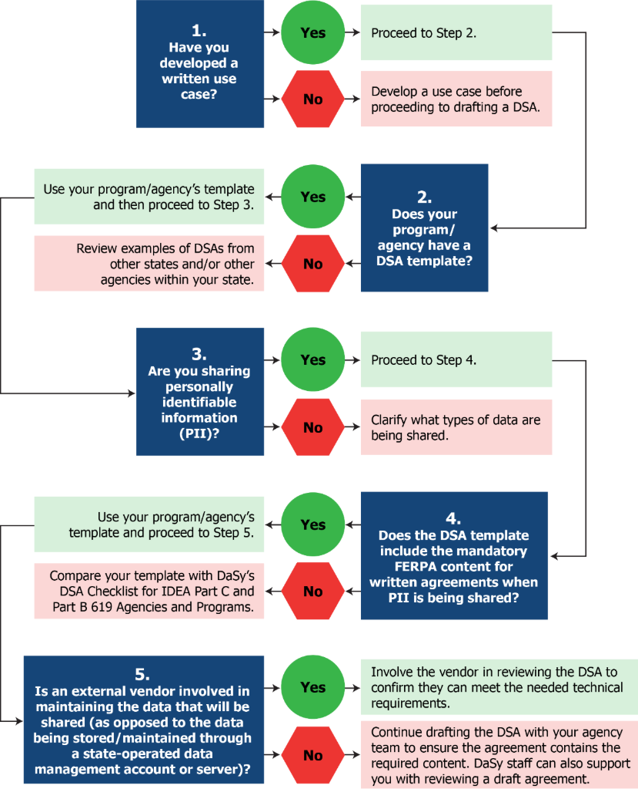
Developing Data Sharing Agreements: A Guide for IDEA Part C and ECSE Who Want to Share, Link, or Integrate Data with Other Programs
Coming soon from the DaSy Center!
Identifies considerations for entering into a DSA.
Outlines recommended actions for creating and implementing a DSA.
Highlights key differences between a DSA and a MOU.
Provides state examples of a DSA and MOU.

Slide 30

Transition Information and Resources
ECTA Early Childhood Transition Topic Page:
Early Childhood Transition
Federal Requirements
OSEP Guidance and Resources
National Center Resources
Transition Monitoring
State Examples and Resources
Eligibility Differences between Part C and Part B, Section 619
Transition from Preschool Services to Kindergarten

Slide 31
Next Steps and Follow-up

Slide 32
Next Steps
Complete Session 2 Evaluation
Link forthcoming after today's call.
Plan to Attend Session 3: Accurate Annual Reporting for Indicators C8 and B12
Thursday, May 28, 2026, 3:00–4:30 PM EDT
Will focus on annual reporting requirements and key resources to aid in state planning, facilitation, and reporting related to the early childhood transition.
REMINDER: Questions submitted through the Q&A feature will be addressed in a follow-up FAQ, which will be posted on ECTA website. All participants will be notified when it is available.

Slide 33
Technical Assistance Contact Info:
ECTA
DaSy
Sharon Lunn, ECTA Transition Topic Lead
sharon.lunn@unc.edu
ECTA State Contact
https://ectacenter.org/contact/state-assignments.asp
Michelle Lewis, DaSy Transition Topic Lead
mlewis@picnh.org
DaSy State Liaison
https://dasycenter.org/technical-assistance/state-technical-assistance-liaisons/

Slide 34
Find out more at ectacenter.org and dasycenter.org

