Slide 1
Transition 101: Session 1
“Early Childhood Transition Basics: Roles and Responsibilities”
February 5, 2026
Sharon Lunn, Nancy Surbrook-Goins, Ruth Gallucci, Sheresa Blanchard

Slide 2
Transition 101 Series Outcomes
Series designed to:
Strengthen understanding of Part C and Part B transition roles, requirements, and responsibilities.
Promote effective collaboration across systems through the use of interagency and intra-agency agreements/MOUs.
Support accurate and consistent reporting for SPP/APR indicators C8 and B12.
Increase awareness and use of tools and resources that support smooth and effective early childhood transitions.

Slide 3
Transition 101 Series Overview (February-July 2026)
Session 1: Early Childhood Transition Basics: Roles and Responsibilities
Session 2: Agency Collaboration: Creating and Implementing an Effective Transition Agreement/MOU
Session 3: Accurate Annual Reporting for SPP/APR Indicators C8 and B12
Session 4: Final Reflection and Listening Session

Slide 4
Participant Snapshot
State Part C Coordinator
Part C Other State Staff
State ECSE Coordinators
Part B Other State Staff
National/ Regional TA Provider/Staff
Local TA Provider/Staff
Other
44 States/Territories Represented

Slide 5

Poll #1- Who’s Here Today?
What best describes your role?
How long have you worked in your current role supporting early childhood transition?

Slide 6
Poll #2- Parent or Family Member?
Do you also have lived experience as a parent or family member of a child who has received early intervention or early childhood special education services?

Slide 7
"Early Childhood Transition Basics: Roles and Responsibilities" Session 1 Objectives
Overview foundations of early childhood transition under IDEA
Clarify IDEA Part C and Part B roles, requirements, and responsibilities
Highlight common implementation challenges and improvement strategies
Reflect on state context
Share relevant technical assistance (TA) resources
Identify next steps and follow-up activities

Slide 8

Engagement, Questions, and Follow-up
Today’s session will include interactive polls, chats, individual, and cross-state reflection opportunities.
Please submit questions using the Q&A feature.
Questions will be addressed in a posted FAQ.
Participants will be notified when the FAQ is available on our website.

Slide 9
Q&A Feature
The Q&A feature allows you an option to submit questions during the call.
To submit a question:
Locate the "More" icon in the meeting toolbar
Choose "Q&A" from the drop-down menu
Type a question in the box, and hit "Send"

Slide 10

Chat Reflection #1
What do the families in your communities consider most important when transitioning to new learning environments?

Slide 11
Foundations of Early Childhood Transition

Slide 12
IDEA- Part C
§ 303.209 Transition to preschool and other programs.
Part C of IDEA requires each State to have in place policies and procedures it will use to ensure a smooth transition for infants and toddlers with disabilities under the age of three and their families from receiving early intervention services under Part C to—
(i) Preschool or other appropriate services (for toddlers with disabilities); or
(ii) Exiting the program for infants and toddlers with disabilities.
[34 CFR 303.209(a)]

Slide 13
IDEA- Part B
§ 300.124 Transition of children from the Part C program to preschool programs.
Part B of IDEA requires each State must have in effect policies and procedures to ensure that—
Children participating in early intervention programs under Part C, and who will participate in preschool programs under Part B, experience a smooth and effective transition to those preschool programs.
By the 3rd birthday, an IEP or, an IFSP (as consistent with State policy), has been developed and is being implemented for the child; and
Each affected local educational agency (LEA) will participate in transition planning conferences arranged by the designated lead agency (LA).
(34 CFR 300.124)

Slide 14
Defining Terms- "Transition"
Transition- refers to the events, activities, and processes associated with key changes between environments or programs during the early childhood years and the practices that support the adjustment of the child and family to the new setting.
-(Division for Early Childhood (DEC), 2014).
These changes occur at the:
Transition from hospital to home
Transition into early intervention (EI)
Transition out of early intervention to community early childhood programs
Transition into early childhood special education (ECSE)
Transition to kindergarten or school-age programs

Slide 15
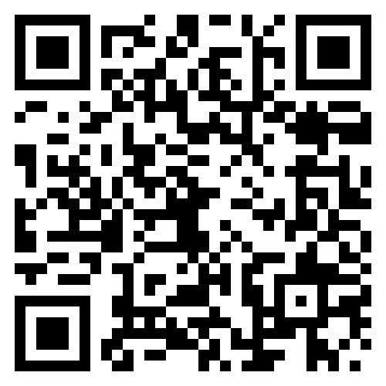
Division for Early Childhood (DEC) Recommended Practices
The DEC recommends the following transition practices:
TRANSITION PRACTICE 1. Practitioners in "sending" and "receiving" programs exchange information before, during, and after transition about practices most likely to support the child's successful adjustment and positive outcomes.
TRANSITION PRACTICE 2. Practitioners use a variety of planned and timely strategies with the child and family before, during, and after the transition to support successful adjustment and positive outcomes for both the child and family.
https://ectacenter.org/decrp/decrp.asp

Slide 16
Defining Terms- “Early Childhood Transition”
Early childhood transition is the process by which a child with a disability transitions from receiving early intervention (EI) services under IDEA Part C to receiving preschool services under IDEA Part B, Section 619 (and other appropriate programs/services) as deemed eligible.

Slide 17

IDEA Implementation: Part C and Part B
Part C: Early Intervention
Serves ages Birth–3
Services provided in accordance with an Individualized Family Service Plan (IFSP)
Family‑centered supports and services
Part B/619: Preschool Special Education
Serves ages 3–5
Services provided in accordance with an Individualized Education Program (IEP)
School‑based educational supports and services

Slide 18
Why It Matters
Helps ensure a coordinated, seamless transition experience for children and families.
Promotes collaboration among cross-agency partners.
Promotes continuity of services; Reduces disruption.
Improves outcomes for children and families.
Complies with applicable federal, state, and local mandates.

Slide 19
Part C and Part B Roles, Requirements, and Responsibilities

Slide 20
Poll #3- Transition Requirements
How familiar are you with Part C to Part B transition roles and responsibilities?

Slide 21
Part C vs. Part B Roles
Part C Role
Part B Role
Support family understanding and readiness
Discuss transition during IFSP meetings
Document transition steps and services
Notify (refer) potentially eligible toddlers to Part B (unless family opts out of notification per state policy)
Obtain and document parent consent when required
Convene the transition conference
Communicate clearly with families and EI partners
Accept and act on referrals
Conduct timely evaluations
Determine eligibility using Part B criteria
Develop and implement the IEP by age 3 (if eligible)
Ensure a free and appropriate public education (FAPE) begins on or before the 3rd birthday

Slide 22
Key Phases and Requirements
Transition Planning (Steps and Services) | SEA/LEA Transition Notification (Referral to Part B) | Transition Conference | Initial Evaluation & Eligibility Determination | IEP Development & Implementation
Part C | Part C (Requires response from Part B) | Part C (Requires participation from Part B) | Part B | Part B
No fewer than 90 days before 3rd bday | No fewer than 90 days before 3rd bday | No fewer than 90 days before 3rd bday | Within 60 days of parental consent | Within 30 days of eligibility determination/By 3rd bday

Slide 23
Transition Planning
Purpose
Provide support; Identify roles, responsibilities and timelines to ensure a smooth transition.
Part C Responsibilities- (Lead Agency):
Must ensure a transition plan is established in the IFSP of all exiting children no fewer than 90 days (and at the discretion of all parties, not more than 9 months) before the 3rd birthday. [34 CFR 303.209(d)(2)]
Must ensure the plan include steps to exit the Part C program, and any transition services necessary to support the transition to preschool or other appropriate services. [34 CFR 303.209(d)]
Must ensure steps include: discussions and parent training, as appropriate, regarding future placements; procedures to prepare the child for service delivery changes; transmitting child find information to the local education agency (LEA) or other appropriate agency in accordance with state policy; and identification of the services and activities necessary to support the transition. [34 CFR 303.344(h)]

Slide 24
SEA/LEA Transition Notification
Purpose
Ensure that toddlers with disabilities and their families experience a smooth and effective transition.
Ensure implementation of the IDEA Part B child find responsibilities and provide sufficient time for individualized planning.
Part C Responsibilities- (Lead Agency):
Must provide the SEA and LEA with notification of toddlers potentially eligible for Part B preschool services no fewer than 90 days before the toddler turns 3. [34 CFR 303.209(b)(1)(i)]
Must ensure that transition notification is consistent with any transition notification opt-out policy adopted by the state. [34 CFR 303.209(b)(2); 34 CFR 303.401(e)]
Must ensure that notification includes: child's name, date of birth, and parent contact information (name, home and email address, telephone number). [34 CFR 303.401(d)]

Slide 25
SEA/LEA Transition Notification (cont’d)
Part B Responsibilities- [Local Educational Agency (LEA)]:
Must treat the transition notification as an initial referral.
Must provide parents with a copy of the Part B procedural safeguards notice. [34 CFR 300.504(a)(1)]
Must provide prior written notice of LEA proposal to conduct an initial evaluation, if suspected that a child has a disability under Part B. [34 CFR 300.503(a)(1)]
Must request parental consent to conduct an initial evaluation to determine a child’s eligibility for Part B services, if a disability is suspected. [34 CFR 300.300(a)]
Must provide the parent with prior written notice that explains, among other things, the basis for its decision, if the LEA does not suspect that a child has a disability under Part B. [34 CFR 300.503(a)(2)]

Slide 26
Chat Reflection #2- One Word Round Up
What's one word you would use to describe the transition notification process in your state?

Slide 27
Transition Conference
Purpose
Discuss any services the toddler may receive under Part B.
Part C Responsibilities- [Lead Agency (LA)]:
Must convene a transition conference not fewer than 90 days and at the discretion of all parties, not more than 9 months before the toddler’s 3rd birthday. [34 CFR 303.209(c)(1)]
Must provide written notice of the conference to the family and other participants (including LEA), early enough to ensure attendance. [34 CFR 303.342(d)(2)]
Must still hold the conference to provide the family with information about Part B preschool services, if the LEA fails to attend after receiving timely notice.
Must ensure reasonable efforts to convene a conference (with family approval) among the LA, family, and providers of other appropriate services, if determined that a toddler is not potentially eligible for preschool services. [34 CFR 303.209(c)(2)]

Slide 28
Transition Conference (cont’d)
Part B Responsibilities- (Local Educational Agency):
Must participate in the transition planning conference arranged by the early intervention service (EIS) program or provider. [34 CFR 300.124(c)].
Should provide the parent with procedural safeguards at the transition conference, if not already done so.
May request consent for evaluation (to determine Part B eligibility) at the transition conference if not already obtained, as determined by state policy.
Should explain to the family the Part B eligibility requirements and evaluation procedures.
Should provide information about Part B program options, as appropriate, to inform parents in their decision-making.
Should inform the family that they can request to invite their Part C service coordinator to the initial IEP meeting.

Slide 29
Initial Evaluation and Eligibility Determination
Purpose
Ensure a Free and Appropriate Public Education (FAPE) at age three.
Part B Responsibilities- [Local Educational Agency (LEA)]:
Must comply with Part B child find responsibilities to conduct a timely evaluation and make an eligibility determination. (34 CFR 300.301)
Must provide parents with notice of procedural safeguards. (34 CFR 300.504)
Must provide prior written notice of LEA proposal to conduct an initial evaluation. [34 CFR 300.503(a)(1)]
Must obtain informed consent from the parent before conducting the initial evaluation. (34 CFR 300.300)
Must conduct the initial evaluation within the 60-day timeline or its state-established timeline. [34 CFR 300.301(c)(1)]
Should consider all relevant Part C assessment information in the context of the evaluation and eligibility determination, and seek additional data, if IEP Team determines it necessary.

Slide 30
IEP Development and Implementation
Part B Responsibilities- (Local Educational Agency):
Must conduct a meeting to develop the IEP within 30 days of a determination that the child needs special education and related services. [34 CFR 300.323(c)(1)]
Must send initial IEP meeting invitation to the Part C service coordinator (or other Part C representative) to assist with the smooth transition of services, upon parent request. [34 CFR 300.321(f)]
Must develop and implement the IEP by the 3rd birthday of a child referred by Part C, found eligible for Part B. [34 CFR 300.101(b)(1)(ii)]
Must ensure that as soon as possible following development of the IEP, special education and related services are made available to the child in accordance with the child's IEP. [34 CFR 300.323(c)(2)]
(If a child's 3rd birthday occurs during the summer, the child's IEP Team shall determine the date when services under the IEP or IFSP will begin. [34 CFR 300.101(b)(2)]

Slide 31
Shared Responsibilities
Understand and fulfill defined roles and requirements.
Coordinate across agencies to ensure smooth transitions.
Maintain consistent communication with partners and families.
Focus on a smooth transition experience for all exiting children and their families.

Slide 32
Poll #4- Confidence Check
How confident are you that your state’s current practices align with IDEA requirements?

Slide 33
Common Challenges and Improvement Strategies

Slide 34
Common Challenges and Improvement Strategies
Challenges
Improvement Strategies
Aligning Part C and Part B system efforts
Understanding steps in the transition process and related roles and responsibilities
Coordinating SEA and LEA notification
Effective data sharing
Other
Personnel and scheduling challenges
Late referrals to C early intervention services, and the resulting impact on Part B
Increase agency collaboration
Prioritize training and professional development
Update policies and procedures
Revise transition agreements/MOUs
Enhance data systems
Exploring Part C extension option

Slide 35
Reflection and Discussion

Slide 36

Self-Guided Small Group Discussion
In your groups, take a few minutes to discuss:
“In what ways does your state support a collaborative, family-centered transition process?”
In CHAT, feel free to share one idea or insight that resonated with you.
We’ll highlight a few comments when we come back together!

Slide 37
Final Considerations
Transition is a shared, coordinated process.
IDEA requires that States have in place policies and procedures to ensure smooth transitions for all exiting children and their families.
Successful transition depends on strong collaboration.
Families should be supported throughout each phase of the transition process.

Slide 38
Technical Assistance (TA) Resources

Slide 39

Transition Information and Resources
ECTA Early Childhood Transition Topic Page:
Early Childhood Transition
Federal Requirements
OSEP Guidance and Resources
National Center Resources
Transition Monitoring
State Examples and Resources
Eligibility Differences between Part C and Part B, Section 619
Transition from Preschool Services to Kindergarten

Slide 40
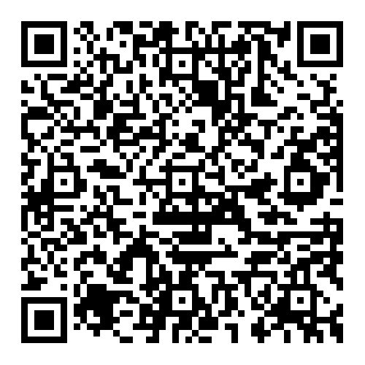
2023 Early Childhood Transition Questions and Answers (OSEP QA 24-01)
Longstanding policy
Provides clarification
Updates 2009 Frequently Asked Questions (FAQs)
Incorporates 2011 Letter to IDEA Infant Toddler Coordinators Association (ITCA)
Incorporates 2023 Letter to Nix
IDEA Requirements and best practice considerations

Slide 41
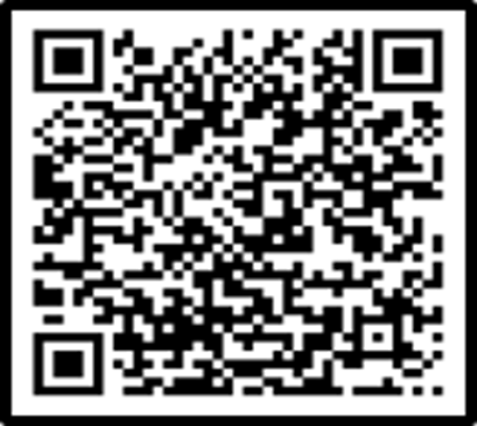
OSEP Transition Checklist
Assist states in ensuring their policies and interagency agreements comply with federal requirements for transitioning children from Part C EI services to Part B preschool special education services.

Slide 42
Next Steps and Follow-up
Complete Session 1 Evaluation
Link forthcoming after today's call
Plan to Attend Session 2: “Agency Collaboration: Creating and Implementing an Effective Transition Agreement/MOU”
Thursday, April 2, 2026, 3:00–4:30 PM EDT
Will focus on the content and use of effective interagency/intra-agency transition agreements/MOUs to promote agency collaboration.
REMINDER: Questions submitted through the Q&A feature will be addressed in a follow-up FAQ, which will be posted on our website. All participants will be notified when it is available.

Slide 43
Technical Assistance Contact Info:
ECTA
DaSy
Sharon Lunn, ECTA Transition Topic Lead
sharon.lunn@unc.edu
ECTA State Contact
https://ectacenter.org/contact/state-assignments.asp
Michelle Lewis, DaSy Transition Topic Lead
mlewis@picnh.org
DaSy State Liaison
https://dasycenter.org/technical-assistance/state-technical-assistance-liaisons/

Slide 44
Thank You!

