Slide 1
Strengthening Recruitment & Retention in the EI/ECSE Workforce
SESSION 5 | Sustaining & Advancing the Workforce
Facilitators
Ted Burke, ECTA
Jani Kozlowski, ECTA
October 13, 2026 • 3:00–4:30 PM Eastern
Guest presenters
Rachel Moyer-Trimyer, Texas ECI
Katari Coleman & Dr. Colleen Morrison, Institute for Home Visiting Workforce Development
Sandy Miller, Wisconsin Early Learning Technical Assistance & Implementation
How do we turn promising workforce strategies into durable systems that we can learn from, adapt, and sustain progress?

Slide 2
A 90-minute sequence from evidence and infrastructure to a 12-month workforce roadmap.
SESSION 5 AGENDA
1
Bridge + sustainability frame
What has to be in place so recruitment and retention strategies survive leadership, funding, and staffing changes?
2
Data leadership + policy tools
DaSy self-assessment • ECS 50-state dashboard • workforce metrics.
3
Guest perspectives
Texas EI data • Home Visiting Workforce Dashboard • Wisconsin coaching/TA.
4
State infrastructure models
CSPD: AZ, MN, HI • integrated PD/TA: VA, KS, IL.
5
ECTA / DEC supports
Personnel Solutions Learning Community • intensive TA • SC toolkit.
6
Apply + sustain
Choose one infrastructure move, three metrics, owners, and a review cadence.

Slide 3
By the end of Session 5, participants will be able to…
LEARNING OBJECTIVES
1
2
3
4
Identify sustainability conditions
Use data for stewardship
Compare system models
Build a 12-month roadmap
Distinguish a one-time workforce activity from infrastructure that can be owned, funded, measured, and improved.
Select a small set of workforce measures and strengthen the leadership competencies needed to use them.
Identify transferable lessons from CSPD and integrated PD/TA systems across multiple states.
Choose one infrastructure move, three metrics, named owners, and a review cadence.

Slide 4
Session 5 closes the loop: build the infrastructure that keeps good workforce strategies working.
SERIES ROADMAP
AUG 11
AUG 25
SEP 9
SEP 22
OCT 13
Landscape +
resources
Attract
Build
pathways
Retain
Sustain +
advance
Today: turn learning into a repeatable operating system for workforce improvement.

Slide 5
A strategy becomes sustainable when the system can keep it going without relying on one person.
BRIDGE FROM SESSION 4
CHOOSE
OWN
RESOURCE
MEASURE
IMPROVE
A strategy that fits the problem
A role or team accountable for it
Time, funding, tools, and partners
Evidence that tells us what is changing
A cadence to review, adapt, and scale
Reflection: Which of these five conditions is currently weakest for your workforce strategy?

Slide 6
What is the biggest sustainability risk in your workforce work right now?
INTERACTIVE PULSE CHECK
A Leadership / ownership
B Data / measurement
C PD / TA capacity
The work depends on one champion.
We cannot consistently show what is changing.
Support is episodic or disconnected.
D Career advancement
E Funding / policy
People cannot see roles, growth, or leadership pathways.
The strategy is vulnerable to short-term funding or policy changes.

Slide 7
1. Sustainability Fundamentals
SESSION 5 | SUSTAINING & ADVANCING THE WORKFORCE
Sustainability is not “keeping every program forever.” It is building the leadership, data, professional-learning, partnership, and career infrastructure needed to keep improving.

Slide 8
Five capabilities turn workforce initiatives into infrastructure.
SUSTAINABILITY CAPABILITIES
LEADERSHIP
DATA
PD + TA
CAREER GROWTH
PARTNERSHIPS + FINANCE
Shared ownership • clear decisions • succession
Common definitions • routine review • improvement questions
Job-embedded learning • coaching • differentiated support
Mentor • coach • specialist • leadership roles
Cross-sector ownership • aligned resources • sustainability
System test: Can the work continue, improve, and survive turnover in leadership, staff, or funding?

Slide 9
Move from “we ran an initiative” to “this is how our system works.”
FROM PROJECT TO INFRASTRUCTURE
PROJECT MODE
INFRASTRUCTURE MODE
• Time-limited funding
• One champion
• Participation depends on interest
• Measures are collected for the grant
• Learning stays within the project team
• Embedded in policy / routine
• Shared ownership
• Defined access and support
• Measures drive decisions
• Learning feeds system improvement

Slide 10
Advancement is part of retention: people need to see a future in the field.
CAREER ADVANCEMENT
PRACTITIONER
MENTOR / COACH
SPECIALIST
PROGRAM LEADER
SYSTEM LEADER
Build expertise and confidence
Support others and model practice
Develop deep expertise or cross-sector role
Supervise, improve systems, manage data
Align policy, workforce, finance, and partnerships
Design question: How can expertise be rewarded without requiring people to leave the children, families, or practice settings they value?

Slide 11
A sustainable workforce strategy tracks a small set of measures that answer real management questions.
WORKFORCE METRICS FOR THE NEXT 12 MONTHS
SUPPLY
STABILITY
EXPERIENCE
Headcount • FTE • vacancies • time-to-fill
Turnover • 1/3/5-year retention • early-tenure exits
Workload • supervisor support • belonging • well-being
PATHWAY
GROWTH
ACCESS
Applicants → enrollment → completion → credential → hire
Mentor/coach roles • credentials • leadership movement
Role • geography • language • entry route • setting
Start with the decision you need to make—then identify the smallest useful data set that can support it.

Slide 12
Data becomes useful when teams create a repeatable review-and-action cadence.
FROM DATA TO STEWARDSHIP
1
2
3
4
5
1
2
3
4
5
QUESTION
REVIEW
LISTEN
ACT
REVISIT
What decision are we trying to make?
What does the data show—and not show?
What do practitioners and partners say?
What will we test, stop, strengthen, or scale?
Did the condition or measure change?

Slide 13
DaSy Data Leadership Competencies Self-Assessment: build the human capacity behind a data culture.
DASY DATA LEADERSHIP
Open the DaSy Data Leadership Competencies Self-Assessment
FOUNDATIONAL DATA SKILLS
INFRASTRUCTURE
CULTURE OF DATA USE
Knowledge and skills needed to interpret, communicate, and use data.
Capacity to lead collection, storage, analysis, transfer, security, and evaluation.
Leadership behaviors that normalize inquiry, learning, and data-informed improvement.
Individual use → professional development plan | Team use → collective competency profile and gap analysis
Source: DaSy Center, 2026. Data Leadership Competencies Self-Assessment.

Slide 14
Use the self-assessment as a workforce sustainability tool—not just a data-team exercise.
APPLYING DASY TO WORKFORCE PLANNING
ASSESS
PROFILE
PRIORITIZE
BUILD
REASSESS
Individuals identify strengths, essential competencies, and growth needs.
Team combines results to identify collective gaps.
Select the competencies most important to current workforce questions.
Use PD, coaching, role changes, or hiring to close gaps.
Track growth and whether stronger data leadership improves decisions.
Leadership question: What data competency is missing—not just what data are missing?

Slide 15
Borrow a policy lens from K–12: the ECS 50-State Teacher Recruitment & Retention comparison.
A CROSS-SECTOR DATA + POLICY RESOURCE
Education Commission of the States — 50-State Comparison: Teacher Recruitment & Retention (2025)
SHORTAGE DATA
PIPELINE
EARLY CAREER
ADVANCEMENT
COMPENSATION
State shortage reports • working-condition surveys
High school pathways • paras • residencies • apprenticeships
Induction • mentoring • reduced loads • mentor qualifications
Planning time • advanced licensure • teacher leader roles
Minimum pay • geographic/shortage incentives • additional pay
Use it to ask better state-policy questions across the full workforce pipeline.
K–12 resource; use as a transferable policy lens rather than EI/ECSE-specific evidence.

Slide 16
The 2025 ECS comparison shows how many states are using multiple policy levers across the teacher pipeline.
K–12 POLICY LANDSCAPE — TRANSFERABLE QUESTIONS
34 + DC
30 + DC
32
38 + DC
Shortage data
Apprenticeships
Induction / mentoring
Shortage incentives
published teacher-shortage data in the prior five years
create or support teacher apprenticeships
require induction and mentoring support for new teachers
have at least one financial incentive for shortage subjects / populations
Transfer question: Which policy levers could strengthen entry, early-career support, advancement, or compensation in EI/ECSE?
Source: Education Commission of the States, 2025 50-State Comparison.

Slide 17
2. Data in Action
SESSION 5 | SUSTAINING & ADVANCING THE WORKFORCE
Three guest perspectives show how different systems use workforce data: Part C retention data in Texas, a new cross-model home visiting dashboard, and a statewide coaching/TA system in Wisconsin.

Slide 18
Data considerations for Part C retention
GUEST PRESENTER
Rachel Moyer-Trimyer
10 MINUTES
Texas Early Childhood Intervention (ECI)
Listen for: What is being measured or supported? What makes the approach sustainable? What could transfer to your state or system?

Slide 19
Strategies and Data Considerations for Improving IDEA Part C Personnel Retention

Slide 20
Background
In 2020, the Office of Special Education Programs (OSEP) awarded Texas Part C funding through the discretionary grant, Improving Retention of Special Education Teachers and Early Intervention Personnel. Texas Part C:
  Contracted with The University of Texas at El Paso (UTEP).
  Allocated funds to 17 Early Childhood Intervention (ECI) subrecipients.
  Submitted the final report in December 2025 after the five-year grant period.
Activities supported ECI subrecipients in hiring and retaining direct service staff.
  Early intervention specialists (EISes)
  Service coordinators
  Physical therapists
  Occupational therapists
  Speech language pathologists

Slide 21
Initial Data
During state fiscal years (SFY) 2017-2019, 84.7% statewide average annual retention rate.
    SFY 2017: 87%
    SFY 2018: 84%
    SFY 2019: 83%
Significant range of retention rates across ECI programs.
    Highest 94.5%
    Lowest 49.8%
Lowest retention was among service coordinators and EISes.
  More than 50% of service coordinators stayed less than a year.
  More than 30% of EISes stayed less than a year.

Slide 22
Project Measures
Increase in average rate of retention per year.
  Subrecipients engaging in general professional development activities.
  Subrecipients engaging in intensive professional development activities.
Increase in rate of retention for EISes and service coordinators in the community of practice.

Slide 23
Overview of Grant Activities
Personnel retention advisory workgroup.
Needs assessment.
  Published research article – Perspectives of Early Intervention Program Directors on Provider Retention Efforts
Four annual summits.
Three summer webinar series.
Targeted stipends for programs with retention rates below 85%.
Technical assistance to support subrecipients with implementing their retention action plans.
Community of practice for early intervention specialists and service coordinators.

Slide 24
Subrecipient Action Plans
The grant funded 68 evidence-based initiatives implemented by ECI subrecipients to address local retention needs.
16 for building and sustaining a personnel pipeline.
25 for creating and supporting a positive work environment.
16 for enhancing training and professional development opportunities.
11 for providing and strengthening formal and informal mentoring.

Slide 25
Grant Outcome
Measure | 2023 | 2024 | 2025
Retention rate for all ECI programs. | 88% | 88% | 78%
Retention rate for ECI programs that received financial incentives. | 87% | 85% | 76%
Retention rate for early intervention specialists and service coordinators in the community of practice | 97% | 96% | 97%
*Counts are based on a reporting period of May 1 – April 30 to align with annual reporting timeframes.

Slide 26
Analysis
Retention rates are driven by multiple factors:
  Subrecipient closures and service area changes.
  Subrecipient variations, such as:
    Size
    Geographic location
    Entity type (education service center, private non-profit, etc.)

Slide 27
Lessons Learned
Have the right team at the beginning (data, budget, subject-matter experts, project manager).
Plan for potential staff changes on the grant team.
Collect both qualitative and quantitative data and collect data from different stakeholder groups.
  Use the data you collect.
  Ensure project measures reflect all positive impacts of the grant activities.
Ensure measurable goals are actionable and reasonable.
  Year over year improvement may not be realistic.
Use the same data metrics throughout the grant cycle.

Slide 28
Sustainability
Update and enhance individualized professional development plans for all ECI providers.
Coordinate projects to improve faculty’s knowledge of ECI and enhance partnerships between subrecipients and universities.
Support EISes and service coordinators leading the PEER Network to sustain collaborative learning.
Use grant materials to meet program director training requirement.
Continue research on the core knowledge and skills ECI leaders need to retain professionals.

Slide 29
Rachel Moyer-Trimyer
Rachel.Moyer-Trimyer01@hhs.Texas.gov

Slide 30
The updated Home Visiting Workforce Data Dashboard: why it was built and how to use it
GUEST PRESENTER
Katari Coleman & Dr. Colleen Morrison
10 MINUTES
Institute for Home Visiting Workforce Development
Listen for: What is being measured or supported? What makes the approach sustainable? What could transfer to your state or system?

Slide 31
Preview of the 2026 Home Visiting Workforce Data Dashboard
September 2026

Slide 32
Agenda
About the Dashboard
  Why we built it
  What it includes
  Where the data come from
Dashboard uses: Case use scenarios
Questions

Slide 33
About the Dashboard
The only public resource that provides data on the home visiting workforce across models and funding sources
WHY WE BUILT IT
THE BENEFIT
No consistent, cross-model data exists on the home visiting workforce
Programs, states, and funders lack shared evidence for planning
Developed with home visiting models as founding data partners
Combines administrative and public-use data into one tool
Soft-launched the 2025 Dashboard after 1+ years of model and field engagement
State and local programs: target expansion where need is greatest
Funders and models: direct investment where demand outpaces supply
System leaders: strengthen pipelines and career pathways
Home visitors and programs: see their workforce represented and valued

Slide 34
What the Dashboard Includes
An interactive tool for exploring workforce supply, demand, and trends—nationally, by state, and by county
CORE CAPABILITIES
BUILT FOR
National, state & county maps of workforce data
  Workforce supply metrics: counts, age, sex, experience, education
  Household demand metrics: counts of households with children under 3 or 6 or pregnant women, for all income levels and for incomes below 200% FPL
  Trends in adjacent fields: average earnings and number of degree completers in nursing, early childhood education, social work, community/public health
Printable, pre-built state profiles
State and local program leaders: planning funding and staffing
Researchers and policy analysts: studying workforce trends
Training and education institutions: shaping pipeline investments
Funders and advocates: making the case for investments in the workforce

Slide 35
Where the Data Comes From
Metrics on the Dashboard combine multiple data sources to provide a consistent picture of the workforce
DATA SOURCES
WHAT EACH SOURCE ADDS
Home visiting model administrative data
  29 models provided data in 2026, up from 13 models in 2025
Institute for the Advancement of Family Support Professionals (IAFSP) data
Public-use files from US Census Bureau and US Departments of Labor and Education
Model administrative data: workforce counts, location, *wages, turnover, vacancies
IAFSP data: age, experience, education, sex
Public-use files: household demand and adjacent-field labor market data

Slide 36



One Dashboard, Many Users
Each persona maps onto one of the Dashboard’s three core walk throughs
Steven
Maria
Imani
Model Developer
MIECHV State Administrator
Community College Planner
Identify where to target model expansion efforts
Make the case for scaling workforce to expand reach
Consider demand for a new certificate program
Broader, national scope
Narrower, local scope

Slide 37
Persona Walk Through: Steven
Explore demand to inform decisions about model expansion
GOAL
Plan model expansion efforts
HOW THEY USE THE DASHBOARD
Steven
Look at the national map
Identify states with high demand
Consider trends in adjacent fields in notable priority areas
Consider potential funders to support investments in home visiting in identified states
Model Developer
Identify where to target model expansion efforts

Slide 38
Persona Walk Through: Maria
Making the case for scaling the workforce to expand reach
GOAL
Determine areas to target expansion with increase in MIECHV funding; justify needs for workforce scaling to state leaders
HOW THEY USE THE DASHBOARD
Maria
Open their state profile to get a ready-made, printable, state-specific snapshot
Compare state to national averages on workforce size and characteristics
Identify counties with high demand
Use findings to inform expansion planning under MIECHV
Justify needs for workforce scaling to expand services in counties with high demand
MIECHV State Administrator

Slide 39
Persona Walk Through: Imani
Consider demand for new certificate program
GOAL
Decided where to invest in a new certificate program to build a pipeline for the home visiting workforce
HOW THEY USE THE DASHBOARD
Imani
Review workforce education levels and years of experience by state and county
Identify credentialing gaps a new certificate program could fill
Compare graduate counts and earnings in adjacent fields versus home visiting
Consider whether career path is competitive enough to attract students
Consider ways to bring components of home visiting into existing degree programs and internship opportunities
Community College Planner
Consider demand for a new certificate program

Slide 40

Additional Dashboard User Personas
Secondary audiences who draw on Dashboard data for their own decisions
Miguel
Dr. Chen
Angela
National Technical Assistance Provider
Researcher and Policy Analyst
State Workforce Development Coordinator
Develop tailored TA tools
Study workforce trends and inform policy recommendations
Identify opportunities to expand workforce pipeline

Slide 41
Questions?

Slide 42
Early Learning Technical Assistance & Implementation (EL-TAI): a networked coaching approach for ECSE/ECE
GUEST PRESENTER
Sandy Miller
10 MINUTES
Wisconsin
Listen for: What is being measured or supported? What makes the approach sustainable? What could transfer to your state or system?

Slide 43

ELTAI
Sandy Miller
WI EL-TAI Specialist
smiller@cesa6.org

Slide 44

EL-TAI Purpose
The overarching purpose of the Early Learning Technical Assistance and Implementation (EL‐TAI) project is to improve positive outcomes for preschool children with disabilities in Wisconsin, by providing universal, targeted, and intensive supports and leadership to Local Education Agencies (LEAs) through the use of equitable and evidenced‐based inclusive practices.

Slide 45
EL-TAI Mission
Our mission is to strengthen the capacity of early childhood teams through effective coaching, collaborative problem-solving, professional learning, and data-informed systems improvement. We support educators in creating inclusive learning environments and delivering high-quality instruction that ensures the rightful presence and meaningful participation of students with IEPs, leading to positive outcomes.

Slide 46

EL-TAI Leaders

Slide 47

EL-TAI Early Learning Specialists

Slide 48



Our Focus
Technical
Assistance
Professional
Learning
Coaching

Slide 49
Universal Supports
Dissemination of Resources
Statewide Webinars
Statewide Trainings
EC Listserv

Slide 50
Targeted Supports
Indicator 6 & 7 Data Collection, Reporting, and Analysis
Inclusive Practices Technical Assistance
Support to Address Behaviors that Challenge Adults
Language and Early Literacy Strategies and Practices
Support for Collaborative Partnerships

Slide 51
Intensive Supports
Indicator 6 Continuous Improvement
Inclusive Services Coaching to Address Mindsets
Indicator 7 Systems Development and Consultation
Coaching and Professional Learning to Enhance Social and Emotional Supports
Targeted professional development to support growth and identified needs.

Slide 52

Statewide Professional Learning System
Statewide Learning Events
Virtual Learning Events

Slide 53

Coaching Supports
District Leadership Teams
Directors of Special Education
Community Partners
Service Providers

Slide 54
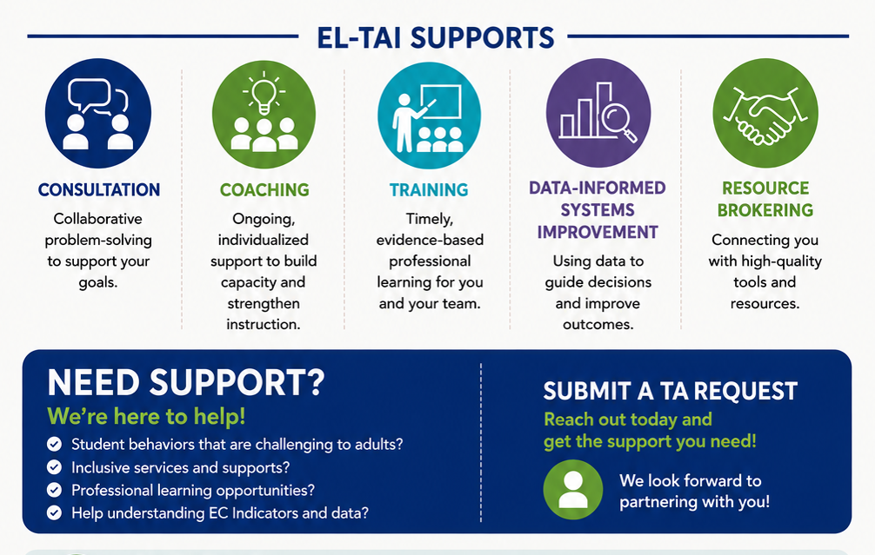
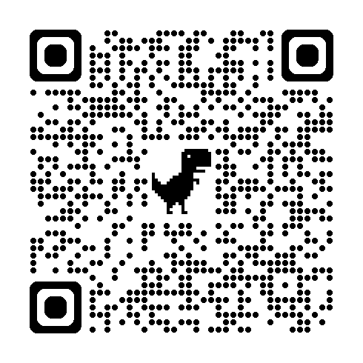
Need Support? Submit a TA Request
Submit a Technical Assistance Request Form
Menu of EL-TAI Supports

Slide 55
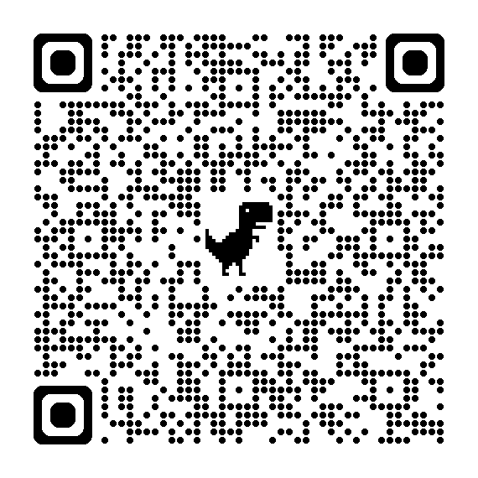
EL-TAI State Professional Learning Offerings
An up-to-date list of professional learning opportunities is available !

Slide 56
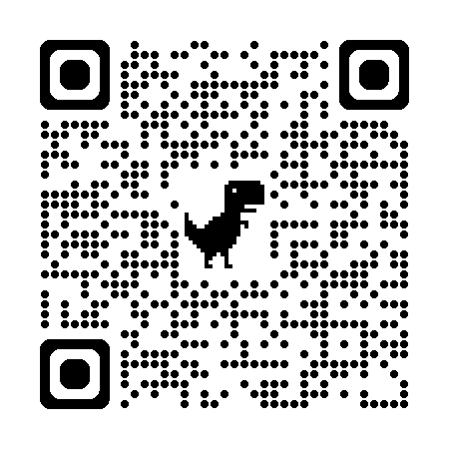
Stay in the Loop
Sign Up For the Early Childhood Special Education (ECSE) Email List
The email list provides individuals who work with and support preschoolers with IEPs with information on best practices, EC indicators, state updates, and professional learning opportunities across the state. To register:
Enter your email address, respond to the security feature, and 'Submit'
Scroll down to the 'Division for Learning Support' and 'Special Education' sections
Click on the box next to 'Early Childhood Special Education'
Scroll to the bottom of the page and click 'Submit'

Slide 57
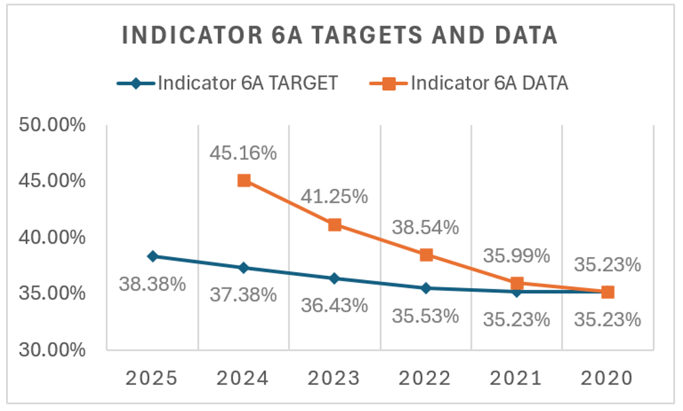
Wisconsin’s Growth

Slide 58
Curious? Let’s Connect!
Michelle Ogorek: mogorek@cesa1.k12.wi.us
Jenny Bibler:Jennifer.Bibler@dpi.wi.gov

Slide 59
3. State Infrastructure Models
SESSION 5 | SUSTAINING & ADVANCING THE WORKFORCE
CSPD and integrated professional-development / TA systems show how states can connect leadership, standards, preparation, coaching, data, and workforce supports rather than operating isolated initiatives.

Slide 60
Arizona, Minnesota, and Hawaiʻi illustrate different ways to organize a comprehensive personnel system.
CSPD STATE MODELS
ARIZONA
MINNESOTA
HAWAIʻI
Collaborative EI/ECSE CSPD explicitly connects recruitment, retention, training, and personnel development.
Integrates and aligns existing personnel-development systems across an interconnected birth-to-kindergarten workforce.
Cross-sector CSPD with shared mission/vision, component workgroups, standards, evaluation, and workforce priorities.
Open state CSPD →
Open state CSPD →
Open state CSPD →
Sources: Arizona DES; Minnesota Department of Education; Hawaiʻi CSPD (accessed Oct. 2026).

Slide 61
Across CSPD models, sustainability comes from alignment—not from adding another workforce committee.
WHAT THE CSPD MODELS ILLUSTRATE
SHARED GOVERNANCE
ALIGNED STANDARDS
PRESERVICE ↔ INSERVICE
R&R ↔ PD
EVALUATION
A leadership structure that can coordinate decisions across agencies and sectors.
Clear expectations that connect preparation, hiring, PD, and practice.
Higher education and field-based learning reinforce one another.
Recruitment and retention strategy is connected to competence and growth.
Workgroups use data and feedback to revise the system over time.

Slide 62
Virginia, Kansas, and Illinois show how statewide PD + TA can be organized as ongoing infrastructure.
INTEGRATED STATE PD + TA SYSTEMS
VIRGINIA | VEIPD
KANSAS | KITS
ILLINOIS | EITP + STAR NET
CSPD backbone • eLearning • topical resources • coordinated statewide EI professional development
Statewide training + TA • resources • individualized support • impact/evaluation focus
EI professional development + ECSE regional PD/consultation/TA • multiple access points
Visit system →
Visit system →
Visit system →
Sources: VEIPD; KITS; Illinois EITP / STAR NET (accessed Oct. 2026).

Slide 63
Integrated PD/TA systems connect learning to implementation—not simply a catalog of trainings.
COMMON ARCHITECTURE OF STATE PD + TA
BACKBONE
MULTIPLE ACCESS POINTS
JOB-EMBEDDED SUPPORT
ROLE DIFFERENTIATION
FEEDBACK + DATA
A stable organization or collaborative holds the infrastructure.
Web resources • courses • communities • consultation • TA
Coaching and problem solving connect learning to real practice.
New staff, experienced practitioners, coaches, supervisors, and leaders need different supports.
Needs, participation, implementation, and outcomes inform the next cycle.

Slide 64
4. National Supports & Tools
SESSION 5 | SUSTAINING & ADVANCING THE WORKFORCE
Use national TA, learning communities, toolkits, and cross-state resources to reduce reinvention and accelerate implementation.

Slide 65
ECTA Early Childhood Personnel Solutions Learning Community: peer infrastructure for Prepare • Attract • Retain.
ECTA LEARNING COMMUNITY
ECTA Learning Communities — Early Childhood Personnel Solutions
SHARE
COMPARE
PROBLEM SOLVE
SUSTAIN
Bring state/local strategies, tools, questions, and implementation lessons.
Learn how other systems are adapting Prepare • Attract • Retain strategies.
Use peers to test assumptions and identify practical next steps.
Create a recurring cross-state learning relationship beyond one webinar series.
Source: ECTA Center Learning Communities (accessed Oct. 2026).

Slide 66
ECTA Intensive TA opportunity: move from a workforce priority to sustained implementation.
RECRUITMENT & RETENTION INTENSIVE TA
DIAGNOSE
DESIGN
IMPLEMENT
MEASURE
SUSTAIN / SCALE
Define the priority challenge and root causes using data + stakeholder voice.
Select a strategy with clear theory of change, partners, and measures.
Build roles, milestones, supports, and feedback loops.
Track implementation and workforce outcomes; learn quickly.
Embed ownership, resources, policy, PD/TA, and review cadence.
Application / eligibility / timeline: https://ectacenter.org/topics/personnel/recruitment2026.asp
ECTA Recruitment & Retention resources: https://ectacenter.org/topics/personnel/recruitment.asp

Slide 67
DEC Service Coordination Recruitment & Retention Toolkit: ready-to-adapt materials plus retention ideas.
SERVICE COORDINATION TOOLKIT
DEC Service Coordination Workforce Recruitment & Retention Toolkit
RECRUITMENT MATERIALS
RETENTION IDEAS
ADAPTATION
SUSTAINABILITY
Pre-packaged assets that can be used or customized to raise awareness and advertise SC roles.
Strategies to strengthen support and connection among service coordinators.
Use state/program language, pathways, benefits, and local workforce data.
Assign ownership so materials stay current and become part of recurring recruitment/retention work.
Source: Division for Early Childhood — Service Coordination Committee.

Slide 68
Choose the resource that matches the system condition you need to strengthen.
RESOURCE → ACTION MAP
Data leadership
DaSy self-assessment + Team Profile
Build individual/team competencies and a learning plan.
Policy scan
ECS 50-state comparison
Ask new questions about shortages, pathways, early-career support, advancement, and incentives.
Cross-sector workforce data
Home Visiting Workforce Dashboard
Compare workforce, population need, geography, and adjacent labor markets.
Peer learning
ECTA Personnel Solutions Learning Community
Share state strategies and implementation lessons.
Implementation support
ECTA intensive TA
Move a priority strategy from assessment to sustained implementation.
Role-specific R&R
DEC Service Coordination toolkit
Adapt ready-made recruitment and retention resources.

Slide 69
Use the Session 5 planning page to turn the series into a sustainable implementation roadmap.
PARTICIPANT IMPLEMENTATION PLANNING TOOL
1. PRIORITY
2. INFRASTRUCTURE MOVE
3. THREE METRICS
4. OWNER + PARTNERS
5. CADENCE
What workforce outcome or system condition matters most?
What leadership, data, PD/TA, career, policy, or partnership change will support it?
Which three measures will tell you whether the system is moving?
Who is accountable? Who must be engaged?
When will you review progress and decide what to adapt?

Slide 70
Final action plan: one infrastructure move + three metrics + an owner + a review date.
YOUR 12-MONTH SUSTAINABILITY ROADMAP
INFRASTRUCTURE MOVE
METRIC 1
METRIC 2
What system capacity will we strengthen?
Supply / pathway
Retention / stability
METRIC 3
OWNER
FIRST REVIEW
Experience / implementation
Who is accountable?
Date + decision point
Write it down. Name the owner. Put the first review on the calendar.

Slide 71
End the series with a short implementation runway—not a long wish list.
30–60–90 DAY COMMITMENT
30
60
90
ALIGN
DESIGN
TEST
Confirm the priority, owner, partners, and baseline data.
Finalize the strategy, measures, roles, and implementation supports.
Launch one manageable change and create a feedback loop.

Slide 72
Five ideas to carry forward from the series.
SERIES TAKEAWAYS
1
Diagnose before choosing a strategy
Use workforce data + lived experience to define the problem.
2
Attraction is a portfolio
Compensation, incentives, public awareness, and access work together.
3
Pathways are transitions
Make entry, preparation, qualification, employment, and growth navigable.
4
Retention is a system outcome
Onboarding, workload, supervision, belonging, growth, and well-being shape staying.
5
Sustain through infrastructure
Assign ownership, build data/PD/TA capacity, fund the work, and review progress.

Slide 73
Resources to continue the work after Session 5.
RESOURCES & LINKS
• DaSy Data Leadership Competencies Self-Assessment
• Minnesota CSPD
• ECS 50-State Teacher Recruitment & Retention Comparison
• Hawaiʻi CSPD
• Home Visiting Workforce Data Dashboard
• Virginia VEIPD
• ECTA Early Childhood Personnel Solutions Learning Community
• Kansas KITS
• ECTA Recruitment & Retention Synthesis / Strategies
• Illinois EITP
• DEC Service Coordination Recruitment & Retention Toolkit
• Wisconsin Early Childhood Special Education / EL-TAI
• Arizona CSPD

Slide 74
Thank you for investing in the people who make early intervention and early childhood special education possible.
SERIES COMPLETE
Your next step: schedule the first review of your 12-month workforce roadmap.
Strengthening Recruitment & Retention in the EI/ECSE Workforce
Sessions 1–5 • 2026

Slide 75
20-minute presenter-led conversations: go deeper on the model and translate it to your context.
BREAKOUT SESSIONS
ROOM A
ROOM B
ROOM C
Rachel Moyer-Trimyer
Katari Coleman &
Dr. Colleen Morrison
Sandy Miller
Texas ECI-
Retention Data
Wisconsin Early Learning Technical Assistance & Implementation-
Universal & Targeted Coaching/TA
Institute for Home Visiting Workforce Development-
Data Dashboard

Slide 76
ECTA Acknowledgments slide

