Slide 1
Strengthening Recruitment & Retention
in the EI/ECSE Workforce
SESSION 4 | Retaining the Workforce
Facilitators
Ted Burke, ECTA
Jani Kozlowski, ECTA
September 22, 2026 • 3:00–4:30 PM Eastern
Guest presenters
Susan Connor, Illinois EITP
Misty Goosen, Kansas KITS
Arrealia Gavins, ECIN
What makes skilled people decide that this is a place—and a profession—where they can stay, grow, and thrive?
Notes:
Ted: TIME: 2 minutes
Welcome participants to Session 4. Connect the series arc: Session 1 framed the workforce challenge, Session 2 focused on attraction, and Session 3 focused on accessible pathways. Today asks what happens after people enter the field. Retention is shaped by everyday working conditions, leadership, onboarding, belonging, professional support, and well-being. Preview the three 10-minute guest presentations and the 20-minute presenter-led breakout rooms.

Slide 2
A 90-minute sequence from retention fundamentals to models, application, and action.
SESSION 4 AGENDA
1
Bridge from Session 3
What did pathway mapping reveal about the conditions people encounter once they enter?
2
Retention fundamentals
Working conditions, onboarding, supervision, belonging, workload, growth, and well-being.
3
Guest models
Illinois Self-Care Café • Kansas coordinator onboarding • ECIN workforce well-being.
4
Data for retention
Turnover, stay/exit information, climate, workload, and early-tenure indicators.
5
Breakout sessions
Three concurrent 20-minute rooms facilitated by the guest presenters.
6
Apply & commit
Use the planning tool to select one workplace practice to strengthen, test, or scale.
Notes:
Ted: TIME: 2 minutes
Orient participants to the flow. Emphasize that the session will move from system conditions to concrete models and then to participant application. Invite participants to listen for one workplace condition they can influence directly and one support that requires broader system partnership.

Slide 3
By the end of Session 4, participants will be able to…
LEARNING OBJECTIVES
1
2
3
4
Diagnose retention pressure
Distinguish support strategies
Use retention data
Choose one next move
Identify the workplace conditions and early-career experiences that influence whether people stay or leave.
Explain how onboarding, peer connection, supervision, self-care, and organizational well-being address different retention needs.
Select a manageable set of measures and listening strategies to understand where and why turnover occurs.
Use the planning tool and breakout discussion to select one feasible workplace practice to strengthen, test, or scale.
Notes:
Ted: TIME: 2 minutes
Review these as outcomes rather than as an agenda. The goal is not to leave with a long list of wellness activities. The goal is to diagnose the retention problem, understand which conditions are within influence, and choose a strategy that fits the root cause.

Slide 4
Session 4 focuses on what makes staying sustainable once people enter and prepare for the work.
SERIES ROADMAP
AUG 11
AUG 25
SEP 9
SEP 22
OCT 13
Landscape + ECTA resources
→
Attracting the workforce
→
Building pathways
→
Retaining the workforce
→
Sustaining + advancing
Today: make the work sustainable by strengthening the conditions around people—not only asking individuals to be more resilient.
Notes:
Ted: TIME: 1 minute
Locate Session 4 in the learning journey. Attraction and pathways matter, but they do not guarantee retention. Once people enter, the quality of onboarding, supervision, workload, peer connection, growth opportunities, and organizational support becomes the retention strategy.

Slide 5
A pathway can get people into the field. The workplace determines whether they can stay.
BRIDGE FROM SESSION 3
ENTER
ORIENT
CONNECT
CONTRIBUTE
GROW
“I made it into the role.”
→
“I know what success looks like.”
→
“I have people to turn to.”
→
“My work is
manageable and valued.”
→
“I can see a future here.”
Quick reflection from Session 3
When you mapped the route into your workforce, what did you notice about the first 30–90 days after someone enters the role?
Notes:
Jani: TIME: 3 minutes
Use this as the bridge from pathway design to retention. Ask participants to think about what happens immediately after entry. Is there role clarity? Orientation? A named person to call? Time to learn? Peer support? Supervision? Ask for a few examples in chat.

Slide 6
Where is retention pressure most visible in your system right now?
INTERACTIVE PULSE CHECK
A First-year turnover
B Burnout / workload
C Supervision / leadership
People leave before they feel competent or connected.
Caseload, paperwork, travel, vacancies, or emotional demands feel unsustainable.
People lack feedback, role clarity, problem-solving support, or recognition.
D Isolation / belonging
E Growth / future
People feel disconnected from peers, teams, or the larger purpose of the work.
Personnel cannot see advancement, specialization, or professional growth.
Use the result as your retention problem statement for the rest of the session.
Notes:
Jani: TIME: 4 minutes
Launch a Zoom poll or invite in chat. Debrief quickly: Which pressure rose to the top? Are there differences by role, geography, or employer type? Emphasize that different problems require different retention responses.

Slide 7
1. Retention Fundamentals
SESSION 4 | RETAINING THE WORKFORCE
Retention is not a single initiative. It is the cumulative experience of how the work is designed, led, supported, and recognized.
Notes:
Ted: TIME: 1 minute
Transition into the retention fundamentals section.

Slide 8
People experience retention one workday at a time.
RETENTION IS A SYSTEM OUTCOME
ROLE CLARITY
WORKLOAD
SUPPORT
I understand what is expected and why it matters.
The work can be done without chronic overload.
I have supervision, coaching, and help solving problems.
BELONGING
GROWTH
WELL-BEING
I am connected to peers and treated as a valued member of the team.
I can learn, specialize, lead, and see a future in the field.
The organization attends to stress, psychological safety, and sustainable practice.
Retention improves when people experience several of these conditions together—not when one benefit is expected to compensate for everything else.
Notes:
Ted: TIME: 3 minutes
Frame retention as cumulative. A strong supervisor cannot fully offset a chronically impossible workload; a wellness activity cannot fix unclear roles; a pay increase may not solve isolation. Encourage participants to think in terms of the whole work experience.

Slide 9
National EI/ECSE workforce data show both commitment to the work and substantial risk of leaving.
THE RETENTION RISK IS REAL
40%
>25%
27%
14%
reported they were likely or very likely to leave the EI/ECSE workforce within five years
reported looking for a new job outside EI/ECSE in the prior six months
of ECSE teachers reported severe or potentially dangerous levels of stress
of EI providers reported severe or potentially dangerous levels of stress
Important counterpoint: respondents also described the work as meaningful and rewarding. Retention strategy should protect what people value while reducing what makes the work unsustainable.
Source: ECPC/NIEER national EI/ECSE workforce survey (2022–2023), as presented in Session 1.
Notes:
Ted: TIME: 3 minutes
Use these figures as a signal, not as a diagnosis for any individual state. Emphasize the coexistence of high meaning and high stress: people can love the work and still decide it is not sustainable. The retention question is how systems preserve purpose while changing conditions that drive exit.
SOURCE / REFERENCE:
ECPC/NIEER national EI/ECSE workforce survey, 2022–2023; figures carried forward from Session 1 materials.

Slide 10
2026 ITCA Tipping Points: Retention pressure remains systemic
CURRENT PART C SIGNALS
State Part C leaders continue to connect workforce shortages to workload and compensation—and expect provider shortages to persist.
78%
73%
38%
87%
High workload
Low compensation
Shortages increased
Looking ahead
identified as a key factor contributing to provider shortages
identified as a key factor contributing to provider shortages
another 38% said shortages were about the same
expect provider shortages to remain an issue over the next five years
n=40
n=40
n=40
n=47
SERVICE IMPACT
85% of responding states identified provider capacity as a contributor to gaps between planned and delivered IFSP services (n=39).
Retention implication: Addressing workload and compensation is central to sustaining system capacity—not separate from it.
Source: Infant & Toddler Coordinators Association, 2026 Tipping Points Survey Report. Percentages reflect responding states; n varies by item.
Notes:
Ted: TIME: 3 minutes
Use this slide to update the retention story with current Part C system data from ITCA’s 2026 Tipping Points Survey. Forty states answered the provider-shortage questions. High workload (78%) and low compensation (73%) were the two most frequently cited factors contributing to shortages. Thirty-eight percent reported that shortages had increased in the past year, while another 38% said they were about the same. Looking forward, 87% of 47 respondents expected shortages of direct service providers to remain an issue over the next five years.
Connect this directly to retention: workforce instability is not only a recruitment problem. High workload and low compensation can make it harder for existing personnel to stay, while shortages increase pressure on the workforce that remains. The service consequence is also visible: 85% of 39 responding states identified provider capacity as a contributor to gaps between planned and delivered IFSP services.
Caution participants not to over-interpret the figures. ITCA reports aggregated responses from state and jurisdiction Part C coordinators, respondent counts vary by question, and ITCA states that it does not independently verify the data or draw conclusions from the responses.

Slide 11
Pair individual supports with organizational and system changes.
SELF-CARE MATTERS. IT CANNOT CARRY THE WHOLE RETENTION STRATEGY.
INDIVIDUAL / RELATIONAL SUPPORTS
ORGANIZATIONAL / SYSTEM CONDITIONS
• Mindfulness and self-reflection
• Reasonable workload and staffing
• Peer connection and mutual support
• Clear roles, policies, and priorities
• Boundaries and recovery practices
• High-quality onboarding and supervision
• Access to mental health supports
• Time for learning, teaming, and documentation
• Reflective supervision and consultation
• Recognition, growth, and decision-making voice
Retention becomes stronger when both sides are designed intentionally.
Notes:
Ted: TIME: 3 minutes
Make the distinction explicit: self-care is valuable, but it should not be used to shift responsibility for structural problems onto individual workers. The practical question is how individual and relational supports are paired with changes in workload, supervision, role clarity, staffing, and organizational culture. This sets up Susan Connor’s Self-Care Café example while keeping the systems lens.

Slide 12
Onboarding is a process—not an event on someone’s first day.
THE FIRST YEAR IS A RETENTION INTERVENTION
1
2
3
4
5
BEFORE START
0–30 DAYS
30–90 DAYS
3–12 MONTHS
YEAR 1 REVIEW
System orientation • shadowing • essential procedures
Coaching • feedback • case review • peer connection
Role preview • requirements • contact person
Milestone check-ins • advanced learning • problem solving
What helped? What remains hard? What support is next?
Design question: What would a new practitioner know, feel, and be able to do after 30 days, 90 days, and one year?
Notes:
Jani: TIME: 3 minutes
Use this slide to reframe orientation as a year-long retention strategy. New personnel need staged learning, access to experienced colleagues, feedback, and opportunities to revisit questions once they have enough experience to know what they do not yet know. This sets up the KITS example.

Slide 13
The supervisor’s job is not only compliance—it is helping people make sense of complex work.
SUPPORTIVE SUPERVISION REDUCES “FIGURE IT OUT ALONE”
CLARITY
Do I know what matters most and what “good” looks like?
COACHING
Do I receive useful feedback and help applying learning?
PROBLEM SOLVING
Can I bring difficult cases and system barriers without fear?
REFLECTION
Is there space to process the emotional and relational demands of the work?
RECOGNITION
Does anyone notice effort, progress, expertise, and impact?
Notes:
Jani: TIME: 3 minutes
Ask participants to think about supervision from the employee perspective. Supportive supervision includes clarity, feedback, problem solving, reflection, and recognition. Depending on role and model, reflective supervision or mental health consultation can add a relational space for processing the emotional dimensions of the work.

Slide 14
The total burden is the combination of volume, complexity, travel, documentation, vacancies, and control over the work.
WORKLOAD IS MORE THAN CASELOAD
VOLUME
COMPLEXITY
TIME
Caseload • ratios • referrals
Family needs • clinical demands • coordination
Travel • scheduling • documentation
VACANCIES
AUTONOMY
SUPPORT
Covering open roles • onboarding new staff
Flexibility • decision authority • control over schedule
Administrative help • team capacity • consultation
Measure what the work actually requires—not only the number of people assigned.
Notes:
Jani: TIME: 3 minutes
Broaden the workload conversation. Two people with the same caseload can experience very different workload depending on travel, acuity, documentation, vacancies, administrative support, and schedule control. Encourage participants to identify which workload dimension is driving strain locally.

Slide 15
Retention includes professional identity, connection, recognition, and a future—not simply avoiding burnout.
PEOPLE STAY WHERE THEY CAN BELONG AND GROW
CONNECTION
VOICE
RECOGNITION
LEARNING
ADVANCEMENT
Peer forums • communities of practice • team learning
Input into decisions • feedback loops • practitioner advisory roles
Celebrate expertise • milestones • contribution
Coaching • mentoring • role-specific professional development
Specialization • mentor roles • leadership pathways
Retention is not only “Will I stay in this job?” It is also “Can I see myself staying in this field?”
Notes:
Ted: TIME: 3 minutes
Connect retention to professional identity and career sustainability. A person may leave one job but remain in the field if there are visible pathways for growth. Conversely, someone may leave the field when they cannot see how to advance without abandoning direct service entirely.

Slide 16
A small retention dashboard can turn anecdotes into targeted action.
USE DATA TO UNDERSTAND WHY PEOPLE STAY—AND WHY THEY LEAVE
TURNOVER
STABILITY
VACANCY
Annual exits • voluntary/involuntary • early-tenure exits
1/3/5-year retention • tenure by role/region
Vacancy duration • time-to-fill • repeated vacancies
WORKLOAD
EXPERIENCE
LISTENING
Caseload • ratios • travel • overtime • documentation
Climate • supervisor support • belonging • well-being
Stay interviews • exit interviews • focus groups • open-ended survey
Disaggregate where useful: role • geography • setting • tenure • entry route • other locally relevant characteristics.
Notes:
Ted: TIME: 3 minutes
Encourage participants to begin with a manageable dashboard. Turnover rate alone tells you that people left; it does not tell you when, where, or why. Combine administrative indicators with listening strategies such as stay interviews and open-ended feedback.

Slide 17
Stay interviews are a simple way to learn what to protect and what to change.
ASK BEFORE PEOPLE LEAVE
1
What makes you want to stay here?
2
What part of your work gives you the most energy?
3
What makes your work harder than it needs to be?
4
When have you recently felt well-supported—or unsupported?
5
What is one change that would make staying easier?
Close the loop: tell staff what you heard, what can change now, what requires longer-term action, and what cannot change.
Notes:
Ted: TIME: 3 minutes
Offer these as sample prompts, not a required instrument. The most important design feature is closing the loop. Asking for input and then never responding can make trust worse. Encourage leaders to distinguish immediate changes from issues requiring policy, funding, or cross-agency work.

Slide 18
Do not default to the easiest activity. Start with what is actually making people consider leaving.
MATCH THE RETENTION RESPONSE TO THE PRESSURE POINT
Observed retention pressure | Likely response(s) to test
New hires feel overwhelmed and leave early | Structured onboarding + staged learning + mentor/check-ins
People report isolation or weak connection | Peer forum + communities of practice + team routines
Stress is high even among experienced staff | Workload redesign + consultation/supervision + well-being supports
Supervisors are inconsistent or overloaded | Supervisor training + role clarity + coaching + escalation pathways
Personnel cannot see a future in the field | Career ladders + leadership roles + specialization + recognition
Leaders do not know why people leave | Retention dashboard + stay/exit interviews + practitioner voice
Notes:
Ted: TIME: 3 minutes
Use this as the decision table for the session. There is no universal retention intervention. Invite participants to identify the row that is closest to their current problem and listen to the guest examples through that lens.

Slide 19
2. Models in Action
SESSION 4 | RETAINING THE WORKFORCE
Three different retention levers: peer well-being support, intentional first-year onboarding, and organization-level workforce well-being.
Notes:
Ted: TIME: 1 minute
Introduce the guest segment. Each presenter has 10 minutes. Ask participants to listen for: the retention problem being addressed, the core design features, who owns the strategy, what participation looks like, and what another state could adapt.

Slide 20

WORKFORCE WELLNESS IN ACTION
EITP's Monthly Self-Care Café: Supporting Illinois' Early Intervention Workforce
ECTA Session on Strengthening Retention in Early Intervention/Early Childhood Special Education Systems
September 2026
Susan Connor, Ed.M.
Director & Principal Investigator, Early Intervention Training Program, University of Illinois
Notes:
Ted: TIME: 5 minutes of 10-minute guest segmentHandoff to Susan Connor. Invite Susan to describe the origin and purpose of the Self-Care Café, the format and facilitation approach, who participates, and what EITP has learned about creating meaningful space for self-care and connection. Ask Susan to update any details shown on the slide. Give a subtle time cue around minute 4.SOURCE / REFERENCE:Illinois EITP has documented “Self-Care Café – A Monthly Mindfulness and Self-Care Check-in” in its training calendar/newsletters. Current EITP mission emphasizes growth, service, and belonging.

Slide 21






Workforce Wellness at EITP
TODAY'S CONVERSATION
Illinois Part C Early Intervention
A quick snapshot of our system and workforce
Why Self-Care, Why Now
The story behind the Café(s)
Grounded in Research
What the literature tells us about workforce wellness
Inside the Self-Care Café(s)
History, format, and what to expect
What Participants Say and Learn
Feedback, impact, and evaluation themes
What We've Learned
Takeaways to bring back to your state, program, territory
EITP Self-Care Café | National ECTA Session on Strengthening Retention in Early Intervention/Early Childhood Special Education Systems
2

Slide 22
A System Snapshot
ILLINOIS PART C EARLY INTERVENTION
40,000+
4,500+
1,500–2,000
children & families served annually (cumulative)
credentialed service providers statewide
children enter & exit the system every month
25
450
Regional System Points of Entry (SPOE)
funded Dedicated Service Coordinators
Illinois’ Part C System is a vendor, fee-for-service model with most providers working as independent contractors, often without a shared office or co-located colleagues.
EITP Self-Care Café | National ECTA Session on Strengthening Retention in Early Intervention/Early Childhood Special Education Systems
3

Slide 23

The Story Behind the Café(s)
WHY SELF-CARE?
Many providers work as independent contractors, often without a shared office or nearby colleagues; isolation was already part of the job.
Grounded In
EI Principles
COVID-19 changed how we delivered EI services; a stressful time for our whole workforce and families.
Supporting Caregiver Capacity, Facilitating Active Participation, Collaborative Relationships, Ongoing Communication, and Quality Services.
We saw a parallel process: providers who reflect and practice mindfulness are better able to model it for the families they serve. We also knew those opportunities were limited.
DEC Recommended Practices
Leaders build a culture of belonging and a professional development system with a variety of supports for practitioners.
Another parallel process: Relationships are the foundation of high-quality EI services – providers and service coordinators who feel connected, taken care of and in community can extend those same things to the families they support.
EITP's Possibility Statements
Our own guide, centered on growth, service, and belonging — intentional practices that build reflection and a sense of being included, cared for, and appreciated.
eitp.education.illinois.edu/Files/Resources/PossibilityStatements.pdf
EITP Self-Care Café | National ECTA Session on Strengthening Retention in Early Intervention/Early Childhood Special Education Systems
4

Slide 24
A Burst of Light (1988)
“Caring for myself is not self-indulgence, it is self-preservation.”
— Audre Lorde
EITP Self-Care Café | National ECTA Session on Strengthening Retention in Early Intervention/Early Childhood Special Education Systems
5

Slide 25



What Is Self-Care?
DEFINING THE WORK
Intentional Actions
Rooted in Stress Management
to support well-being — not an afterthought
a well-being tool with real physiological and psychological benefit
Individualized & Sustainable
Multi-Dimensional
it looks different for everyone, and it isn't selfish or costly
mental, physical, emotional, professional, spiritual, and social
“Self-care is fundamentally about stress management — a well-being tool with real physiological and psychological benefit.”
— Greater Good Science Center, UC Berkeley
EITP Self-Care Café | National ECTA Session on Strengthening Retention in Early Intervention/Early Childhood Special Education Systems
6

Slide 26

Grounded in Research
THE EVIDENCE BASE
Burnout Is Well-Defined — and Well-Studied
Mindfulness-Based Programs Show Promise for Caregiving Professionals
Protected Time Is Often Missing
Decades of research describe burnout as a pattern of exhaustion, cynicism, and reduced sense of effectiveness, work the World Health Organization drew on when it formally recognized burnout as an occupational phenomenon.
A 2025 study of a virtual, structured wellness program for early childhood educators and nurse managers found improved sleep quality and other wellbeing gains, strongest when supported by leadership and organizational culture.
National data show many infant-toddler teachers have no designated daily break and no dedicated space to relax, a gap linked to rising burnout across the early childhood field.
Maslach & Leiter; World Health Organization, 2019
Healthcare journal, 2025 (CPR² program study)
ZERO TO THREE
EITP Self-Care Café | National ECTA Session on Strengthening Retention in Early Intervention/Early Childhood Special Education Systems
7

Slide 27
EITP's Self-Care Café: A Brief History
HOW WE GOT HERE
Mindfulness, Breath & Yoga in Your EI Practice
Mindfulness Mini-Series
Second offering launches: A Focus on Self-Care: One Dimension at a Time
FALL 2019
FALL 2020
JANUARY 2025
Calm the Chaos of COVID: Help the Helpers
Self-Care Café launches as a monthly offering
SPRING 2020
JULY 2021
Both offerings are free and carry EI recredentialing hours plus state licensure CE. The second series was added in 2025, in direct response to participant feedback and requests.
EITP Self-Care Café | National ECTA Session on Strengthening Retention in Early Intervention/Early Childhood Special Education Systems
8

Slide 28
Inside the Self-Care Café(s)
THE FORMAT
A safe space to share thoughts, explore current practices, support each other, learn, connect and take a break. Both follow same structure, with the One Dimension focusing on specific dimensions at each gathering.
One Hour
Once a month, 2nd Monday AM
Once a month, 4th Thursday PM
1
Start with breath and/or meditation
Free to Attend
Registration required
Assess our own self-care practice using a self-care assessment tool
2
Dual Credit
EI hours + state licensure CE
3
Reflect on what we discovered — an invitation to share
Drop In
Attend as often as you'd like
4
Set an informal action plan
Two Offerings
5
End with a loving-kindness meditation or blessing
Original Café + “One Dimension at a Time” (added 2025)
EITP Self-Care Café | National ECTA Session on Strengthening Retention in Early Intervention/Early Childhood Special Education Systems
9
Notes:
Both follow same structure but the One Dimension session focuses on one dimension for each day – for example, breath awareness, seated yoga, social self-care, personal/spiritual, emotional/psychological, physical, etc.

Slide 29

The Impact
WHAT PARTICIPANTS SAY
I am grateful for this time each month. I really enjoy that connection and being reminded that what I do is important.
1,300+
participants since the Café launched in July 2021
I love the sharing aspect as a provider — realizing that we all share not only the profession, but the feelings, the frustrations, and the desire to find balance.
7–35+
participants per monthly session
Sharing in a group of professionals helps build me up, to keep on keeping on when challenges arise and life gets to be overwhelming.
“This is the best ongoing training EITP ever started — it has been a literal life changer for me.”
EITP Self-Care Café | National ECTA Session on Strengthening Retention in Early Intervention/Early Childhood Special Education Systems
10

Slide 30

What Participants Learned
FROM OUR EVALUATION DATA
“Tell us one thing that you learned and incorporated into your daily or weekly life.”
Mindfulness as a Shared Practice
Breathing & Meditation Techniques
Self-Awareness & Reflection
Work-Life Balance
Modeling mindful habits for the caregivers and families they serve, not just themselves
Mindful pauses between visits; regularly using breath or meditation to manage stress
Using tools like the self-care wheel and a gratitude journal to check in regularly
Setting boundaries, learning to say no, and protecting time for self outside of work
Personal Growth & Support
Practical Self-Care Strategies
Reinforcing & Restarting Habits
Seeking therapy or mentorship; recognizing self-care looks different for everyone
Simple walks, visual tracking tools, mindfulness woven between home visits
Recommitting without judgment, and integrating mindfulness into weekly routines
EITP Self-Care Café | National ECTA Session on Strengthening Retention in Early Intervention/Early Childhood Special Education Systems
11

Slide 31
What We've Learned
TAKEAWAYS FOR OTHER STATES, PROGRAMS, TERRITORIES
Self-care doesn't need to be costly
Consistency builds trust
A consistent, low-cost offering can carry real weight.
Same time, same place, every month; the workforce knows where to find us.
Validation matters
Listen and iterate
Participants feel their time and wellbeing are genuinely valued and they describe feeling validated.
Our second monthly offering exists because participants asked for it.
EITP Self-Care Café | National ECTA Session on Strengthening Retention in Early Intervention/Early Childhood Special Education Systems
12

Slide 32



Let's Connect
Thank you — we'd love to keep the conversation going.
Susan Connor, Ed.M., Director & Principal Investigator
Meg Bracco Liebreich, PT, Professional Development Specialist
Early Intervention Training Program, University of Illinois
suec@illinois.edu
eitp.education.illinois.edu
Self-Care Café resources: blogs.illinois.edu/view/8619/5456617
EITP Self-Care Café | National ECTA Session on Strengthening Retention in Early Intervention/Early Childhood Special Education Systems
13

Slide 33
References
SOURCES
Charlot-Swilley, D., Zuskov, S., Curtis, L., Mitchell, S., & Anderson, E. (2025). Fostering workforce wellness: Insights from nurse managers and early childhood educators. Healthcare, 13(5), Article 487. https://doi.org/10.3390/healthcare13050487
Early Intervention Training Program. (n.d.). Possibility statements. University of Illinois. https://eitp.education.illinois.edu/Files/Resources/PossibilityStatements.pdf
Kwon, K.-A., Ford, T. G., Salvatore, A. L., Randall, K., Jeon, L., Malek-Lasater, A., Ellis, N., Kile, M., Horm, D. M., Kim, S. G., & Han, M. (2020). Neglected elements of a high-quality early childhood workforce: Whole teacher well-being and working conditions. Early Childhood Education Journal, 50, 157–168. https://doi.org/10.1007/s10643-020-01124-7
Lorde, A. (1988). A burst of light: And other essays. Firebrand Books.
Maslach, C., & Leiter, M. P. (2016). Understanding the burnout experience: Recent research and its implications for psychiatry. World Psychiatry, 15(2), 103–111. https://doi.org/10.1002/wps.20311
Tiayon, S. B. (2025, October 13). Are we getting self-care wrong? Greater Good Magazine. https://greatergood.berkeley.edu/article/item/are_we_getting_self_care_wrong
World Health Organization. (2019, May 28). Burn-out an “occupational phenomenon”: International classification of diseases. https://www.who.int/news/item/28-05-2019-burn-out-an-occupational-phenomenon-international-classification-of-diseases
ZERO TO THREE. (n.d.). Early childhood teachers’ well-being: What we know and why we should care. https://www.zerotothree.org/resource/journal/early-childhood-teachers-well-being-what-we-know-and-why-we-should-care/
EITP Self-Care Café | National ECTA Session on Strengthening Retention in Early Intervention/Early Childhood Special Education Systems
14

Slide 34

Kansas Inservice Training System
Supporting and Retaining EI Professionals Providers in Kansas
Misty D Goosen ED.S.

Slide 35

Relationships Are Key
Organized Opportunities for Connection
Multiple Modes of Connection
Connections State/Groups/Individuals

Slide 36

PSP Mindset Set’s the Stage

Slide 37
Kansas Examples
New Provider Training
New Coordinator Training
Local Program TA
Coordinator Connections
Coaching Facilitator

Slide 38


New Provider Training

Slide 39

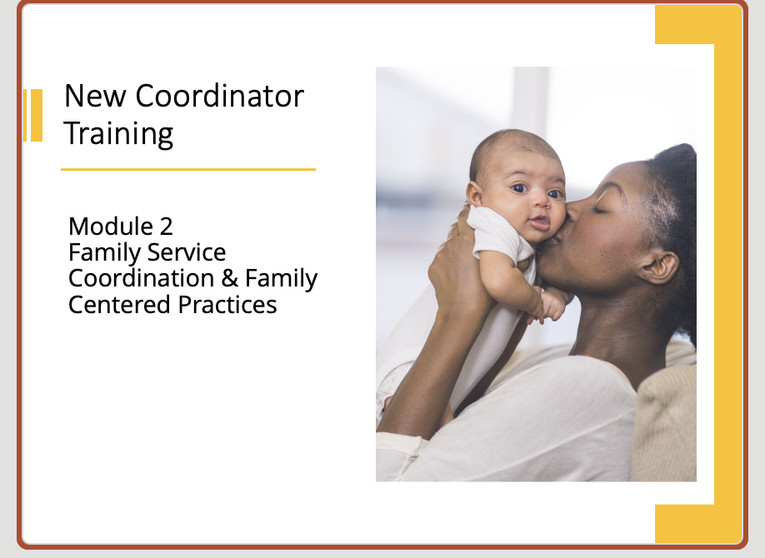
New Coordinators

Slide 40
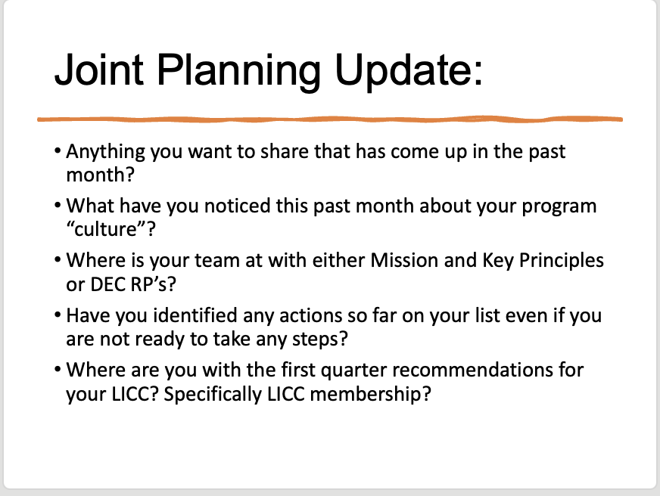
Joint Planning

Slide 41

KITS TA Providers
Assigned TA
Monthly Coordinator
TA as PSP

Slide 42
Coordinator Connections
Highest Priority Today
Discussion w/Peers
Questions for State
Questions/Topics

Slide 43

Coaching Facilitators
Topics that support the PSP model
Topics that support CF individuals
Opportunities to address real life situations
Opportunities to learn from and with others

Slide 44

Reflections and Questions

Slide 45

PROMISE
Promoting Resilience and Mental Health
in Early Learning Settings
Practical Strategies for Early Childhood
Workforce Wellbeing & Retention
Early Childhood Innovation Network
MedStar Georgetown University Hospital
Georgetown University THRIVE Center for Children, Families and Communities
Arrealia Gavins, Director of Early Learning Practice
Contact: ACG149@georgetown.edu, 240-459-2635
PROMISE asks what early childhood systems can put around the workforce—not simply what we can ask the workforce to do—to promote wellbeing, job satisfaction and retention.
Notes:
[Sources]
- User-provided presentation brief.
- ECIN logo supplied by user.
[/Sources]

Slide 46
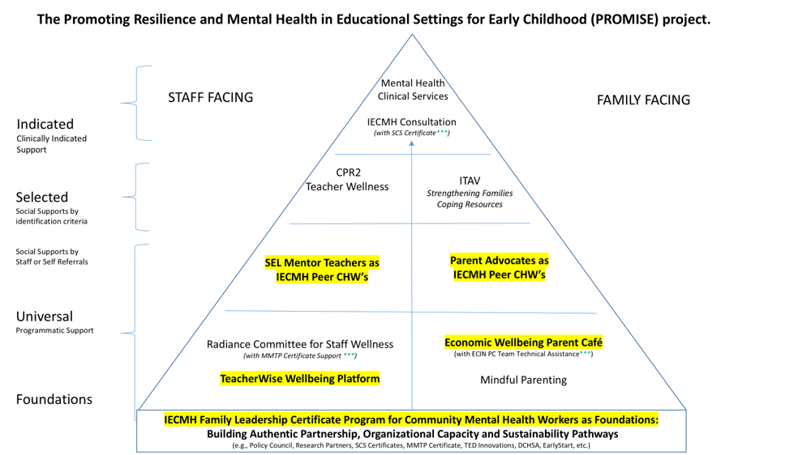
PROMISE: A Multilevel Approach to Workforce Wellbeing
The PROMISE project seeks to that promote a culture of school-wide social emotional well-being and
mental health supports for children, families, and staff in early learning settings.
Workforce retention requires multiple levels of support.
Staff Facing | Family Facing | Organizational Facing | System Facing
Notes:
[Sources]
- User-provided presentation brief.
- ECIN logo supplied by user.
[/Sources]

Slide 47
What Can Partners Implement?
Four Research and Evidence-Informed PROMISE Strategies to Promote Workforce Retention
TeacherWISE
Peer Mentoring
IECMH Family Leadership
Community Mental Health Workers
Movin’ On Up!
Economic Café
Educator wellbeing
Connection, professional
growth & belonging
Peer mental-health support
& resource navigation
Economic wellbeing
& mobility
ECIN can support implementation through training, technical assistance, consultation and implementation support.
Wellbeing • Belonging • Family Support • Economic Stability → Retention
Notes:
[Sources]
- User-provided presentation brief; strategy names reflect PROMISE materials supplied by user.
[/Sources]

Slide 48

TeacherWISE: Make Educator Wellbeing Part of Workforce Development
www.teacherwise.org
TeacherWISE is an online platform that provides tools and strategies across five dimensions of staff wellbeing:
P
O
I
S
E
Physical
Occupational
Intellectual
Social
Emotional
Mindfulness Integration Across All Dimensions
Breathing, awareness and stress-management practices are integrated into wellbeing skill building.
Retention Connection
“Support the person—not only their professional competencies.”
ECIN Partnership: Implementation • Professional Development • Leadership TA • Organizational & State-Wide Wellbeing Integration
Notes:
[Sources]
- TeacherWISE_English Manual Translation.pdf, POISE wellbeing domains and mindfulness content.
- 11.21.23 Educare DC PROMISE Intervention One Pager, staff-facing PROMISE model.
- Image generated for this presentation.
[/Sources]

Slide 49
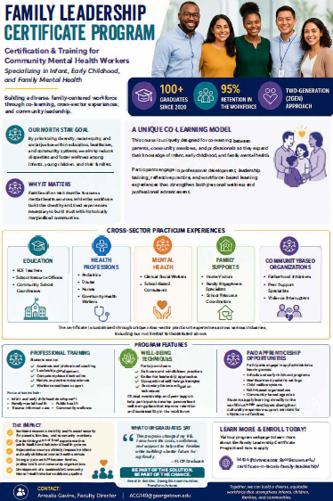
Educators Have Families TOO!
The Power of IECFMH Community Mental Health Peer Support
“The educator who supports children and families all day goes home to a family of their own.”
IECMH Family Leadership Certificate + Community Mental Health Workforce Supports
Lived experience
Relevant to ECE /EI / ECSE
IECFMH knowledge
The IECMH Family Leadership Certificate program designed for expansion of Community Mental Health Workers also includes Early Intervention and Early Childhood Special Education.
Peer support
Resource navigation
Workforce development
Retention Connection
“Trusted peers can help employees navigate family, mental health and community systems—not only workplace challenges.”
Notes:
[Sources]
- FY 26 GU IECMH Family Leadership One_Pager.pdf.
- IECMH Family Leadership_Community Mental Health Worker Certificate_Overview.pdf.
- User-provided clarification that certificate program includes Early Intervention and ECSE.
- Image generated for this presentation.
[/Sources]

Slide 50
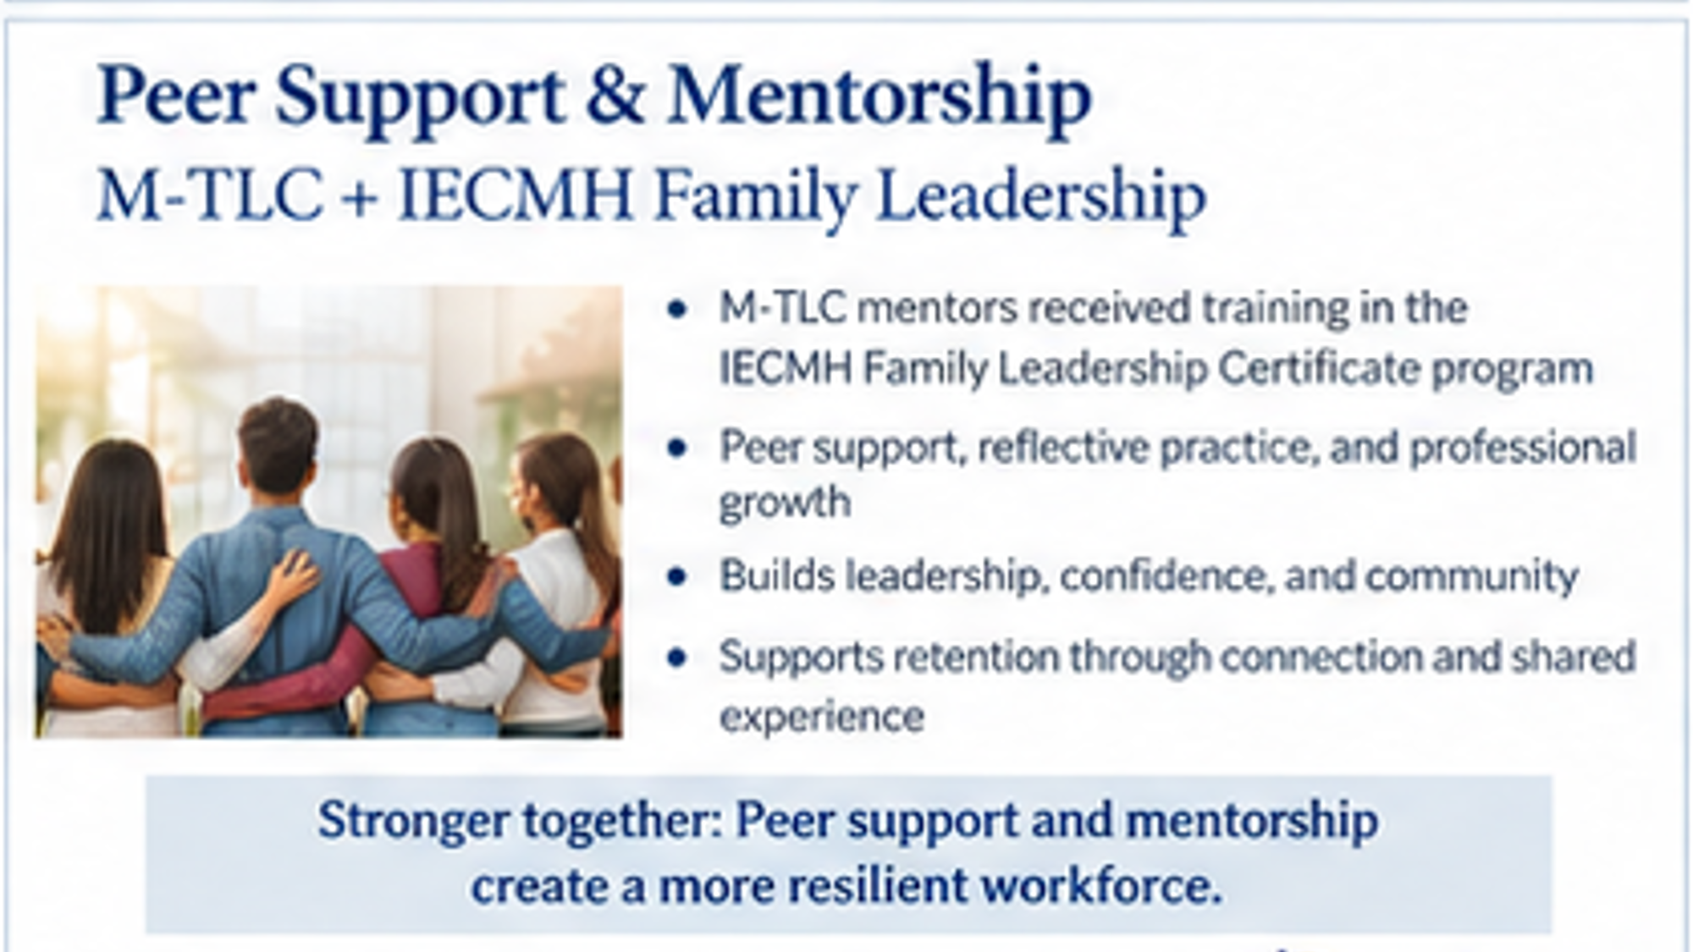
Peer Mentoring: Build Belonging Into the Workplace
Mentor Teacher Learning Collaborative (M-TLC) through IECMH Community Mental Health Workers
The PROMISE mentoring model was designed around:
Educators as experts
Non-evaluative peer learning
Social connection and belonging
Restorative practices
Educator wellbeing
Improved teaching practice
PROMISE → M-TLC → DC LEAD
From site-based implementation into the District’s workforce-development infrastructure.
ECIN Partnership: Mentor Program Needs Assessment & Design • Mentor Training • Facilitator Development
• Sustainable Implementation TA • CQI
Notes:
[Sources]
- ECIN PROP_MTLC History to DC LEAD Timeline_05.08.2025(1).pdf.
- Polinger Four-Year Investment Final Sustainability Report, M-TLC/DC LEAD transition.
- Image generated for this presentation.
[/Sources]

Slide 51
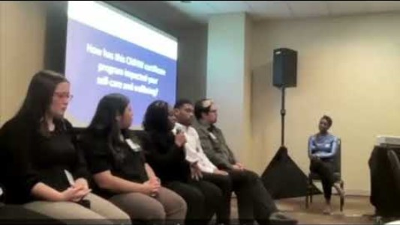
IECMH Community Mental Health Worker Retention Supports
PROMISE ECE & EI Staff Wellbeing Testimonies

Slide 52

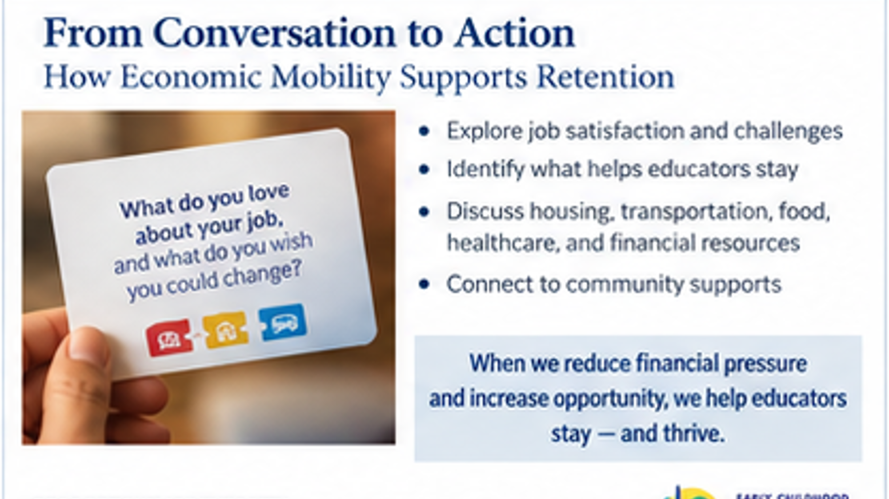
Economic Wellbeing Is Workforce Wellbeing

Slide 53
Economic Wellbeing Is Workforce Wellbeing
Movin’ On Up! broadens the retention conversation beyond wages alone.
1
2
3
4
5
INCOME &
EMPLOYMENT
EDUCATION
COMMUNITY
VITALITY
SOCIAL
SUPPORT
WELLNESS
(HOLISTIC VITALITY)
Fair wages • Job Stability • Benefits •
Entrepreneurship • Assets Building
Credentials • Skill Development • Continuing Education •
Career Advancement pathways
Affordable Healthy Housing •
Transportation • Local Opportunities •
Safe Neighborhoods
Family & Peer Networks • Mentors • Professional Connections •
Resource Navigation
Physical Health • Mental Health
Healthcare Access • Insurance •
Stress Management
Two Pathways for Retention:
INCREASE household resources + REDUCE household costs and instability
Retention Connection
ECIN’s Five Economic Mobility Protective Factors:
“The factors work together to support economic resilience, upward mobility and sustained workforce well-being”
GEORGETOWN UNIVERSITY
Notes:
[Sources]
ECIN Parent Cafe on Economic Mobility_Overview(1).pdf: five Economic Mobility Protective Factors.
ECIN_2025Cards_Eng_D4 (5).pdf: economic mobility prompts spanning wages, benefits, career advancement, housing, transportation, food, healthcare, mental health and social networks.
[/Sources]

Slide 54
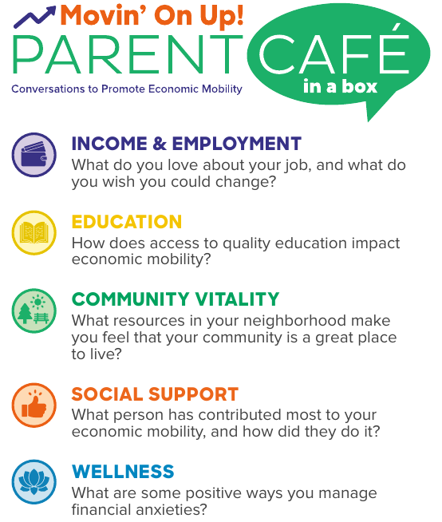
Movin’ On Up!: Turn Economic Mobility Into Conversation + Action
The Café is the Method: a peer-led reflective space that surfaces barriers, assets, resources and next steps for Economic Stability Wellbeing.
WHY THIS MATTERS FOR WORKFORCE RETENTION?
• What do you love about your job—and what would you change?
• What challenges affect getting or keeping a job?
• How do you navigate job frustrations to stay employed?
• What resources reduce financial anxiety or instability?
Train facilitators → Convene Workforce Economic Cafés → Identify Economic Barriers + Protective Factors → Track Data → Connect Resources → Inform Organizational Level & State System Responses → Promote INNOVATIVE Solutions w/ CQI
GEORGETOWN UNIVERSITY
Notes:
[Sources]
ECIN_2025Cards_Eng_D4 (5).pdf: 30-card Movin’ On Up! deck and workforce-relevant prompts.
ECIN Parent Cafe on Economic Mobility_Overview(1).pdf: Parent Café uses parent-led conversations to build community, share resources and navigate economic challenges.
ECIN Parent Cafe Economic Mobility(1).pdf: host training invitation.
[/Sources]

Slide 55
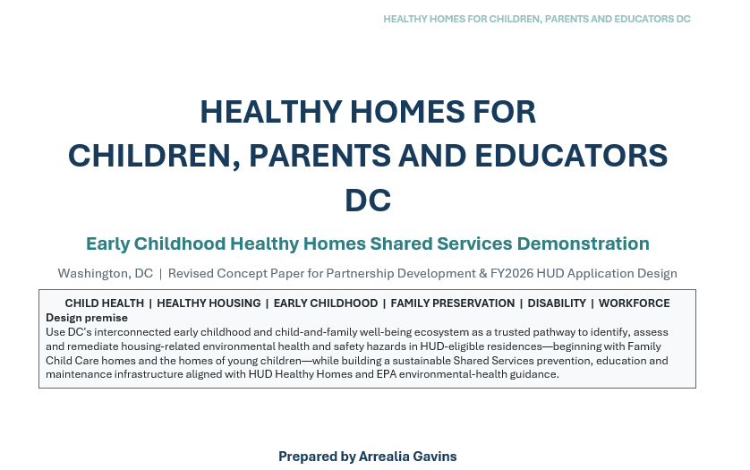
Economic Wellbeing Is Workforce Wellbeing 2
Movin’ On Up! From Economic Café Conversations to State System ACTION!
Compensation matters.
So does the cost of living.
Economic mobility strategies can increase resources AND reduce household costs.
Example: Healthy Homes / housing supports can improve community vitality and reduce household economic pressure
even when ECE professionals salaries does not change.
How are you supporting staff retention with the following?
housing • childcare • transportation • benefits navigation • education & career advancement • financial capability • community resources
ECIN Partnership: Economic Café Training • Facilitator TA • Economic Mobility System Strategies
• Innovative Thought Leadership • Resource Navigation Integration
Notes:
[Sources]
- ECIN Parent Cafe on Economic Mobility_Overview.pdf, five Economic Mobility Protective Factors.
- ECIN_2025Cards_Eng_D4 (5).pdf, Movin’ On Up! conversation prompts and economic mobility framework.
[/Sources]

Slide 56
What PROMISE Has Taught Us About Retention
Lessons learned that ECE/ EI / Part C / ECSE leaders can adapt in their own systems.
Organizational conditions, culturally responsive and inclusive supports matter. Integrating personal and professional supports strengthens retention.
1
Wellbeing cannot rest solely on the individual.
Relationships are workforce infrastructure.
Peer mentoring builds confidence, community belonging, leadership and social connection.
2
3
Educators have families too.
Family wellbeing and mental health needs of Educators do not stop at the workplace door. Flexibility and real-work application increase engagement and retention.
4
Economic wellbeing is mental wellbeing.
Pay equity is critical — and so is housing, transportation, benefits, health and other household pressures. Economic Wellbeing requires a BOTH/AND approach: Increasing wages & reducing cost.
Layer universal, peer/social, targeted and system supports. Build cross-sector system level partnerships to expand impact.
5
Retention requires a system, not one intervention.
“Sustainable change happens we address the WHOLE person, not just the work role…
Because when ECE WORKFORCE THRIVE, children and families THRIVE too!”
GEORGETOWN UNIVERSITY
Notes:
[Sources]
Synthesis of ECIN PROMISE implementation materials and ECTA requested focus on supportive work environments, job satisfaction, retention and replicable strategies.
[/Sources]

Slide 57



From PROMISE to Your System
Breakout reflection for ECE / Early Intervention / Part C / ECSE leaders.
STAFF WELLBEING
PEER SUPPORT + PATHWAYS
ECONOMIC WELLBEING
Where could TeacherWISE, mindfulness or organizational wellbeing supports fit?
How could IECFMH Community Mental Health Workers strengthen belonging and advancement?
What economic pressures affect retention—and which protective factors can your system influence?
Which PROMISE strategy could you adapt, test or scale in
your state, jurisdiction or community?
GEORGETOWN UNIVERSITY
Notes:
[Sources]
ECTA webinar request: breakout application to states, jurisdictions and communities.
[/Sources]

Slide 58
From PROMISE to Practice
What could this look like in your ECE / EI / ECSE system?
Workforce Need
PROMISE Strategy
ECIN Can Support
Educator stress & wellbeing
TeacherWISE
Training + implementation
Belonging & professional support
Peer Mentors as IECMH Community Mental Health Workers
Model design + TA
Family / mental-health needs
IECMH Community Mental Health Workers for Family Wellbeing
Workforce development + peer support
Economic stress
Economic Café
Training + economic mobility strategies
ECIN Provides Training • Technical Assistance • Consultation • Implementation Support
Retention isn’t one intervention. It is the result of building a system in which people are supported to stay.
Notes:
[Sources]
- User-provided presentation brief.
- ECTA invitation/email supplied earlier by user: breakout focused on replication/adaptation within states, jurisdictions and communities.
[/Sources]

Slide 59
Use the models to diagnose—not to copy.
THREE MODELS, THREE DIFFERENT RETENTION LEVERS
Illinois EITP
Connection + self-care space
Isolation, stress, need for reflection and community
Kansas KITS
Intentional onboarding + later follow-up
New-leader overwhelm, role complexity, just-in-time learning
Early Childhood Innovation Network (ECIN)
Layered workforce well-being + organizational culture
Stress, burnout, peer and leader support, organizational culture
Common design question: What pressure are we trying to reduce—and what condition are we trying to strengthen?
Notes:
Ted: TIME: 3 minutes
Synthesize without ranking the models. Each addresses a different mechanism. Ask participants to identify which lever is closest to the pressure they selected in the opening poll.

Slide 60
Choose one workplace condition that is important, actionable, and measurable.
USE THE SESSION 4 PLANNING PAGE TO TURN INSIGHT INTO A TEST
Apply the Learning to My Context
Strategy Fit Check
1. Why are people leaving or considering leaving?
• Potential benefit
• Fit / feasibility
2. Which workplace conditions are within our direct influence?
• Who benefits—and who may not
3. What supports do supervisors and program leaders need?
• Questions or concerns
4. How could retention and well-being be measured more consistently?
• Evidence needed before scaling
Notes:
Ted: TIME: 3 minutes
Ask participants to open the Session 4 page of the implementation planning tool. Give them a minute to choose a retention pressure and a candidate strategy. The breakout is not just Q&A; it should help them test fit and refine a next action.

Slide 61
Retention improves when systems reduce friction, strengthen relationships, and make sustainable practice possible.
FOUR IDEAS TO CARRY FORWARD
1
2
3
4
Start early
Support the whole person—and the work
Listen before people leave
Test one condition
Retention begins with role preview, orientation, and the first-year experience.
Pair self-care and relational supports with organizational change.
Use stay interviews, climate data, and practitioner voice alongside turnover metrics.
Choose a workplace practice you can strengthen, measure, learn from, and refine.
Notes:
Jani: TIME: 2 minutes
Rapidly reinforce the four takeaways. Remind participants that the planning tool asks them to select one workplace practice to strengthen, test, or scale.

Slide 62
Use these as starting points for continued retention planning.
RESOURCES & NEXT STEPS
Illinois Early Intervention Training Program
eitp.education.illinois.edu
Kansas Inservice Training System (KITS)
kskits.org
Early Childhood Innovation Network (ECIN)
ecin.org/innovations/promise
ECTA Recruitment & Retention Synthesis
ectacenter.org/topics/personnel/recruitment.asp
Participant Implementation Planning Tool
Session 4: Retaining the Workforce
Between sessions: review retention data • ask at least two practitioners what would make them more likely to stay • select one workplace practice to strengthen, test, or scale.
Notes:
Jani: TIME: 1 minute
Highlight the guest resources and the ECTA recruitment and retention synthesis. Reinforce the between-session commitments from the planning tool.

Slide 63
October 13, 2026 • 3:00–4:30 PM Eastern
SESSION 5 — SUSTAINING & ADVANCING THE WORKFORCE
Leadership • career advancement • professional learning • CSPD alignment • workforce data • long-term sustainability
Bring back your retention test: What did you learn from listening to practitioners or strengthening one workplace practice?
Thank you!
Notes:
Jani: TIME: 1 minute
Thank the guest presenters and breakout facilitators. Bridge to Session 5: retention is strengthened when people can see a future in the field and when systems align professional learning, advancement, data, and long-term workforce planning. Close with the required ECTA/OPSE acknowledgment as appropriate for the final production deck.

Slide 64
20-minute presenter-led conversations: go deeper on the model and translate it to your context.
BREAKOUT SESSIONS
ROOM A
ROOM B
ROOM C
Susan Connor
Misty Goosen
Arrealia Gavins
Illinois EITP Self-Care Café
Kansas KITS Coordinator Orientation
ECIN: Workforce PROMISE + Well-Being
Bring one local retention pressure + one question.
Bring one local retention pressure + one question.
Bring one local retention pressure + one question.
Notes:
Jani: TIME: 2 minutes before breakouts
Explain the three rooms and the purpose. Ask participants to choose the room that best matches the retention pressure they want to work on. Encourage them to use the planning-tool prompts during the conversation. Tech team opens rooms for a full 20 minutes and provides a 2-minute warning.

Slide 65
ECTA Acknowledgments slide
Notes:
Jani: Close with the required ECTA acknowledgement.
Thank participants for attending, acknowledge the ECTA Center and OSEP funding statement, and direct participants to ectacenter.org for additional resources.

