Slide 1

Strengthening Recruitment & Retention
in the EI/ECSE Workforce
SESSION 3 | Building Pathways
Facilitators:
Dr. Evandra Catherine, ECTA
Ted Burke, ECTA
Jani Kozlowski, ECTA
Guest presenters:
Randi Wolfe, ECEPTS
Kelly Kazeck, Minnesota GYO
Charles Anderson, ECIC
Katari Coleman,EDC
Grow Your Own, Apprenticeships & Alternative Pathways
September 9, 2026 • 2:30–4:00 PM Eastern
How do we turn interest in the field into an accessible route to preparation, qualification, employment, and growth?

Slide 2
Session 3 Agenda
SESSION 3 AGENDA
A 90-minute sequence from pathway fundamentals to guest models, breakouts, and action.
1
Bridge from Session 2
From attracting candidates to helping them enter and progress
2
Pathway fundamentals
Define the pathway, diagnose friction points, and identify who is missing
3
Guest models
GYO, apprenticeships, HBCUs, Indigenous/community-rooted models, related services
4
Data & access lens
Measure pathway health and identify barriers by group, role, and geography
5
Breakout sessions
Dive deeper into the models presented, and identify partners, barriers, and supports in your own context
6
Apply & commit
Use the planning tool to select one gap and one next action

Slide 3
Today’s learning objectives
LEARNING OBJECTIVES
By the end of Session 3, participants will be able to…
1 Diagnose pathway gaps
2 Distinguish pathway models
3 Broaden the pipeline
4 Map one next move
Identify where potential candidates enter, stall, or leave the route into EI/ECSE/ECE.
Describe how grow your own (GYO), apprenticeships, alternative routes, and institutes of higher education (IHE) partnerships address different barriers.
Apply pathway thinking to teachers, service coordinators, OT/PT/SLP, home visitors, and other roles.
Use data, partner input, and the planning tool to select one feasible pathway improvement.

Slide 4
The 5-session learning journey
SERIES ROADMAP
Session 3 strengthens the “prepare and enter” portion of the workforce strategy.
AUG 11
AUG 25
SEP 9
SEP 22
OCT 13
Landscape + ECTA resources
Compensation, incentives + public awareness
Grow Your Own + pathways
Supportive environments + professional learning
Leadership + action planning
Today: make the route into the field visible, affordable, supported, and connected to real jobs.

Slide 5
Attraction opens the door. Pathways help people get through it.
BRIDGE FROM SESSION 2
A compelling message is only useful when candidates can see—and complete—the route into the field.
ATTRACT
ENTER
PREPARE
QUALIFY
WORK + GROW
“This career is for me.”
“I know where to start.”
“I can afford and complete it.”
“I can meet the requirements.”
“There is a place and future for me.”
Quick reflection from Session 2
Think about the audience you tried to attract. What is the very next step they would have to take—and what could stop them?

Slide 6
Where does your pathway break most often?
INTERACTIVE PULSE CHECK
Awareness → first step
Entry → enrollment
People are interested but do not know how to begin.
Prerequisites, cost, admissions, or navigation block entry.
Preparation → completion
Credential → employment
Time, practicum, transportation, child care, or academic supports derail progress.
Licensure, certification, hiring, or role requirements create a gap.
Employment → advancement
People enter but cannot see a sustainable career pathway.
Use the result as your “pathway problem statement” for the rest of the session.

Slide 7
Make the route visible. Remove friction. Support completion. Connect preparation to real jobs.
SESSION 3 | BUILDING PATHWAYS
1. Pathway Design Fundamentals

Slide 8
What do we mean by a “career pathway”?
PATHWAY FUNDAMENTALS
A connected sequence of entry points, preparation experiences, qualifications, employment, and advancement—with supports at the transitions.
1
2
3
4
5
6
AWARENESS
ENTRY
PREPARATION
QUALIFICATION
EMPLOYMENT
ADVANCEMENT
See the role and its value
Know where to start
Build knowledge + skills
Earn required credential/license
Enter a supported role
Grow, specialize, lead
Pathway test
Can a prospective candidate see the next step, understand the requirements, afford the transition, get support, and see where the pathway leads?

Slide 9
GYO is a pathway strategy—not just a recruitment campaign.
GROW YOUR OWN
ECTA describes GYO programs as local partnerships that recruit candidates to earn degrees and licenses while reducing barriers and helping people remain in their communities.
Recruit locally
Remove barriers
Prepare with partners
Start with people already connected to children, families, schools, programs, and communities.
Address tuition, time, travel, practicum, admissions, testing, and navigation.
Connect agencies/employers with IHEs, EPPs, mentors, and community organizations.
Support completion
Connect to jobs
Use cohorts, coaching, paid time, advising, and milestone supports—not only entry incentives.
Make placement, hiring, and service commitments visible from the beginning.
Source: ECTA, Recruitment and Retention of Personnel Serving Young Children with Disabilities: Grow Your Own Programs.

Slide 10
Different candidates need different entry points
PATHWAY DESIGN
A strong system has multiple doors into the field rather than one “ideal” route.
1
2
3
4
High school / youth
Incumbent workforce
Career changers
Community-rooted candidates
Career exploration, dual credit, clinical experiences, pre-educator pathways
Paraprofessionals, child care staff, service coordinators, aides, home visitors
Prior degree or experience; accelerated or alternative routes; credit for prior learning
Local residents, bilingual candidates, family leaders, cultural/community organizations

Slide 11
Access is built through supports around the pathway
PATHWAY SUPPORTS
The pathway can be technically “open” and still be practically inaccessible.
Money
Time
Navigation
Scholarships, tuition, fees, stipends, paid practicum, wage replacement
Flexible schedules, release time, part-time routes, accelerated options
Advising, credential mapping, application help, one point of contact
Belonging
Logistics
Academic + clinical
Cohorts, mentoring, culturally responsive supports, peer networks
Child care, transportation, technology, housing, rural/remote access
Tutoring, prerequisite supports, supervision, high-quality field experiences
Design principle: identify the barrier first; fund the support that changes the barrier.

Slide 12
Match the pathway response to the friction point
STRATEGY FIT
Do not start with the program you want to build. Start with the transition that is failing.
Observed pathway problem
Likely response(s) to test
Interested candidates do not know where to start
Pathway map + navigator + clear entry requirements
Current staff cannot afford preparation
Scholarship + paid release/practicum + employer commitment
Students drop out during preparation
Cohort/mentoring + advising + logistics + academic support
Qualified graduates do not enter EI/ECSE
EI/ECSE-specific experiences + hiring partnerships + service commitments
Workforce does not reflect communities served
Community-rooted recruitment + accessible admissions + responsive supports
Hard-to-fill related-service roles remain vacant
IHE partnership + specialty preparation + scholarships + local clinical experiences

Slide 13
Strategies from the database in action
SESSION 3 | BUILDING PATHWAYS
A quick look at alternative and multidisciplinary strategies

Slide 14
Alternative does not mean lower standard—it means a different route to the standard
ALTERNATIVE PATHWAYS
Alternative routes are useful when candidates bring relevant experience or prior education but the traditional sequence creates unnecessary delay or duplication.
Keep the standard clear
Recognize what candidates bring
Define the competencies, credential, or license that still must be achieved.
Use prior learning, experience, credentials, or related degrees where policy allows.
Provide structured supports
Make the route understandable
Mentoring, coursework, supervision, and checkpoints protect quality while accelerating entry.
Candidates and employers should know what is provisional, what is required next, and by when.
ECTA example: Oklahoma’s special education “Boot Camp” pairs provisional certification with continued coursework toward a master’s degree.
Source: ECTA Grow Your Own Programs one-page overview.

Slide 15
EI-focused occupational therapist (OT) and physical therapist (PT) preparation
Multidisciplinary
A personnel-preparation partnership can target a specific shortage by embedding EI content and financial support inside professional preparation.
Doctoral PT personnel preparation
OT Doctoral personnel preparation
Hawaii Pacific University (HPU) received a five-year OSEP Personnel Preparation grant designed to strengthen the early childhood intervention physical therapy workforce in Hawaiʻi by preparing DPT scholars for EI practice with young children and families.
HPU stood up a parallel OSEP-supported effort for occupational therapy, including EI/preschool preparation and support to address workforce shortages serving young children with disabilities.
Transferable lesson: do not wait for graduates to “discover” EI/ECSE after licensure. Build EI/ECSE exposure, competencies, field experiences, and service connections into preparation.
Source: Hawaiʻi Pacific University, Department of Education Personnel Preparation Grants (accessed Aug. 2026).

Slide 16
2. Models in Action
SESSION 3 | BUILDING PATHWAYS
Four pathway architectures. Four different levers. What can your system adapt?

Slide 17

Grow Your Own Early Childhood & Family Educator Grant
Kelly Kazeck | Early Childhood Workforce Collaboration Specialist
Supporting the Early Childhood Workforce

Slide 18

WHY Early Childhood GYO?
Early childhood and family educator teacher shortage across the field
High-quality early childhood programs rely on employing educators who meet the specific knowledge and competencies needed for working with young children
Some regions of the state are experiencing a severe lack of early childhood program access, where parents are unable to find any care/education programs for their children in an area near their homes or workplaces
Rising costs for tuition, training, and professional development can be a barrier to a workforce that is often undercompensated

Slide 19

Background
Began as a pilot program funded through Preschool Development Grant informed by the general preK-12 GYO Grant started in MN in 2016-2017 and administered by the Department, focused on diversifying the workforce in Minnesota of Education. (Licensure only)
The GYO EC&FE Grant program was put into legislation in 2023 and began in FY24/25. Focused on diversifying the workforce, flexible entry points, and wrap around supports.
Minnesota Statutes Sec. 142D.33
First two rounds had approximately $2,325,000 to award per round.
Current round (third), estimates awarding: $344,000.00

Slide 20

What is a Grow Your Own program?
Grow Your Own programs:
are partnerships between early educator preparation/professional development programs, early care and education programs, and community organizations
recruit and prepare local community members (e.g. parents, classroom assistants, and high school students) to enter and/or advance in the early education profession and provide early care and education services in their communities

Slide 21

How do GYO Programs Work?
Grantees recruit individuals from their programs, communities, and schools they feel would be a good candidate for the Grow Your Own program.
The grantees provide support services to candidates to assist them with:
  Completing identified training, courses, and degrees needed to meet program qualifications enabling them to enter or advance in the program.
  Costs of attendance through providing stipends, scholarships, and unique student teaching or field placement experiences.

Slide 22

Eligibility for Early Childhood and Family Education GYO
Eligible applicants include:
Minnesota-licensed family child care or licensed center-based child care programs
School district or charter schools, including Early Childhood Special Education, Early Childhood Family Education, School Readiness, Voluntary PreK, and Career and Technical Education programs
Head Start programs, including Tribal Head Start and Early Head Start
Institutions of higher education
Community partnership nongovernmental organizations

Slide 23

EXAMPLES
Provide scholarships or stipends to participants pursuing early childhood degrees and credentials for example:
a Birth to Third Grade teacher license
Early Childhood Special Education teacher license
Parent Education teacher license
A bachelor’s degree in early childhood education
An associate’s degree in early childhood education or child development
A Child Development Associate (CDA) or other early childhood credential
Montessori Credential
Training required for entry level positions
Providing programming and mentorship support for teacher candidates to help them be successful in the licensure program, degree program, or the credential program.

Slide 24

Current Grantees
24 grantees: more than 200 individuals supported
  Child Care Centers, Head Start Programs, School Districts, Institutes of Higher Education and Training Programs, Community-Based Training Programs including tribal and multilingual
Includes individuals working on various degrees and training including but not limited to:
  Montessori Credentials (including Spanish)
  Child Development Associate Credentials
  AA/AS degrees in Early Childhood/Child Development
  BA/BS+ degrees in Family and Parent Education and Early Childhood Special Education

Slide 25

Removing Barriers
One of the defining features of the GYO program is its holistic approach to support. Participants receive assistance not only with tuition but also with:
Technology and laptops
Books and learning materials
Transportation
Dedicated study time
Language and translation support
These supports proved especially impactful for multilingual participants—representing more than 15 languages—who are already strengthening cultural and linguistic representation in Minnesota’s early childhood settings.

Slide 26

Innovative Language and Instructional Supports
In response to participant feedback, Minneapolis Community and Technical College (MCTC) made notable advancements in linguistic accessibility. MCTC began offering language supports, hired bilingual faculty, and provided textbooks in Spanish. When students expressed a desire to take courses fully in Spanish, faculty advocated for—and achieved—changes in instructional languages offered, making Spanish-delivered coursework available.
GYO funding also empowered one child care center to recruit a Spanish-speaking Association Montessori Internationale (AMI) trainer from out of state, removing a major barrier for staff pursuing Montessori credentials.

Slide 27

Ripple Effects
A Ripple Effect of Mentorship and Community Leadership
Beyond the 200+ direct participants, the program’s impact extends through mentor relationships within early childhood programs.
Seasoned educators supported new learners, creating a ripple effect of shared knowledge, confidence, and professional growth across multiple program sites.

Slide 28
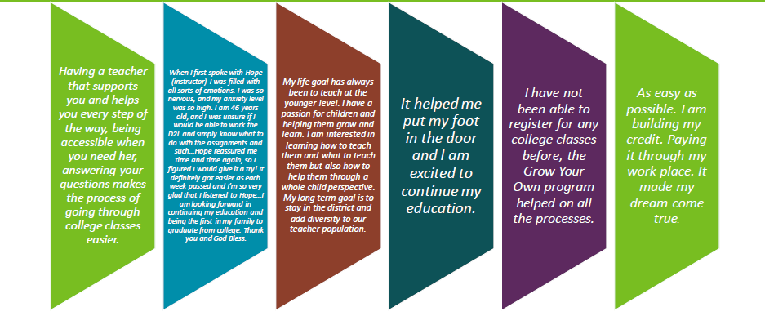
Participant Feedback

Slide 29

GYO EC&FE Grantee Toolkit
The Early Care and Education System is complex and difficult to navigate.
We are developing a toolkit to:
Support grantees to easily find resources to support preservice early care and education professionals.
Streamline access to essential information and resources making it easier for organizations to recruit, train and guide participants towards careers as early educators.
Develop a web-based toolkit to ensure grantees have access to the tools and resources needed to successfully implement their programs – can benefit others in the state as well.

Slide 30
More Information
Grow Your Own Early Childhood and Family Educator Grant (Department of Children, Youth, and Families) Links to MN GYO resourcesGrow Your Own (MN Department of Education)
Special Education Teacher Pathway Program (MN Department of Education)
SPED Teacher Pathway Program
Careers in the Early Childhood Workforce ((Department of Children, Youth, and Families)
  Stories from the field: An Early Childhood Special Education Teacher
Teach Special Education Minnesota – Explore, Become, Grow and Thrive.

Slide 31
Thank You!
Kelly Kazeck
Kelly.kazeck@state.mn.us
651-539-7724

Slide 32

Early Care & Education Pathways to Success (ECEPTS) Apprenticeship Programs
ECEPTS | SCALE + INFRASTRUCTURE
.
Source: ECEPTS Apprenticeships and Field Building pages (accessed Aug. 2026).

Slide 33

Delaware Early Childhood Innovation Center (ECIC)
DELAWARE ECIC | PATHWAY SUPPORTS

Slide 34
Building the Pathway
STRENGTHENING RECRUITMENT & RETENTION IN EI/ECSE
The Delaware ECIC Model
Increasing access • Removing barriers • Supporting advancement
Charley Anderson | Career Development Coordinator
ECTA National Webinar
September 9, 2026
Delaware Early Childhood Innovation Center
Delaware State University • An HBCU

Slide 35
Opportunity does not automatically create access
THE WORKFORCE CHALLENGE
College
Scholarships
Credentials
THE
EDUCATOR
State Requirements
Employers
Professional Development
Career Options
The challenge is not only creating opportunities. It is helping people find, navigate, complete, and build upon them.
DELAWARE EARLY CHILDHOOD INNOVATION CENTER • DELAWARE STATE UNIVERSITY
02

Slide 36
ECIC connects the pieces around the educator
DELAWARE'S RESPONSE
Scholarships &
financial supports
Career development
& advisement
ECIC
PATHWAY HUB
CDA & credential
pathways
Higher education, state
& workforce partnerships
A statewide workforce initiative housed at Delaware State University, an HBCU
ECIC IMPACT AT A GLANCE
691
Credentials / degrees earned
$2.95M
Tuition & financial supports
174
Current Fall 2026 degree scholars
DELAWARE EARLY CHILDHOOD INNOVATION CENTER • DELAWARE STATE UNIVERSITY
03

Slide 37
A usable pathway shows people what comes next
A PATHWAY, NOT A PROGRAM
1
2
3
4
5
EXPLORE
ENTER
CREDENTIAL
EDUCATE
ADVANCE
Understand roles
and possibilities
Find an accessible
starting point
Earn a CDA or
required credential
Pursue AA / BA
coursework
Connect learning
to career goals
CAREER ADVISEMENT MAKES THE PATHWAY USABLE
INQUIRE → INFORM → INTEGRATE
EDUCATION • EXPERIENCE • EXPOSURE
DELAWARE EARLY CHILDHOOD INNOVATION CENTER • DELAWARE STATE UNIVERSITY
04

Slide 38
Barrier removal must be built into the pathway
ACCESS BY DESIGN
COST
Scholarships and financial supports
COMPLEXITY
Individualized advisement and navigation
ACCESS
Multiple credential and education pathways
DISCONNECTED SYSTEMS
State, higher education, and workforce partnerships
“I don’t know where to start.” → A human connection
DELAWARE EARLY CHILDHOOD INNOVATION CENTER • DELAWARE STATE UNIVERSITY
05

Slide 39
Career pathways are created by connecting people to possibilities
A TRANSFERABLE SET OF QUESTIONS
1
Do people know where to enter your system?
2
Can they afford to move through it?
3
Is someone helping them navigate it?
4
Can they see where the pathway leads?
EXPLORE → ENTER → CREDENTIAL → EDUCATE → ADVANCE
Charley Anderson • Delaware Early Childhood Innovation Center
06

Slide 40

Preparing Indigenous Teachers for Arizona Schools (PITAS) presentation
MODEL IN ACTION
Transferable lesson: pair full financial support with local, work-compatible delivery so candidates never have to choose between preparation and their community.

Slide 41
Preparing Indigenous Teachers for Arizona Schools (PITAS)
Angelina E. Castagno, PhD
Professor & Chair, Educational Leadership
Northern Arizona University
Strengthening Recruitment & Retention in the EI/ECSE Workforce
Early Childhood Technical Assistance Center
September 9, 2026

Slide 42
Who, What, How
Who?
Tribal leaders said there was a need.
What?
Current system wasn’t addressing the need.
Stay home & keep working. Relevance and representation. Structures for success.
How?
Relationships.
Responsibility to listen, learn, lead. Resources are necessary but not sufficient.
Data confirmed the need.

Slide 43
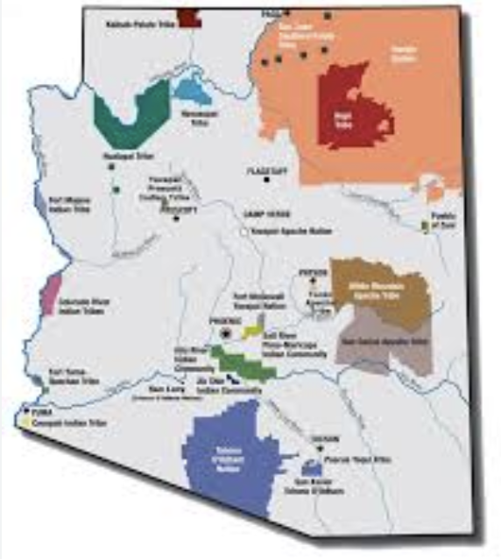
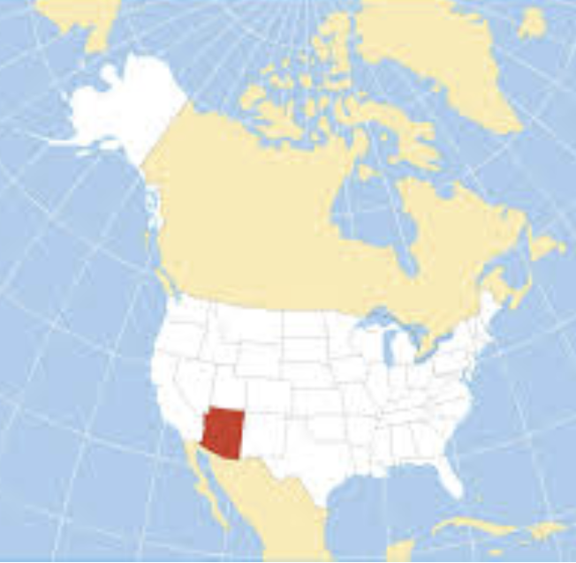
AZ Context
22 federally recognized tribes in Arizona.
27% of Arizona is currently designated tribal land.
Roughly 7% of AZ students identify as Native, but only 2% of AZ teachers are Native.

Slide 44
Barriers and Strategies
Barriers to the Recruitment of Indigenous People into Teaching Positions | Strategy/Approach that Addresses the Issue
Lack of programs that don’t require individuals to leave their jobs and/or home communities | Online program with synchronous video course meetings that follow a consistent 2-day-per week, evening schedule.
Lack of financial support | Full tuition costs are covered. Financial assistance in the form of a $500 stipend each semester in the program Laptop provided. Textbooks and course materials provided.
Absence of culturally responsive coursework that is relevant and meaningful to students’ lived experiences and community issues | Culturally responsive course material that is relevant to teaching in Native communities. Intentional recruitment of faculty who understand and center racially- and linguistically-diverse knowledges, histories, peoples, and issues.
Inflexible policies and practices that don’t accommodate unique student experiences | Dedicated PITAS Anchor Faculty member who teaches one course per semester to each cohort and who provides regular mentoring and wrap-around support. Dedicated PITAS Program Coordinator who knows the students well and advocates for flexibility and/or accommodations when needed. Go-to advocates in key university offices/units.
Lack of a sense of belonging in higher education | Intentionally-designed cohort of peers with similar lived experiences. Once-per-semester in person gatherings on a weekend. Summer 2-week residency at NAU. Learning from former PITAS graduates about their experiences. Intentional, consistent messaging about value, expertise, and community.

Slide 45
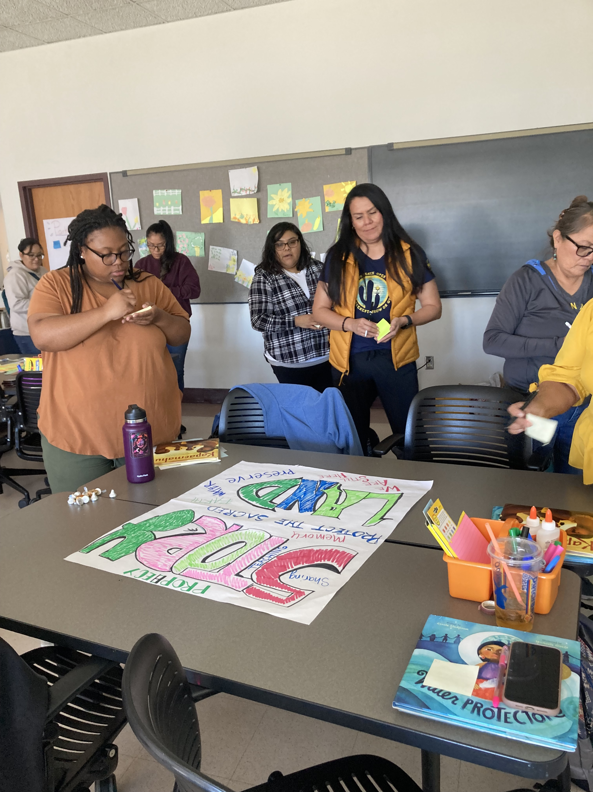
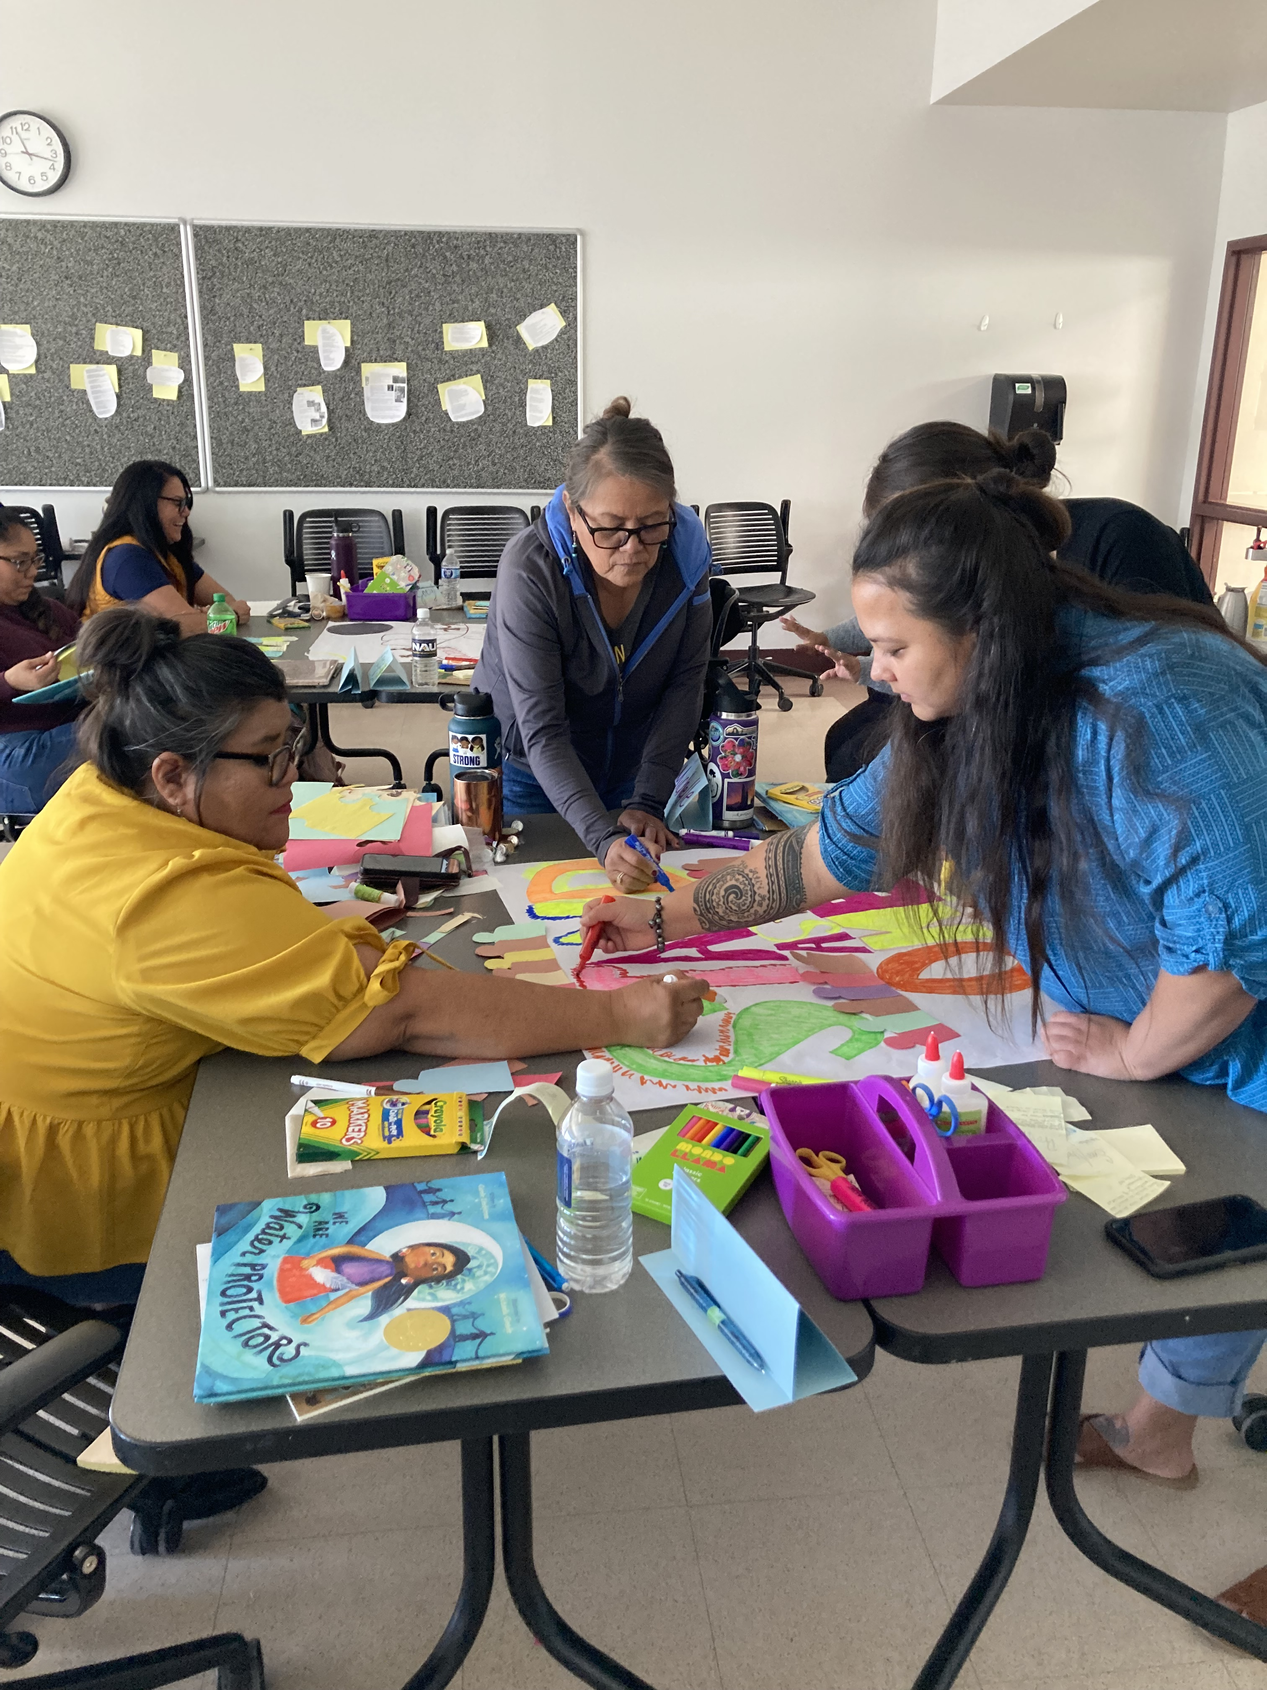
Cultural responsiveness is our design principle.
Both / and is often how we get there.
Practicum: Both local school experience and summer Flagstaff experience
Coursework: Both Indigenous-centered and state-standards-aligned
Format: Both online and in person

Slide 46
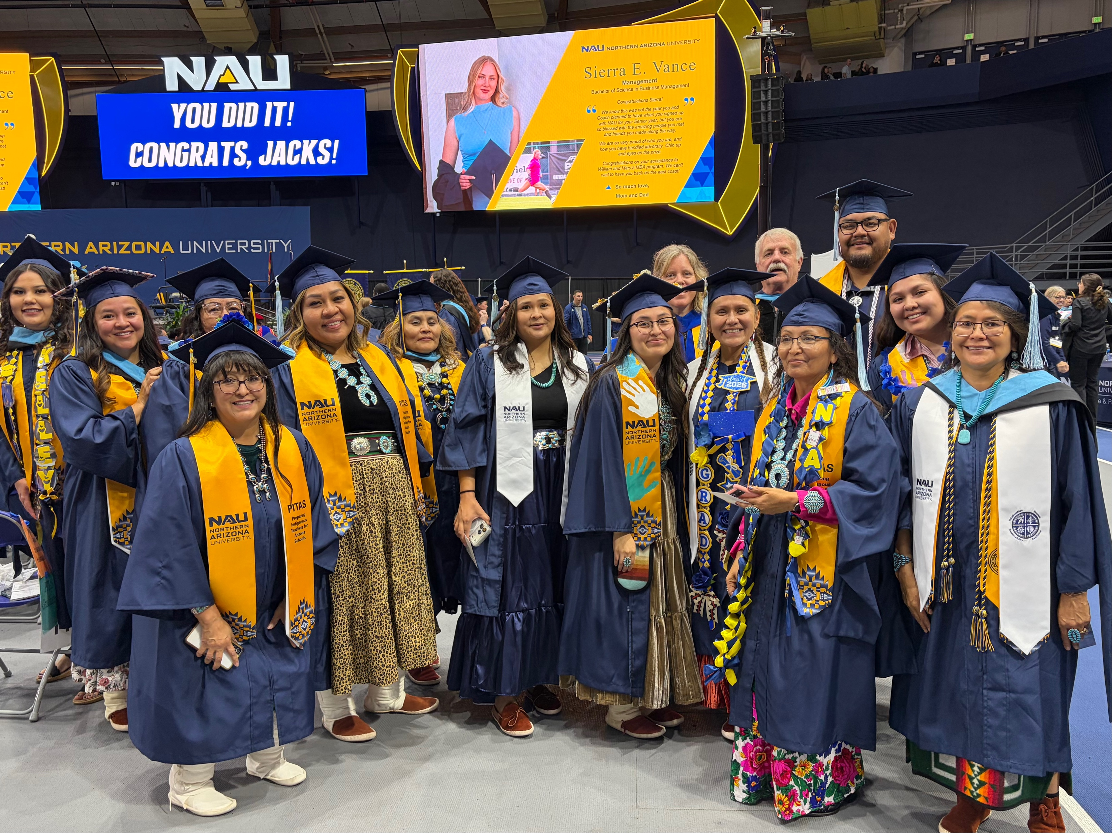
Trajectory of PITAS Graduates
2022 cohort
19 graduates in May 2024
2023 cohort
9 graduates in May 2025
2024 cohort
17 graduates in May 2026
2025 cohort
14 scholars on track to graduate in May 2027
2026 cohort
36 scholars just started PITAS and will graduate in May 2028

Slide 47
PITAS Program Interest by Year

Slide 48
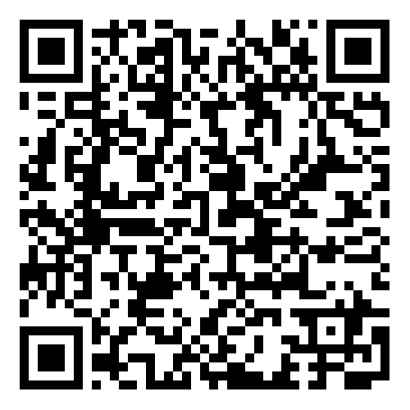
Scan for
CRAIS Tool
“Our guiding thesis…is that truly culturally responsive learning for Indigenous youth is a highly complex endeavor that requires systemic change within and across a number of levels in our schooling system…[M]ore explicit and sustained attention must be paid to tribal sovereignty and self-determination, the racism experienced by Indigenous youth, and Indigenous epistemologies if educators and scholars hope to move away from the essentializations, generalizations, and easy anecdotes that seem to derive from much of the literature and instead move toward engaging in genuinely culturally responsive learning for Indigenous youth”
(Castagno & Brayboy, 2008, p.943).

Slide 49
3. Data, Access & Partnership Architecture
SESSION 3 | BUILDING PATHWAYS
A pathway is only strong if people can move through it—and the system can see where they are getting stuck.

Slide 50
Measure the health of the pathway—not just the size of the workforce
PATHWAY DATA
Track movement between stages so you can see where candidates are lost, delayed, or excluded.
AWARENESS
ENTRY
PREPARATION
QUALIFICATION
EMPLOYMENT
ADVANCEMENT
Inquiry sources
Career-event reach
Applicant demographics
Applications
Eligibility/admission
Conversion to enrollment
Persistence
Credits/milestones
Practicum completion
Credential/license pass
Time to completion
Provisional → full
Placement in EI/ECSE
Time to hire
Geography/role
1/3/5-year retention
Credential growth
Leadership movement
Disaggregate by role, geography, language, entry route, and other locally relevant characteristics whenever feasible and appropriate.

Slide 51
At each transition, ask: who can move forward—and who cannot?
ACCESS LENS
Equity is a pathway-design question because barriers accumulate across multiple transitions.
Requirements
Cost
Time
Are prerequisites and admissions rules necessary, transparent, and consistently applied?
What must candidates pay before support arrives? Who can absorb that cost?
Can working adults complete the route without leaving the workforce?
Place
Community
Access and support
Does geography create travel, housing, broadband, or clinical-placement barriers?
Are advising, coursework, mentoring, and recruitment responsive to the communities served?
Do candidates see people like themselves, have mentors, and know where to seek help?

Slide 52
No single agency owns the whole pathway
PARTNERSHIP ARCHITECTURE
Pathways work when partners are explicit about the transition each one can influence.
State agencies
IHEs
Community partners
Standards • funding • data • policy
Preparation • advising • fieldwork
Trust • outreach • navigation • place-based supports
SHARED PATHWAY
GOAL
Employers / programs
Workforce boards / funders
Recruitment • paid work • mentoring • hiring
Training funds • scholarships • sustainability

Slide 53
Use the Session 3 page to turn the map into a decision
IMPLEMENTATION PLANNING TOOL
Use the breakout insight to identify where candidates stall or leave, what barrier is most actionable, and which partner could help close the gap.
Apply the learning to my context
Strategy Fit Check
Where do potential candidates enter, stall, or leave?
Which communities or groups are underrepresented?
What preparation, credential, licensure, tuition, practicum, or navigation barriers exist?
Which partner could help close a pathway gap?
Compare candidate strategies by:
Potential benefit
Fit / feasibility
Who gains access—and who may not
Questions or concerns
Evidence needed before scaling
Participant Implementation Planning Tool — Session 3: Building the Pathways.

Slide 54
Make one pathway test before Session 4
BETWEEN SESSIONS
Small tests build the evidence and partnerships needed for larger change.
1
2
3
Sketch
Validate
Act
Sketch the current career pathway from awareness to entry and advancement.
Review the map with a practitioner, student, candidate, or preparation partner.
Identify one gap that can be addressed through a partnership or policy change.
Bring the result back on September 22: What did you learn about the pathway—and how does it affect retention?

Slide 55
Four ideas to carry forward
KEY TAKEAWAYS
Pathways are infrastructure for recruitment, preparation, access, and long-term workforce stability.
1 Map the transitions
2 Design around the barrier
3 Broaden the partners
4 Measure movement
The pathway is a sequence of handoffs—not a program list.
Money, time, geography, requirements, and navigation require different solutions.
IHEs, community organizations, employers, and agencies each influence different transitions.
Track who enters, progresses, completes, qualifies, gets hired, and advances.
No one-size-fits-all pathway. The goal is a route that fits the workforce, community, standards, and context
you actually have.

Slide 56
Resources to continue pathway planning
RESOURCES
Use these resources as starting points for adaptation—not templates to copy without local data and partner input.
ECTA Recruitment & Retention Synthesis — Grow Your Own
https://ectacenter.org/topics/personnel/recruitment.asp
ECTA State Recruitment & Retention Strategies Search
https://ectacenter.org/topics/personnel/strategies-search.asp
ECEPTS Apprenticeships
https://ecepts.org/apprenticeships/
Delaware Early Childhood Innovation Center
https://ecic.desu.edu/
Preparing Indigenous Teachers for Arizona Schools (PITAS)
https://in.nau.edu/college-education/pitas/
Hawaiʻi Pacific University — OSEP Personnel Preparation Grants
https://www.hpu.edu/gchs/personnel-preparation-grants.html
DREAM Center — Personnel Preparation Support
https://dreamtacenter.org/

Slide 57
Session 4 — Retaining the Workforce
NEXT SESSION
September 22, 2026 • 3:00–4:30 PM Eastern
Supportive Work Environments & Well-Being
Leadership support • workload • reflective supervision • mental health and well-being • retention data
Bring back your pathway test: What did you learn by mapping and validating the route into your workforce?
Thank you!

Slide 58

Small groups join a presenter for a more in-depth Q&A and discussion on the shared strategy.
BREAKOUT SESSION
20-minute breakout with the presenters
Breakout rooms: 20 minutes • Presenters rotate as facilitators
37

Slide 59
ECTA Acknowledgments slide

