Slide 1

Compensation, Incentives, Public Awareness & Accessibility
Strengthening Recruitment & Retention
in the EI/ECSE Workforce
Facilitators:
Ted Burke, ECTA
Jani Kozlowski, ECTA
Presenters:
Katari Coleman, EDC
Rowena Kamo, University of Hawaii
Benny Delgado, Illinois EI System
Allison Miller, Early Years
Edith Locke, Early Years
Peggy Kemp, DEC
SESSION 2 | Attracting the Workforce
August 25, 2026 • 3:00–4:30 PM Eastern
What makes people choose—and stay connected to—our field?
1
Notes:
TIME: 2 minutes
Welcome participants to Session 2. Connect today’s focus to the series arc: Session 1 established the workforce landscape and introduced the ECTA resources; today shifts to the “attract” side of the workforce equation. Emphasize that attraction is not one strategy—it is the interaction of compensation, incentives, public image, and equitable access to opportunity. Preview the guest voices from Hawaiʻi, Illinois, DEC, and T.E.A.C.H./WAGE$.

Slide 2
Session 2 Agenda
SESSION 2 AGENDA
A 90-minute sequence from evidence to examples to application.
1
Bridge from Session 1
Feedback, pulse check, and the priority challenge participants brought forward.
2
Financial levers
Salary/rate increases, stipends, loan forgiveness, housing and relocation supports.
3
Public awareness
Branding, storytelling, and career campaigns
4
Access lens
Recruitment strategies that remove barriers, reach and support all populations.
National Home Visiting Workforce, Hawaii cross-sector policy work, Illinois EI, T.E.A.C.H./Child Care WAGE$, and DEC’s “Be Part of EI” effort.
5
State & national examples
6
Apply & commit
Use the planning tool to identify one attraction strategy and one next action.
2
Notes:
TIME: 2 minutes
Orient participants to the flow. Note that guest segments are intentionally embedded in the content rather than saved for one panel at the end. Invite participants to listen for two things throughout: (1) what problem each strategy was designed to solve and (2) what evidence or partnerships made implementation possible.

Slide 3
Today’s learning objectives
LEARNING OBJECTIVES
By the end of Session 2, participants will be able to…
1 Differentiate financial levers
2 Analyze real-world examples
3 Apply an access lens
4 Move from message to action
Explain how salary/rate increases, stipends, debt supports, and housing supports address different recruitment barriers.
Identify design choices and implementation lessons from Hawaii, Illinois, T.E.A.C.H./WAGE$, and DEC.
Assess who can access a recruitment strategy—and who may be unintentionally excluded.
Draft a recruitment message and identify one feasible strategy to test in their own context.
3
Notes:
TIME: 2 minutes
Read these as outcomes, not an agenda. Reinforce that participants do not need to leave with four new initiatives. The aim is to improve strategy fit—matching the lever to the actual barrier, using data, and considering who benefits.

Slide 4
The 5-session learning journey
SERIES ROADMAP
Session 2 deepens the “Attract” portion of the workforce strategy.
AUG 11
AUG 25
SEP 9
SEP 22
OCT 13
Landscape + ECTA resources
Compensation, incentives + public awareness
Grow Your Own + pathways
Supportive environments + professional learning
Leadership + action planning
Across all sessions: state examples + interaction + data use + an evolving implementation plan
Today: attract people into the field by improving the offer, reducing barriers, and communicating a compelling value proposition.
4
Notes:
TIME: 1 minute
Locate Session 2 in the series. Remind participants that compensation and awareness are linked to future sessions on pathways and retention. A compelling campaign cannot compensate for an inaccessible pathway or an unsustainable job.

Slide 5
From “What is the problem?” to “What can we change?”
BRIDGE FROM SESSION 1
Session 1 established a systems view; Session 2 begins selecting levers.
Session 1 | Define the challenge
Between sessions | Bring evidence
Session 2 | Test attraction levers
Vacancies, turnover, pathway gaps, workload, compensation, access, data.
One data point + one partner perspective + one strategy/resource to explore.
Match financial and awareness strategies to root causes and target audiences.
Chat prompt: What is one workforce challenge you are carrying into today’s session?
5
Notes:
TIME: 3 minutes
Invite one-sentence responses in chat. Acknowledge patterns without trying to solve them yet. If time allows, name 2–3 clusters—for example, “I’m seeing compensation, hard-to-fill disciplines, and public understanding.” This creates a live bridge to the content. Avoid describing this as formal Session 1 evaluation data unless you actually have evaluation results to insert.

Slide 6
What we heard in the Session 1 chat
SESSION 1 FEEDBACK
Participants reinforced a broad, systems-oriented view of the workforce.
The workforce is cross-system
Workforce pathways are fragile
Participants named teachers, service coordinators, therapists, home visitors, child care providers, medical professionals, paraprofessionals, and others who support young children and families.
Participants expressed concern about declining personnel preparation programs and fewer people entering credentialed professions.
State examples reduce isolation
The challenge is local—and systemic
Comments such as “We aren’t alone!” reflected strong interest in learning how peers are addressing similar recruitment and retention challenges.
Participants connected local shortages to broader issues in compensation, preparation, data, financing, and cross-sector coordination.
“Everyone that interacts with young children birth–five…”
Source: Session 1 Zoom chat, August 11, 2026. Qualitative themes; not a formal evaluation.
6
Notes:
TIME: 3 minutes
Share these as qualitative themes from the Session 1 chat, not as representative survey findings. Emphasize the breadth of participants’ workforce definition and the concern about preparation pipelines. The strongest through-line was that local problems are rooted in system conditions—and that participants value hearing how other states are responding. Use the closing quote to reinforce the intentionally broad workforce lens for this series.

Slide 7
What participants want to carry forward
SESSION 1 FEEDBACK
The chat pointed toward practical tools, adaptable strategies, and better evidence for decisions.
TOOLS
FIT
DATA
FINANCING
Searchable state strategies and implementation resources were repeatedly named as useful.
Participants emphasized that solutions must be adapted to local context.
Workforce data was seen as essential for understanding and acting on shortages.
Participants are thinking about how funding conditions affect recruitment and retention.
“The databank of the projects other states are working on. So helpful!”
“No one-size-fits-all solutions.”
“Local issue, yet systemic… affirms the efforts in our state to collect workforce data.”
A closing question asked how federal funding concerns are affecting R&R.
Session 2 responds by testing financial levers, public awareness strategies, and access
through real state and national examples.
Source: Session 1 Zoom chat, August 11, 2026. Qualitative themes; not a formal evaluation.
7
Notes:
TIME: 3 minutes
Connect the feedback directly to today’s design. Participants said they value practical tools, state examples, and strategies they can adapt rather than copy. They also affirmed the importance of workforce data and raised financing concerns. Preview that Session 2 will respond to those needs through Home Visiting Workforce, Hawaii and Illinois compensation examples, T.E.A.C.H./WAGE$ supports, DEC’s public-awareness work, and an equity screen participants can apply to any strategy.

Slide 8
Which attraction barrier is most urgent in your system right now?
INTERACTIVE PULSE CHECK
Compensation
Up-front cost
Pay or reimbursement is not competitive
Tuition, licensure, testing, or entry costs deter candidates
Cost of living
Awareness
Housing, transportation, or relocation makes jobs infeasible
Potential candidates do not know the field or understand the impact
Access & belonging
Other
Recruitment channels do not reach or support all candidates
A barrier we have not named
Use the poll result as your “problem statement” for the rest of the session.
8
Notes:
TIME: 4 minutes
Launch a Zoom poll or ask participants to enter the top 2 or 3? in chat. Debrief quickly: Which barrier rose to the top? Which are closely connected? Point out that each barrier suggests a different lever. This is the organizing logic for the next section.

Slide 9
Four financial levers target four different barriers
FINANCIAL LEVERS
Start by naming the mechanism you need to change.
Salary / rate increases
Stipends / bonuses
Loan forgiveness / debt support
Housing & relocation supports
Make ongoing compensation more competitive
Best when the core problem is sustained earnings
Reduce up-front costs or reward entry/milestones
Best when a one-time cost blocks participation
Lower the burden of preparation-related debt
Best for credentialed professions with substantial education costs
Reduce place-based cost barriers
Best in high-cost, rural, remote, or shortage regions
10
Notes:
TIME: 3 minutes
Walk left to right. Emphasize that these are not interchangeable. A $1,000 hiring bonus may help with an immediate hurdle but will not solve a chronic wage gap. Similarly, a salary increase may not address a rural housing shortage. Strategy fit begins with the mechanism.

Slide 10
Choose the lever by the barrier—not by what is easiest to fund
STRATEGY FIT
Observed pattern
Likely lever(s) to test
People apply but decline offers
Compare total compensation and cost-of-living; consider salary/rate + housing/relocation
Candidates cannot afford preparation
Stipends, scholarships, paid practicum, tuition support, loan/debt strategies
High-need providers leave for other sectors
Rate/salary increases plus workload and professional supports
Qualified candidates do not see EI/ECSE as a career option
Public awareness + targeted outreach + clear pathway + realistic compensation
Recruitment does not reflect communities served
Redesign channels, supports, eligibility, and selection criteria with a variety of data
11
Notes:
TIME: 3 minutes
Use this as a decision table. Encourage participants to distinguish symptoms from causes. For example, “few applicants” can reflect low pay, poor awareness, cumbersome entry requirements, geography, or all four. The intervention should be designed after that diagnosis.

Slide 11
Salary and reimbursement increases
FINANCIAL LEVER 1
The strongest direct lever when earnings are the barrier.
What it changes
Design questions
Evidence to monitor
Improves the recurring value of the job or service.
Can reduce the gap with competing sectors and make entry or continued participation financially feasible.
Who receives the increase?
Is it permanent or time-limited?
Does it reach employees, contractors, or both?
How will funding be sustained?
What unintended consequences could result?
Applications and acceptance rates
Vacancy and time-to-fill
Provider enrollment / re-entry
Turnover and retention
Service access by geography and discipline
12
Notes:
TIME: 2 minutes
Clarify the distinction between salary increases for employees and reimbursement/rate increases for contracted providers. Both can be compensation levers, but the pathway from public funding to the individual workforce member differs. This distinction will matter in the Hawaiʻi and Illinois examples.

Slide 12
Stipends and bonuses
FINANCIAL LEVER 2
Useful for reducing entry costs, supporting preparation, or rewarding milestones.
ENTRY
PREPARATION
MILESTONE
SERVICE
Tuition, books, fees, background checks
Paid practicum, release time, travel
Credential, degree, onboarding completion
Sign-on or shortage-area incentives
Guardrail: a temporary payment should not be presented as a substitute for sustainable compensation.
13
Notes:
TIME: 2 minutes
Describe stipends as targeted tools. They are particularly useful when the barrier is up-front or time-limited. Stress the guardrail: do not use one-time incentives to mask structurally low compensation. Pair incentives with a longer-term compensation strategy whenever possible.

Slide 13
Loan forgiveness and debt supports
FINANCIAL LEVER 3
A recruitment lever when preparation costs are high and debt shapes career choice.
Potential forms
Best fit
Access questions
Federal or state loan forgiveness eligibility
Employer repayment assistance
Service-linked debt relief
Scholarships that prevent new debt
Targeted supports for high-need disciplines
Occupations that require substantial postsecondary preparation and licensure—such as therapy and other specialized disciplines—where debt can steer graduates toward higher-paying settings.
Does the program require applicants to carry debt first?
Are part-time or nontraditional students eligible?
Are eligibility rules understandable?
Does support reach all candidates?
14
Notes:
TIME: 2 minutes
Keep this high level and avoid giving advice about specific federal programs (HELP, PSLF etc.). The strategic point is that debt and the cost of credentialing can affect specialty choice and setting choice. In planning, consider both debt relief and debt prevention through scholarships or paid preparation.

Slide 14
Housing, relocation, and place-based supports
FINANCIAL LEVER 4
In high-cost or hard-to-staff regions, the job offer may be only part of the affordability equation.
Rent / housing
Employer or public housing assistance
Relocation
Moving expenses, travel, temporary lodging
Transportation
Mileage, transit, rural travel supports
Geographic incentives
Differentials for shortage or remote areas
Key test: Does the support change whether a qualified person can realistically live and work in the community?
15
Notes:
TIME: 2 minutes
Use Hawaiʻi, California and other high-cost or rural contexts as the intuitive example without overgeneralizing. Housing supports can be employer-based, community-based, or public policy levers. The design should be tied to documented geographic recruitment barriers.

Slide 15
High-impact strategies usually combine levers
PORTFOLIO DESIGN
A single incentive is rarely enough when barriers are layered.
Make the job viable
Make entry possible
Make the career visible
Make accessible for all
Competitive salary/rate
Benefits
Cost-of-living supports
Scholarships
Stipends
Paid preparation
Debt relief
Branding
Storytelling
Career campaigns
Targeted outreach
Alternative pathways to eligibility
Community partnerships
Language access
Data disaggregation
16
Notes:
TIME: 2 minutes
Summarize the first financial-lever section. Invite participants to notice how public awareness and equity already sit inside the portfolio. Transition: “Now let’s look at how states and national models have used these levers in practice.”

Slide 16
Build the access questions into financial strategy design
Accessibility IS NOT AN ADD-ON
The same dollar amount can have very different value and accessibility across groups.
Who is eligible—and who is excluded by employment status, hours, credential, geography, or program type?
1
Who must pay first and wait for reimbursement?
2
Are supports sufficient for people with caregiving, transportation, language, or disability-related needs?
3
Are application and documentation requirements easy to navigate?
4
Can we disaggregate participation, completion, hiring, and retention outcomes?
5
17
Notes:
TIME: 2 minutes
Make accessibility operational. These are implementation questions, not values statements only. Encourage participants to apply these questions to every example they hear, including state and national models.

Slide 17
National Strategy for the Home Visiting Workforce
THREE PILLARS, ONE SHARED GOAL
Pillar 1
Create Pathways to Home Visiting Careers
Pillar 2
Strengthen the
Workforce
Pillar 3
Support Workforce
Well-Being
Purpose: Open doors into home visiting through education, training, and participant experience, ensuring it is seen as a respected, rewarding profession.
Purpose: Invest in the people who make home visiting possible by supporting fair pay, core
competencies, and professional growth.
Purpose: Sustain the people at the heart of home visiting by creating safe, balanced, and supportive working conditions.
Outcomes
Outcomes
Outcomes
Greater public awareness, stronger recruitment, and clear routes into the field.
A stable, skilled, and respected workforce with opportunities for advancement and recognition.
Increased morale, improved
retention, and reduced burnout
through practices that help staff thrive.
Notes:
This strategy invites alignment across partners — federal, state, local, and community.
It is not replacing existing efforts, but bringing greater coordination to them.
It is designed to strengthen and sustain the profession over time.
Three Pillars, One Shared Goal
The strategy is organized around three pillars, all working toward a shared goal.
These pillars reflect what we’ve learned from research, the field, and existing investments.

Slide 18

Create Pathways to Home Visiting Careers
National Strategy for the Home Visiting Workforce
Pillar 1
Purpose: Open doors into home visiting through education, training, and participant experience, ensuring it is seen as a respected, rewarding profession.
Notes:
Create Pathways to Home Visiting Careers
This pillar focuses on strengthening pathways into the field.
This includes education, training, and early exposure to home visiting careers.
The goal is to support recruitment and expand entry into the workforce.

Slide 19
Actions
Pillar 1 | Create Pathways to Home Visiting Careers
01
Elevate public awareness and national recognition
of home visiting as a respected professional career.
Outcomes
Greater public awareness, stronger recruitment, and clear routes into the field.
02
Expand education and career preparation pathways
aligned with home visiting practice.
03
Recognize participant experience as a valued and supported pathway into the workforce.
04
Promote early exposure to home visiting careers and
financial incentives to ease entry into the field.
05
Strengthen workforce data to inform career pathways
and system planning.
Notes:
These are specific actions to create pathways to home visiting careers that cane result in greater public awareness, stronger recruitment, and clear routes into the field.

Slide 20


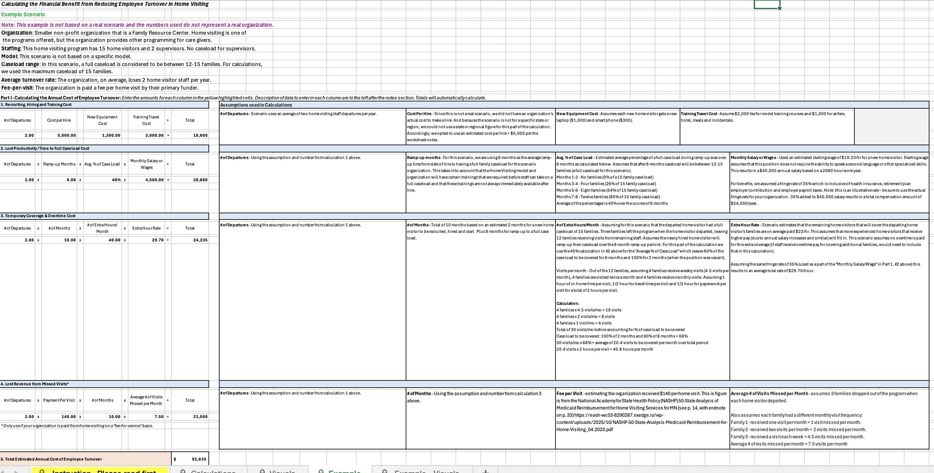
HVWFD Resources
Calculating the Financial Benefit from Reducing Employee Turnover
Notes:
Home Visiting studies & reports have shown:
When home visitors leave, families experience reduced visit frequency
In the brief/infographic Making the Case for Home-Visiting Workforce Well-Being - Why This Matters: The Cost of Turnover in Home Visiting
Home Visiting studies and reports have shown:
The top drivers of turnover are low salary and staff burnout/heavy caseload
Newly hired home visitors generally need 1-3 months to gain the skills to work independently
Workplace well-being programs return $3 for every $1 invested within 3-5 years
Another resource, which is more of a tool to help programs calculate the financial benefit from reducing employee turnover “Calculating the Financial Benefit from Reducing Employee Turnover” comes in the form of a spreadsheet to help programs factor in the necessary variables.

Slide 21



Tools to Support the Workforce—Available Now
Workforce
Data Dashboard
Real-time data for planning and decision-making
Professional Development Planning Tools
Support staff growth and advancement
Well-Being Resources
Tools to support retention
Learning Communities
and Peer Networks
Shared learning and system alignment
STAY CONNECTED
Join the Workforce
Institute listserv to:
Receive tools, resources,
and updates
Learn about upcoming
events and opportunities
Stay engaged in advancing
the National Strategy
ACCESS
RESOURCES
The Resource Library features research and evaluation, tools, and resources from the field to inform recruitment, support, and retention of a qualified home visiting workforce
Notes:
Lastly, I just want to remind you of the tools we have to support program leads and supervisors in the resource library.
https://dashboard.hvworkforce.org/
https://hvworkforce.org/about/

Slide 22
Hawaiʻi
STATE EXAMPLE
Using workforce evidence to make the case for compensation and preparation supports.
18
Notes:
SPEAKER: Host → Rowena Kamo
TIME: 1 minute
Introduce Rowena Kamo and invite her to situate the Hawaiʻi example. Suggested transition: “Hawaiʻi illustrates how compensation challenges are amplified by cost of living, geography, and workforce supply. Rowena will share how data and cross-sector policy work have informed the state’s response.”

Slide 23



National Perspective
HAWAIʻI | EVIDENCE
2015
2018
2020

Slide 24

State Perspective
HAWAIʻI | EVIDENCE
“The RAND report is the first step to achieving our vision of building a well-prepared, well-supported, and well-compensated early care and education workforce for our children, birth through age eight, and families in Hawaiʻi.”
2022

Slide 25
When the market signal is clear, compensation becomes a systems issue
HAWAIʻI | EVIDENCE
Wage gap
Cost of Living
Recruitment and Retention
RAND reported median hourly wages for Hawaiʻi early educators of roughly $13–$17, well below a statewide living-wage estimate of at least $28.50 at the time of the study.
Although Hawai‘i ranks 13th among the states in its median hourly wage for child care workers, that ranking falls to 47th once the high cost of living in the state is accounted for.
Surveys, interviews and focus groups revealed that despite a strong commitment to the work of service children and families, low compensation and physical and emotional burnout lead to challenges for recruitment and retention.
Sources: RAND, Early Childhood Educators in Hawaiʻi (2022); Hawaiʻi EI Coordinating Council testimony (2025); Hawaiʻi Act 46 report (2025).
19
Notes:
TIME: 3 minutes
Use these data points as a launch pad, then replace or supplement with the most current Hawaiʻi figures you want participants to know. Explain which workforce segments the data represent—ECE broadly versus state EI positions—so participants do not conflate them. Emphasize how evidence helped move the conversation from “we have vacancies” to “we have a compensation and workforce-supply problem.”

Slide 26
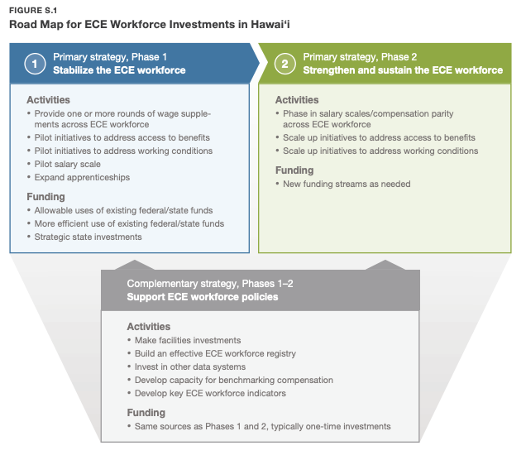
Road Map for ECE Workforce Investment in Hawai’i
HAWAIʻI | EVIDENCE
Sources: RAND, Early Childhood Educators in Hawaiʻi (2022)

Slide 27
Lessons Learned
HAWAIʻI | EVIDENCE
Approach with a systems lens
Cultivate leadership within the field
Building mixed-delivery system

Slide 28
Hawaiʻi: connect the data to the policy lever
HAWAIʻI | STRATEGY STORY
Suggested story arc for Terry’s case example.
1
Document
2
Translate
3
Build coalition
4
Select levers
5
Track results
Vacancies, wage gaps, hard-to-fill disciplines, cost of living
Connect workforce gaps to service access for children and families
State agencies, higher education, workforce partners, providers, families
Salary/rate changes, tuition stipends, preparation and career-pathway supports
Vacancy, hiring, retention, credential completion, geographic access
Which lever produced the most movement—and what made it politically or operationally feasible?
20
Notes:
TIME: 7 minutes
Tell the Hawaiʻi story as a decision story rather than a list of programs. What data were persuasive? Who needed to be at the table? Which levers were feasible first? What has been harder? Where possible, distinguish enacted supports from proposed or emerging strategies. Close with one lesson another state could adapt without copying Hawaiʻi directly.

Slide 29
What can other states learn from the Hawaiʻi example?
HAWAIʻI | REFLECTION
Data
Coalition
Design
Measurement
Which single data point helped make the workforce problem visible?
Which partners were essential to moving from evidence to action?
How did cost of living, geography, or employment structure affect the solution?
What outcome will tell you whether the strategy worked?
Chat: Identify one part of the Hawaiʻi approach that could transfer to your context—and one part that would need adaptation.
21
Notes:
TIME: 2 minutes
Thank Rowena. Use one or two chat responses to reinforce the idea of adaptation rather than replication. Transition to Illinois: “Now we’ll look at a different compensation mechanism—provider reimbursement rates—and how a state has sequenced increases and cost modeling.”

Slide 30

Illinois
STATE EXAMPLE
Strategic early intervention rate increases and a cost-modeling approach to provider supply.
22
Notes:
SPEAKER: Host → Benny Delgado
TIME: 1 minute
Introduce Benny Delgado. Note that Illinois provides a particularly timely example because provider rates have been adjusted in multiple steps and the state is continuing to use cost information to target changes.

Slide 31

Illinois: Building Toward More Competitive and Equitable Compensation
ILLINOIS | RATE INCREASES
Compensation policy can be iterative—not one-and-done.
2023
2025
Oct. 2026
10%
5–8%
FY27 update
increase for all EI providers
targeted increases for selected provider types
targets provider types still at or below 50% of modeled cost after the FY26 increase
Illinois continues to monitor provider supply and access, with particular attention to high-need disciplines including OT, PT, speech, and developmental therapy.
Source: Illinois Department of Early Childhood, Early Intervention for Providers; FY2027 Provider Rate Update (2026).
23
Notes:
TIME: 4 minutes
Walk through the sequence. Explain the rationale for broad versus targeted increases and what the state learned between adjustments. Clarify that the October 2026 update is designed to target provider types whose rates remain at or below 50% of modeled cost after the prior increase. Connect this to provider supply—not simply to the rate schedule itself.

Slide 32

ILLINOIS | DATA FOR DECISIONS
Using Data to Inform EI Compensation Decisions
A model is a decision tool—not the decision itself.
1
2
3
4
Understand the cost
Understand the gap
Prioritize investments
Monitor & adjust
Estimate what it takes to deliver services under realistic workforce and operating assumptions
Compare modeled costs with current reimbursement and identify where gaps remain
Consider cost, provider supply, access, workforce pressure and available resources
Track provider participation, service availability and access—and revisit assumptions as conditions change
Source: Illinois EI Cost Modeling & Payment Reform materials (2025–2026).
24
Notes:
TIME: 5 minutes
Describe how Illinois used cost modeling as one input to payment reform. Share what was included, what the model can and cannot tell the state, and how stakeholder dialogue matters. If possible, explain what data the state will monitor after rate changes—provider enrollment, service availability, wait times, or geographic/discipline gaps.

Slide 33
Beyond Rates: Building an EI Workforce Strategy
ILLINOIS | DATA FOR DECISIONS
Connecting recruitment, retention, and system supports to build a sustainable EI workforce.
Attract
Retain
Enable
Sustain
Tell the EI story
Invest in the workforce
Make it easier to participate
Connect the pieces
Illinois Cares for Kids
Social media & career awareness
“Be a Real Life Influencer”
Competitive and equitable compensation
Provider participation
Family access
System capacity
ARPA-Funded EI incentive payments
Recognition of provider contributions
Targeted financial supports
Payment practices
Technology
Administrative processes
Workforce development
Source: Illinois EI Cost Modeling & Payment Reform materials (2025–2026).
24
Notes:
Option 2 for TikTok post https://www.tiktok.com/@illinoiscaresforkids/video/7323298099844189482?_r=1&_t=ZT-99A5mjzoXpG

Slide 34
Question: what would your state need to target a rate increase?
ILLINOIS | REFLECTION
Supply data
Provider enrollment, vacancies, availability by discipline and geography
Cost data
Time, wages, overhead, travel, documentation, non-billable activity
Access data
Wait time, unmet service needs, family experience, rural/urban variation
Decision rules
How will you prioritize? What threshold triggers action?
Sustainability
What funding source and policy mechanism can maintain the change?
25
Notes:
TIME: 2 minutes
Thank Benny and make the bridge to T.E.A.C.H./WAGE$: Illinois shows a system-level rate lever; the next example shows structured scholarship and salary-supplement models designed around education, compensation, and retention.

Slide 35
T.E.A.C.H. Early Childhood® + Child Care WAGE$®
NATIONAL MODEL
Linking education access, compensation, and commitment to strengthen the early childhood workforce.
26
Notes:
SPEAKER: Host → Edith Locke and Allison Miller
TIME: 1 minute
Introduce the T.E.A.C.H./WAGE$ guest presenter. Note that these models come from the broader ECE workforce and offer design lessons that EI/ECSE leaders can consider when building cross-sector workforce strategies.

Slide 36
TEACH Early Childhood® and Child Care WAGE$® National Overview
Frank Porter Graham Child Development Institute
Early Childhood Technical Assistance Center Webinar
August 25, 2026
Allison Miller and Edith Locke, Early Years

Slide 37

Early Years Vision and Mission
TEACH Early Childhood® National Center Overview
TEACH and WAGE$ Program Overview

Slide 38
Early Years
Administrative Home for TEACH, WAGE$ and TEACH National Center
Vision
For all children to benefit from affordable, high-quality early care and education, which lays the foundation for successful life outcomes.
Mission
Early Years leads efforts to strengthen accessible and affordable high-quality early care and education by providing support for families, communities and the workforce.

Slide 39
TEACH Early Childhood® National Center
Created in 2000
Support TEACH and WAGE$ program expansion and implementation within states
Launched Apprenticeship Intermediary work in 2022
National presence, collaborative partnerships and committee engagement

Slide 40
TEACH Program Overview
TEACH Early Childhood® scholarships
provide ECE workforce with access to debt free college education through a package of comprehensive, economic and counseling supports
support higher education, credit bearing coursework, encourage credential and degree attainment on a pathway
lead to better education, compensation and career stability and mobility for the workforce

Slide 41
States with Administrative Organizations
Alabama
Arkansas
Colorado
Florida*
Indiana
Iowa*
Maine
Michigan
Minnesota
Missouri*
Nebraska
Nevada
New Hampshire
North Carolina*
Ohio
Pennsylvania
Rhode Island*
South Carolina
Tennessee+
Utah
Vermont
Wisconsin
*Denotes TEACH and WAGE$ Programs
Denotes WAGE$ only Programs

Slide 42
TEACH Scholarship Components
Compensation
College Education
Program Specialist
Comprehensive
And Capped
Scholarship
5 Cs
Commitment

Slide 43
Types of Scholarships
( Options are determined by each state in conjunction with the TEACH National Center
CDA Assessment/Renewal
State Credentials
Associate Degree
Bachelor’s Degree
Teaching License
Practicum/Student Teaching
Working Scholar
Master’s Degree

Slide 44

IMPACT

Slide 45
Child Care WAGE$® Program
Child Care WAGE$® awards education-based salary supplements that
go directly to the workforce
address the key issues of under-education, poor compensation and high turnover within the workforce
enhance teacher well-being

Slide 46
WAGE$ Supplement Components
Compensation
Counselor
College Education
Commitment
4 Cs

Slide 47
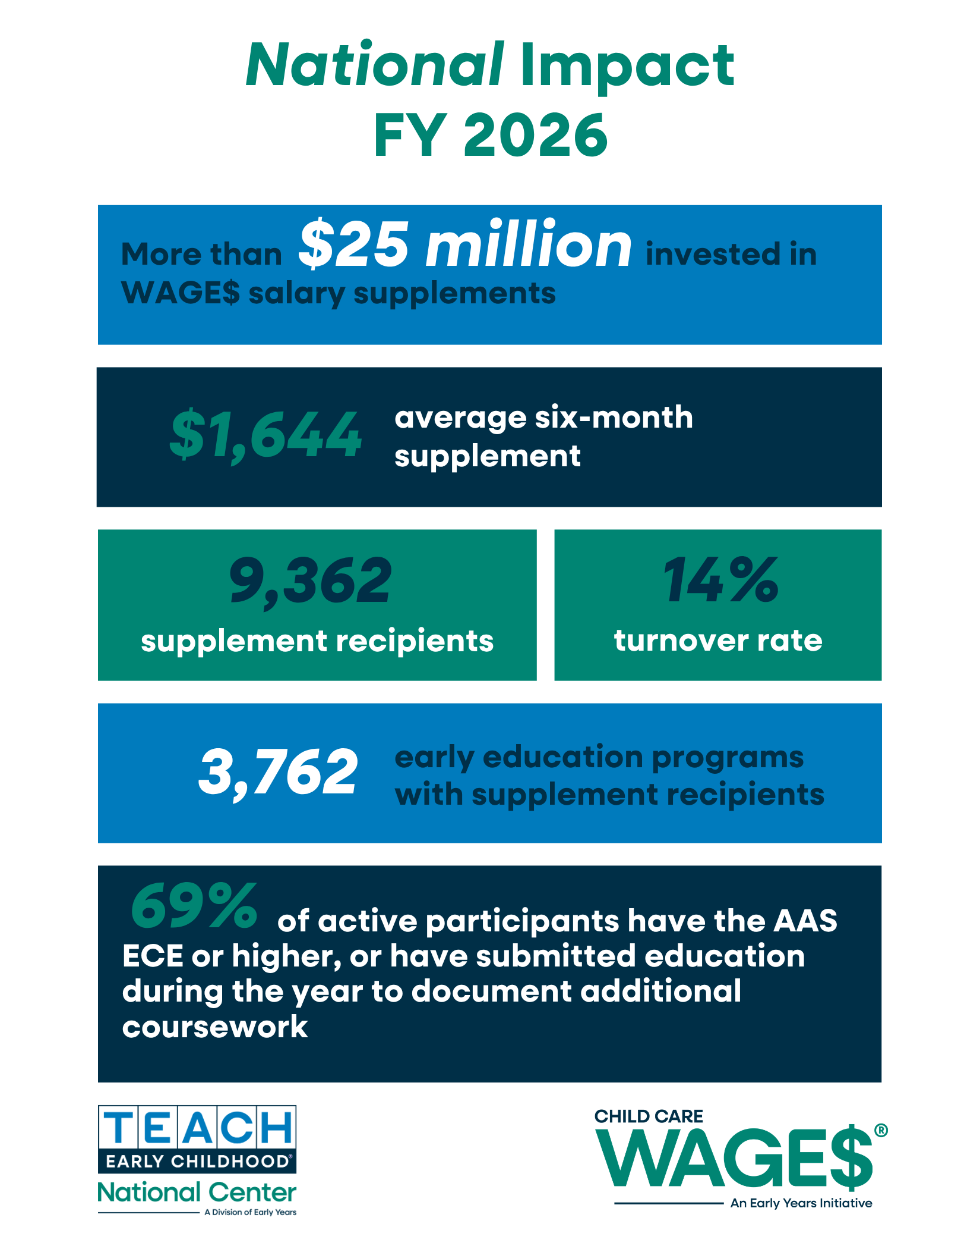
IMPACT
2

Slide 48
Key Components of a TEACH or WAGE$ Operation
State Programs
Raise funds to support scholarships or supplements
Provide public awareness
Build partnerships with key stakeholders
Award, implement and monitor scholarships or supplements
Support recipients
Work to improve workforce supports
Maintain model fidelity
Collect, manage and report on data

Slide 49
Continuous Quality Improvement
Programmatic and database training and technical assistance
Required routine program and data reporting
Monitoring and Continuous Quality Assurance
Library of tools on password protected website
Continual resource, product & strategy development

Slide 50
Thank You!
Allison Miller
allisonm@earlyyearsnc.org
Edith Locke
edithl@earlyyearsnc.org

Slide 51
What can EI/ECSE borrow from T.E.A.C.H. and WAGE$?
TRANSFER LESSONS
Focus on design principles, not program replication.
Bundle supports
Reward progression
Share responsibility
Track outcomes
Financial aid + navigation + compensation + commitment
Make career advancement visible and economically meaningful
Use partnerships among public funds, employers, higher education, and workforce organizations
Education progress, compensation gains, retention, and participation by demographic group
29
Notes:
TIME: 3 minutes
Invite the T.E.A.C.H./WAGE$ presenter to name one adaptation they think is most relevant to EI/ECSE systems. Then ask participants to identify where a similar “bundle” could support service coordinators, therapists, teachers, or other shortage roles.

Slide 52
Shift potential applicant perceptions
PUBLIC AWARENESS
Branding, storytelling, and career campaigns can reshape who sees themselves in EI/ECSE.
30
Notes:
TIME: 1 minute
Transition from financial value to perceived value. State clearly: public awareness is not a substitute for compensation. It helps candidates understand the work, impact, career options, and community—but the underlying offer must be credible.

Slide 53
People cannot choose a career they cannot see—or understand
PUBLIC AWARENESS
Recruitment messages often fail because the field is invisible, fragmented, or described in institutional language.
SYSTEM LANGUAGE
CAREER VALUE
“Part C provider”
Help families support learning in everyday routines
“Service coordination”
Connect families to services and make the system easier to navigate
“Developmental intervention”
Support infants and toddlers during the years of fastest development
“619 services”
Build inclusive early learning opportunities for young children with disabilities
31
Notes:
TIME: 3 minutes
Demonstrate the difference between insider terminology and candidate-facing language. Public awareness does not mean oversimplifying the work; it means translating the work into human impact, career identity, and clear entry points.

Slide 54
A strong recruitment campaign answers five questions
CAMPAIGN DESIGN
Think beyond a slogan.
WHO
WHY
WHAT
HOW
PROOF
Who are we trying to reach?
Why would this audience care?
What role or career opportunity are we offering?
What is the realistic pathway to enter?
What story, data, or voice makes the message credible?
32
Notes:
TIME: 3 minutes
Walk through the five questions. The “how” and “proof” elements are where many campaigns are weak. A candidate may be inspired but still not know how to enter the field, or may distrust a campaign that does not acknowledge compensation or workload realities.

Slide 55
DEC: “Be Part of Early Intervention” as a collective awareness effort
DEC | BE PART OF EI
Use shared stories, pooled resources, and coordinated influence to elevate EI.
Collective focus
Audience
Recruitment opportunity
DEC’s 2026 effort invites stakeholders to pool resources, share stories, expand influence, and elevate early intervention as a shared national priority.
EI leaders, family leaders, policymakers, CSPD teams, state ICC members, and other state/local partners shaping future campaigns.
Translate the campaign into career-facing assets: practitioner stories, “day in the life” content, role spotlights, pathways, and calls to action.
#BePartOfEI2026
Source: Division for Early Childhood, “Be Part of Early Intervention: A Collective Effort” (2026).
33
Notes:
Introduce Peggy
TIME: 7 minutes
Describe the intent and current development of the Be Part of EI campaign. Share what DEC hopes partners will do collectively, what kinds of stories or assets are emerging, and how states can participate or amplify the effort. Connect the campaign to workforce recruitment: What do future practitioners need to see and hear to imagine themselves in EI?

Slide 56

Be a part of EI

Slide 57
Introduction Objectives Campaign Approach Next Steps
AGENDA
© 2026 DEC — Division for Early Childhood — Confidential and Proprietary. All rights reserved.

Slide 58

Early Intervention
bring out so much good… But we have two
really big problems.

Slide 59
Nomenclature Branding
PROBLEMS

Slide 60
— Indiana: First Steps
THE NOMENCLATURE PROBLEM
Michigan: Early On
Iowa: Early Access
Wisconsin: Birth to 3 Program
California Early Start: Texas Early Childhood Intervention Services
Florida: Early Steps
Alabama: Early Intervention
Maine: Child Development Services
Illinois Early Intervention: Early Childhood Services

Slide 61
We need to simplify and visualize our message
to be more consistent so we can rigorously recruit
WHAT WE NEED TO DO
and actively promote Early Intervention.

Slide 62
1. Develop an awareness campaign for Early Intervention specific to
each state, making it unique by utilize the signature shape of every state or territory.
OBJECTIVES
Increase awareness by reminding and encouraging students currently pursuing degrees that touch Early Intervention to “Be Part of EI” because of all the positive aspects that careers in EI can deliver.
Tell a visual story by engaging students with various branded elements that serve as a visual reminder of the campaign while concurrently inviting them to explore engaging online resources.
© 2026 DEC — Division for Early Childhood — Confidential and Proprietary. All rights reserved.

Slide 63
This campaign was conceived with the idea of sharing powerful resources that maximize your funding and fuel your recruiting efforts.
HELP US HELP YOU

Slide 64
Campaign Approach

Slide 65
To truly ‘Be Part of EI’ we all need to reframe our thinking and our messaging to make it more perfectly clear that Early Intervention is about providing the guidance, tools, and resources needed to foster development, celebrate progress, and build meaningful skills.
CREATIVE APPROACH
By reframing EI as an opportunity for growth and comfort during a crucial time, we can inspire hope and encourage families to take confident, proactive steps toward their child’s future.

Slide 66
UNIVERSAL
© 2026 DEC — Division for Early Childhood — Confidential and Proprietary. All rights reserved.

Slide 67
What we believe…

Slide 68



EI is powerful
© 2026 DEC — Division for Early Childhood — Confidential and Proprietary. All rights reserved.

Slide 69



EI is comforting
© 2026 DEC — Division for Early Childhood — Confidential and Proprietary. All rights reserved.

Slide 70



EI is foundational
© 2026 DEC — Division for Early Childhood — Confidential and Proprietary. All rights reserved.

Slide 71

EI is nurturing
© 2026 DEC — Division for Early Childhood — Confidential and Proprietary. All rights reserved.

Slide 72



EI is family
© 2026 DEC — Division for Early Childhood — Confidential and Proprietary. All rights reserved.

Slide 73

Be Part of EI
© 2026 DEC — Division for Early Childhood — Confidential and Proprietary. All rights reserved.

Slide 74
Nurturing
OUR TENETS
© 2026 DEC — Division for Early Childhood — Confidential and Proprietary. All rights reserved.

Slide 75
State by State Graphics

Slide 76









State-by State

Slide 77
Video

Slide 78

Helping Little ones

Slide 79


VIDEO SHORTS — BE PART OF EI, IOWA
© 2026 DEC — Division for Early Childhood — Confidential and Proprietary. All rights reserved.

Slide 80


VIDEO SHORTS — BE PART OF EI, IOWA 2
© 2026 DEC — Division for Early Childhood — Confidential and Proprietary. All rights reserved.

Slide 81

Partnering with Parents

Slide 82


VIDEO SHORTS — BE PART OF EI, IOWA 3
© 2026 DEC — Division for Early Childhood — Confidential and Proprietary. All rights reserved.

Slide 83
Thank you.

Slide 84
The best workforce stories connect impact, belonging, and possibility
STORYTELLING
Use authentic voices while avoiding “hero” narratives that hide structural problems.
1
Moment
A concrete interaction with a child, family, colleague, or community
2
Meaning
Why the work mattered—and what expertise the practitioner brought
3
Path
How the person entered the field and what helped them succeed
4
Reality
A truthful acknowledgment of challenge, compensation, or support needs
5
Invitation
A clear next step for someone who may want to join the field
34
Notes:
TIME: 3 minutes
Use this as a practical storytelling template. Invite Peggy to add guidance from DEC’s campaign work. Emphasize consent, dignity, and accuracy when using family and practitioner stories. Avoid messaging that celebrates personal sacrifice while ignoring structural workforce conditions.

Slide 85
Inclusive recruitment expands who can enter, succeed, and belong
Accessibility
Representation is an outcome of systems design—not only outreach.
REACH
Where do we recruit?
Community organizations, underserved communities, organizations and institutions, workforce boards, disability communities, rural networks
ACCESS
Can people participate?
Language access, flexible schedules, paid preparation, transportation, technology, application support
SELECTION
How do we define “qualified”?
Review unnecessary barriers, recognize relevant lived experience, use transparent criteria
SUPPORT
What happens after entry?
Mentoring, supervision, cohort supports, culturally responsive professional learning
ADVANCEMENT
Can people grow?
Clear career ladders, leadership pathways, inclusive access to credentials and higher education
36
Notes:
TIME: 3 minutes
Shift the conversation from “diverse outreach” to the full recruitment experience. Reaching a candidate is only the first step. A strategy can look inclusive at the top of the funnel and still lose candidates through unpaid preparation, rigid schedules, inaccessible applications, or lack of belonging after hire.

Slide 86
Run every attraction strategy through this five-question screen
Accessibility SCREEN
1 Who benefits?
2 Who is missing?
3 What does it cost to participate?
Which groups are most likely to access and gain from the strategy?
Whose barriers are not addressed—or may be made worse?
Money, time, transportation, technology, paperwork, unpaid labor?
4 Whose voice shaped the design?
5 How will we know?
Can outcomes be disaggregated by a variety of relevant factors (e.g., geography, role)?
Were practitioners, families, candidates, and communities involved?
38
Notes:
TIME: 3 minutes
Ask participants to pick one strategy discussed today and silently answer the five questions. Invite one example. This keeps equity concrete and prepares them to use the same screen in their planning tool.

Slide 87

Small groups join a presenter for a more in-depth Q&A and discussion on the shared strategy.
BREAKOUT SESSION
20-minute breakout with the presenters
Breakout rooms: 20 minutes • Presenters rotate as facilitators • Reporters share out in the main room
37
Notes:
TIME: 20 minutes
Ask participants to join breakout rooms led by presenters to ask more in depth Q&A about the strategies the presenters shared.

Slide 88
Use the planning tool to move from “interesting” to “implementable”
IMPLEMENTATION PLANNING
Complete the Session 2 page with one priority attraction strategy.
1 Key takeaways
2 Apply to my context
3 Strategy fit check
4 Between sessions
Capture the 2–3 ideas or examples most relevant to your challenge.
What barrier are you trying to change? Which audience is affected?
Rate benefit, feasibility, sustainability, and data needs.
Commit to one action and identify who needs to help.
Suggested commitment: gather one pathway data point and identify one partner for Session 3.
39
Notes:
TIME: 5 minutes
Give participants 3 minutes of quiet planning time. Ask them to identify one strategy—not a list. Encourage them to write the exact barrier it is intended to change and one measure they could monitor. Connect the between-session action to Session 3: pathways, Grow Your Own, and alternative preparation routes.

Slide 89
Four takeaways from Session 2
SESSION 2 SYNTHESIS
Attraction improves when the offer, message, and access align.
Match lever to barrier
Use evidence to target investment
Make the career visible and credible
Design for accessibility from the start
Compensation, stipends, debt support, and housing solve different problems.
Hawaiʻi and Illinois show the value of workforce, cost, and access data.
Public awareness works when stories connect to real pathways and real supports.
Who can access, benefit, and advance should shape strategy design and measurement.
Chat: Which takeaway changes how you are thinking about recruitment?
40
Notes:
TIME: 3 minutes
Invite a final chat reflection. Name one or two responses and tie them back to the session objectives. Emphasize that compensation and public awareness should be coordinated with pathway design, which is the focus of Session 3.

Slide 90
Prepare to map the pathway into your workforce
BEFORE SESSION 3
Bring one example, one data point, and one partner perspective.
Map one pathway
Bring one data point
Talk to one partner
Choose one hard-to-fill role and sketch how a person enters, prepares, becomes eligible, and gets hired or enrolled as a provider.
Examples: program enrollment, completion, credential time, applicant source, cost, practicum capacity, demographic representation.
Ask a higher education, workforce, community, or practitioner partner: “Where do people get stuck in this pathway?”
Session 3 • September 9, 2026 • 2:30–4:00 PM ET • Building the Pathways
41
Notes:
TIME: 2 minutes
Preview Session 3 and give participants a concrete bridge task. Encourage them to focus on one role so pathway mapping is manageable.

Slide 91
Key resources for Session 2
RESOURCES
Use these to explore models, adapt strategies, and prepare for Session 3.
ECTA Recruitment & Retention Synthesis
ectacenter.org/topics/personnel/recruitment.asp
ECTA Strategies Search
ectacenter.org/topics/personnel/strategies-search.asp
T.E.A.C.H. Early Childhood® National Center
teachecnationalcenter.org
Illinois Early Intervention for Providers
idec.illinois.gov/forproviders/early-intervention.html
DEC — Be Part of Early Intervention
dec-sped.org
RAND — Early Childhood Educators in Hawaiʻi
rand.org/pubs/research_reports/RRA1908-1.html
42
Notes:
TIME: 1 minute
Point participants to the resources. Note that the slide contains live links. Encourage them to save the deck and use the ECTA strategy search as they refine their planning tool.

Slide 92
Thank you
Presenters featured in Session 2
Katari Coleman, Home Visiting
Rowena Kamo, Hawai’i
Benny Delgado, Illinois
Peggy Kemp, DEC
Edith Locke & Allison Miller TEACH/WAGE$
Questions & reflections
Session 3: Building Pathways
September 9, 2026 • 2:30–4:00 PM ET
43
Notes:
TIME: 1 minute
Thank the guest presenters and participants. Invite final questions if time remains. Remind participants of the Session 3 date and between-session pathway task. Before distribution, confirm the final T.E.A.C.H./WAGE$ presenter name and replace “Edith Locke or Kristi Snuggs” throughout the deck if desired.

Slide 93
ECTA Acknowledgments slide
Notes:
Close with the required ECTA acknowledgement.
Thank participants for attending, acknowledge the ECTA Center and OSEP funding statement, and direct participants to ectacenter.org for additional resources.

