Slide 1




Strengthening Recruitment & Retention
in the EI/ECSE Workforce
August 11, 2026 • 3:00–4:30 PM Eastern
SESSION 1 | Overview of the Workforce Landscape, ECTA Resources & Implementation Planning
Ted Burke, ECTA
Jani Kozlowski, ECTA
Allison Friedman-Krauss, NIEER
Katari Coleman, EDC
Notes:
Welcome everyone to Session 1 of the Strengthening Recruitment and Retention in the EI/ECSE Workforce webinar series.
Frame today as the foundation for the full series: shared language, a common view of the workforce landscape, ECTA resources, and an implementation planning routine participants will use across all five sessions.

Slide 2
Session 1 Agenda
1. Welcome & audience snapshot
2. Workforce landscape
3. ECTA Synthesis tools
Cross-sector challenges, participant needs, and system pressures shaping recruitment and retention.
Recruitment & Retention Synthesis and Personnel/Workforce component of the System Framework.
Who is here, what they are hoping to gain, and how the series responds.
4. Data for decisions
5. Planning tool routine
6. Reflection, Resources & next steps
Minimum indicators and the data-to-action cycle for strategy selection.
Capture ideas, test strategy fit, and define commitments between sessions.
Choose a starting challenge, identify evidence, and prepare for Session 2.
Please use the Q&A feature to ask any questions!
Notes:
Walk participants through the agenda and emphasize that the session intentionally moves from context to tools to action.
Point out that the webinar is not only about learning about strategies; it is also about practicing how to select strategies that fit local data, partners, and root causes.

Slide 3
Today’s learning objectives
By the end of Session 1, participants will be able to…
1
2
3
4
Describe the recruitment and retention challenge as a cross-sector systems issue.
Navigate ECTA’s Recruitment & Retention Synthesis and related tools.
Explain how workforce data supports sharper questions and better strategy choices.
Use the planning tool to identify one priority area for deeper exploration and action.
Notes:
Review the learning objectives. Emphasize that participants should leave able to explain the workforce issue as a systems issue, not as a single program or staffing problem.
Invite participants to listen for one idea they can test before Session 2 and one partner they may need to engage.

Slide 4
The 5-session learning journey
Each session adds evidence, examples, data use, and planning time.
AUG 11
AUG 25
SEP 9
SEP 22
OCT 13
Landscape + ECTA resources
Attracting the Workforce
Building Pathways
2:30–4 PM ET
Retaining the Workforce
Sustaining and Advancing the Workforce
Across all sessions: state examples + interactive breakouts + an evolving action plan
Notes:
Use this slide to orient participants to the full learning journey.
Explain that each session adds a layer: landscape and resources today, then compensation and data, Grow Your Own pathways, supportive work environments and professional learning, and finally leadership, public awareness, and action planning.
Note that the action plan will grow over time rather than being created all at once at the end.

Slide 5
Audience at a glance
A national, cross-system group with strong early intervention and birth-to-five representation.
270
47
5
95%
registrants
states
DC / Pacific / U.S.-affiliated
jurisdictions
expect to attend all
sessions
Primary age focus
Broad reach, strong birth-to-five focus
Birth–3
131 (48.5%)
Registrants represent 47 states, DC, and four Pacific/U.S.-affiliated jurisdictions. 71% selected Birth–3 or Birth–5.
Birth–5
63 (23%)
Ages 3–5
32 (11.9%)
Birth–8
26 (9.5%)
Birth–21
19 (7%)
71% selected Birth–3 or Birth–5.
Notes:
Highlight the breadth of the group: 219 registrants from 45 states, DC, Pacific and U.S.-affiliated jurisdictions.
Emphasize the strong birth-to-five focus. This matters because recruitment and retention strategies must work across early intervention, ECSE, and broader early childhood settings.

Slide 6
Registrant roles
The audience includes State Part C/619 staff, TA providers, and a substantial “Other” category.
Other
118 (43.7%)
Role-based takeaways
Other Part C staff
52 (19.3%)
26%
Part C coordinators or staff
National/regional TA
30 (11.1%)
Local TA
29 (10.7%)
7%
Part B 619 coordinators or staff
Part C coordinator
18 (6.7%)
22%
national, regional, or local TA personnel
Part B 619 coordinator
12 (4.4%)
Other Part B 619 staff
7 (2.3%)
44%
selected “Other,” signaling diverse workforce perspectives including local ECE directors, practitioners, policy specialists, and students
Presenter/Planner
4 (1.4%)
Notes:
Summarize the range of roles in the room. State Part C and Part B 619 staff, TA providers, and many 'Other' roles bring different views of the same workforce challenge.
Name the value of that diversity: we need policy, program, higher education, local implementation, and practitioner perspectives to make workforce strategies realistic.

Slide 7
What registrants hope to gain
Open-ended responses point to practical, immediately usable support.
Most requested content
Concrete recruitment and retention strategies
Tools that can be implemented locally
Workforce systems, career pathways and Grow Your Own approaches
Examples from states and peers
Every session should answer:
What works, how has it been implemented elsewhere, and what can we do next?
Source: Registrant Snapshot deck; 126 open-ended responses.
Notes:
Explain that registrants asked for practical and immediately usable support.
Lift up the throughline: people want concrete recruitment and retention strategies, tools, career pathway examples, state examples, and ideas they can adapt locally.
Use the question at the bottom as the facilitation standard for the series: What works, how has it been implemented, and what can we do next?

Slide 8
Needs assessment: linked system pressures
Respondents describe recruitment, compensation, pathways, workload, and diversity as connected—not separate—challenges.
Hardest-to-fill roles
OT, PT, SLP, classroom teachers, developmental specialists, preschool educators, service coordinators, social workers, behavior analysts, and bilingual home visitors.
Interpretation
The series should help participants move from isolated activities toward coordinated workforce systems that attract, prepare, retain, and sustain personnel.
Source: Needs Assessment Executive Summary deck; 15 respondents.
Notes:
Frame the needs assessment findings as evidence that workforce pressures are connected.
Recruitment, compensation, career pathways, workload, and diversity should not be treated as separate problems. A strategy focused on only one issue may not be enough if the root causes sit elsewhere in the system.

Slide 9
Workforce data capacity is a major weakness
A manageable dashboard can help participants target strategy, funding, and partnership decisions.
47%
60%
40%
Do not systematically
collect workforce data
Report limited use of
available workforce data
Collect workforce
demographics
What participants need
A manageable set of workforce measures
Connected data across agencies and programs
Dashboards that support policy, funding, recruitment, and retention decisions
Source: Needs Assessment Executive Summary deck.
Notes:
Emphasize that data capacity is itself a workforce strategy issue.
Many systems do not systematically collect or use workforce data, which makes it harder to target resources, make funding arguments, understand equity implications, or know whether a strategy is working.

Slide 10

Who is the workforce?
Image via iStock
Notes:
Use this as an interaction point. Ask participants to type into chat: Who counts as part of the workforce in your system?
After a few responses, broaden the lens. Include practitioners, service coordinators, related service providers, supervisors, coaches, faculty, TA providers, administrators, families, and community partners.

Slide 11
Where are we now?
What does the research show?
Notes:
Transition from the participant snapshot to the broader research and national context.
Invite participants to consider whether the trends they see nationally match what they are experiencing in their own state, program, or community.

Slide 12
The Current Context
workforce
considerations
Enrollment in personnel preparation programs is decreasing, and more staff are leaving the field in the last 5 years.
Shortages of early intervention and early childhood special education providers impact availability of services for young children with disabilities, their families, and communities.
Key priority identified by Part C Coordinators and Early Childhood Special Education Coordinators across the country
Disproportionality issues
Impacts felt across the early childhood field
Requires collaboration across sectors and partners
Notes:
Summarize the current context: preparation program enrollment is decreasing, more personnel have left the field, and shortages affect service availability for young children with disabilities and their families.
Stress that this is a cross-sector issue. EI, ECSE, ECE, child care, Head Start, related services, and higher education are all connected in the same labor market.

Slide 13

Help Wanted: Early Intervention & Early Childhood Special Education Workforce Needs
Allison Friedman-Krauss
Notes:
Good afternoon. Today, I will discuss some findings from a national survey of the early childhood special education and early intervention workforce. This work was a partnership between NIEER and Mary Beth and Darla Gundler at the Early Childhood Personnel Center with their funding from the Office of Special Education Programs. The goal of the survey was to gather information about the status of the Early Intervention (EI) and Early Childhood Special Education (ECSE) workforce. We developed a set of questions about workforce characteristics, education, training, job experiences, stress, and knowledge. It was an entirely online survey that was administered between June 2022 and January 2023. The survey was primarily distributed through Part B & Part C coordinators in each state.

Slide 14
QUALIFIED PERSONNEL IDENTIFIED IN IDEA
Part C (ages 0-3)
Part B (ages 3-5)
Special Educators;
Speech-Language Pathologists and Audiologists;
Occupational Therapists;
Physical Therapists;
Psychologists;
Social Workers;
Nurses;
Nutritionists;
Family Therapists;
Orientation and Mobility Specialists; and
Pediatricians and other Physicians;
Special Education;
General Education;
Related Service Personnel:
  Speech-Language Pathologists and Audiologists;
  Occupational Therapists;
  Psychologists;
  Physical Therapists;
  Recreational Therapists;
  Social Workers;
  Counseling services;
  Orientation and Mobility Specialists, and
  Pediatricians and other Physicians, except that such medical services shall be for diagnostic and evaluation purposes only
Notes:
We received responses from the workforce in all but two states with over 4,600 total respondents across three main groups – Early Intervention Providers, Early Childhood Special Education Teachers, and Part B Related Services Providers.

Slide 15
Respondents were primarily White, Non-Hispanic
89%
Notes:
Survey respondents were primarily White (and non-Hispanic).

Slide 16
Almost All Respondents were Female
97%
Notes:
Not surprisingly, nearly all, 97%, of respondents were female.

Slide 17
Only 15% of Respondents Spoke a Language other than English
15%
Notes:
85% of respondents spoke English only. Only 15 percent spoke a language other than English – half of these respondents spoke Spanish. Unfortunately, this does not match the needs of the children as a growing number of children who qualify for services are dual language learners.

Slide 18
Most of the Workforce had a Qualification
84% of all respondents held a certification or license.
  58% for the early childhood years
  37% for the lifespan
Notes:
The majority of respondents reported having full professional licenses or certifications for their current positions – these covered the early childhood years and/or the lifespan.
Those who did not have a certification or license tended to report their main role as a service coordinator or early interventionist.

Slide 19
97% had at least a BA degree
3%

Slide 20
Low Compensation
Of those who reported a salary, the two most frequently reported salary categories were $50,000 to $59,000 and $60,000 to $69,000.
Those with higher educational attainment tended to earn higher salaries.

Slide 21
Years in the Field Ranged from 0 to 55
An average of almost 14 years in the EI/ECSE field

Slide 22
Working in this Field is Rewarding
Notes:
Some positive news…
NIEER saw similar patterns in the child care workforce in NJ.

Slide 23
High Risk of Turnover
40% of respondents reported they are likely or very likely to leave the EI/ECSE workforce in the next 5 years.
More than 25% reported looking for a new job outside the EI/ECSE field in the last 6 months.
Notes:
Similar to child care in NJ
NIEER also did a survey of faculty in institutes of higher education who train and teach future early childhood special education teachers and found that most programs were underenrolled at all levels – BA, MA, PHD, suggesting threats to the workforce pipeline as well.

Slide 24
Severe or Potentially Dangerous Levels of Stress
Notes:
One-quarter (27%) of ECSE Teachers reported severe or potentially dangerous levels of stress.
Nearly one-fifth of ECSE Related Service Providers reported severe or potentially dangerous stress levels.
14% of EI Providers reported severe or potentially dangerous stress levels.

Slide 25

Acknowledgments
Funding for this report was provided by the Early Childhood Personnel Center at the University of Connecticut through a cooperative agreement grant from the U.S. Department of Special Education, Office of Special Education Programs.
The Early Childhood Personnel Center is a project of the A.J. Pappanikou Center for Excellence in Developmental Disabilities at the UConn Health Center. The Center is funded through cooperative agreement number H325B170008 from the Office of Special Education Programs, U.S. Department of Education. Materials and opinions expressed herein do not necessarily represent the Department of Education’s position or policy.

Slide 26
Most Stressful Factors for Part C Coordinators
Factor | 2019 | 2020 | 2021 | 2022 | 2023 | 2024
Federal reporting requirements | 13% | 24% | 27% | 30% | 41% | 47%
SPP/SiMR activities | 36% | 35% | 45% | 40% | 35% | 35%
Lack of administrative support | 23% | 35% | 22% | 16% | 16% | 20%
Insufficient funding for services | 57% | 51% | 41% | 54% | 53% | 61%
Lack of staffing at the lead agency level | 47% | 53% | 47% | 40% | 49% | 37%
Lack of providers to meet service needs | 75% | 61% | 71% | 86% | 90% | 84%
ITCA 2024 Tipping Points Survey: https://ideainfanttoddler.org/pdf/2024-Tipping-Points-Survey.pdf
Notes:
Introduce the ITCA Tipping Points Survey as a view into Part C system stressors.
Focus the discussion on how increasing stress for coordinators reflects system-level pressure, not only individual workload. Ask participants what stressors are most visible in their own system.

Slide 27
Key Factors Contributing to Shortages in the EI Workforce
Factor | 2024 (40) | 2025 (37)
Poor management or unsupportive… | 13% | 14%
Limited Professional Development | 18% | 29%
Insufficient resources or support | 30% | 22%
High workload/burnout | 63% | 76%
Increased number of… | 73% | 46%
Low compensation | 90% | 73%
ITCA 2025 Tipping Points Survey: https://ideainfanttoddler.org/pdf/2025-Tipping-Points-Survey.pdf
Notes:
Use this slide to identify the factors contributing to EI workforce shortages.
Connect the survey findings to the earlier needs assessment themes: compensation, workload, recruitment pool, preparation pathways, administrative demands, and retention supports.

Slide 28
Question in 2023 619 Coordinator Survey:
Does your state utilize innovations in personnel recruitment and retention?
https://ectacenter.org/sec619/sec619survey.asp
Notes:
Explain that the 2023 Section 619 Coordinator Survey points to uneven use of recruitment and retention innovations across states.
Use this as a bridge to the ECTA synthesis: many strategies exist, but states need ways to identify, adapt, and coordinate them based on context.

Slide 29
Recruitment & Retention Issues
ECE WORKFORCE
Persistent workforce instability is driven by a mix of compensation, working conditions, career pathways, and system-capacity challenges.
Low wages & limited benefits
Competition for qualified staff
$
↗
Pay often lags K–12, retail, and service-sector jobs; benefits are uneven.
Programs lose candidates to public pre-K, schools, health care, and other sectors.
Burnout, stress & workload
Career pathway barriers
!
⚑
High emotional demands, ratios, paperwork, and vacancies push staff out.
Credentials, tuition, practicum access, and advancement routes can be hard to navigate.
Unstable program financing
Insufficient workforce data
◷
◎
Thin margins limit pay increases, substitutes, planning time, and professional support.
Many systems cannot track vacancies, turnover, demographics, supply, or retirement risk.
Bottom line: recruitment improves when ECE jobs are competitive; retention improves when educators feel respected, supported, and able to grow.
Sources: National ECE Workforce Center, NAEYC, CSCCE, MDRC/OPRE
Notes:
Summarize the ECE workforce recruitment and retention issues as a parallel and connected landscape.
Emphasize the bottom line: recruitment improves when jobs are competitive; retention improves when educators and providers feel respected, supported, and able to grow.

Slide 30
Interactive poll
Where is the greatest pressure in your system right now?
Recruiting enough qualified people
Keeping experienced personnel
Building accessible preparation pathways
Improving working conditions and support
Using workforce data for decisions
Aligning partners across sectors
Notes:
Launch the poll and ask participants to rank the top 3 areas of greatest pressure in their system right now.
During the debrief, look for patterns by role or sector. Ask: Are we seeing more pressure around recruiting, retention, pathways, working conditions, data, or alignment?

Slide 31
Workforce challenges are interconnected
WORKFORCE LANDSCAPE
Vacancies are the visible symptom; root causes sit across the system.
Supply & pathways
Compensation & benefits
Working conditions
Too few candidates; barriers to preparation, licensure, and entry
Pay, debt, reimbursement, and unstable funding affect attraction and staying
Workload, support, role clarity, wellness, and belonging
Development & mobility
Awareness & value
Data & coordination
Coaching, credentials, leadership, and advancement
Limited understanding of careers and EI/ECSE impact
Incomplete data limit forecasting and targeted action
Source: ECTA Center Recruitment and Retention of Personnel Serving Young Children with Disabilities.
Notes:
Use this slide to reinforce the systems frame. Vacancies are the visible symptom; root causes may sit in preparation, compensation, working conditions, advancement, public awareness, or data coordination.
Encourage participants to avoid jumping directly to a solution before naming the root cause.

Slide 32

Guiding Principles in Addressing Personnel Shortages
Shortages:
Are a local issue
Impact young children with disabilities and their families disproportionately
Occur at any stage of practitioners’ careers
Require collaboration across sectors and partners
cherylholt via Pixabay
Notes:
Review the guiding principles. Shortages are local, affect children with disabilities and families disproportionately, and can occur at any stage of a practitioner’s career.
Emphasize collaboration: no single agency or program controls all of the levers needed to solve workforce shortages.

Slide 33
ECTA Recruitment & Retention Synthesis
A curated collection of research-informed strategies and state examples.
What it offers
Financial incentives
Grow Your Own
A common framework for discussing workforce solutions
Concise strategy summaries with references
Examples from states, programs, and partner organizations
Ideas to adapt—not prescriptions to copy
Public awareness
Professional learning
Leadership & advancement
Supportive environments
ectacenter.org/topics/personnel/recruitment.asp
Source: ECTA Recruitment and Retention Synthesis, updated October 2025.
Notes:
Introduce the ECTA Recruitment and Retention Synthesis as a practical resource for strategy selection.
Clarify that the strategies are ideas to adapt, not prescriptions to copy. Participants should use data and context to decide what fits.

Slide 34
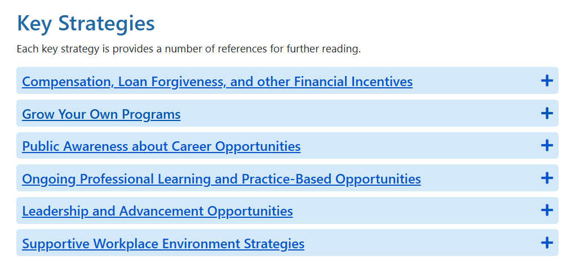

Session Resources Strategies
https://ectacenter.org/topics/personnel/recruitment.asp
Notes:
Point participants to the session resource page and show where the recruitment and retention strategies are located.
Encourage participants to keep the link open during the webinar or bookmark it for use between sessions.

Slide 35
State and Local Recruitment and Retention Strategies
Notes:
Orient participants to the state and local strategy examples.
Explain that these examples can help teams move from abstract categories to concrete actions, partners, funding mechanisms, and implementation steps.

Slide 36

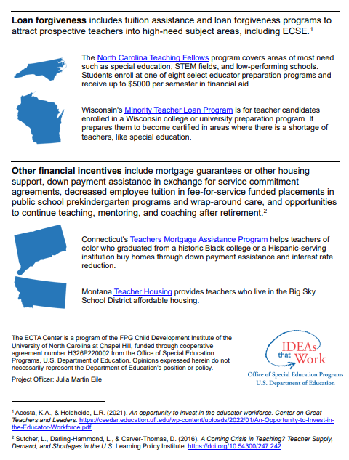
Compensation, Loan Forgiveness, and Other Financial Incentives
Notes:
Introduce compensation, loan forgiveness, and financial incentives as one strategy category.
Note that financial strategies can support both recruitment and retention, but they work best when paired with career pathways, role clarity, and supportive working conditions.

Slide 37


Grow Your Own Strategies
Notes:
Introduce Grow Your Own strategies as approaches that build the workforce from within communities and existing early childhood systems.
Emphasize that these strategies often require partnerships with higher education, local programs, communities, and funding partners.

Slide 38


Public Awareness About Career Opportunities
Notes:
Introduce public awareness strategies as ways to improve understanding of EI/ECSE careers and the impact of the work.
Connect public awareness to recruitment: people are more likely to enter a field when they understand the role, value, career path, and supports available.

Slide 39


Ongoing Professional Learning and Practice-Based Opportunities
Notes:
Introduce ongoing professional learning and practice-based opportunities as retention and quality strategies.
Emphasize that personnel are more likely to stay when they have coaching, mentoring, peer support, and learning opportunities connected to their daily practice.

Slide 40


Leadership and Advancement Opportunities
Notes:
Introduce leadership and advancement opportunities as part of a sustainable workforce system.
Highlight that retention is not only about staying in one role; it can also mean seeing a future in the field through advancement, specialization, mentoring, or leadership pathways.

Slide 41

Recruitment and Retention Website
Key Strategy One Page Overviews
NEW- State Recruitment and Retention Strategies Search
  Discover strategies that may work for your state using our database of EI/ECSE recruitment and retention strategies used in state and local programs nationwide.
Website Address:
https://ectacenter.org/topics/personnel/recruitment.asp
Notes:
Demonstrate the recruitment and retention website, including the one-page strategy overviews and the new state strategy search tool.
Encourage participants to search by problem, strategy type, funding source, geography, or role to find examples that might translate to their context.

Slide 42

Strategies Search Demonstration
Use the searchable strategies tool, to seek out solutions for one of the following scenarios https://ectacenter.org/topics/personnel/strategies-search.asp :
  I’m a Part C coordinator seeking “Grow Your Own” recruitment ideas.
  I’m a state PD/TA provider in the Midwest looking for ongoing professional learning strategies in neighboring states.
  I’m looking for public awareness strategies that use state/local funds.
Notes:
Introduce the activity: We’re going to spend a few minutes using the Strategies Search tool to explore practical ideas for recruitment and retention. Walk them through one of the examples.
Ask them to open the link, search for relevant examples, and identify one or two strategies that could translate to their own state or local context. Encourage them to notice which search terms and filters are most useful, what information helps them assess a strategy, and what details may still be missing. Close by noting that the tool is intended as a starting point for adaptation—not a one-size-fits-all solution—and transition to the role of workforce data in choosing and monitoring strategies.

Slide 43

Why does workforce data matter?
Notes:
Use this transition slide to shift from strategies to data.
Ask participants to reflect: What data do you currently use when making recruitment and retention decisions, and what data do you wish you had?

Slide 44
Why workforce data matters
Data turns broad concern into answerable questions and targeted choices.
How many?
Who?
Where?
Headcount, FTE, vacancies, caseloads, turnover
Role, credential, demographics, language, geography
Regional shortages, service deserts, rural/remote access
Why?
What next?
Exit reasons, job satisfaction, compensation, workload
Retirement risk, preparation pathway, projected demand
Start with a priority question, inventory what exists, and identify the smallest useful next step.
Notes:
Explain that workforce data helps turn broad concerns into answerable questions.
Walk through the question categories: how many people, who they are, where shortages show up, why people leave or stay, and what is likely to happen next.

Slide 45
Core cross-sector indicator map
These domains create a shared data language across EI, ECSE, and ECE.
Workforce size & FTE
Demographics
Qualifications
Vacancies
Headcount, FTE, employment status, role, setting
Language, age bands, geography
Degree, license, credential, provisional status
Authorized vs. filled positions, time-to-fill
Turnover & retention
Compensation & benefits
Workload
Career pathways
Annual exits, 1/3/5-year retention, exit reasons
Wages, benefits, paid time, comparability
Caseload, ratios, travel, documentation, complexity
Preparation enrollment/completion, apprenticeships
Source: Workforce-Level Data Indicators deck.
Notes:
Review the cross-sector indicator map as a shared data language across EI, ECSE, and ECE.
Emphasize that teams do not need every data element immediately. The goal is to choose the smallest useful set of indicators tied to a decision.

Slide 46

Using the Participant
Implementation Planning Tool
Strengthening Recruitment & Retention in the EI/ECSE Workforce
Notes:
Transition to the participant implementation planning tool.
Explain that the tool is the bridge between the webinar content and the participant’s own state or organizational action plan.

Slide 47

What the planning tool is for
Keep focused on one feasible, data-informed strategy.
Capture learning
Core message
Participants use each session page to record useful ideas, examples, resources, and implications for their own state or organization.
This is not a note-taking packet.
It is a decision-making and implementation tool.
Narrow the work
The tool intentionally prevents strategy overload by guiding participants toward one high-priority strategy that can be implemented with partners.
Use it every session, then revisit it between sessions.
Leave with a roadmap
Across the series, participants build a practical plan with outcomes, measures, roles, milestones, risks, and next steps.
Notes:
Clarify the purpose of the planning tool. It is not just a place for notes; it is a decision-making and implementation tool.
Participants will capture learning, narrow the work to one feasible strategy, and leave the series with a practical roadmap.

Slide 48
The learning-to-action cycle
The same routine repeats before, during, after, and across the series.
1
2
3
4
5
LEARN
REFLECT
APPLY
COMMIT
REVIEW
Session content
and examples
What fits our context?
Test ideas against data
One action before
next time
What changed?
Notes:
Introduce the learning-to-action cycle that repeats across the series: learn, reflect, apply, commit, and review.
Emphasize that small between-session actions are how participants will test fit and build momentum.

Slide 49
Start with the workforce challenge activity
Take 3-5 minutes on your own and use the first pages to define the problem and assess readiness.
1. Define the challenge
Tip for participants
Who is affected? What is happening? Where is it visible? What evidence and root causes support the conclusion?
Bring one data source and one partner perspective. The strongest plans combine evidence with lived experience.
2. Rate readiness
Use the 1–4 self-assessment to locate strengths and gaps across data, incentives, pathways, supervision, PD, and coordination.
Examples: vacancy data, turnover trends, applicant sources, compensation barriers, geographic shortages, preparation program input, practitioner feedback.
3. Name an initial priority
Select the area that is both important and actionable right now.
Notes:
Give participants three to five minutes to begin the workforce challenge activity.
Ask them to define the challenge, rate readiness, and name one initial priority. Remind them to combine at least one data source with at least one partner or practitioner perspective.

Slide 50
Use each session page the same way
Key takeaways → context prompts → strategy fit check → commitment.
1
Key Takeaways
Capture the three most useful ideas, examples, or resources.
2
Apply to My Context
Translate session content into local implications.
Repeat for Sessions 2–5
3
Strategy Fit Check
Compare strategies by benefit, feasibility, and concerns.
4
Between Sessions
Commit to one action and identify who will help.
Notes:
Explain how to use each session page in the same routine: key takeaways, local context, strategy fit, and a between-session commitment.
Encourage participants to be selective. Three useful ideas are better than a long list that does not lead to action.

Slide 51
Facilitate the “between sessions” bridge
The workbook turns each webinar into a small implementation test.
Session 1
Session 2
Session 3
Session 4
Session 5
Review framework assessment
Gather one workforce data source
Invite one stakeholder
Review recruitment data
Identify a feasible lever
Draft a value proposition
Sketch current pathway
Validate with practitioner or partner
Identify one pathway gap
Review retention data
Ask two practitioners what helps them stay
Select one workplace practice
Finalize roadmap
Confirm sponsor and lead
Schedule post-series meeting
Use the start-of-next-session review table to ask: What did you complete? What did you learn? What changed in your plan? What support do you need?
Notes:
Use this slide to show how the workbook creates continuity from one webinar to the next.
Emphasize that each session ends with a manageable commitment and the next session begins by reviewing what participants learned from trying it.

Slide 52
What other resources are available to help us?
Notes:
Transition to additional resources that can support participants beyond the webinar series.
Frame the next slides as examples of related national supports and tools that can strengthen state and local workforce planning.

Slide 53


Introducing the National Strategy for the
Home Visiting Workforce
Healthy Families, Thriving Communities, Strong Nation:
A National Movement to Recognize and
Sustain the Home Visiting Profession

Slide 54
National Strategy for the
Home Visiting Workforce
THREE PILLARS, ONE SHARED GOAL
Pillar 1
Create Pathways
to Careers
Pillar 2
Strengthen the
Workforce
Pillar 3
Support Workforce
Well-Being
Purpose: Open doors into home visiting through education, training, and participant experience, ensuring it is seen as a respected, rewarding profession.
Purpose: Invest in the people who make home visiting possible by supporting fair pay, core
competencies, and professional growth.
Purpose: Sustain the people at the heart of home visiting by creating safe, balanced, and supportive working conditions.
Outcomes
Outcomes
Outcomes
Greater public awareness, stronger recruitment, and clear routes into the field.
A stable, skilled, and respected workforce with opportunities for advancement and recognition.
Increased morale, improved
retention, and reduced burnout
through practices that help staff thrive.

Slide 55
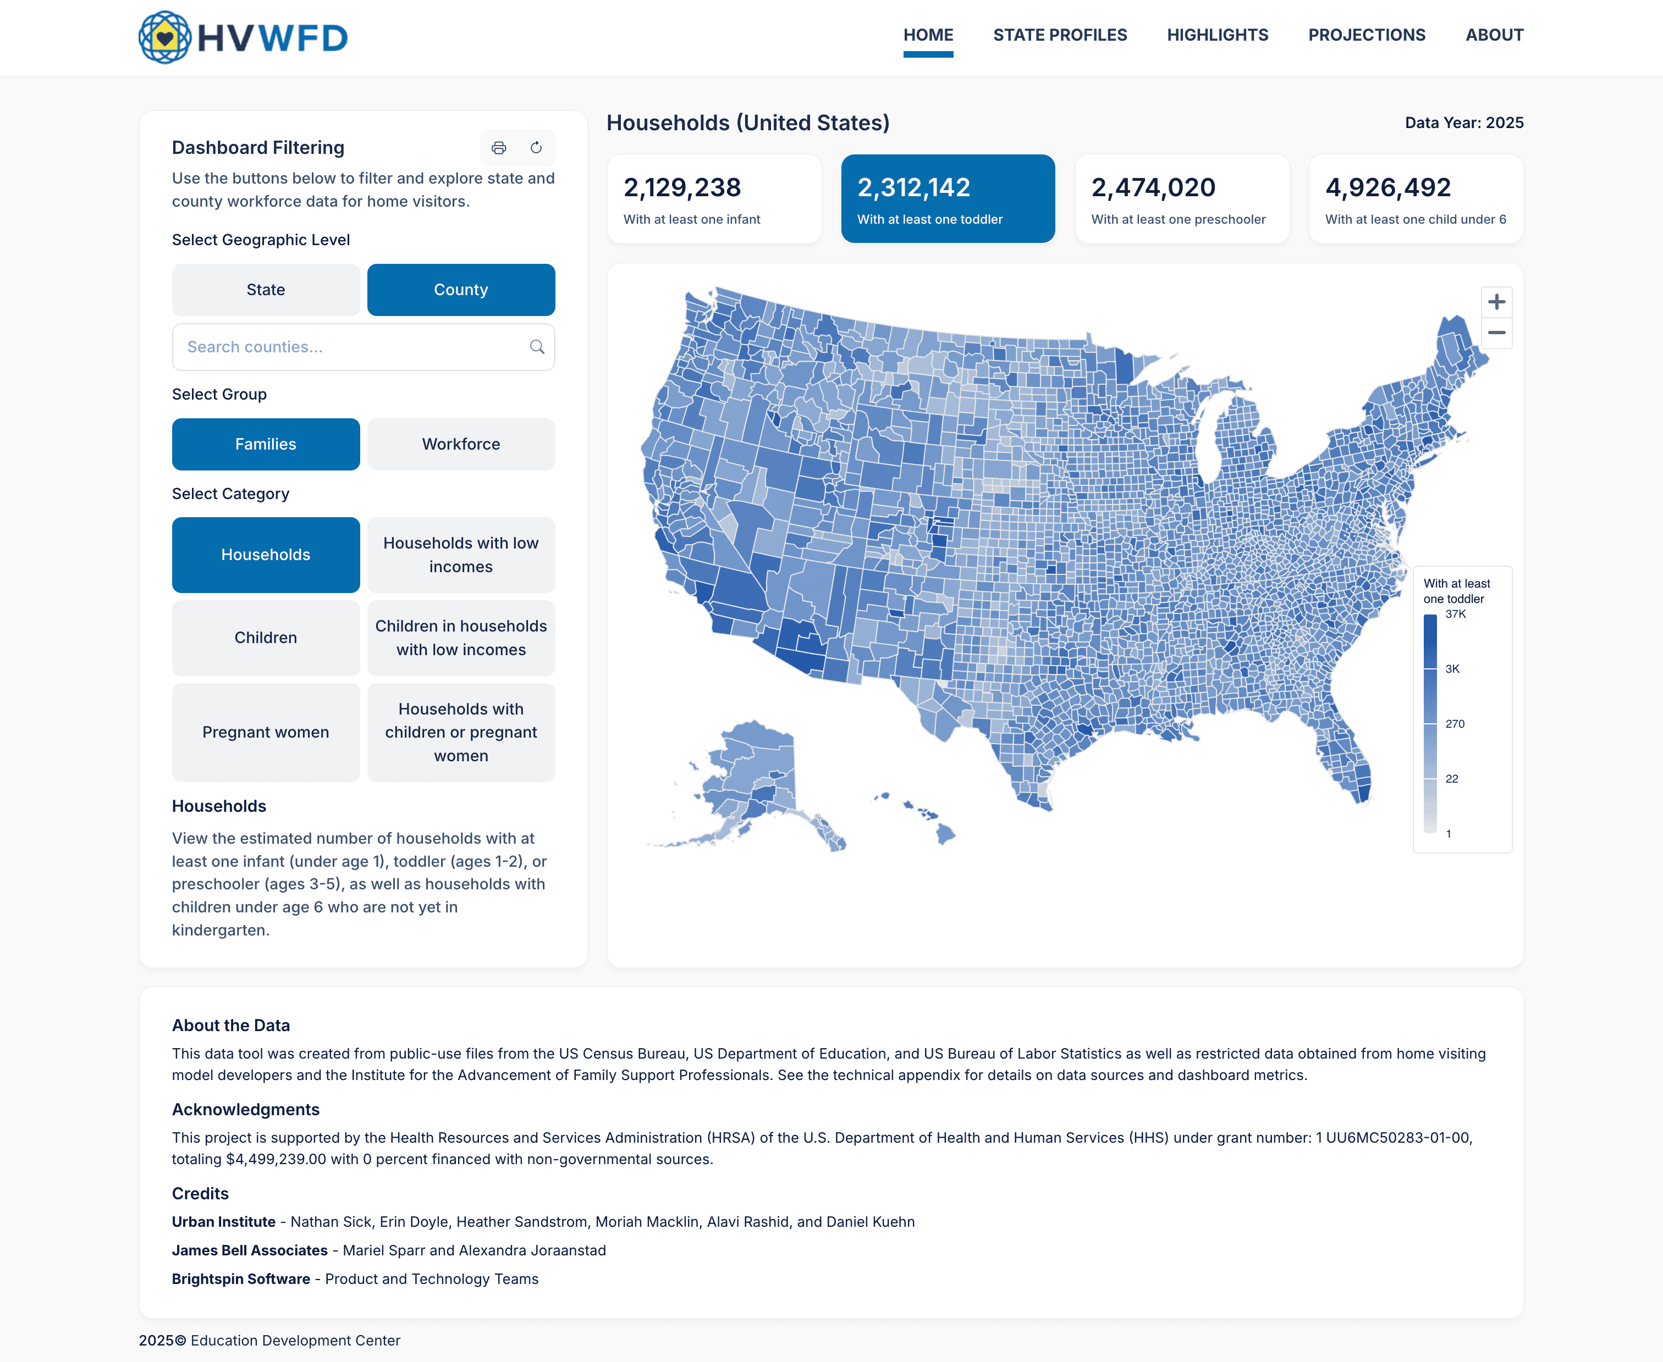
Home Visiting Workforce Data Dashboard

Slide 56
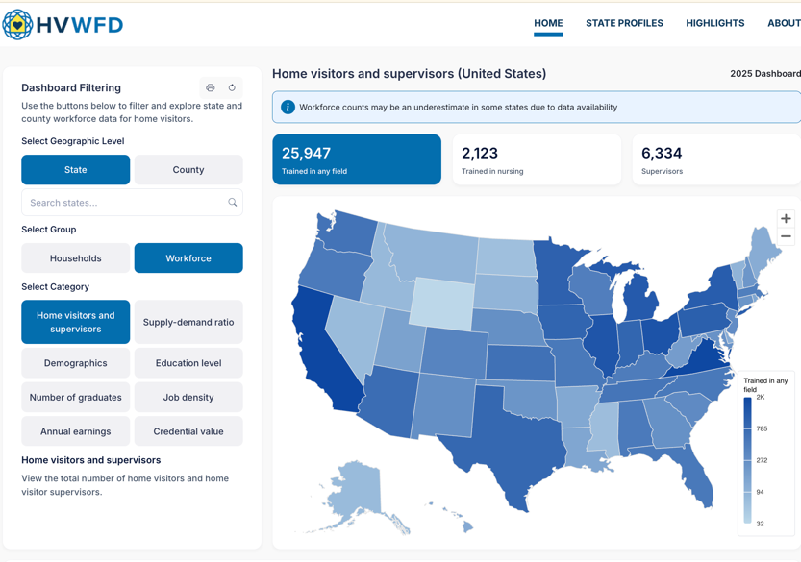


Tools to Support the Workforce
Workforce
Data Dashboard
State, county, and national data for planning and decision-making.
Professional Development
Planning Tools
Support staff growth and advancement.
Workforce Well-Being Resources
Tools to support retention.
Learning Communities
and Peer Networks
Shared learning and system alignment.
STAY CONNECTED
Join the Workforce
Institute listserv to:
Receive tools, resources,
and updates
Learn about upcoming
events and opportunities
Stay engaged in advancing
the National Strategy
Workforce Data Dashboard
Explore real-time workforce data

Slide 57

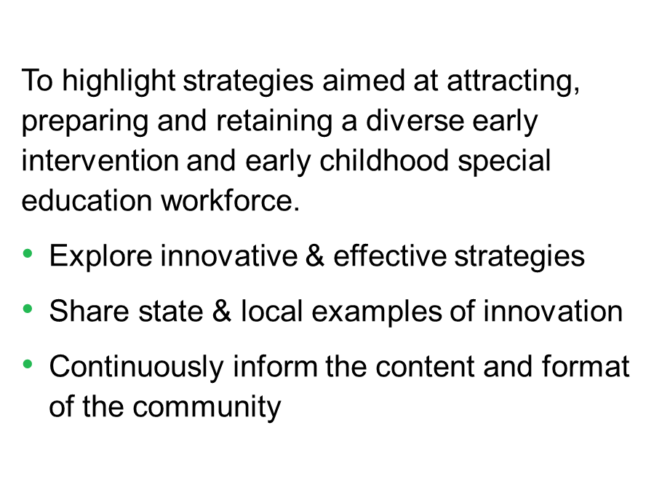
Early Childhood Personnel Solutions Learning Community Purpose
Notes:
Introduce the Early Childhood Personnel Solutions Learning Community.
Highlight that it is designed for state-level IDEA Part C and Part B 619 leaders to share strategies, examples, and learning around OSEP’s Prepare, Attract, Retain framework.

Slide 58
Five subcomponents of a quality workforce system
Together, the subcomponents connect leadership, standards, preparation, ongoing learning, and workforce stability.
Leadership, Coordination, and Sustainability
1
State Personnel Standards
2
Preservice Personnel Development
3
In-service Personnel Development
4
Recruitment and Retention
5
https://ectacenter.org/sysframe/component-personnel.asp
ECTA Center System Framework, Second Edition — Personnel/Workforce Component
Notes:
Introduce the ECTA System Framework Personnel/Workforce component and its five subcomponents.
Explain that the framework helps states assess the full personnel system rather than focusing only on individual strategies or isolated programs.

Slide 59
How the five subcomponents work together
Quality depends on alignment across the full personnel development continuum.
LEAD
STANDARDIZE
PREPARE
DEVELOP
SUSTAIN
Shared vision and plan
Clear competency expectations
Aligned preservice programs
Statewide in-service PD and TA
Recruit and retain the workforce
The system is strongest when standards drive preparation and professional learning, workforce data inform recruitment and retention, and leadership coordinates the entire cycle.
ECTA Center System Framework, Second Edition — Personnel/Workforce Component
Notes:
Use this slide to show how the five subcomponents reinforce one another.
Emphasize alignment: standards should inform preparation and professional development, workforce data should inform recruitment and retention, and leadership should coordinate the cycle.

Slide 60
Four takeaways from Session 1
A shared foundation for the work ahead.
Workforce challenges are systemic
Inclusion expands the lens
Data sharpens strategy
No one-size-fits-all solution
They reflect policy, financing, pathways, conditions, supports, and public value.
EI/ECSE capacity is intertwined with ECE, child care, Head Start, home visiting, and related services.
Start with a decision question and combine numbers with personnel and family experience.
Build a coordinated portfolio that fits root causes, context, and feasibility.
Share in the Chat : Which takeaway is most important for your work?
Notes:
Summarize the four takeaways from Session 1.
Ask participants to share in chat which takeaway is most important for their work. Use responses to reinforce the systems frame, the inclusion lens, the role of data, and the need for local fit.

Slide 61
Before Session 2
Turn today’s reflection into a focused question.
Complete a quick scan
Bring one data point
Invite a partner
Review the shared resources and select one recruitment/retention strategy or resource that aligns with your priority.
Find one piece of evidence—quantitative or qualitative—that helps describe the challenge.
Identify someone from another agency, sector, or role whose perspective is needed.
Session 2 • August 25, 2026 • Compensation, incentives, and using data to target solutions
Notes:
Preview the work before Session 2. Ask participants to complete a quick resource scan, bring one data point, and invite one partner perspective.
Connect the assignment to the next session on compensation, incentives, and using data to target solutions.

Slide 62
Thank you
Key resources
Use these links throughout the series.
ECTA Recruitment & Retention Synthesis
https://ectacenter.org/topics/personnel/recruitment.asp
ECTA System Framework: Personnel/Workforce
https://ectacenter.org/sysframe/component-personnel.asp
Questions & reflections
System Framework Self-Assessment
https://ectacenter.org/sysframe/selfassessment.asp
System Framework Quick Start Guide
https://ectacenter.org/sysframe/quickstart.asp
Notes:
Review the key resource links and encourage participants to keep them accessible throughout the series.
Invite final questions and reflections. Remind participants that these resources are intended to support action planning, not simply provide background reading.

Slide 63
ECTA Acknowledgments slide
Notes:
Close with the required ECTA acknowledgement.
Thank participants for attending, acknowledge the ECTA Center and OSEP funding statement, and direct participants to ectacenter.org for additional resources.

