Slide 1
This webinar will begin shortly. There will be no audio until the webinar begins at 1:00 p.m. Thank you for your patience.

Slide 2
A Blueprint to Inclusion: Supporting Systemic Change in California
Opportunities for All Branch
Early Education Division Special Education Division
Date: October 4, 2024
Time: 1 to 2 p.m.

Slide 3
Welcome and Introduction
Sarah Neville-Morgan, Opportunities for All Branch,
Chief Deputy
Stephen Propheter,
Early Education Division Director
Rachel Heenan,
Special Education Division Director
Notes:
Sarah Neville-Morgan
Hello, & welcome to this webinar.
My name is Sarah Neville-Morgan, & I am the Deputy Superintendent over the Opportunities for All Branch (AKA OFAB) at the CA Department of Education
I am joined here today by my colleagues from the CDE, Stephen Propheter, the Early Education Division Director & Rachel Heenan, the Special Education Director which are two divisions in OFAB. I am also joined by our partners from the Early Childhood Technical Assistance Center (AKA ECTA).
We are excited you have decided to join this webinar, which will focus on sharing free tools & resources developed by the ECTA that are available to CA’s early education programs. Today’s content will support developing plans to improve inclusion opportunities using the ECTA Indicators of High-Quality Inclusion.
Before we turn it over to ECTA we would like to share a little about CA’s Commitment to inclusive opportunities & rightful presence for children with disabilities.
As you may know, in recent years, CA & CDE have prioritized inclusion & while CA has a way to go, we are proud of the work that has been done to increase inclusive opportunities for all our young children.
I’m both proud & excited that our uplifting of this has created much needed action through both state budget investments & a change in messaging & practice. As a matter of fact, our first Preschool Development Grant application was all about expanding inclusive preschool programs &, while we didn’t get the federal award, DOF was so excited about our application that they asked us to build a proposal based on it, which ultimately became the Inclusive Early Education Expansion Program also known as IEEEP.
Chat: https://www.cde.ca.gov/sp/cd/op/iee.asp
As most of you know, the purpose of the IEEEP is to increase access for children with disabilities, including severe disabilities, to inclusive early learning & care programs. Because it uses state education funds, Prop 98, this is accomplished through funding to LEAs to collaborate with community partners through a site leadership team, provide professional development training & coaching for general education & special education staff, purchase & install adaptive equipment, & address facility needs for inclusive classrooms.
The original IEEEP grant is due to sunset at the end of this year, but the next round of funding has been awarded to 58 LEA grantees and continues until June 30, 2027. This second grant places a strong emphasis on professional development & coaching, areas that proved to offer the most sustainability & long-term benefits in the first IEEEP grant. This focus aims to enhance educators’ confidence & competence in supporting children with disabilities in early learning & care settings.
The IEEEP funding also includes allocations for state-level systems building & aligning local practices with research-based strategies. These efforts aim to enhance child outcomes for children with disabilities & improve program quality across CA.
In collaboration with county offices of education, the state will enhance inclusion support for grantees by offering numerous professional learning opportunities for early education programs, including expert training for coaches.
The goal of this piece of the IEEEP funding is to build sustainability within the state, reach many programs across CA, including community-based organizations & those outside of CSPP, & provide supports to the field to help programs meet the set aside for children with disabilities.
Along with IEEEP, the CDE also began convening the Impact Inclusion Workgroup (AKA IIW) in 2019. The workgroup is a cross-sector & includes state & local representatives including the Special Education Division, IEEEP grantees & partners, Department of Social Services Child Care Licensing, Department of Developmental Services, family resources centers, Head Start, tribal representatives, & training & technical assistance providers.
The workgroup aims to share challenges, barriers, & best practices for including children with exceptional needs in early learning & care settings. It focuses on continuous improvement of inclusion in high-quality programs across CA. This hands-on group collaborates to share resources & develop plans to support ongoing improvements in the early learning & care field.
During this webinar we will share some of the accomplishments of this workgroup.
You’ve also seen the prioritization of inclusion in our messaging around high-quality inclusive UPK, in our Prek-3rd grade initiative, & in our budget hearing testimony.
In addition, the UPK Mixed Delivery Quality & Access Workgroup’s Legislative Report includes recommendations that focus on inclusion such as:
Encouraging programs to review the federal Policy Statement on Inclusion of Children with Disabilities in Early Childhood Programs, which enshrines a “commitment to ensure that each child’s individual needs are supported appropriately, that each family’s goals for their children are considered, & all have high expectations for each child.”
Chat: https://sites.ed.gov/idea/idea-files/policy-statement-inclusion-of-children-with-disabilities-in-early-childhood-programs/#:~:text=This%20policy%20statement%2C%20released%20jointly%20by%20the%20Departments,meet%20high%20expectations%2C%20and%20achieve%20their%20full%20potential.
Providing best practice recommendations to support the implementation of inclusive models (including an itinerant model)
Providing best practices & technical assistance to encourage the workforce to utilize the Universal Design for Learning framework for proactively addressing the needs of diverse & exceptional learners.
Work with the resource and outreach centers at the California Schools for the Deaf through the California Department of Education’s State Special Schools and Services Division to increase preschool access for deaf and hard of hearing children.
And just a note for this recommendation, we acknowledge that for some unique populations, such as those students who are deaf or hard of hearing, specialized environments may ensure that the students’ unique language, communication, cultural and related needs are properly addressed. In this regard, the least restrictive environment for deaf and hard of hearing children may be one in which students have direct access to language and communication and are able to directly engage other deaf and hard of hearing peers and adults.
The IIW is working to support these recommendations & successful strategies through continuous communication to the field to address awareness & share best practices.
I’ll end my introduction today with our P-3 Vision: CA will provide a strong & early start to education for all children with high-quality, developmentally informed, joyful, rigorous, & inclusive PreKindergarten (PreK) through 3rd grade (P-3) learning opportunities—beginning with equitable access to universal PreK (UPK).
I will now turn it over to Steve to share with you all the accomplishments & what’s to come from the workgroup before we move into the webinar. Steve – over to you.
Steve
Thanks, Sarah. It’s great to be here today with all of you. I’m going to highlight a few accomplishments of the IIW.
Led by the Early Education Division at the CDE, the IIW has been working hard to highlight & develop resources to support the early education field to increase inclusive opportunities & a rightful presence for children with disabilities. In 2019, with support from the ECTA in partnership with the Special Education Division, through a non-monetary grant, some of the IIW accomplishments have included:
Development of a mission, vision, guiding principles, & call to action for the workgroup which can be found on our CDE website, which we will link in the chat.
Chat: Impact Inclusion Workgroup - Child Development (CA Dept of Education)
Completion of the ECTA state indicators for high-quality inclusion
Completion of an action plan to guide the efforts of the workgroup
Continued work on activity deliverables & fulfillment of several accomplishments which included development of a webpage with a matrix library of inclusion resources. The link to the webpage will be provided in the chat.
Chat: https://www.cde.ca.gov/sp/cd/op/ieeresources.asp
The workgroup also developed a 1-page flyer that programs can use to share these resources & support programs in developing a local inclusion definition & move towards continuous improvement at the local level. The flyer can be found on the CA Educators Together webpage & the link will be provided in the chat.
Chat: https://www.caeducatorstogether.org/resources/134811/CA-early-learning-and-care-inclusion-resources
An inclusion newsletter was first released in the Spring & the second edition was just released in September. The newsletters provide the field valuable information about inclusion, including newly released resources, professional development opportunities, training & technical assistance highlights & bright spot highlights showcasing local programs moving the needle on inclusion. These newsletters are posted in the inclusive early education resources page under CA State Preschool Program Resources
Chat: https://www.cde.ca.gov/sp/cd/op/ieeresources.asp
We’re proud of the work of the IIW & thrilled to offer this webinar to introduce more free tools to help programs achieve high-quality inclusion & support continuous improvement in local & community initiatives.
I will now turn it over to Rachel for a few words from the Special Education Division before we transition over to ECTA.
Rachel
Thank you, Steve, and thank you all for joining us today. As the Director of the Special Education Division, I want to emphasize how critical it is for general education and special education to work hand in hand in creating environments where every child has a rightful place, where they are not only included but are truly valued members of their educational community. I’m honored to be here alongside my colleagues from the Early Education Division and our partners at the Early Childhood Technical Assistance Center (ECTA) to discuss California’s commitment to inclusion and rightful presence for children with disabilities.
The Special Education Division, as representatives of the Impact Inclusion Workgroup (IIW), echo the importance of programs having tools and resources to support them in increasing inclusive opportunities for children with disabilities in high-quality settings. This is why we are excited about this webinar and the opportunity to partner with ECTA in sharing these resources with you.
To support this vision, the Special Education Division has many resources available with the goal of inclusion.
One of the projects, called the Statewide System of Supports (SSOS) is a comprehensive system leveraging coordination, collaboration, and integration with various educational entities, including County Offices of Education, Local Educational Agencies (LEAs), and charter schools. The ultimate goal of the SSOS is to provide coordinated, needs-based, and differentiated resources and supports to LEAs that lead to improved services for all students evidenced by the closing of opportunity gaps and improved student outcomes. Lead Agencies, often situated within designated county offices, provide expertise, programs, and resources, to empower local educators to leverage the wide variety of resources and supports at the universal, targeted, and intensive levels, to help meet the needs of their individual LEAs.
The SSOS Students With Disabilities for Inclusions group focusses specifically on inclusive practices. This team promotes inclusion across the state.
We are currently forming an offshoot of this group aimed at our Birth to Five-year-old children. We are very excited about the formation of this group.
California Early Childhood Special Education (CalECSE) Network is a valued partner of CDE. They are funded through CDE to improve the capacity, knowledge and implementation of evidence-based practices through:
Chat: https://calecse.org/
Resource Development: CalECSE creates valuable resources such as exemplar lead videos and virtual sessions for professionals in early childhood special education. Topics are based on exemplary practices aimed at addressing the field's needs to cover an array of different areas including innovative inclusive practices.
CalECSE also provides comprehensive support and technical assistance to local educational agencies (LEAs), Special Education Local Plan Areas (SELPAs), County Offices of Education (COEs), and other agency partners across California. CalECSE is a cornerstone for enhancing early childhood education quality. They assist LEAs in building capacity, knowledge, collaboration & implement evidence-based practices
CalECSE offers Professional Development Symposiums such as the "Building Bridges" Symposium in October 2024 which highlights their commitment to professional learning and capacity building that is aimed to ensure all preschool-aged students in California have the opportunity to thrive.
CalECSE is working with CDE to improve outcomes for children and their families by addressing and eliminating barriers to access to educational programming for California’s youngest children with disabilities across agencies throughout California."
Another valuable partner of CDE is Supporting Inclusive Practices (SIP). Their aim is to provide statewide technical assistance to educational communities in their pursuit of an inclusive and equitable system within an environment of belonging, community, and connection.
Chat: https://www.sipinclusion.org/
They assist and support LEAs by identifying evidence-based practice programs and improvement processes and provide resources and materials which include documents, presentations, and interactive modules to provide collaborative professional development and sustain the implementation of practices for students with disabilities. This year they are scheduled to host 4 virtual events, free of charge, focused on inclusion.
Another project we coordinate is the Partnership for Effective Practices in Transition and Inclusion (PEPTI). PEPTI is a five-year initiative—ending in 2027— funded by the State Personnel Development Grant in collaboration with the Department of Developmental Services. The project aims to improve outcomes for young children with disabilities and those at risk of developmental delays by supporting smooth transitions and promoting inclusion through evidence-based practices. PEPTI focuses on enhancing learning and development for children from birth through preschool by fostering cross-agency collaboration, providing resources, and incorporating a strong implementation and coaching process. In 2024, six local LEAs from diverse regions joined PEPTI. By maintaining consistent, high-quality training and resources, PEPTI strives to create inclusive environments and improve outcomes for children with disabilities across California.
Chat: https://pepti.org/
The Special Education Division also provides funding through grants and contracts for LEAs to receive coaching support in evidence-based practices. These practices use research-based coaching and embedded instruction to promote inclusion of our youngest learners into programs through designing approaches for planning, implementing, and evaluating instruction for preschool based upon each child’s individualized goals which are embedded into instruction in a naturalistic way. These practices empower teachers to feel capable of teaching All children and improves outcomes for All children.
Without further ado, we will now hand it over to ECTA to share with you what their technical assistance center provides including an overview of the indicator tools they have available with a deeper dive on the tool to support program administrators & partners in measuring high quality inclusion at the local level

Slide 4
A Blueprint for Inclusion: Supporting Systemic Change in California
Alissa Rausch
Jani Kozlowski

Slide 5
Webinar Objectives
Participants will:
gain a comprehensive understanding of the ECTA Indicators of High-Quality Inclusion
review relevant challenges to implementing inclusion and identify ongoing opportunities for advancing inclusion within California
learn practical approaches to use the ECTA Indicators to leverage opportunities at the state, community, local program, and environment levels

Slide 6
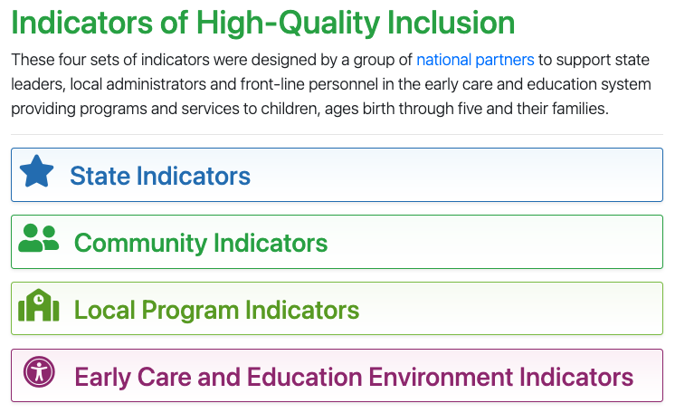
It’s Takes the Whole System!
State
Community
ECEE
Local Program
https://ectacenter.org/topics/inclusion/indicators.asp

Slide 7
How Revisions Were Informed
2 Intensive states having worked with all 4 sets of indicators
7 intensive TA states with the state leadership teams across 3 years
Inclusive childcare piloted and provided revisions for ECEE indicators in 4 classrooms age 1-6
OSEP request to highlight equity- developed partnership with Children’s Equity Project
Other users across the nation supporting inclusion at all levels

Slide 8
Examples of State Indicators
Cross-Sector Leadership Team
Policy and Guidance
Funding
Accountability, Data and Use of Quality Assurance Systems
Personnel and State Standards
Professional Development
Allocation of Resources
Public Awareness

Slide 9
Potential State Challenge
How can a state provide local-level resources (funding, professional development, etc.) to support inclusion?

Slide 10
Potential State Solution #1
Possible solution
Indicator: Cross-Sector Leadership
Install a state-level inclusion team to support strategic planning efforts
Develops and implements a written strategic plan that reflects its purpose statement and builds on an assessment of the current landscape of state early childhood initiatives. The strategic plan highlights experiences and issues that disproportionately affect children from historically and contemporarily marginalized communities and specific policies, funding, and approaches to address those issues.
Notes:
https://www.cde.ca.gov/sp/cd/op/impactinclusionworkgroup.asp

Slide 11
Potential State Solution #2
Possible Solution
Indicator: Funding
Incentive and support grants for local programs
Determine strategies for leveraging funds and resources at state and local levels.
Write guidance for local programs on braiding and coordinating resources that reference policies, regulations, and requirements.
Monitor and evaluate the effectiveness of braiding and coordination of funds

Slide 12
Examples of Community Indicators
Community Inclusion Teams
Family Partnerships
Policies and Procedures
Collaborative Teaming
Fiscal Resources
Staff Policies and Structures
Communities are:
Local area teams/ geographically close teams that have cross-sector resources, skills and abilities to leverage change. Communities are representative of families and have knowledge of resources to best support all children and families across the system.

Slide 13
Potential Community Challenge
How can children receive IDEA supports and services in the settings where children would be if they did not have a disability?

Slide 14
Potential Community Solution #1
Possible SOlution
Indicator: Program supports for Professional Development
Shared professional development across the system
Guides and informs programs on evidence-based professional development approaches such as training, coaching, mentoring, and reflective practice (i.e., supervisor-facilitated opportunities to reflect on one's experiences and biases as it relates to working with children and families).

Slide 15
Examples of Community Solutions
State Leaders partnered with Child Care Resource and Referral and Early Learning Hub directors to elevate the strategies to support Early Care and Education Providers when a child who experiences disability is enrolled in their program
New training and technical assistance supports are being developed in partnership with Inclusive Partners, OCCD, ELD, and Inclusive Services

Slide 16
Examples of Local Program Indicators
Program Leadership Teams for Inclusion
Shared Purpose
Family Engagement and Partnerships
Curriculum
Policies and Procedures
Staff Policies and Structures
Collaborative Teaming

Slide 17
Potential Local Program Challenge
How can administrators learn more about how to support preschool inclusion at the administrative level?

Slide 18
Possible Local Program Solution #1
Possible Solution
Indicator: fiscal Resources
The local program:
Develops a budget for staffing, training, and coaching to support inclusion.
Plans for, monitors, and evaluates the effective use of fiscal, staff and other resources to support inclusive practices.

Slide 19
Possible Local Program Solution #2
Possible Solution
Indicator: Collaborative Teaming
Administrators create a culture that values inclusion across the program
Establishes interdisciplinary teams that include individuals who share families' culture or language to help them support families and their children in ways that are culturally responsive and sustaining.
Establishes an appropriate staffing structure to ensure EI, special education, and related service providers can support providers in using inclusive practices and embedded services to meet the needs of children with disabilities and their families.

Slide 20
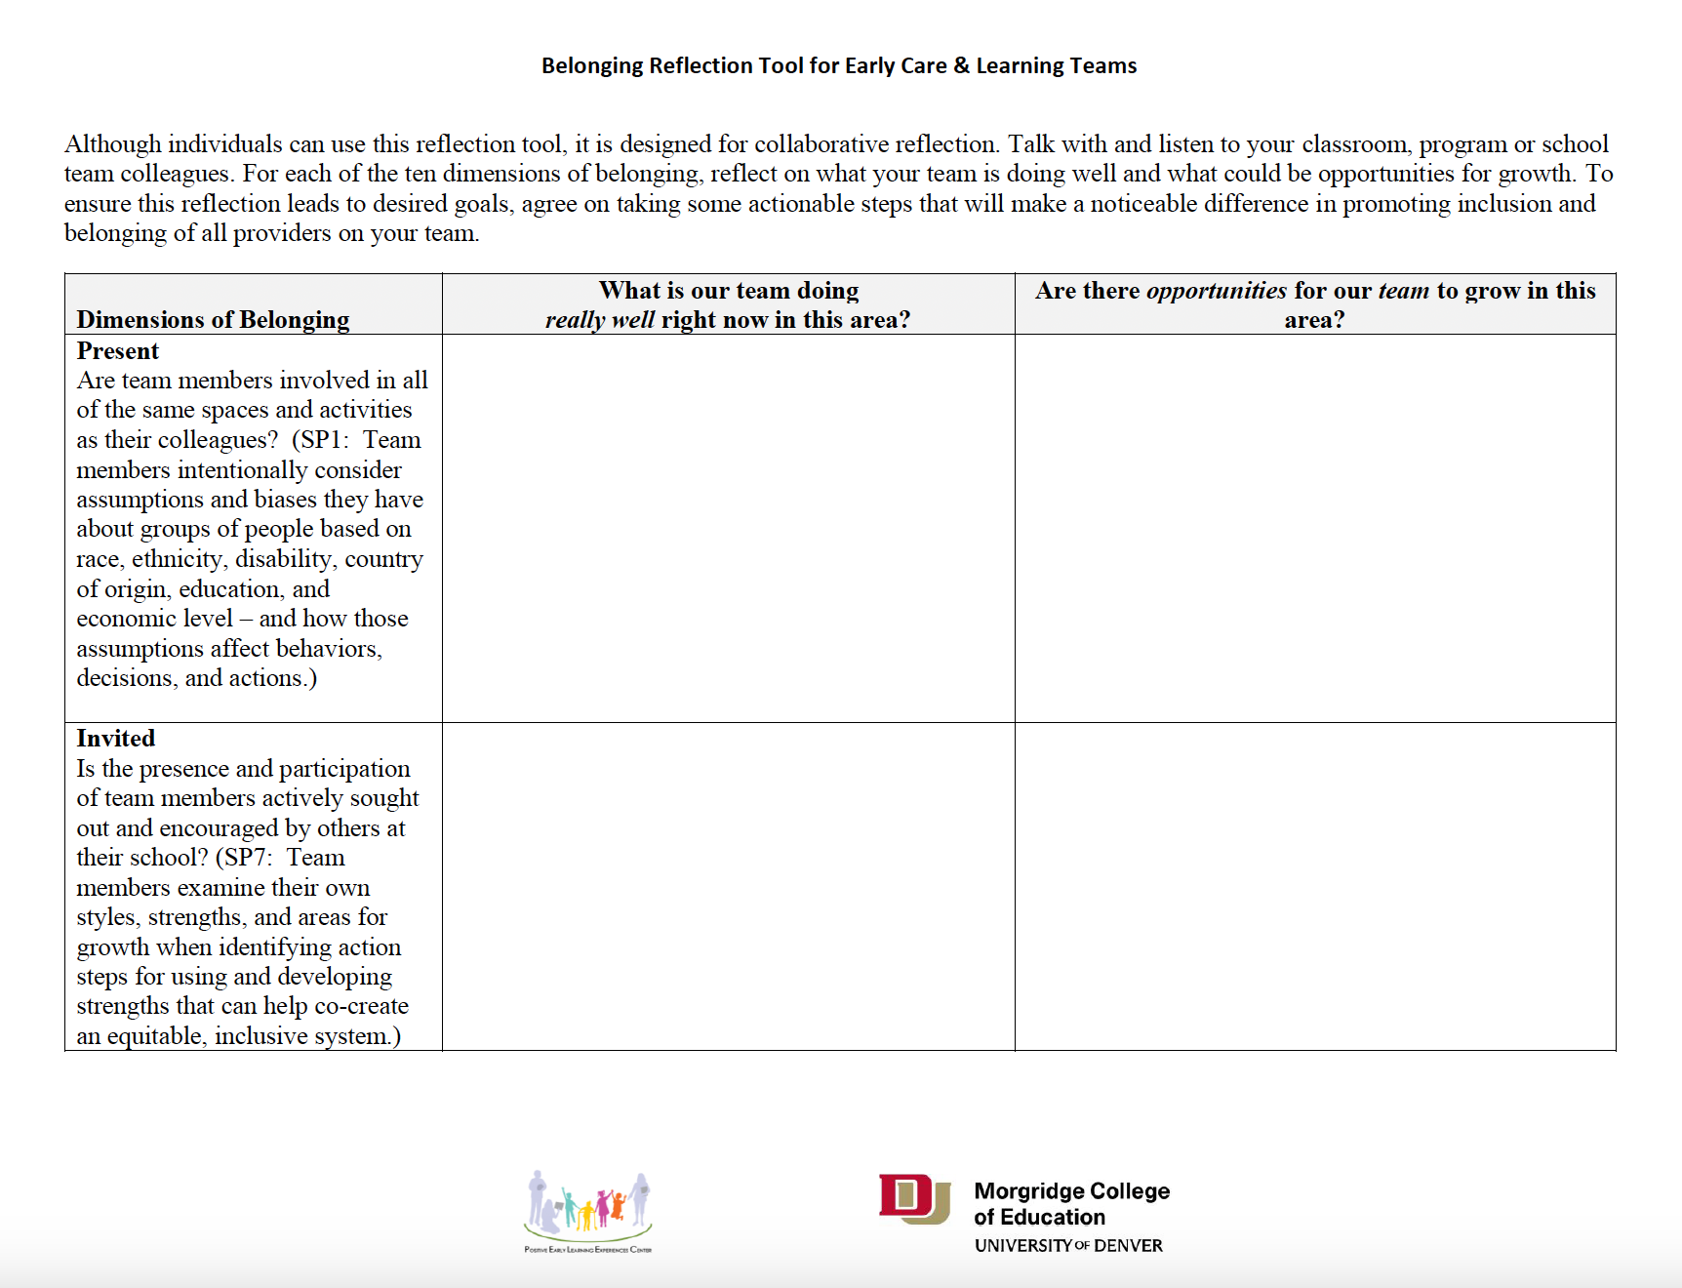
20

Slide 21
Examples of Local Programs Solutions
A guide for program administrators to build a collaborative services model.
Notes:
https://www.isbe.net/Documents/Resource-Guide-Collaborative-Services.pdf

Slide 22
Examples of Environment Indicators
Physical Environment
Children’s Autonomy and Child-Centered Approaches
Family Partnerships
Instruction
Supporting Dual Language Learners with Disabilities
Anti-Bias, Culturally Responsive, Sustaining and Identity Affirming Practices

Slide 23
Potential Environment Challenge
How can children receive IDEA supports and services within the general education classroom environment?

Slide 24
Potential Environment Solution #1
Possible SOlution
Indicator: Instruction
Build capacity to engage in practices that use natural routines to support IEP goals and objectives
Observe and record children's strengths, needs, interests, abilities, and reinforcers to inform instruction.
Develop or alter the environment, materials, and instruction to ensure children can engage in activities and reach their individualized goals.
Embed instruction and targeted goals into naturally-occurring opportunities for learning.

Slide 25
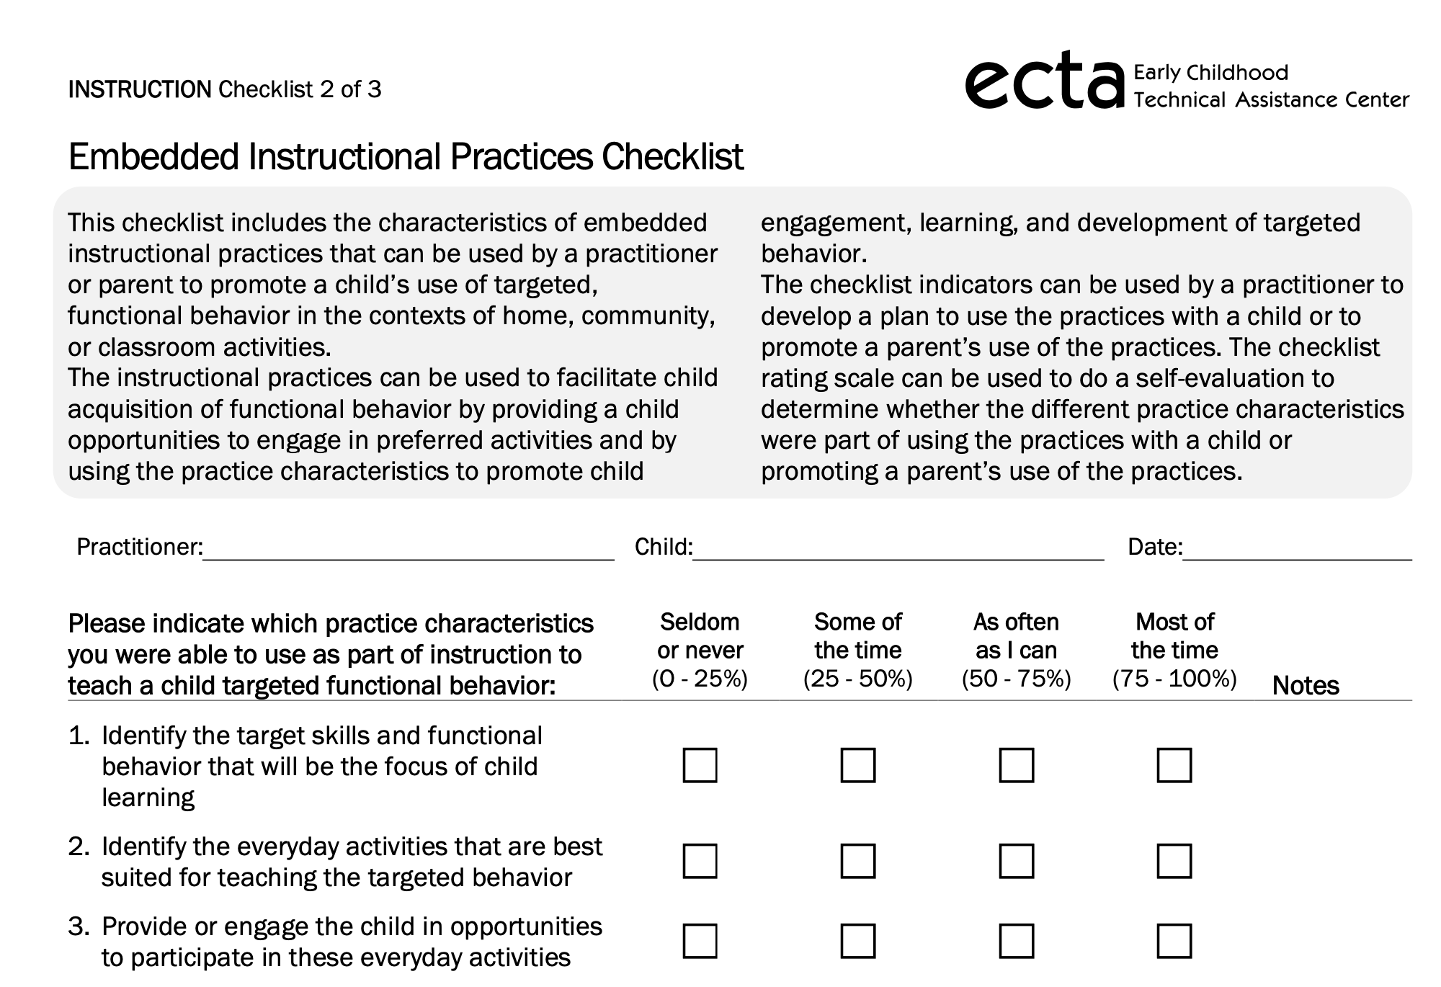
25
Notes:
https://ectacenter.org/decrp/type-checklists.asp

Slide 26
Thank you!

