Slide 1
Implementing, Sustaining and Scaling-Up High-Quality Inclusive Preschool Policies and Practices: Application for Intensive TA

Slide 2
Agenda
Overview of the purpose of the TA
Description of the TA model and activities
Discussion of the responsibilities of the TA Team (State, Community, Implementation sites and ECTA Staff)
Description of selection and notification timeline
Ask Your Questions at
Any Point!

Slide 3
Intensive TA Goal
Enhance State Capacity To:
Implement systems-level approach
Foster Inclusion
Reduce disparity especially for those at the intersections of disability, race, language and/or extensive support needs
Notes:
Enhance state capacity plan, implement and sustain a systems-level approach to providing equitable and effective early childhood inclusion.
Efforts will be made to enhance the State’s systems’ capacity to foster inclusion and belonging for each and every child by reducing the disparity in opportunities that children with disabilities, and especially those at the intersections of disability and race, language and or extensive support needs, experience.

Slide 4
What’s in it for you?
Each and Every Child Wins!
Selected states (2) will receive technical assistance and training to result in the sustainable implementation of the Indicators of High-Quality Inclusion at the state, LEA/Community, and implementation site levels.

Slide 5
IMPLEMENTING, SUSTAINING AND SCALING-UP HIGH-QUALITY INCLUSIVE PRESCHOOL POLICIES AND PRACTICES
RFA posted on ECTA website; online submission
Applications due August 18, 2023
Submitted by Part B 619 Coordinator and state Special Education Director
TA Provided from September 2023- August 2025
Notes:
**Identify that the due date moved to the 18th

Slide 6
High-Quality Inclusion: What is It?
Values, Policies, Practices
Membership, Belonging, Positive Social Relationships
Learning and Reaching Full Potential through Access, Participation and Supports
DEC/NAEYC 2009
Notes:
Early childhood inclusion embodies the values, policies, and practices that support the right of every infant and young child and his or her family, regardless of ability, to participate in a broad range of activities and contexts as full members of families, communities, and society. The desired results of inclusive experiences for children with and without disabilities and their families include a sense of belonging and membership, positive social relationships and friendships, and development and learning to reach their full potential. The defining features of inclusion that can be used to identify high quality early childhood programs and services are access, participation, and supports.
DEC/NAEYC 2009

Slide 7
High-Quality Inclusion: How do We Get There?
Changing minds, beliefs, attitudes and values: increase understanding of the importance of high-quality preschool inclusion
Changing state implementation infrastructure: implementing funding, personnel, professional development, and other actions that promote high-quality preschool inclusion
Changing practice: implementing high- quality inclusion practices within ECE environments
“values, policies, and practices”
“access, participation, and supports”

Slide 8
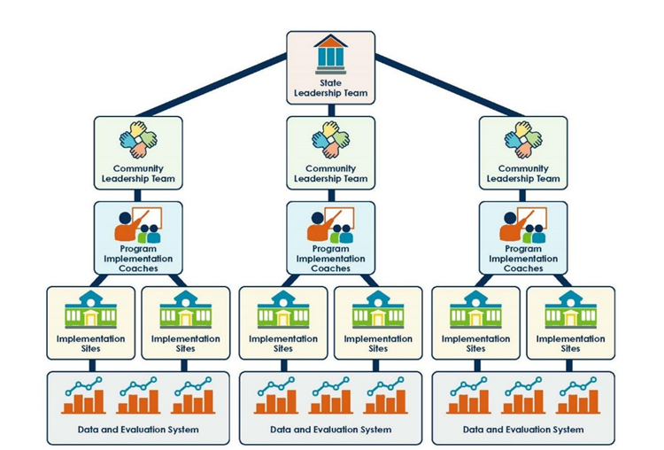
Professional Development Network
Notes:
A state professional development network of Program Implementation Coaches (i.e., systems coaches or training and technical assistance providers) who can provide training and coaching to community inclusion teams and local implementation site leadership teams leading to high fidelity implementation of equitable and effective inclusion practices. The professional development network of Program Implementation Coaches will be instrumental in scale-up as the state continues this work after the intensive TA and expands the number of communities and programs that are providing effective and equitable inclusive options to preschool children.
2-3 Community Inclusion Teams across the state. The Community Inclusion Team (CIT) is comprised of LEA administrators, community program administrators, program staff, family members, and others as appropriate who implement action plans, using the Community Indicators of High-Quality Inclusion, to guide and support the availability of effective and equitable inclusive early care and education environments. The state will continue to recruit CITs after the intensive TA is completed to expand the number of communities and programs providing equitable and effective inclusion.
At least 2 local implementation sites within each community. The CIT establishes a minimum of 2 local implementation sites to implement the Early Care and Education Environment indicators, which include critical teaching practices needed to maximize the access, meaningful participation, belonging, and developmental outcomes of young children with disabilities in early care and education environments.
Data decision-making tools are used to evaluate fidelity of implementation, outcomes, and data-based decision-making strategies.
Written plans and budgets to scale up and sustain these efforts over time at both the State and community levels.

Slide 9
Using the ECTA & NCPMI High Quality Indicator Tools
A national initiative with partners across early care and education to develop indicators of high-quality inclusive policies and practices at the
State,
Community,
Local program, and
Early care and education environments levels
The four sets of indicators will guide team processes to strengthen implementation and collaboration for high quality inclusion

Slide 10
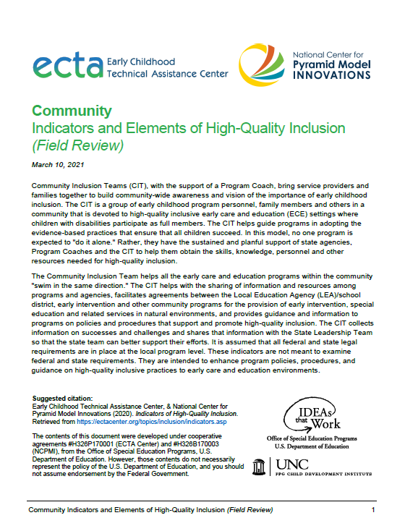
The Indicators of High-Quality Inclusion
https://ectacenter.org/topics/inclusion/indicators-state.asp

Slide 11
Terms We Use and What They Mean
State Leadership Team (SLT): An interagency, collaborative team that develops or strengthens policies, procedures, funding and other system infrastructure components. The SLT will use the State Indicators of High-Quality Inclusion to guide planning and measure progress.
Community Inclusion Team (CIT) : A leadership team comprised of LEA administrators, community program administrators, program staff, family members, and others as appropriate. The team implements action plans, using the Community Indicators of High-Quality Inclusion, to guide and support the availability of high-quality inclusive early care and education environments
Notes:
State Leadership Team: an interagency, collaborative team (this may be an already existing group) to develop or strengthen policies, procedures, funding and other system infrastructure components. The State Leadership Team will use the State Indicators of High-Quality Inclusion to guide planning and measure progress. This team of about 15 people agrees to meet monthly and make decisions collaboratively to build the state capacity to implement, sustain and scale-up high- quality inclusion.
Community Inclusion Team : a leadership team comprised of LEA administrators, community program administrators, program staff, family members, and others as appropriate. The team implements action plans, using the Community Indicators of High- Quality Inclusion, to guide and support the availability of high-quality inclusive early care and education environments and serves as a model for others in the state

Slide 12
What is a Program Implementation Coach?
Professional development experts responsible for providing guidance and technical assistance to Community Inclusion Teams and program-wide leadership teams in implementation sites. They provide training on practices and consultation to practitioner coaches as they guide the implementation of high-quality inclusion.

Slide 13
More Terms
Implementation Site: CIT establishes a minimum of 2 sites/ programs to use the ECE Environment Indicators of High-Quality Inclusion to implement critical teaching practices and create high-quality inclusive environments.
Implementation Site Leadership Team: Composed of administrators, program staff, family members, and community partners who implement action plans that guide, support, and ensure the availability of high-quality inclusive settings and the implementation of evidence-based inclusion practices.
Practitioner Coach: Provides onsite coaching to practitioners in high-quality inclusive practices as measured by the ECE Environment Indicators of High-Quality Inclusion.
Notes:
Implementation Site: The Community Inclusion Team establishes a minimum of 2 sites or programs to use the ECE Environment Indicators of High-Quality Inclusion to implement the critical teaching practices and environments needed to maximize the access, meaningful participation, and developmental outcomes of young children with disabilities in early care and education environments.
Implementation-Site Leadership Team: Composed of administrators, program staff, family members, and community partners who implement action plans that guide, support, and ensure the availability of high-quality inclusive settings and the implementation of evidence-based inclusion practices.
Practitioner Coach: Provides onsite coaching to practitioners in high-quality inclusive practices as measured by the ECE Environment Indicators of High-Quality Inclusion.

Slide 14
Our Implementation and Scale-up Approach: Statewide Implementation Guide
A process for implementing evidence-based practices statewide
Includes tools, materials, and examples
http://ectacenter.org/sig/

Slide 15
Major Components of the Guide
Installation
Implementation
Scale Up
Exploration and Planning
4 Essential Support Structures
State Leadership Team
Professional Development Network of Program Implementation Coaches
Implementation Sites
Data Evaluation Systems
Implementation Science
Resources, templates and examples
Notes:
Implementation Science: stages of implementation
Exploration and Planning
Installation
Implementation: Initial to Full
Scale-up
Resources, templates and examples

Slide 16
Intensive TA to be provided by ECTA across two and 1/2 years
Phase I: Relationship building and current inclusion initiatives. Monthly consultation and training events to the State Leadership Team, Program Implementation Coaches, Community Inclusion Teams, Implementation Sites, Classroom/Practitioner Coaches, and Practitioners.
Phase II: Monthly consultation to the state coordinators of the State Leadership Team and Program Implementation Coaches with a focus on state independence, sustainability, and scale-up.
Notes:
Phase I involves relationship building and understanding ongoing state context and current inclusion initiatives. Activities include monthly consultation and training events to the State Leadership Team, Program Implementation Coaches, Community Inclusion Teams, Implementation Sites, and Classroom/Practitioner Coaches.
Phase II involves monthly consultation to the state coordinators of the State Leadership Team and Program Implementation Coaches with a focus on state independence, sustainability, and scale-up.

Slide 17
Intensive TA Phase I: State Leadership Team
ECTA will:
Build relationships, establish communication system, understand context to optimize sustainability.
Meet with SLT to provide orientation and support
Communicate regularly to support planning of monthly meetings, reviewing and discussing progress
Support State team as they develop the Professional Development network of Program Implementation Coaches
Support Program Implementation Coaches
Notes:
State Leadership Team (SLT) selected and monthly meeting schedule established.
ECTA staff will meet with the SLT the first meeting to provide orientation to the initiative within the context of the state and to provide recommendations for effective meeting strategies and tools
SLT coordinator and ECTA staff communicate regularly to plan monthly meetings, discuss progress, share information.
SLT meets monthly using the State Indicators of High-Quality Inclusion to guide planning and measure progress (selecting and guiding Community Inclusion Teams, Program Coaches, data collection and analysis)
ECTA staff meet several times with the SLT in the first year; fewer meetings the second year
SLT will identify, with ECTA team support, the professional development network of program implementation coaches. These coaches will serve as the professional development network of program implementation coaches and provide ongoing training and external coaching to communities and local programs for their implementation of the Community, Local Program, and ECEE Indicators of High-Quality Inclusion, the Preschool Inclusion Toolbox, First Steps to Preschool Inclusion and other resources.

Slide 18
Intensive TA Phase I: Community Inclusion Teams
ECTA will:
Assist with identification of future implementation communities for scale-up
Provide on-going TA and training to Program Implementation Coaches
Provide support using Community, Local Program, and ECEE Indicators of High-Quality Inclusion
Notes:
LEAs establish (or confirm) their Community Inclusion Team that meets monthly
Program Coaches support meetings, data collection and data-based decision- making and the implementation of inclusive policies and practices as measured by Local Program and ECE Environment Indicators of High-Quality Inclusion with ECTA distance support
Community Inclusion Teams select 2-3 sites to serve as high fidelity implementation sites with Program Coach support
Community Inclusion Teams provide Practitioner Coaches to assist site practitioners in reaching high fidelity as measured by the ECE Environment Indicators of High-Quality Inclusion
Program Coaches support Practitioner Coaches as needed with ECTA distance support
Community Inclusion Teams provide data on quality indicator improvement
Program Coaches assist Community and State leadership teams to make data-based decisions with ECTA distance support

Slide 19
Intensive TA Phase I: Implementation Site Leadership Team
ECTA will:
Support Program and Practitioner Coaches
Support use of Local Program and ECE Environment Indicators
Support data-based decision making
Support expansion efforts
Notes:
ECTA staff will provide ongoing distance support to Program Coaches and Practitioner Coaches as they work toward establishing high quality inclusive programs and practices. ECTA staff will support Program Coaches to:
Support Community Inclusion Teams to implement high quality inclusive policies and practices as measured by the Local Program and ECE Environment Indicators of High-Quality Inclusion
Guide Practitioner Coaches at implementation sites as they strive for implementation of the ECE Environment Indicators of High-Quality Inclusion
Assist Community Inclusion Teams in collecting relevant data to make decisions across sites
Collaborate with the SLT to expand LEAs and implementation sites and maintain quality across years

Slide 20
Intensive TA Phase I: Practitioner Coaches
CIT and Implementation sites will:
Receive ongoing support from Program Implementation Coach
Identify/assign Practitioner Coaches
Practitioner Coaches provide on-going coaching to practitioners on high-quality inclusion practices.

Slide 21
Intensive TA Phase I: Practitioners
Practitioners will :
Receive on-site and ongoing coaching on high-quality inclusion practices as measured on the ECE Environment Indicators of High-Quality Inclusion

Slide 22
Intensive TA Phase II: Focus on Independence, Sustainability and Scale-Up
ECTA will :
Provide monthly consultation to SLT
Provide monthly consultation to Program Implementation coaches
Support independence, sustainability, and scale-up

Slide 23
Intended Outcomes
SLT Establish Program Implementation Coach Cadres
SLT Scale-up Community Inclusion Teams and Program Implementation Coaches
SLT and CIT: Data-based decision making, written sustainability plans
Notes:
The State Leadership Team (SLT) will make sustained progress on the State Indicators of High-Quality Inclusion
The SLT will have established a cadre of Program Coaches
The SLT will have increased the number of Program Coaches to scale-up
The Community Inclusion Teams will make sustained progress on the Local Program Indicators of High-Quality Inclusion
The implementation sites will make sustained progress on the ECE Environment Indicators of High-Quality Inclusion
SLT will have selected at least 2 more LEA teams and their programs for scale up
The SLT and Community Inclusion Teams will be collecting and using data to make decisions about progress, and the quality and effectiveness of the inclusive opportunities
The SLT and CIT teams will have written sustainability and scale-up plans and budgets

Slide 24
Application Requirements
COMMITMENT
Submitted by Part B 619 Coordinator and state Special Education Director
Letters of Commitment
Ability to allocate $20,000 per year to support your implementation activities
Committed FTE to implementation (1.0; can be two people)
Commitment of 2-3 LEAs to serve as initial implementation sites
Notes:
Submitted by Part B 619 Coordinator and state Special Education Director
Description of cross-agency State Leadership Team (letters of commitment)
Ability to allocate $20,000 per year to support your implementation activities
Committed FTE to implementation (1.0; can be two people)
Commitment of 2-3 LEAs to serve as initial implementation sites
In it for the long haul! Commitment to implementation is evident in the narrative.

Slide 25
Selection and Award
Applications due: August 18, 2023
States notified on or about: By the end of September. NOTE: OSEP must approve before we notify.
We will not select more than 2 states
Once selected, we will schedule a planning call

Slide 26
Frequently Asked Questions
What are our considerations for LEA selection? Should we select LEAs that have struggled with providing FAPE and LRE?
Will you do training on preschool inclusion practices?
We have a statewide system for training in inclusive practices and provide technical assistance to LEAs when requested. Are we eligible to apply?
4. Who should be selected as a program coach? Are they staff already within the LEA?
5. Our state wants to do a birth to five implementation in all settings and IDEA services. Can you help us with that?
6. We have a state team already, but it is not cross-sector. Should we form a new one?

Slide 27
Any Other Questions?
Thank you!

Slide 28
Conclusion

