Slide 1





Leadership TA Series
Leading from the Middle
Part 1: Maximizing Influence through Collaboration and Communication
April 6, 2022
4-5 pm ET
Session materials will be made available on the ECTA Center website after the presentation.
in collaboration with
Notes:
Christina:
Welcome to the first session, Leading from the Middle: Maximizing Influence Through Collaboration and Communication!
Thank you to all of you for taking time to join today and also a big thank you to our planning team for these standalone sessions includes representatives from Part C and 619 coordinators, DaSy, ECPC, ECTA, ITCA, and NASDSE 619 Affinity Group
Today’s call will be recorded and session materials (e.g., recording, powerpoint, and handout) will be available on the webpage after the presentation. https://ectacenter.org/~calls/2020/leadership.asp

Slide 2
Welcome to the Webinar!
For Networking and Accessibility:
Find your name in the participant’s list. Please select "More“ and then "Rename” to include your state/entity and role
Auto-generated closed captioning is available by selecting options in “CC Live Transcript ^” by selecting “show subtitle” or “full transcript”
Notes:
To support networking and getting to know each other, please find your name in the participant list– select more– and “rename” to include more about you (e.g., role, state, pronouns)

Slide 3
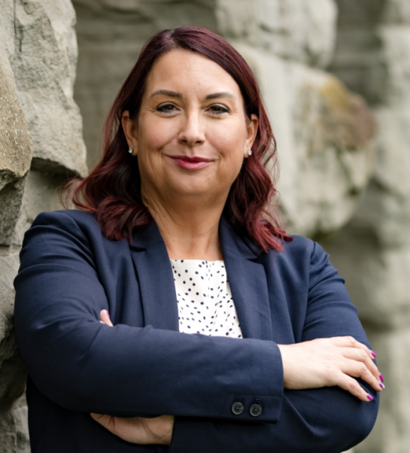
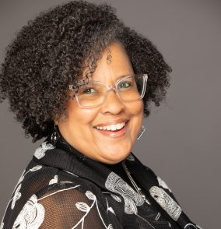
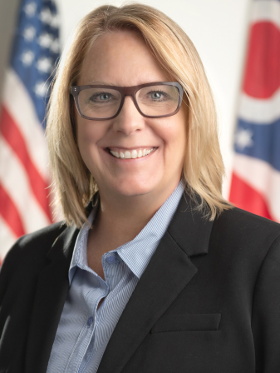
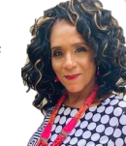
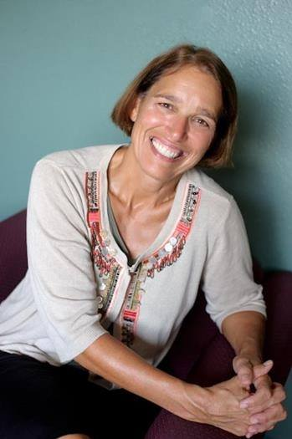
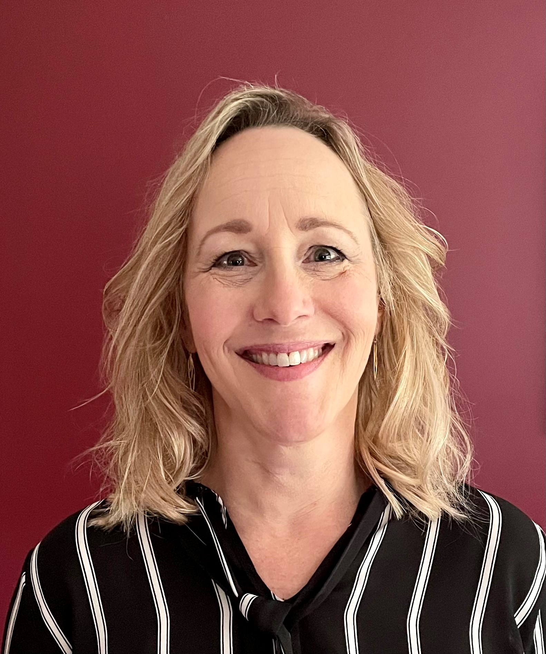
Overview for Today
Welcome and Introduction
Remarks from Glenna Gallo
Grounding by Dr. Sherri Killins Stewart
Conversation with the Panel
Peer group discussion and reflection
Concluding remarks
Glenna Gallo
Dr. Sherri Killins Stewart
Kim Hauck
Tracy Turner
Dr. Charlie Silva
Dr. Andrea Brinnel
Notes:
Kimberly Hauck, Director of the Ohio Department of Developmental Disabilities (Part C)
Tracy Turner, Part C Coordinator, Arkansas
Charlie Silva, State Special Education Director of Idaho (Part B)
Andrea Brinnel, 619 Coordinator, Connecticut
Please read more about the great group of leaders from their bios on the webpage located here: https://ectacenter.org/~calls/2020/leadership.asp

Slide 4
What do you experience when leading from the middle to shift policy, program, and practices to ensure equitable access to high-quality services (e.g., leaning into populations who have been historically underserved)….
Challenges
Successes
Leadership: Educating upper leadership and increasing attention on critical issues; Motivating school division leaders to prioritize early childhood special education (ECSE); Resistance to change at different levels
Policy: Being excluded from policy decisions; Layers of bureaucracy to navigate, limited resources to serve
Taking Action: Action planning; Engaging “everyone” in focusing on a racial/cultural equity lens
Network: Building a network/team internally; Developing a robust network of collaborative partners to support the system change
Planning: Intentional planning and attention to communication efforts and building relationships
Partners: Building relationships with partner programs such as child protection; getting tribal leadership to the table; Engaging families and providers
Notes:
Thank you for sharing challenges and success you’ve experienced when leading from the middle to shift policy, program, and practices to ensure equitable access to high quality services, especially for children and families who have been historically underserved…
Three main challenges you described are in leadership, policy, and taking action. The three main areas of successes are building a network, planning, and engaging partners which are necessary to meet the challenges you’ve described.

Slide 5
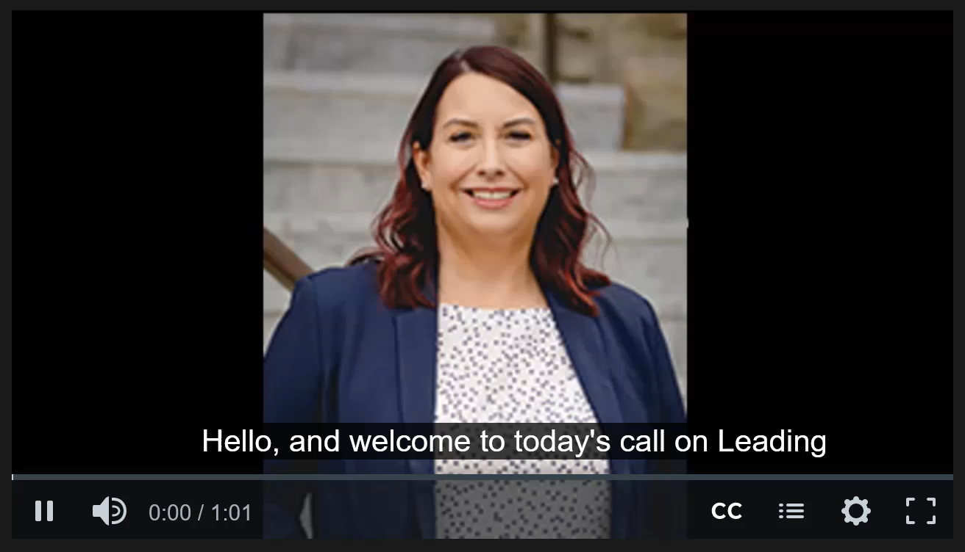
Introduction
Notes:
Glenna Gallo, former NASDSE president and Washington State Special Education Director will share her strategy for leading from the middle with three main points. (show the video)
She expands on her remarks in the video that you’ll be able to access on the webpage following the event.

Slide 6
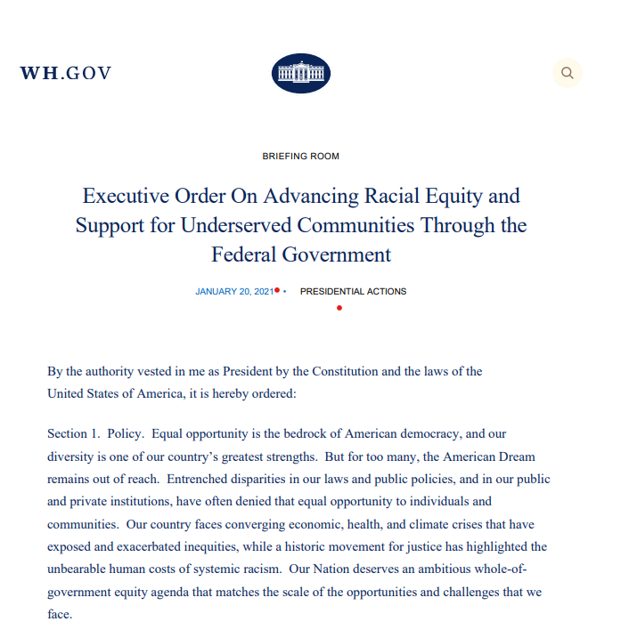
Executive Order
The term “equity” means the consistent and systematic fair, just, and impartial treatment of all individuals, including individuals who belong to underserved communities that have been denied such treatment, such as Black, Latino, and Indigenous and Native American persons, Asian Americans and Pacific Islanders and other persons of color; members of religious minorities; lesbian, gay, bisexual, transgender, and queer (LGBTQ+) persons; persons with disabilities; persons who live in rural areas; and persons otherwise adversely affected by persistent poverty or inequality.
The term “underserved communities” refers to populations sharing a particular characteristic, as well as geographic communities, that have been systematically denied a full opportunity to participate in aspects of economic, social, and civic life, as exemplified by the list in the preceding definition of “equity.”
Notes:
(Start with picture of Executive Order):
In addition to listening to perspectives from the field, this session and the leadership series overall will align with the Executive Order which describes the impact of systemic racism in policies, practices, and programs, emphasizes our collective role in taking action, and provides a definition (advance slide to definition) of equity focusing on the communities who have been historically underserved…
for those who may be listening in, I will read the definition of equity which states “equity” means the consistent….
And underserved communities haven been systematically denied a full opportunity to participate in aspects of economic, social, and civic life…

Slide 7
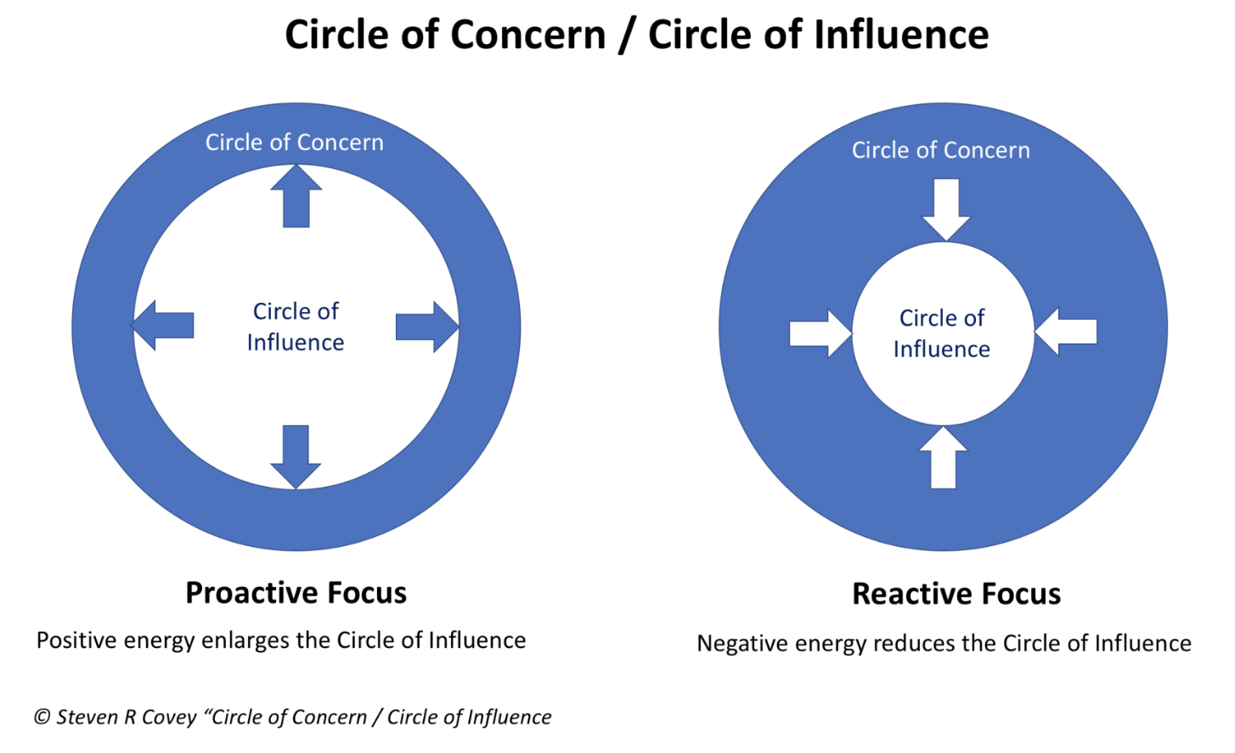
Circles of Influence
Notes:
And so, the Executive Order requires us to have a proactive focus to identify how we can influence disparities to ensure that each and every young child with disabilities and their families, especially those who have been historically underserved, experience equitable access to high-quality services that result in positive outcomes.
Reactively focusing on our concerns without identifying what we can do, limits our circle of influence as shown on the right….
A shift in our mindset to expand what we think we can affect expands our circle of influence (as shown on the left with the inner circle getting bigger) especially as we partner with others building networks where we can leverage our collective influence to create and sustain system changes that benefit all children, families, and communities.

Slide 8
Grounding by
Dr. Sherri Killins Stewart
Director of State Systems Alignment and Integration and Co-Director of State Services for the BUILD Initiative and an Independent Consultant
Notes:
Now I’d like to welcome and thank Dr. Sherri Killins Stewart, Director of State Systems Alignment and Integration and Co-Director of State Services for the BUILD Initiative and an Independent Consultant, who we’ve been grateful to have supporting the planning of this leadership series and who will be providing initial grounding before moderating the conversation with the panel.

Slide 9
Poll: How influential do you feel in your…
  Ability to develop strategic partnerships from the middle with leadership, staff, and community?
  Ability to include and respond to diverse partners?
  Ability to educate, inform, and advocate for changes based on multiple partners and interest?
1 = Not at all influential
2 = Slightly influential
3 = Somewhat influential
4 = Very influential
5 = Extremely influential
Notes:
Great, thanks Christina. We’d like to learn from you about how influential you feel in your role… please take 30 seconds or so and answer these three questions…

Slide 10
Leadership Knowledge and Skills
Strategic Leadership
Operational Leadership
3.2.3: Develop strategic partnerships with programs, agencies, and organizations to meet the needs of all infants and young children with risk conditions, delays, and/or disabilities (birth to five) and their families.
2.1.3. Demonstrate the ability to identify, gather, and use input from *diverse **stakeholders to administer the Part C and/or Part B (619) service system.
Notes:
While you’re answering,
Do the operational leadership in a strategic way
3.0 Strategic Leadership
3.2 Strategic Thinking and Planning: After completion of this module, you will be able to facilitate *diverse **stakeholder groups to implement a work plan with equitable and measurable goals, objectives, activities, identified resources, timelines, and outcomes to develop or improve a service issue/need for the state Part C and/or Part B (619) service system.
3.2.3. Develop strategic partnerships with programs, agencies, and organizations to meet the needs of all infants and young children with risk conditions, delays, and/or disabilities (birth to five) and their families.
2.0 Operational Leadership
2.1 Communication and Collaboration:
After completion of this module, you will be able to build state and local collaborations with programs, agencies, and organizations to meet the needs of all infants and young children with risk conditions, delays, and/or disabilities and their families who represent *diverse backgrounds.
2.1.3. Demonstrate the ability to identify, gather, and use input from *diverse **stakeholders to administer the Part C and/or Part B (619) service system.
Key:
* Diverse (e.g., representing linguistic, racial, ethnic, cultural, socio-economic, educational, and historically underrepresented backgrounds).
**Stakeholders (e.g., including families, administrators, staff, school and other board or council members, community members, faculty, policy makers, and historically underrepresented populations).

Slide 11
Equity Leadership Proposition
Ensuring racial and economic equity for young children including ensuring:
Increasing opportunities for children and adults who care for very young children of color and in poverty and
Removing barriers to those opportunities that support optimal growth and development;
that resources, burdens, and rewards are distributed in ways that remove and do not exacerbate inequities; so that those with the greatest challenges are adequately maintained and not further disadvantaged; and
Mechanisms are in place to determine who is advantaged and disadvantaged by initiatives, policies and programs designed to advance equity and dismantle inequities.
Source: developed by The BUILD Initiative through the leadership of Sherri Killins Stewart Ed.D., Aisha Ray Ph.D, and Michelle Stover Wright M.S.
Notes:
In your operational and strategic leadership role we’re asking you to do… out of your circle of influence

Slide 12
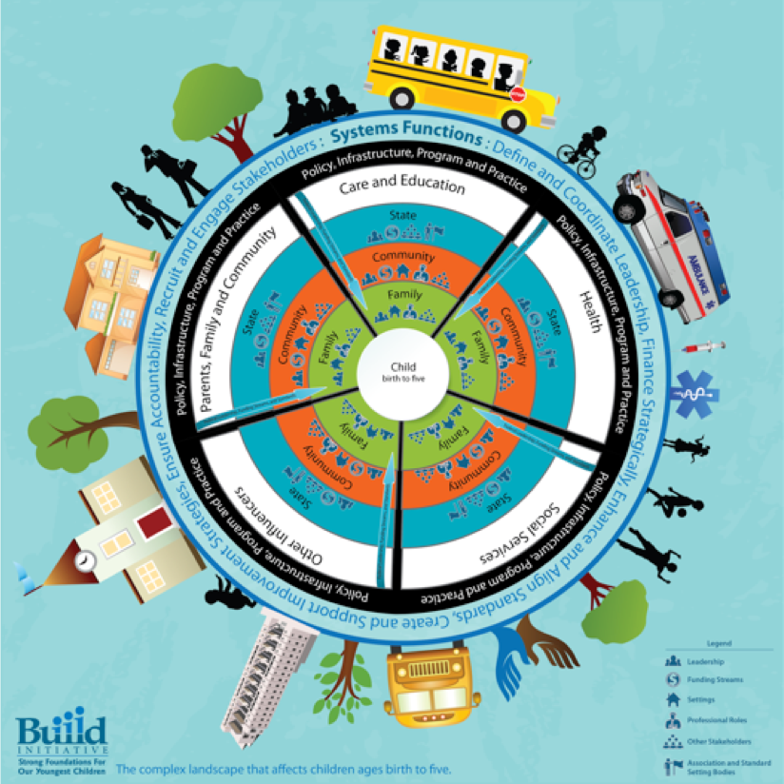
Build Initiative

Slide 13
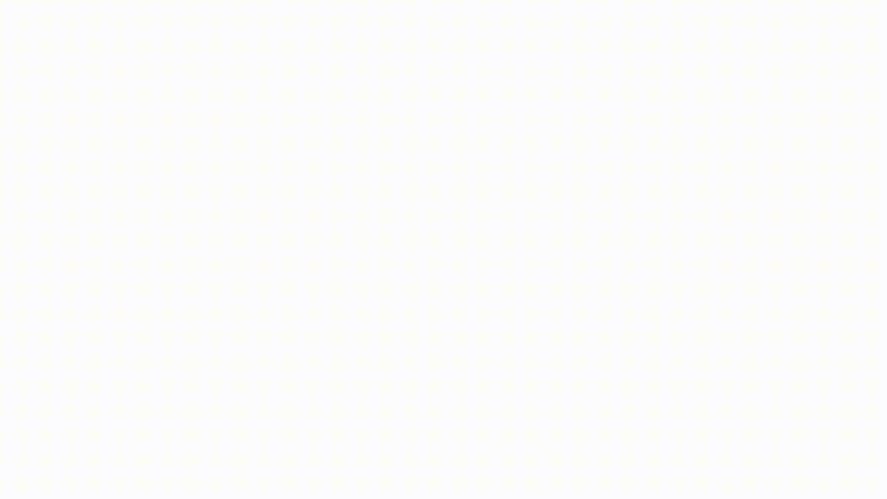
Early Childhood System
https://buildinitiative.org/approach/early-childhood-system/
Notes:
Point: Kids and Families need more and it’s not just up to them… Way to influence
Potential transition to next slide:
It’s important to understand the situatedness of families and children within your state or entity by race/ethnicity, place, economic status, and other characteristics of underserved communities as defined in the Executive Order as these communities have been “systematically denied a full opportunity to participate in aspects of economic, social, and civic life”
Benefiting from services is not just about the service is self but the situatedness of families and children matter.
An early childhood system contains:
Interdependent policies, programs, services, and infrastructure.
All child- and family-serving systems—such as early learning, health, housing, economic development, and transportation.
Connections of each of these elements to each other.
https://buildinitiative.org/approach/early-childhood-system/
Every member of our team must recognize that the child- and family-serving systems that are not generally considered to be under the umbrella of the early childhood system—like housing, economic development, and transportation—are less often viewed as opportunities for or barriers to child and family well-being. Each of these systems, and how they interact with one another, impacts a child’s outcome.
It is up to early childhood systems builders to identify the barriers to positive outcomes that result from an issue with any of the elements within the overall system. This is one of the early childhood systems builders’ greatest challenges, as these barriers are deeply interwoven with our country’s history and ongoing practice of racial discrimination and disinvestment.

Slide 14
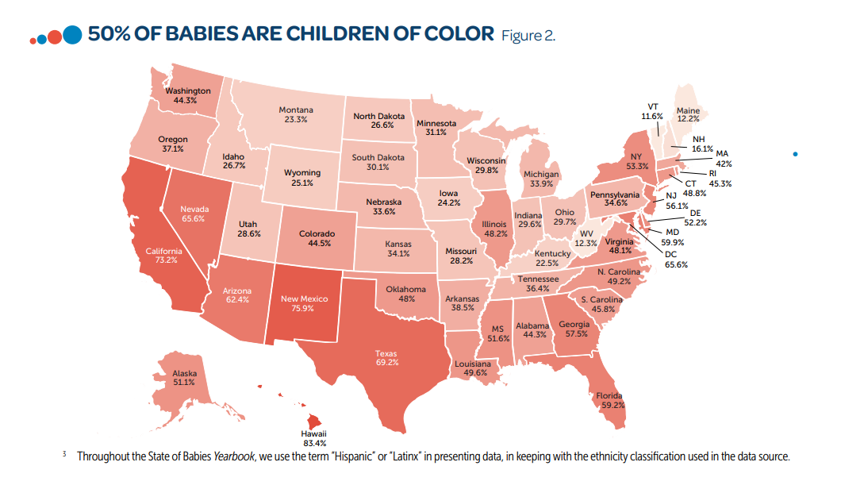
Children of Color
ZERO TO THREE. State of Babies Yearbook 2021. Retrieved from https://stateofbabies.org/about-us/
Notes:
(Set the context that the point of this is not for these data slides to prove that there is a problem.... the work is understanding how children and families are situated within local and state context...across many indicators and different types of data)
50% of Babies (or infants and toddlers) are children of color.. How do you listen to children and families of color in your state or entity?
https://stateofbabies.org/national/Note that the Puerto Rico (PR); the outlying areas of American Samoa, Guam, the Northern Mariana Islands, and the Virgin Islands; and the three freely associated states of the Federated States of Micronesia, the Republic of Palau, and the Republic of the Marshall Islands are not included in the map in the State of Babies Yearbook

Slide 15
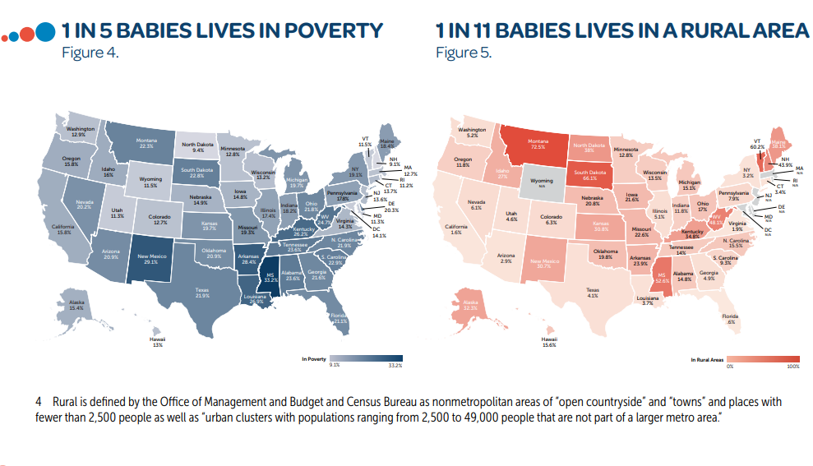
Babies living in poverty or rural areas
ZERO TO THREE. State of Babies Yearbook 2021. Retrieved from https://stateofbabies.org/about-us/
Notes:
1 in 5 Babies lives in poverty and 1 in 11 babies lives in a rural area… .How do you listen to children and families living in poverty or from rural parts of the state? (and listen to families of color, living in rural poverty and in a rural part of the state)
ACCESS = Access includes the following elements: awareness, affordability, accessibility, availability, accommodation, and acceptability
https://buildinitiative.org/wp-content/uploads/2018/07/ProjectHopeProtocol_TakingAction.pdf
How does access vary for children and families?

Slide 16
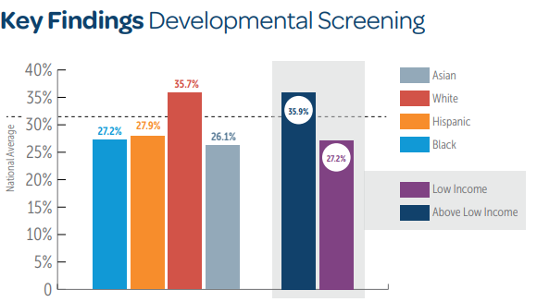
Developmental Screenings
ZERO TO THREE. State of Babies Yearbook 2021. Retrieved from https://stateofbabies.org/about-us/
Notes:
(Paraphrase from below)
According to the Zero to Three State of Babies 2021 Yearbook,
“Nationally, only 1 in 3 (32.5 percent) infants and toddlers from 9 through 35 months old received a developmental screening in the past year. “
“Nationally, the percentage of White parents (35.7 percent) reporting that their infants and toddlers had received a developmental screening in the past year was higher than the national average of 32.5 percent. Hispanic (27.9 percent), Black (27.2 percent), and Asian (26.1 percent) parents reporting that their child had received a developmental screening in the past year were similar and lower than the national average.
• Income—Nationally, the average number parents with low income (27.2 percent) reporting that their child had received a developmental screening in the past year was significantly less than the number of families above low income (36.0 percent). Due to small sample sizes, most of the state estimates for families with low income were either unreliable or suppressed, however, among states with significant differences, all differences also showed lower rates of screening for families with low income.”
Significance Quoted from the State of Babies Yearbook “Children who receive a developmental screening are more likely to have delays identified, be referred for early intervention, and be determined eligible for early intervention services. For this reason, the American Academy of Pediatrics recommends that children receive developmental screening from their physicians at least three times before their third birthday. It is difficult to interpret the percentage of children receiving early intervention services, which has remained stable over several years. Because the Yearbook shows concerning rates of conditions that create risk for developmental delays, such as preterm birth, living in crowded housing, high rates of maltreatment, and multiple ACEs—more prevalent in children of color and those in families with low income— monitoring the development of these infants and toddlers is an important prevention measure. Even as early intervention service providers worked hard to continue supporting the infants and toddlers already identified as having developmental delays and disabilities, the pandemic exacerbated the conditions, including mental health issues, that could undermine future development. Yet, only six states have elected to serve an “at risk” category of children, to catch and address those risks before they develop into something more serious.”

Slide 17
Recent IDEA Section 618 Child Count Data
“Recent IDEA section 618 (20 U.S.C. 1418) child count data from State IDEA Part C and Part B, section 619 programs indicate that these systems are not being implemented as effectively or equitably as they should be.
The data show that there are groups of infants and toddlers, specifically Black, Asian and American Indian or Alaska Native and preschool children, specifically Black and Asian Americans, that are less likely to receive IDEA services.”
-OSEP
Notes:
“Recent IDEA section 618 (20 U.S.C. 1418) child count data from State IDEA Part C and Part B, section 619 programs indicate that these systems are not being implemented as effectively or equitably as they should be. The data show that there are groups of infants and toddlers, specifically Black, Asian and American Indian or Alaska Native and preschool children, specifically Black and Asian Americans, that are less likely to receive IDEA services. “
Quick mention:
You can see in the graphs the groups highlighted where the % served is lower than the % in the population compared to the white group is more likely to be % served under IDEA Part C and 619
**************************************************
The 43rd Annual Report to Congress, 2021 presents data collected from States.
https://sites.ed.gov/idea/2021-individuals-with-disabilities-education-act-annual-report-to-congress/
https://sites.ed.gov/idea/files/43rd-arc-for-idea.pdf
• Cumulative child count data reveal Native Hawaiian or Other Pacific Islander and Hispanic/Latino infants and toddlers had risk ratios of 1.3 and 1.1, respectively, indicating that infants and toddlers in each of these racial/ethnic groups were more likely than those in all other racial/ethnic groups combined to be served under IDEA, Part C. Cumulative child count data reveal American Indian or Alaska Native, Asian, and Black or African American infants and toddlers and infants and toddlers associated with two or more racial/ethnic groups had risk ratios xxi of 0.8, 0.9, 0.9, and 0.9, respectively, indicating that infants and toddlers in each of these groups were less likely than those in all other racial/ethnic groups combined to be served under IDEA, Part C. Cumulative child count data reveal White infants and toddlers had a risk ratio of 1, indicating they were as likely to be served under Part C as the infants and toddlers of all other racial/ethnic groups combined (Exhibit 4).
In 2019, American Indian or Alaska Native, Native Hawaiian or Other Pacific Islander, and White children and children associated with two or more racial/ethnic groups ages 3 through 5 (early childhood) had risk ratios above 1 (i.e., 1.3, 1.3, 1.1, and 1.4, respectively). This indicates that the children in each of these groups were more likely to be served under Part B than were children ages 3 through 5 (early childhood) in all other racial/ethnic groups combined. Hispanic/Latino and Asian children ages 3 through 5 (early childhood), were associated with risk ratios less than 1 (i.e., 0.8 and 0.7, respectively), indicating that the children in each of these groups were less likely to be served under Part B than children ages 3 through 5 (early childhood) in all other racial/ethnic groups combined. Black or African American children ages 3 through 5 (early childhood) were associated with a risk ratio of 1, indicating that they were as likely to be served under Part B as the children of all other racial/ethnic groups combined (Exhibit 14).

Slide 18
Probability of being identified with a disability ages 5-21
“In 2019, for all disabilities, American Indian or Alaska Native students, Black or African American students, Hispanic/Latino students, Native Hawaiian or Other Pacific Islander students, and students associated with two or more races ages 5 (school age) through 21...were more likely to be served under IDEA, Part B, than were students ages 5 (school age) through 21 in all other racial/ethnic groups combined."
Notes:
Then comes the shift:
In general, school aged students of color were more likely to be served under IDEA.
AND if you remember, in Early Childhood (Early Intervention and Preschool), Black or African American children specifically were less likely to receive services….
You can read more about disparities described in countless other reports including the Children’s Equity Project reports, National Black Child Agenda.... which we have linked to as resources at the end…. And these are all reminders of how important it is to have our data disaggregated by race and ethnicity and include different sources of data to better understand how children and families are situated in the context of our state and across communities... the child count data is only one part of the story of access as you know -- looking at outcomes, suspension and expulsion data, whether children with disabilities are included with their peers, receiving services in their natural environment...
And how are we listening to families and communities to inform decision making?
In 2019, for all disabilities, American Indian or Alaska Native students, Black or African American students, Hispanic/Latino students, Native Hawaiian or Other Pacific Islander students, and students associated with two or more races ages 5 (school age) through 21, with risk ratios of 1.6, 1.4, 1.1, 1.5, and 1.1, respectively, were more likely to be served under IDEA, Part B, than were students ages 5 (school age) through 21 in all other racial/ethnic groups combined.
https://sites.ed.gov/idea/2021-individuals-with-disabilities-education-act-annual-report-to-congress/
In 2019, for all disabilities, American Indian or Alaska Native students, Black or African American students, Hispanic/Latino students, Native Hawaiian or Other Pacific Islander students, and students associated with two or more races ages 5 (school age) through 21, with risk ratios of 1.6, 1.4, 1.1, 1.5, and 1.1, respectively, were more likely to be served under IDEA, Part B, than were students ages 5 (school age) through 21 in all other racial/ethnic groups combined. Asian students and White students ages 5 (school age) through 21, with risk ratios of 0.5 and 0.8, respectively, were less likely to be served under IDEA, Part B, than were students ages 5 (school age) through 21 in all other racial/ethnic groups combined (Exhibit 26).

Slide 19
Conversation with the Panel
  Kim Hauck, Director of the Ohio Department of Developmental Disabilities (Part C)
  Tracy Turner, Part C Coordinator, Arkansas
  Charlie Silva, State Special Education Director of Idaho (Part B)
  Andrea Brinnel, 619 Coordinator, Connecticut
Notes:
The equity leadership proposition provides as a framework for taking action:
to shift policy, program, and practices
ensuring equitable access to high-quality services
by tailoring solutions that result in positive outcomes for each and every young child with disabilities and their families, especially those who have been historically underserved.
This is not work that can be done alone. Partnerships with leadership and those we contract with to provide services are essential partners to achieve goals. Benefiting from services is not just about the service is self but the situatedness of families and children matter.
Strategic thinking, listening, planning, communication, and collaboration are critical leadership skills especially when leading from the middle. This includes considering what values are held and the messages that are needed for different audiences. Leveraging your power from the middle to influence decisions and share foundational information for system changes to increase benefit, access, and outcomes.
Briefly Introduce yourself including a short response to this question in 3 minutes. The overall conversation will be centering young children with delays and disabilities (birth to five) and their families, especially those who have been historically underserved, and how are you building strategic partnerships, empowering leaders, and leading from the middle to build equitable and inclusive systems to meet their needs.
Considering your role what suggestions do you have about leading from the middle?
Charlie and Kimberly, please speak to: How do you work with and empower the Part C or 619 coordinator in your state?
Andrea and Tracy: Please mention any specific strategies you use as you provide input and try to influence leadership in your state
Question and Answer with Charlie & Kimberly (7 minutes total): Who are the partners in your state who help create policy and practice to ensure (access, benefit, or positive outcomes) for each and every young child with disabilities and their families? How does the Part C or 619 coordinator contribute to and inform that work? Please share an example from your experience that speaks to access, benefit, or positive outcomes for children and families, especially those who have been historically underserved.
Question for Andrea and Tracy: Regardless of our best intentions, we know from the data that Black and Brown children and families are most often not included. How do you leverage leaders in a position above you and partners across the system to ensure all children and their families have access to experiences in Part C and 619 as we build these strategic partnerships especially when some need a differential response? Please share an example from your experience.
Open question for a panel member to answer: How are you engaging partners (teams, networks) in listening to families and communities most impacted to proactively to shape policies and practices? Please share an example from your experience.
Open question for a panel member to answer: What are some of the opportunities and barriers in expanding your influence in workgroups and committees so you’re investing your time with partners in ways that increases access for all children, especially those mentioned in the Executive Order who have been historically underserved? Please share an example from your experience.

Slide 20
Peer Group Discussion and Reflection
Sharing your experiences, how can Part C and 619 leaders
How do you educate, advocate, and leverage partnerships to tailor solutions that result in positive outcomes for each and every young child with disabilities and their families, especially those who have been historically underserved?
How do you identify your partners to reach populations who do not connect to services based on the current structures? What are examples of tailored solutions to achieve universal goals?
What are your experiences working with leadership and those who support your work in shifting policies and practices responding to the children and families you serve? What are examples of shifts in policy, programs, and practices? How did the foundational work of building partnerships lead to these system changes?
Notes:
Sharing your experiences with your peers, how can Part C and 619 leaders
Educate, advocate, and leverage partnerships to tailor solutions that result in positive outcomes for each and every young child with disabilities and their families, especially those who have been historically underserved?
How do you identify your partners to reach populations who do not connect to services based on the current structures? What are examples of tailored solutions to achieve universal goals?
What are your experiences working with leadership and those who support your work in shifting policies and practices responsive to the children and families you serve?
What are examples of shifts in policy, programs, and practices?
How did the foundational work of building partnerships lead to these system changes?

Slide 21
Leading from the Middle Part 2: Application in Your Daily Work
April 14 @ 3-4pm ET (2-3pm CT; 1-2pm MT; 12-1pm PT)
Action Challenge:
  What is one key action you can take based on your learning today?
  Continue reflecting on these questions from the small group and bring your ideas to the next session
  What data can you bring about children and families in your Part C and 619 state/entity system, leaning into populations who have been historically underserved?
Notes:
We hope you’ll join us for part 2 and come and share with your colleagues
bring data about children and families in Part C and/or 619 systems (i.e., leaning into populations who have been historically underserved

Slide 22
Additional Resources
Dawn of System Leadership: https://ssir.org/articles/entry/the_dawn_of_system_leadership
Project HOPE Protocols to Support a Leadership Learning Journey: https://buildinitiative.org/hope-protocols/
Mary Pauper: A Historical Exploration of Early Care and Education Compensation, Policy, and Solutions https://earlyedcollaborative.org/what-we-do/ourwork/mary-pauper/
Children's Equity Project Resources: https://childandfamilysuccess.asu.edu/cep/initiatives/reports
Black Child National Agenda: America Must Deliver on its Promise: https://equity-coalition.fpg.unc.edu/wp-content/uploads/Black-Child-Natl-Agenda-Final2_Web.pdf
Targeted Universalism, Othering and Belonging Institute: https://belonging.berkeley.edu/targeted-universalism
Franklin Covey Resources

