Slide 1
NY Part C Early Intervention Program – Incorporating Learn The Signs. Act Early in Child Find
Donna M Noyes, PhD, Co-Part C Coordinator
Kirsten Siegenthaler, MSPH, Part C Data manager
June 27, 2014

Slide 2
NYS Early Intervention Program
NYS Department of Health is Lead Agency
One of the nation’s largest early intervention systems, serving approximately 68,000 children annually
Local programs are administered by 57 counties and New York City
Comprehensive child find system and public awareness program to ensure eligible infants and toddlers are identified, located, and referred for evaluation

Slide 3
State Implementation Grant
State Implementation Grant to Improve Services for Children with ASD and other disabilities and their families (Sept 2009 – Aug 2011)
Health Resources and Services Administration, H6MMC15104
Funded in Year 2 of the federal initiative for two years
Major goals included improving adherence to AAP guidelines for ASD screening of 18 & 24 month olds & increasing public awareness of early signs of ASD and other developmental disabilities
Important opportunity to incorporate Learn the Signs. Act Early. as part of Child Find

Slide 4
Learn the Signs. Act Early.
New York Part C Early Intervention Program has incorporated LTSAE campaign materials and messages in many ways over past 4 years:
Brochure and Poster for the public
Public Library campaign
Social Media Campaigns
Physician Grand Rounds and CME Trainings
Online Portal for Physicians
Best Practice Protocol for Early Screening for ASD
Public Health Live broadcast

Slide 5
Brochure and Poster
Available in 3 languages:
English
Spanish
Mandarin
Incorporated in many initiatives
Tens of thousands distributed

Slide 6
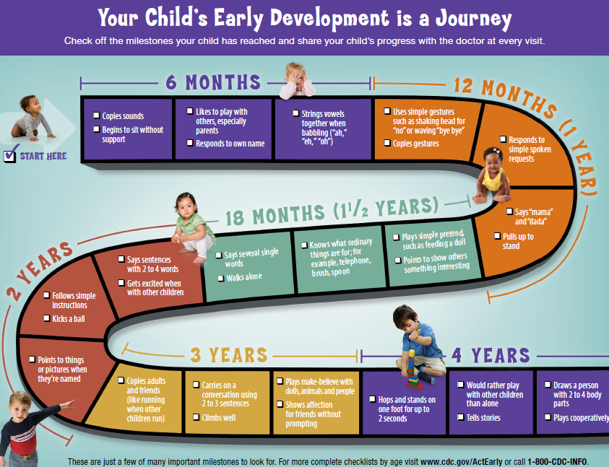
Public Library Campaigns
First year: 173 public library branches
Second year: 295 public library branches
Library Connections (NJ librarians)

Slide 7
Social Media Campaigns
Bureau of Marketing and Creative Communication
Facebook
Twitter
Promote awareness, early screening for autism and developmental delays
Connect families to resources in NY and nationally

Slide 8
Grand Rounds
NYS Association of Family Physicians
CDC developed
Autism Case Training (ACT) curriculum
5 grand rounds

Slide 9
CME Trainings
Collaborations:
NYS Academies of Pediatricians & Family Physicians
University Centers for Excellence in Developmental Disabilities
Hunter College and FAR Fund
Two-Night 6 hour curriculum
Part 1: Screening, Diagnosis, Early Identification and Referral of children with ASDs
Part 2: Communicating with Parents, Evidence Based Interventions and Alternative Medicine Interventions
Abbreviated curriculum in 2 ½ hours
Annual and regional meetings of the academies’ members
Department sponsored meetings for physicians
Over 300 physicians attended the trainings
Parents acted as trainers
Local Part C Early Intervention Officials attended to reinforce connections with physicians and to promote referrals to EI

Slide 10
Online Portal
Support physicians after they were trained
Link to find local resources for families
Link to order DOH and LTSAE materials

Slide 11
Best Practice Protocol
Promote pediatricians’ knowledge and understanding of ASDs and adherence to American Academy of Pediatrics guidelines for universal screening of toddlers for ASDs
Full protocol available on-line
Desk Reference distributed to pediatricians across the State

Slide 12
Public Health Live
SUNY Albany School of Public Health
CDC LTSAE Grant
Podcast on April 19, 2012
CDC “Learn the Signs. Act Early.” messages
video “Baby Steps”
1,607 registrants live
337 views after
Free online
www.phlive.org

