Slide 1
Learn the Signs. Act Early.
Improving Early Identification of Children with Autism and other Developmental Disabilities
Camille Smith, M.S., Ed.S.
Behavioral Scientist
National Center on Birth Defects and Developmental Disabilities
Division of Birth Defects and Developmental Disabilities, Prevention Research Branch
Notes:
Thank you very much for joining the webinar today. I hope that today’s webinar will give you practical ideas and tools that you can take back into your communities to improve early identification for children with autism and other developmental disabilities.

Slide 2
What I will cover:
Overview of “Learn the Signs. Act Early.”
Overview of Birth to Five: Watch Me Thrive!
Some LTSAE products available to you
Notes:
I’ll give you a brief overview of the LTSAE program, as well as the new federal initiative “Birth to Five Watch Me Thrive” and briefly talk about our products including some new ones that you may be able to use within your programs.

Slide 3
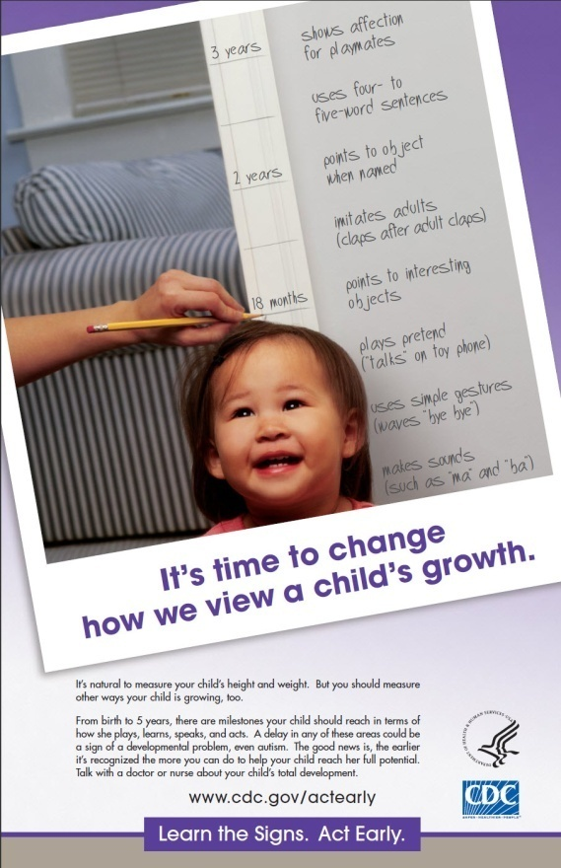
"Learn the Signs. Act Early." Mission
To improve early identification of autism and other developmental disabilities so children and their families can get the services and support they need
Notes:
LTSAE has as it’s goal to improve early identification of autism and other developmental disabilities so children and families can get the services and support they need as soon as possible. This goal goes beyond traditional goals of public awareness campaigns; we want to improve identification, not just awareness about its importance. The program also goes beyond just focusing on children with autism. We have a broader mission and work to identify all developmental disabilities.

Slide 4
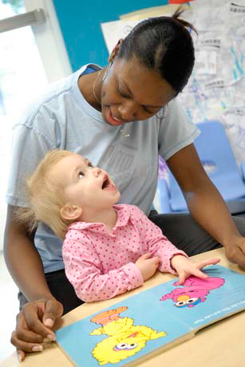
Why “Learn the Signs. Act Early.”?
1 in 4 children, age 0-5 years are at moderate or high risk for developmental, behavioral, or social delay
About 1 in 6 children aged 3-17 has a developmental disability
About 1 in 68 children has autism spectrum disorder
Notes:
Why Learn the Signs Act Early?
We know that developmental disabilities are more common than people think. The national survey of children’s health states that 1 in 4 children between the ages of birth and 5 are at moderate or high risk for developmental, behavioral or social delay. In addition, about 1 in 6 children aged 3-17 has a developmental disability and recent data from CDC’s Autism Developmental Disability Monitoring Network reported that 1 in 68 children has an autism spectrum disorder. We also know that most children identified with Autism had a developmental concern documented in their evaluation records before the age of 2 years, however the median age of diagnosis is 4 years.
Since the prevalence of disability is increasing we want to identify children so they can get the services and supports they need as early as possible. We all know that early intervention improves skills and outcomes, increases school readiness and enables families to develop strategies and obtain resources needed for successful family functioning.

Slide 5
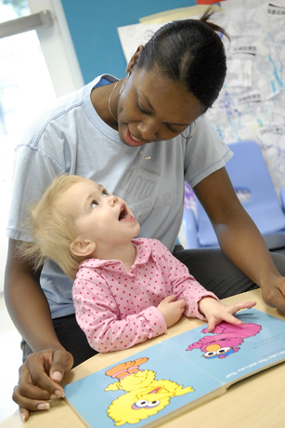
Learn the Signs. Act Early. Program Components
Health education campaign
Act Early initiative
Research and evaluation
Notes:
The Learn the Signs Act Early program has three components: a health education campaign, the act early initiative and we engage in a great deal of research and evaluation. I am going to very briefly tell you about each of these.

Slide 6
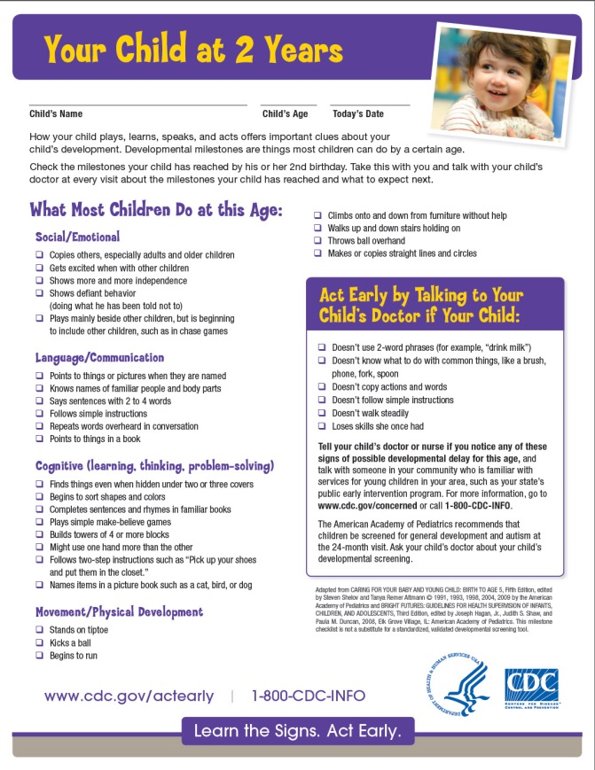
"Learn the Signs" Program Component 1: Health Education Campaign
Aims to change perceptions about the importance of identifying developmental concerns early
Gives parents, professionals free tools to help track development
Notes:
As was mentioned previously, developmental disabilities are more common than most people think, and intervention can be more helpful than people realize. We want to change these perceptions, and we want to give parents and professionals the tools they need to take action. The milestone checklist you see here is the foundation of all we do. It provides milestones in each of 4 domains, warning signs, and what to do if you’re concerned, all in a parent-friendly way.
And who is our audience?
Our primary target audience is all parents of children under 5
Our secondary target audiences are:
Early child care and education providers – broadly defined. When we talk about early care and education providers, we are talking about child care and head start providers, home visitors, child welfare and child mental health workers, all those providers who work with or spend time with young children under the age of 5. in fact, all those places and people where Child Find efforts may reach out to in an effort to identify children for services.
Health care providers are also a target audience as well as Public Health Professionals such as WIC staff.

Slide 7
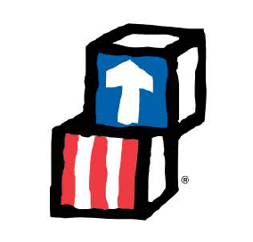
Campaign Strategy: Developmental Monitoring
To integrate Learn the Signs materials into other national, state, and local programs that
Serve parents of young children
Serve low-income, disadvantaged populations
Have interest or mandate in child development
Lack tools/resources for helping parents track milestones
High priority programs
WIC and Child Find efforts
Child care and Head Start
Home visiting
Notes:
Where are parents? Especially, where are the low-income, disadvantaged families who really need us? We can find them through programs that serve young children and their families. Here at the national level we are specifically targeting underserved populations by working these high-priority partners to integrate Learn the Signs… materials into their programs.

Slide 8
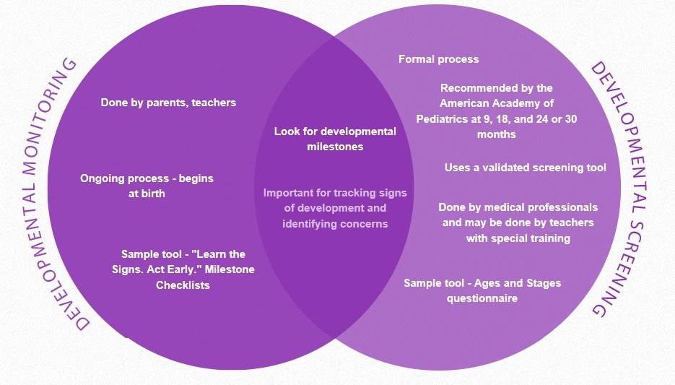
Developmental Monitoring and Developmental Screening
Notes:
Our milestone checklists are designed to promote developmental monitoring.
I thought it might be helpful to compare that with developmental screening: developmental monitoring is important for all young children. All parents and providers should be aware of developmental milestones – how children grow, move, communicate, interact, learn and play. This information helps equip parents to know what to expect in regard to their child’s developmental milestones, get ideas on how to promote positive development and be aware of potential concerns and what to do about those concerns. Monitoring means observing and noting these milestones in an ongoing way, usually using an objective checklist.
Developmental Screening is a more formal process frequently administered according to the American Academy of Pediatrics recommended schedule and uses a validated screening tool.
Developmental monitoring and screening complement one another nicely and both are important.
Monitoring can help determine if a developmental screen is needed sooner than expected, empower families to be aware of their child’s development, can help facilitate communication between provider and parent and provide additional support to developmental screening results.

Slide 9
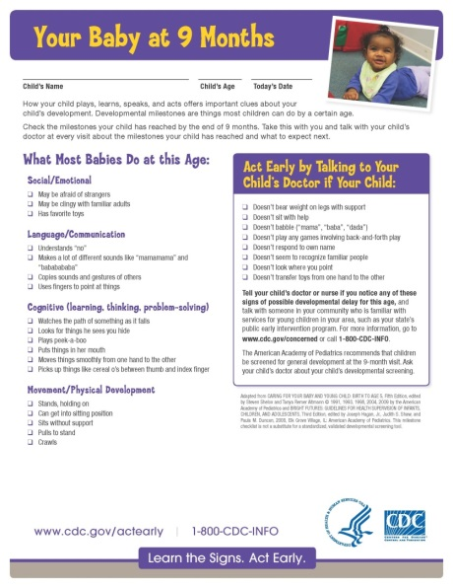
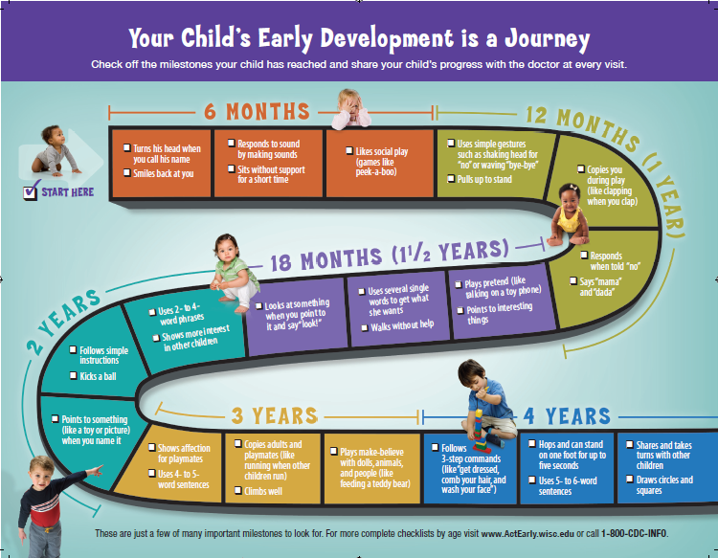
Notes:
Here’s just a sampling of our most popular materials including a milestone checklist, the Milestones brochure, the Milestone Moments booklet, and growth chart.

Slide 10
Campaign Materials
Free, customizable materials for state and community programs
Are research-based and parent-friendly
Build on AAP gold standard lists
Parents, early educators can use as monitoring tools
Encourage parent-health care provider dialogue
Available in English and Spanish
Useful for
Any program that serves parents of young children and has interest or mandate in child development
www.CDC.gov/ActEarly
ActEarly@cdc.gov
Notes:
LTSAE materials are based on the gold standard lists of developmental milestones from the American Academy of Pediatrics. They are easy to use and self-explanatory, and they are are available in English and Spanish, and a few materials are available in other languages as well. The materials are a perfect fit for child find efforts for use within communities that are working to educate providers and parents about development and that have as their mission to identify children who may be eligible for early intervention services.
Any program can use the Learn the Signs materials and also any program can put its own logo and contact information on them and make them their own. In fact, we strongly encourage that.
The brochure shown here is a product of great collaboration over an idea that our Act Early Ambassador in Wisconsin, Gail Chodron (who you will hear from soon) and her team initiated, and it's become one of our hallmark products.

Slide 11
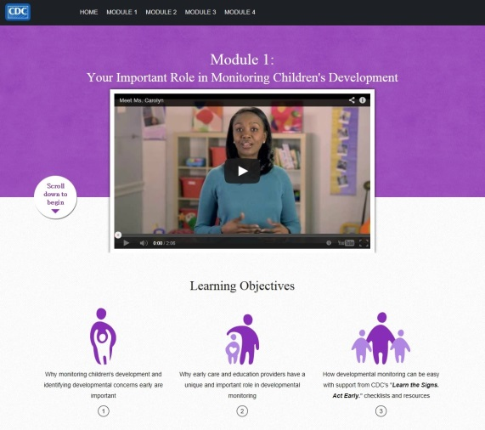
Watch Me! Celebrating Milestones and Sharing Concerns
Training on developmental monitoring w/ LTSAE
For child care professionals (CCPs)
Free, 1 hour, online
CE’s available
4 Modules:
CCPs important role in dev monitoring
Understanding children’s dev milestones
Objective and engaged dev monitoring
How to talk with parents about their child’s development
Notes:
We are really excited about our new training called “Watch Me! Celebrating Milestones and Sharing Concerns”.
This is a new online training course for child care providers that we expect will be ready to use in July or early August. We developed it in conjunction with a group of partners, who helped us think through the content and who will help us promote and distribute it when it’s ready. We’ve tested it with child care providers and gotten great reviews so far, so we’re hoping people will find it appealing and useful.
We developed this training in collaboration with subject matter experts from the:
National Association of the Education for Young Children
Child Care Aware
American Academy of Pediatrics
HRSA, Administration on Children and Families – Office of Head Start and Office of Child Care
Yale Child Study Center, and
Healthy Child Care America

Slide 12
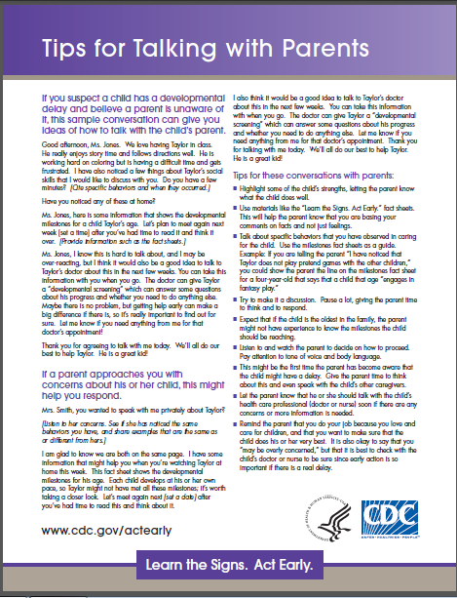
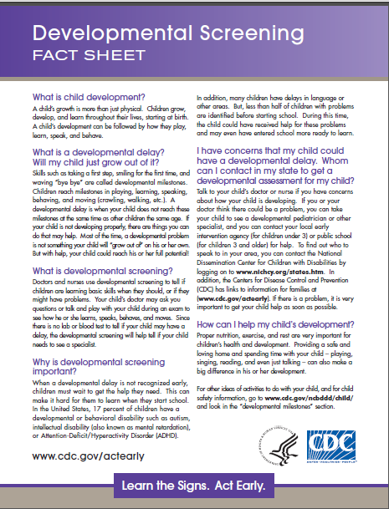
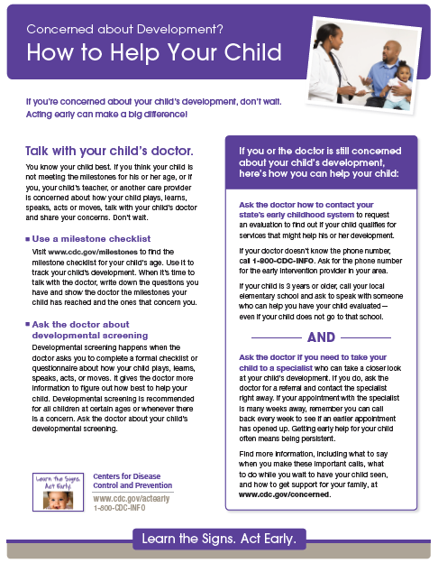
Fact Sheets
Tips for Talking with Parents
Developmental Screening
Concerned About Development?
How to Help Your Child
How to Talk to the Doctor
Notes:
We also have fact sheets that can be very helpful for providers to have handy if they uncover a potential developmental concern or if they or a parent is worried about a child’s development.

Slide 13
Birth to Five: Watch Me Thrive!
Coordinated public outreach campaign to promote awareness of child development and developmental and behavioral screening, referral, and follow-up.
Celebrating developmental milestones
Promoting universal developmental and behavioral screening
Improving early detection
Enhancing developmental supports
Notes:
We have talked about the materials and messages developed by the LTSAE program encouraging developmental monitoring, now we are going to talk about a new federal initiative “Birth to Five: Watch Me Thrive!”
This is a coordinated public outreach campaign to promote awareness of child development and developmental and behavioral screening, referral and follow up. LTSAE materials are featured prominently in the campaign.
The campaign emphasizes:
Celebrating milestones
Promoting universal screening
Identifying possible delays and concerns early

Slide 14
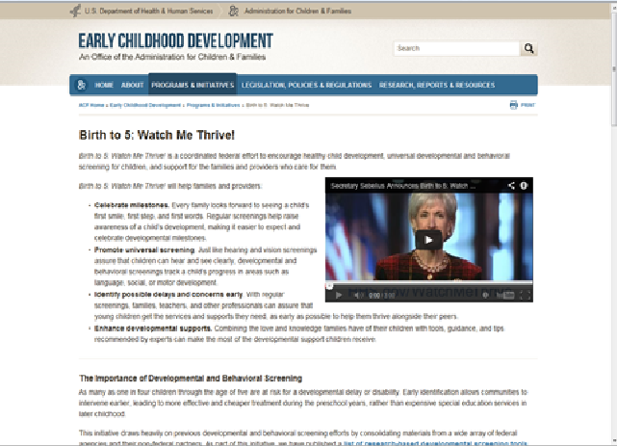
Birth to Five: Watch Me Thrive! Toolkit
A compendium that reviews implementation, reliability and validity characteristics of screening instruments
User guides, designed for providers from multiple sectors and the communities in which they live
Collection of resources to bring awareness to parents and providers about healthy child development
Notes:
There are three components to the campaign:
There is a compendium that reviews implementation, reliability and validity characteristics of screening instruments. The compendium contains first line screening instruments for children birth to five and provides pertinent information that includes cost, administration time, quality level, training required and age range covered.
In addition, User guides have been developed for providers from multiple sectors as well as the communities in which they live. Early care and education providers, home visitors, health care providers, early interventionists-Part C and Part B coordinators, behavioral health workers all have their own individual user guide to assist in selecting screening instruments, information on developmental milestones, how to engage families in the screening process, and how and where to refer if concerns are detected.
The last component of the campaign is the collection of resources that can be accessed by the various providers who are screening and serving young children in their care including parents.

Slide 15
Learn the Signs. Act Early. Program Components
Health education campaign
Act Early initiative
Research and evaluation
Notes:
Now, I am going to talk about the second and third component of the Learn the Signs Act Early program – the Act Early Initiative and our ongoing research and evaluation efforts.

Slide 16
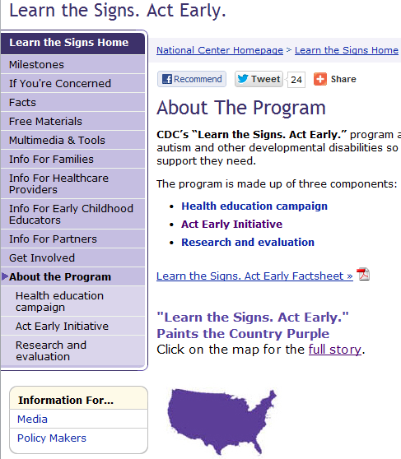
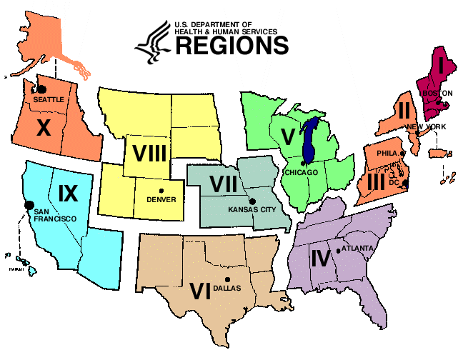
"Learn the Signs" Program Component 2: Act Early Initiative
Improves collaboration among early childhood systems in states
In collaboration with HRSA, AUCD, AMCHP
Act Early Summits
Act Early Ambassadors
State Systems grants
Notes:
Several years ago we held Act Early Summits in every state with the goal of improving early identification efforts across state systems. Those summits were the foundation of what we now call the Act Early Initiative.
We currently have 30 Act Early Ambassadors and they serve as community champions to increase awareness activities and improve early identification practices.
They serve as state or territory point-of-contact for the national LTSAE program, and they can help you. If you want to know who in your state is an Ambassador go to our website and click on the map in the About the Program section.
We also have 7 state systems grants that work on targeted and specific activities to promote early identification within a variety of service delivery systems within their state.

Slide 17
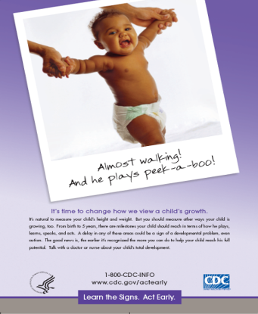
"Learn the Signs" Program Component 3: Research and Evaluation
Advance understanding of
Information needs of key campaign audiences
How to reach special populations
How to improve state systems
Evaluation of campaign strategies
MO WIC expansion project
Child care and LTSAE
Feasibility, strategy effectiveness
Notes:
Research and evaluation is a major focus of Learn the Signs, Act Early. Everything we produce is research-based, and it’s a top priority to learn what are the outcomes and impacts of our messages, materials, and strategies. We have several projects going on now, for example, to evaluate the impact of our children’s book Amazing Me; to fine-tune our Act Early call-to-action message, and to evaluate strategies for implementing developmental monitoring with Learn the Signs in WIC clinics and child care settings.

Slide 18
Thank You
cas0@cdc.gov
Notes:
Thank you for all your hard work in helping identify children as early as possible in need of services and extra support.- we look forward to helping you with this most important mission!
We are now going to hear from Gail Chodron in Wisconsin who is going to talk about how they have integrated the LTSAE materials and messages into their state systems for young children.

