Slide 1
Christina Kasprzak Austin, Texas March 2011
Integrating child outcomes measurement and IEP process

Slide 2
Objective for the day
To provide presentations, resource materials, and activities that can be used when providing TA to districts related to integrating the outcomes measurement into the IEP process and involving families in the IEP process and COSF process
2

Slide 3
Agenda
Integrating child outcomes and IEP process
Communication strategies to build collaboration
Involving families in the COSF discussion
Involving families in the IEP process

Slide 4
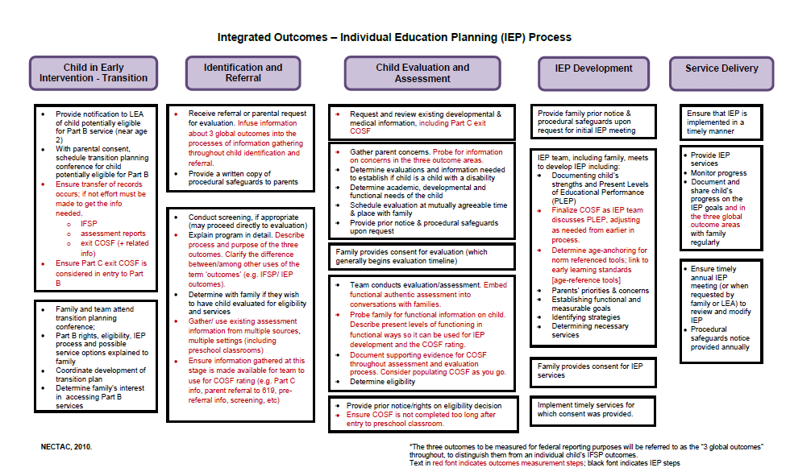
Integrating child outcomes measurement into the IEP Process
4

Slide 5
Background
Desire to make outcomes ‘fit’ into existing processes (not an extra/separate piece)
Local programs naturally integrated to make the outcomes process efficient and effective
Family involvement from the beginning improve data collection and communication with family
Notes:
Integration of the child outcomes measurement with the IFSP/IEP process emerged in the last couple years. As states were rolling out their child outcomes measurement systems, there was a desire from the field to make outcomes ‘fit’ into existing processes – so that it would not be this ‘extra’ or ‘separate’ piece (disconnected from the work professionals were doing with children and families).
And we found, at the national level, that some local programs had naturally integrated to make the outcomes process efficient and effective. So, it emerged from local programs. Local programs figured out how to make it fit naturally into their IFSP/IEP processes.
Essentially, local programs figured out how to involve families in the outcomes measurement from the beginning and found that that improved their data collection and also improved their work with families.

Slide 6
March 2010 Think Tank
NECTAC and ECO co-sponsored (NECTAC, ECO, RRCP, Researchers, State and Local program staff)
The purpose of the think tank was to discuss ways to integrate IFSP and IEP processes with the child outcomes measurement process.
Recommended practices flow chart and documents (originals from 2008)
Notes:
Think Tank worked with an older document from 2008 -- Agreed upon practices for providing services in natural environments. OSEP TA Community of Practice- Part C Settings.
http://www.nectac.org/topics/families/families.asp
http://www.nectac.org/~pdfs/topics/families/AgreedUponPractices_FinalDraft2_01_08.pdf
The document and flow chart were used as a basis for developing 619 preschool IEP flow chart.
Subsequently, the flow charts were reviewed by experts at the think tank to identify places in the IFSP/IEP process where the outcomes measurement could be integrated.
Think Tank was hosted by NECTAC and ECO and occurred in March 2010 in Chapel Hill. Participants included national TA providers, state and local administrators, and researchers: Betsy Ayankoya, Debbie Cate, Siobhan Colgan, Suzanne Cotterman, Debra Hannigan, Sandi Harrington, Connie Hawkins, Kathy Hebbeler, Joicey Hurth, Lynne Kahn, Christina Kasprzak, Anne Lucas, Robin McWilliam, Lynda Pletcher, Sharon Ringwalt, Robin Rooney, Dathan Rush, Arlene Russell, M’Lisa Shelden, Donna Spiker, Karen Walker, Sharon Walsh, and Naomi Younggren.
The purpose of the think tank was to discuss ways to integrate IFSP and IEP processes with the child outcomes measurement process.

Slide 7
IEP Process Flow Chart
Transition from EI (for some)
Identification and Referral
Child Evaluation and Assessment
IEP Development
Service Delivery
Notes:
The IFSP and IEP process flow charts were developed in 2008 as part of an initiative around ‘agreed upon practices’ in the field. These charts were edited as part of the Think Tank in 2010 to integrate the child outcomes data collection and reporting. The flow chart has 5 steps or headers:
The child in early intervention who transitions to 619 (applicable to only some children)
Identification and referral
Child evaluation and assessment
IEP development, and
Service delivery
[have participants review the flow chart during the next set of slides]

Slide 8
Transition from Part C
Provide notification to LEA of child potentially eligible for Part B service (near age 2)
With parental consent, schedule transition conference for child potentially eligible for Part B
Family and team attend transition planning conference;
Part B rights, eligibility, IEP process and possible service options explained to family
Coordinate development of transition plan
Determine family’s interest in accessing Part B services
Notes:
Beginning with those children who transition from Part C, the IEP process is generally … (read list).

Slide 9
Transition from Part C
Ensure transfer of records occurs; if not effort must be made to get the info needed.
IFSP
assessment reports
exit COSF (+ related info)
Ensure Part C exit COSF is considered in entry to Part B
Notes:
If one wanted to integrate the child outcomes data collection process into the IFSP/IEP process, you might also… (read items in red).
Ideas were generated from the Think Tank participants. Do you have other ideas of how the outcomes might be integrated into this part of the process?

Slide 10
Identification and Referral
Receive referral or parental request for evaluation.
Provide a written copy of procedural safeguards to parents
Conduct screening, if appropriate (may proceed directly to evaluation)
Explain program in detail.
Determine with family if they wish to have child evaluated for eligibility and services
Notes:
Regarding the identification and referral process, the general steps are… (read list).

Slide 11
Receive referral or parental request for evaluation. Infuse information about 3 global outcomes into the processes of information gathering throughout child identification and referral.
Provide a written copy of procedural safeguards to parents
Conduct screening, if appropriate (may proceed directly to evaluation)
Explain program in detail. Describe process and purpose of the three outcomes. Clarify the difference between/among other uses of the term “outcomes‟ (e.g. IFSP/ IEP outcomes).
Determine with family if they wish to have child evaluated for eligibility and services
Notes:
If one wanted to integrate the child outcomes data collection process into the IFSP/IEP process, you might also… (read items in red).
[more on next slide]

Slide 12
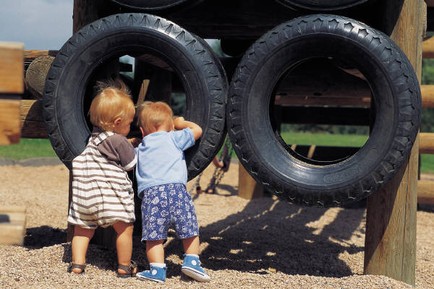
Gather/ use existing assessment information from multiple sources, multiple settings (including preschool classrooms)
Ensure information gathered at this stage is made available for team to use for COSF rating (e.g. Part C info, parent referral to 619, pre-referral info, screening, etc)
Notes:
And you might also… (read items in red).
These ideas were generated from the Think Tank participants. Do you have other ideas of how the outcomes might be integrated into this part [identification and referral] of the process?

Slide 13
Child Evaluation and Assessment
Request and review existing developmental & medical information, including Part C exit COSF
Notes:
Regarding the child evaluation and assessment, the first step would be to request and review existing developmental and medical information. You might also “include the Part C exit COSF” in that process if you wanted to integrate the child outcomes measurement into the ongoing IFSP/IEP process

Slide 14
Gather parent concerns. Probe for information on concerns in the three outcome areas.
Determine evaluations and information needed to establish if child is a child with a disability
Determine academic, developmental and functional needs of the child
Schedule evaluation at mutually agreeable time & place with family
Provide prior notice & procedural safeguards upon request
Family provides consent for evaluation.
Team conducts evaluation/assessment.
Determine eligibility
Provide prior notice/rights on eligibility decision
Notes:
Other general steps in the child evaluation and assessment include… (read list except what’s in red) If you were integrating the child outcomes measurement into this part of the IFSP/IEP process, you might also ‘probe for information on concerns in the 3 outcome areas’ when you’re gathering parent concerns.

Slide 15
Child Evaluation and Assessment
Team conducts evaluation/assessment. Embed functional authentic assessment into conversations with families.
Probe family for functional information on child. Describe present levels of functioning in functional ways so it can be used for IEP development and the COSF rating.
Document supporting evidence for COSF throughout assessment and evaluation process. Consider populating COSF as you go.
Determine eligibility
Notes:
Integrating the child outcomes, you might… (read the parts in red)

Slide 16
Provide prior notice/rights on eligibility decision
Ensure COSF is not completed too long after entry to preschool.
Notes:
And the final steps in the child evaluation and assessment process was to provide prior notice on the eligibility decision. But, integrating the outcomes, you might also… (read the part in red)

Slide 17
IEP Development
Provide family prior notice & procedural safeguards upon request for initial IEP meeting
IEP team, including family, meets to develop IEP including:
Documenting child’s strengths and Present Levels of Educational Performance
Parents’ priorities & concerns
Establishing functional and measurable goals
Identifying strategies
Determining necessary services
Notes:
Now we’re at the IEP development process and that involves… (read list)

Slide 18
IEP team, including family, meets to develop IEP including:
Documenting child’s strengths and Present Levels of Educational Performance (PLEP)
Finalize COSF as IEP team discusses PLEP, adjusting as needed from earlier in process.
Determine age-anchoring for norm referenced tools; link to early learning standards [age-reference tools]
Notes:
Integrating the outcomes, you might also… (read the part in red)

Slide 19
Family provides consent for IEP services
Implement timely services for which consent was provided.
Notes:
And the final steps in the IEP development are … (read list)

Slide 20
Service Delivery
Ensure that IEP is implemented in a timely manner
Provide IEP services
Monitor progress
Document and share child’s progress on the IEP goals and in the three global outcome areas with family regularly
Ensure timely annual IEP meeting (or when requested by family or LEA) to review and modify IEP
Procedural safeguards notice provided annually
Notes:
Finally, with service delivery we’re talking about… (read list except what’s in red) If you’re integrating the outcomes into the service delivery, you might also document and share the child’s progress in the 3 global outcome areas with the family regularly.

Slide 21
Activity 1:
IEP Flow Chart Integrating Child Outcomes

Slide 22
Small Group Instructions:
Break into small groups – each assigned an area of the process
Discuss the IEP process area assigned to your group
1. How does the ____ process work in your program?
2. What are the opportunities during the ____ process to collect information about the 3 global outcomes?
3. Where are the challenges and barriers to integrating the COSF process with an effective IEP process?
4. Have you seen or can you see benefits for integrating the IEP and COSF processes? What are they?
3. Share back with whole group

Slide 23
Implementation Rating Scale
23

Slide 24
Background and Purpose:
Source: Resource aligned with the recommendations from the IFSP/IEP-Outcomes Integration Think Tank
Purpose: To feature opportunities for measuring outcomes that naturally occur in the IEP process
Use: Self assessment process to reflect on existing practices in a state/district/program
Note: italics identify possible ways to integrate child outcomes data collection into the IEP process
Notes:
The document entitled “INTEGRATING CHILD OUTCOMES MEASUREMENT WITH THE INDIVIDUALIZED EDUCATION PROGRAM (IEP) PROCESS: IMPLEMENTATION RATING SCALE” was developed in JULY 27, 2010.
It was drafted in alignment with recommendations from the IFSP/IEP-Outcomes Integration Think Tank.
The purpose of the document is to help programs self assess their processes and identify opportunities for measuring outcomes that naturally occur in the IEP process from referral through evaluation and eligibility, IEP development, and ongoing intervention and progress monitoring.
Note that the outcomes measurement steps are based on use of the Child Outcomes Summary Form (COSF) but may have utility for all states.

Slide 25
Content areas:
Referral
1. Determine family’s initial concerns about their child
2. Determine next steps in the referral process
3. Facilitate smooth transitions from Part C
4. Describe the 619 program…
Child Evaluation
Plan the evaluation
Conduct the evaluation
Notes:
The document has 5 content areas. (review the ones on this slide; threeadditional areas are on the next slide)

Slide 26
Eligibility Determination
Collaboratively determine if the child is eligible for 619
(depending on state) determine COSF ratings
IEP Meeting
Review the purpose and process of the IEP meeting
Collaboratively develop the IEP
(depending on state) determine COSF ratings
Review the IEP at least annually
Ongoing Intervention
1. Collect initial and ongoing assessment data
2. Promote child engagement, learning and independence in everyday activities, routines and transitions
3. Monitor children’s progress toward goals

Slide 27
Activity 2:
Implementation Rating Scale

Slide 28
Small Group Instructions:
Break into small groups – each assigned an area
A. Referral (p. 2-4)
B. Child Evaluation (p. 4-5)
C. Eligibility Determination (p. 5-6)
D. IEP Meeting (p. 6-8)
E. Ongoing Intervention (p. 9-10)
2. Review the IEP process area assigned to your group
1. Rate whether you think the practices are implemented, needs improvement, or not implemented.
2. List some barriers for practices not well implemented.
3. Share back with whole group

Slide 29
Application
How could you use the flow chart and/or either activity in your training and TA?
Are there any districts/programs already integrating outcomes with the IEP?

Slide 30
Activity 3:
Materials for Informing Families about Outcomes Measurement

Slide 31
State Materials: Informing Families about Outcomes
31
Notes:
From the beginning of the outcomes measurement work in 2004, state and local programs have been trying to figure out how to explain outcomes measurement to families.
Examples that we’ve come across are listed on the ECO web site and include brochures, letters, FAQ documents.
Some of them are included in your packets for review during the next activity.

Slide 32
Small Group Instructions:
Break into small groups – each assigned specific materials to review
Review each material assigned to your group
1. What do you like about it?
2. What do you not like about it?
3. Would you recommend something like it for TX?
4. How would it be used (who would share it with whom and when)?
3. Share back with whole group

Slide 33
CONNECT: The Center to Mobilize Early Childhood Knowledge http://community.fpg.unc.edu/connect Communication strategies to build collaboration: http://community.fpg.unc.edu/connect-modules/resources/handouts/CONNECT-Handout-3-1.pdf/download
Communication strategies to build collaboration
33
Notes:
The Center to Mobilize Early Childhood Knowledge (CONNECT) is an OSEP-funded project housed at the University of North Carolina at Chapel Hill. They have developed materials FREE for use by trainers, higher ed, teachers, providers, etc.
In this section, I want to share with you some materials on communication strategies to build collaboration.
Refer to your handout: Communication strategies to build collaboration

Slide 34
Attending and Active Listening
Body language: physical posture is relaxed to show openness, interest, and empathy.
Reflecting content and feelings: Using your own words to identify the content and feelings in a message is one way to let the speaker know you understand.
Encouraging and affirming: Acknowledging the speaker through simple verbalizations encourages the speaker to continue.
Notes:
The first section of the communication strategies focuses on “attending and active listening” … (review the list; also review the examples on the handout and invite others to provide examples)

Slide 35
Seeking and Verifying
Questioning: Using different types of questions gives you information that helps to define preferences and strengths, as well as issues and concerns
Silence: Waiting patiently and quietly gives the speaker time to think before answering a question and lets the speaker know you want to hear from him/her.
Clarifying and validating: Restarting the main message and asking if your understanding of what has been said is correct can help avoid misunderstandings.
Summarizing: Pulling together the main points of the discussion into a brief statement is a good way of obtaining closure.
Notes:
The second section of the communication strategies focuses on “seeking and verifying” … (review the list; also review the examples on the handout and invite others to provide examples)

Slide 36
Joining and Supporting
Building: Adding to the speaker’s ideas lets the other person know you value their input and that you have something to contribute.
Informing: Sharing information and knowledge enhances understanding and addresses the speaker’s needs.
Seeking consensus: Reaching agreement is important to ensure that everyone involved understands the goals and the ways of achieving them together.
Notes:
The third section of the communication strategies focuses on “joining and supporting” … (review the list; also review the examples on the handout and invite others to provide examples)

Slide 37
Activity 4:
Communication Strategies—Observation Checklist

Slide 38
Activity Instructions:
1. Observe videos
Using observation checklist, indicate if the practice occurs
Make notes about examples you observed
2. Share back with whole group
Notes:
There are 3 videos– one for each part of the handout (attending and active listening, seeking and verifying, and joining and supporting). Play one video at a time, have participants observe and mark on checklist, and share back with whole group. Repeat for each video.

Slide 39
Application
How could you use the communication strategies information and/or activity in your training and TA?
What experiences and/or resources do you currently use in your TA to enhance communication skills?

Slide 40
Involving Families in the COSF Process
40

Slide 41
Informing Families
What is being done to inform families about
the data collection?
Why it is occurring
What it involves
What it means for them and their child
41

Slide 42
Preparing Families
Helping families be active participants in the discussion
What is working?
What is not working?
General principle: Families need to know what to expect
42

Slide 43
What Do We Expect from Families
Yes - That they will be able to provide rich information about their child’s functioning across settings and situation
Maybe but not necessarily – That they will know whether their child is showing age appropriate behavior
43

Slide 44
Involving Families in a Conversation about Their Child
Avoid jargon
Avoid questions that can be answered with a yes or no
“Does Anthony finger feed himself?”
Ask questions that allow parents to tell you what they have seen
“Tell me about how Anthony eats”
44

Slide 45
Strategies for Involving Families in the COSF Rating Discussion
Individualizing to family; giving family choice
Using the ‘words’ rather than numbers when discussing ratings with families
Other?
45

Slide 46
Involving Families in the Rating Discussion
What % of families are participating?
What is working?
What is not working?
46

Slide 47
Families’ Right to COSF Information
All families have a right to know what ratings have given to their child -- and to the records containing the information.
47

Slide 48
Activity 5: Quality review of COSF team discussion
48

Slide 49
Quality Review of Family Involvement in COSF Discussion
Emily
3 Yr 4 mo
Mom and SLP
discuss outcome 1
(at Entry)

Slide 50
Quality Review of Family Involvement in COSF Discussion
Ethan
4 Yr 10 mo
Parents, ECSE teacher,
SLP, OT
Discuss outcome 2
(at Exit)

Slide 51
Application
How could you use the videos in your training and TA?
What experiences or resources do you have with using videos in your training and TA?
51

Slide 52
COSF Rating Scale Descriptor Statements
52

Slide 53
The use of descriptor statements
Emerged from local programs in the field
Purpose/Use – family friendly language for talking about COSF rating scale with families
Virginia – resource
EDIS – resource
Notes:
The idea of using descriptor statements is another practice that emerged from the field. Local programs in states were trying to find family-friendly language to use when talking about the 7 points on the rating scale.
Walk through the two examples (VA, EDIS). Note that Virginia is a Part C example but the general text is applicable for any age child.

Slide 54
Activity 6:
Descriptor Statements

Slide 55
Activity Instructions:
Review each statement and identify the COSF rating associated with each statement
Discuss the possible usefulness of ‘descriptor statements’ or ‘culminating statements’ in the COSF discussions

Slide 56
Application
How could you use the descriptor statements information and/or activity in your training and TA?

Slide 57
Much of the content from this presentation is from CONNECT: http://community.fpg.unc.edu/connect-modules/instructor-community/dashboards/module-4
Involving families in the IEP process
57

Slide 58
Family-Professional Partnership Framework
Trust
Advocacy
Family Focus
Child Focus
Commitment
Equality
Enhanced Communication
High Expectations
Respect
Effective basic communication
Effective teaching
From: CONNECT Module 4. Dr. Ann Turnbull, Distinguished Professor, Co-Founder and Co-Director of the Beach Center on Disability
Notes:
Dr. Ann Turnbull, Distinguished Professor, Co-Founder and Co-Director of the Beach Center on Disability, describes the family-professional partnership framework to illustrate partnership-oriented practices.
The Family-Professional Partnership Framework has evolved from her research over decades. Her experiences as the mother of a son with multiple disabilities influenced gave her the family perspective about trust-building.
The pinnacle of trust is at the top. Families build strong, trusting relationships with some professions, but unfortunately experience a lack of trust in others.
The figure illustrates the building blocks that make a difference in experiencing trust.
The blue arrows on the side of the figure--Family Focus and Child Focus. As you set out to develop a trusting partnership with families, you need to consider your relationship with the family (which is the family focus) and also your relationship with the child (or the child focus).
Two green blocks that make up the foundation. On the left side, a family focus builds on basic communication skills. These basic skills, such as active listening, are essential in all of your interactions with families.
On the right side, a child focus builds on effective teaching skills of children. Families need to be confident that their child’s teacher has sound teaching competence and is eager to learn additional skills necessary to provide individualized support.
For both the family and child focus, practices that constitute the building blocks of trusting partnerships include enhanced communication, high expectations, respect, commitment, equality, and advocacy.

Slide 59
Activity 7:
Reflect on your partnerships with professionals

Slide 60
Activity Instructions:
Individually - answer the questions on the handout to reflect on experiences you have had when working with professionals.
In small groups at your tables, share the ‘major points’ you want to incorporate into your own professional practice.
Whole group – sharing; themes.

Slide 61
Partnership-Oriented Practices
Building trust can be thought of in terms of three phases:
Developing an initial friendly relationship – Being on beginning ground
Making shared decisions – Being on middle ground
Addressing challenging issues – Being on firm ground
Notes:
Building trust can be thought of in terms of three phases:
Developing an initial friendly relationship – Being on beginning ground
Making shared decisions – Being on middle ground
Addressing challenging issues – Being on firm ground
The length of time it takes to reach a trusting partnership can vary significantly from one family to another. It is much easier to address challenging issues when you are on firm ground in your relationship with families.
You need to adapt your partnership-oriented practices to each family’s preferred communication style, cultural considerations, and preferences.

Slide 62
Partnership-Oriented Practices
Enhanced communication: Building on basic communication skills to dignify each child and family by honoring their uniqueness in terms of their family history, present circumstances, and future possibilities.
Encouraging families to tell their stories
Reframing differences of opinions, values or perspectives without judgment
Notes:
Another resource from CONNECT is their handout on Partnership-Oriented Practices: Examples of Applications
Section A focuses on Enhanced communication (review examples and additional info on the handout about beginning ground, middle ground, and firm ground)

Slide 63
High expectations:
Having confidence in the child’s and family’s future possibilities, as well as confidence in one’s own competence in actualizing positive outcomes.
Building on a child’s strengths throughout all instruction and interactions and incorporating a strengths-based orientation into practices
Conveying to families one’s own beliefs about the goals the child will be able to accomplish
Notes:
Section B focuses on High expectations (review examples and additional info on the handout about beginning ground, middle ground, and firm ground)

Slide 64
Respect:
Regarding families with esteem and demonstrating that esteem through actions and words.
Identifying and incorporating cultural values into decision-making
Identifying the family’s preferences for interaction with practitioners, and then interacting with them accordingly
Notes:
Section C focuses on Respect (review examples and additional info on the handout about beginning ground, middle ground, and firm ground)

Slide 65
Commitment:
Providing a sense of assurance that the relationship with the family and child is ‘more than obligation;’ rather, it represents devotion and loyalty to the child and family and shared belief in the importance of goals being pursued.
Being flexible to accommodate the changing needs of the family and child
Notes:
Section D focuses on Commitment (review examples and additional info on the handout about beginning ground, middle ground, and firm ground)

Slide 66
Equality:
Ensuring that families have roughly equal power as practitioners in making decisions.
Sharing power by supporting families as equal partners in helping their child to be successful now and in the future.
Notes:
Section E focuses on Equality (review examples and additional info on the handout about beginning ground, middle ground, and firm ground)

Slide 67
Advocacy:
Speaking out and taking action in pursuit of finding just solutions to problems.
Informing families of their rights and supporting them to be effective advocates.
Notes:
And the last section focuses on Advocacy (review examples and additional info on the handout about beginning ground, middle ground, and firm ground)

Slide 68
Activity 8:
Partnership-Oriented Practices: Observation Checklist
Notes:
Let’s now try to observe partnership-oriented practices.

Slide 69
Activity Instructions:
Watch video and observe communication practices (3 videos - beginning ground, middle ground, firm ground)
Make a check in the box if you observe an example of each practice.
Debriefing of observations after each video.
Notes:
Using the Partnership-Oriented Practices: Observation Checklist
Video 1: focus on ‘beginning ground’ (page 1-2 of checklist)
Video 2: focus on ‘middle ground’ (page 3-4 of checklist)
Video 3: focus on ‘firm ground’ (page 5-6 of checklist)
There are 6 areas – if the video goes too fast, you could have small groups/tables focus on listening for just one section instead of all six.

Slide 70
Application
How could you use the information and/or activities regarding building family-professional partnerships in your training and TA?

Slide 71
Find out more about CONNECT:
http://community.fpg.unc.edu/connect-modules/learners

Slide 72
Find more resources at:
NECTAC: http://www.nectac.org
ECO: http://www.the-eco-center.org/

