Slide 1
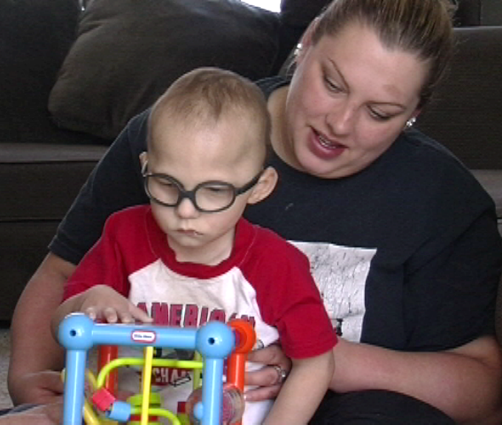
The Desired Results Access Project, Napa County Office of Education California Department of Education, Special Education Division
How California Shares Indicator 7 Results
with Local Education Agencies
09/11/17

Slide 2
Today’s Presenters
Sheila Self, M.Ed.
619 Coordinator, Policy and Program Services
California Department of Education, Special Education Division
Patty Salcedo, M.A.
Co-Director
Desired Results Access Project
Elizabeth Schroeder, M.S.
Senior Data Reports System Manager
Desired Results Access Project
Jennifer Fisher, ECSE M.A.
Early Start & Preschool Program Specialist
Southwest SELPA

Slide 3
Agenda
Introductions
California’s Indicator 7 Reporting to Local Education Agencies (LEAs)
Desired Results Developmental Profile (DRDP, 2015) Overview
Indicator 7 Reports for LEAs
Using the Indicator 7 Reports
Questions

Slide 4
California’s Indicator 7 Reporting
The California Department of Education (CDE), Special Education Division (SED) contracts with the Desired Results Access Project to:
Assure the appropriate assessment of children with Individual Family Service Plans (IFSPs) and Individualized Education Program (IEPs) with the DRDP (2015)
Produce the Indicator 7 report for the Part B State Performance Plan (SPP)-Annual Performance Report (APR) using DRDP assessment results
Notes:
NOTE: The CA Dept of Dev. Services is the lead agency for Part C, and thus produces the Part C SPP-APR

Slide 5
The CDE uses the DRDP for Indicator 7
The DRDP (2015) is an early childhood assessment developed by the CDE for all children birth to five receiving CDE services
SELPAs report DRDP data twice yearly to the CDE, SED.
Notes:
California is unique in that we have developed our own instrument for all children and includes the ability to address federal reporting requirements.
Note: need to define SELPA, just in case folks aren’t aware on the call.
SELPAs are Special Education Local Plan Areas: In 1977, all school districts and county school offices in California were required to form geographical regions of sufficient size and scope to provide for all special education service needs of children residing within the region. Each region became known as a Special Education Local Plan Area – SELPA. Today, there are over 120 SELPAs in the State.

Slide 6
Indicator 7 Results: An Evolution of Sharing
2006-2014
2015
The Desired Results Access Project prepared an Excel spreadsheet by SELPA and school district.
2016
Indicator 7 Reports for LEAs website launched providing interactive access to district, SELPA and state results.
Results published by SELPA with the SPP document posted on the CDE website.
Notes:
Indicator 7 results have not always been widely available for SELPAs and districts to review and use.
Starting in 2008 these results were only available on annual basis in the SPP report
In 2009, the department started to release LEA reports that include the results for Indicator 7 at the SELPA level. Flat file published materials on our state website. Not interactive or easy to access. Wanted to shift to a method of delivering this information to the field…
In 2015, in an effort to provide this information at a further disaggregated level, the DR Access Project released the results in an Excel spreadsheet by SELPA and district
Finally, we rolled out the website that allows administrators access to the Indicator 7 results on an easy-to-use platform broken down by SELPA and district
We are looking forward to showing you this fantastic resource that has certainly increased access to Indicator 7 results across our state, but also increased the utility of this information. Elizabeth will dive into the system in just a few minutes, but first… Patty will give you a brief introduction to our assessment, the DRDP (2015)…

Slide 7
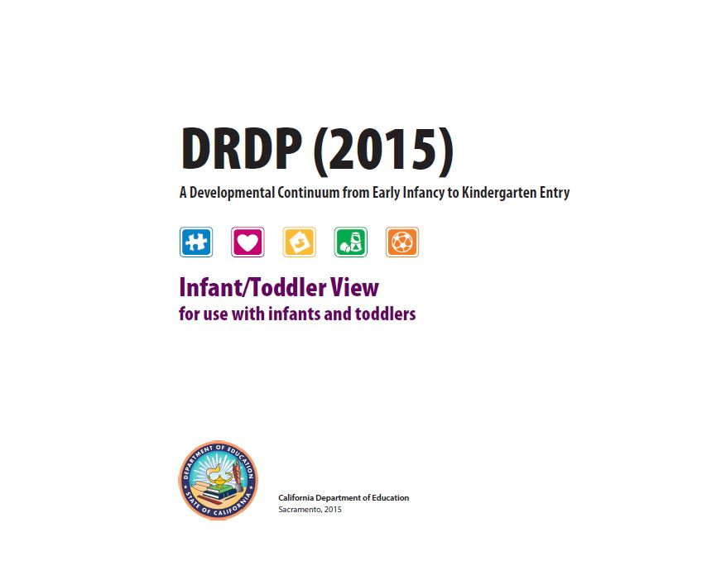
The DRDP (2015)

Slide 8
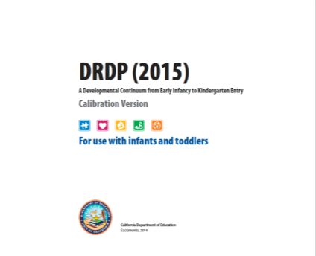
Key Features of the DRDP (2015)
Designed for all children
Developed using universal design
Includes adaptations for children with disabilities
Focuses on progress, not deficits
Is an authentic, observation-based assessment
Promotes family participation
Provides reports to teachers
Meets federal accountability requirements:
Scaled on a large sample of California’s children using a Rasch measurement model
View at
https://draccess/org
8

Slide 9
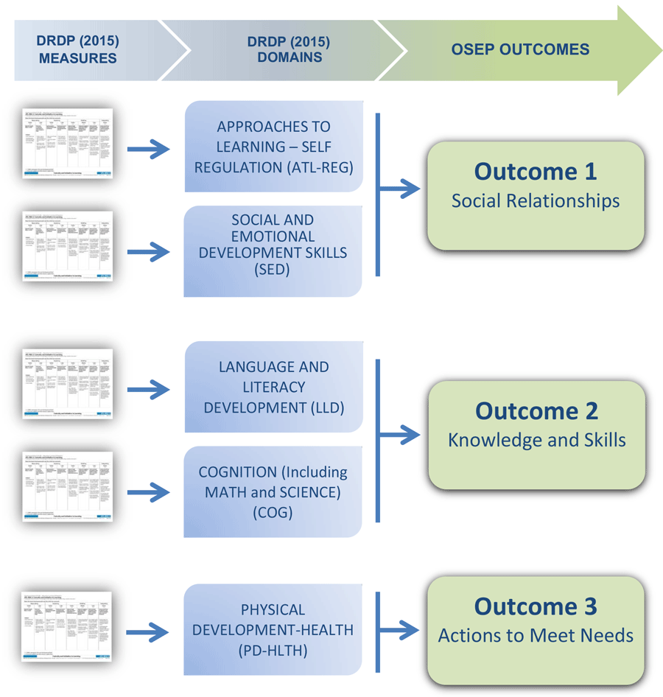
How DRDP data is used to measure progress on the preschool outcomes
Notes:
This diagram illustrates how the measures on the DRDP are aligned and provide information relative to the three OSEP outcome areas.
The three OSEP outcome areas should be familiar to you….
OSEP 1: Social relationships, which includes getting along with other children and relating well with adults,
OSEP 2: Use of knowledge and skills, which refers to thinking, reasoning, problem-solving, and early literacy and math skills, and
OSEP 3: Taking action to meet needs, which includes feeding, dressing, self-care, and following rules related to health and safety.

Slide 10
Indicator 7 Reports System for LEAs

Slide 11
Indicator 7 Reports System for Local Educational Agencies
This reports system is intended for SELPA and district administrators
The “Indicator 7 Reports System for LEAs” website is an interactive portal where you can view Indicator 7: Preschool Outcomes results by SELPA and District
The system went live in May 2016 and includes results for 2012-13, 2013-14, 2014-15, and 2015-16.

Slide 12
Features of the Reports System
View state, SELPA, and district-level results
View state results by disability category
Print state, SELPA, or district results

Slide 13
Utility of the Reports System
Administrators can review:
results over time at the State, SELPA and district level
SELPA results compared to state actual results as well as targets
district results compared to overall SELPA results and other districts within that SELPA
Notes:
Third bullet: Why we do state results? We offer this because it is important for SELPAs and district to see how their results compare to the state actual results, because the original targets were set high.

Slide 15
State-level Results
Notes:
Deleted two comments

Slide 16
State-level Results by Year

Slide 17
Select a SELPA

Slide 18
SELPA-level Results

Slide 19
SELPA-level Results by Year

Slide 20
District-level Results

Slide 21
District-level Results by Year

Slide 22
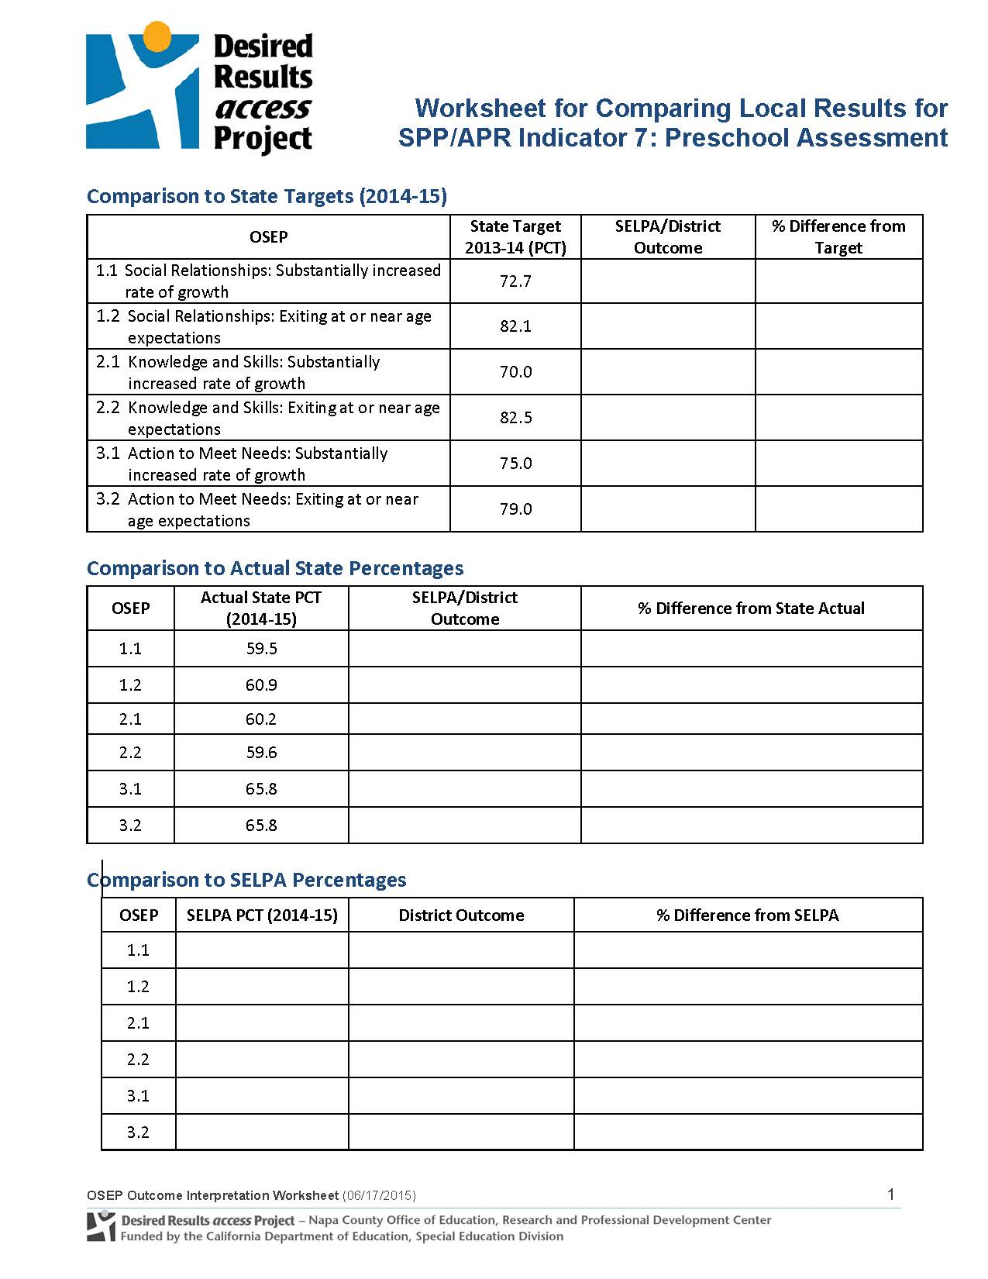
Worksheet

Slide 23
Using the Indicator 7 Reports for LEAs: Perspectives of an LEA Administrator

Slide 24
Using the Indicator 7 Reports
What is the first thing
you look at on this
report?

Slide 25
Using the Indicator 7 Reports
How do you use this report?

Slide 26
Using the Indicator 7 Reports
How do you link this data
back to professional development
and support for teachers and
administrators?

Slide 27
Questions?

Slide 28
Resources and Support
Detailed guidance, including detailed instructions for navigating the website are available on the website: indicator7reports.draccess.org
DR Access Project website: www.draccess.org
Any questions?
Email: reports@draccess.org
Phone: 1-800-673-9220 Ext. 4

Slide 29
Thank you!

