Slide 1
Embedding Child and Family Outcomes into Practice - Part 5 Kathy Hebbeler ECO at SRI International
Webinar for the Massachusetts ICC Retreat
October 3, 2012

Slide 2
Does anyone care about these numbers?

Slide 3
…..on behalf of the President and the White House…
We know that state collection of data is very complicated and can be very difficult related to infants and toddlers with disabilities. But the rewards far outweigh any complications because that data, that information that we gain, demonstrates that early intervention works and that Part C program can be a model for state coordination of statewide services.
And so what we know from these data, what we know from the data that everybody is collecting under the Part C program, which is vital, is that 74% of infants and toddlers with disabilities who receive Part C services show increases in their rate of development. And we also know that 60% of infants and toddlers with disabilities who receive the Part C services exit the program at the age of three or earlier with the skills expected, or that are expected, for their age. These are good numbers but we all know that we need to and we must do better and these percentages must go up.
These Part C regulations that we are releasing today support the development of high-quality state and local data so that we can collect the valid and reliable information that we need related to Part C Early Intervention, including data on early childhood outcomes.
Kareem Dale,
Special Assistant to the President for Disability Policy
Part C Final Regulations Conference Call, September 6, 2011
Notes:
Seven years ago when we started talking about what the outcomes should be, who would have thought that someone would have been citing these data on behalf of the President.

Slide 4
The Take Home Message
The outcomes are meaningful at many levels.
Policy makers -- want the data to see that children and families are achieving them.
Families – want to support their children to achieve good outcomes.
Everyone in between plays a role in helping that happen.

Slide 5
The outcomes can be a lens for how you see all families and children
In assessment
In planning
In working with children
In talking with parents
All in the service of a very important goal……

Slide 6
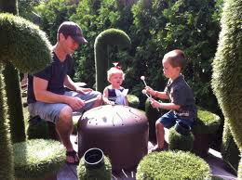
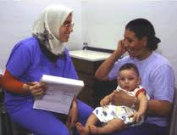
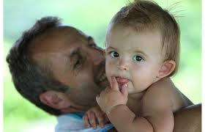
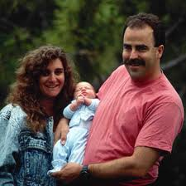
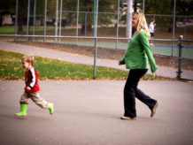
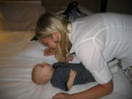
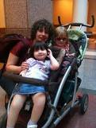
Families who can care for their children and participate in their community

Slide 7
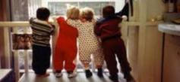
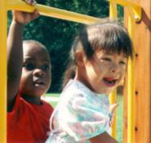
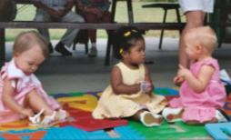
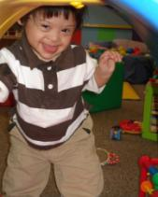
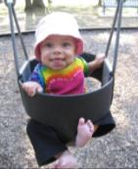
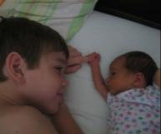
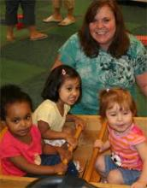
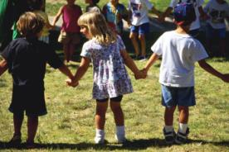
Children who are active and successful participants
Notes:
To helping all children achieve what matters.

