Slide 1
Embedding Child and Family Outcomes into Practice –
Part 4
Kathy Hebbeler
ECO at SRI International
Webinar for the Massachusetts ICC Retreat
October 3, 2012

Slide 2
The National Data on Child Outcomes for EI and ECSE
for 2010-11
Notes:
2

Slide 3
OSEP Reporting Categories
Percentage of children who:
a. Did not improve functioning
b. Improved functioning, but not sufficient to move nearer to functioning comparable to same-aged peers
c. Improved functioning to a level nearer to same-aged peers but did not reach it
d. Improved functioning to reach a level comparable to same-aged peers
e. Maintained functioning at a level comparable to same-aged peers
3 outcomes x 5 “measures” = 15 numbers

Slide 5

The Summary Statements
Of those children who entered the program below age expectations in each outcome, the percent who substantially increased their rate of growth by the time they turned 3 [6] years of age or exited the program.
The percent of children who were functioning within age expectations in each outcome by the time they turned 3 [6] years of age or exited the program.
Notes:
States set targets on the Summary Statements

Slide 6
State Approaches to Outcomes Data, 2009-10
Approach | Part C (56 states/jurisdictions) | Preschool (59 states/jurisdictions)
COS* 7 pt. scale | 41/56 (73%) | 37/59 (63%)
One tool statewide | 7/56 (13%) | 9/59 (15%)
Publishers’ online analysis | 3/56 (5%) | 6/59 (10%)
Other | 5/56 (9%) | 7/59 (12%)
*Child Outcomes Summary Rating

Slide 7
Child Outcomes: What we know
States are in various stages with regard to building their child outcomes measurement systems
Some phrased in
Some changed approaches

Slide 8
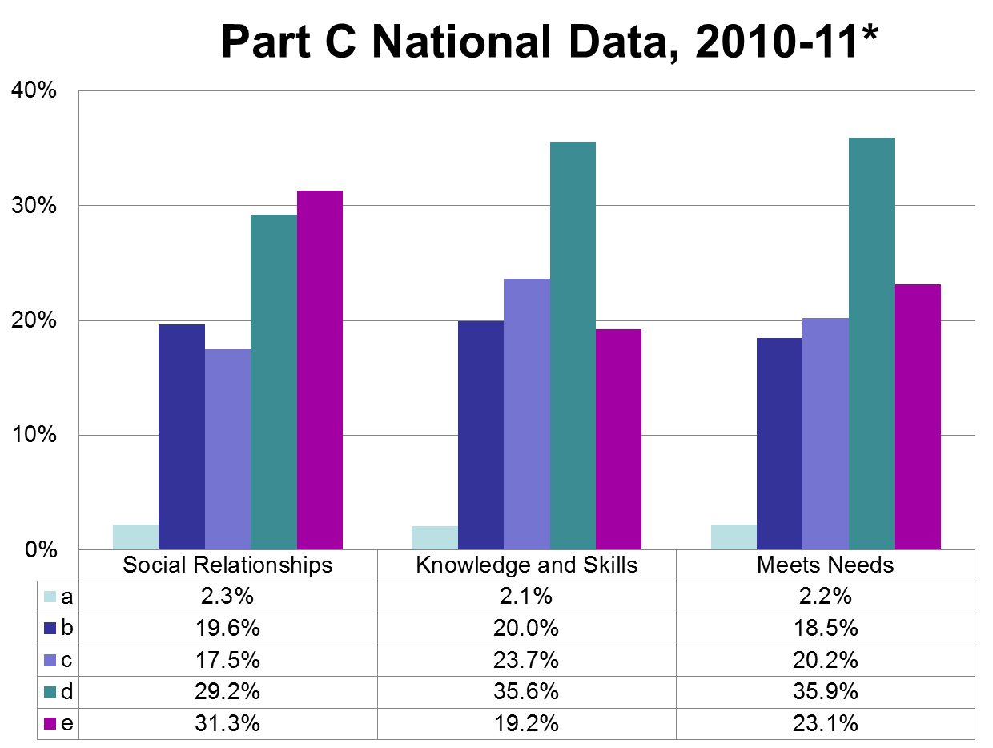

Slide 9
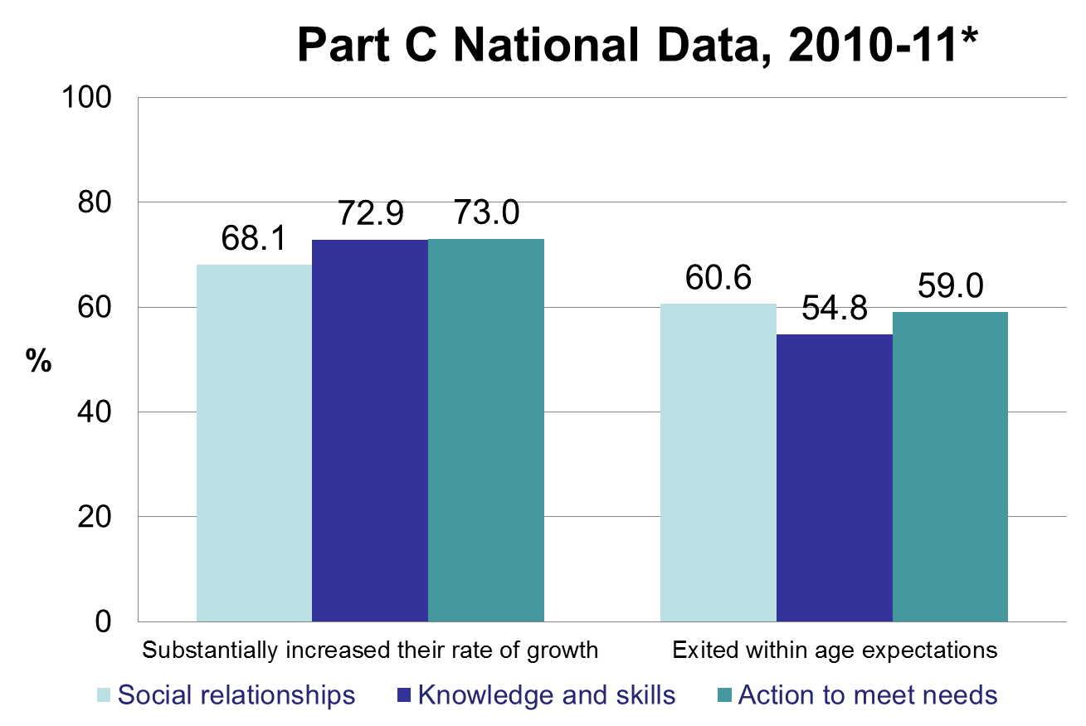
*Based on 39 states with highest quality data

Slide 10
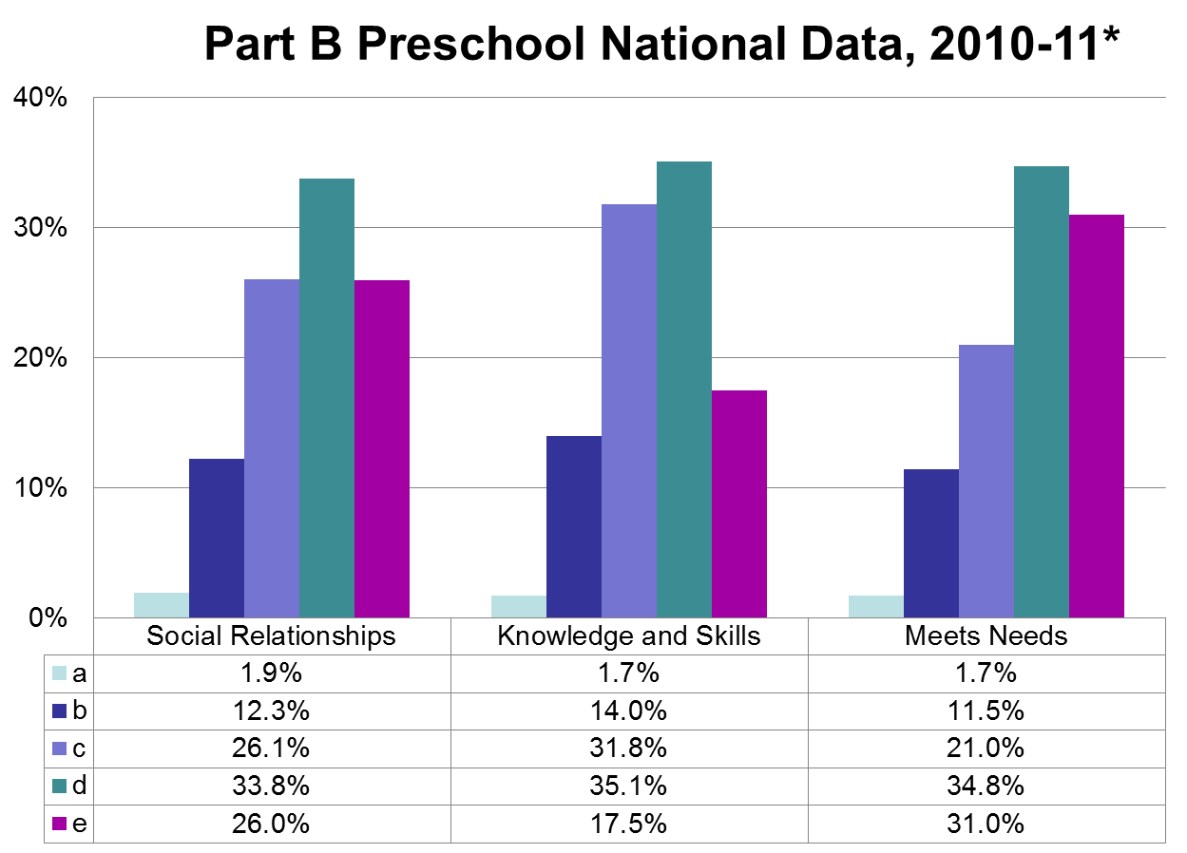
*Based on 36 States with the highest quality data.

Slide 11
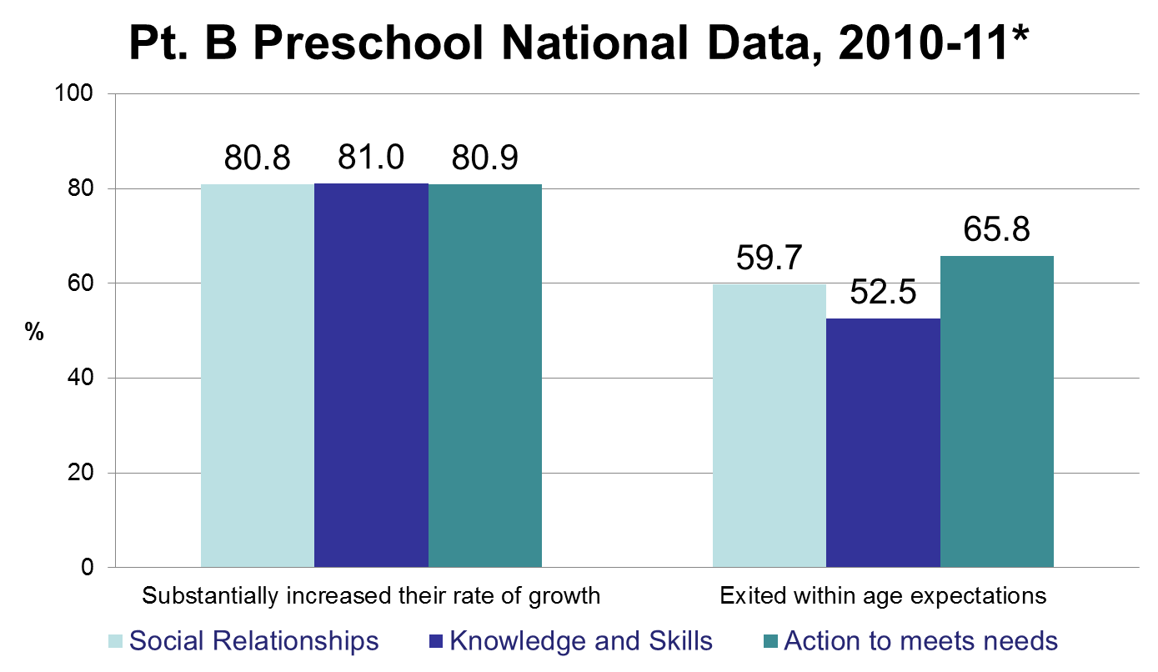
*Based on 36 States with the highest quality data.

Slide 12
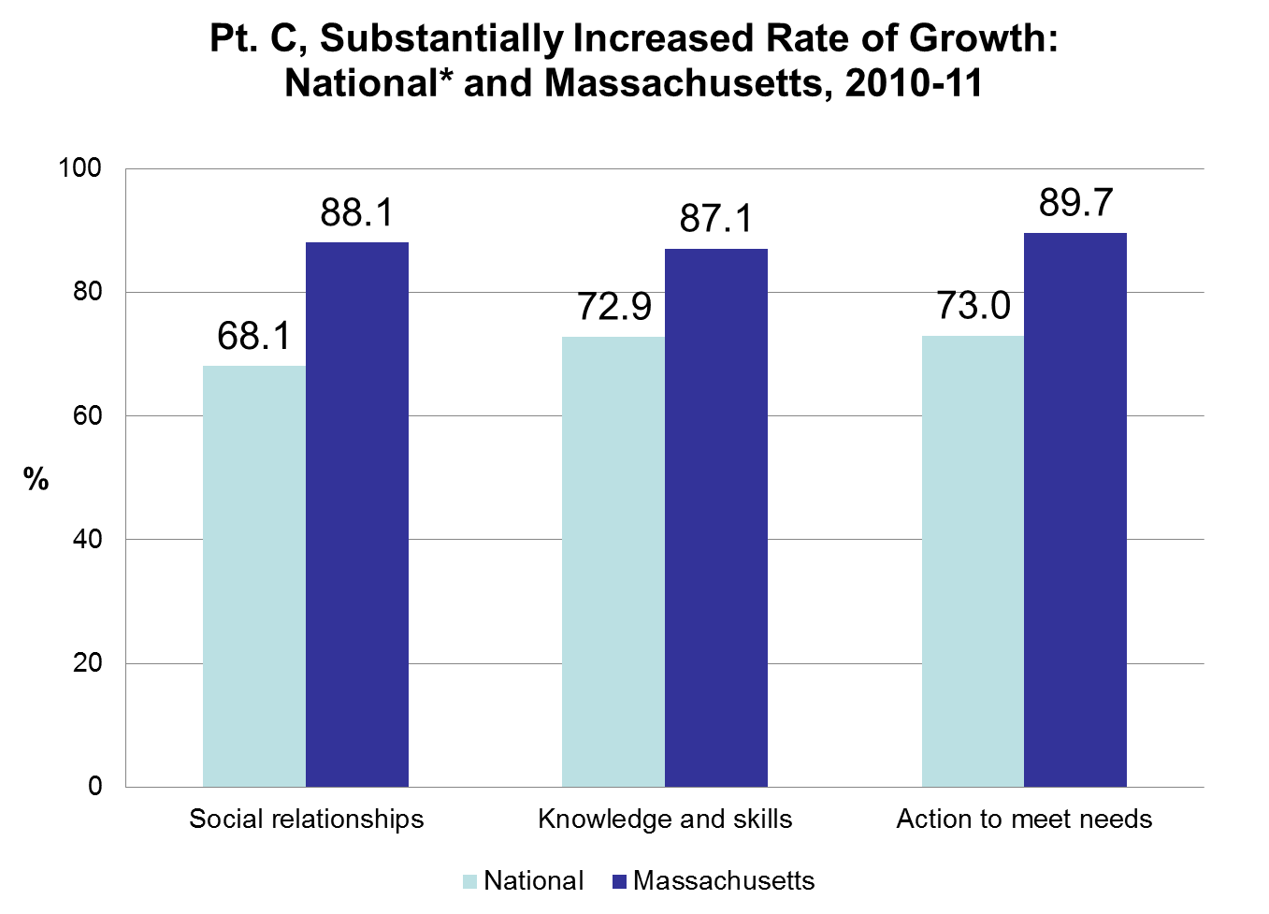

Slide 13
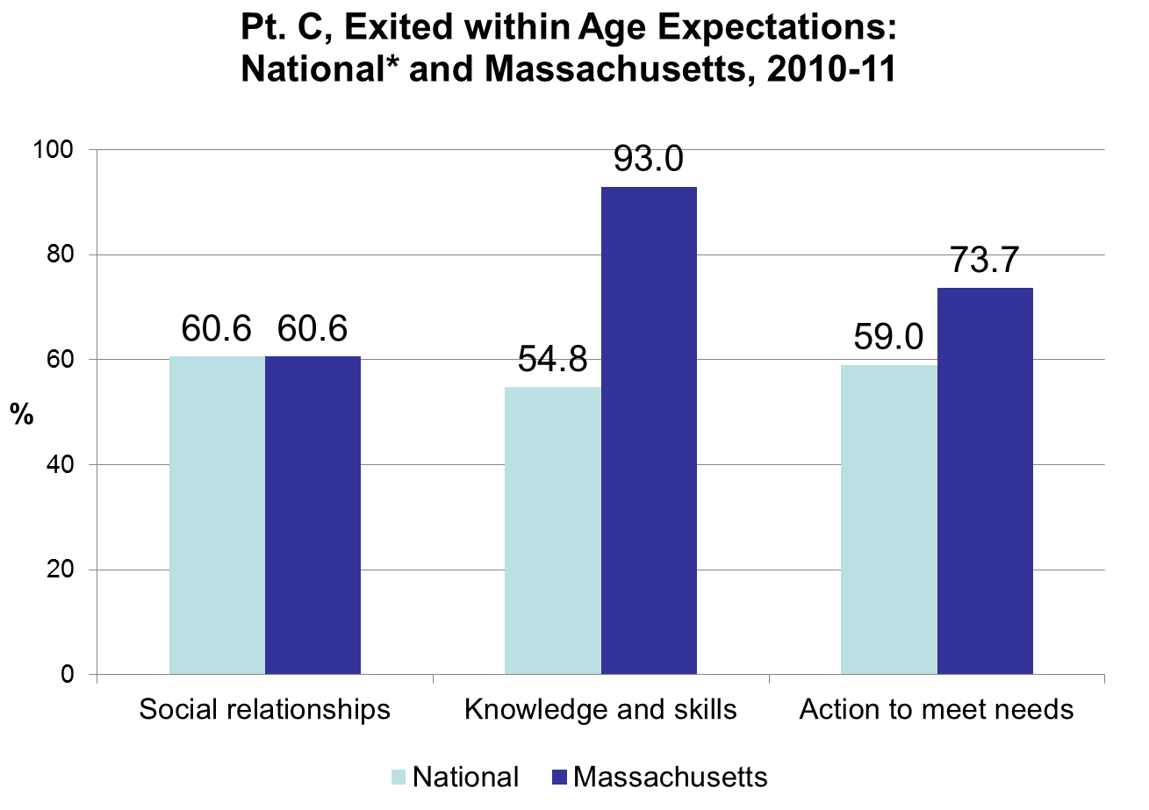

Slide 14
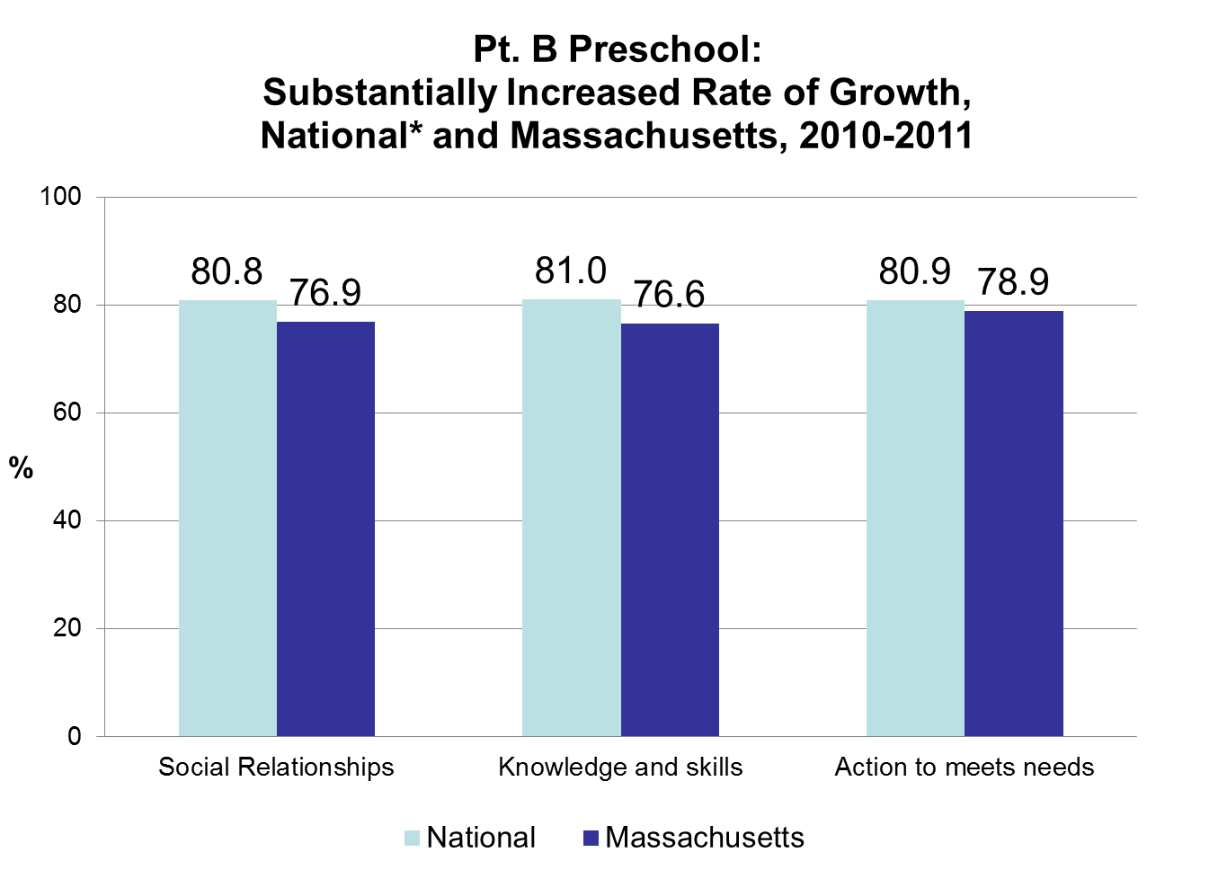

Slide 15
