Slide 1
Embedding Child and Family Outcomes into Practice –
Part 3
Kathy Hebbeler
ECO at SRI International
Webinar for the Massachusetts ICC Retreat
October 3, 2012

Slide 2
Integrating Outcomes: Using the Outcomes as an Organizing Framework

Slide 3
Notes:
The pink line on this graph represents typical development. The graph title says ‘language’ but it could just as easily say social interaction or problem solving or independence. Development follows a predictable course that involves acquiring more skills and more complex behaviors as children get older. We also know there is variation in development and no child’s development follows this kind of a line. We can, however, describe what we expect of 4 year olds and that differs from what we expect of 3 year olds. If children are developing new skills a little slower than other children, the aqua line after 21 months, these children will be a little bit behind when they arrive at kindergarten. Other children are acquiring new skills so slowly that they are substantially behind other children and we say these children have a developmental delay (red line). We intervene to change their trajectories (blue line). Without intervention, we assume that these children will continue on their same course. The goal is to do everything we can to help them achieve and stay on a higher trajectory.

Slide 4
Why do we intervene?
Development in young children follows a predictable course
Children who acquire new skills at a slower rate get further and further behind
We know how to change trajectories for many children
  But we need to use interventions that are effective.
Notes:
Comparing the child’s skills and behaviors to those expected for his age helps us document whether our services are making a difference. This is based on an assumption that intervention helps children with special needs move closer to the age expectations. Age expected development follows a predictable course. If children with special needs are not keeping up with age expectations, we provide services to help move their development along.

Slide 5
Why it is important to track outcomes?
So we can see if we are making a difference in the child’s trajectory
So we can see if the program is supporting families
So we can adjust the intervention/strategies/curriculum/etc. if we are not

Slide 6
Disconnect?
States accountable for…
Programs working toward….
Providers focus on….
Assessment reports describe…
Children achieve….
Families will..

Slide 7
Disconnect?
States accountable for…
Programs working toward….
Providers focus on….
Assessment reports describe…
Children achieve….
Families achieve….
GLOBAL
INDIVIDUALIZED

Slide 8
Alignment Across Levels
States accountable for….
Programs working toward….
Providers focus on….
Assessment reports address…
Children achieve….
Families achieve…
….the 3 child outcomes
….the 5 family outcomes

Slide 9


Child Outcomes:
What is the Framework Guiding Our Thinking?
Practitioners (teachers, therapists, early interventionists) always bring some kind of framework for where they want to see children go next
Are these guiding ideas explicit or unspoken? Using a unified framework or multiple frameworks?

Slide 10
Examples of Guiding Frameworks
The items on a specific assessment tool
A milestone checklist or series of skills to learn based on a provider’s specialty area
A specific curriculum, with assessment identifying starting point
Whatever the family wants

Slide 11
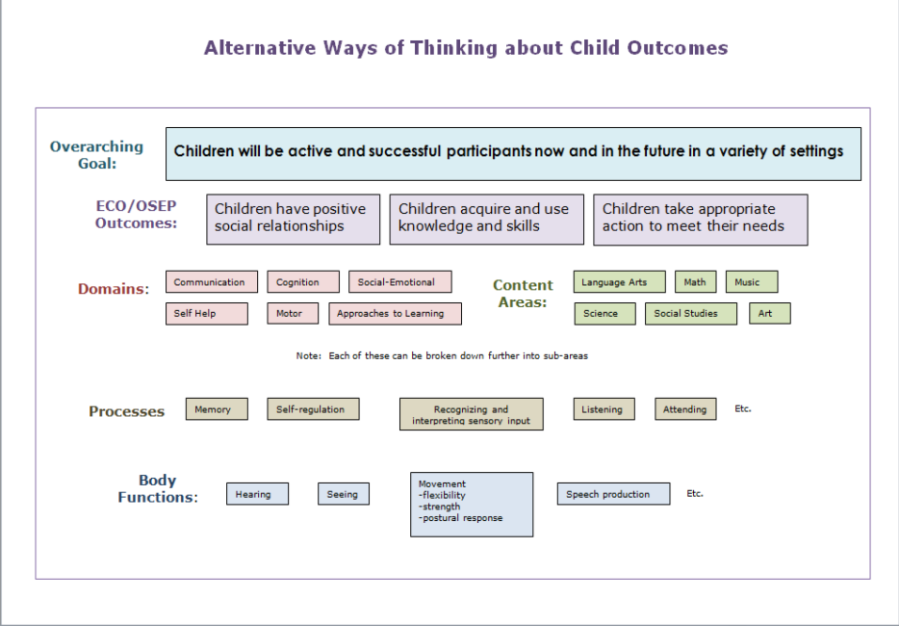
Notes:
There are many different ways of thinking about child outcomes. There is not a right way or wrong way because the alternative conceptualizations have different uses. In this slide, you see the overarching goal for young children with disabilities across the top and the three child outcomes, key to achieving the overarching goal, directly underneath. In working with children, you will certainly encounter outcomes characterized as domains. Nearly all assessment tools present outcomes in different domains. The domains feed into the three child outcomes but not in a one-to-one match because, for example, communication skills can be a critical contributor to good functioning in all three OSEP outcomes. As children get older and move into the K-12 arena, the emphasis in thinking about outcomes switches to content or subject areas. Yet another way to think about outcomes is by looking at processes, such as memory or self-regulation, another critical contributor to the more global OSEP outcomes. Also, discrete body functions that are often the focus of therapy play a critical role in children being able to achieve the OSEP outcomes and the overall goal of participation. All of these conceptualizations are legitimate and serve a purpose. The critical message of intervention is that it is not enough to focus only body functions, processes, or domains. We need to ask why these things matter – and they matter because they contribute to the overall goal of successful participation. Interventionists need to help the child put the functions and processes to use so the child can participate in everyday life.

Slide 12
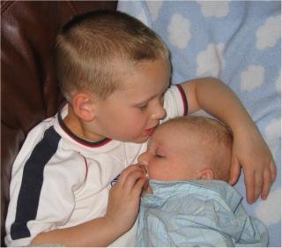
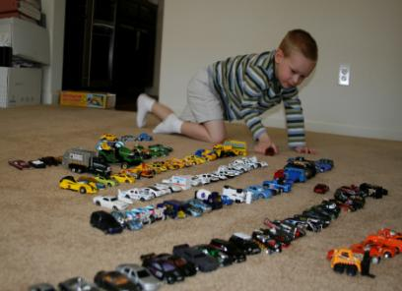
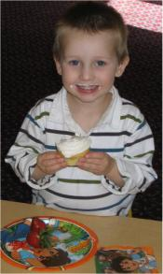
Outcomes as a Framework
The 3 functional outcomes can be a framework, a lens, for viewing child functioning and planning intervention

Slide 13
The instruction/intervention cycle
Assess (collect information)
Plan
Implement

Slide 14
The instruction/intervention cycle
Assess (collect information)
Plan
Implement
3 Child Outcomes

Slide 15
Why Use the Outcomes??
Socially validated as what we’re trying to achieve, a focus that matters
They’re functional – reinforce getting functional information in our assessment and writing functional IFSP/IEP goals/objectives for what to work on
They’re holistic – Emphasize the whole child - a key to overall goal of effective participation
Flexible – not wedded to one particular assessment, curriculum, or level of child functioning

Slide 16
Re-thinking Assessment in Early Childhood
Major changes in last 15 years in how assessment of young children is viewed
Old position: Do not test little kids
New position: Ongoing assessment is part of a high quality early childhood program

Slide 17
What changed
New and different tools became available
  Curriculum-based assessments were developed
  General EC: Tools for 3-5 came first; 0-3 tools are coming now
Interesting sidebar: Curriculum-based assessments for programs serving children 0-5 with disabilities have been around for years

Slide 18
What changed
The purpose of assessment was redefined
Not about: sorting, labeling, using to deny access
Now about: Getting a rich picture of what children can do and can’t do and using that information to help them acquire new skills
  “progress monitoring”

Slide 19
What changed
Assessment had always been seen as a process with multiple purposes
Distinctions were made been good and bad uses of assessment with young children
Good uses are now promoted
For more information: NAEYC web site (Position statement on Curriculum, Assessment and Evaluation)

Slide 20
Interesting Irony
Even though the disability community had developed many curriculum-based assessment tools, currently many programs do not practice ongoing assessment
  We do assess for eligibility
The push for ongoing assessment to monitor how a child is doing and plan for instruction/intervention is coming from the general education community

Slide 21
What Might Integration Look Like?
Assessment
Assessment – What does our assessment tell us about child functioning in each outcome area across settings and situations?
  Organizer for writing or sharing results
  Organizer for planning breadth and type of assessment approaches needed and who should be involved in it
  Produces information for outcomes and planning

Slide 22
What might integration look like?
Assessment
Positive Social Relationships
How does the child communicate her/his feelings?
How does the child interact with parents, siblings, known adults, strangers?
Consider progression of social development
Smiles - holds out arms to be picked up - Likes to look at faces -laughs aloud - distinction of strangers - parallel play - interest in other kids - associative play
Consider relationship with primary caregivers
Soothed by caregiver - varying cries - reliance on primary caregiver

Slide 23
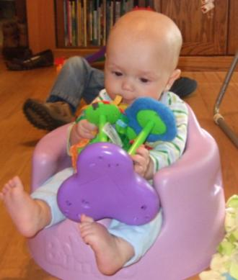
Assessment Summary-Outcome 2
Acquisition and use of knowledge and skills:
Danny is learning most of his new knowledge and skills by exploring things with his hands and mouth at this time. Danny is picking up small toys such as rings or a block and most of what he is able to get into his hands goes into his mouth for exploration. Danny will also look for a toy that he has dropped showing that he is gaining some understanding that toys do not disappear when they are out of sight.
Example developed by Sandy Harrington,
Norfolk Infant Program, Norfolk, VA
Notes:
We also learned ways that assessment summaries could be written according to the three outcomes, as shown in this excerpt from Danny’s assessment summarized for Outcome 2: acquisition and use of knowledge and skills.

Slide 24
What Might Integration Look Like?
IFSP/IEPs
Planning IFSP/IEP goals objectives –
  Has the team considered how to write objectives that continue help the child progress in each of the outcome areas?
  Will the objectives written support effective participation (overarching goal)?
  With outcomes as an organizer for where we want the child to go, use of discrete, domain-specific goals/objectives won’t make sense.

Slide 25
3 (Global) Child Outcomes and Individualized Outcomes
Active and Successful Participation
Positive Social Relationships
Knowledge and Skills
Action to Meet Needs
……..
……..
……..
…….
……..
…….
Notes:
One way to think about the overarching goal and the three child outcomes is as organizers for the IFSP. Are there things the team should be working on related to helping the child with positive social relationship? This doesn’t mean that specific outcomes must be written in each of the 3 areas. Using the 3 outcomes as an organizing framework leads teams to think about whether outcomes are needed in each of the areas.

Slide 26

Family Outcomes:
What is the Framework Guiding Our Thinking?
How do professionals decide on what to work on with families?
How do families think about what they need or want?
  What are the options?
Are these guiding ideas explicit or unspoken? Using a unified framework or multiple frameworks?
Notes:
Just like the child outcomes, all members of the team, including the family members, bring some framework for thinking about family outcomes. Each team member is working with some set of probably unspoken set of categories or options for how to think about what families need or want. Families new to early intervention probably have the least well articulated framework because they have not been thinking about this as long as the professionals have. Having a common framework can benefit communication.

Slide 27
Ultimate Goal for EI and ECSE: Families
“to enable families to provide care for their child and have the resources they need to participate in their own desired family and community activities. .”
Based on the ECO stakeholder process when identifying outcomes
Notes:
The same stakeholder process that identified the overarching goal for children and the three global child outcomes also identified an overarching goal for families.

Slide 28
5 (Global) Family Outcomes and Individualized Outcomes
Care for child and participate in community
Understand child’s strengths…
Know rights and advocate..
Help develop and learn..
……..
……..
…….
……..
…….
Have support systems
Access desired services, programs…
……..
Notes:
And just like the goal and outcomes for children, the five family outcomes are critical to achieving the overarching family goal. The five family outcomes provide areas to be considered in identifying individualized family outcomes for an IFPS. There is no expectation that every family would have individual outcomes for each of the five. Rather they are topics to be considered and discussed to identify which of the five outcomes should become a focus of early intervention for that family.

Slide 29
The instruction/intervention cycle
Assess (collect information)
Plan
Implement
5 Family Outcomes

Slide 30

Opportunities for Thinking about Child and Family Outcomes
Explaining EI to families
Play-Based Assessment
Gathering parent input
IFSP/IEP development
Ongoing intervention/service provision
Collaborative annual review
Transition/exit
Notes:
.

Slide 31
Benefits
More understandable, measureable individualized IFSP/IEP outcomes
Families can tell when their children are achieving desired outcomes
Reinforces the assessment and planning cycle
Improves practice
Supports progress in the overarching areas that are central to EI and ECSE
Notes:
Using the global outcomes as a framework produces understandable, measureable, individualized outcomes that are meaningful to families. The global outcomes also help families understand what programs are trying to do.
The outcomes tie assessment, planning, and intervention together. They improve practice and help programs to keep the focus firmly on what it is trying to achieve and what the state is being held accountable for. Supporting children and families in acquiring the outcomes is critical….

Slide 32
The outcomes provide a framework for how we look at and work with children and families
---They are not a formula---
Notes:
In using the three child outcomes and the five family outcomes as a general framework for how we work with children, it is critical to remember that a framework provides guiding categories-- Categories to guide assessment, planning, and intervention. The global outcomes should never be used as a formula that is mechanically applied and works against the individualization that is the cornerstone of early intervention.

Slide 33
Interested in Learning More?
www.the-eco-center.org

Slide 34
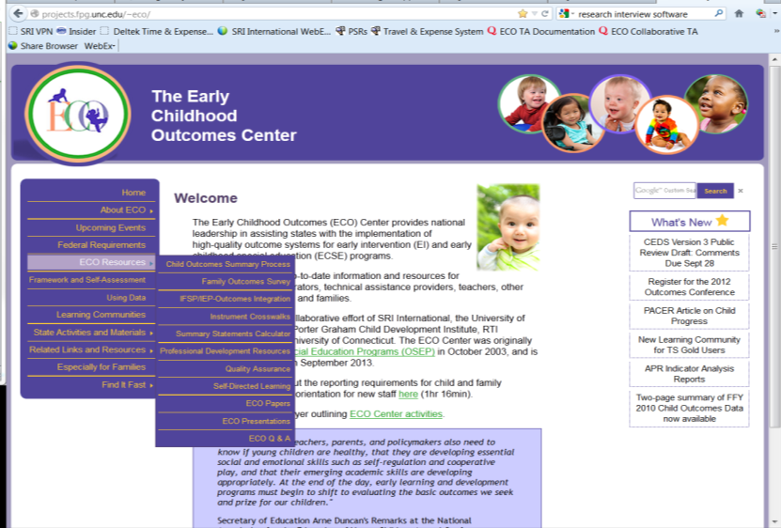

Slide 35


