Slide 1
Embedding Child and Family Outcomes into Practice – Part 2 Kathy Hebbeler ECO at SRI International
Webinar for the Massachusetts ICC Retreat
October 3, 2012

Slide 2
Background on the 3 Child and 5 Family Outcomes
What outcomes should we be measuring for children with delays and disabilities?
What outcomes are important for their families?

Slide 3
Push for the Outcomes
Office of Special Education (OSEP) is required by federal legislation (1993) to report on outcomes achieved by its programs
Early intervention and Early Childhood Special Education are line items programs in IDEA funding
In 2003, OSEP had no data on these programs.

Slide 4
What should the child outcomes be?
Individualized outcomes?
How much is enough?
How to aggregate and look across children?
Weak data for making case with policy-makers that program is effective
Domains-based outcomes?
Undermine the emphasis on functional outcomes

Slide 5
Themes from the Stakeholders: Child Outcomes
Consistent with IDEA and legislative intent
Reflect what EI and ECSE are trying to do
Reflect what is known about development and learning
Incorporate universal design
applicable to all children
28

Slide 6
Themes from the Stakeholders
Apply to the entire birth through 5 age span
Be compatible with best practice (esp. transdisciplinary service models, functional behaviors)
Have potential to influence practice in a positive way
Be succinct
Be readily understood

Slide 7
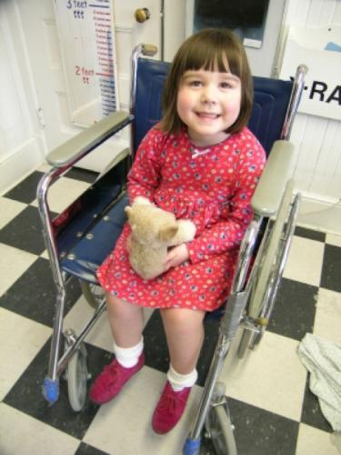
Assumption
Possible (and desirable) to develop a set of outcomes that apply to:
All children with delays or disabilities
Their families

Slide 8
Themes from the Stakeholders
Functional outcomes
Best practice – kind of outcomes recommended for IFSPs and IEPs
Reflects transdisciplinary service delivery
Not reflected well in a pure domains framework
Not captured well in current assessment tools

Slide 9
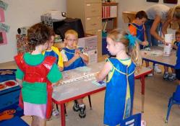
Functional Outcomes
Functional refers to things that are meaningful to the child in the context of everyday living
Refers to an integrated series of behaviors or skills that allow the child to achieve the outcomes
They are not
a single behavior, nor are they
the sum of a series of discrete behaviors

Slide 10
Functional Outcomes
What does a child typically do?
Actual performance across settings and situations
How child uses his/her skills to accomplish tasks
Not the child’s capacity to function under unusual/ideal circumstances
Notes:
Application of knowledge and skills in more realistic situations

Slide 11
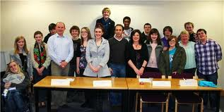
Themes from the Stakeholders
Decision: Functional outcomes
Decision: Global, not specific
Decision: Status wording, not progress wording
Progress wording: “Children will make progress toward…”

Slide 12
Features of the child outcomes
One set of outcomes for birth to 5 years
One set of outcomes for all disabilities and conditions
Functional
Drive the field forward, not backwards

Slide 13
Ultimate Goal for EI and ECSE
“To enable young children to be active and successful participants during the early childhood years and in the future in a variety of settings – in their homes with their families, in child care, preschool or school programs, and in the community.”
Based on the ECO stakeholder process when identifying 3 functional outcomes
Notes:
Outcomes aren’t just about accountability…
This is where we want our children (EI and ECSE children) to accomplish and so we want to be accountable for helping children/families achieve this goal…

Slide 14
The Child Outcomes
Positive social relationships)
Acquisition and use of knowledge and skills
Taking action to meet needs

Slide 15
Considerations in Developing Family Outcomes for Part C and 619
How can a national system to assess family outcomes accommodate the wide range of individualized outcomes?
What measurement strategies should be used that are objective yet sensitive to the fact that many outcomes are perceptions?
Should a similar set of family outcomes be expected of early intervention and preschool programs?
38

Slide 16
Input Process and Recommendations
Technical Workgroup on Family Outcomes
Developed priority outcome statements based on commonalities across the literature
ECO Constituent Workgroups
Reacted to and tweaked the resulting list of outcome statements
Recommended that the same set of family outcomes be used birth through five
Recommended family report of perceptions as the measurement strategy
39

Slide 17
The Family Outcomes
Families understand their child’s strengths, abilities, and special needs
Families know their rights and advocate effectively for their child
Families help their child develop and learn
Families have support systems
Families are able to gain access to desired services and activities in their community

Slide 18
What is reported in the APR for families are not outcomes
Percent of families participating in Part C who report that early intervention services have helped the family:
A. Know their rights;
B. Effectively communicate their children's needs; and
C. Help their children develop and learn.

Slide 19
Outcomes vs. other things
Outcome is a benefit, an end result
Other things programs could be interested in:
Helpfulness of services
Satisfaction
Involvement with the program
Quality of the services
Etc.

Slide 20
What is reported in the APR for families are not outcomes
Percent of families participating in Part C who report that early intervention services have helped the family:
A. Know their rights;
B. Effectively communicate their children's needs; and
C. Help their children develop and learn.

Slide 21
Effect of Program and Family Outcomes
Some families will achieve the outcomes without support from early intervention
Note: This is not the assumption we make for the child outcomes
We want all families to achieve the outcomes regardless of the program’s role.

Slide 22
Effect of Program and Family Outcomes
Some families will not achieve the outcomes with support of the program
Because the program was not helpful or effective
Because the family’s needs surpassed the capacity of the program to address those needs

