Slide 1
Introduction to
Integrating Outcomes Measurement with IFSP and IEP Processes
Come Together!
Notes:
This presentation is an introduction to the practice of integrating child outcomes measurement with the IFSP or IEP process. The material presented here was originally a part of a presentation for the 2011 National Conference on Measuring and Improving Child and Family Outcomes, held in New Orleans, Louisiana. In this introduction, we will describe the background and history of efforts to integrate child outcomes measurement with the steps of IFSP and IEP development, as well as the rationale for integrating the two processes.
This presentation may be helpful for anyone interested in the integration of child outcomes measurement with the IFSP or IEP process.

Slide 2
Measuring Child and Family Outcomes Conference -- 2007
Panel: Local Benefits of Implementing Child Outcomes Data Collection
  Sandi Harrington, VA Part C
  Teresa Rivenes, MT Part C
  Carol Trillia, UT Part C
Three local program staff shared their experiences implementing the Child Outcomes Summary process, describing how they collect data, the struggles they have encountered, and the improvements they have seen in practices.
Notes:
The idea of integrating both the child outcomes measurement and the IFSP process started in 2007. At the Outcomes Conference that year in Baltimore, we heard from a panel of local experts who introduced the notion of integrating child outcomes measurement with the IFSP process. One program shared their process for collecting data for the child outcomes measurement while also gathering information for the IFSP.

Slide 3
‘Child Progress Determination Questions to Guide the Discussion of Functional Indicators’
Positive Social-Emotional Development / Positive Social Relationships
How does the child communicate her/his feelings?
How does the child interact with parents, siblings, known adults, strangers?
Consider progression of social development
Smiles - holds out arms to be picked up - Likes to look at faces -laughs aloud - distinction of strangers - parallel play - interest in other kids - associative play
Consider relationship with primary caregivers
Soothed by caregiver - varying cries - reliance on primary caregiver
Notes:
Sandi Harrington, the director of the Norfolk Infant Program in Virginia, shared resources she had developed to help infant-toddler specialists gather functional information from families, caregivers, and others who spend time with the child in his or her everyday life. The resources also helped the specialists listen for developmental milestones that would help them ground their information in age expectations for infants. Prompts, such as the ones provided in this excerpt for Outcome 1 on the slide, led to the gathering of functional information. In using the resources Sandi developed, the providers discovered that information could be gathered from the time the program first learned about the child throughout the process, just as is done in ongoing progress monitoring. With child outcomes measurement, there was no need to wait and ask these questions after the child had entered services.

Slide 4
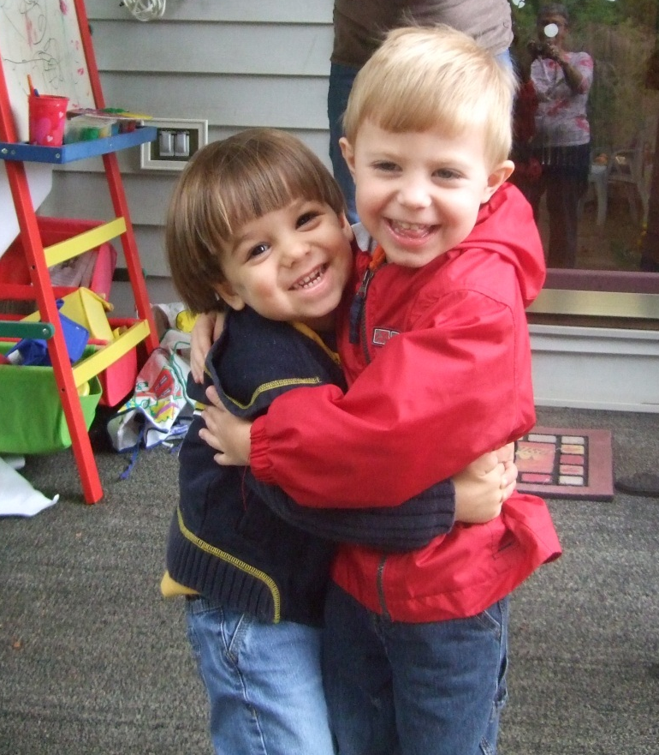
‘Current Functional Strength’
Demonstrating positive social-emotional skills:
Georgie is very friendly- he has no stranger anxiety and often hugs/kisses strangers. He enjoys playing with people of all ages and will bring toys over in an effort to engage others. He knows and responds to his name. Georgie is very sensitive to the moods of other people and gives away toys to strangers.
Notes:
The panelists at this session also showed us ways that current levels of functioning could be organized by the three child outcomes, such as this example describing Georgie’s social-emotional functioning.

Slide 5
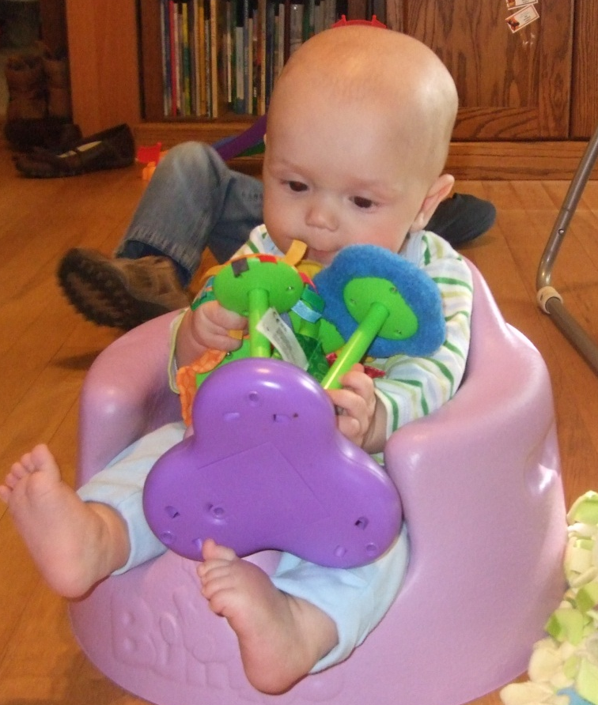
Assessment Summary-Outcome 2
Acquisition and use of knowledge and skills:
Danny is learning most of his new knowledge and skills by exploring things with his hands and mouth at this time. Danny is picking up small toys such as rings or a block and most of what he is able to get into his hands goes into his mouth for exploration. Danny will also look for a toy that he has dropped showing that he is gaining some understanding that toys do not disappear when they are out of sight.
Notes:
We also learned ways that assessment summaries could be written according to the three outcomes, as shown in this excerpt from Danny’s assessment summarized for Outcome 2: acquisition and use of knowledge and skills.

Slide 6
Integrating outcomes measurement with Evaluation/Eligibility
Advantages:
Disadvantages:
Reinforces focus on functional development
Expedites outcome rating before intervention
If core evaluation team all children evaluated from that common lens
If using RBI as part of evaluation increased functional information is gathered
Raters may not have enough information to make rating
Evaluation alone might not yield functional information
Rating with family can create a “mega meeting”
Notes:
At the Outcomes Conference in 2008, Sandi Harrington presented again about integrating outcomes measurement with the IFSP process – this time with Naomi Younggren with the Department of Defense – Army. They got everyone talking about ‘why’ integrate the two processes and presented pros and cons, such as in this slide from their presentation

Slide 7
Suggested Language for
Talking with Families
Somewhat (rating of 5)
  Compared with his 18 month old peers, Johnny is somewhat where we would expect him to be at this age. This means that Johnny has some of the skills we would expect at this age in regard to (outcome) (you can list if you like), but he does not yet have all of the skills we would expect of this age across settings and situations which include (list functional skills child is lacking to be age appropriate).
Notes:
Sandi and Naomi also introduced new descriptions for each of the ratings on the 7 point scale using family-friendly language. These new descriptions, such as the one seen here, allowed families to become more involved in the Child Outcomes Summary (COS) process.

Slide 8

Opportunities for Outcomes Measurement in IEP Process
EI Transition Meeting
Play-Based Assessment
Parent Input
IEP Development/Eligibility
Ongoing Intervention
Collaborative Annual Review
Transition/Exit
Notes:
In 2009, the Outcomes Conference session on integration brought Naomi and Sandi back to talk more about integration and the IFSP process, and added Donna Nylander, the director of a local preschool program in Illinois, to show the ways in which child outcomes measurement can be integrated with the IEP process. This slide from Donna’s presentation shows the opportunities to collect information about the child’s functioning in the three outcomes during the IEP process.

Slide 9
Implementation ‘AHAs’
Formatting evaluation narrative in 3 outcome areas actually saves time & makes the discussion more meaningful for families.
Staff have entered into a stronger partnership with families, sharing the responsibility for the evaluation narrative with the families to provide the information that isn’t collected by the assessment tool.
Notes:
Naomi, Sandi, and Donna explained the benefits of integration, as shown in this slide from their 2009 presentation At this point, we were beginning to notice that many more benefits (than barriers) were coming out of the integration process, and determined that it was time to think about taking this idea to the next level.

Slide 10
Outcomes-IFSP/IEP Think Tank-2010 Participants
Betsy Ayankoya
Debbie Cate
Siobhan Colgan
Suzanne Cotterman
Debra Hannigan
Sandi Harrington
Connie Hawkins
Kathy Hebbeler
Joicey Hurth
Lynne Kahn
Christina Kasprzak
Anne Lucas
Robin McWilliam
Donna Nylander
Lynda Pletcher
Sharon Ringwalt
Robin Rooney
Dathan Rush
Arlene Russell
M’Lisa Shelden
Donna Spiker
Karen Walker
Sharon Walsh
Naomi Younggren
Notes:
Given all the good work that was happening at the state and local level, NECTAC and ECO decided it was time for an Integration Think Tank. We brought together staff, state administrators and technical assistance providers, local administrators, families, and researchers to look at the integration efforts that had been shared and to determine how to take the integration ideas to a larger scale.

Slide 11
IFSP/IEP-Outcomes Flow Charts
IFSP
Identification and Referral
Intake and Family Assessment
Child Evaluation and Functional Assessment
IFSP Development
Service Delivery and Transition
IEP
Transition
Identification and Referral
Child Evaluation and Assessment
IEP Development
Service Delivery
Notes:
One of the products that the Integration Think Tank generated were generic flow charts – one for the IFSP process and one for the IEP process. These flow charts show opportunities throughout the IFSP and IEP processes to collect information that can be used for the child outcomes measurement.

Slide 12
For the IEP….
Identification and Referral
Receive referral or parental request for evaluation
Infuse information about 3 global outcomes into the processes of information gathering throughout child identification and referral.
Provide a written copy of procedural safeguards to parents
Explain program in detail. Describe process and purpose of the three global outcomes to be measured for federal reporting.
Determine with family if they wish to have child evaluated for eligibility and services
Notes:
This is an example of one section of the generic flow chart for the IEP. The black text represents typical activities within the IEP process. The red text indicates the opportunities for outcomes measurement .

Slide 13
For the IFSP….
Intake and Family Assessment
Gather information about child and family, incorporating 3 global outcomes
Use outcomes framework to think about child’s functioning,
discussing everyday routines and activities of child and family
Use information gathered at intake to help determine evaluation team
Gather and document information about the child’s functioning through naturalistic observation
Gather information about family concerns and priorities for their child and family
Gather information about family resources to assist in addressing priorities and concerns
Notes:
This is an example of one section of the generic flow chart for the IFSP. Again, the black text represents typical activities within the IFSP process. The red text indicates the opportunities for outcomes measurement.

Slide 14
Integrating Child Outcomes Measurement
Into the IFSP Process
d. Eligibility determination
How does the team make the eligibility decision, what is the family role, etc.
Does the generic flow chart reflect your eligibility determination process? Why or why not?
Are there opportunities during eligibility determination to collect information about the 3 global outcomes? Describe.
Could the 3 global outcomes be discussed, summarized, or integrated during the eligibility process?
Notes:
The Integration Think Tank also developed worksheets with discussion questions for teams at the state and/or local levels. These worksheets are designed to help teams figure how and where to integrate outcomes measurement into their ongoing IFSP or IEP process. This slide shows an example of how to think about outcomes data collection as part of the eligibility determination process for Part C.

Slide 15
West Virginia - Completing the COST
COST is completed following determination of eligibility and prior to writing IFSP outcomes
Developmental Specialist facilitates the conversation based on all the information that has just been shared through the review of pages 1 – 7 of the IFSP
WV does not use numbers but uses language from COST (foundational, somewhat)
Use naturally occurring opportunities for exit ratings
Notes:
The information and resources from the Think Tank were presented, along with state-specific flow charts in the 2010 Outcomes Conference, which brought Naomi (Department of Defense), Sandi (local program-Virginia), and Donna (local program – Illinois) back to present. The 2010 panel also featured Mel Woodcock of the West Virginia-Part C program, who described their methods for completing their child outcomes summary tool, called the COST, within their IFSP process, as shown in the slide.

Slide 16
WV - COST into IFSP Outcomes/Intervention
Provides a better understanding of the child’s functional skills and abilities across settings
Provides a better understanding of the child’s functional limitations and need for assistive technology
Limits teams from suggesting the next test item as outcomes/interventions
Helps the family know what is expected at that age and where the child is at now
Focuses the conversation on functional skills not isolated skills
Notes:
Mel also shared the benefits that had been noted in West Virginia as a result of integrating the two processes.

Slide 17
Fast Forward to TODAY!!
Page with resources on ECO website
http://www.fpg.unc.edu/~eco/pages/integration.cfm
Outcomes integration session at the mega
Session and workshop on integrating outcomes with IFSPs and IEPs – 100 people registered for the workshop!
We’d still like to form a Learning Community to support programs trying to integrate these processes…
Notes:
Since the 2010 Outcomes Conference, ECO has organized state, local and Think Tank resources to support integrating outcomes measurement with the IFSP and IEP processes on their website. At the 2011 OSEP Mega Leadership Conference, Mel Woodcock and Margie Marion (a parent from West Virginia), and Phyllis Mondak (from the preschool program in Virginia) presented a session on the integration of the two processes from a family perspective. At the 2011 Outcomes Conference, we celebrated five years of work toward supporting the integration of outcomes measurement and the IFSP or IEP.

Slide 18
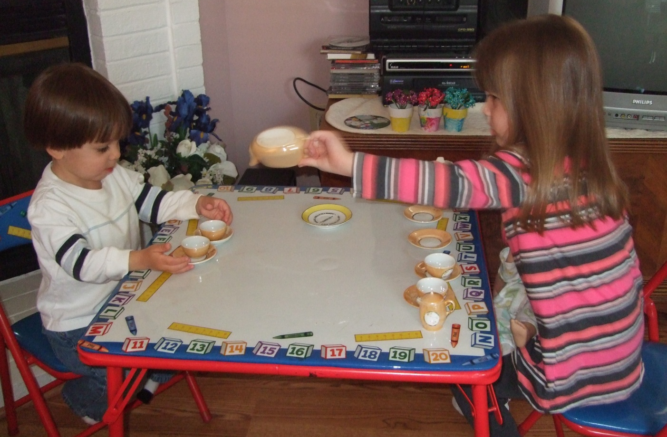
Integrating Outcomes Measurement:
Focus and Purpose
Notes:
Next, we’ll take a moment to step back and think about why we might strive to integrate child outcomes measurement activities within the IFSP or IEP process.

Slide 19
Integration
Not just about creating a more seamless process…not just details and how
BIG
Critical to the picture of what we are all trying to accomplish
Notes:
Integrating outcomes measurement is not just about streamlining forms or making the entire process feel more cohesive for families. Those benefits will occur. But, the main reason for integration is that embedding the global outcomes in all facets of our practice helps us achieve the vision of what we want to accomplish for and with children and their families.

Slide 20
Disconnect?
States accountable for….
Programs working toward….
Providers focus on….
Children achieve….
Notes:
Now we have a global set of outcomes that states are held accountable for. Programs are working to ensure they can help children show progress on these, and want to see that children’s progress in their program is moving in the direction of state targets.
And, we have providers focusing on individualized outcomes with children and families. These help guide children’s achievements and progress…
But, is there a disconnect?
Does the emphasis at the level of the intervention support the global outcomes that the program is trying to achieve and that the state is held accountable for?

Slide 21
Alignment Across Levels
States accountable for….
Programs working toward….
Providers focus on….
Children achieve….
… the 3 outcomes
Notes:
We want these pieces to come into alignment.
Focusing on the 3 global outcomes is the glue that can connect these pieces.
Integrating the 3 global outcomes into the IFSP/IEP process brings what we want to accomplish for all children and families into the discussion about how we can best support each individual child and family.

Slide 22
Ultimate Goals for EI and ECSE
For children:
“To enable young children to be active and successful participants during the early childhood years and in the future in a variety of settings – in their homes with their families, in child care, preschool or school programs, and in the community.”
Based on the ECO stakeholder process when identifying 3 functional outcomes
Notes:
The 3 outcomes aren’t just about having a set of numbers for accountability.
Integrating the child outcomes into the IFSP/IEP process helps us be better able to accomplish our vision. Making progress on the 3 outcomes is critical for all children for successful participation. By focusing on the 3 outcomes, programs can help children be active and successful participants now and in the future in all the settings they are in… at home, at school, in child care, and in the community.

Slide 23
Thinking
Notes:
There is always some kind of thinking, or a framework, that teams are using.
They use frameworks as they gather and interpret assessment information and use it to formulate an individualized plan for each child.

Slide 24
What is the Framework Guiding
Our Thinking?
Providers always bring some kind of framework for taking information about the skills a child currently uses and planning where they want to see the child go next
Are these guiding ideas explicit or unspoken?
Are they using a unified framework or multiple frameworks?
Notes:
What is the framework that guides your thinking for identifying outcomes for a child?
Is it explicit?
Is it one framework?
Or are there really multiple frameworks? Maybe each provider on the team is using a different one.

Slide 25
Examples of Guiding Frameworks
The items on a specific assessment tool
A milestone checklist or series of skills to learn based on a provider’s specialty area
A specific curriculum, with assessment identifying starting point
Whatever the family wants
Notes:
Here are some examples of the kinds of frameworks that practitioners might use:
Teams might use items from a specific assessment tool. They might look at the next item in the sequence and use that to plan an intervention.
Or, the framework might be a series of skills or a specific milestone checklist based on the provider’s specialty area that guides planning.
Another option is that a specific curriculum might be the guide for planning.
Or, sometimes teams completely follow the family member’s lead. The plan is based on whatever the family wants.

Slide 26
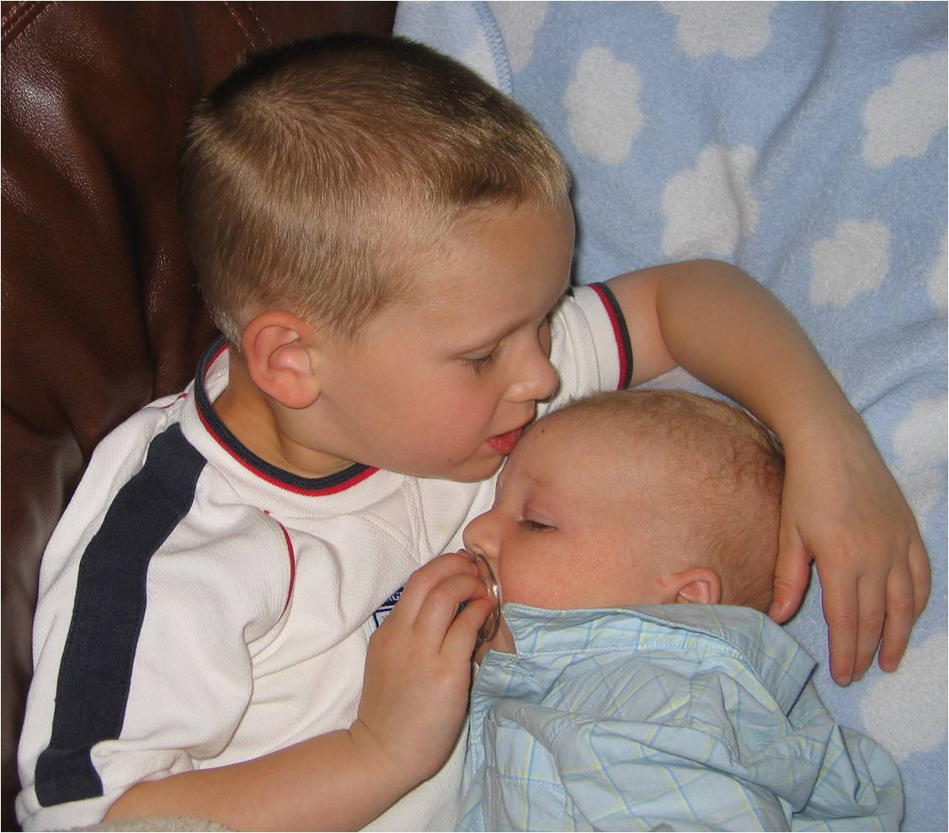
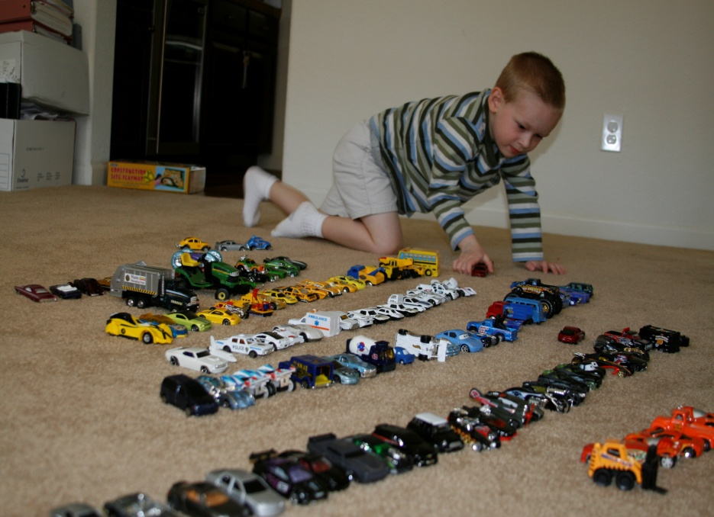
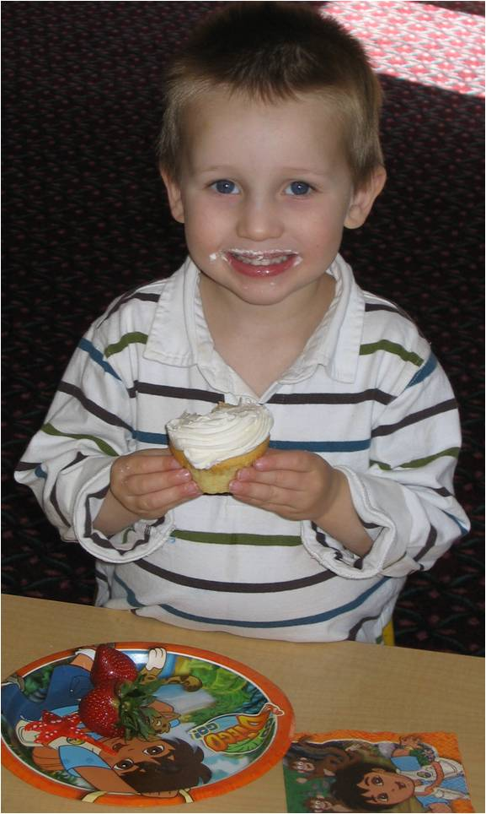
The 3 Outcomes as a
Guiding Framework
The 3 functional outcomes can be a framework, a lens, for viewing child functioning and planning intervention
Notes:
The three functional outcomes are an alternative framework.
They are a lens through which to view child functioning and plan interventions.
This does NOT mean that the family’s concerns and priorities are not considered. It means that what matters to families is talked about with regard to each of the three outcomes.

Slide 27
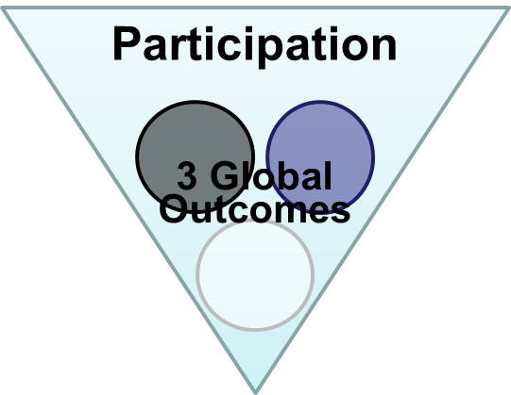
Global Outcomes =
Having positive social relationships
Taking appropriate action to meet needs
Acquiring and using knowledge and skills
Notes:
The 3 outcomes are general statements of what we want the child to achieve. Remember, we want all children to be successful participants in a variety of settings.
The global outcomes are a way to think about what skills the child uses. They also provide a lens to organize how to help the child continue to learn to use his/her skills in richer, more complex, successful ways.

Slide 28

Why Use the Outcomes??
Socially validated – reflect what we are trying to achieve
Functional
They’re integrated – emphasize the whole child
Flexible – not wedded to one particular assessment, curriculum, or level of child functioning
Notes:
With all these frameworks, why should we use the 3 global outcomes?
The 3 global outcomes have been socially validated - thousands of stakeholders all over the country, including families of children with disabilities, have said that these are important outcomes for children
The 3 global outcomes also are functional. So, they reinforce the need to gather functional information about how children use their skills to perform meaningful tasks during assessments and they reinforce the need to write functional individualized IFSP/IEP outcomes.
The 3 outcomes focus on the whole child. They aren’t tied to any one domain. Instead, they emphasize the whole child. Integration across domains is critical for effective participation.
Finally, the 3 outcomes are flexible. Because they are global, they are not wedded to the use of any one particular assessment, curriculum, or level of child functioning.

Slide 29
What Might It Look Like?
Assessment
What does our assessment tell us about the child’s functioning in each outcome area across settings and situations?
  Organizer for planning breadth and type of assessment approaches needed and who should be involved in it
  Organizer for writing or sharing results
  Produces information for outcomes and planning
Notes:
What does assessment look like when it is organized around the 3 outcomes?
The global outcomes focus the collection and reporting of information on the child’s functioning in each outcome area across settings and situations.
The 3 outcomes serve as an organizer for the type of assessment approaches to use.
The 3 outcomes also are an organizer for how teams write or share results, organizing results by outcome rather than by the domains.
Assessments are still individualized to the child, but the outcomes provide a useful framework for organizing the information.

Slide 30
Assessment
Global Outcomes =
Having positive social relationships
Taking appropriate action to meet needs
Acquiring and using knowledge and skills
Notes:
The framework provided by the 3 global outcomes is helpful through all phases of assessment and intervention. The 3 outcomes inform the initial assessment process and what is learned about how the child uses his/her skills in everyday situations.

Slide 31
What Might It Look Like?
IFSP/IEPs
Planning IFSP/IEP outcomes
  Has the team considered how to write individualized outcomes that continue help the child progress in each of the 3 outcome areas?
  Will the individualized outcomes written support effective participation (overarching goal)?
  With global outcomes as an organizer for where we want the child to go, use of discrete, domain-specific objectives won’t make sense.
Notes:
What do IFSPs or IEPs look like when the global outcomes provide the framework?
Thinking about the global outcomes challenges teams to consider how the individualized outcomes help the child progress in each of the 3 global outcome areas--again, because success in the three global outcomes is critical to the overarching goal of effective participation.
The global outcomes do not dictate the individualized outcomes. Rather, they provide a framework for thinking about development and learning. They help a team identify where they need to support the child’s functioning in a way that will be far more effective than domains or discrete skills.

Slide 32
IFSP/IEP Development
Global Outcomes =
Having positive social relationships
Taking appropriate action to meet needs
Acquiring and using knowledge and skills
Notes:
The 3 outcomes provide a framework during the IFSP or IEP meeting that helps teams consider the individualized outcomes and shape an intervention plan that supports the child’s effective participation across settings.

Slide 33
IFSP/IEP Development
Global Outcomes =
Having positive social relationships
Taking appropriate action to meet needs
Acquiring and using knowledge and skills
Notes:
Note that use of the 3 global outcomes as an overarching organizer for individualized outcomes helps teams think about a broad array of individualized outcomes to guide the intervention. It does not mean that there should be a one-to-one correspondence between each global and individualized outcome. The team decides what the right mix should be.

Slide 34
What Might it Look Like?
Intervention
Intervention
Global Outcomes =
Having positive social relationships
Taking appropriate action to meet needs
Acquiring and using knowledge and skills
Notes:
The three global outcomes continue to be an overarching consideration as intervention activities are implemented and the team examines progress on the individualized outcomes.

Slide 35
What Might it Look Like?
IFSP/IEP Review
IFSP/IEP Review
Global Outcomes =
Having positive social relationships
Taking appropriate action to meet needs
Acquiring and using knowledge and skills
Notes:
At the IFSP or IEP review meeting, we discuss progress on the individualized outcomes and revisit the 3 global outcomes to identify if the intervention and support activities are making a difference. If the child did not have an individualized outcome in one or more of the 3 outcome areas, the review is a good time for the team to make sure that the child’s development remains on target in this outcome. This review discussion informs the development of new individualized outcomes and interventions that will help the child continue to make progress in the 3 global outcomes.

Slide 36
Benefits
More understandable, measureable individualized IFSP/IEP outcomes
Families can tell when their children are achieving desired outcomes
Reinforces the assessment and planning cycle
Improves practice
Supports progress in the overarching areas that are central to EI and ECSE
Notes:
Using the 3 global outcomes as a framework produces understandable, measureable, individualized outcomes that are meaningful to families. The 3 outcomes also help families understand what programs are trying to do.
The 3 outcomes tie assessment, planning, and intervention together. They improve practice and help programs to keep the focus firmly on what it is trying to achieve and what the state is being held accountable for. Supporting children in acquiring the outcomes is critical….

Slide 37
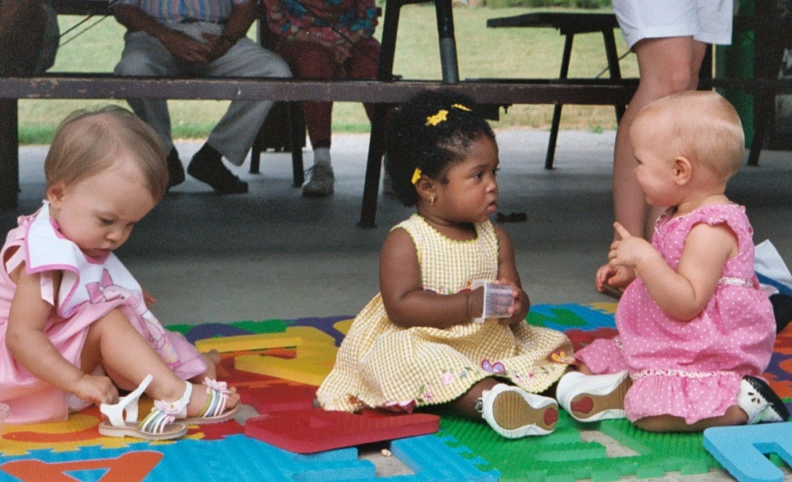
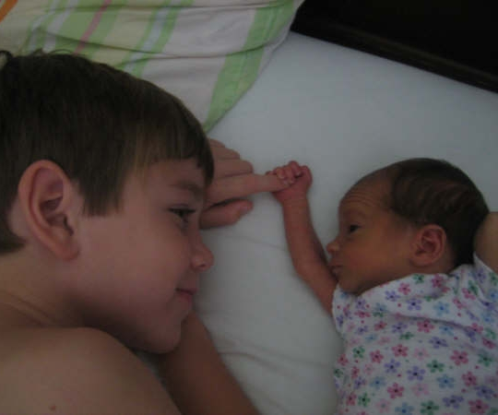
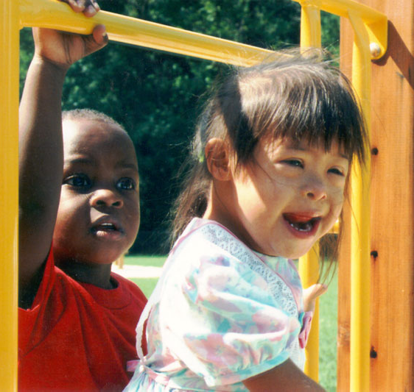
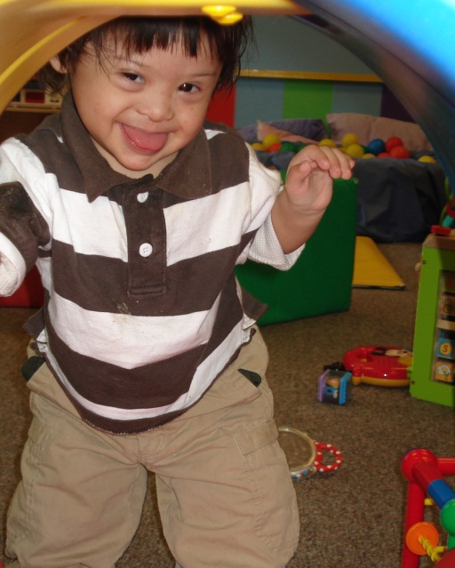
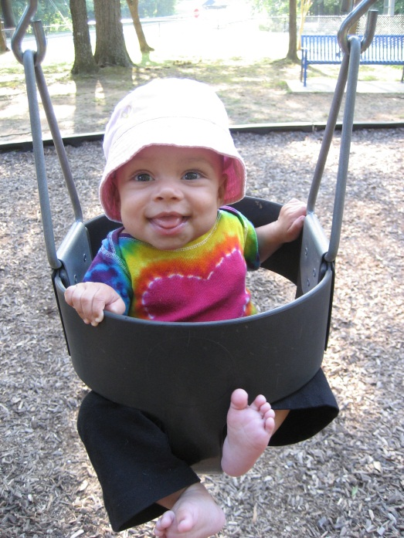
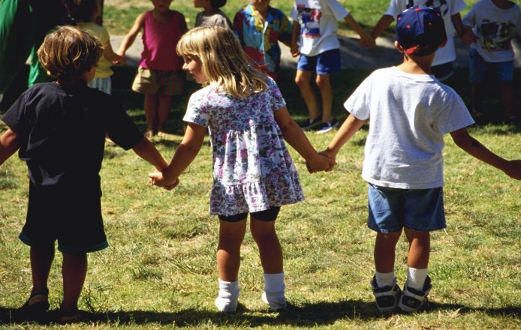
Active and Successful Participation
Notes:
To helping all children achieve what matters.

