Slide 1
Early Childhood Outcomes Workshop
Kathi Gillaspy
Early Childhood Outcomes Center
National Early Childhood TA Center
Kathy Hebbeler
Early Childhood Outcomes Center
June 13, 2012
Notes:
Welcome and introductions
Purpose of the day – refresher on different components of the COS process, with outcomes to improve the quality of the data, create stronger foundations in the rating process, and enhance the team process to determining and documenting the rating.

Slide 2
Workshop Topics
Overview of the three outcomes, the 7 point scale and the decision tree
Recommended practices in the COS process – assessment and age anchoring
The COS team process
Practice using the COS process
Documenting the rating
COS quality review
Data reporting, including an overview of the national data
Notes:
This is what we will cover.
Not covering data analysis or use for program improvement, specifics on filling out forms that are used. Focusing on the key components of the process that you will be able to take back to your local program and use.
Throughout the presentation we’ll be asking you to tell us how things go here in Iowa. Encourage lots of discussion about the content we’re sharing and how it relates to current practices. Want you to think critically about your process and how this information can be used in your local programs.

Slide 3

Review of the Three Child Outcomes

Slide 4
Tell us about Iowa…
Notes:
For those of you who work in outcomes, what issues do you have with the content of the three outcomes?

Slide 5
Goal of early intervention
“…To enable young children to be active and successful participants during the early childhood years and in the future in a variety of settings – in their homes with their families, in child care, in preschool or school programs, and in the community.”
(from Early Childhood Outcomes Center,
http://www.fpg.unc.edu/~eco/pdfs/eco_outcomes_4-13-05.pdf)
Notes:
This is an important message, worth repeating…

Slide 6
Three child outcomes
  Positive social emotional skills (including positive social relationships)
  Acquisition and use of knowledge and skills (including early language/ communication)
  Use of appropriate behaviors to meet their needs
Notes:
Handout – one-pager on 3 outcomes
SHOW VIDEO!

Slide 7
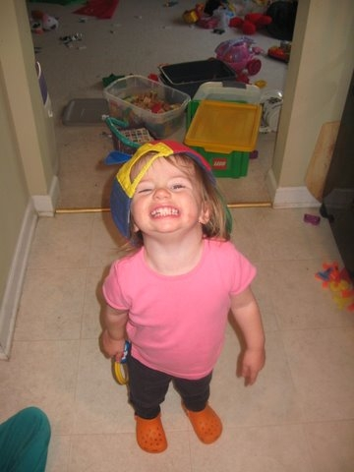
Recommended Practices and the COS Process- Assessment

Slide 8
Tell us about Iowa…
Notes:
When do you do assessment?
How often are you using assessment?
What kinds of assessment data to you typically bring into your COS discussions at entry? At exit?
Does the information help you in your process?

Slide 9
Iowa (COS) Process
Child Outcome Summary = Early Childhood Outcome in Iowa
COS = ECO in Iowa
COSF = ECO Summary Page
Notes:
Dee to present this slide.

Slide 10
What is the Child Outcomes Summary (COS) Process?
A team process for reviewing child assessment data from different sources culminating in the ‘rating’ of a child’s functioning on a scale of 1-7
Considers the child’s functioning across situations and settings
Compares child’s functioning to same age peers

Slide 11
Why was the process developed?
For federal reporting on child outcomes
No method to synthesize child outcomes data from multiple sources
Different programs would be using different assessment instruments, and outcomes data would need to be aggregated across programs

Slide 12
Purposes of the COS
It is not an assessment tool
It uses information from multiple sources, including assessment tools, observations, and family interview to get a global sense of how the child is doing at one point in time

Slide 13
Features of the COS
7-point rating scale
Rating is based on the child’s functioning:
  What the child does across settings and situations
  Compared with what is expected given the child’s age

Slide 14
The two COS questions
a. To what extent does this child show age-appropriate functioning, across a variety of settings and situations, on this outcome? (Rating: 1-7)
b. Has the child shown any new skills or behaviors related to [this outcome] since
the last outcomes summary? (Yes-No)

Slide 15
Why two questions?
a. The first question compares the child’s functioning to age expectations, on a scale of 1-7
b. The second question is only addressed after the entry COS (annually or at exit depending upon state procedures) and compares child’s skills with his or her earlier functioning

Slide 16
Why two COS questions?
Progress data for federal reporting are calculated from the COS ratings (entry versus exit) plus the yes/no progress question
The yes/no progress question differentiates between children who made absolutely NO progress or regressed -- and children who gained at least one new skill

Slide 17
Summary ratings are based on…
Types of Information
  Curriculum-based assessments (e.g., HELP)
  Norm-referenced assessments (e.g.,
  BDI-2)
  Developmental screenings (e.g.,
  Ages & Stages)
  Observation and report
Sources of Information
  Routines Based Interview (family information)
  Service providers
  Therapists
  Physicians
  Child care providers
  Teachers
  People familiar with the child in all of the settings and situations he’s in
Notes:
Reiterate multiple sources that reflect multiple settings and situations. These are all potential sources of information to inform the rating.

Slide 18
Essential Knowledge for Completing the COS
Among them, IFSP team members must:
Know about the child’s functioning across settings and situations
Understand age-expected child development
Understand the content of the three child outcomes
Know how to use the rating scale
Understand age expectations for child functioning within the child’s culture

Slide 19

Important point
It is not necessary that all team members be knowledgeable in all 5 areas
Especially, there is no expectation that parents understand the rating scale or typical child development
But the professionals have to!
Notes:
Together, at least one member of the team has to be knowledgeable in each of the 5 areas. Together, team members should be able to describe the child’s functioning as compared to age expectations. The child’s parent is a key team member and critical to understanding how his or her child functions in every day life. We don’t expect parents to be able to compare their child’s development to other children. That’s the role of the professional. It’s essential that the professionals understand age-expected child development!

Slide 20

How we learn about the child’s functioning across settings and situations
Good Assessment
Notes:
How do you collect information about the child’s functioning across settings and situations to inform the rating on the 7 point scale?
We learn about the child’s everyday functioning through good assessment practices.

Slide 21
DEC* recommended practices for assessment
Involve multiple sources
  Examples: family members, professional team members, service providers, caregivers
Involve multiple measures
  Examples: observations, criterion- or curriculum-based instruments, interviews, norm-referenced scales, informed clinical opinion, work samples
*Division for Early Childhood of the Council for Exceptional Children
Notes:
Our professional organization for early childhood special education – the Division for Early Childhood of the Council for Exceptional Children – defines good assessment practices as those that use multiple sources of information, and multiple measures.

Slide 22
Assessment practices appropriate for outcomes measurement: ASHA*
ASHA recommended practices:
  Gather information from families, teachers, other service providers
  Collect child-centered, contextualized, descriptive, functional information
*American Speech-Language-Hearing Association
Notes:
The professional association for Speech-Language Pathologists, AHSA, says that a balanced assessment includes information from families, teachers, other service providers, and information that is child-centered, contextualized, descriptive and functional.

Slide 23

1. WHAT is Functional Assessment?
Adapted from materials developed by Naomi Younggren, 2011
Assessment of the young child’s skills in the real life contexts of family, culture and community rather than discrete isolated tasks irrelevant to daily life.
“the science of the strange behavior of children, with strange adults, in strange settings for the briefest possible period of time.”
Bronfenbrenner, 1979, p. 19
Notes:
Functional or authentic assessment of the young child’s skills in the real life contexts of family, culture and community, rather than in isolation. Results reflect the “whole child”.
Differs from our traditional approach (read quote)

Slide 24
WHAT: Functional Assessment is…
Adapted from materials developed by Naomi Younggren, 2011
contextually relevant information about the child’s strengths and needs
more culturally sensitive
individually focused
IS NOT…
domain based and discipline specific
deficit driven
threatening
Notes:
Assessment is conducted and interpreted within the framework of how the child functions within these systems.
Uses ecological & ethnographic approaches as well as more formal assessment methods.
•Research shows that it yields more valid assessment results
Not just…
Know how to make eye contact, smile, and give a hug
Know how to imitate a gesture when prompted by others
Use finger in pointing motion
Show a skill in a specific situation
But does he/she…
Initiate affection toward caregivers and respond to others’ affection
Watch what a peer says or does and incorporate it into his/her own play
Point to indicate needs or wants
Use a skill in actions across settings and situations to accomplish something meaningful to the child

Slide 25
WHAT: Functional Assessment is Authentic…
Adapted from materials developed by Naomi Younggren, 2011
The more realistic or natural the task,
  the more motivated the child
  the more applicable it is to everyday events and situations
Authentic tasks and circumstances reinforce
  competency-based approach to the education of young children
  assessment of all disciplines across complex skills and processes
  generalization of learning across settings
Authentic tasks require the assessor to make no inferences about a child's capabilities, because the behaviors sampled are directly observable.
  University of Illinois at Chicago
Notes:
Authenticity in is important because:
The more realistic or natural the task,
the greater the motivation is to the child, and
the more applicable the task is to everyday events and situations
Authentic tasks and circumstances promote
the importance of a competency-based approach to the education of young children with special needs and
the focus the assessment across all disciplines on a complex sets of skills and processes and
the generalization of learning across settings
Authentic tasks require the assessor to make no inferences about a child's capabilities, because the behaviors sampled are directly observable.
University of Illinois at Chicago

Slide 26
Conventional Assessment
Adapted from materials developed by Naomi Younggren, 2011
Conventional testing does have its place
  “to distinguish typical from atypical performance”
Everything that can be measured counts,
but not everything that counts
can be measured.
(attributed to Albert Einstein, 1951)
Notes:
Traditional standardized evaluation alone:
do not provide the information needed to develop functional IFSPs or IEPs that can be implemented within the day to day routines of the family/school house/community/child care…
do not determine what the child is able to do, likes to do, or needs to do in regards to the family’s/players’ priorities.
do not provide a clear understanding of the child’s abilities across environments and care providers – this is accomplished through observation and information sharing
Do not provide sufficient information to complete the rating in the three outcome areas alone
Conventional testing is useful “to distinguish typical from atypical performance”.

Slide 27
Assessment should focus on…
What does the child usually do?
Actual performance across settings and situations
How the child uses his/her skills to accomplish tasks
Not the child’s capacity to function under unusual or ideal circumstances
Not necessarily the child’s performance in a structured testing situation

Slide 28
Activity
Functional or Discreet?
Notes:
Worksheet –
Have do individually, then do group debrief

Slide 29
Listening and learning from parents is good assessment
See the discussion prompts on the ECO website for possible questions to ask families
The Routines-Based Interview offers lots of information
Check in with parents to see how the child is doing and incorporate this information into the SFP rating process
Notes:
The discussion prompts file provides some questions you can ask families about their child’s skills and behaviors in everyday life. These are possible questions; it is not expected that you would ask all of the questions to the same family. This ‘real life’ information provided by family’s answers helps determine the child’s level of functioning across different aspects of the global outcomes, and helps identify the most appropriate rating.

Slide 30
A domain score on an assessment tool does not necessarily translate directly into an outcome rating
Ratings require:
  Looking at functional behaviors
  Collecting and synthesizing input from many sources familiar with how what the child does in across different settings and situations
Notes:
A provider of early intervention services should never make decisions about a child based on one assessment source, such as the scores from one tool. The rating on the Summary of Functional Performance should reflect all the information we can learn about a child to understand not only the skills he has acquired, but also how he uses them in everyday life.

Slide 31
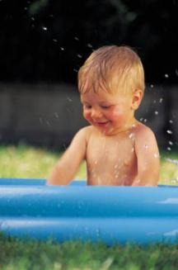
Activity
Jack’s Narrative
Notes:
Jack’s narrative
At tables, read the narrative description based on evaluation information alone. As a group, determine what other information would want to know about the child, and methods that might consider using to gather that information.

Slide 32
Crosswalks
Identify relationships between assessment instruments and the three child outcome
Display how content on a given assessment instrument is related to each outcome
Are not meant to be used as a “checklist” or “score sheet” for measuring child outcomes
Find crosswalks on http://www.fpg.unc.edu/~eco/pages/crosswalks.cfm

Slide 33
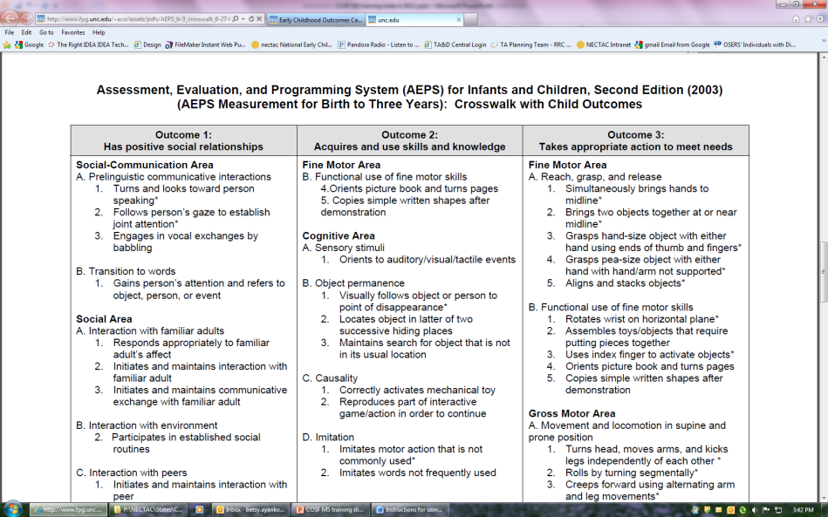
AEPS Crosswalk example
Notes:
Here is a screen shot of the AEPS. Have this, the DAYC and a draft of the GOLD.
Brief activity: Take out one that you use and look at the items that fall under outcome one. Does it cover all that you think it should to effectively rate a child in this outcome? Why or why not? What additional information would you want to gather? What sources would you use?
Mention using these as an orienting mechanism to plan for assessment.
Take break (15 minutes)

Slide 34




The seven points on the COS scale

Slide 35
Tell us about Iowa…
Notes:
Have you had any issues applying the rating scale?
What kinds of problems do you encounter?
Are there types of children that you have difficulty applying the rating scale to?

Slide 36
7 – Completely
Child shows functioning expected for his or her age in all or almost all everyday situations that are part of the child’s life
Functioning is considered appropriate for his or her age
No one has any concerns about the child’s functioning in this outcome area
Notes:
Refer to handout – rating scale definitions – Go through quickly

Slide 37
6 – Between completely and somewhat
Child’s functioning generally is considered appropriate for his or her age but there are some significant concerns about the child’s functioning in this outcome area
These concerns are substantial enough to suggest monitoring or possible additional support
Although age-appropriate, the child’s functioning may border on not keeping pace with age expectations

Slide 38
5 – Somewhat
Child shows functioning expected for his or her age some of the time and/or in some settings and situations
Child’s functioning is a mix of age-appropriate and not age-appropriate behaviors and skills
Child’s functioning might be described as like that of a slightly younger child

Slide 39
4 – Between somewhat and nearly
Child shows occasional age-appropriate functioning across settings and situations
More functioning is not age-appropriate than age-appropriate

Slide 40
3 – Nearly
Child does not yet show functioning expected of a child of his or her age in any situation
Child uses immediate foundational skills, most or all of the time across settings and situations
Immediate foundational skills are the skills upon which to build age-appropriate functioning
Functioning might be described as like that of a younger child

Slide 41
2 – Between nearly and not yet
Child occasionally uses immediate foundational skills across settings and situations
More functioning reflects skills that are not immediate foundational than are immediate foundational

Slide 42
1 – Not yet
Child does not yet show functioning expected of a child his or her age in any situation
Child’s functioning does not yet include immediate foundational skills upon which to build age-appropriate functioning
Child functioning reflects skills that developmentally come before immediate foundational skills
Child’s functioning might be described as like that of a much younger child

Slide 43
Levels of functioning
Notes:
This is a view of children holistically – all the children in the population. COS focuses on the outer edges – that shows movement. Can think of as a normal curve. Wide variation at any age – most of population is in the middle.

Slide 44
50:50
Welcome to
Who Wants to be a Millionaire
15
$1 Million
14
$500,000
13
$250,000
12
$125,000
11
$64,000
10
$32,000
9
$16,000
8
$8,000
7
$4,000
6
$2,000
5
$1,000
4
$500
3
$300
2
$200
1
$100
Notes:
Good data are worth millions. Let’s see if you can earn that million.
[NOTE TO TRAINER: THE INFORMATION ON THE GAME SHOW SLIDES IS PHASED IN. IT WILL COME IN ON ITS OWN SLOWLY OR YOU CAN SEE IT MORE QUICKLY BY PRESSING ENTER OR PAGE DOWN.]

Slide 45
15
$1 Million
14
$500,000
13
$250,000
12
$125,000
11
$64,000
10
$32,000
9
$16,000
8
$8,000
7
$4,000
6
$2,000
5
$1,000
4
$500
3
$300
2
$200
1
$100
Notes:
We will begin at the $100 level.

Slide 46
15
$1 Million
14
$500,000
13
$250,000
12
$125,000
$100 Question
11
$64,000
10
$32,000
9
$16,000
8
$8,000
What rating is for age-appropriate
functioning with no concerns?
7
$4,000
6
$2,000
5
$1,000
4
$500
3
$300
2
$200
50:50
1
$100
A: 7
B: 5
C: 1
D: 6
Notes:
[NOTE TO TRAINER: READ THE QUESTION AND THE FOUR ANSWER CHOICES. HAVE THE GROUP SELECTS AN ANSWER BEFORE MOVING ON TO THE NEXT SLIDE WHICH CONTAINS THE ANSWER.]

Slide 47

15
$1 Million
14
$500,000
13
$250,000
12
$125,000
$100 Question
11
$64,000
10
$32,000
9
$16,000
8
$8,000
What rating is for age-appropriate
functioning with no concerns?
7
$4,000
6
$2,000
5
$1,000
4
$500
3
$300
2
$200
50:50
1
$100
A: 7
B: 5
C: 1
D: 6
Notes:
The answer is A.

Slide 48
15
$1 Million
14
$500,000
13
$250,000
12
$125,000
11
$64,000
10
$32,000
9
$16,000
8
$8,000
7
$4,000
6
$2,000
5
$1,000
4
$500
3
$300
2
$200
1
$100
Notes:
Next question.

Slide 49
15
$1 Million
14
$500,000
13
$250,000
12
$125,000
$1,000 Question
11
$64,000
10
$32,000
9
$16,000
8
$8,000
7
$4,000
Andrew is showing a mix of age-
appropriate and not yet age-
appropriate skills. The rating?
6
$2,000
5
$1,000
4
$500
3
$300
2
$200
50:50
1
$100
A: 5
B: 4
C: 3
D: Two of these
Notes:
[READ QUESTION AND ANSWER CHOICES.]

Slide 50
15
$1 Million
14
$500,000
13
$250,000
12
$125,000
$1,000 Question
11
$64,000
10
$32,000
9
$16,000
8
$8,000
7
$4,000
Andrew is showing a mix of age-
appropriate and not yet age-
appropriate skills. The rating?
6
$2,000
5
$1,000
4
$500
3
$300
2
$200
50:50
1
$100
A: 5
B: 4
D: Two of these: A or B, depending on the mix
C: 3
Notes:
The correct answer is D.

Slide 51
15
$1 Million
14
$500,000
13
$250,000
12
$125,000
11
$64,000
10
$32,000
9
$16,000
8
$8,000
7
$4,000
6
$2,000
5
$1,000
4
$500
3
$300
2
$200
1
$100

Slide 52
15
$1 Million
14
$500,000
13
$250,000
$16,000 Question
12
$125,000
11
$64,000
10
$32,000
9
$16,000
James has shown lots of progress.
He has early skills and can accomplish new tasks,
but does not yet have immediate foundational
or age-expected skills.
8
$8,000
7
$4,000
6
$2,000
5
$1,000
4
$500
3
$300
2
$200
50:50
1
$100
A: 3
B: 1
C: 2
D: Either 1 or 2
Notes:
[READ QUESTION AND ANSWER CHOICES.]

Slide 53
15
$1 Million
14
$500,000
13
$250,000
$16,000 Question
12
$125,000
11
$64,000
10
$32,000
9
$16,000
James has shown lots of progress.
He has early skills and can accomplish new tasks,
but does not yet have immediate foundational
or age-expected skills.
8
$8,000
7
$4,000
6
$2,000
5
$1,000
4
$500
3
$300
2
$200
50:50
1
$100
A: 3
B: 1
C: 2
D: Either 1 or 2
Notes:
The correct answer is B.

Slide 54
15
$1 Million
14
$500,000
13
$250,000
12
$125,000
11
$64,000
10
$32,000
9
$16,000
8
$8,000
7
$4,000
6
$2,000
5
$1,000
4
$500
3
$300
2
$200
1
$100

Slide 55
15
$1 Million
14
$500,000
13
$250,000
$32,000 Question
12
$125,000
11
$64,000
10
$32,000
9
$16,000
Aside from the concern regarding 42-month old
Anna’s occasional hitting, she has all the early skills in social
relationships that we expect for a child this age.
8
$8,000
7
$4,000
6
$2,000
5
$1,000
4
$500
3
$300
2
$200
50:50
1
$100
A: 5
B: 6
C: 7
D: 4
Notes:
[READ QUESTION AND ANSWER CHOICES.]

Slide 56
15
$1 Million
14
$500,000
13
$250,000
$32,000 Question
12
$125,000
11
$64,000
10
$32,000
9
$16,000
Aside from the concern regarding 42-month old
Anna’s occasional hitting, she has all the early skills in social
relationships that we expect for a child this age.
8
$8,000
7
$4,000
6
$2,000
5
$1,000
4
$500
3
$300
2
$200
50:50
1
$100
A: 5
B: 6
C: 7
D: 4
Notes:
The correct answer is B.

Slide 57
15
$1 Million
14
$500,000
13
$250,000
12
$125,000
11
$64,000
10
$32,000
9
$16,000
8
$8,000
7
$4,000
6
$2,000
5
$1,000
4
$500
3
$300
2
$200
1
$100

Slide 58
15
$1 Million
14
$500,000
13
$250,000
$250,000 Question
12
$125,000
11
$64,000
10
$32,000
9
$16,000
8
$8,000
7
$4,000
Evidence for a
rating of 3 would include…
6
$2,000
5
$1,000
4
$500
3
$300
2
$200
50:50
1
$100
A: Mention of no age-expected functioning
B: Description of many immediate foundational skills
C: Mention of occasional age-expected functioning
D: Two of these
Notes:
[READ QUESTION AND ANSWER CHOICES.]

Slide 59
15
$1 Million
14
$500,000
13
$250,000
12
$125,000
$250,000 Question
11
$64,000
10
$32,000
9
$16,000
8
$8,000
7
$4,000
Evidence for a
rating of 3 would include…
6
$2,000
5
$1,000
4
$500
3
$300
2
$200
50:50
1
$100
A: Mention of no age-expected functioning
B: Description of many immediate foundational skills
C: Mention of occasional age-expected functioning
D: Two of these: A & B
Notes:
The correct answer is D.

Slide 60
The process for determining a rating:
Discuss the child’s current functioning in this outcome area across settings and situations
Identify areas where the child’s functioning is age appropriate
If not all functioning is age appropriate, identify areas where the child’s functioning reflects immediate foundational skills
Decide which rating best describes the child’s current functioning

Slide 61
Activity
Kim -- Child Example
Rate Kim’s skills and behaviors for Outcome 2:
  Thinking and reasoning
  Remembering
  Problem solving
  Using symbols and language
  Understanding his physical and social worlds
Notes:
See process agenda for activity, also Instructions for Kim-17 Child Example. Use 1-pager with description of 3 outcomes
This activity is here prior to explaining age anchoring to point out how difficult the process is without using tools and team process to determine the rating. Debrief with group about difficulties reaching rating, and use as a lead in.
Introduce the bucket list BRIEFLY as one visual that is used in the field to help with the decision making process.

Slide 62
Is the rating subjective?
What is subjective?
  “relating to the mind of the thinking subject and not the nature of the object being considered”
The child outcome summary ratings involve clinical decision making from the team
  much like that used in deciding on goals and intervention strategies
Notes:
A question that sometimes arises in the context of the summary of functional performance process is whether or not rating a child’s functioning on the 7-point scale is ‘subjective.’ Subjectivity can be defined as related to the ‘mind’ of the rater, rather than the nature of the subject being rated. If your team determines a rating based on what is in their minds, rather on the what the child demonstrates and the rating criteria, the rating may be subjective. If the rating is based on the child’s demonstrated functioning, as compared to age-expected functioning and the criteria for each of the 7 points, it is a data based decision – not unlike the decisions the team makes when designing an appropriate program for a child.
Next section on age – anchoring – a practice, that when used consistently, helps ensure the proper application of the rating.

Slide 63
Informed Decisions
Conditions:
Operational definitions of the observed attributes
Structured rating format to record informed opinion
Gather data from multiple sources
Establish consensus-decision making process
Provide training to facilitate reliable ratings
Research on clinical judgment shows that professionals can reach reliable conclusions under certain conditions
The process meets all of these conditions.
Notes:
Rating a child’s functioning based on assessment data draws upon the clinical judgment that professionals develop as part of their experience and training. Research shows that practitioners will reach the same conclusions when certain conditions are in place.

Slide 64
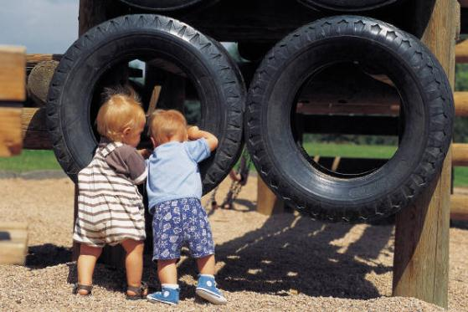
Recommended Practices and the COS Process – Age Anchoring

Slide 65
Tell us about Iowa…
Notes:
Do you have any challenges about bringing knowledge of child development to bear in the rating process?
Has it been difficult?
Who has been able to do this well?

Slide 66
Why age anchor?
The two COS questions:
a. To what extent does this child show age-appropriate functioning, across a variety of settings and situations, on this outcome? (Rating: 1-7)
b. Has the child shown any new skills or behaviors related to [this outcome] since
the last outcomes summary? (Yes-No)
Notes:
Remember the measurement process – the two COS questions.
In order to be able to describe the extent to which a child shows age appropriate functioning, need to know what age appropriate functioning is.
For the purposes of the COS process, use three terms to describe children’s functioning:
Age expected
Immediate foundational
And Foundational skills
Starting with foundational…

Slide 67
What are foundational skills?
Foundational skills are….
  Skills and behaviors that occur earlier in development and serve as the foundation for later skill development
  Teachers and interventionists often use foundational skills to help children move to the next level developmentally

Slide 68
What are immediate foundational skills?
Immediate foundational skills are…
  Skills that are conceptually linked to later skills and immediately precede the later skills developmentally
  Example: Children play alongside one another before they interact in play

Slide 69
Immediate foundational skills
The set of skills and behavior that occur developmentally just prior to age-expected functioning
Are the basis on which to build age-expected functioning
Functioning looks like a younger child
Notes:
The focus is on functionally meaningful actions. Many assessment tools have items that measure discrete skills that aren’t individually meaningful to the child. The skills are meaningful only when they are integrated with other things so that the child can accomplish something.

Slide 70
How foundational skills lead to age-expected functioning
Age-expected functioning
Immediate foundational skills
Foundational skills
Foundational skills
Notes:
Refer to the stair steps in the handout on immediate foundational skills.
The key to using this information in the rating process is understanding the developmental progression.

Slide 71
Activity
Age Anchoring Practice
– TYLER, 13 months
- NOLAN, 34 months
Notes:
Brainstorm what would be expecting to see in a 12 month old child by outcome. Document on flip chart or white board.
Orient to video – watch video. Based on what observed, what type of development is Tyler demonstrating?
AE **
IF
F?
Brainstorm what would expect to see in 34 month old child by outcome. Watch segment of Nolan video. Based on what observed, what type of development is Nolan demonstrating for the most part?
AE
IF
F **

Slide 72
Understanding Developmental Progression
Age Expected Skills
Immediate
Foundational Skills
Foundational Skills
Foundational Skills
Notes:
Important points to consider:
we’ve all had education/training in typical and atypical child development, some more recent than others!
It’s a lot of information – hard to keep right at hand everyday
Some of us are discipline specific so we hone in on the developmental progression related to the field we work in – sometimes “narrows” our focus
We spend a lot of time with children with disabilities, so what is “typical” changes/morphs over time relative to what we see every day.
Need to use tools and resources to support our continued understanding of what’s typical. Show handouts of tools available in their packet.

Slide 73
Activity
For a 30 month old, determine which skills are
  Age expected (AE)
  Immediate foundational (IF)
  Foundational (F)
Notes:
Practice reminding ourselves of the progression.
Use tools, at table, determine which skill comes first (F), second (IF) and third (AE) in each set of three.
Debrief as a large group.
How did you use your tools?
Were they an exact match? How did you reconcile if they didn’t?
How can you incorporate discussion about developmental progression into your COS rating discussions?
Reiterate the importance of using tools and resources (i.e. each other) to connect to typical child development information when doing the rating.

Slide 74
Using the Decision Tree

Slide 75
Tell us about Iowa…
Notes:
Have you seen the decision tree?
Do you use it?
Has it been helpful?

Slide 76
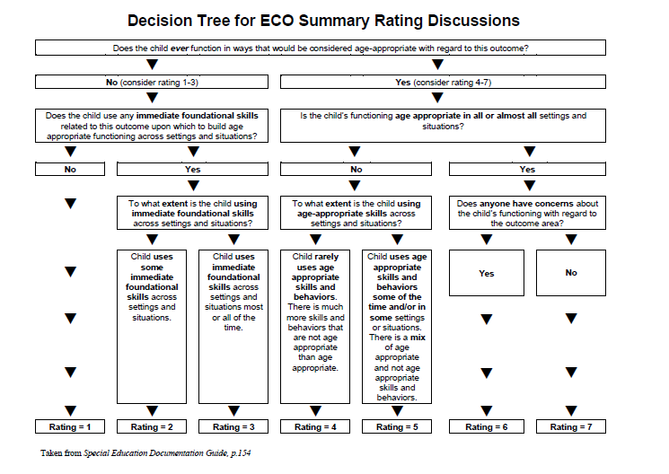
Notes:
Walk through the questions to demonstrate the use of the decision tree

Slide 77
Activity
Kim child example --
  Age anchor Kim’s social skills using your tools and resources –
  Outcome 1
  Relating with adults
  Relating with other children
  Use the decision tree to estimate a rating
Notes:
Refer to assessment summary – turn to Outcome 1. Small groups use age anchoring tools to approximate Kim’s skills for Outcome 1. In large group, refer to decision tree. Talk through Kim’s social skills and behaviors using decision tree. Make reference to age-expected child development resources.
Lunch break – boxed lunches are available – can bring back to eat here. Will begin promptly at 1 p.m. for afternoon session

Slide 78

The COS Team Process

Slide 79
Tell us about Iowa…
Notes:
How many of you have included families in 90% or more in the decisions for the ratings? 75%? 50%? <25%?
What are some of your issues in involving the families meaningfully?
How do you complete the COS process?
How many of you use a team? Have one person complete the rating?

Slide 80
What is a high-quality team discussion?
All team members participate
Parent input is respectfully considered
Multiple sources of assessment information are considered (observation, family report, formal ‘testing’)

Slide 81
In a quality team discussion…
The team describes the child’s functioning (not just test scores)
Discussion includes the child’s full range of functioning
The team documents the rationale for the rating

Slide 82
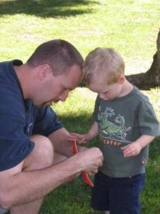
Involving
Families

Slide 83
Involving families in a conversation about their child’s functioning
Avoid jargon
Avoid questions that can be answered with a yes or no
  “Does Anthony finger feed himself?”
Ask questions that allow parents to tell you what they have seen
  “Tell me how Anthony eats”
Notes:
Information about the family is critical to a COSF rating that reflects all the settings and situations that make up the child’s natural environment

Slide 84
What we should expect from family involvement
That they can provide rich information about their child’s functioning across settings and situation – YES!
That they will know whether their child is showing age appropriate behavior? Maybe… but not necessarily!
Notes:
Part of our job in IFSP development is to help the family understand where the child is, where he is going, and when he gets there. The same is true for the COS discussion. The family input should help the rest of the team where the child is (skills and behaviors shown at home and in the community), the progress the family would like to see and, in subsequent data collection, the new skills and behaviors the child is showing at home and in the community.
Refer to blocks/bucket list without numbers to illustrate a tool that can be used to assist with this communication.

Slide 85
Integrating the COS Process with the IFSP/IEP Process – Conversations with Families
There are multiple opportunities throughout the IFSP/IEP process to talk with families about the child outcomes, beginning with identification and referral through transition from the program.
Notes:
Throughout the IFSP/IEP process, there are multiple opportunities to talk with families about the child outcomes. Can introduce with the purpose of early intervention/ECSE at initial conversations, which gives families the frame of what to expect from participation in the program.
Throughout the process, can connect eval/assessment and intervention planning to the three outcomes, which helps families understand where their child is compared to self and compared to same age peers throughout their tenure with EI/ESCE. Supports our value that families are informed and feel confident and competent to meet child’s needs.
Stands to reason that if we support their understanding of the outcomes from the beginning, it supports their participation as full team members in the COS rating discussions.

Slide 86
Activity
Evaluate a team discussion and the participation of the family in a team discussion
Notes:
Handouts – quality review checklists – 1) team and 2) family. (Do both?) Debrief.

Slide 87
In a high-quality team discussion…
All team members participate
Parent input is respectfully elicited and considered
Multiple sources of assessment information are considered (observation, family report, formal ‘testing’)
Discussion focuses on the outcomes and includes the full breadth of the outcome
Group reaches consensus on rating
Notes:
Review key components.
So what happens when disagree or have trouble reaching consensus?

Slide 88
Where to focus in deciding the rating
Focus on the child’s overall functioning across settings and situations
Functioning that is displayed rarely and/or when the child is provided with a lot of unusual support or prompts is of little significance for the rating
Notes:
Start here.
Overall functioning – and most often used functioning

Slide 89
Suggestions for reaching consensus on COS ratings
Re-visit process – describe functioning first, not #
Focus on outcome content – considering breadth of outcome content, does the skill fit, is it functional?
Share examples – settings, situations, supports, and describe if view as AE, IF, F (do not correct for prematurity)
Include more discussion about skills that would see in child with typical developmental pattern as common ground for comparison
Policy – what to do in rare case of disagreement (majority, supervisor, additional info, etc.)
Notes:
Refer to Reaching Consensus Handout

Slide 90
Example probe in team discussion
Tell me about the kinds of evidence that suggest to you this child has [AE, IF, F] functioning in this outcome?
When have you observed those skills? In what situations?
How frequently does that occur?
Were the accommodations/supports available in that setting? What were they?
Are there other steps in the sequence of development that need to occur between developing this skill and the skills same-aged peers display (AE) in this area? (when an IF skill is identified)
Is there other information we need to be better equipped to make this decision?

Slide 91

Practice Using the COS Process
Notes:
To use tools given so far, going to do two different activities. Reminder – DON’T focus on documentation heavily here – use the things we’ve discussed so far (age anchoring, decision tree, rating scale, etc.) and do a bit of documentation – but we’ll work more on that in the next segment after we’ve had practice with the steps that proceed the documentation.
Kim outcome 3 activity (30 minutes)– have them read for outcome 3. Use highlighters to mark AE, IF and F. Age anchor using resources, use the decision tree, document on form what will be considered, and approximate a rating.
Debrief: Challenges? What went well? Questions?
Example from participant (30 minutes). Select outcome to discuss, discuss the child’s functioning in that area, encourage use of discussion prompts. Document (notetaking guide) throughout the conversation. Age anchor, use decision tree, document, rate.
Debrief: Challenges? What went well? Questions?
Take a 15 minutes break (2:30 – 2:45)

Slide 92
Documenting the Rating

Slide 93
Documenting the rating
On the form, you will need to document:
  What evidence led to the selected rating, evidence of …..
    Age expected functioning?
    Immediate foundational skills
    Skills and behaviors that will lead to foundational skills
  -Who participated in the conversation and the decision

Slide 94
Why is it important to document the rating?
Provides a written rationale for the rating
Evidence can be reviewed to see whether people are using the system properly (i.e., rating similar children in the same ways)
Helps identify needs for future training and technical assistance
Maybe useful for new team members reviewing the file

Slide 95
Activity
Using the example from your group, develop the documentation to fully support your rating on the outcome selected.
Notes:
Debrief –
What did you write?
What was your rating?
From others – is the documentation sufficient? What else do you want to know?

Slide 96

Data Reporting and Data Quality

Slide 97
Tell us about Iowa…
Notes:
What questions do you have about what happens to the data after you complete it?
What questions to you have about the progress categories or summary statements?
Do you have access to your data?

Slide 98
Why it’s important
If data are not (yet) valid, they cannot be used for program effectiveness, program improvement or anything else.
If data are not as good as they should be…
Continue to improve data collection through ongoing quality assurance

Slide 99
Training and communication for quality assurance
Increase data quality through training and communication related to:
  Assessment
  Understanding the COS process
  Age expectations
  Data entry
Notes:
Before beginning in the COS process, fundamental that those involved receive training and information about the key components of the process, including those we’ve talked about, but also including data entry.

Slide 100
After the rating is complete…
Check the completed COS rating for quality:
Does the documentation match the appropriate outcome area? Is it functional?
Is there adequate evidence for the basis of the rating? Consistent with the rating?
Does evidence reflect the child’s functioning across settings and situations?

Slide 101
Data Reporting
Developmental Trajectories
Progress Categories
Summary Statements
Notes:
Importance of quality data has implications for the quality of the information that gets reported to the federal government
The ratings on children at entry and exit describe the child’s developmental trajectory as a result of receiving EI or ECSE services
The trajectories translate into the progress categories to quantify the changes children experience as a result of services.
The summary statements simplify the data for each outcome (3 outcomes, 5 progress categories = 15 numbers)

Slide 102
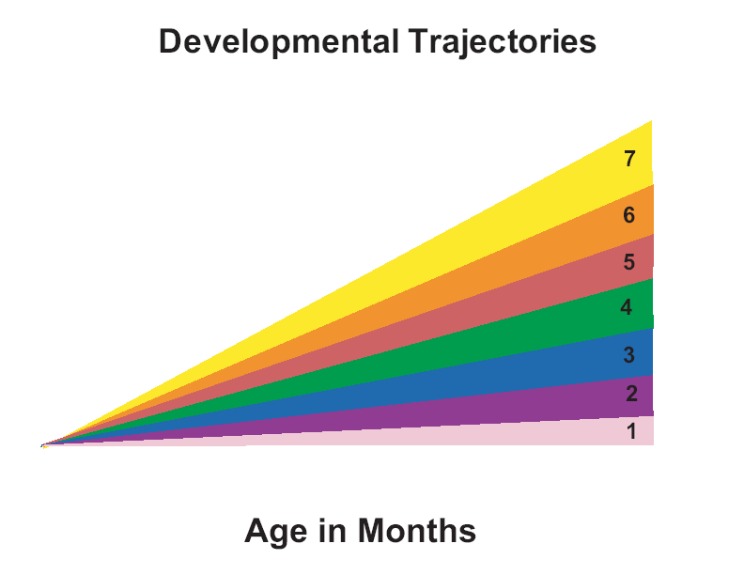
Functioning
13

Slide 103
Entry
14

Slide 104
Entry
Exit
15

Slide 105
Entry
Exit
16

Slide 106
Key Point
The OSEP categories describe types of progress children can make between entry and exit
Two COSF ratings (entry and exit) are needed to calculate what OSEP category describes a child progress

Slide 107
How changes in ratings on the COSF correspond to reporting categories a - e
e. % of children who maintain functioning at a level comparable to same-aged peers
Rated 6 or 7 at entry; AND
Rated 6 or 7 at exit

Slide 108
Entry
Exit
Notes:
Both 6 and 7 indicate age appropriate functioning.

Slide 109
Entry
Exit

Slide 110
Entry
Exit

Slide 111
How changes in ratings on the COSF correspond to reporting categories a - e
d. % of children who improve functioning to reach a level comparable to same-aged peers
Rated 5 or lower at entry; AND
Rated 6 or 7 at exit

Slide 112
Entry
Exit
Notes:
An exit rating of 6 or 7 indicates the child is now showing age expected functioning.

Slide 113
How changes in ratings on the COSF correspond to reporting categories a - e
c. % of children who improved functioning to a level nearer to same aged peers, but did not reach it
Rated higher at exit than entry; AND
Rated 5 or below at exit

Slide 114
Entry
Exit
Notes:
Child showed sufficient improvement in functioning to move to a higher developmental trajectory (i.e., higher point on scale) but had not yet achieved age appropriate functioning.

Slide 115
Entry
Exit

Slide 116
How changes in ratings on the COSF correspond to reporting categories a - e
b. % of children who improved functioning, but not sufficient to move nearer to same aged peers
Rated 5 or lower at entry; AND
Rated the same or lower at exit; AND
“Yes” on the progress question (b)

Slide 117
Entry
Exit
Notes:
Note the slope - the line is not flat; the child is showing improved functioning

Slide 118
Entry
Exit
Notes:
Note the slope - the line is not flat; the child is showing improved functioning

Slide 119
Entry
Exit

Slide 120
Entry
Exit
Notes:
Note the slope - this child is showing improved functioning

Slide 121
How changes in ratings on the COSF correspond to reporting categories a - e
a. % of children who did not improve functioning
Rated lower at exit than entry; OR
Rated 1 at both entry and exit; AND
Scored “No” on the progress question (b)

Slide 122
Entry
Exit

Slide 123
Entry
Exit

Slide 124
State Approaches to Outcomes Data, 2009-10
Approach | Part C (56 states/jurisdictions) | Preschool (59 states/jurisdictions)
COS* 7 pt. scale | 41/56 (73%) | 37/59 (63%)
One tool statewide | 7/56 (13%) | 9/59 (15%)
Publishers’ online analysis | 3/56 (5%) | 6/59 (10%)
Other | 5/56 (9%) | 7/59 (12%)
*Child Outcomes Summary Rating

Slide 125
Child Outcomes: What we know
States are in various stages with regard to building their child outcomes measurement systems
Some phrased in
Some changed approaches

Slide 126
The National Data on EI and ECSE
for 2010-11
Notes:
126

Slide 127
OSEP Reporting Categories
Percentage of children who:
a. Did not improve functioning
b. Improved functioning, but not sufficient to move nearer to functioning comparable to same-aged peers
c. Improved functioning to a level nearer to same-aged peers but did not reach it
d. Improved functioning to reach a level comparable to same-aged peers
e. Maintained functioning at a level comparable to same-aged peers
3 outcomes x 5 “measures” = 15 numbers

Slide 129
*Based on 39 states with highest quality data

Slide 130
*Based on 36 States with the highest quality data.

Slide 131
The Summary Statements
Of those children who entered the program below age expectations in each Outcome, the percent who substantially increased their rate of growth by the time they turned 6 years of age or exited the program.
The percent of children who were functioning within age expectations in each Outcome by the time they turned 6 years of age or exited the program.
Notes:
Reported by each outcome to show the impact of services on children with disabilities.
THIS is what demonstrates to others at the local, state and federal level that what we do REALLY makes a difference for the development and wellbeing of children and families

Slide 132
*Based on 39 states with highest quality data

Slide 133
*Based on 36 States with the highest quality data.

Slide 137
*Based on 36 states with highest quality data

Slide 138
The National Data – what is it telling us after three years?
For both early intervention and early childhood special education:
  High percentages of children are showing increased rates of growth
  High percentages of children are exiting functioning like same-aged peers.
The data have been stable for 3 years.
Pt. C and Pt. B Preschool are the only 2 federal EC programs with national data on outcomes.
Notes:
Kathy!! ☺

Slide 139

Questions and Answers
Notes:
Related to data; transition to the entire day (any loose ends). Ask Dee to include any next steps.

Slide 140
ECO Center web site
Additional information is available on our website
www.the-eco-center.org

Slide 141
Contact Information
Kathi Gillaspy
NECTAC/ECO – FPG
kathi.gillaspy@unc.edu
Kathy Hebbeler
ECO – SRI
kathleen.hebbeler@sri.com

Slide 142
Iowa Contact Information
Dee Gethmann
Iowa Department of Education
Dee.Gethmann@iowa.gov
515-281-5502

