Slide 1
Early Childhood Outcomes Training
Lauren Barton
Early Childhood Outcomes Center
Kathi Gillaspy
Early Childhood Outcomes Center
Early Childhood TA Center
June 18, 2013
Notes:
Welcome and introductions
Purpose of the day – refresher on different components of the COS process, with outcomes to improve the quality of the data, create stronger foundations in the rating process, and enhance the team process to determining and documenting the rating.

Slide 2





Our various hats…
Visit these centers at:
www.the-eco-center.org
www.dasycenter.org
ectacenter.org
Notes:
Quick overview for context and resources.
www.the-eco-center.org
www.dasycenter.org
ectacenter.org

Slide 3
Workshop Topics
Overview of the three outcomes and why we collect outcomes data
Recommended practices in the COS process – assessment and age anchoring
The 7 point scale
The COS team process
Practice using the COS process
Data reporting, including an overview of the national data
Use of data for program improvement
Additional resources
Notes:
This is what we will cover.
Not covering specifics on filling out forms that are used. Focusing on the key components of the process that you will be able to take back to your local program and use.
Throughout the presentation we’ll be asking you to tell us how things go here in Arkansas. Encourage lots of discussion about the content we’re sharing and how it relates to current practices. Want you to think critically about your process and how this information can be used in your local programs.
Today one of the resources you have in your packet is a document of links on the ECO website, content areas that could be addressed by using each resource.

Slide 4

Reviewing the Outcomes

Slide 5
Tell us about Arkansas…
Notes:
What do you think of the 3 child outcomes?

Slide 6
Overarching Goal of EI and ECSE
“…To enable young children to be active and successful participants during the early childhood years and in the future in a variety of settings – in their homes with their families, in child care, in preschool or school programs, and in the community.”
(from Early Childhood Outcomes Center,
http://www.fpg.unc.edu/~eco/pdfs/eco_outcomes_4-13-05.pdf)
Notes:
This is an important message, worth repeating…
Relevant: Outcome –
a benefit experienced as a result of services
Looking at global outcomes – the benefits we want all children in the program to experience
Different from individualized outcomes on an IEP/IFSP

Slide 7
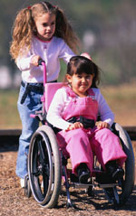
Three child outcomes
  Positive social emotional skills (including positive social relationships)
  Acquisition and use of knowledge and skills (including early language/ communication)
  Use of appropriate behaviors to meet their needs
Notes:
Handout – one-pager on 3 outcomes – use cheat sheet instead….
SHOW VIDEO!

Slide 8
Five family outcomes
Families understand their child's strengths, abilities, and special needs.
Families know their rights and advocate effectively for their children.
Families help their child develop and learn.
Families have support systems.
Families access desired services, programs, and activities in their community.
Notes:
Families are critical to these outcomes… If meeting these in a broad sense and we are helping families accomplish these things, we will likely see improvements in the children’s outcomes. In AR, we measure family outcomes through the family outcomes survey… a different process. Not talking as much about that today… But, as we promote family outcomes, we would expect that it also supports improvement in child outcomes.

Slide 9

Why All This Outcomes Data?
What Happens with the Data?
What Difference Does It Make?

Slide 10

National Need
1993: outcomes required
2002: review
“results not demonstrated”
Notes:
The ECO Center was established as an outgrowth of a significant national need.
Back in 1993 congress mandated that all federal programs were required to report on their outcomes, show their results
But, almost 10 years later when the budget office conducted a review, early childhood programs funded under the individuals with disabilities education act could not demonstrate data on their results, they had no data on the outcomes of children in their programs.
Or put another way, we can think about what the public policy context was:
Age of accountability
Accountability increasingly means looking at results, not just process
Office of Special Education Programs (OSEP) is under increasing pressure to produce outcome data on children participating in early intervention and early childhood special education programs

Slide 11

National Need
Program
Funding?
> $3.5 billion
> 1,000,000 children
Notes:
Would the funds for these critical programs serving more than a million children and their families be cut?

Slide 12
Why? People Demanded It….
Service numbers the difference it makes
Do some kids benefit more than others?
Is the $ worth it?
  Does it change outcomes?
  Does it produce results?
Notes:
Examples of the kinds of issues that made people want outcomes data…
Read these fake quotes to illustrate each point…
Bullet 1___Telling me what services you provided isn’t the same as showing that it made a difference in what my child can do.
Bullet 2 ___There are stories of what a difference the program made for this child or that child, but does it make a difference for all children? Or, are some kids really benefiting more than others? -- # 2… In some communities, in some racial/ethnic/socioeconomic groups, for some kinds of disabilities… the list goes on and on..
Bullet 3 __This program costs a lot. Is it worth it? Does it actually produce better outcomes for kids?

Slide 13
Why Collect Child Outcomes Data?
To identify strengths and weaknesses of programs and use the information to improve programs.
To provide information for policymakers to justify future funding
To provide information for families who as consumers have the right to know if their child’s program is effective
Because the federal government requires it

Slide 14

What Do People Look At?
Notes:
Beginning with the end in mind….
What comes of all this effort?

Slide 15
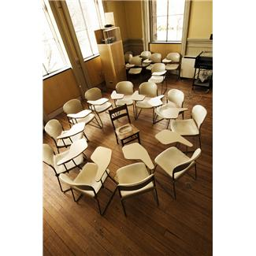

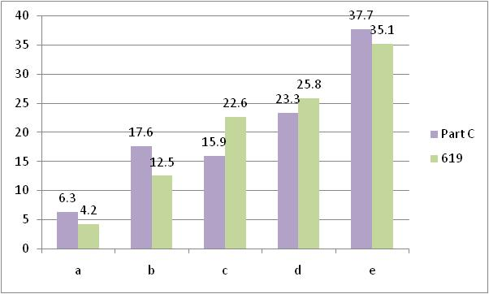
Following the data
2 summary statements
Child’s progress
over time
1-7 rating
at entry & exit
a – e progress categories
(State: 3 outcomes,
15 percentages)
Child’s
status
Notes:
Data goes through a number of transformations….Talk about steps in this process today… [Walk through] zoom to the end for just a moment….
Rich detail…. Convert to a form consistent for all kids… manageable level of detail
Rich data, teams synthesize, come up with a rating based on child’s functioning relative to age-expected behavior… may not know what happens next…converts to progress categories & derive summary statements.. Both go to federal government – reporting, setting targets, state use program improvement, split out by local area (reported by local district for the first time in 2011), split out for kids who enter at different ages, split out by kids with different types of disabilities, eventually use for monitoring, etc.
Today as we talk…. We’ll do a little back and forth… what are the skills you need to produce high quality data and then look at different parts of this picture as well, what the data looks like, what it might mean, how it gets used… But, we often feel it helps to begin with the end in mind, to see what information some others use that comes from the COS.

Slide 16
The Summary Statements
Of those children who entered the program below age expectations in each Outcome, the percent who substantially increased their rate of growth by the time they turned 6 years of age or exited the program.
The percent of children who were functioning within age expectations in each Outcome by the time they turned 6 years of age or exited the program.
Notes:
Reported by each outcome to show the impact of services on children with disabilities.
THIS is what demonstrates to others at the local, state and federal level that what we do REALLY makes a difference for the development and wellbeing of children and families
Match further wording explanation to what is shown on conversion sheet….

Slide 17
Other Ways to Think about
Summary Statement 1
How many children changed growth trajectories during their time in the program?
Percent of the children who entered the program below age expectations made greater than expected gains, made substantial increases in their rates of growth, i.e. changed their growth trajectories
c + d___
a + b + c + d

Slide 18
Summary Statements
The percent of children who were functioning within age expectations in each Outcome by the time they exited the program.
d + e__
a + b + c + d + e

Slide 19
Other Ways to Think about Summary Statement 2
How many children were functioning like same aged peers when they left the program?
Percent of the children who were functioning at age expectations in this outcome area when they exited the program, including those who:
    started out behind and caught up and
    entered and exited at age level

Slide 20
*Based on 36 States with the highest quality data.

Slide 21
*Based on 39 states with highest quality data
Notes:
Could also convert C & B on same slide…. Both summ statement 1, then both sum statement 2.

Slide 22
Interpretations
If a state’s data looked like this, what would you think?
What else would you want to know?
Notes:
A group of us may look at the same numbers, the same type of evidence, but have many different interpretations, or ideas about what to think when they look at those numbers. We make inferences based on our own perspectives and experiences, what we think about it in relation to…. Does it seem big? Or small?
Show candy jar….inferences for one child, for the child with allergies…

Slide 23
Substantially Increased Rate of Growth - One State - Section 619
Notes:
Summary Statement 1

Slide 24
Substantially Increased Rate of Growth- One State Part C
Notes:
Summary statement 1

Slide 25
Exited Within Age Expectations – One State Section 619
Notes:
Summary Statement 2
Is there something different going on between outcomes?

Slide 26
Exited Within Age Expectations – One State Part C
Notes:
Summary Statement 2
How is interpretation influenced by seeing the graph just before this (619 data from the state)?

Slide 27

What If…
Start looking at these patterns…
  across programs/districts?
  for groups of children with different types of disabilities?
  In families with different characteristics?
Notes:
Start looking at these patterns about greater than expected growth and functioning within age expectations at exit
It is already underway….
In other trainings with more focus, could share a few slides of local area differences? C & B?
Different disability groups?
Multiple levels…. Not another data slide… just make the point.

Slide 28
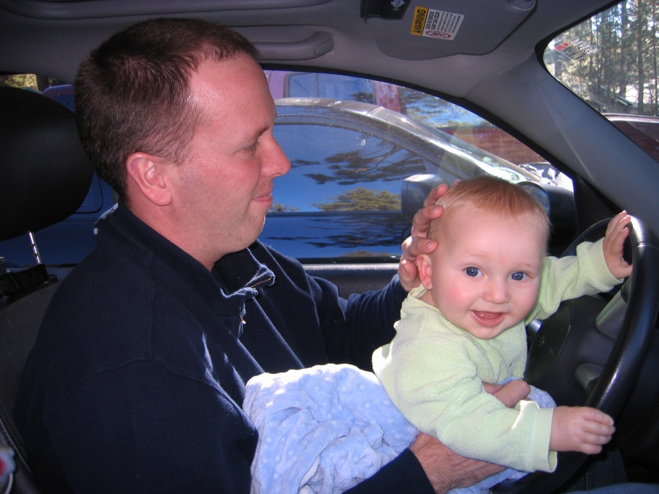
High quality data helps us drive our program in the right direction

Slide 29
Why collect data on outcomes?
Because we want to offer
every child and family
the best services that
we know how to provide
Notes:
We are measuring outcomes that are appropriate for all children. These outcomes support children’s successful participation in family & community life. We want to know how each child is doing in these areas.
Measuring these outcomes allows us to…
Increase understanding of our program and children served
Improve services
Provide information about all the children served to funders and stakeholders
Can be a useful reference as we plan the individualized focus for your child

Slide 30
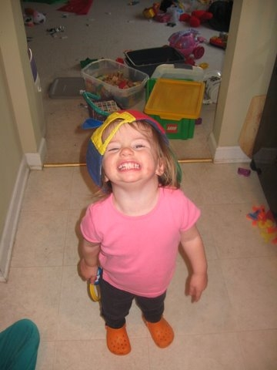
Recommended Practices and the COS Process: Assessment

Slide 31
Tell us about Arkansas…
Notes:
When do you do assessment?
How often are you using assessment?
What kinds of assessment data to you typically bring into your COS discussions at entry? At exit?
Does the information help you in your process?

Slide 32
Why was the process developed?

Slide 33
Why was the process developed?
Federal reporting on child outcomes required aggregate information on all children in the state
Different programs would be using different assessment instruments, and outcomes data would need to be aggregated across programs
Most accurate child outcomes data had to be able to synthesize information about the child from multiple sources

Slide 34
What is the Child Outcomes Summary (COS) Process?
A team process for reviewing child assessment data from different sources culminating in the ‘rating’ of a child’s functioning on a scale of 1-7
Considers the child’s functioning across situations and settings
Compares child’s functioning to that of same age peers

Slide 35
Purposes of the COS
It is not an assessment tool
It uses information from multiple sources, including assessment tools, observations, and family interview to get a global sense of how the child is doing at one point in time

Slide 36
Features of the COS
7-point rating scale
Rating is based on the child’s functioning:
  What the child does across settings and situations
  Compared with what is expected given the child’s age

Slide 37
COS Form
Notes:
May look slightly different in AR….

Slide 38
The two COS questions
a. To what extent does this child show age-appropriate functioning, across a variety of settings and situations, on this outcome? (Rating: 1-7)
b. Has the child shown any new skills or behaviors related to [this outcome] since
the last outcomes summary? (Yes-No)

Slide 39
Why two questions?
a. The first question compares the child’s functioning to age expectations at a single point in time, using a scale of 1-7
b. The second question is only addressed after the entry COS (annually or at exit depending upon state procedures) and compares child’s skills with his or her earlier functioning
Notes:
The first question tells us about the child’s status RIGHT NOW compared to others his/her age
The second question - answered only for follow-up or exit ratings - tells us about the child’s progress relative to him/herself at an earlier time. It compares the child’s skills with his/her earlier functioning. Does the child’s functioning show any new skills since the previous rating of this child?

Slide 40
Why two COS questions?
Progress data for federal reporting are calculated from the COS ratings (entry versus exit) plus the yes/no progress question
The yes/no progress question differentiates between children who made absolutely NO progress or regressed -- and children who gained at least one new skill

Slide 41
Summary ratings are based on…
Types of Information
  Curriculum-based assessments (e.g., HELP, Brigance)
  Norm-referenced assessments (e.g., ELAP,
  BDI-2, DECA)
  Developmental screenings (e.g., Ages & Stages)
  Assessments about specific skills (e.g., Vineland-II)
  Observation and report
Sources of Information
  Routines Based Interview (family information)
  Service providers
  Therapists
  Physicians
  Child care providers
  Teachers
  People familiar with the child in all of the settings and situations she’s in
Notes:
Reiterate multiple sources that reflect multiple settings and situations. These are all potential sources of information to inform the rating.
KEY instruments IN AR: BDI-2, Brigance, Vineland, ELAP, DECA

Slide 42
Essential Knowledge for Completing the COS
Among them, IFSP team members must:
Know about the child’s functioning across settings and situations
Understand age-expected child development
Understand the content of the three child outcomes
Know how to use the rating scale
Understand age expectations for child functioning within the child’s culture

Slide 43

Important point
It is not necessary that all team members be knowledgeable in all 5 areas
Especially, there is no expectation that parents understand the rating scale or typical child development
But the team of professionals has to!
Notes:
Together, at least one member of the team has to be knowledgeable in each of the 5 areas. Together, team members should be able to describe the child’s functioning as compared to age expectations. The child’s parent is a key team member and critical to understanding how his or her child functions in every day life. We don’t expect parents to be able to compare their child’s development to other children. That’s the role of the professional. It’s essential that the professionals understand age-expected child development!

Slide 44

How we learn about the child’s functioning across settings and situations
Good Assessment
Notes:
How do you collect information about the child’s functioning across settings and situations to inform the rating on the 7 point scale?
We learn about the child’s everyday functioning through good assessment practices.

Slide 45
DEC* recommended practices for assessment
Involve multiple sources
  Examples: family members, professional team members, service providers, caregivers
Involve multiple measures
  Examples: observations, criterion- or curriculum-based instruments, interviews, norm-referenced scales, informed clinical opinion, work samples
*Division for Early Childhood of the Council for Exceptional Children
Notes:
Our professional organization for early childhood special education – the Division for Early Childhood of the Council for Exceptional Children – defines good assessment practices as those that use multiple sources of information, and multiple measures.
ASHA and other organizations rec practices as well

Slide 46

1. WHAT is Functional Assessment?
Adapted from materials developed by Naomi Younggren, 2011
Assessment of the young child’s skills in the real life contexts of family, culture and community rather than discrete isolated tasks irrelevant to daily life.
“the science of the strange behavior of children, with strange adults, in strange settings for the briefest possible period of time.”
Bronfenbrenner, 1979, p. 19
Notes:
Functional or authentic assessment of the young child’s skills in the real life contexts of family, culture and community, rather than in isolation. Results reflect the “whole child”.
Differs from our traditional approach (read quote)

Slide 47
WHAT: Functional Assessment is…
Adapted from materials developed by Naomi Younggren, 2011
contextually relevant information about the child’s strengths and needs
more culturally sensitive
individually focused
IS NOT…
domain based and discipline specific
deficit driven
threatening
Notes:
Assessment is conducted and interpreted within the framework of how the child functions within these systems.
Uses ecological & ethnographic approaches as well as more formal assessment methods.
•Research shows that it yields more valid assessment results
Not just…
Know how to make eye contact, smile, and give a hug
Know how to imitate a gesture when prompted by others
Use finger in pointing motion
Show a skill in a specific situation
But does he/she…
Initiate affection toward caregivers and respond to others’ affection
Watch what a peer says or does and incorporate it into his/her own play
Point to indicate needs or wants
Use a skill in actions across settings and situations to accomplish something meaningful to the child

Slide 48
Conventional Assessment
Adapted from materials developed by Naomi Younggren, 2011
Conventional testing does have its place
  “to distinguish typical from atypical performance”
Everything that can be measured counts,
but not everything that counts
can be measured.
(attributed to Albert Einstein, 1951)
Notes:
Traditional standardized evaluation alone:
do not provide the information needed to develop functional IFSPs or IEPs that can be implemented within the day to day routines of the family/school house/community/child care…
do not determine what the child is able to do, likes to do, or needs to do in regards to the family’s/players’ priorities.
do not provide a clear understanding of the child’s abilities across environments and care providers – this is accomplished through observation and information sharing
Do not provide sufficient information to complete the rating in the three outcome areas alone
Conventional testing is useful “to distinguish typical from atypical performance”.

Slide 49
A domain score on an assessment tool does not necessarily translate directly into an outcome rating
Ratings require:
  Looking at functional behaviors
  Collecting and synthesizing input from many sources familiar with how what the child does in across different settings and situations
Notes:
A provider of early intervention services should never make decisions about a child based on one assessment source, such as the scores from one tool. The rating on the COS should reflect all the information we can learn about a child to understand not only the skills he has acquired, but also how he uses them in everyday life.

Slide 50

Functional Assessment
Our Focus Shifts
From |  | To
Knows how to make eye contact, smile, and give a hug |  | Initiates affection toward caregivers and respond to others’ affection
Knows how to imitate a gesture when prompted by others |  | Watches what a peer says or does and incorporate it into his/her own play
Uses finger in pointing motion |  | Points to indicate needs or wants
Shows a skill in a specific situation |  | Uses a skill in actions across settings and situations to accomplish something meaningful to the child
Notes:
Our focus shifts from specific skills in specific situations to a more complete functional picture of the child. For example, our focus shifts from noticing that the child makes eye contact, smiles and gives hugs to noticing how the child initiates affection with the important people in his/her life.
Trainer Notes:
Review the examples on the slide and invite participants to share their own examples.

Slide 51
Assessment should focus on…
What does the child usually do?
Actual performance across settings and situations
How the child uses his/her skills to accomplish tasks
Not the child’s capacity to function under unusual or ideal circumstances
Not necessarily the child’s performance in a structured testing situation

Slide 52
Listening and learning from parents is good assessment
See the discussion prompts on the ECO website for possible questions to ask families
Check in with parents to see how the child is doing and incorporate this information into the COS rating process
Notes:
The discussion prompts file provides some questions you can ask families about their child’s skills and behaviors in everyday life. These are possible questions; it is not expected that you would ask all of the questions to the same family. This ‘real life’ information provided by family’s answers helps determine the child’s level of functioning across different aspects of the global outcomes, and helps identify the most appropriate rating.

Slide 53
Using Information within the IEP Process
Info from IIEP process | Determine Eligibility | Develop /Goals | Select Routines, Activities Settings | Develop /Objectives | Determine People and Resources (Services) | Determine Frequency and Intensity | Determine Criteria to Measure Progress
Family hopes |  | √ | √
Family concerns priorities |  | √ |  |  |  | √ | √
Family resources |  |  | √ | √ | √ | √
Child needs | √ | √ | √ |  |  | √ | √
Child strengths |  | √ | √ | √
Child interests |  | √ | √ | √ | √
Behaviors in Settings |  | √ | √ | √ | √ |  | √
Desired activities | √ | √ | √ | √ | √ |  | √
Notes:
This chart illustrates how information gathered through functional assessment can be used for multiple purposes throughout the IEP process. For example, information about the child’s interests can be used in developing outcomes/goals, in selecting routines, activities and settings, in developing strategies and objectives, and in determining people, resources and services.

Slide 54
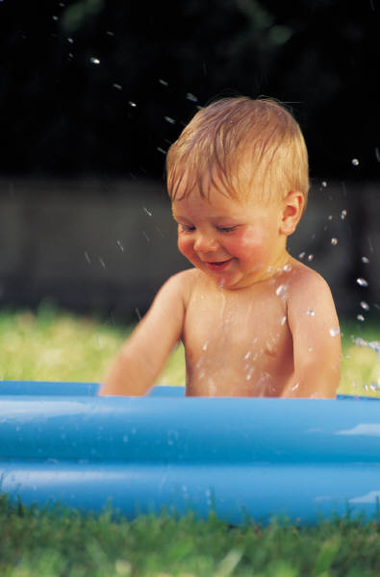
Activity
Jack’s Narrative
Notes:
Jack’s narrative
At tables, read the narrative description based on evaluation information alone. As a group, determine what other information would want to know about the child, and methods that might consider using to gather that information.

Slide 55
Crosswalks
Identify relationships between assessment instruments and the three child outcome
Display how content on a given assessment instrument is related to each outcome
Are not meant to be used as a “checklist” or “score sheet” for measuring child outcomes
Find crosswalks on http://www.fpg.unc.edu/~eco/pages/crosswalks.cfm

Slide 56


The seven points on the COS scale

Slide 57
Tell us about Arkansas…
Notes:
Have you had any issues applying the rating scale?
What kinds of problems do you encounter?
Are there types of children that you have difficulty applying the rating scale to?

Slide 58

What COS Measures
1-7 COS rating measures
  STATUS
    At a given point in time, how is this child functioning relative to age-expected?
    Base ratings on a snapshot in time.
    NOT based on changes in child’s functioning over time (NOT based on progress).

Slide 59
7 – Completely
Child shows functioning expected for his or her age in all or almost all everyday situations that are part of the child’s life
Functioning is considered appropriate for his or her age
No one has any concerns about the child’s functioning in this outcome area
Notes:
Refer to handout – rating scale definitions – Go through quickly

Slide 60
6 – Between completely and somewhat
Child’s functioning generally is considered appropriate for his or her age but there are some significant concerns about the child’s functioning in this outcome area
These concerns are substantial enough to suggest monitoring or possible additional support
Although age-appropriate, the child’s functioning may border on not keeping pace with age expectations

Slide 61
5 – Somewhat
Child shows functioning expected for his or her age some of the time and/or in some settings and situations
Child’s functioning is a mix of age-appropriate and not age-appropriate behaviors and skills
Child’s functioning might be described as like that of a slightly younger child

Slide 62
4 – Between somewhat and nearly
Child shows occasional age-appropriate functioning across settings and situations
More functioning is not age-appropriate than age-appropriate

Slide 63
3 – Nearly
Child does not yet show functioning expected of a child of his or her age in any situation
Child uses immediate foundational skills, most or all of the time across settings and situations
Immediate foundational skills are the skills upon which to build age-appropriate functioning
Functioning might be described as like that of a younger child

Slide 64
2 – Between nearly and not yet
Child occasionally uses immediate foundational skills across settings and situations
More functioning reflects skills that are not immediate foundational than are immediate foundational

Slide 65
1 – Not yet
Child does not yet show functioning expected of a child his or her age in any situation
Child’s functioning does not yet include immediate foundational skills upon which to build age-appropriate functioning
Child functioning reflects skills that developmentally come before immediate foundational skills
Child’s functioning might be described as like that of a much younger child

Slide 66
50:50
Welcome to
Who Wants to be a Millionaire
15
$1 Million
14
$500,000
13
$250,000
12
$125,000
11
$64,000
10
$32,000
9
$16,000
8
$8,000
7
$4,000
6
$2,000
5
$1,000
4
$500
3
$300
2
$200
1
$100
Notes:
Good data are worth millions. Let’s see if you can earn that million.
[NOTE TO TRAINER: THE INFORMATION ON THE GAME SHOW SLIDES IS PHASED IN. IT WILL COME IN ON ITS OWN SLOWLY OR YOU CAN SEE IT MORE QUICKLY BY PRESSING ENTER OR PAGE DOWN.]

Slide 67
15
$1 Million
14
$500,000
13
$250,000
12
$125,000
11
$64,000
10
$32,000
9
$16,000
8
$8,000
7
$4,000
6
$2,000
5
$1,000
4
$500
3
$300
2
$200
1
$100
Notes:
We will begin at the $100 level.

Slide 68
15
$1 Million
14
$500,000
13
$250,000
12
$125,000
$100 Question
11
$64,000
10
$32,000
9
$16,000
8
$8,000
What rating is for age-appropriate
functioning with no concerns?
7
$4,000
6
$2,000
5
$1,000
4
$500
3
$300
2
$200
50:50
1
$100
A: 7
B: 5
C: 1
D: 6
Notes:
[NOTE TO TRAINER: READ THE QUESTION AND THE FOUR ANSWER CHOICES. HAVE THE GROUP SELECT AN ANSWER BEFORE MOVING ON TO THE NEXT SLIDE WHICH CONTAINS THE ANSWER.]

Slide 69

15
$1 Million
14
$500,000
13
$250,000
12
$125,000
$100 Question
11
$64,000
10
$32,000
9
$16,000
8
$8,000
What rating is for age-appropriate
functioning with no concerns?
7
$4,000
6
$2,000
5
$1,000
4
$500
3
$300
2
$200
50:50
1
$100
A: 7
B: 5
C: 1
D: 6
Notes:
The answer is A.

Slide 70
15
$1 Million
14
$500,000
13
$250,000
12
$125,000
11
$64,000
10
$32,000
9
$16,000
8
$8,000
7
$4,000
6
$2,000
5
$1,000
4
$500
3
$300
2
$200
1
$100
Notes:
Next question.

Slide 71
15
$1 Million
14
$500,000
13
$250,000
12
$125,000
$1,000 Question
11
$64,000
10
$32,000
9
$16,000
8
$8,000
7
$4,000
Andrew is showing a mix of age-
appropriate and not yet age-
appropriate skills. The rating?
6
$2,000
5
$1,000
4
$500
3
$300
2
$200
50:50
1
$100
A: 5
B: 4
C: 3
D: Two of these
Notes:
[READ QUESTION AND ANSWER CHOICES.]

Slide 72
15
$1 Million
14
$500,000
13
$250,000
12
$125,000
$1,000 Question
11
$64,000
10
$32,000
9
$16,000
8
$8,000
7
$4,000
Andrew is showing a mix of age-
appropriate and not yet age-
appropriate skills. The rating?
6
$2,000
5
$1,000
4
$500
3
$300
2
$200
50:50
1
$100
A: 5
B: 4
D: Two of these: A or B, depending on the mix
C: 3
Notes:
The correct answer is D.

Slide 73
15
$1 Million
14
$500,000
13
$250,000
12
$125,000
11
$64,000
10
$32,000
9
$16,000
8
$8,000
7
$4,000
6
$2,000
5
$1,000
4
$500
3
$300
2
$200
1
$100

Slide 74
15
$1 Million
14
$500,000
13
$250,000
$ 16,000 Question
12
$125,000
11
$64,000
10
$32,000
9
$16,000
James has shown lots of progress.
He has early skills and can accomplish new tasks,
but does not yet have immediate foundational
or age-expected skills.
8
$8,000
7
$4,000
6
$2,000
5
$1,000
4
$500
3
$300
2
$200
50:50
1
$100
A: 3
B: 1
C: 2
D: Either 1 or 2
Notes:
[READ QUESTION AND ANSWER CHOICES.]

Slide 75
15
$1 Million
14
$500,000
13
$250,000
$ 16,000 Question
12
$125,000
11
$64,000
10
$32,000
9
$16,000
James has shown lots of progress.
He has early skills and can accomplish new tasks,
but does not yet have immediate foundational
or age-expected skills.
8
$8,000
7
$4,000
6
$2,000
5
$1,000
4
$500
3
$300
2
$200
50:50
1
$100
A: 3
B: 1
C: 2
D: Either 1 or 2
Notes:
The correct answer is B.

Slide 76
15
$1 Million
14
$500,000
13
$250,000
12
$125,000
11
$64,000
10
$32,000
9
$16,000
8
$8,000
7
$4,000
6
$2,000
5
$1,000
4
$500
3
$300
2
$200
1
$100

Slide 77
15
$1 Million
14
$500,000
13
$250,000
$32,000 Question
12
$125,000
11
$64,000
10
$32,000
9
$16,000
Aside from the concern regarding 36-month old
Anna’s occasional hitting, she has all the early skills in social
relationships that we expect for a child this age.
8
$8,000
7
$4,000
6
$2,000
5
$1,000
4
$500
3
$300
2
$200
50:50
1
$100
A: 5
B: 6
C: 7
D: 4
Notes:
[READ QUESTION AND ANSWER CHOICES.]

Slide 78
15
$1 Million
14
$500,000
13
$250,000
$ 32, 000 Question
12
$125,000
11
$64,000
10
$32,000
9
$16,000
Aside from the concern regarding 36-month old
Anna’s occasional hitting, she has all the early skills in social
relationships that we expect for a child this age.
8
$8,000
7
$4,000
6
$2,000
5
$1,000
4
$500
3
$300
2
$200
50:50
1
$100
A: 5
B: 6
C: 7
D: 4
Notes:
The correct answer is B.

Slide 79
15
$1 Million
14
$500,000
13
$250,000
12
$125,000
11
$64,000
10
$32,000
9
$16,000
8
$8,000
7
$4,000
6
$2,000
5
$1,000
4
$500
3
$300
2
$200
1
$100

Slide 80
15
$1 Million
14
$500,000
13
$250,000
$250,000 Question
12
$125,000
11
$64,000
10
$32,000
9
$16,000
8
$8,000
7
$4,000
Evidence for a
rating of 3 would include…
6
$2,000
5
$1,000
4
$500
3
$300
2
$200
50:50
1
$100
A: Mention of no age-expected functioning
B: Description of many immediate foundational skills
C: Mention of occasional age-expected functioning
D: Two of these
Notes:
[READ QUESTION AND ANSWER CHOICES.]

Slide 81
15
$1 Million
14
$500,000
13
$250,000
12
$125,000
$250,000 Question
11
$64,000
10
$32,000
9
$16,000
8
$8,000
7
$4,000
Evidence for a
rating of 3 would include…
6
$2,000
5
$1,000
4
$500
3
$300
2
$200
50:50
1
$100
A: Mention of no age-expected functioning
B: Description of many immediate foundational skills
C: Mention of occasional age-expected functioning
D: Two of these: A & B
Notes:
The correct answer is D.

Slide 82
YOU WIN*!!!
*may substitute more accurate child outcomes summary data for prize if insufficient funds

Slide 83
The process for determining a rating:
Discuss child’s current functioning
in different aspects of this outcome area
across settings and situations
Identify where functioning is age appropriate
Identify any areas where functioning reflects immediate foundational skills
Decide which description/rating best describes the child’s current functioning
Notes:
At the heart of knowing the appropriate rating…. Is knowing how to compare the child’s skills to what is expected at that age…. Age anchoring.
For each outcome
Discuss the child’s current functioning in this outcome area across settings and situations
Identify areas where the child’s functioning is age appropriate
If not all functioning is age appropriate, identify areas where the child’s functioning reflects immediate foundational skills
Decide which description/rating best describes the child’s current functioning

Slide 84
Age-anchoring
Notes:
At the heart of assigning the appropriate rating…. Is knowing how to compare the child’s skills to what is expected at that age…. Age anchoring.

Slide 85
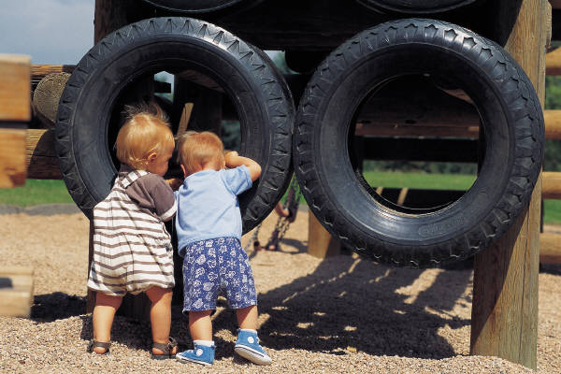
Recommended Practices and the COS Process – Age Anchoring

Slide 86
Tell us about Arkansas…
Notes:
Do you have any challenges about bringing knowledge of child development to bear in the rating process?
Has it been difficult?
Who has been able to do this well? What helps to make it easier?

Slide 87
Why age anchor?
The two COS questions:
a. To what extent does this child show age-appropriate functioning, across a variety of settings and situations, on this outcome? (Rating: 1-7)
b. Has the child shown any new skills or behaviors related to [this outcome] since
the last outcomes summary? (Yes-No)
Notes:
Remember the measurement process – the two COS questions.
In order to be able to describe the extent to which a child shows age appropriate functioning, need to know what age appropriate functioning is.
For the purposes of the COS process, use three terms to describe children’s functioning:
Age expected
Immediate foundational
And Foundational skills
Starting with foundational…

Slide 88
What are foundational skills?
Foundational skills are….
  Skills and behaviors that occur earlier in development and serve as the basis, or foundation, for later skill development
  Teachers and interventionists often use foundational skills to help children move to the next level developmentally

Slide 89
What are immediate foundational skills?
Immediate foundational skills are…
  Skills that are conceptually linked to later skills and immediately precede the later skills developmentally
  Example: Children play alongside one another before they interact in play

Slide 90
Immediate foundational skills
The set of skills and behavior that occur developmentally just prior to age-expected functioning
Are the basis on which to build age-expected functioning
Functioning looks like a younger child
Notes:
The focus is on functionally meaningful actions. Many assessment tools have items that measure discrete skills that aren’t individually meaningful to the child. The skills are meaningful only when they are integrated with other things so that the child can accomplish something.

Slide 91
How foundational skills lead to age-expected functioning
Age-expected functioning
Immediate foundational skills
Foundational skills
Foundational skills
Notes:
Refer to the stair steps in the handout on immediate foundational skills.
The key to using this information in the rating process is understanding the developmental progression.

Slide 92
Activity
Age Anchoring Practice
– TYLER, 12 months
- NOLAN, 36 months
Notes:
Brainstorm what would be expecting to see in a 12 month old child by outcome. Document on flip chart or white board.
Orient to video – watch video. Based on what observed, what type of development is Tyler demonstrating?
AE **
IF
F?
Brainstorm what would expect to see in 36 month old child by outcome. Watch segment of Nolan video. Based on what observed, what type of development is Nolan demonstrating for the most part?
AE
IF
F **

Slide 93
Bringing It All Together
Notes:
Pulling together all the resources we need to be able to complete the ratings accurately
Section header

Slide 94
Tell us about Arkansas…
Notes:
What resources do you use to keep yourself grounded in what typical child development is?
What resources do you use to remind yourself how to do the ratings?

Slide 95

Tools we recommend…
Age anchoring tools
The rating scale definitions
The Decision Tree

Slide 96
Understanding Developmental Progression
Age Expected Skills
Immediate
Foundational Skills
Foundational Skills
Foundational Skills
Notes:
Why we use age anchoring tools:
we’ve all had education/training in typical and atypical child development, some more recent than others!
It’s a lot of information – hard to keep right at hand everyday
Some of us are discipline specific so we hone in on the developmental progression related to the field we work in – sometimes “narrows” our focus
We spend a lot of time with children with disabilities, so what is “typical” changes/morphs over time relative to what we see every day.
Need to use tools and resources to support our continued understanding of what’s typical. Show handouts of tools available in their packet.

Slide 97
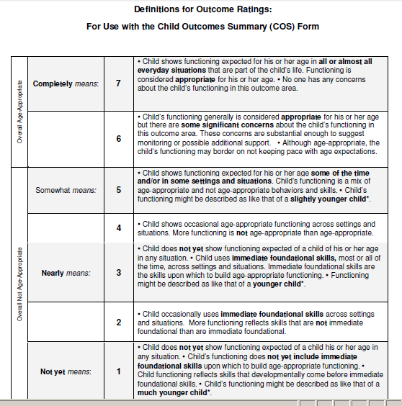
Notes:
Description on one page of the information Lauren shared

Slide 98









7-Point Rating Scale
Please refer to handout – “The Bucket List”
1
Child does not yet show functioning expected of a child his or her age in any situation.
6
Child’s functioning generally is considered appropriate for his or her age but there are some significant concerns about the child’s functioning in this outcome area. These concerns are substantial enough to suggest monitoring or possible additional support.
7
Child shows functioning expected for his or her age in all or almost all everyday situations that are part of the child’s life. Functioning is considered appropriate for his or her age.
2
3
4
5
No one has any concerns about the child’s functioning in this outcome area.
Although age-appropriate, the child’s functioning may border on not keeping pace with age expectations.
Child’s functioning does not yet include immediate foundational skills upon which to build age-appropriate functioning.
Child functioning reflects skills that developmentally come before immediate foundational skills.
Child’s functioning might be described as like that of a much younger child.
Child occasionally uses immediate foundational skills across settings and situation. More functioning reflects skills that are not immediate foundational than are immediate foundational.
Child does not yet show functioning expected for a child of his or her age in any situation.
Child uses immediate foundational skills, most or all of the time, skills upon which to build age-appropriate functioning.
Functioning might be described as like that of a younger child.
Child shows occasional age-appropriate functioning across settings and situations. More functioning is not age-appropriate than age-appropriate.
Child shows functioning expected for his or her age some of the time and/or in some settings and situations. Child’s functioning is a mix of age-appropriate and not age-appropriate behaviors and skills.
Childs functioning might be described as like that of a slightly younger child.
Notes:
This is the 7-point rating scale used in the Child Outcome Summary process. This slide is the same information that is found on the handout, “The Bucket List”.
In review, when a child is rated a 6 or 7 that is essentially saying that a child is functioning at an age-expected level in the specific outcome level. At the other end of the continuum, a rating of 1 is saying the child is functioning below both age-expected and immediate foundational levels.
A rating of 4 and 5 is saying that a child is functioning with a combination of age-expected and immediate foundational skills.
And, a rating of 2 and 3 is saying that a child is functioning with a combination of foundational and immediate foundational skills.

Slide 99
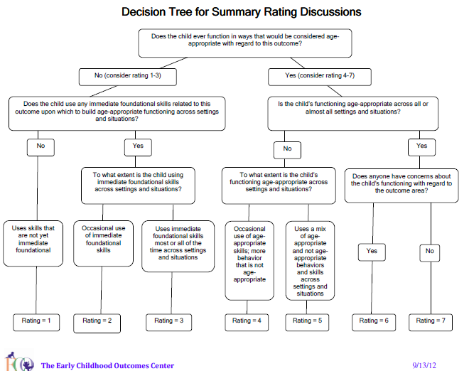
Notes:
This tool really brings the decision making together.
Walk through the questions to demonstrate the use of the decision tree

Slide 100
Activity
Kim child example --
  Age anchor Kim’s social skills using your tools and resources –
  Use all of your resources to estimate a rating
Notes:
Refer to assessment summary – Assign tables different outcomes. Small groups use age anchoring tools to approximate Kim’s skills for the outcome assigned. In large group, refer to decision tree. Talk through Kim’s skills and behaviors for each outcome using decision tree. Make reference to age-expected child development resources.
Add exit information: Outcome one: Kim continues to have communication skills in social interactions that include vocalizations and gestures, and now include a few word approximations such as “uh” for “up” and “muh” for “mine” and “mom”. She’s trying more than once to be understood and rarely expresses frustration when she isn’t understood.
Knowing that there is much more information to be considered in rating the outcome, how would you answer the progress question for Kim in Outcome 1? Why?
Explain that the acquisition of even one new skill, even if the rating is the same as it was at entry. Questions?
More practice in the afternoon…
Lunch break –Will begin promptly at 1 p.m. for afternoon session

Slide 101
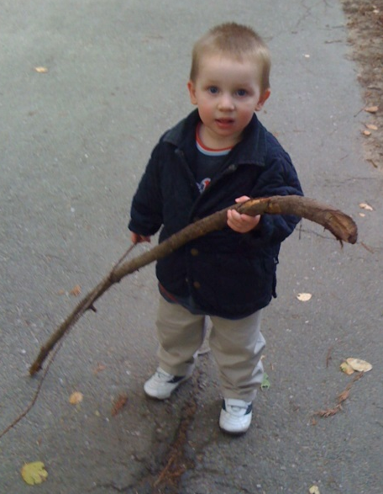
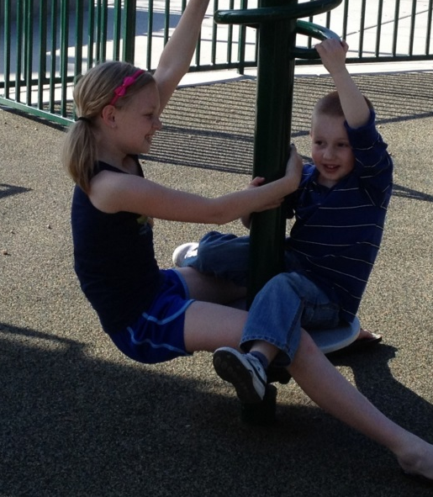

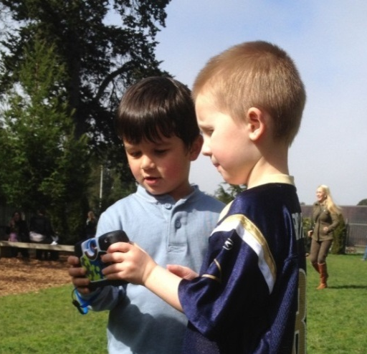
Progress, Trajectories, and Progress Categories…Huh?
Notes:
Warning… some people find this explanation helpful for thinking about the big picture and how all this fits together… others not so much…

Slide 102
Where Progress Fits In…
Status | Single time. Snapshot. Compared to others. | 1-7 COS rating at one time point.
Notes:
Now that you’ve worked with the progress rating and an exit case… let’s take a step back and think about progress and where this all fits in….

Slide 103
Levels of functioning
Notes:
This is a view of children holistically – all the children in the population. COS focuses on the outer edges – that shows movement. Can think of as a normal curve. Wide variation at any age – most of population is in the middle.
Spread out circles into bands on a chart…

Slide 104
Where Progress Fits In…
Status | Single time. Snapshot. Compared to others. | 1-7 COS rating at one time point.
Progress | Change over time. Compared to self (Intra-individual) | COS progress question – any progress
Notes:
Now that you’ve worked with the progress rating and an exit case… let’s take a step back and think about progress and where this all fits in….
Take a few moments to walk you through thinking about what we mean by progress and how different kinds of progress show up in the ratings.

Slide 105

Progress Compared to Self
2nd question: yes/ no progress question on the COS
Common anecdotes and descriptions of progress to family members

Slide 106
Levels of functioning
Notes:
This is a view of children holistically – all the children in the population. COS focuses on the outer edges – that shows movement. Can think of as a normal curve. Wide variation at any age – most of population is in the middle.
Spread out circles into bands on a chart…

Slide 107
Where Progress Fits In…
Status | Single time. Snapshot. Compared to others. | 1-7 COS rating at one time point.
Progress | Change over time. Compared to self (Intra-individual) | COS progress question – any progress
 | Change over time. Compared to others/normative peers. (Inter-individual) | Developmental trajectories – Progress categories
Notes:
Now that you’ve worked with the progress rating and an exit case… let’s take a step back and think about progress and where this all fits in….
Take a few moments to walk you through thinking about what we mean by progress and how different kinds of progress show up in the ratings.

Slide 108
Levels of functioning
Notes:
Over time… Think about this as movement across the bands of the circle…. Toward or away from age-expected functioning…
Spread out circles into bands on a chart…

Slide 109
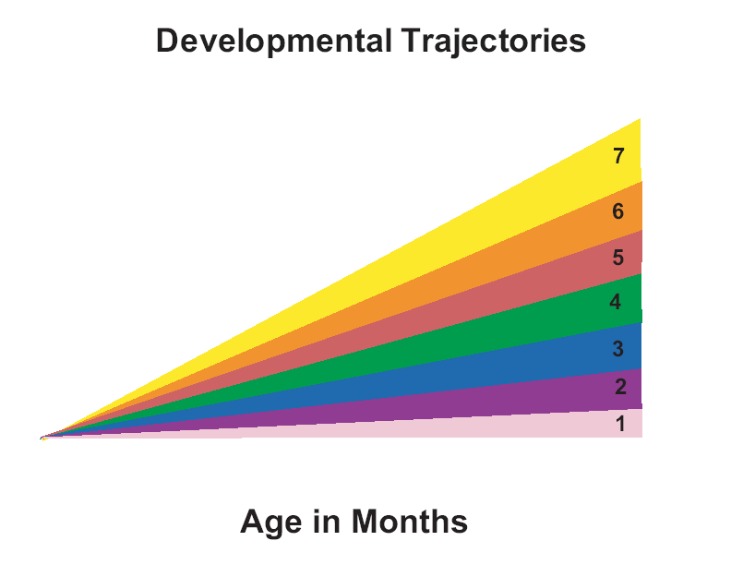
Functioning
13

Slide 110
Entry
14

Slide 111
Entry
Exit
15

Slide 112
Entry
Exit
16

Slide 113
Key Point
The OSEP categories describe types of progress children can make between entry and exit
Two COSF ratings (entry and exit) are needed to calculate what OSEP category describes a child progress

Slide 114
Following the data
2 summary statements
Child’s progress
over time
1-7 rating
at entry & exit
a – e progress categories
(State: 3 outcomes,
15 percentages)
Child’s
status
Notes:
Orient how this relates to the process…

Slide 115
How changes in ratings on the COSF correspond to reporting categories a - e
e. % of children who maintain functioning at a level comparable to same-aged peers
Rated 6 or 7 at entry; AND
Rated 6 or 7 at exit
Notes:
Draw attention to the progress categories on the cheat sheet…

Slide 116
Entry
Exit
Notes:
Both 6 and 7 indicate age appropriate functioning.

Slide 117
Entry
Exit

Slide 118
Entry
Exit

Slide 119
How changes in ratings on the COSF correspond to reporting categories a - e
d. % of children who improve functioning to reach a level comparable to same-aged peers
Rated 5 or lower at entry; AND
Rated 6 or 7 at exit

Slide 120
Entry
Exit
Notes:
An exit rating of 6 or 7 indicates the child is now showing age expected functioning.

Slide 121
How changes in ratings on the COSF correspond to reporting categories a - e
c. % of children who improved functioning to a level nearer to same aged peers, but did not reach it
Rated higher at exit than entry; AND
Rated 5 or below at exit

Slide 122
Entry
Exit
Notes:
Child showed sufficient improvement in functioning to move to a higher developmental trajectory (i.e., higher point on scale) but had not yet achieved age appropriate functioning.

Slide 123
Entry
Exit

Slide 124
How changes in ratings on the COSF correspond to reporting categories a - e
b. % of children who improved functioning, but not sufficient to move nearer to same aged peers
Rated 5 or lower at entry; AND
Rated the same or lower at exit; AND
“Yes” on the progress question (b)

Slide 125
Entry
Exit
Notes:
Note the slope - the line is not flat; the child is showing improved functioning

Slide 126
Entry
Exit
Notes:
Note the slope - the line is not flat; the child is showing improved functioning

Slide 127
Entry
Exit

Slide 128
Entry
Exit
Notes:
Note the slope - this child is showing improved functioning

Slide 129
How changes in ratings on the COSF correspond to reporting categories a - e
a. % of children who did not improve functioning
Rated lower at exit than entry; OR
Rated 1 at both entry and exit; AND
Scored “No” on the progress question (b)

Slide 130
Entry
Exit

Slide 131
Entry
Exit

Slide 132
OSEP Reporting Categories
(Progress Categories)
Percentage of children who:
a. Did not improve functioning
b. Improved functioning, but not sufficient to move nearer to functioning comparable to same-aged peers
c. Improved functioning to a level nearer to same-aged peers but did not reach it
d. Improved functioning to reach a level comparable to same-aged peers
e. Maintained functioning at a level comparable to same-aged peers
3 outcomes x 5 “measures” = 15 numbers

Slide 134
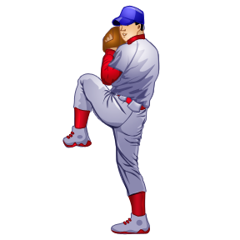
Curve Ball Quiz
True or False:
Since this child’s COS entry and exit ratings are both “2,” I know that the progress question should be “no” because the child did not make any progress.

Slide 135

Curve Ball Quiz
FALSE –
Often new skills and individual progress even if same rating at entry and exit.
If any progress compared to self = yes on progress question
Only increase entry to exit rating if change trajectories, a big enough rate of new skill acquisition to move closer to age-expected levels than they were at entry.
Notes:
Many children receiving the same COS rating at entry and exit make progress in acquiring new skills and would receive a “yes” on the 2nd progress question. However, their exit rating will not increase unless their rate of new skill acquisition was so great that it moved them closer to age-expected levels than they were at entry.

Slide 136
Curve Ball Quiz
Multiple Choice:
Compared to younger children, older children:
Have to do more to get the same rating on the COS
Have to demonstrate more skills to achieve age-expected levels
May show more spread between foundational, immediate foundational, and age-expected skill levels

Slide 137
Curve Ball Quiz
2. All of these –
It is not easy to keep the same rating as children get older.
With age, the bar rises – must show more skills to get the same rating
As expectations increase, the distance and complexity of skills that separates foundational, immediate foundational, and age-expected increases.
Notes:
It is not easy to keep the same rating as children get older. The bar continually raises as children are expected to do more and more. As expectations about skills increase with age, the distance and complexity of skills that separates foundational, immediate foundational, and age-expected increases.

Slide 138

Activity
Post-it Writing: Choose one (2 min):
  Use your own words to describe to a parent how a five at entry differs from a five at exit. OR
  A colleague says “I don’t think a five is right because Johnny made so much progress in the last 2 years.” What would you say?
Share your ideas with a partner. (5 min)
Post your best ideas for the larger group.
Notes:
Post-it Writing: Choose one:
Use your own words to describe to a parent how a five at entry differs from a five at exit. (2 min.)
A colleague says “I don’t think a five is right because Johnny made so much progress in the last 2 years.” What would you say?
Share your ideas with a partner. (5 min)
Use your post-it to attach your best ideas to the wall.
DEBRIEF a few of the ideas (?perhaps compile a list for the state)

Slide 139

The COS
Team Process

Slide 140
Tell us about Arkansas…
Notes:
How many of you have included families in 90% or more in the decisions for the ratings? 75%? 50%? <25%?
What are some of your issues in involving the families meaningfully?
How do you complete the COS process?
How many of you use a team? Have one person complete the rating?

Slide 141


Voting:
What’s happening in Arkansas?
All or most
Many
Some
A few
None
Notes:
Use Cell phone voting
Across all of your COS experiences, in how many was:
--The rating decided by a team that included at least one other professional and me.
--At least one other professional in addition to me provided input about the child’s functioning (could be, but not necessarily in a team process)
--Information about the child’s functioning from multiple settings and situations was used in deciding a rating
--Family was present during the decision of the child outcomes ratings
--Family provided input about the child’s functioning (may or may not have been present during the rating).
Compare numbers to 856 providers from 8 states participating in ENHANCE

Slide 142
Using Teams
Benefits
Challenges
Notes:
Lead open-ended discussion about these…
Benefits:
Consistent with best practice/service models
Input from multiple perspectives, best picture of the child across settings
Likely to have people with all 5 key types of understandings needed for effective rating
Likely to come out with most accurate representation of status (whole is greater than sum of parts)
Biases/mistakes kept in check
Challenges:
Time/getting people together
May be difficult to reach consensus (though don’t necessarily hear that much)
Payment process
May have different understanding of rating process

Slide 143
What is a high-quality team discussion?
All team members participate
Minimal jargon is used so that all team members can fully participate
Input from all (including parents) is shared and respectfully considered
Multiple sources of assessment information are considered (e.g., family report, observation, authentic assessment, standardized ‘testing’)
Notes:
Reference handout

Slide 144
In a quality team discussion…
The team describes the child’s functioning across settings (this goes beyond just sharing test scores or jumping to ratings)
Discussion includes the child’s full range of functioning (what child does and does not yet do across settings)
Discussion examines the full breadth of each outcome

Slide 145
In a quality team COS process
Team description of child’s functioning is age-anchored, considered relative to what is age-expected
COS rating is consistent with rating criteria
Team reaches consensus on rating
The team describes and documents the rationale for the rating

Slide 146
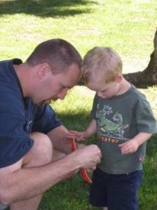
Involving Families
Integrating COS process with IFSP/IEP process… many discussion opportunities:
  From Identification & Referral
  Through Program Exit & Transition
Share & learn together
Notes:
Throughout the IFSP/IEP process, there are multiple opportunities to talk with families about the child outcomes. Can introduce with the purpose of early intervention/ECSE at initial conversations, which gives families the frame of what to expect from participation in the program.
Throughout the process, can connect eval/assessment and intervention planning to the three outcomes, which helps families understand where their child is compared to self and compared to same age peers throughout their tenure with EI/ESCE. Supports our value that families are informed and feel confident and competent to meet child’s needs.
Stands to reason that if we support their understanding of the outcomes from the beginning, it supports their participation as full team members in the COS rating discussions. (reference resources on this topic?)
Encourage family sharing … to tell you what they’ve seen, not yes/no agreement, or appraisals about age level. Rich description is key….

Slide 147
Activity
Evaluate a team discussion and the participation of the family in a team discussion
Notes:
Handouts – quality review checklists – 1) team and 2) family. (Do both?) Debrief.
MARYLAND VIDEO…. What needs to go on slides related to this…. Refine consensus pieces and if should go before or after the video.

Slide 148
Where to focus in deciding the rating
Focus on the child’s overall functioning across settings and situations
Functioning that is displayed rarely and/or when the child is provided with a lot of unusual support or prompts is of little significance for the rating
Notes:
Start here.
Overall functioning – and most often used functioning

Slide 149
Suggestions for reaching consensus on COS ratings
Re-visit process – describe functioning first, not #
Focus on outcome content – considering breadth of outcome content, does the skill fit, is it functional?
Share examples – settings, situations, supports, and describe if view as AE, IF, F (do not correct for prematurity)
Include more discussion about skills that would see in child with typical developmental pattern as common ground for comparison
Policy – what to do in rare case of disagreement (majority, supervisor, additional info, etc.)
Notes:
Refer to Reaching Consensus Handout

Slide 150
Example probes in team discussion
Tell me about the kinds of evidence that suggest to you this child has [AE, IF, F] functioning in this outcome?
When have you observed those skills? In what situations?
How frequently does that occur?
Were the accommodations/supports available in that setting? What were they?
Are there other steps in the sequence of development that need to occur between developing this skill and the skills same-aged peers display (AE) in this area? (when an IF skill is identified)
Is there other information we need to be better equipped to make this decision?

Slide 151
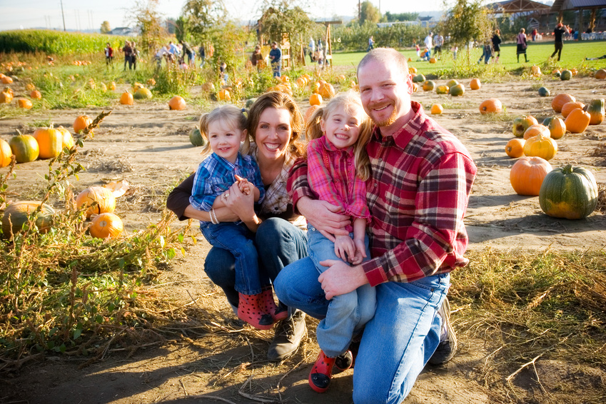
Practice Using the COS Process
Notes:
To use tools given so far, going to do two different activities. Reminder – DON’T focus on documentation heavily here – use the things we’ve discussed so far (age anchoring, decision tree, rating scale, etc.) and do a bit of documentation – but we’ll work more on that in the next segment after we’ve had practice with the steps that proceed the documentation.
Kim outcome 3 activity (30 minutes)– have them read for outcome 3. Use highlighters to mark AE, IF and F. Age anchor using resources, use the decision tree, document on form what will be considered, and approximate a rating.
Debrief: Challenges? What went well? Questions?
Example from participant (30 minutes). Select outcome to discuss, discuss the child’s functioning in that area, encourage use of discussion prompts. Document (notetaking guide) throughout the conversation. Age anchor, use decision tree, document, rate.
Debrief: Challenges? What went well? Questions?
Take a 20 minutes break (2:40 – 3:00)

Slide 152
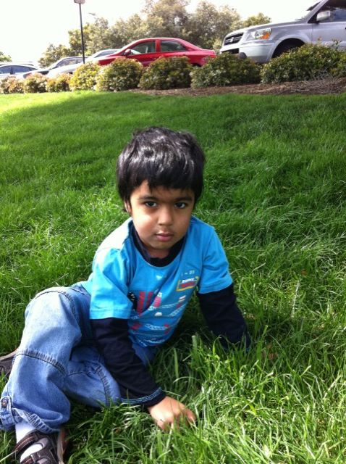
Suggested Resources

Slide 153
Documenting the Rating
Plus - Reviews and Feedback
Notes:
Just to touch on; remember that documentation must match the rating. Make reference to resources that help organize the information by age expected, immediate foundational and foundational skills, so like the highlighting, can tell by the amount in each section where to gear the rating.

Slide 154
Tell us about Arkansas…
Notes:
How many check quality of your data (in system or on forms)? How many look at state or program level data about child progress categories? About summary statements? How do you use this information? What questions do you consider when you look at it?
SHARE ENHANCE data…

Slide 155

Reviewing Data Quality –
Why it’s important
If data are not (yet) valid, they cannot be used for program effectiveness, program improvement or anything else.

Slide 156
After the rating is complete…
Check the completed COS rating for quality:
Does the documentation match the appropriate outcome area? Is it functional?
Is there adequate evidence for the basis of the rating? Consistent with the rating?
Does evidence reflect the child’s functioning across settings and situations?
Check on from and in data system….
For additional resources…

Slide 157
Training and communication for quality assurance
Increase data quality through training and communication related to:
  Assessment
  Understanding the COS process and criteria
  Age expectations
  Data entry
  Teaming with colleagues for COS ratings to maximize group knowledge
Notes:
Before beginning in the COS process, fundamental that those involved receive training and information about the key components of the process, including those we’ve talked about, but also including data entry.

Slide 158

Need for good data
Encompasses all three levels: federal, state, local
Depends on how well local programs are implementing procedures

Slide 159
Many steps to ensuring quality data
Before | Good data collection/Training Good data system and data entry procedures
During | Ongoing supervision of implementation Feedback to implementers Refresher training
After | Review of COS records Data analyses for validity checks Use data, discuss validity, usefulness, identify inconsistencies, areas for checking and improving quality

Slide 160

From Ratings to Action
Data and continuous improvement
The national context
Using data for program improvement
Notes:
New Section…

Slide 161
Continuous improvement
Reflect
Are we where we want to be?
Check
(Collect and analyze data)
Plan (vision)
Program characteristics
Child and family outcomes
Implement
Notes:
What data can tell us….
Data is a party of any continuous improvement cycle.

Slide 162

Continuous improvement individual/family level
Reflect
Are we where we want to be?
Check
(Assessment)
Plan (vision)
IEP/IFSP –identify supports/services to get there, expected outcomes
Implement
Notes:
What data can tell us….
Can do this at the individual level…. Using info for rating process to inform planning and implementation of the IEP/IFSP process
Can do this at the group/ aggregate level

Slide 163

Continuous improvement group data/program level
Reflect
INFERENCE – What do numbers mean? What we expect? What we want?
Check
EVIDENCE – Get numbers in format to discuss. Analyze patterns. Examine in context
Plan (vision)
What should we do?
Happy Kiddo Program
Implement
Quality measures, improvement strategies
ACTION
Notes:
Similar process at group level… program, state, nation except looking across programs….

Slide 164
Data-based Action
EVIDENCE (check) | INFERENCE (reflect) | ACTION (plan & implement)
The numbers | What you think, surmise believe, the numbers mean (how you explain them) | What you do
Just the facts… But there are different ways to run analyses and graph the findings…. | Own… stakeholder group,…Etc. Reasonable people will differ. | Consider program practices… ask questions, plan how to improve practices Implement change, program improvement strategy, data quality improvement strategy And/or: Drill down…new evidence, look at numbers for a different subgroup, time, etc

Slide 165

Looking for expected patterns
Examine the evidence (data, numbers)
Does the overall pattern look “strange?” surprising?
  Compared to what you expect
  Compared to other data
  Compared to similar states/regions/school districts
What might explain the pattern you see?
What action does that suggest taking?
Notes:
Other data, previous years, other knowledge from the field…

Slide 166
Data from Arkansas
2010-2011
In relationship with
most accurate national data
Notes:
How do they think data in Arkansas should be similar to or different from the national data? Why?

Slide 167
Following the data
2 summary statements
Child’s progress
over time
1-7 rating
at entry & exit
a – e progress categories
(State: 3 outcomes,
15 percentages)
Child’s
status
Notes:
Remember this??

Slide 168
Progress Categories – Part B
Positive Social Relationships

Slide 169
Progress Categories – Part B
Acquiring and Using Knowledge and Skills

Slide 170
Progress Categories – Part B
Take Appropriate Action to Meet Needs

Slide 171
Substantially Increased Rate of Growth – AR: Section 619
Notes:
THESE STATEs… = AR… Not sure yet how to do the reveal…

Slide 172
Exited Within Age Expectations – AR: Section 619

Slide 173
Progress Categories – Part C
Positive Social Relationships

Slide 174
Progress Categories – Part C
Acquiring and Using Knowledge and Skills

Slide 175
Progress Categories – Part C
Take Appropriate Action to Meet Needs

Slide 176
Substantially Increased Rate of Growth- AR: Part C

Slide 177
Exited Within Age Expectations – AR: One State Part C

Slide 178
Inferences
Based on this data, what do you think?
What else would you want to know?
Actions:
What might you do?
Notes:
A group of us may look at the same numbers, the same type of evidence, but have many different interpretations, or ideas about what to think when they look at those numbers.
Can repeat by program vs. state, by disability type vs. overall, by age group, by race/ethnicity, by intervention approach, etc.

Slide 179



Numerous ways to examine evidence…dig deeper…

Slide 180
Example Data:
Outcome 2 Entry X Exit Ratings
Entry Exit | 1 | 2 | 3 | 4 | 5 | 6 | 7
1 | 11 | 4 | 1 | 2 | 0 | 0 | 0
2 | 16 | 50 | 5 | 4 | 2 | 0 | 0
3 | 33 | 108 | 68 | 15 | 7 | 3 | 0
4 | 18 | 121 | 151 | 70 | 14 | 5 | 2
5 | 21 | 148 | 213 | 233 | 170 | 18 | 12
6 | 16 | 70 | 138 | 172 | 282 | 217 | 30
7 | 94 | 76 | 48 | 47 | 130 | 219 | 257

Slide 181
Example Distribution Outcome 2: Exit - Entrance Ratings n=3160

Slide 182
Example looking at variation across programs within a state

Slide 183
Take Home Message
You will want to look at your data in lots of different ways
You will want to think about the possible inferences
You may need other information to decide among possible inferences
Act on what you have learned

Slide 184

Jump up and get your data!
Embrace the evidence. Find out about your data!
Dig in at all levels:
  child; by subgroup; program/district; region; state
Resources:
  https://arksped.k12.ar.us/sections/Early%20Childhood.htm
  http://arksped.k12.ar.us/sections/spd/GSEG.htm
Data
Notes:
Activity…. A moment… what is one thing you want to find out from your data? Killer questions… examples… discuss…
Action steps… what do to begin to work with data… next step… if time.

Slide 185
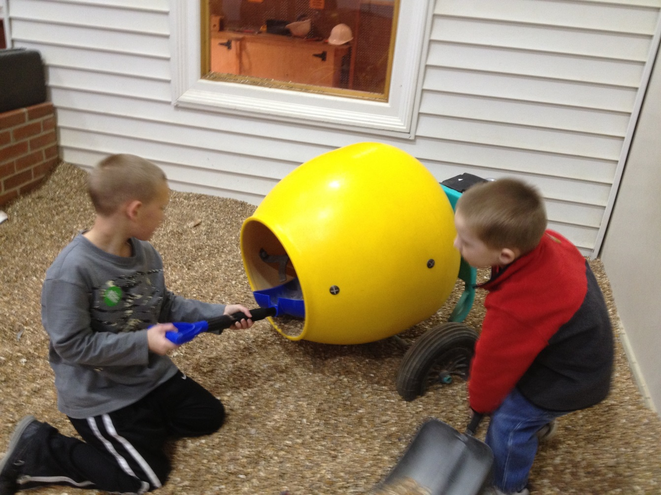
From Ratings to Action… Program Improvement

Slide 186


Slide 187



Keeping our eye on the prize:
High quality services for children and families that will lead to good outcomes.
Notes:
And allow us to address our overarching mission…

Slide 188

Questions and Answers
Notes:
Related to data; transition to the entire day (any loose ends). Ask Dee to include any next steps.

Slide 189
ECO Center web site
Additional information is available on our website
www.the-eco-center.org

Slide 190
Contact Information
Kathi Gillaspy
NECTAC/ECO – FPG
kathi.gillaspy@unc.edu
Lauren Barton
ECO – SRI
lauren.barton@sri.com

Slide 191
END…

Slide 192
EXTRAS & LEFTOVERS….

Slide 193
*Based on 36 States with the highest quality data.

Slide 194
*Based on 39 states with highest quality data

Slide 195
The national data …
After three years…
For both EI and ECSE:
  High percentages of children show increased rates of growth
  High percentages of children exit functioning like same-aged peers.
The national data have been stable for 3 years.
Notes:
Note: Pt. C and Pt. B Preschool are the only 2 federal EC programs with national data on outcomes.

Slide 196
Is the rating subjective?
What is subjective?
  “relating to the mind of the thinking subject and not the nature of the object being considered”
The child outcome summary ratings involve clinical decision making from the team
  much like that used in deciding on goals and intervention strategies
Notes:
A question that sometimes arises in the context of the summary of functional performance process is whether or not rating a child’s functioning on the 7-point scale is ‘subjective.’ Subjectivity can be defined as related to the ‘mind’ of the rater, rather than the nature of the subject being rated. If your team determines a rating based on what is in their minds, rather on the what the child demonstrates and the rating criteria, the rating may be subjective. If the rating is based on the child’s demonstrated functioning, as compared to age-expected functioning and the criteria for each of the 7 points, it is a data based decision – not unlike the decisions the team makes when designing an appropriate program for a child.
Next section on age – anchoring – a practice, that when used consistently, helps ensure the proper application of the rating.

Slide 197
Informed Decisions
Conditions:
Operational definitions of the observed attributes
Structured rating format to record informed opinion
Gather data from multiple sources
Establish consensus-decision making process
Provide training to facilitate reliable ratings
Research on clinical judgment shows that professionals can reach reliable conclusions under certain conditions
The process meets all of these conditions.
Notes:
Rating a child’s functioning based on assessment data draws upon the clinical judgment that professionals develop as part of their experience and training. Research shows that practitioners will reach the same conclusions when certain conditions are in place.

Slide 198
Fake Data: OSEP progress categories
Possible Problems:
  Too many children in “a”
  Too many children in “e”

